Slide 1
Agroecology in the 2021-2027 Multi-annual Financial Framework
The importance of agroecology for sustainable agri-food systems and the Green Deal objectives
INTPA F3 - Webinar
3, 4 and 8 November 2021

Slide 2

Agroecological systems for food security, climate mitigation and adaptation and biodiversity conservation
Emile A. Frison, iPES Food

Slide 3
20th century agriculture works against nature
Industrial/conventional agriculture is based on:
Uniformity/simplification
Economies of scale/specialisation
Chemistry:
  Feeding plants directly with chemical fertilizers
  Protecting plants with pesticides
→ Land degradation: loss of carbon in soils and loss of biodiversity and destruction of life in the soil

Slide 4
Unsustainable food systems
Food systems produce about 1/3 of GHGs with agriculture, forestry & land-use sectors account for nearly a quarter (24%). In addition: Pollution,, malnutrition, inequity …
Current food systems are vulnerable to climate change and need to adapt.
Agriculture is responsible for 80% of biodiversity losses: simplification of agricultural landscapes and deforestation.
Increasing of food insecurity (triple burden of malnutrition)

Slide 5
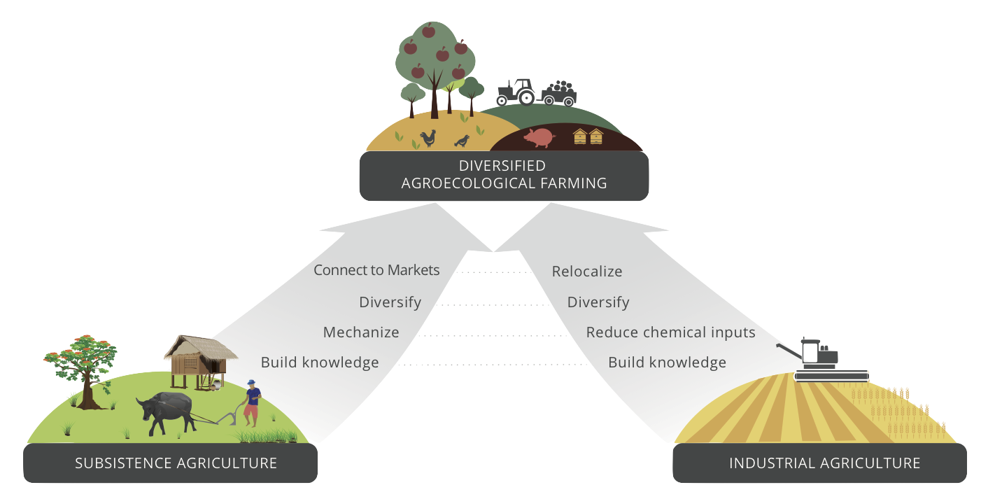
We need transformational change
IPBES report on land degradation 2018
TEEB for Agriculture and Food 2018
IPBES report on Biodiversity 2019
HLPE report on Agroecology 2019
IDDRI report on Agroecology 2019
IPCC report on CC & land 2019
GSDR 2019
Global comm. adaptation 2019
GBO-5 2020
HLPE 2020 report
Mission on soil health and food

Slide 6
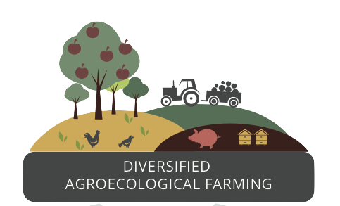
A different paradigm: diversified resilient and sustainable systems
A holistic, integrated approach to simultaneously reach:
  Economic
  Environmental
  Climate M & A
  Health
  Social
  Cultural objectives
DIVERSIFIED
AGROECOLOGICAL SYTEMS

Slide 7
A different paradigm
It is not about promoting a set of agricultural practices, or innovations among others such as climate smart agriculture, nutrition sensitive agriculture, precision agriculture, sustainable intensification …
Diversified agroecological systems are knowledge intensive and take the best of all innovations that are compatible with the 13 principles of agroecology, combined with traditional and farmer knowledge through co-innovation to develop locally adapted sustainable solutions
It is also about changing social relations, empowering farmers, adding value locally and privileging short value chains that link consumers and producers

Slide 8
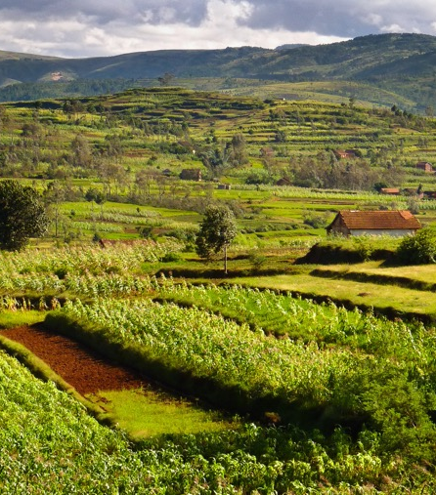
Environmental/climate outcomes of diversified agroecological systems
Diversity provides resilience
Keep/put carbon in the soil - turns agriculture into a solution rather than a problem
Boost biodiversity
Restore degraded land
Improve ecosystem services
  Water and nutrient cycling
  Pollination
  Pest and disease management

Slide 9
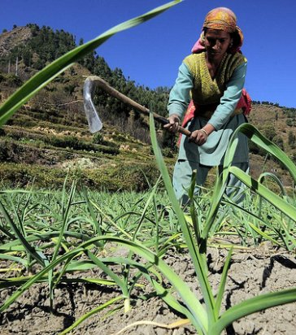
Agroecology for climate mitigation
IPPC: “Biological approaches to carbon capture are the most promising prospects for negative emissions”
Protect current forests
Restore degraded lands
Increase tree cover on agricultural lands through agroforestry
Increase the biomass production of pasturelands
→ This can be achieved through agroecology
Agroecology (including agroforestry) could more than offset agricultural GHG emissions
This Photo by Unknown Author is licensed under CC BY-NC

Slide 10
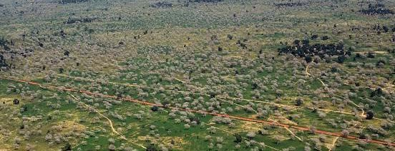
Farmer-Managed Natural Regeneration of trees is being massively upscaled on the croplands in Niger & Mali & Senegal

Slide 11
Transformation at scale
Sahel: millions of Ha of farmer-managed natural regeneration
Andrah Pradesh: 750,000 framers, + 20% productivity, + 50% net income
Alliance for Agroecology in West Africa: 70 organizations with practical evidence
ROPPA and AFA adopt agroecology in their strategy
Agroecology supportive policies in more and more countries (Mexico, Sri Lanka, Nicaragua, …)

Slide 12
Supporting the transition
Support farmers during the conversion
True cost accounting: tax unsustainable practices and subsidize sustainable practices
Facilitate access to land for young farmers starting sustainable diversified agroecological farming
Support short value chains linking consumers and producers

Slide 13
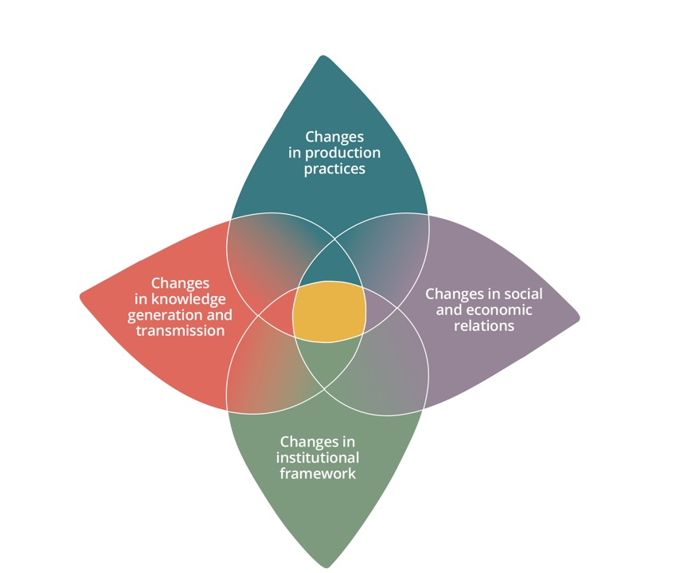
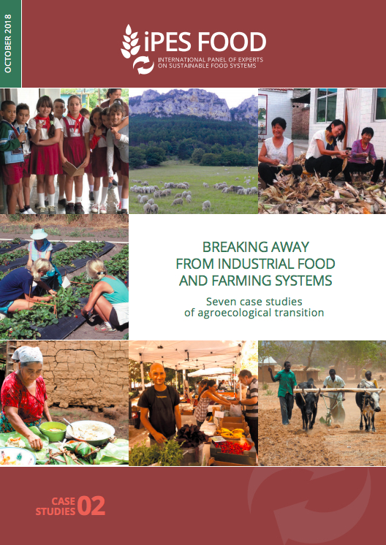
The transition is already underway…

Slide 14
Coalition on agroecology
A major outcome of the UN FoodSystems Summit
Already 27 countries (13 Africa, 6 Europe, 5 Asia, 3 Latin America)
35 Organizations (5 UN, Farmers’, Research, Civil Society, Indigenous people and Philanthropic organizations)

Slide 15
Different pathways, common goal
Agroecology: to achieve food security while addressing the climate and biodiversity challenges

Slide 16
Thank you!
www.ipes-food.org

