Slide 1

Agroecology in the 2021-2027 Multi-annual Financial Framework
The importance of agroecology for sustainable agri-food systems and the Green Deal objectives
INTPA F3 - Webinar
3, 4 and 8 November 2021

Slide 2

Webinar INTPA F3 - Agroecology in the 2021-2027 Multi-annual Financial Framework
The importance of agroecology for sustainable agri-food systems and the Green Deal objectives 2
Climate change and Environmental Contribution
Marie-Laure ROBERT
DG INTPA/F1

Slide 3
Agenda
Historical contributions 2014-2020
NDICI Commitments / State of the Union (15/09/2021)
Rio markers and scoring options
Quick Tips to Integrate Environment and Climate change in Agriculture and Food Systems
Activities that qualify for Rio Markers in Agriculture and Food Systems
EU Technical Facilities for Partner countries – EUDs and HQ
Up coming Webinars – Greening

Slide 4
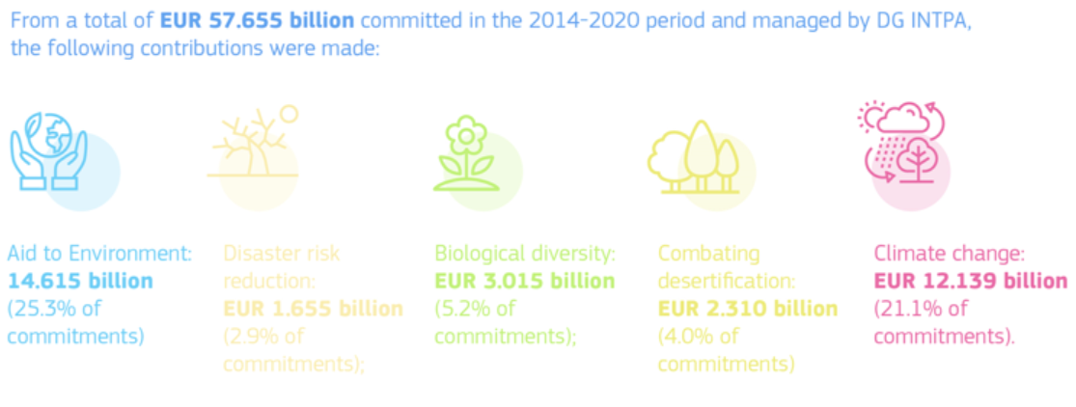
Webinar INTPA F3 - Agroecology in the 2021-2027 Multi-annual Financial Framework
Climate change, DRR and environmental contribution
INTPA Historical contributions 2014 – 2020
The EU’s financial objective of dedicating at least 20% of all EU funds to climate action in the 2014-2020 Multi-annual Financial Framework (MFF) has been exceeded for INTPA managed funds.

Slide 5
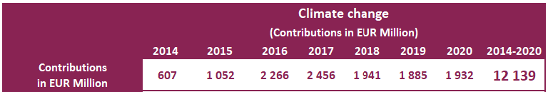
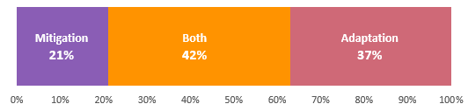
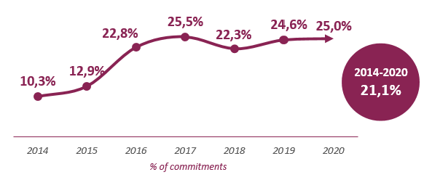
2014-2020 Climate change Performance (INTPA)
If an action scores for both CC mitigation and CC adaptation, only the highest score is considered for purposes of calculating contributions to ‘climate action’
Contributions to CC mitigation and CC adaptation are also reported separately

Slide 6
2014-2020 Share of sector funding contributing to Climate Change
Notes:
The main sectors contributing to Mitigation were: Energy (EUR 2.279 billion, 64.6% of commitments in the sector), Other sectors (EUR 1.300 billion, 4.3% of commitments in the sector) and ARD/FNS (EUR 1.221 billion, 16.0% of commitments in the sector).
In the case of Adaptation, the main contributing sectors were: ARD/FNS (EUR 3.511 billion, 46.0% of contributions in the sector), Other sectors (EUR 1.966 billion, 6.5% of contributions in the sector) and General environmental protection (EUR 1.259 billion, 54.9% of contributions in the sector).

Slide 7
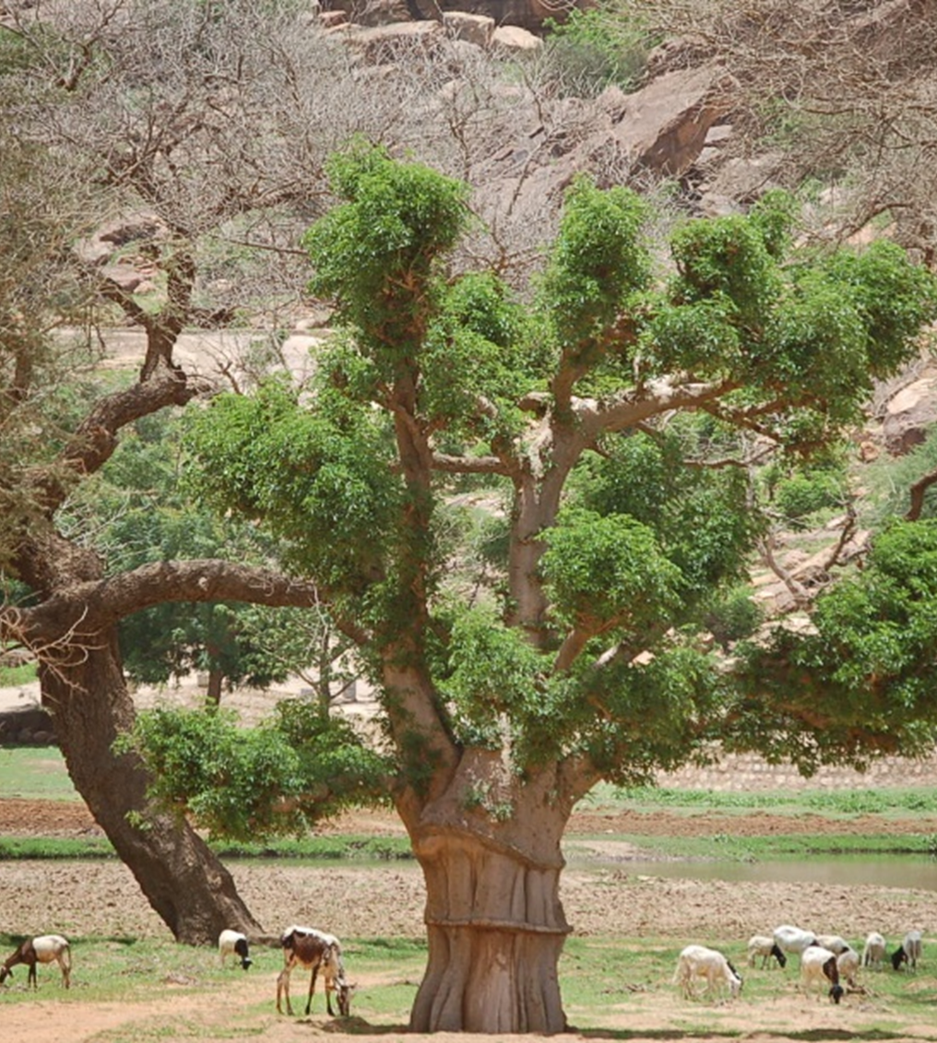
Webinar INTPA F3 - Agroecology in the 2021-2027 Multi-annual Financial Framework
Climate change, DRR and environmental contribution
INTPA Climate change contributions
by sector (OECD-DAC codes) (2014-2020)

Slide 8
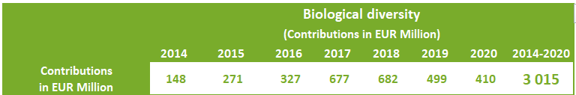
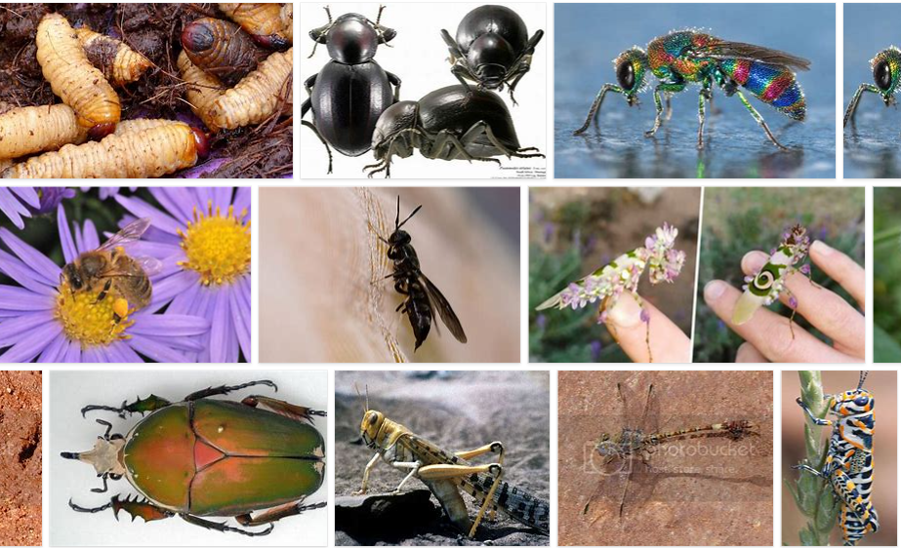
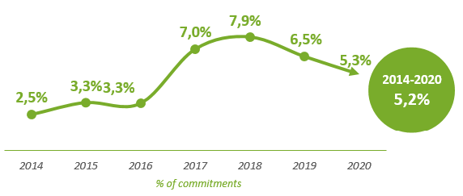
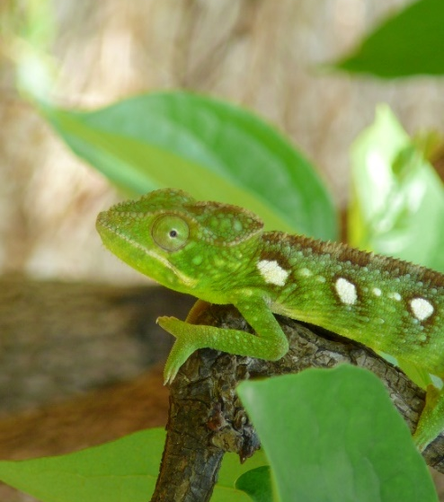
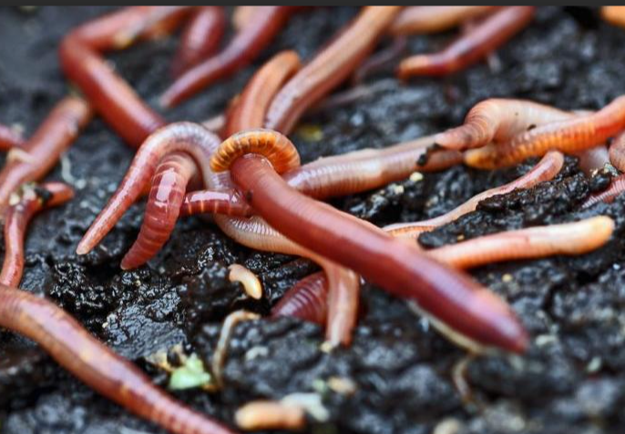
2014-2020 Biodiversity Performance (INTPA)
Google Photos

Slide 9
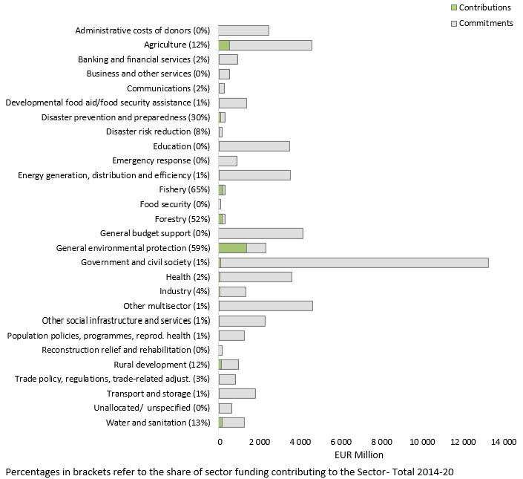
2014-2020 Biodiversity Performance (INTPA) by sector

Slide 10
Climate – Biodiversity Synergies
About 25% of all climate finance ALSO contribute to biodiversity
About 65% of all biodiversity finance ALSO contribute to climate action
We must find opportunities for co-benefits whenever possible!!

Slide 11
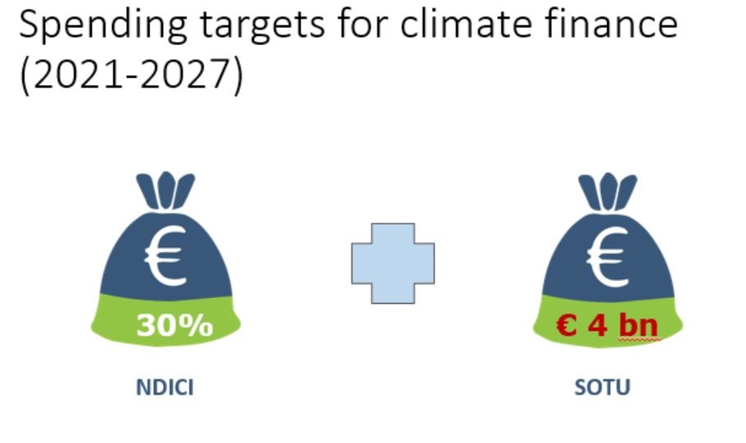
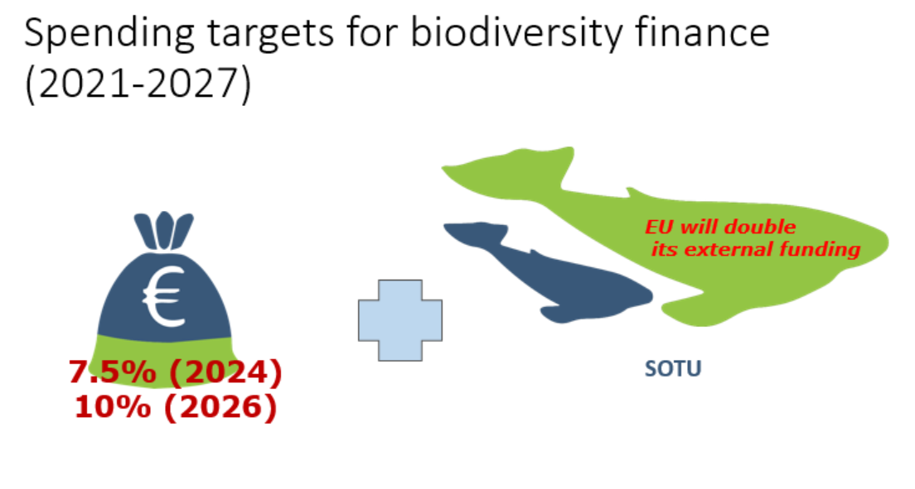
Webinar INTPA F3 - Agroecology in the 2021-2027 Multi-annual Financial Framework
Climate change, DRR and environmental contribution
NDICI – Global Europe – 2021-2027 and State of the Union 2021

Slide 12
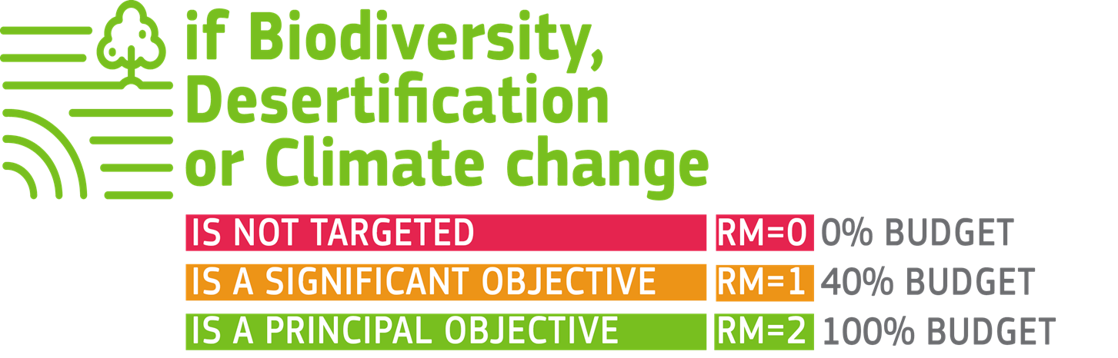
Webinar INTPA F3 - Agroecology in the 2021-2027 Multi-annual Financial Framework
Climate change, DRR and environmental contribution
Rio Markers and Scoring Options
Created by the OECD DAC (Organisation for Economic Co-operation and Development - Development Assistance Committee) to keep track of development aid to the implementation of the Rio Conventions (on biodiversity, combating desertification and climate change)
Not targeted (RM0)
  Avoiding adverse impact does not justify a marker
”Significant” objective (RM1)
  Rio theme is not the main motivation, but the action helps meet environmental/Rio concerns. Still, the (Rio) objective must be explicitly stated
“Principal” objective (RM2)
  Objective of the Rio Convention is fundamental to the design/motivation of the action, i.e. it is one of the principal reasons for undertaking the action
  Note: there can be more than one Principal Objective for an action

Slide 13
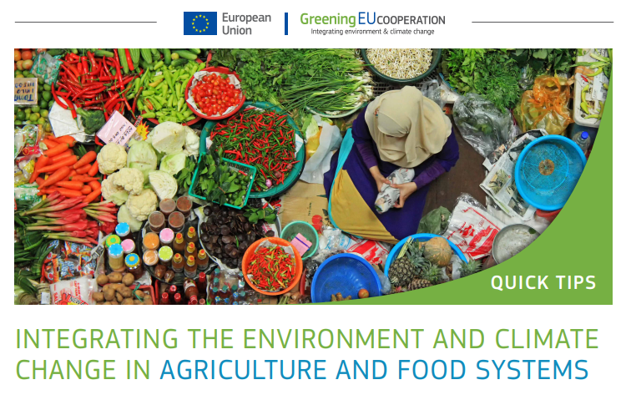

Webinar INTPA F3 - Agroecology in the 2021-2027 Multi-annual Financial Framework
Climate change, DRR and environmental contribution
Quick Tips to Integrate Environment and Climate change in Agriculture and Food Systems
Align with national, EU and international environment and climate commitments and policies
Promote the sustainable and efficient use of natural resources
  Land management and planning
  ‣ Reduce the need to convert natural ecosystems (in particular forests, wetlands) into agriculture (thereby reducing emissions from land-use change and protecting ecosystems).
  ‣ Promote secure and transparent land tenure systems etc.
  Soil management
  ‣ Promote the principles of agroecology
  ‣ Secure and enhance soil health and functioning
  ‣ Promote erosion control measures
  ‣ Promote regeneration of grazing lands
  Water management
  ‣ Promote water use efficiency in irrigation systems (e.g. drip irrigation, rainwater harvesting and storage) and in food processing.
  ‣ Develop measures and fiscal incentives for water conservation
  Etc.

Slide 14





Webinar INTPA F3 - Agroecology in the 2021-2027 Multi-annual Financial Framework
Climate change, DRR and environmental contribution
Quick Tips to Integrate Environment and Climate change in Agriculture and Food Systems
Protect and enhance (bio-) diversity
  ‣ Promote diversified agri-food systems and agricultural landscapes
  ‣ Maintain and enhance diversity of species, functional diversity and genetic resources and maintain biodiversity in the agro-ecosystem over time and space
Promote resilience to ecosystem degradation, natural disasters, climate change and related food crises
Support co-creation, innovation and dissemination of knowledge
Promote green economy principles in sustainable production
  Reduce energy consumption and greenhouse gas emissions
  Preserve and increase carbon stocks
  Minimise pollution
  Encourage sustainable consumption and healthy diets
    Circular economy (waste, recycling, transport)
    Healthy diet

Slide 15
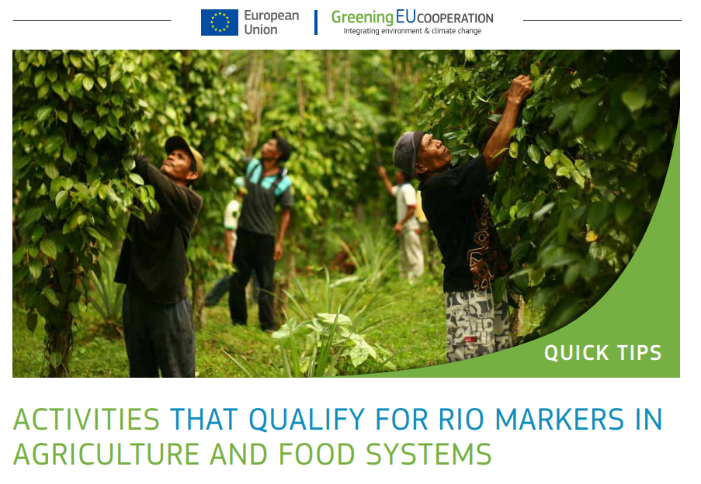
Webinar INTPA F3 - Agroecology in the 2021-2027 Multi-annual Financial Framework
Climate change, DRR and environmental contribution
Activities that qualify for Rio Markers in Agriculture and Food Systems

Slide 16
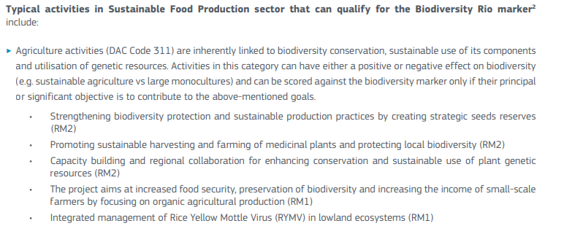
Webinar INTPA F3 - Agroecology in the 2021-2027 Multi-annual Financial Framework
Climate change, DRR and environmental contribution
Activities that qualify for Rio Markers in Agriculture and Food Systems

Slide 17
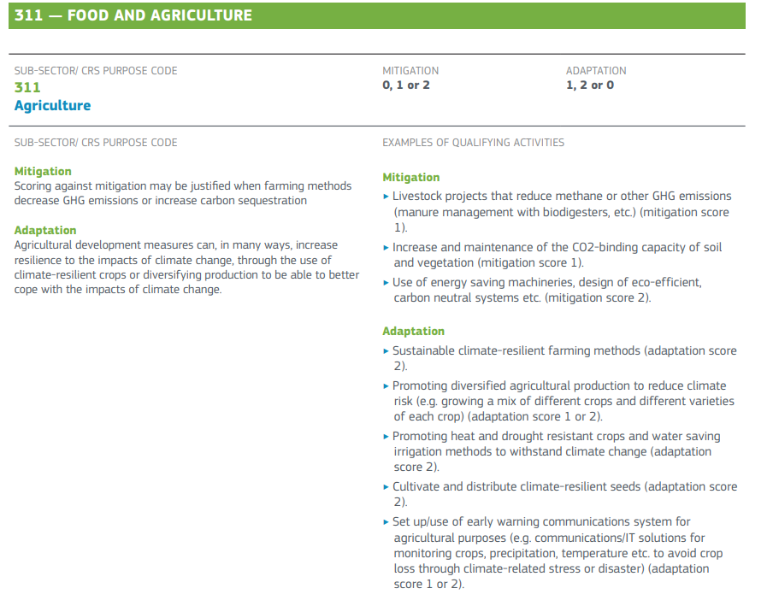

Webinar INTPA F3 - Agroecology in the 2021-2027 Multi-annual Financial Framework
Climate change, DRR and environmental contribution
Activities that qualify for Rio Markers in Agriculture and Food Systems

Slide 18

Webinar INTPA F3 - Agroecology in the 2021-2027 Multi-annual Financial Framework
Climate change, DRR and environmental contribution
Technical Facilities for Partner countries – EUDs and HQ (For DCI Countries)
EU NDC Global Facility
Requests from EUDs or HQ – from Partner countries, from the NDC Partnership…
Contact: Marie-Laure.Robert@ec.europa.eu
INTPA-GREENING-FACILITY@ec.europa.eu
NEAR-GREENING-FACILITY@ec.europa.eu
guidance documents available on capacity4dev.eu (group on Environment, Climate Change and Green Economy)

Slide 19
Webinar INTPA F3 - Agroecology in the 2021-2027 Multi-annual Financial Framework
Title & subtitle and DG of presentation 19
Planning of the 4th Webinar series on Greening EU Cooperation
Tuesday 16 November: Webinar N°2 - Integrated landscape management supporting a green and just transition
Tuesday 23 November: Webinar N°3 - Green & Sustainable Cities
Tuesday 30 November: Webinar N°4 – Updates on Green Deal policy developments
Tuesday 7 December: Webinar N°5 - Tracking EU environment-related expenditure, notably on climate change and biodiversity
Tbc : Webinar N°1 - Green Financing in Public Sector

Slide 20
Webinar INTPA F3 - Agroecology in the 2021-2027 Multi-annual Financial Framework
Title & subtitle and DG of presentation 20
Planning of the 4th Webinar series on Greening EU Cooperation
Tuesday 16 November: Integrated landscape management supporting a green and just transition
Tuesday 23 November: Green & Sustainable Cities
Tuesday 30 November: Updates on Green Deal policy developments
Tuesday 7 December: Tracking EU environment-related expenditure, notably on climate change and biodiversity
Tbc : Green Financing in Public Sector

