Slide 1
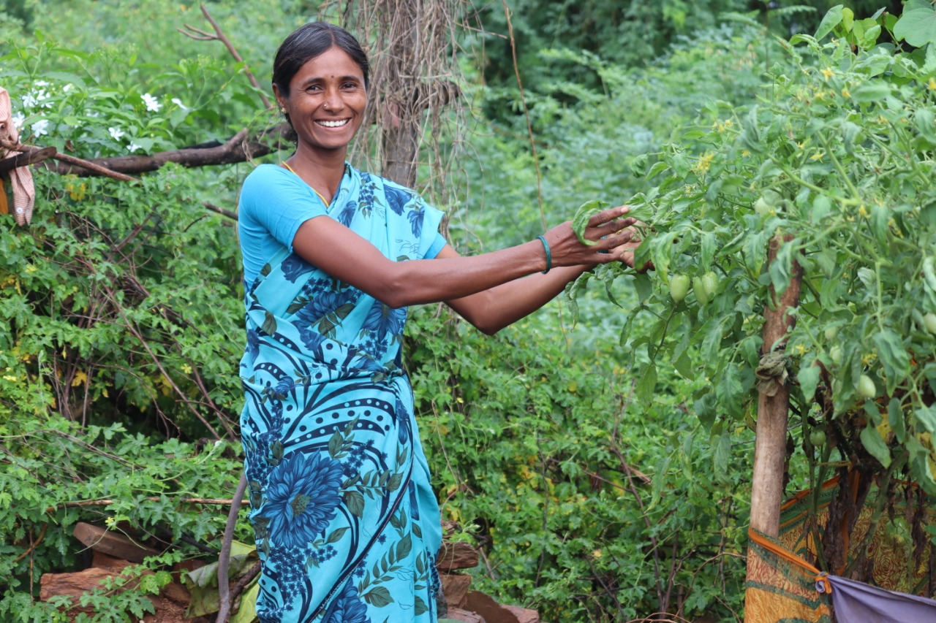
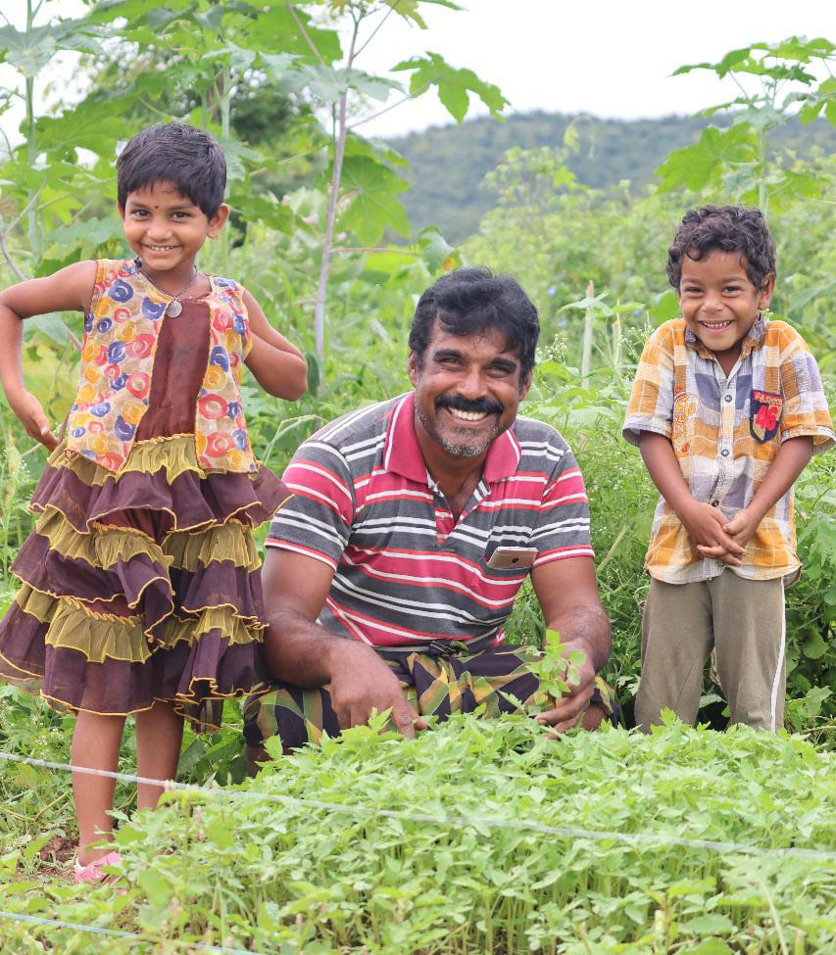
Natural farming for farmers' livelihoods, people's health and for climate resilience - lessons from A.P. Community managed natural farming
Vision 2031 - all 8 million farmers and farm workers
T Vijay Kumar
Executive Vice Chairman, APRySS, Ex-officio Special CS, Natural Farming, GoAP
vjthallam@gmail.com

Slide 2
Andhra Pradesh – population 54 million
India’s Leading Agrarian State
Contributes 34% to state GSDP
Diversified cropping systems
62% of population employed in agriculture & related activities
2nd longest coastline – 974 km
Rice Bowl of India
India’s largest producer of fruits, eggs & aquaculture products
8 million ha
cropped area
Horticulture
1.7 million ha

Slide 3

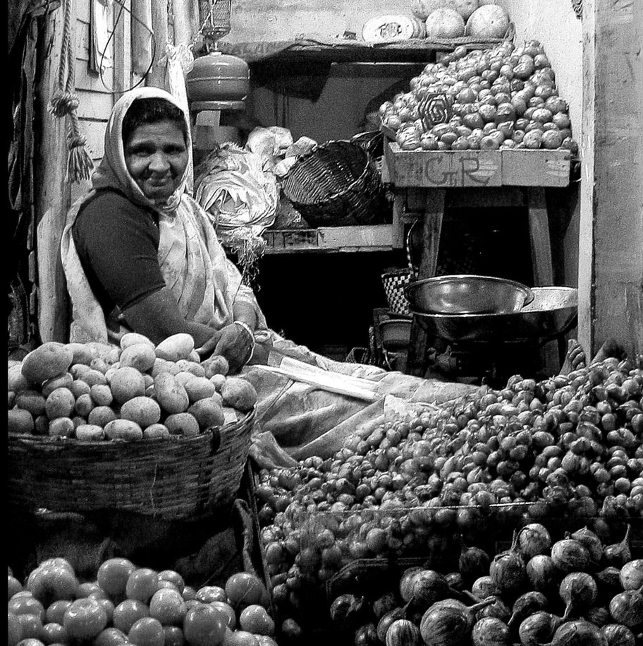
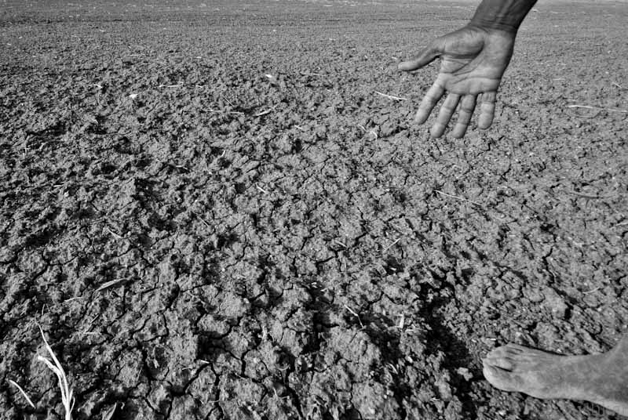
Food system – multiple crises
Farmer Distress
Soil degradation,
Continuous loss of soil organic matter
Water stress and water emergency
Heatwaves – global warming
Decreased bio diversity
Water and air pollution
Consumer Food Plate
High Costs of Cultivation
(Seeds, Fertilizers, Pesticides)
Prolonged Dry Spells,
Droughts
Acute water shortages, Drying of Borewells
More frequent cyclones, floods, unseasonal rains
Problems of Small, marginal farmers and Tenants,
Rural-Urban migration
Market Uncertainty
Food Scarcity
Chemical Residues
Lack of micro nutrients, trace minerals
Environment crisis
Heavy metal contamination in food
Climate emergency
Notes:
2 and 3 combined

Slide 4
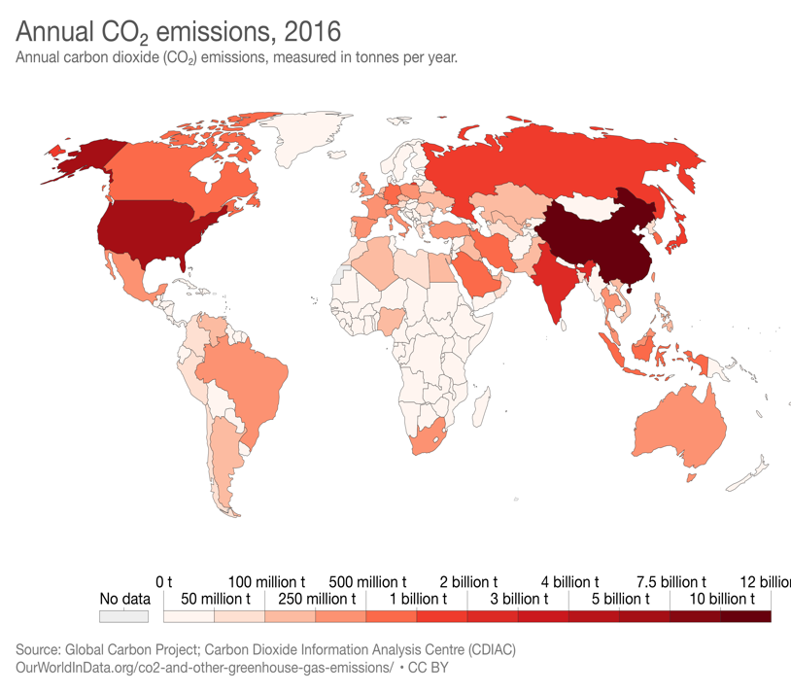
Role of food systems in GHGs – 34%
Current land management – leading to steady loss of soil organic matter
Deforestation
Forest fires Burning crop residues
Ploughing
Keeping lands Fallow
Excess Irrigation
Wind and Water Erosion
Biocides – Chemical fertilizers and pesticides
Over grazing

Slide 5
Farming in harmony with nature – for people and for the planet – a solution for all the inter related emergencies
U.N Food System Summit calls for Nature based solution
What is Natural farming ? It is a holistic land management practice that leverages the power of photosynthesis in plants to close the carbon cycle, and build soil health, crop resilience and nutrient density.

Slide 6
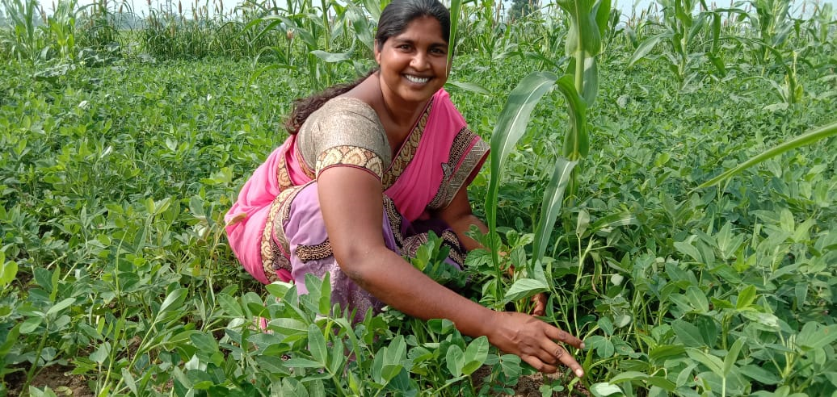
APCNF programme at a glance
3 to 5 years for a farmer to transit from conventional agriculture to Natural farming
28% Villages
15% Farmers
40,656 farmers
704 villages
163,000 farmers
972 villages
523,000 farmers
3011 villages
695,000 farmers and farm workers
3011 villages
190,000 Ha
750,000 farmers and farm workers
3730 villages
215,960 Ha
1.1 million farmers and farm workers
3730 villages
28% Villages
10% Farmers
22% Villages
9% Farmers
2021-22
2020-21
2019-20
2018-19
 | 2020-21 | 2021-22(Target)
Farmers 100% N.F | 481,000 130,000 | 703,000 300,000
Farm workers | 269,000 | 405,000
Gram Panchayats | 3730 | 3730
Acreage (Ha) | 215,960 | 320,000
2017-18
86% -small and marginal farmers
Avg holding – 1 Ha
2016-17
Source of Funds: Govt, KfW loan - $250 m upto 2024
Azim Premji Philanthropy – $16 m upto 2022

Slide 7
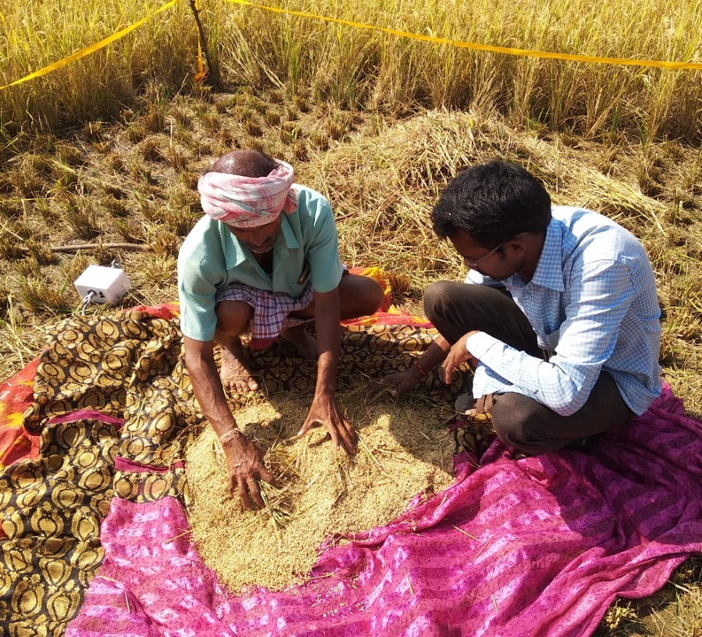
Independent Assessment by Center for Economics and Social Studies (CESS) / I.D.S
6 seasons till now - 2018-19 (2 seasons) and 2019 – 20 (2 seasons) , Kharif 2020 and Rabi 2020-21 ( 2 seasons)
APCNF IMPACTS
Cost of cultivation - significant reduction - NF costs are much lower than non-NF, across all crops
Yield differences are not significant between NF and Non-NF farms
Significant increase in net income for NF farmers
NF farms reported better soil health, crop health, resilience, economic empowerment of farmers and dignity of labor.
The report also mentioned that APCNF has higher potential for expansion of extension services by way of increasing CRPs at the village level

Slide 8
IDS - CCE Study (Independent Assessment)
SUMMARY RESULTS FOR KHARIF 2020 study
Crop | Yield (Qtls/ Ha.) |  |  | Paid-out-cost (Rs/Ha.) |  |  | Net Income (Rs/Ha.)
 | APCNF* | Non-APCNF $ | Changes in yields in % | APCNF | Non-APCNF | Changes in paid out costs in % | APCNF | Non-APCNF | Changes in net incomes in %
Paddy (rice) | 53.95 | 51.75 | 4% | 46,125 | 61,301 | -25% | 53,168 | 33,392 | 59%
Groundnut | 22.12 | 19.59 | 13% | 46,540 | 48,448 | -4% | 49,899 | 20,603 | 142%
Cotton | 12.45 | 10.96 | 14% | 35,797 | 49,952 | -28% | 27,834 | 5,670 | 391%
Black Gram | 9.86 | 11.27 | -13% | 17,705 | 25,186 | -30% | 58,467 | 26,973 | 117%
Red Gram | 7.42 | 7.33 | 1% | 13,305 | 23,489 | -43% | 53,439 | 11,199 | 377%
Ragi (millet) | 18.56 | 12.27 | 51% | 23,840 | 36,947 | -35% | 38,396 | 4,673 | 722%
* APCNF sample HH- 1651, $ Non APCNF sample HH - 646

Slide 9
IDS - CCE Study (Independent Assessment)
SUMMARY RESULTS FOR RABI 2020-21 study
Crop | Yield (Qtls/ Ha.) |  |  | Paid-out-cost (Rs/Ha.) |  |  | Net Income (Rs/Ha.)
 | APCNF* | Non-APCNF $ | Changes in yields in % | APCNF | Non-APCNF | Changes in paid out costs in % | APCNF | Non-APCNF | Changes in net incomesin %
Paddy (rice) | 62.56 | 57.11 | 10% | 43,760 | 52,029 | -16% | 61,207 | 38,782 | 58%
Groundnut | 36.23 | 25.61 | 41% | 39,929 | 57,143 | -30% | 1,68,286 | 73,494 | 129%
Black Gram | 12.97 | 13.05 | -1% | 18,246 | 25,714 | -29% | 66,590 | 58,576 | 14%
Maize (corn) | 75.86 | 63.01 | 20% | 39,819 | 43,598 | -9% | 79,191 | 49,524 | 60%
Green Gram | 12.64 | 10.27 | 23% | 19,310 | 26,692 | -28% | 58,609 | 36,128 | 62%
* APCNF sample HH- 800, $ Non APCNF sample HH - 494

Slide 10
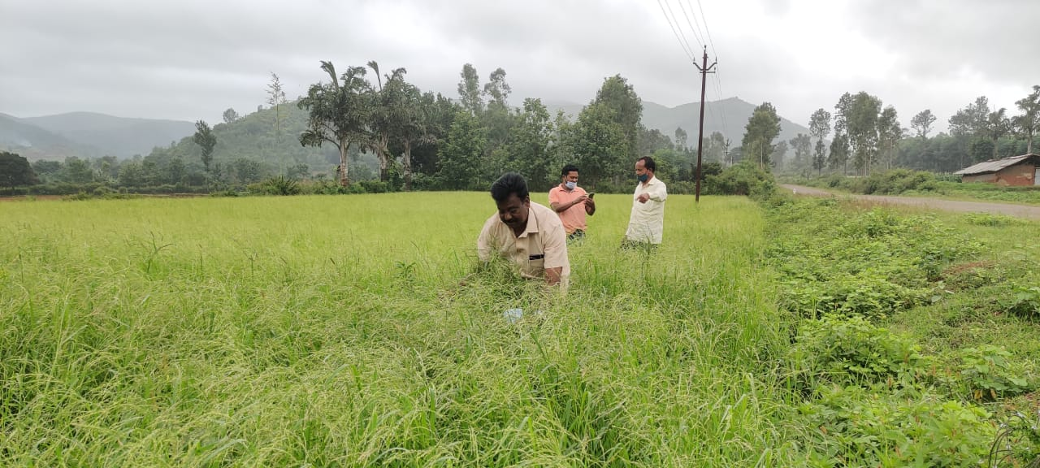
Summary of Guli Ragi Yield and Income Parameters of 2020 Kharif season ( as per CCE data)
 | Yield per acre (kg) |  |  | Gross Income ( Rs) |  |  | Cost of cultivation (Rs) |  |  | Net Income ( Rs)
Method of cultivation | Avg | Lowest | Highest | Avg | Lowest | Highest | Avg | Lowest | Highest | Avg | Lowest | Highest
Guli Ragi | 1203.76 | 663 | 1874 | 36514.08 | 19902 | 56220 | 3570.72 | 3500 | 5000 | 32983.36 | 18402 | 51220
Conventional | 713.22 | 559 | 859 | 21946 | 16767 | 27456 | 5277.78 | 6500 | 7550 | 16668.22 | 10267 | 19906

Slide 11
Internal study - Evaluating the Difference in Water Consumption of Motorized Bore-well Pumps in APCNF and Conventional Farming Method
Aim: Evaluating the difference in water consumption (in litre) of motorized bore well pump in APCNF and conventional farming on the basis of crop types, soil types, number of years of CMNF practice.
Methodology: The study is based on farmer recall method, for crop season 2020-21. The major focus questionnaire is on HP of motor, running hours of the pumpset and interval of irrigation.
    Sample Size: Only those farmers having bore well have been selected for study. This has been done for simplicity in recall for farmers as farmers are in a better position to respond to the interval and irrigation hours, if they are using bore-well. (observations from a large scale internal study).
 | Paddy | Groundnut | Chilli | Cotton
APCNF | 556 | 190 | 50 | 37
Chemical | 556 | 190 | 50 | 37

Slide 12
Water consumption in one cropping cycle 2020-21 (RySS – internal study)
Y-axis = Water consumption in kilolitre

Slide 13
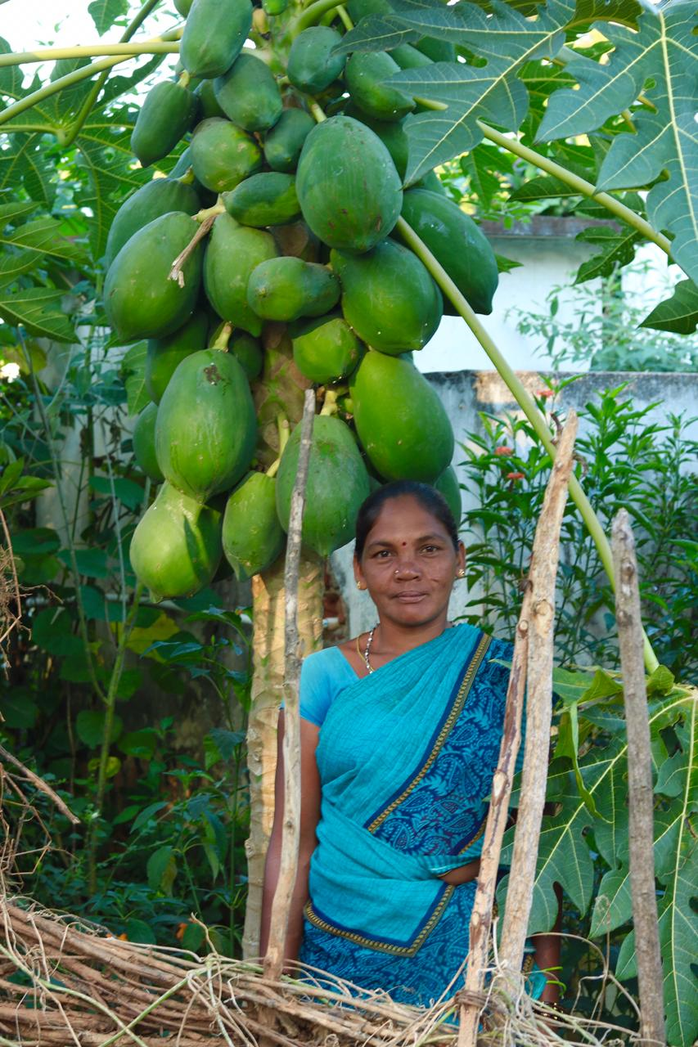
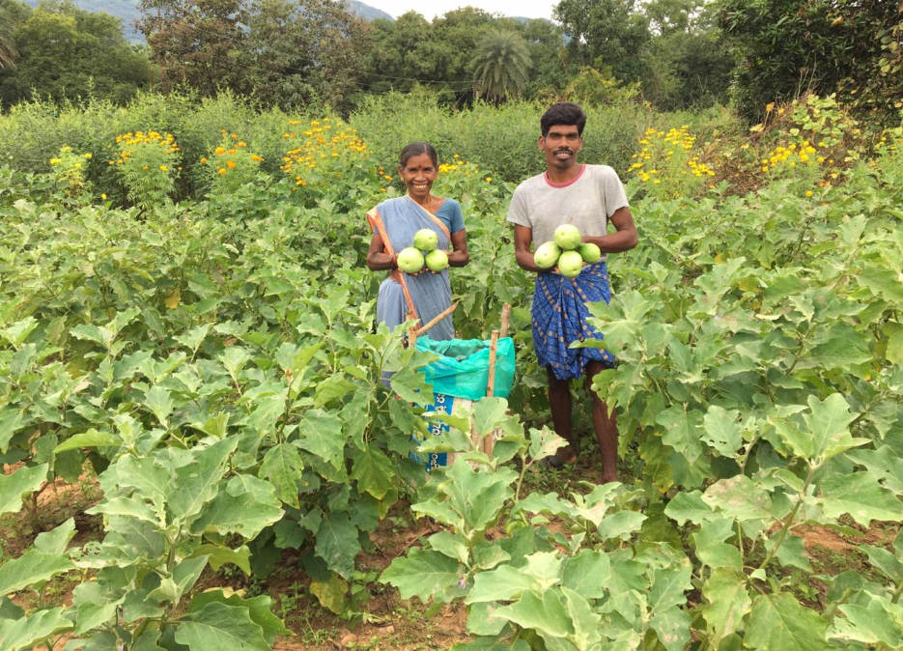
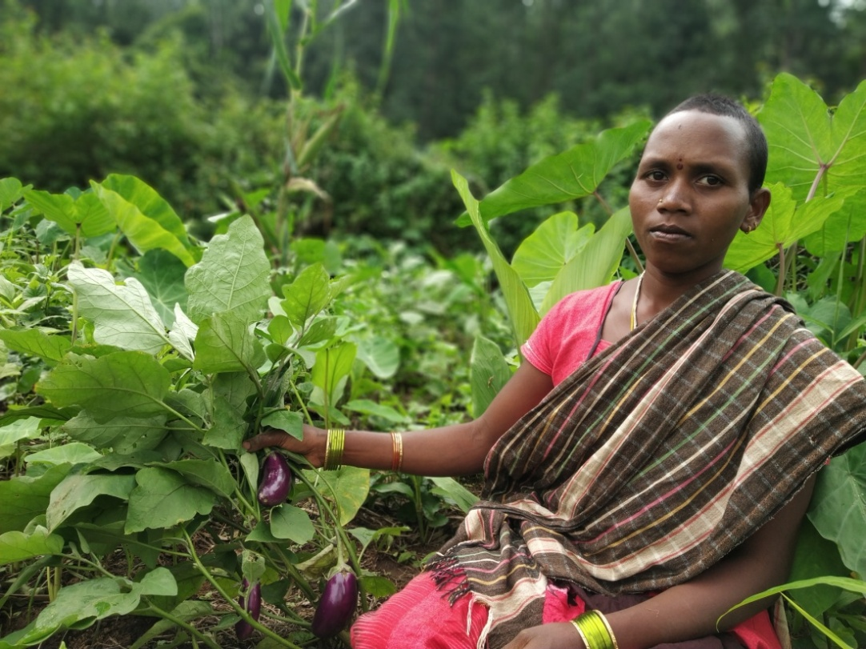
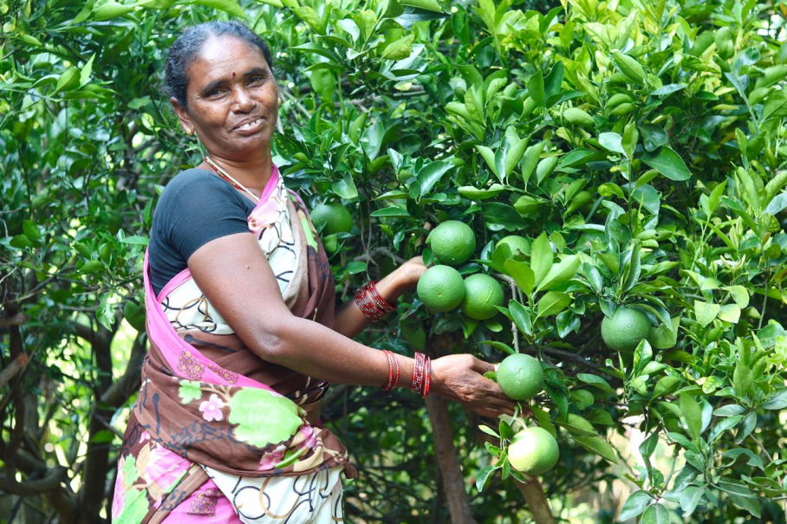
Food
and
Nutrition diversity
Universal coverage strategy
Focus on landless, farmworkers ( 350,000)
Aim to include 5-7 food groups in the household diet
Homestead gardens – Mini food forest in one’s own backyard

Slide 14
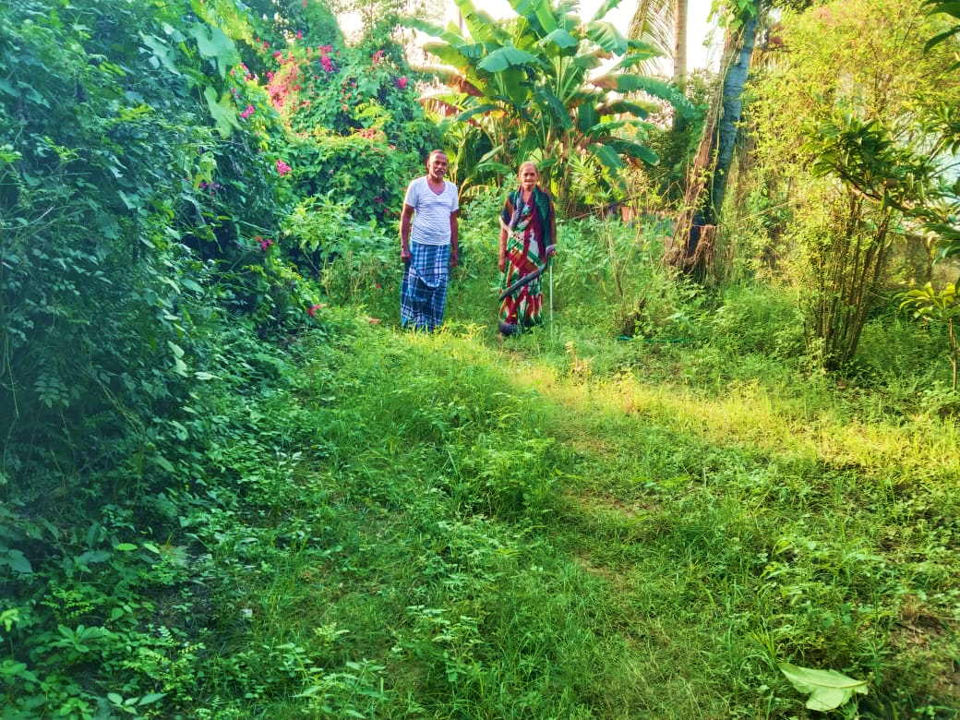
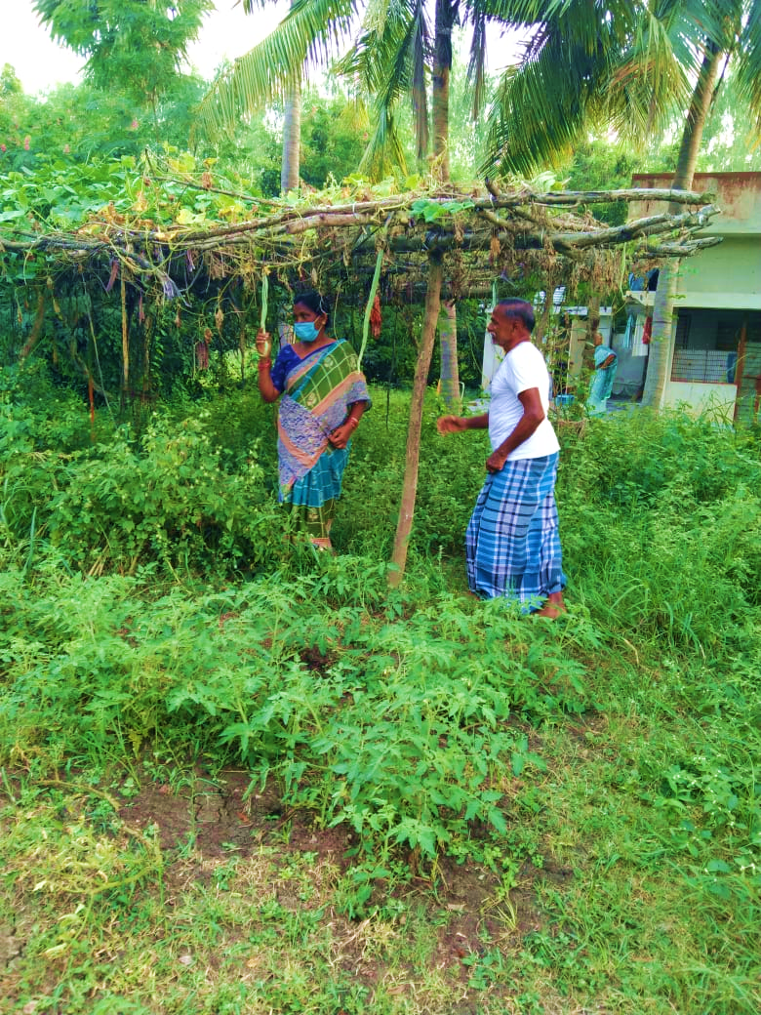
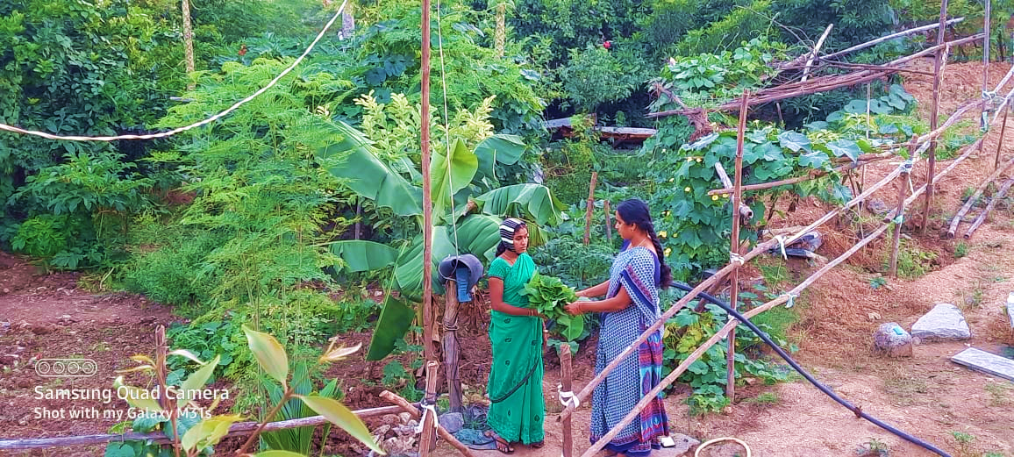

Slide 15
Improved Biodiversity

Slide 16
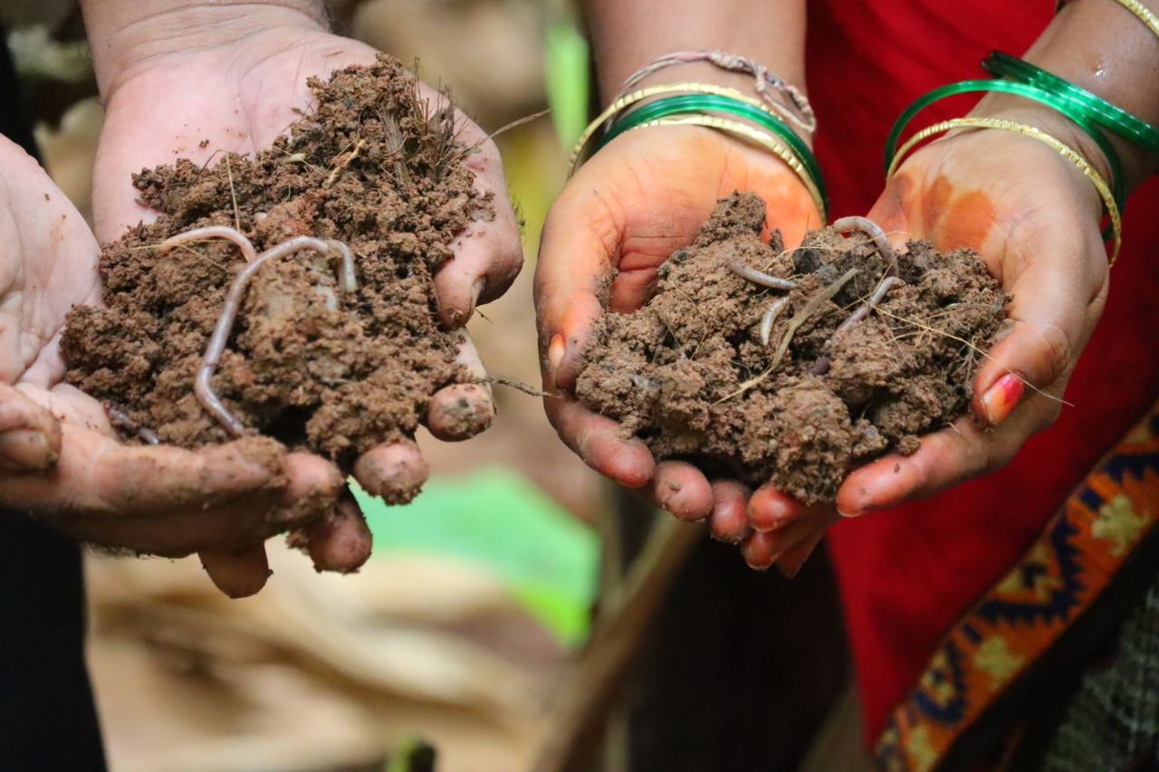
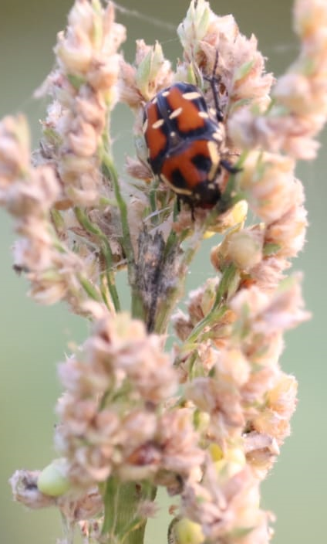
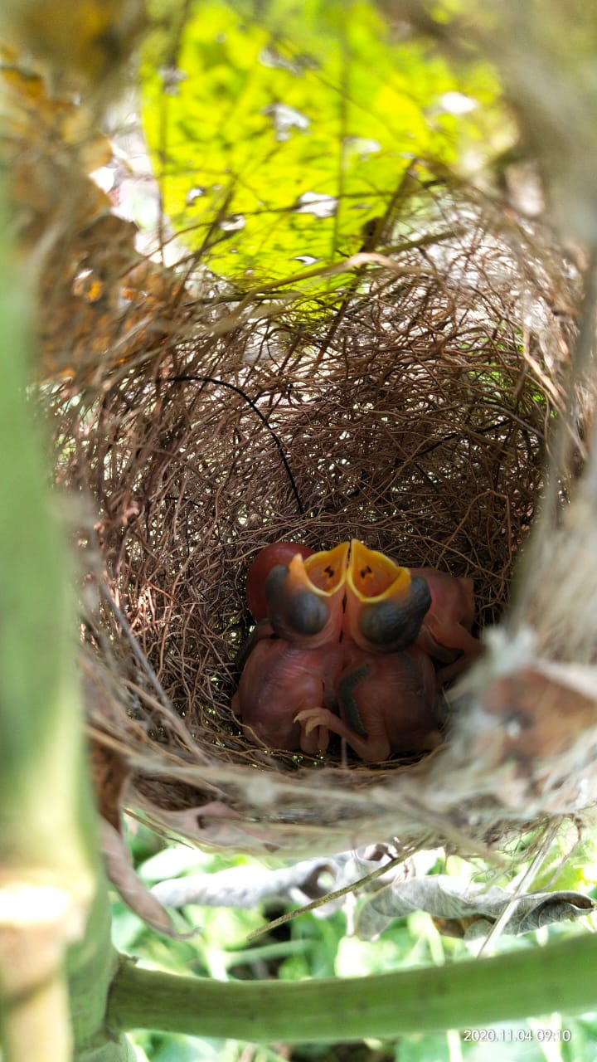

Average number of Earthworms per square meter in Natural Farming plot is 46.83 as compared to conventional plot where it is 5.71
Increase in Beneficial insects
Significant increase in birds nest and birds visiting Natural Farming fields

Slide 17
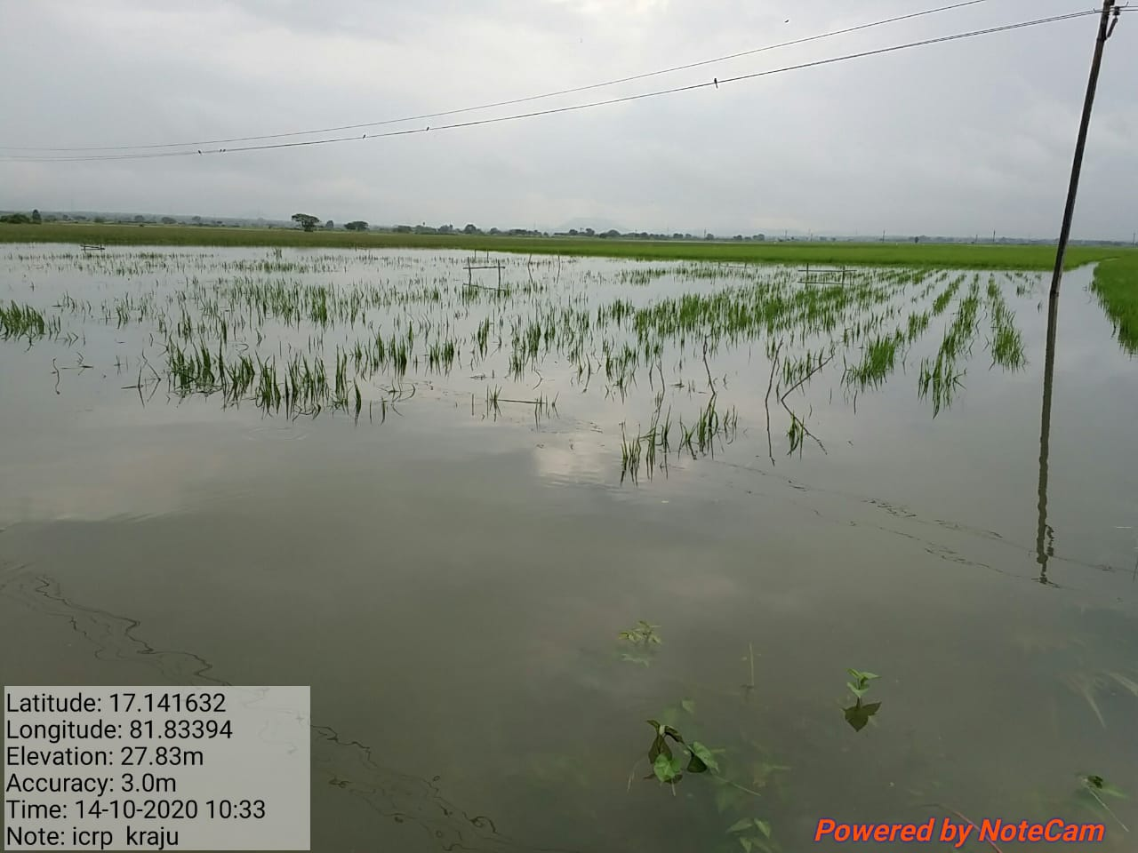
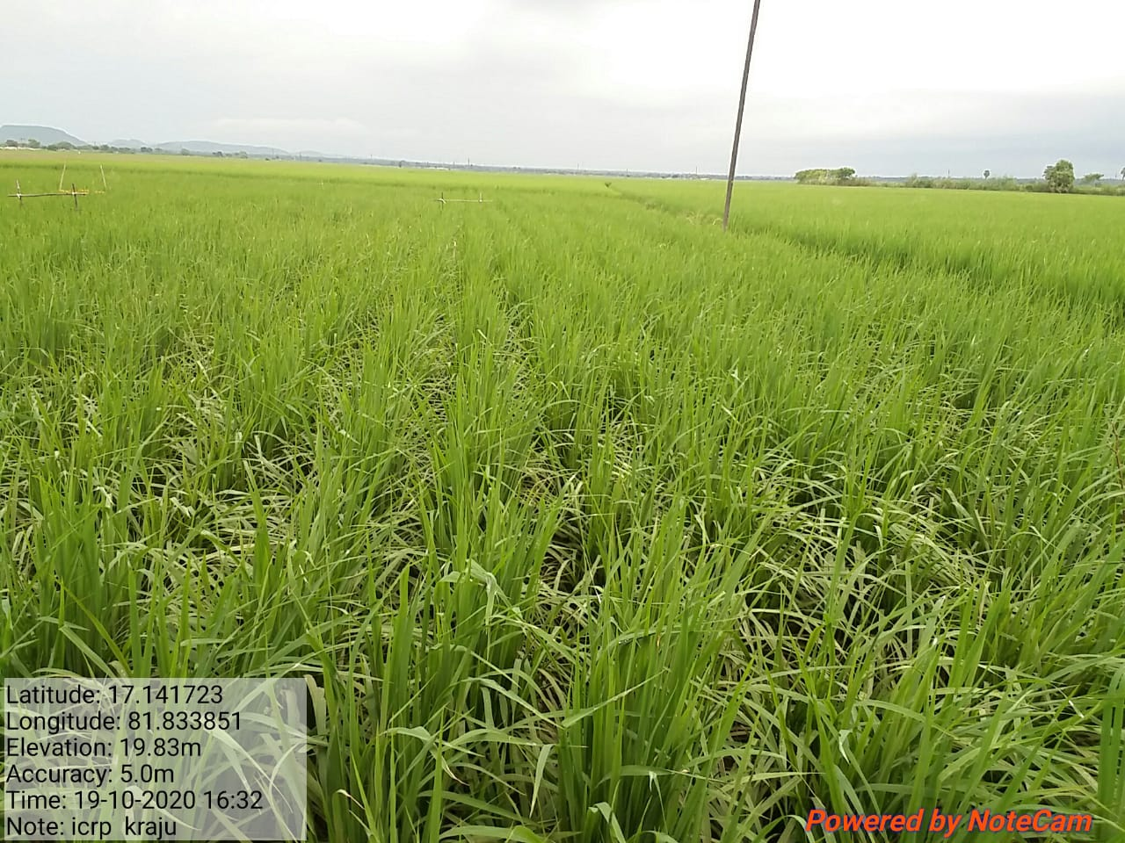
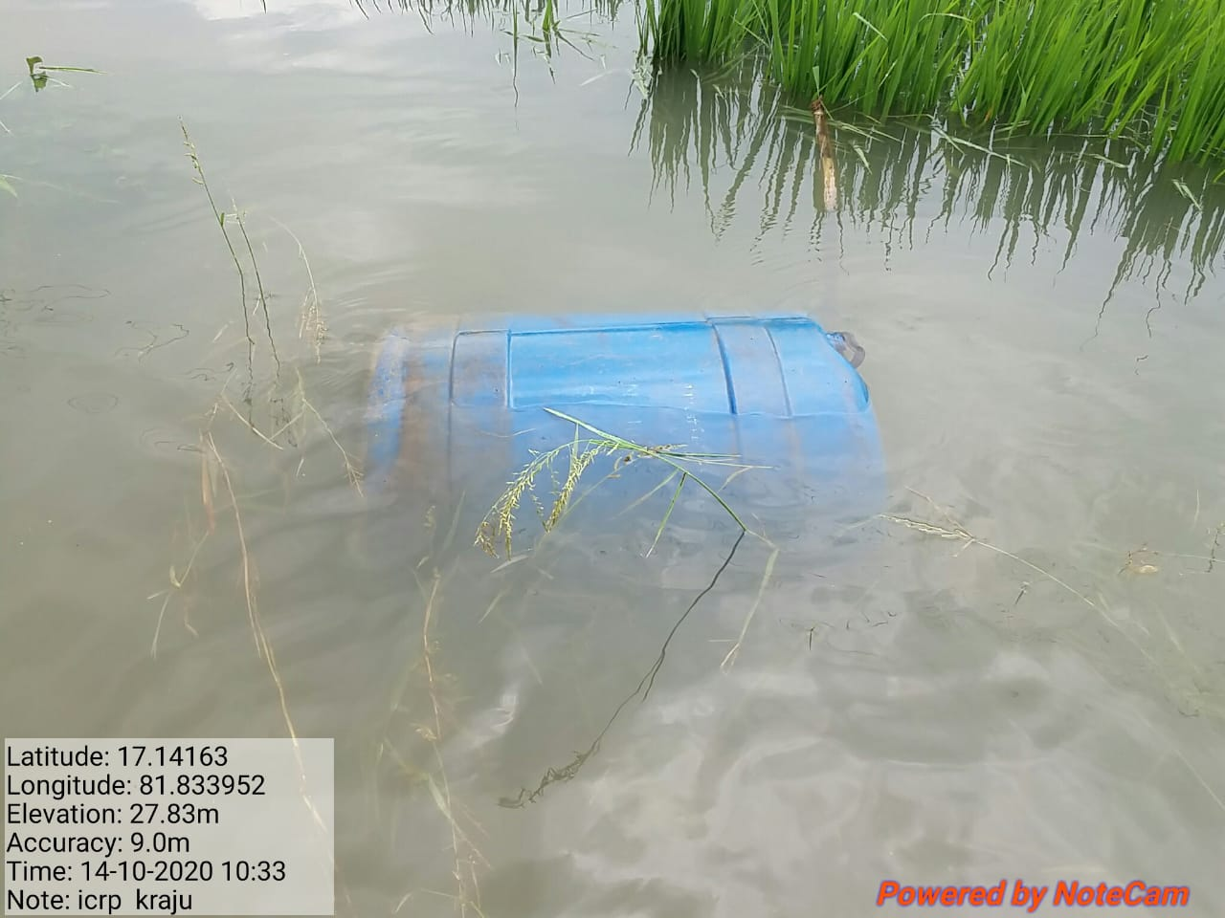
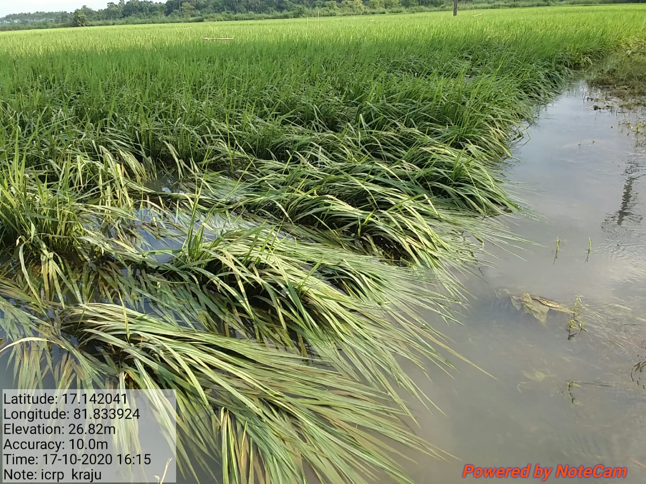
In 2020, Andhra Pradesh has seen unseasonal rainfall across the state.
APCNF Farmers have experienced less damage compared to other farmers
NF PLOT
Conventional Plot

Slide 18
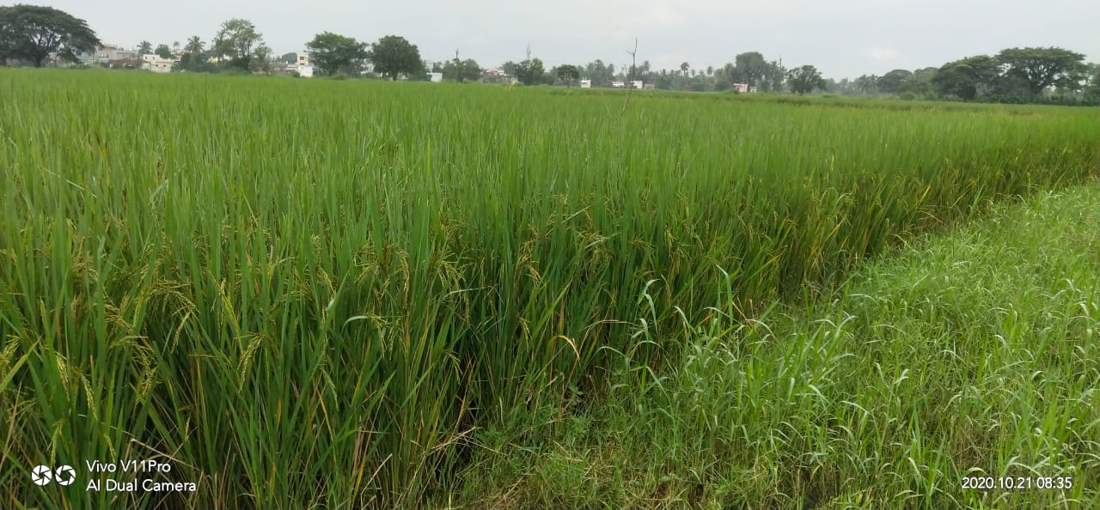
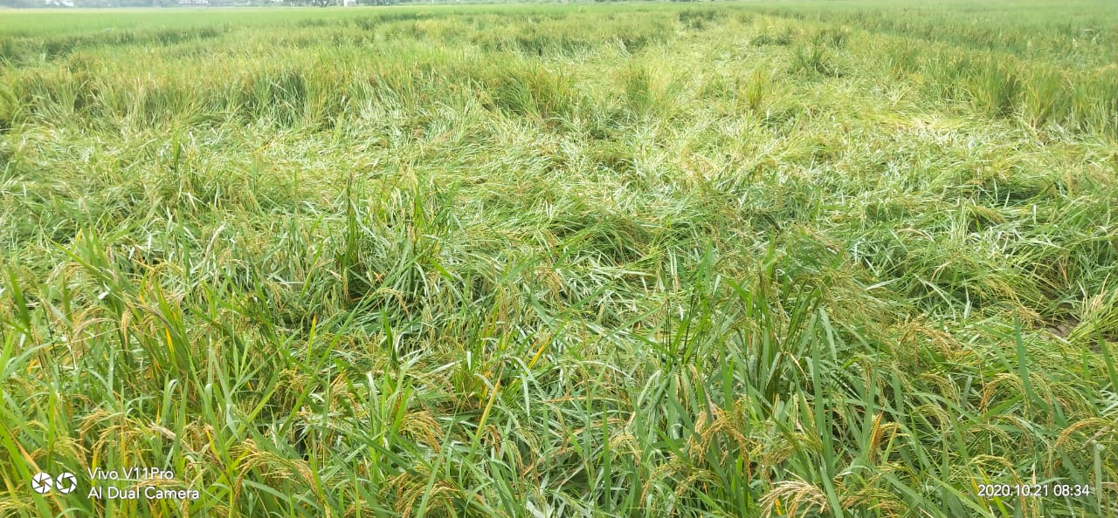
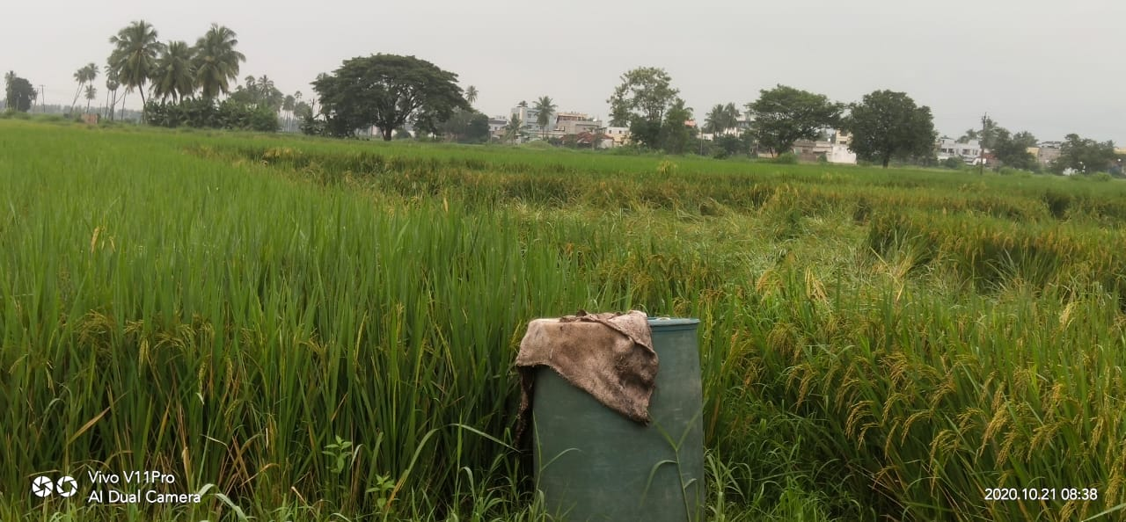
NF Plot
Conventional Plot
Conventional Plot
NF PLOT

Slide 19
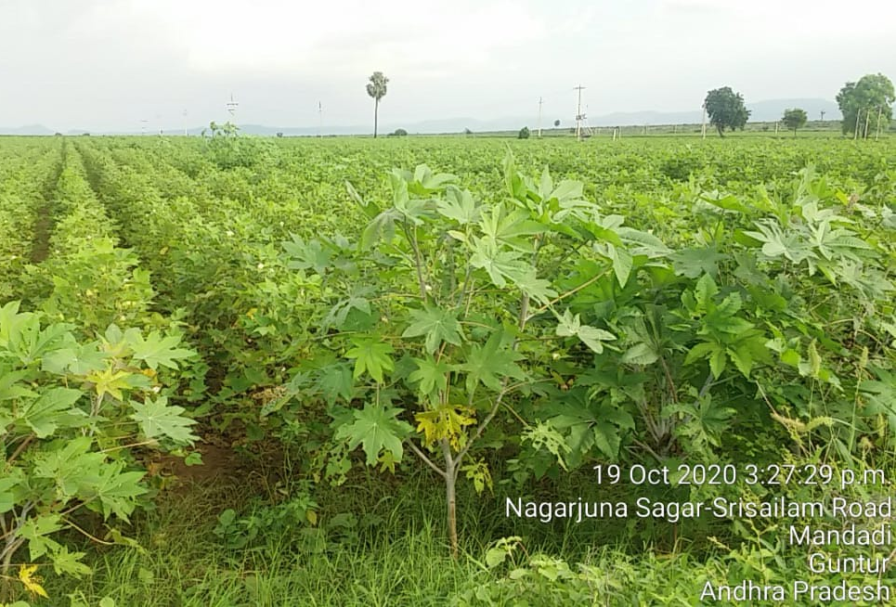
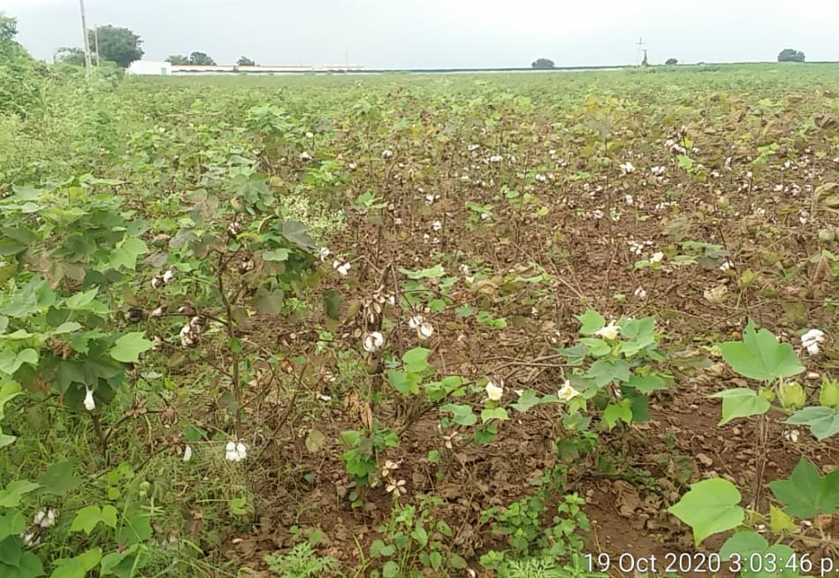
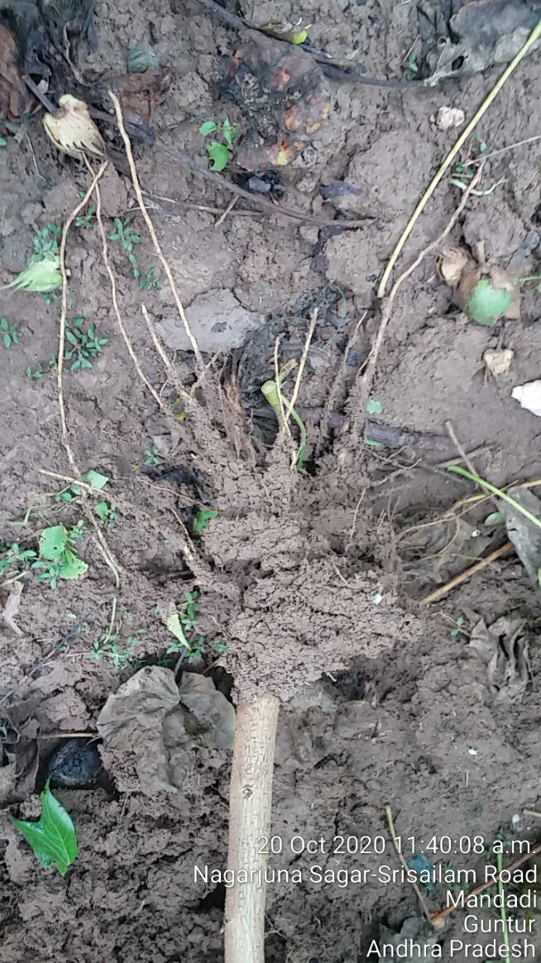
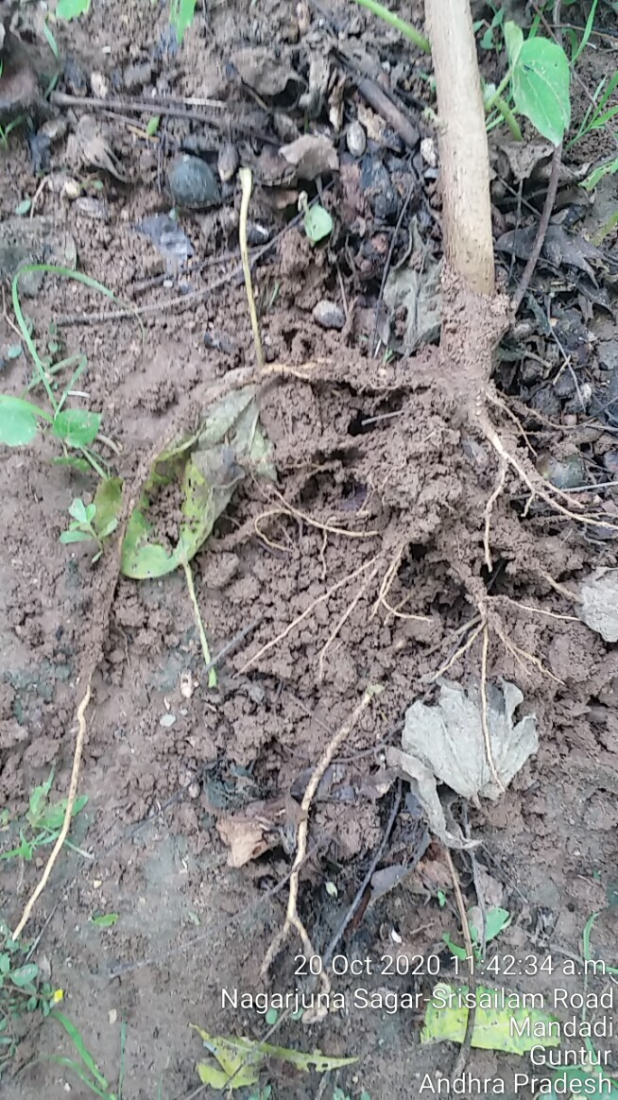
NF Cotton field
Conventional Cotton field
Root length in NF cotton 35.56 cm
Root length in Conventional Cotton 27.94 cm

Slide 20



APCNF Implementation – overcoming obstacles through critical innovations
Farmers’ Mindset – Agriculture cannot be practiced without chemicals
Government support and advocacy – resources and implementation
Knowledge – POPs, videos, etc
Research
Innovations and continuous learning
Women SHG s and federations
Farmer to farmer – extension system
Facilitating organizations – Govt., NGOs and C.B.Os
Collaborations with Global and National institutions and Scientific experts
VESTED INTERESTS
Taking it to every farmer
Challenges
Unique innovations of Govt of A.P and pro farmer policies and welfare measures, across the value chain.
Rythu Bharosa Kendram – farmer service centres – one stop shop Hon’ble C.M’s Organic policy initiative.
Handholding until full adoption
knowledge
Poor extension system
Self sustaining, long-lasting

Slide 21
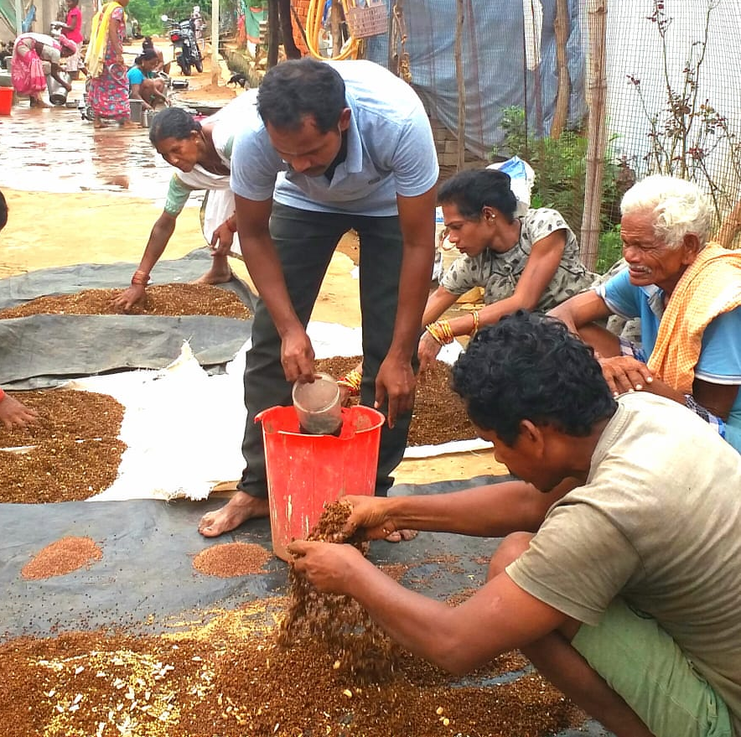
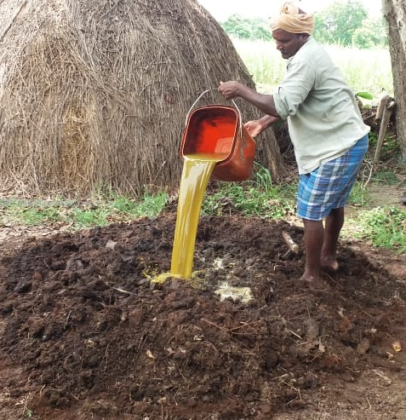
Soil to be covered with crops 365 days
(Living root)
Diverse crops , trees
15 – 20 crops
Minimal disturbance of soils
Integrate animals into farming
Bio stimulants as necessary catalysts
Increase amount and diversity of organic residues
No synthetic fertilizers, pesticides, herbicides, weedicides
Pest management through better agronomic practices, botanical extracts
Use indigenous seed
Universal Principles of Natural Farming – mimicking nature
Microbial Seed Coating
Beejamrutham - cow urine, cow dung, and lime – fermented
Bio-stimulants
Microbial Soil enhancement
Jeevamrutham (bio-stimulant) - cow dung, cow urine, soil, jaggery, pulses flour – mixed and fermented
Bio stimulants - unique strength in Indian Agriculture – reduce the transition period

Slide 22
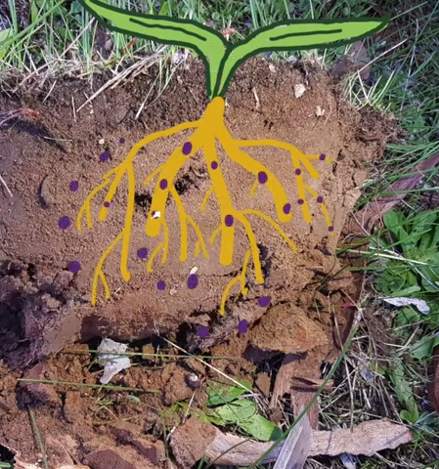
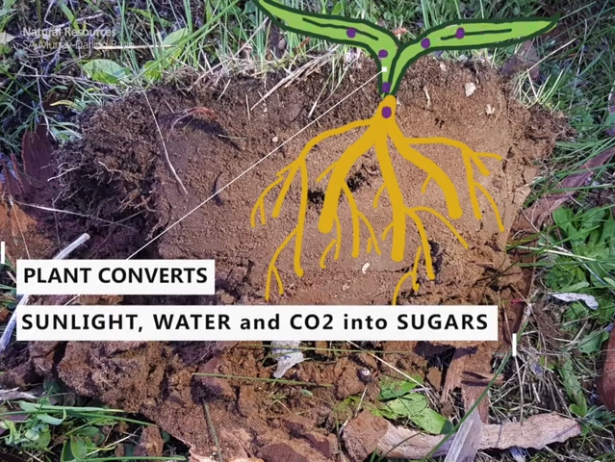
Nutrient Cycling in Nature
Nature’s Sophisticated
Carbon Capture Mechanism
40% of Plant Sugars stored in Above Ground Biomass
Results:
30% of Sugars stored in Roots
1. Soil carbon sequestration
2. Greater water holding(+1 gm carbon -> +8 gm water)
3. Efficient Nutrient absorption mechanism
4. Mycorryzha and other microbes create soil structure
5. Increase in soil porosity – 50% 60 % air
30% of Sugars moves into the Soil as Exudates, feeding vast microbial population
Image courtesy: Natural Resources SA Murray-Darling Basin YouTube channel

Slide 23

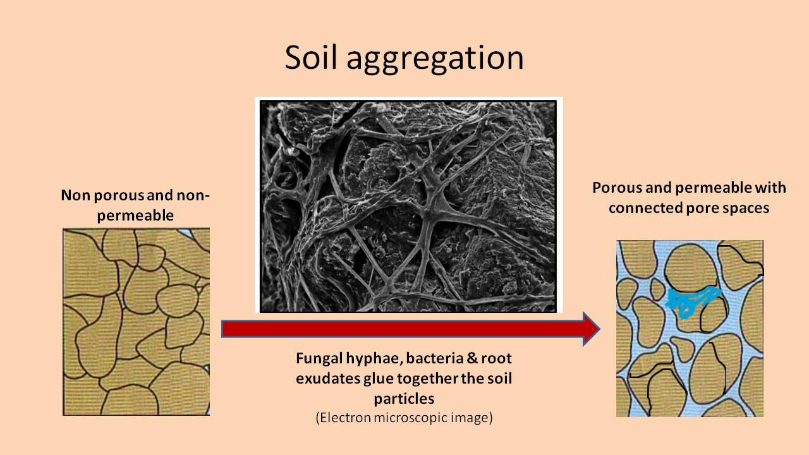
NF - a possible solution to the global water problem and reversal of desertification
Soil Aeration
Water infiltration
Water holding
Water vapour harvested for irrigation
rivers of water in the air – in tropical countries,
air contains 10 times the water in the rivers – upto 50,000 ppm

Slide 24
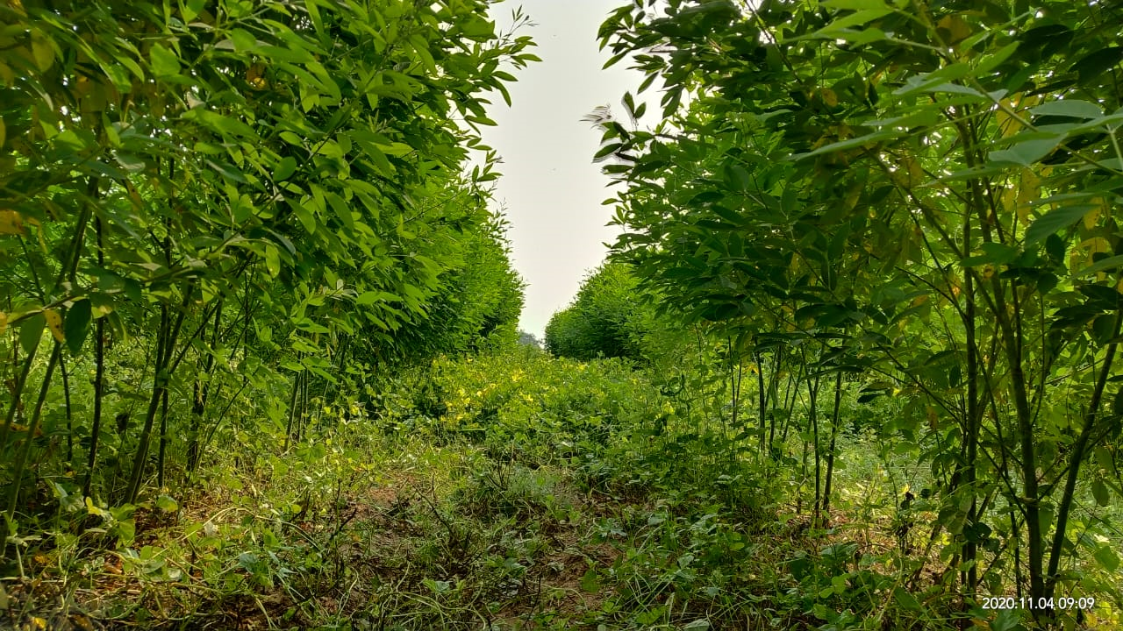
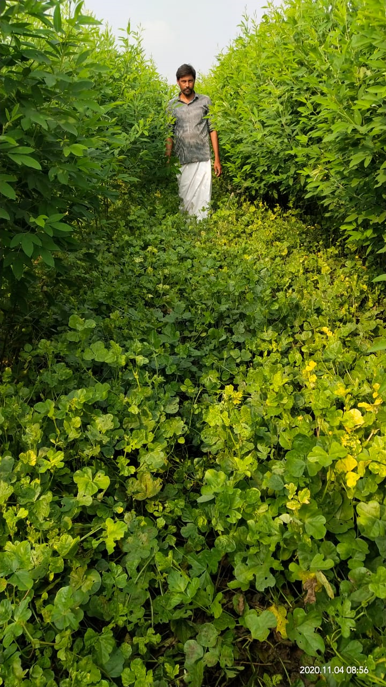
Crop diversity – poly cropping
Crop diversity is an integral part of the APCNF system.
- Resilience from vagaries of weather
Reduces risks, surplus income
Provides nutrition diversity
Strengthens soil structure

Slide 25
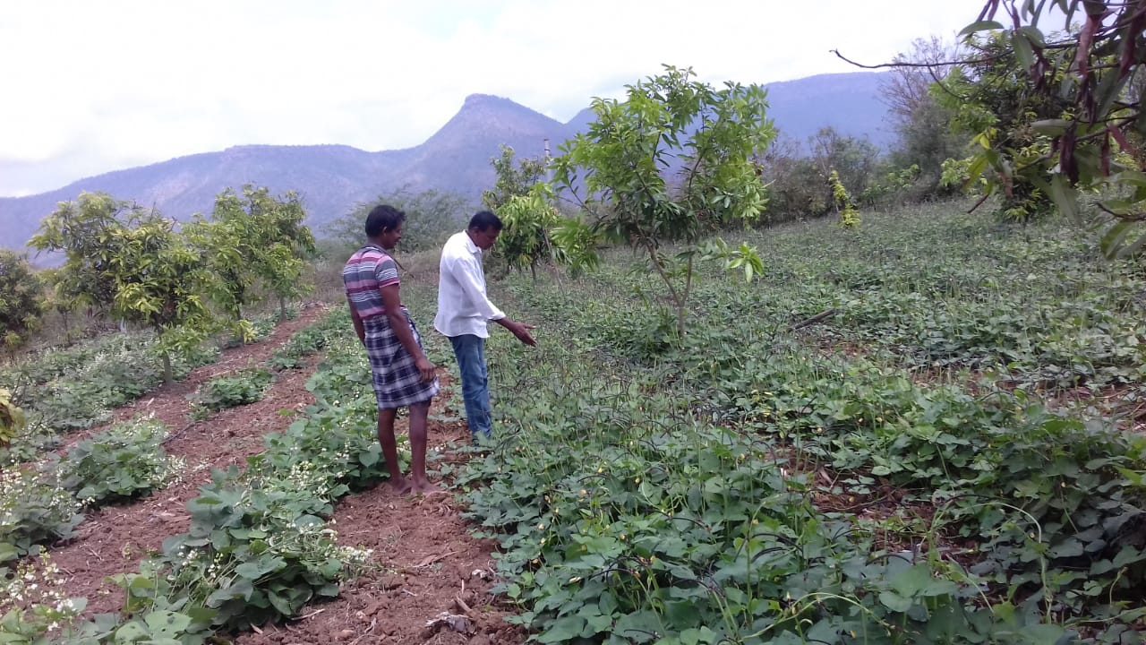
Cowpea and field beans grown as intercrops in Mango orchard

Slide 26

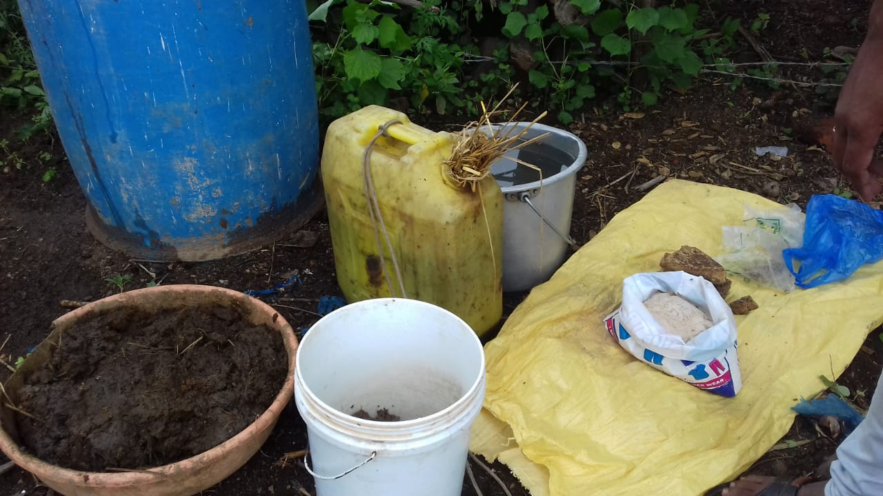
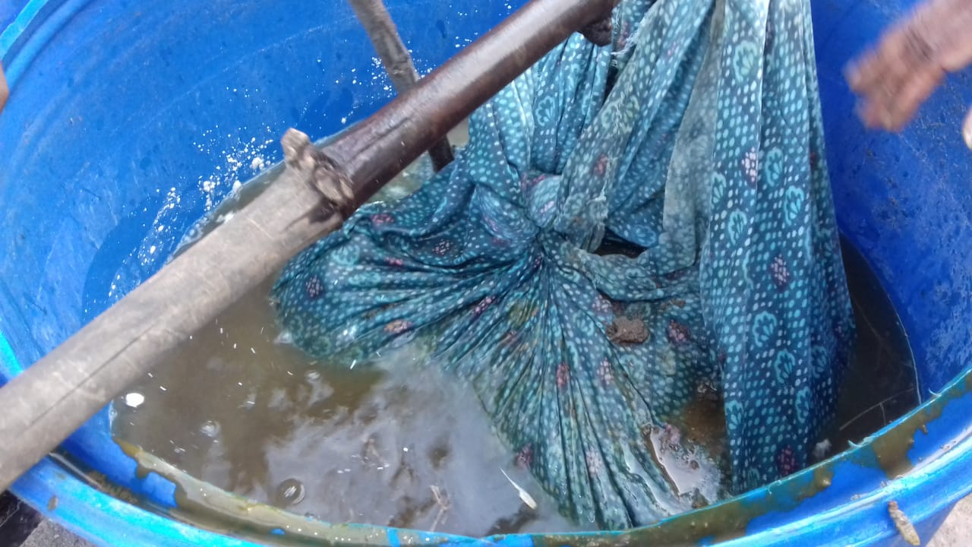
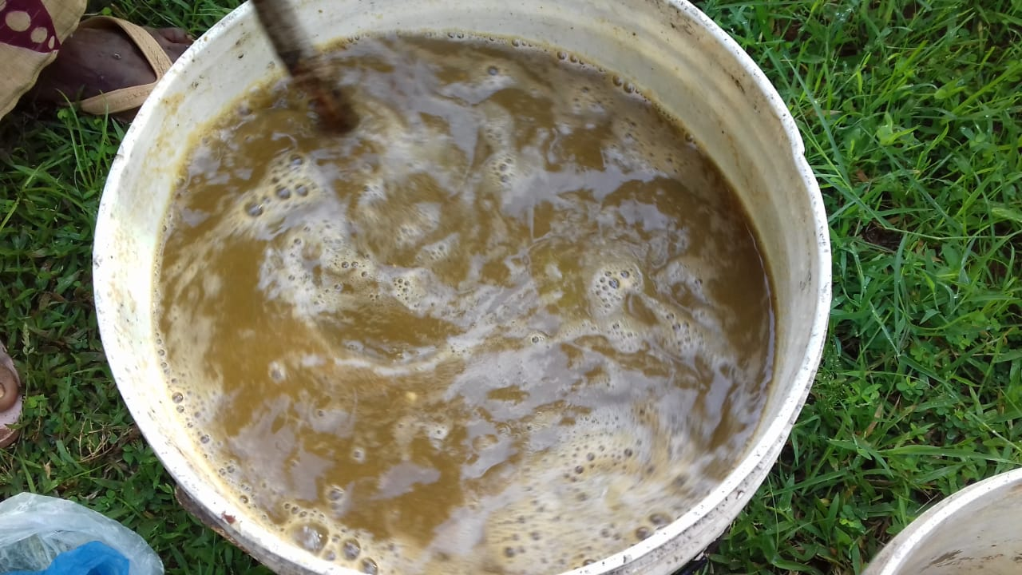
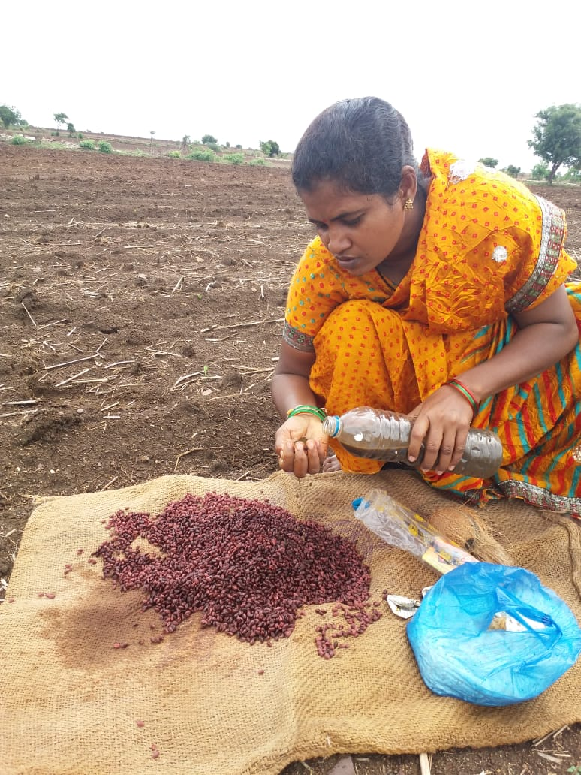
Microbial seed coating - Beejamrutham
Cow dung – 2 kg
Cow urine – 2 liters
Lime – 40 grams
Handful of chemical free soil
Water – 20 liters
Ingredients
Step 1
Wrap the cow dung in a cloth and submerge in water and let it soak for 12 hours
Squeeze the cloth after 12 hours, add lime, chemical free soil. Mix well in clock wise direction
Step 2
Spray the concoction on all seeds and ensuring each seed is coated by it before sowing
Step 3

Slide 27
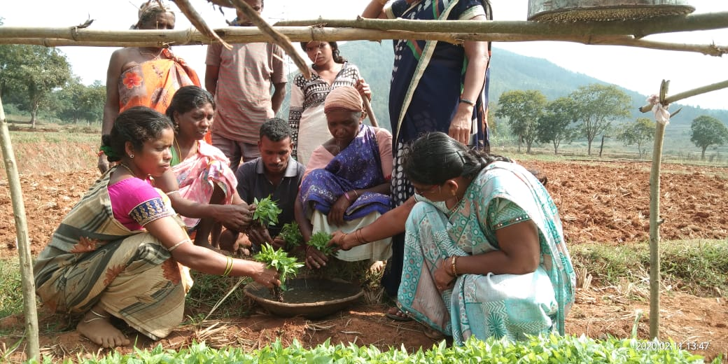

Slide 28

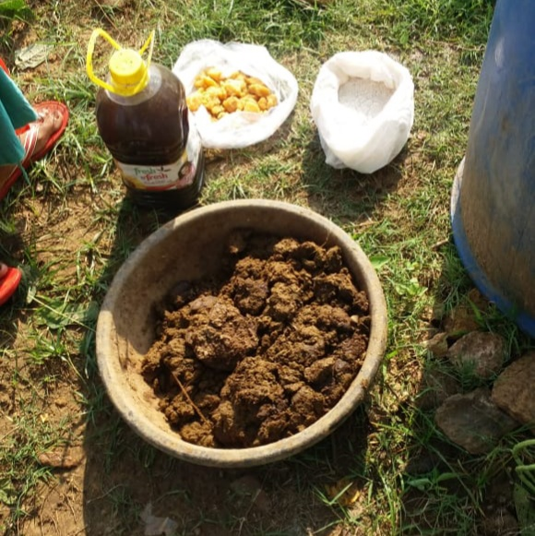
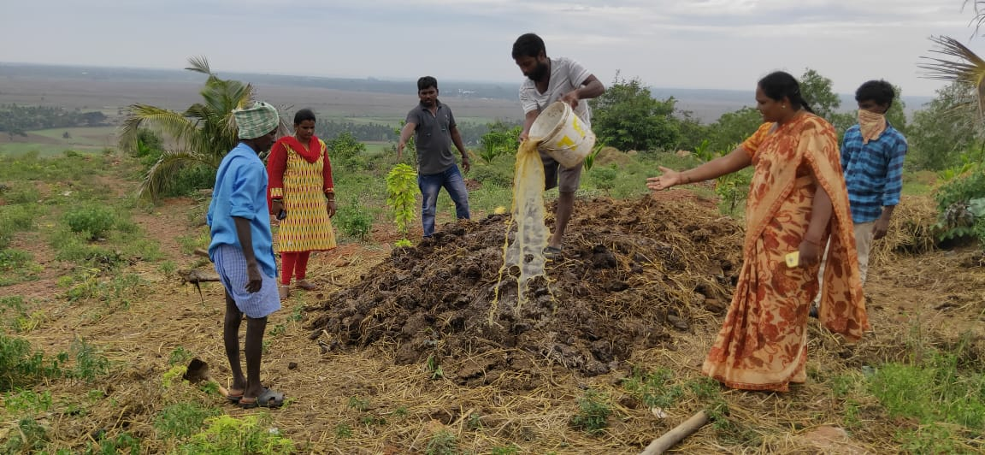
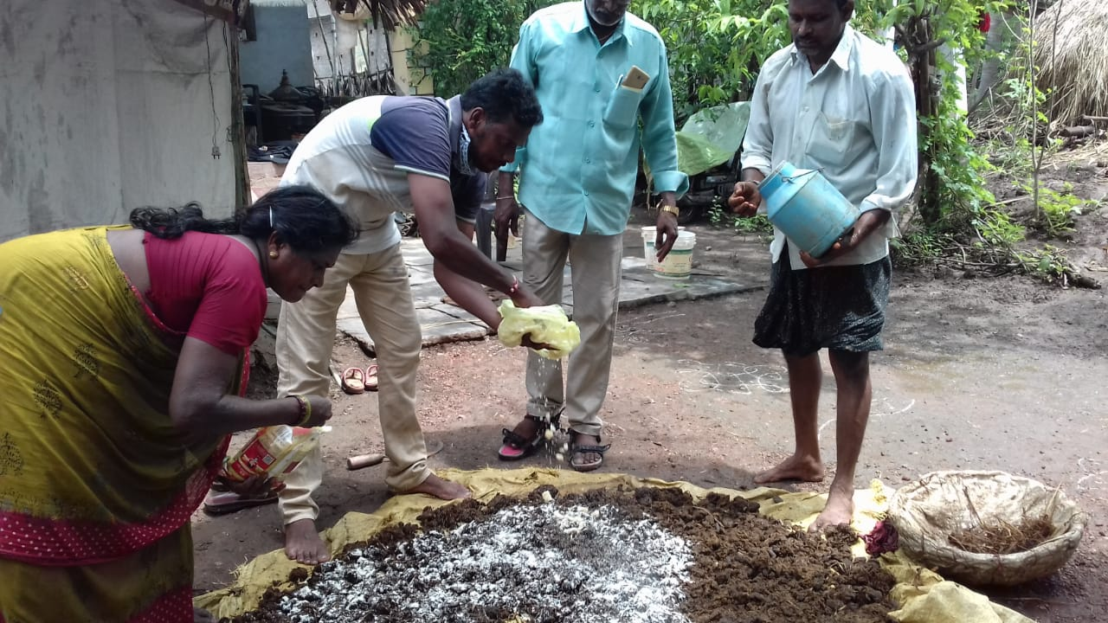
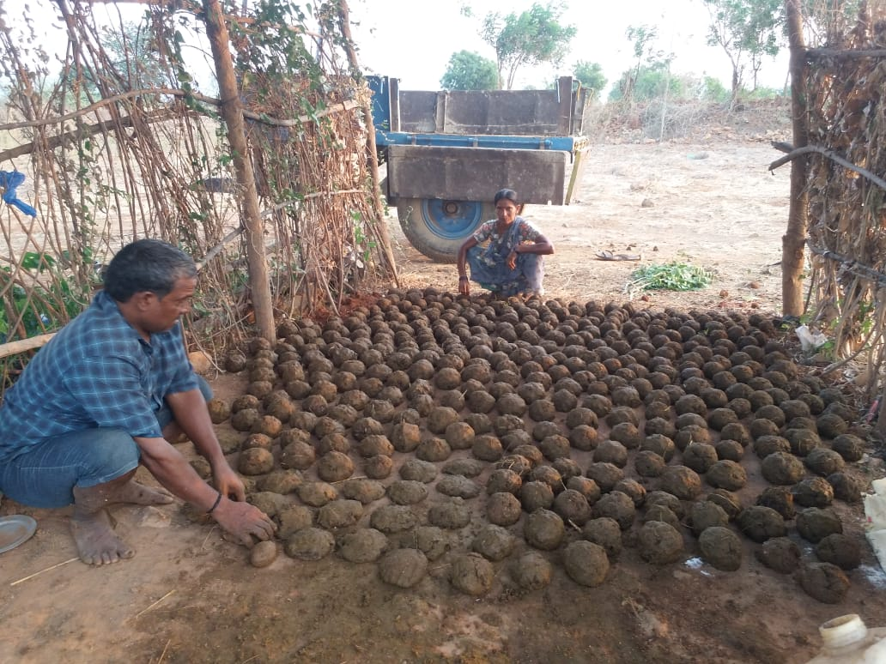
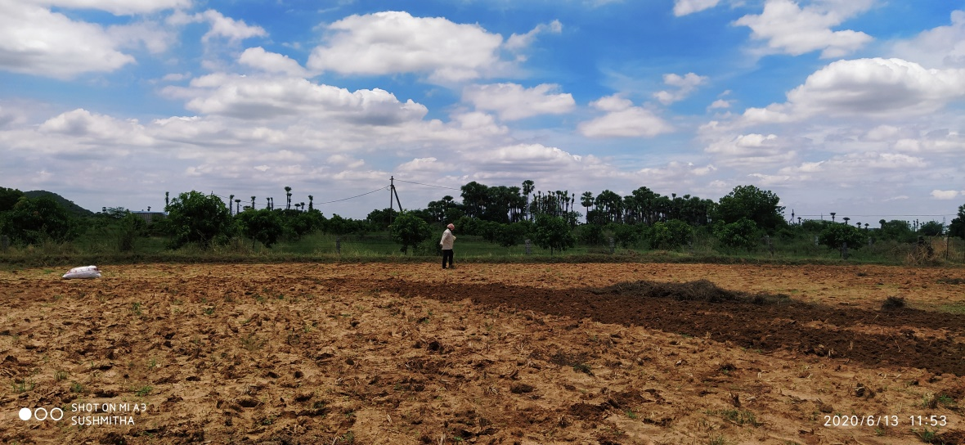
Soil Microbial enhancement – Bio stimulant - Ghanajeevamrutham
Cow dung - 100 kg
Jaggery - 1Kg
Pulse flour- 1 kg
Cow urine - 10 liters
Hand full uncontaminated soil
Ingredients
Step 1
Mix all the ingredients properly
Step 2
Step 3
Make cakes and shadow dry for 5 days for fermentation
Apply these cakes in the field

Slide 29
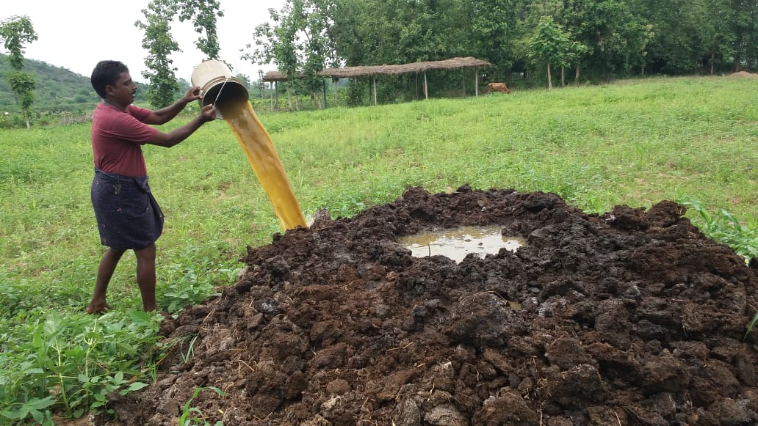

Slide 30
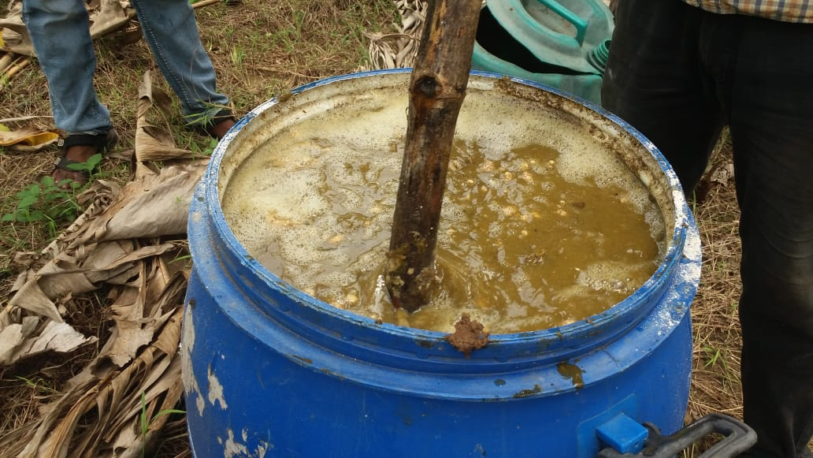
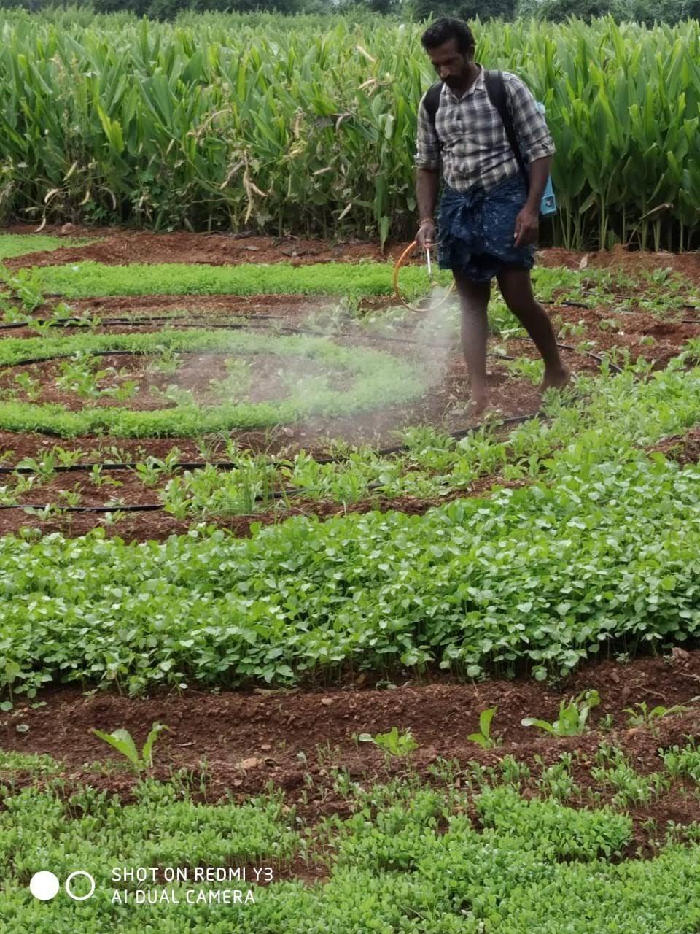


Soil microbial enhancement – Liquid biostimulant - Dravajeevamrutham
Cow dung- 100kg
Jaggery – 2 kgs
Water- 200 ltrs
Hand full of uncontaminated soil
Cow urine- 3-6 ltrs
Pulse flour- 2 kgs
Ingredients
Step 1
Add all the ingredients and mix them in clock wise direction
Step 2
Keep it fermented for 5 days. The colour and smell changes. Keep mixing it in between
Step 3
Spraying of Dravajeevarutham in the field

Slide 31


Slide 32




Pest management through botanical bio stimulants
Preparation of kashayams (bio-innoculants for pest management prepared from local ingredients
Yellow and blue sticky traps

Slide 33



7 active biodiversity blocks
Conserved and characterized 400 traditional varieties
Promotion of agri-biodiversity resource centre
Supply of seed kits for undertaking PMDS, kitchen garden etc

Slide 34
A.P - Women collectivization through SHGs – a long history
Poverty eradication through women solidarity seeded in SERP -
NPM and CMSA - through women SHGs– N.G.O support
Women SHGs at the center stage of the APCNF
Women SHGs and community owned programme
2020 & Beyond
2016
2005
Seeded 20 years ago
Women SHG led APCNF Programme at a glance
Women SHGs implementing NF
123,122
Village Organizations implementing NF
4740
Land less labour taking kitchen gardens
269,000 (75%)
SHG leaders practicing NF
83%

Slide 35




Women in Natural Farming: Our biggest Strength
Peer Learning
Farming Plans, and, consumption plans
Collective Action
Inclusive of the poorest
Programme Management, transparency
123,122 women SHGs and their 4740 Federations are in charge

Slide 36

Farmer ‘heroes’ central to the programme
A Knowledge intensive and not input intensive programme
Most effective dissemination is “farmer to farmer”
Best practicing farmers, Community resource persons (CRPs) engaged to take NF to other farmers.
APCNF identifies such champions in the community and capacitate them
Handholding
Video Dissemination
Knowledge Transfer
Inspiration
Farmer Field Schools
150 Young Agriculture Graduates as Natural Farming Fellows – after 2 years have graduated to trainers and researchers at district and state level
5,899 Community Resource Persons @ 1/100 farmers
Notes:
Merge this and the next slide

Slide 37



Communications
(Local & Global)
&
Marketing
Farmers, Land, Institutions, Monitoring & Learning
ICT in Natural Farming
Finance & Human Resources
Extension & Capacity Building
Data Collection
Data Management
Data Analytics
Decision Making
Information & Communication Technologies (ICTs) in Natural Farming

Slide 38

Changing a farmer means changing entire village
All Villages
All Farmers
All Farms
All Practices
Farmer Transformation
450 farmers in a Village
Village Transformation
Year 5 : High end models
100%
In 5 to 8 years,
a village
becomes a
‘BIO-VILLAGE’
Year 4: full area
Year 2
Year 1
>80%
farmers
Each farmer takes 5 years to cover entire holding.
35- 50% farmers
10 -15%
farmers
Transformation Cost to cover 85% farmers and over 85% area is @ Rs. 15000/farmer over 0+7 years
Year 1
Year 2
Year 3
Year 8

Slide 39
Transformation Cost
# | Categories | COSTS (Rs.) | %
1 | ZBNF Capacity building | 11,600 | 77%
2 | Support to Community Institutions | 1,315 | 9%
3 | PGS Certification, Quality Assurance, Tracking and Monitoring | 1,785 | 12%
4 | Technical Support and Overall Programme Management at the District and State levels | 300 | 2%
 | TOTAL | 15000
Funds required to bring 6 million farmers under Natural Farming, over 10 years –
Rs. 10000 Cr
(1340 million USD)
Reach all farmers by 2027; farmland in the state by 2031
Cost to convert one farmer: Rs. 15000 over 8 years ( USD 201 over 8 years)
1 USD = Rs.74.50

Slide 40
APCNF: costs of transformation and savings from subsidy avoidance
Year | Transformation Cost Rs. Cr | Land Lakh Ha. | Electricity savings, Rs. Cr | Fertilizer subsidy Savings, Rs. Cr
21-22 | 219 | 2.64 | 94 | 188
22-23 | 640 | 7.92 | 302 | 604
23-24 | 1,317 | 15.18 | 619 | 1,239
24-25 | 1,652 | 23.43 | 1,023 | 2,045
25-26 | 1,721 | 30.36 | 1,418 | 2,836
26-27 | 1,407 | 38.94 | 1,946 | 3,892
27-28 | 1,229 | 44.88 | 2,400 | 4,800
28-29 | 771 | 50.82 | 2,908 | 5,815
29-30 | 458 | 55.11 | 3,374 | 6,748
30-31 | 458 | 60.06 | 3,934 | 7,869
Total | 9,873 | 60.06 | 18,018 | 36,035
In million USD | 1300 |  | 2400 | 4800
Other direct benefits to farmers: higher yields, better prices, lower financial costs, etc.
Ecosystem benefits
Soil Health & water security
Climate Resilience
Food, Nutrition and Health Security
Coastal eco-system regeneration
Employment
Bio-Diversity

Slide 41

Collaborations for developing Natural Farming Science
University of Reading , U.K
Walter Jehne – Regenerate Earth, Australia
National Institutes - CEEW, CSTEP
APCNF farmers
Research Coordinators, and, Senior Scientists
Champion farmers
National institutions MoUs in the offing:
ANGRAU
ICAR – IIFSR, CRIDA
WALAMTARI
RySS
GEF, IUCN, Rainforest Alliance
Climate Land Use Alliance, USA
University of Edinburgh, U.K
Setting up a Global Agroeocology Research Centre, with a grant of Rs.200 crores from Govt of Germany. Funding from 2022 to 2027. NITI Aayog will be a partner.
ANGRAU is proposed as a partner.

Slide 42








National and International Collaborations
With Countries
Government of Rwanda
Government of Kenya
Govt of Mexico
CONABIO – Mexico
The Alliance for food Sovereignty in Africa - AFSA
Punjab
Himachal Pradesh
Rajasthan
Meghalaya
Bihar
Bihar
Gujarat
Chhattisgarh
With States, CSOs
National Resource organization to NITI Aayog on Natural Farming
Co-founder National Coalition for Natural Farming
Support to state governments and national civil society institutions
Odisha
Andhra Pradesh
Kerala
Tamil Nadu
Mindtree-PCF
Digital
Green
NGOs in Rajasthan and Bundelkhand and Tribal Welfare department in Telangana

Slide 43



“..We do not inherit the earth from our ancestors, we borrow it from our children..”
LET US ALL ACT NOW
Visit: apzbnf.in Follow us - Twitter/ Facebook/ Youtube @APZBNF

