Slide 1
Indo-German Financial Cooperation, Andhra Pradesh Community Natural Farming
LEc4 Iris Harder; Matthias von Bechtolsheim, Sangeeta Agarwal
Frankfurt am Main, 08 November 2021
Notes:
Bitte bei Allen Vorlagen die Reihenfolge wie Elemente ausgelesen werden optimieren

Slide 2
Outline
KfW Development Bank and Andhra Pradesh Community Natural Farming
1. Background (German Financial Cooperation)
2. Why and How did you get involved in APCNF

Slide 3
Background: German Financial Cooperation through KfW Development Bank / KfW Bank Group

Slide 4
Background
• BMZ (Federal Ministry for Economic Cooperation and Development) is the DONOR.
• BMZ 2021 budget 12.4 billion EUR
• 48% of BMZ budget or bilateral official development cooperation via KfW, GIZ and others (2/3 to 1/3)
• 52% of BMZ budget for European Development Fund, UN-Organizations, WB, other regional banks, International Agricultural and other Research institutions, NGO, Special Initiatives
• KfW receives about 2/3 of the bilateral official development cooperation and generates additional funds from the market with its AAA rating (development loans and promotional loans), result: ODA 11 billion from KfW in 2020
• KfW is owned by the Federal Republic of Germany and the Länder (German states) and has several promotional areas. Official German financial cooperation (FC) is one area of activities. Financing volume 2020: EUR 135.3 billion, 7600 employees
• KfW is serving several German Ministries, EU Commission, other bilateral donors within the context of Mandates

Slide 5
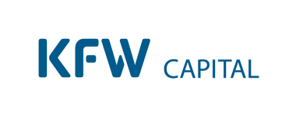


Domestic and international promotion of development
Business sectors
We promote Germany
We support the German and the European economy
We promote development
SME Bank & Private Clients
Digital mass business
Customised Finance &
Public Clients
Individual
financing solutions
and municipal finance
KfW Capital
Venture capital
fund investments
KfW IPEX-Bank
National / International
export and
project finance
KfW Development Bank
Promotion of developing countries and emerging economies – mainly Governments
DEG
Promotion of developing countries and emerging economies – private clients

Slide 6
Why and How did you get involved in APCNF

Slide 7
Why and how did you get involved in the APCNF program
KfW Development Bank finances various sectors like infrastructure, finance system and private sector development, social sectors, others and the green sector: rural development and conservation of natural resources (with sub sectors, like reserving biodiversity, national parks, forest management, blue economy, agriculture and value chains via the finance system/private sector.
The resolution of the parliament of the Federal Republic of 27th June 2019 confirms the policy of BMZ to promote agroecology.
WHY did we get involved: In the Indo-German Agreements the green sector is part of the portfolio.
HOW:
• First meeting with RySS in Sept 2018
• Appraisal in July 2019
• Loan Agreements in December 2019
• Project Concept approved by BMZ, Preparatory Feasibility Study, Appraisal Mission; Appraisal report to be approved by BMZ, if yes then Loan Agreement and Implementation of Project and Program
WHY does KfW support the program?

Slide 8
It fits to our Principles
Guiding principles
Ownership
Alignment
Shared responsibility
Reinforcing the partner country's responsibility for itself
Alignment
towards the partner country's national development strategies and structures
Supporting partners in the preparation, implementation and operation of projects by providing advisory services
  Assessing the impact of projects by means of independent evaluation
Target
Sustainable impacts

Slide 9
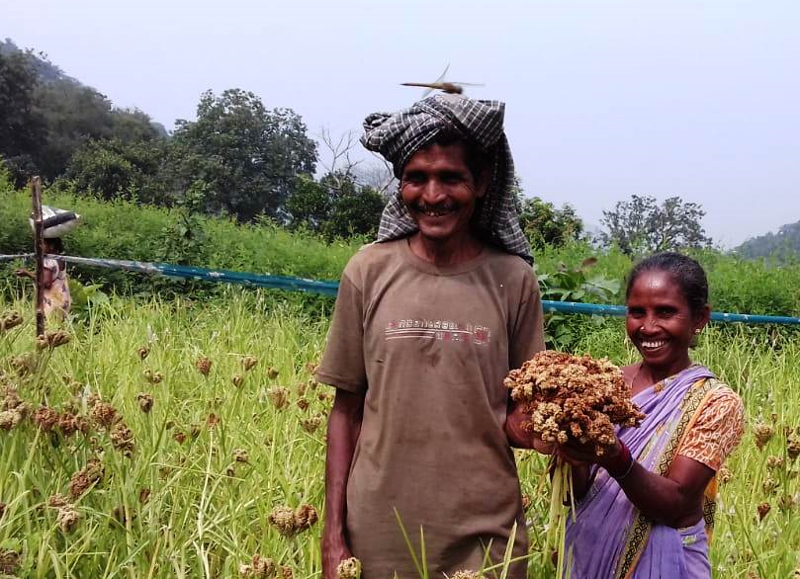
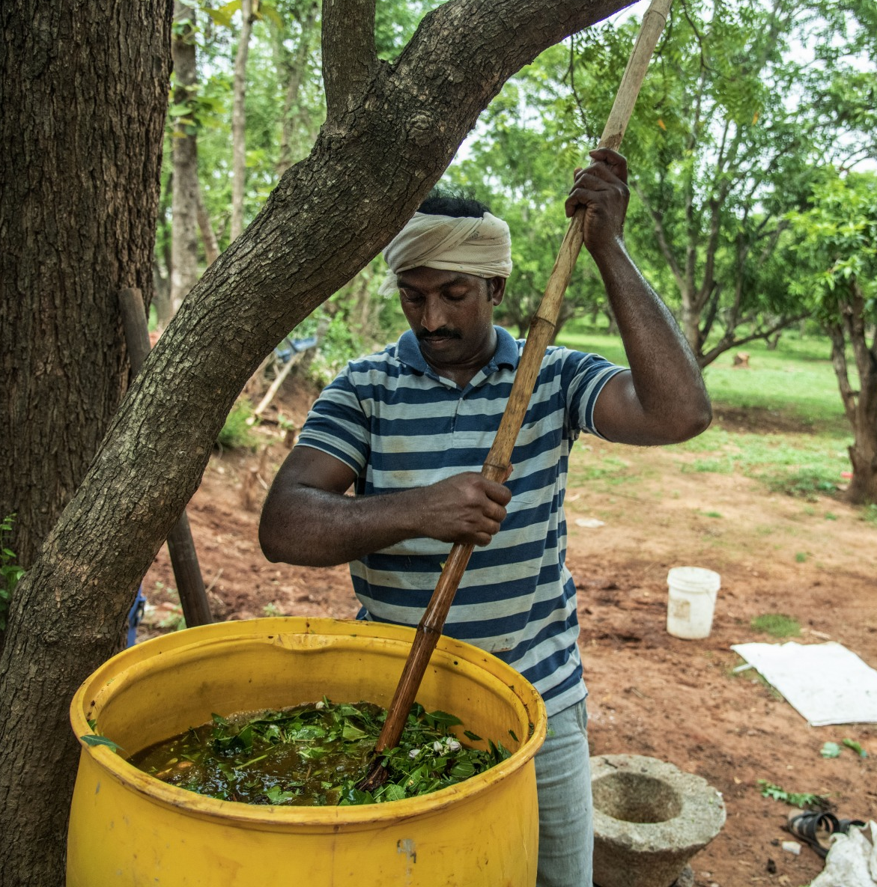
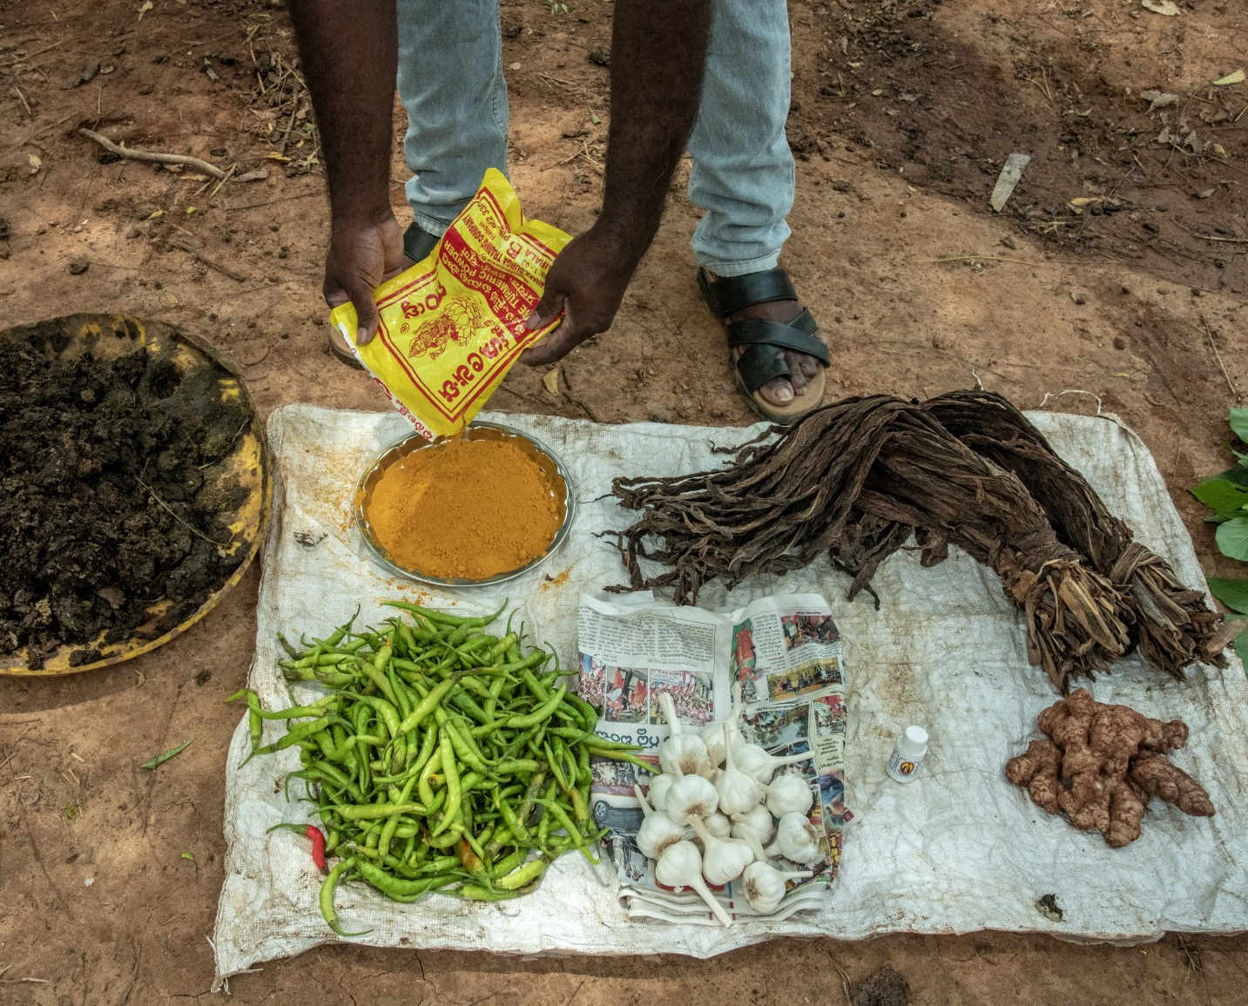
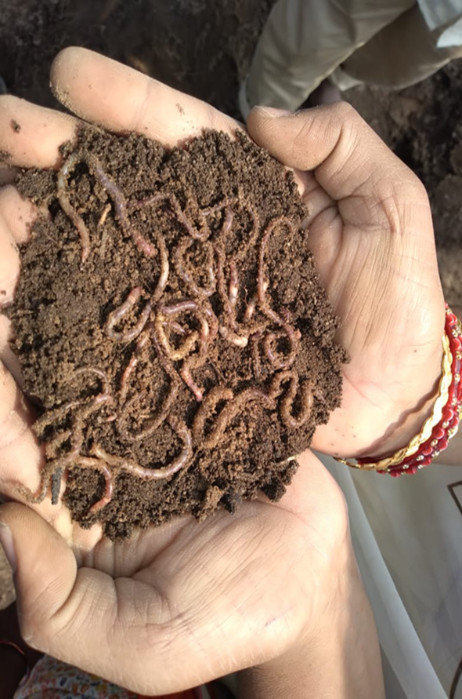
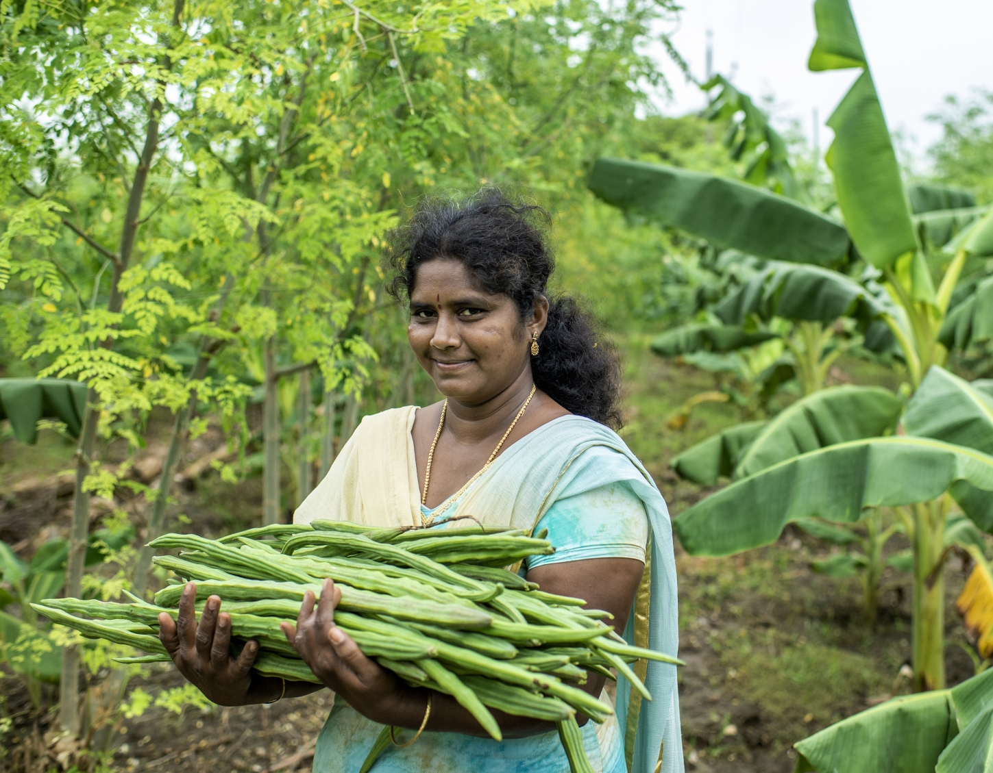
and it fits into the overall Indo – German Programme for Environment and Climate in Rural Areas and addresses key problems in rural India
Problem: Degradation of agricultural soils (“the silent threat”!), threat by climate change and immense poverty in rural areas of AP
Goal: Increased soil health and productivity, stabilized/increased income and climate resilience of participating smallholder families in Andhra Pradesh.
Project description: Promotion of the expansion of Zero external Input Farming (i.e. natural farming with organic seed treatment, fertilization and pest pest control), e.g. through
  Know how transfer by a advisory cadre, champion farmer in villages
  Close cooperation with women self help groups
  Promotion of organic input shops on site, marketing promotion later
  Accompanying research and marketing approaches
Innovation and Investment in Knowledge Generation!

Slide 10
Thank you for your attention!
Questions and feedback?

Slide 11
Contacts
Iris Harder
Portfolio manager
Iris.Harder@kfw.de
Matthias von Bechtolsheim
Senior Technical Advisor
Matthias.Bechtolsheim@kfw.de
Sangeeta Agarwal
Senior Sector Specialist Sangeeta.Agarwal@kfw.de
›KfW Bankengruppe
Palmengartenstrasse 5–9
60325 Frankfurt am Main
Phone +49 69 7431 - 3300
Fax +49 69 7431 - 2944
www.kfw-entwicklungsbank.de
›KfW Office New Delhi
46, Paschimi Marg
Opposite Vasant Vihar Club
Vasant Vihar
New Delhi – 110 057
Phone +91 11 4253 4253
Fax +91 11 2615 5267
E-mail: kfw.newdelhi@kfw.de
Website: www.kfw.de

