Slide 1

Review of the devco/intpa agro-ecology portfolio
Period: 2018 – 2020
PROVISIONAL RESULTS
Presentation of 08/11/2021
Caroline BROUDIC

Slide 2
Analysis of the EU Agro-Ecology portfolio based on:
948 pre-selected contracts in the SANAD sector.
Covering the 2018-2020 period.
Geographical distribution of contracts analysed

Slide 3
Selection of Agroecological projects
1st filter:
The project is automatically selected if it contains one of the following keywords in its logical framework:
« Agroecology » ;
« Permaculture » ;
« Ecological agriculture »
« Food self-sufficiency/autonomy »
« Food sovereignty ».

Slide 4
2nd filter:
The project is selected if it contains at least one keyword in each of the following categories in its logical framework
Type of agriculture:
« Sustainable agriculture »
« Agroforestry »
« Conservation agriculture »
« Organic agriculture »
« Family farming »
« Subsistence agriculture »
« Climate-smart agriculture »
« Climate-resilient agriculture »
Environmental and social :
« Climate change »
« Biodiversity »
« Ecosystem »
« Co-construction »
« Gender »
« Civil society »

Slide 5
Provisional Results after applying the 1st filter

Slide 6
 | Nb of contracts including the term… | %
Agroecology | 51 | 5,4%
Ecological agriculture | 4 | 0,4%
Permaculture | 1 | 0,1%
Food autonomy | 0 | 0,0%
Food sovereignty | 9 | 0,9%
Total A-E | 57 | 6,0%
6 % of contracts categorised under the SANAD sector
(57 contracts out of948), explicitly display an agroecological ambition.

Slide 7
a multi-actor concept
The notion of agroecology was initially introduced:
By scientists (Bensin, 1930; Altieri, 1983…);
By environmental movements ('60s);
By civil society in the South and North
(Via Campesina Movement which brings together more than 180 farmers' organisations)
which has contributed to:
The agro-ecological approach,
Goes beyond agro-ecosystems
To encompass food systems,
by associating to them the notion of « food sovereignty ».
(Source : HLPE 2019)

Slide 8
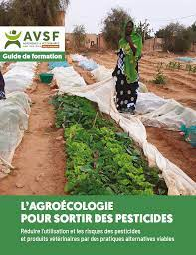
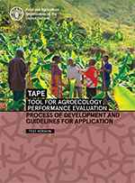
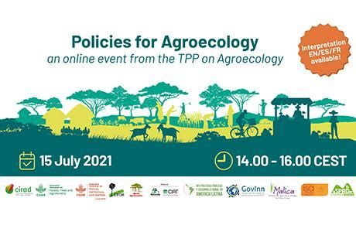
From agroecology to the agroecological transition
The notion of agro-ecological transition has become part of the debate over the last ten years.
The FAO played an important role in its dissemination by organising an international symposium on agro-ecology in 2014, followed by several international meetings in South America, Africa and Asia in 2015.
These meetings contributed to the formulation of the ten elements of agro-ecology (and the 13 principles of the HLPE).

Slide 9
Agro-ecology, we talk about it but do we apply it?
HOWEVER, despite strong positioning in favour of of Agro-ecology...
… only 3,0% of projects put into practice by the United Nations Agencies (FAO, IFAD, WFP) in the partnership framework with the EU explicitly display an agroecological ambition. Only 6.4% of the projects implemented by the FAO have agro-ecology on their agenda.
The same is true for international NGOs, which represent an essential part of the SANAD portfolio, for which only 6,5% of projects put into practice in the partnership framework with the EU display an agroecological ambition.
By way of comparison, the ratio reaches 34,4% for research projects (essentially associated to the DeSIRA programme).

Slide 10
How to explain the huge gap between:
The commitments made par by UN Agencies and International NGOs in favour of agroecology
and
the very low rate of translation into operational projects ?
Won't agro-ecology go beyond the theoretical and rhetorical framework?
Will the agro-ecology projects of these actors be financed by other TFPs, but in such a case, why?
- Calls for proposals leaving little or no room for A-E projects?
- Refusal/rejection of agro-ecological projects by the Delegations?
- The image of the European Union is not associated with Agro-ecology?
The choice of executive partner will be too restricted, not leaving sufficient space to local civil society organisations (farmers' movements, human rights organisations, etc…) ?

Slide 11
How to invert the trend?
Identify the key actors in the agroecology domain (within Ministries, civil society, private sector, cooperation agencies, INGOs, etc) thereby realising cartographies of actors withineach country/sub-region (including actors representing a brake/block for the development of AE).
Display agroecology more explicitly in AAPs an in internal and external communication.
Diversifying entry points by not limiting ourselves to agronomic aspects (or even to the SANAD sector alone), but by considering as priority issues:
  land,
  civil society,
  gender
  …

Slide 12
Themes associated to agroecology
Within project documents, agroecology is mainly associated to:
Climate change (attenuation, adaptation, resilience);
Co-creation and knowledge sharing;
and to a lesser degree, gender.

Slide 13
A paradigm shift
The projects of the agroecology portfolio are often limited to:
agricultural practices (at the farm or landscape scale);
an objective of improving soil fertility and ecosystem services to increase productivity, agricultural production and food security.
It is therefore a very classic food security approach.
It should take into account:
Power balances (on land, price formation, inputs, etc.),
les dependencies and interdependencies within society,
the distribution of roles: entre between women and men; between land owners and land-less farmers.
Who benefits from more fertile soils?
Which are the social impacts of a change in agricultural practices?

Slide 14
Towards a necessary paradigm shift
Need to change the prism:
By introducing plus social sciences in agroecological research (e.g.: in the DeSIRA Programme).
By relying more on local actors.
By encouraging actors to adopt a different approach :
  For example, of the « Change Oriented Approach » type to step outside of the framework.

