Slide 1

Measuring the multidimensional performance of agroecology
TOOL FOR AGROECOLOGICAL PERFORMANCE EVALUATION
Animal Production and Health Division (NSA)
Plant Production and Protection division (NSP)
Anne Mottet, Abram Bicksler, Dario Lucantoni,
Rassoul Sy, Frank Escobar, Jimena Gómez

Slide 2

COAG 26 (2018) request to FAO
“to assist countries and regions to engage more effectively in the transition processes towards sustainable agriculture and food systems by strengthening normative, science and evidence-based work on agroecology, developing metrics, tools and protocols to evaluate the contribution of agroecology and other approaches to the transformation of sustainable agriculture and food systems.” (C 2019/21 Rev.1 , Para. 15 a)
Notes:
Our mandate from COAG 26

Slide 3
FAO’s work on agroecology
Leading and facilitating the global dialog since the first International Symposia on Agroecology on 2014
Leading the Scaling up Agroecology Initiative (2018) with WFP, IFAD, CBD, UNDP and UNEP.
Knowledge and innovation for sustainable food and agricultural systems (TAPE and Agroecology Knowledge Hub)
Policy processes for transformation of food and agricultural systems
Building connections for transformative change (e.g. UN decade on Family farming)
Notes:
The objectives

Slide 4
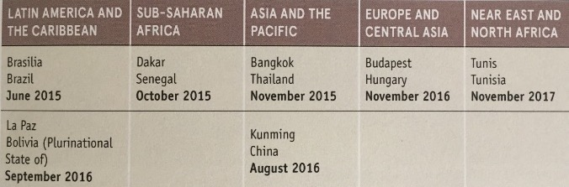
FAO: International and Regional Multistakeholder meetings
A total of 1350 participants from 162 countries
2014 : International Symposium « Agroecology for food security and nutrition » (Rome)
2015-2017 : A series of 7 regional seminars
2018: 2nd International Symposium « Scaling up Agroecology to achieve the SDGs » (Rome)
Notes:
ACTIVE ROLE OF RESEARCHERS AND CSOs
2nd symposium: end of the consultation: moving from dialogue to actions
--------
1st seminar showed the power of ae for Food SECURITY
Led to regional meetings to hear the regional understanding of the concept and needs: consultative and participatory process, understand cso and ff
SDG call for a different thinking: AE and we will see that with the epistemiology of research
Transformative role of agroecology
Role of CSO and researcher: open letters from researchers, active participation of SOCLA
The seminars showed that agroecology is strongly supported by stakholders (CSO and Academia cf open letter) as an holistic approach to transforming food systems.
It was recalled that agroecology goes beyond technical solutions and innovations based on incremental changes and can drive genuine transformative change in fa systems by moving towards socio-ecological systems that place people (farmers and consumers) at the center of food systems. Agroecology takes a system approach to tackle of root causes of poverty and unsustainable practices which often lies outside farms.
Presrvation of natural resource base, access to natural resources (land, water, fisheries, forests and genetic resources), balance of power throughout the food system, resilience of farm regarding CC, capacity builiding and knowledge systems, gender equity, producing more where it is needed, nutrition and health, income earning opportunities in rural areas, particularly for young people, territorial approaches for sustainable food systems
Insisting on the system approach, agroecology is more than a set of practices, but an opportunity to rethink our system
Very wealthy conceptual thinking

Slide 5
The 10 Elements of Agroecology
Guiding Transition To Sustainable Food and Agricultural Systems
Notes:
FAO proposed 10 Elements to support countries to scale-up agroecology. They help to define FAO’s work on agroecology in an inclusive way, without privileging one definition, stakeholder group, or region.
Some are characteristics of agroecological systems (synergies, recycling, co-creation and sharing of knowledge), some are emerging properties (efficiency, resilience).
The 10 Elements point to different entry points for the work of FAO and partners to strengthen agroecology.
The 26th Session of COAG (October 2018):
Welcomed the Scaling Up Agroecology Initiative and requested FAO to develop an action plan with partners
Supported the 10 elements on agroecology
Requested FAO to continue applying agroecology as one of the approaches to implement the five principles of SFA to support the SDGs

Slide 6
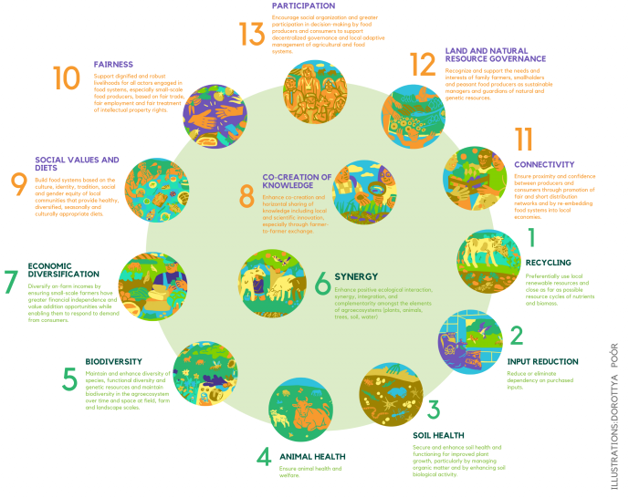
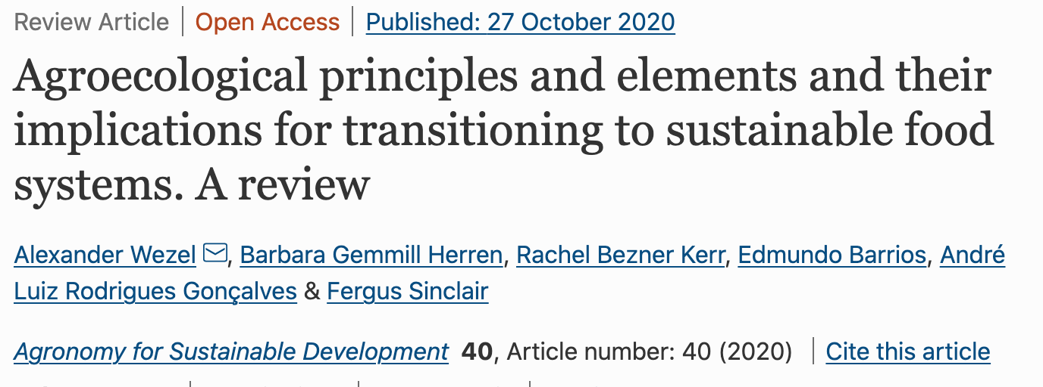
The 13 principles of Agroecology (HLPE
https://www.agroecology-europe.org/the-13-principles-of-agroecology/

Slide 7
Stay simple, operational and flexible
Include all dimensions of sustainability, bearing in mind the various regional priorities
Insure harmonization and comparability

Slide 8

TAPE features
A tool for sustainability assessment in agriculture that is using agroecology as a basis for diagnostic and producing evidence on its multidimensional performance
Developed through a large consultative process led by FAO
Response to mandate received from countries (COAG), based on 10 Elements of Agroecolgy approved by countries and validated methodologies on sustainability criteria (including SDGs sub-indicators where possible)
Stepwise approach with:
  Analysis of enabling environment and context
  Diagnostic of the status (10 Elements)
  10 core quantitative criteria of performance + possibility of advanced criteria
  Participatory interpretation of results and recommendations
Building a global database
Used as design/M&E tool for IFAD and GEF projects
http://www.fao.org/3/ca7407en/ca7407en.pdf
Notes:
The objectives

Slide 9
Reminder: TAPE stepwise approach
Primary and secondary information:
- Production systems, type of household, agroecological zones
- Existing policies (incl. climate change)
- Enabling environment
DESCRIPTION OF SYSTEMS AND CONTEXT
STEP 0
CHARACTERISATION OF AGROECOLOGICAL TRANSITIONS (CAET)
On farm/household survey:
- Describe current status
- Based on 10 elements of agroecology with descriptive scales
- Can be self assessment by producer
STEP 1
Statistical and/or participatory clustering (optional) to reduce sample size if large number of observations in CAET
STEP 1bis
(optional)
TRANSITION TYPOLOGY
On farm/household survey:
- Measure progress and quantify impact
- Addressing 5 key dimensions for policy makers and SDGs
- Time/cost constraints: keep it simple!
CRITERIA OF PERFORMANCE
STEP 2
At territory/community scale:
- Review CAET results with context + enabling environment (step 0)
- Review performance results and explain with CAET
- Analyze contribution to SDGs
ANALYSIS AND PARTICIPATORY INTERPRETATION
STEP 3

Slide 10
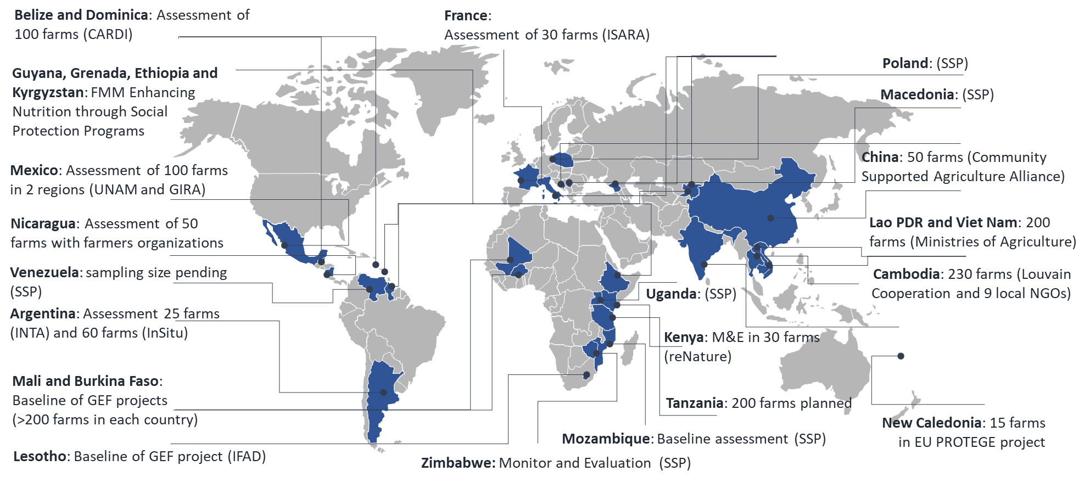
33
COUNTRIES
by the end of 2021
~3.000
6
UN official languages
5
Production systems assessed
by the end of 2021
11
REGIONS
Other languages

Slide 11
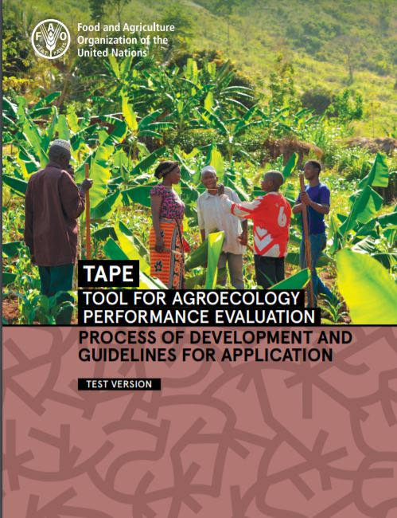
Some results

Slide 12
Process of transition in Step 1 - CAET
Conventional monoculture (tobacco) in Cuba
Conventional farm (tobacco monoculture) (CAET=44%)
Farm in transition to agroecology (CAET=66%)
Diversified agroecological farm (CAET=81%)
Same farm after 3 years of transition to agroecology
Lucantoni, 2020
Lucantoni, 2020

Slide 13
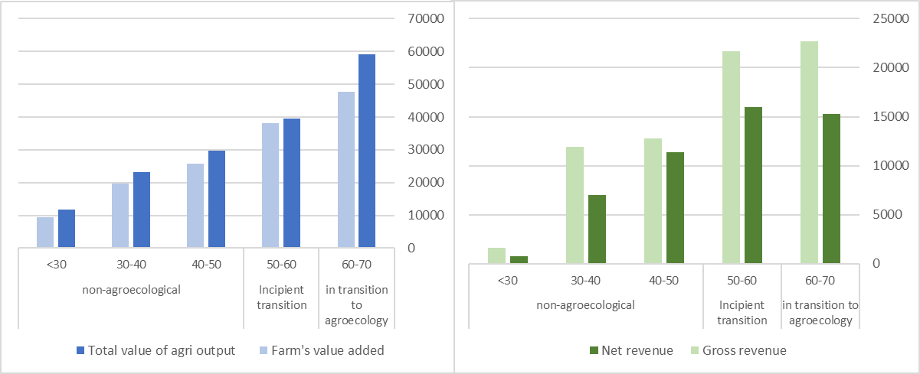
Economic performance of farms in Lesotho (250 farms) by categories of agroecological transition
STEP 1
(aggregated CAET score on the 10 elements)
STEP 1
(aggregated CAET score on the 10 elements)

Slide 14
Social performance of farms in Mali : youth empowerment in agriculture
STEP 1
(aggregated CAET score on the 10 elements)

Slide 15
Social performance of farms in Burkina Faso by categories of agroecological transition
STEP 1
(aggregated CAET score on the 10 elements)
STEP 1
(aggregated CAET score on the 10 elements)

Slide 16
Environmental performances of farms in Mali
STEP 1
(aggregated CAET score on the 10 elements)
STEP 1
(aggregated CAET score on the 10 elements)

Slide 17
Correlation between the 10 elements of agroecology in Mali
Providing data on the key elements influencing the overall agroecological transition of production systems can:
help projects tailor more specific activities in the target territories and
better inform decision makers and public policies to support the processes of transition at different scales.

Slide 18
Correlation between the 10 elements and the performances in France (10 farms)
Step 1 (10 elements)
CAET Average
Governance
Efficiency
Resilience
Recycling
Synergies
Co-creation
Diversity
Culture
Values
Circ eco
Step 2 (criteria of performance)
Wezel et al., unpublished

Slide 19
Lessons Learned
Results are promising and show signals between transitions in agroecology and performance criteria
Thorough enumerator and coordinator training helps ensure consistent data collection and reduces time
Steps 0 and 3 bookend the Steps 1 & 2 and provide links back to the territorial level
Encourage users to incorporate time and budget into conducting Step 0 and Step 3
TAPE can serve as intervention pinpointing tool and provide insights into what enabling/disabling factors need to change
Notes:
The objectives

Slide 20
Next steps
Completing studies and data collection in several countries, including Tanzania, Ethiopia, Yemen, Burkina Faso, Guyana and Argentina
Confirming the interest of TAPE as tool for project design and M&E
Producing reports and peer reviewed articles to disseminate the evidence produced and to inform policy makers
Supporting the processes of agroecological transition at different levels by reinforcing the links with partner organizations
Organizing validation workshop in Rome - Early 2022
Notes:
The objectives

