Slide 1





Joint Programming
How are we doing?
Andy Benfield, 27/11/2012

Slide 2
Progress

Slide 3






1. Joint Country Analysis
2. Joint EU Programming Document
Response to national plan, aligned to its duration. Format up to HoMs but including: priorities, common positions, DoL, indicative sector funding
3. Individual bilateral implementation plans
(not strategies)
Up to you.

Slide 4

Afghanistan Bangladesh Ethiopia Ghana Guatemala
Laos Mali Moldova Rwanda Tunisia Ukraine

Slide 5


E t h i o p i a
We have a Joint Cooperation Strategy…
Additional work on sync, DoL, €, country strategies
“Paves the way”, “lays the building blocks”, Roadmap coming up
GoE now on board

Slide 6


G h a n a
Have a GoG-DP Compact, incl. analysis
Preparing a Joint Framework Document
Joint implementation plan?
Incorporating bilateral country strategies?
DoL, first steps to sync (new strategies in 2011)
GoG on board

Slide 7
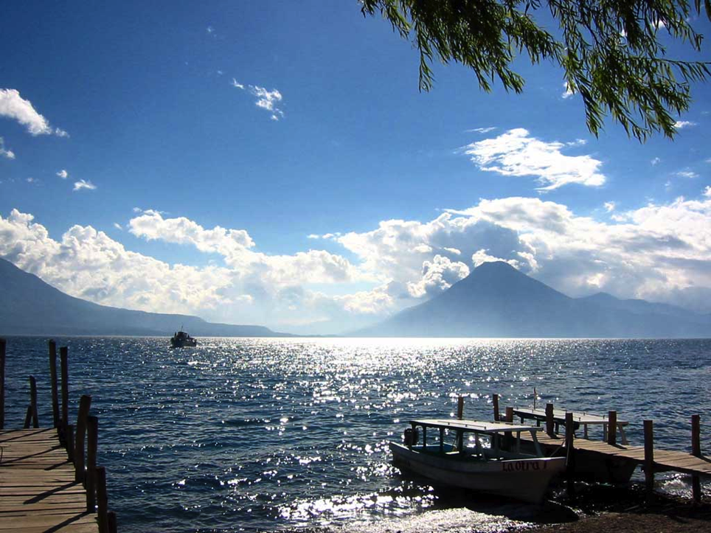

G u a t e m a l a
Joint analysis & draft JP doc done
DoL & allocations
Common positions, aid effectiveness, monitoring
Sync agreed (elections +1)

Slide 8


L a o s
Meetings & Retreat got traction
Joint analysis done
Transitional 2014-15, Full 2016-20
DoL & Sync from 2016

Slide 9


M a l i
Wait and see – groundwork done
Joint positions
National vs sector cycles

Slide 10


R w a n d a
Strong Gov
GoR wants 3 x JPs
Existing DoL
EU doing joint analysis
Sync – planning vs. financing
Waiting for new national strategy
Strengthens policy dialogue?

Slide 11


B a n g l a d e s h
We have a Joint Cooperation Strategy
Need a capitals decision for sync & DoL
End of 2015?

Slide 12
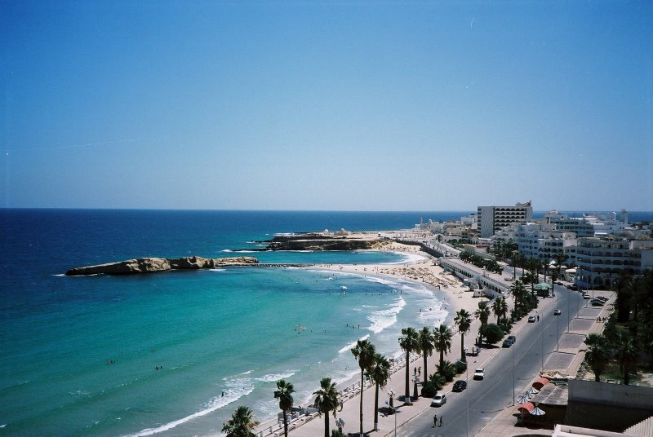

T u n i s i a
A great idea, but we need instructions from HQ…
Post-Arab Spring MS
Some support “has to stay as a bilateral activity without coordination with other partners”
Elections next year, so maybe 2014?
By end of 2012: Road map? Start joint analysis? Define support needs?

Slide 13
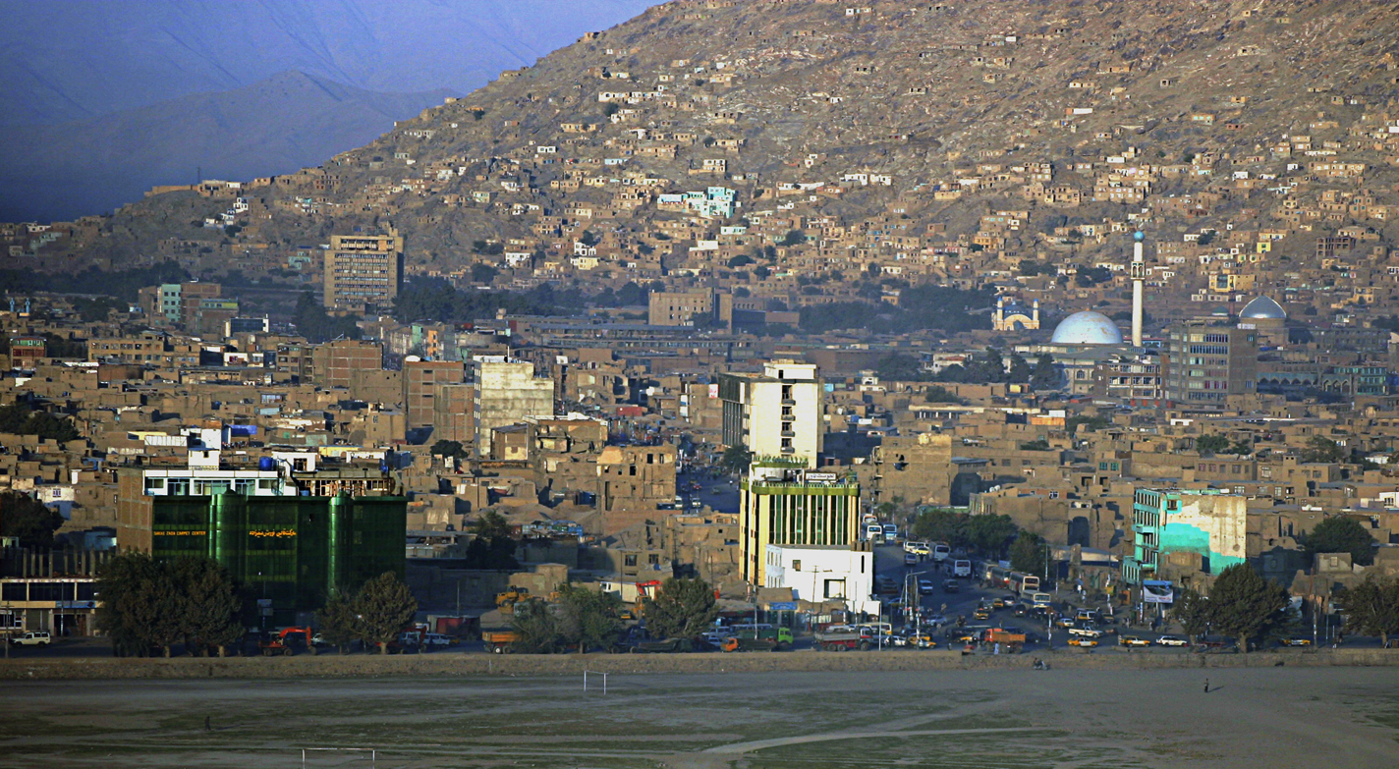

A f g h a n i s t a n
It’s complicated…
JP sounds difficult, time-consuming but…what does it actually mean?
Want capitals consensus, guidance & lessons learned
2015-6?
Already have joint initiatives, common voice

Slide 14
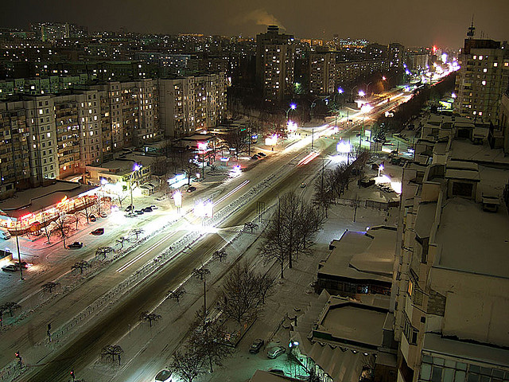

M o l d o v a
We’re different
“Would need more reflection and political will from MS capitals”
Weak GoM leadership
“If and when the guidelines are clearer”
Request for roadmap

Slide 15
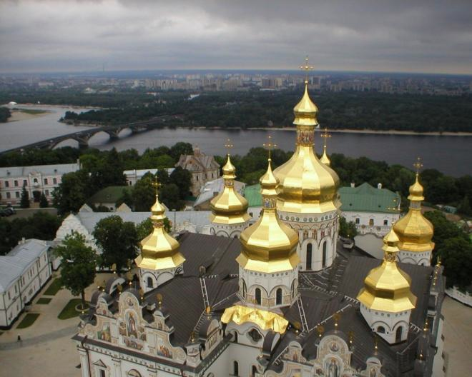

U k r a i n e
“Please remove us from the list”
“Difficult to see where the fundamental building blocks needed to implement such a programme are located”
Not until Government can lead, decent national plan
Will work on coordination, DoL, maybe joint analysis

Slide 16
Ethiopia
Ghana
Guatemala
Laos
Mali
Rwanda
Afghanistan
Moldova
Ukraine
Bangladesh
Tunisia

Slide 17
Support

Slide 18
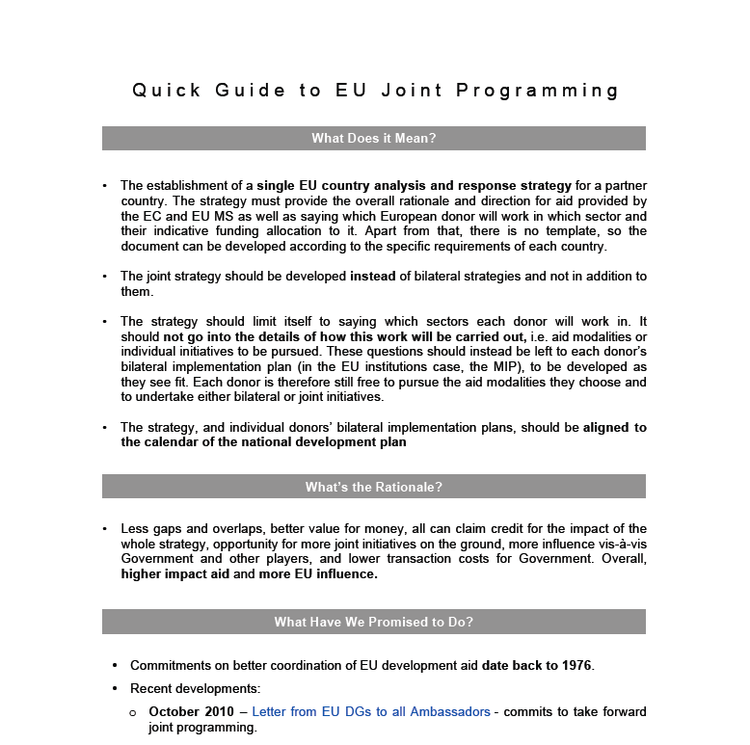
Clarify

Slide 19
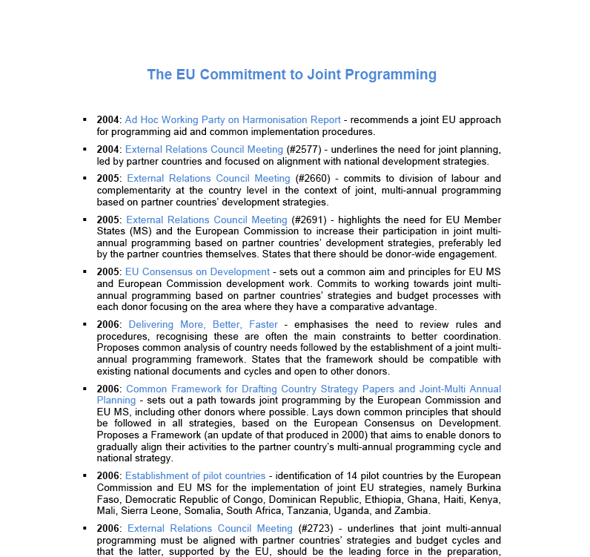

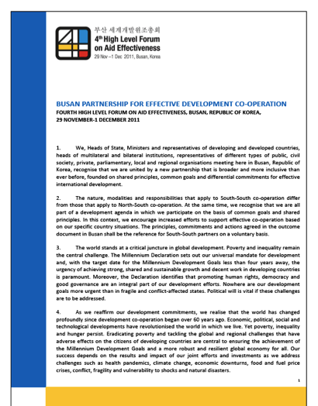
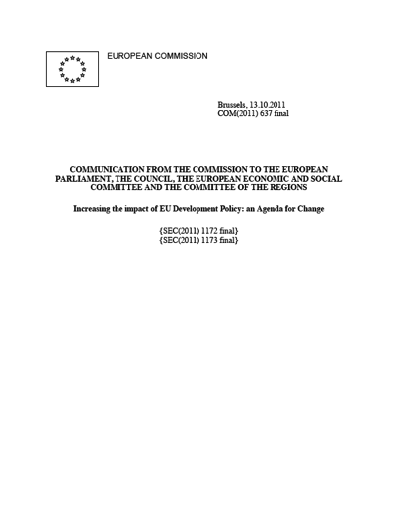
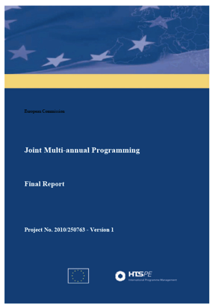
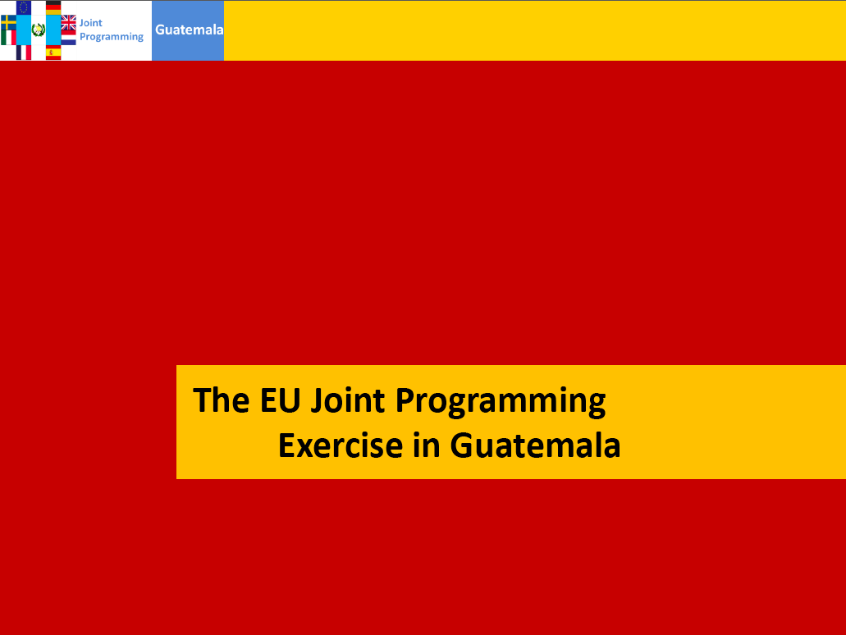
Reference

Slide 20



Reference
“Essential to move ahead on JP…should resolve the problem of DoL”
“Will increase coherence, impact and leverage vis-à-vis other donors”
“Decentralise decision making, ensure light structures”
“Country-led approach, HoMs should play key role”
“Adapt to situation on the ground, not Brussels-led”

Slide 21

Reassure
1: Brussels will decide what we do
2: EU MS not present on the ground will decide what we do
3: We’ll have to use EU templates, procedures & timetables
4: I’ll have to scrap my bilateral implementation plan
5: All our projects will have to be implemented jointly & simultaneously

Slide 22

Rationale
P a r t n e r C o u n t r y
Ownership & alignment ⬆
Predictability & transparency ⬆
Aid fragmentation ⬇
Transaction costs ⬇
Cash doesn’t ⬇
D o n o r s
Influence ⬆
Ability & willingness to do DoL ⬆
Pressure to do everything myself ⬇
Bang per buck ⬆

Slide 23

Rationale
Cambodia: EU vs. China: Share of Aid

Slide 24
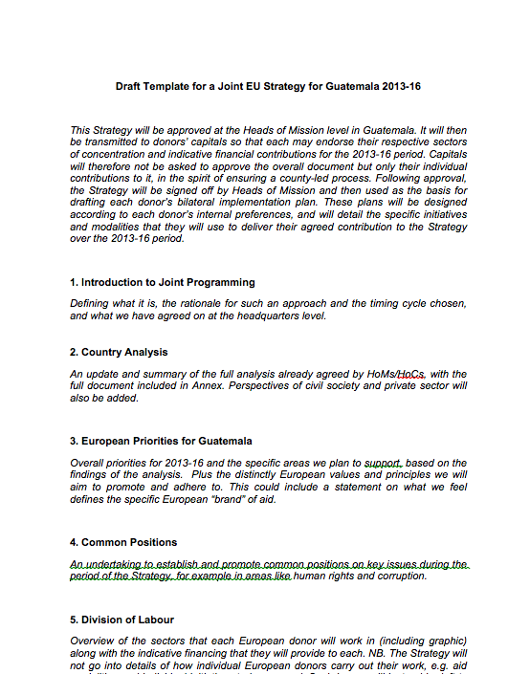
Practicalities – JP doc

Slide 25
Practicalities - sync
 | 2011 | 2012 | 2013 | 2014 | 2015 | 2016 | 2017 | 2018 | 2019 | 2020
GoL | NSEDP-7 |  |  |  |  | NSEDP-8
EU | <<
Finland
France | <<
Germany
Hungary
Ireland
L'bourg

Slide 26
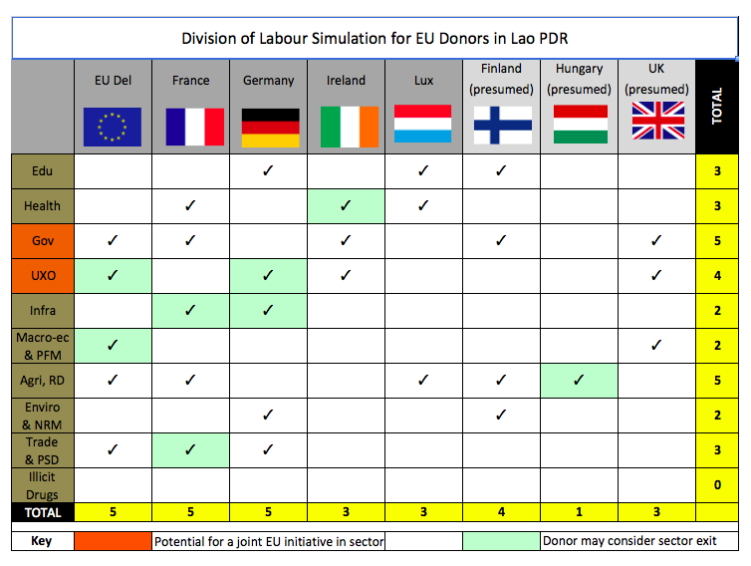
Practicalities - DoL

Slide 27
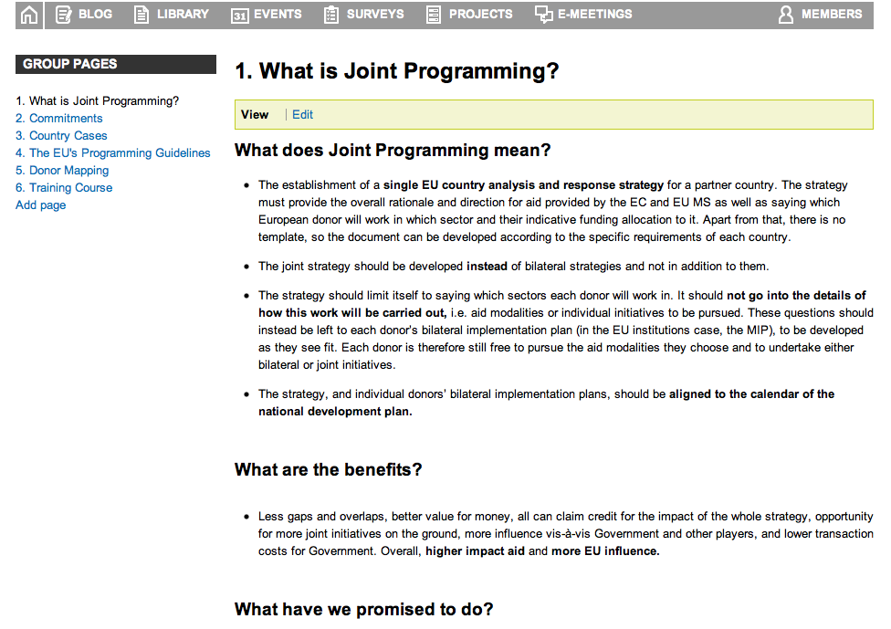
Practicalities – knowledge sharing

Slide 28

Challenges
Knowledge of what it means & involves
Need for practical examples
Knowledge of capitals’ commitments
Cycles & sectors set by HQs?
Planning vs. financing
Control, visibility
Concerns about workload

Slide 29

Over to You
1. Comments on countries?
2. Experiences to share?
3. How can we improve our general support? (guidelines, FAQs/LLs, website, share instructions, JP study update?)
4. Pre and post mission liaison?
5. What does a focus on results mean for DoL?

Slide 30


Joint Programming
Policy & Practice
Thank you! For more please see:
http://capacity4dev.ec.europa.eu/joint-programming/
consultancy@andybenfield.com

