Slide 1
EuropeAid’s today’s quality framework and the Results agenda
Thierry Dudermel, Head of Sector, DEVCO B1

Slide 2
Quality assurance mechanisms during the EU operational cycle
EC Development Policy
Partner Government Policy
I Quality Support Group (Programming)
Programming
Evaluation (final or ex-post)
O Quality Support Group (projects/ programmes)
Step 1
Follow-
Up
PPCM Guidelines
Identi-
fication
O Quality Support Group
Step 2
Monitoring& Evaluation during implementation
Formulation
Implementation
Notes:
2

Slide 3
Methodology of the QSG system - OECD/DAC evaluation criteria
Relevance
  Identifying real needs and formulating relevant interventions
Efficiency
Effectiveness
Impact
Sustainability
Focus of oQSG step 1
Feasibility:
  well designed and will deliver sustainable benefits to target groups
Focus of oQSG step 2
Notes:
Relevant: Consistent with and supportive of EC policies and strategies Paris declaration on aid effectiveness Cross-cutting issues; Consistent with the beneficiary country’s policies and strategies; Problem analysis; Analysis and identification of: -stakeholders, institutional capacity local ownership and commitment; Analysis of: Lessons learned Options available Donors co-ordination
Feasible: Objectives (overall, specific, results, indicative activities) -Logic of intervention; Resources and costs
Visibility of the action; Implementation issues; Risks and assumptions; Social, environmental and technical sustainability

Slide 4
Reporting on EU Aid portfolio
TOOLS: Implementation Reports (EAMR)
INTERVENTIONS COVERED
100% of projects and programmes
RESULTS INDICATORS
Within the Logframe
PERFORMANCE CRITERIA
Progress in Implementation
AGGREGATION
REPORTING
2 final Key Performance Indicators at EU Delegations level: % of Implementation Reports with green traffic light at activities and at objective level
Internal: External Assistance Management Report twice a year
Likely achievement of projects purpose (potential impact) → Results
USE
Management at HQ and EU Delegations level

Slide 5
Reporting on EU Aid portfolio
TOOLS: Results Oriented Monitoring - ROM (external review) for projects/programmes approaches
INTERVENTIONS COVERED
Around 1000 interventions per year, according to eligibility criteria, covering 20% of the EU budget. Around 30% of interventions
RESULTS INDICATORS
Logframe
PERFORMANCE CRITERIA
DAC Criteria (relevance, efficiency, effectiveness, impact, sustainability) - Cross cutting issues - Capacity Development
AGGREGATION
REPORTING
Rates are aggregated per DAC criteria. Can be split by main variables of the portfolio (geo, DAC…) provides performance trends on a sample of the portfolio
Internal and external: EuropeAid Annual report
USE
Management and accountability

Slide 6
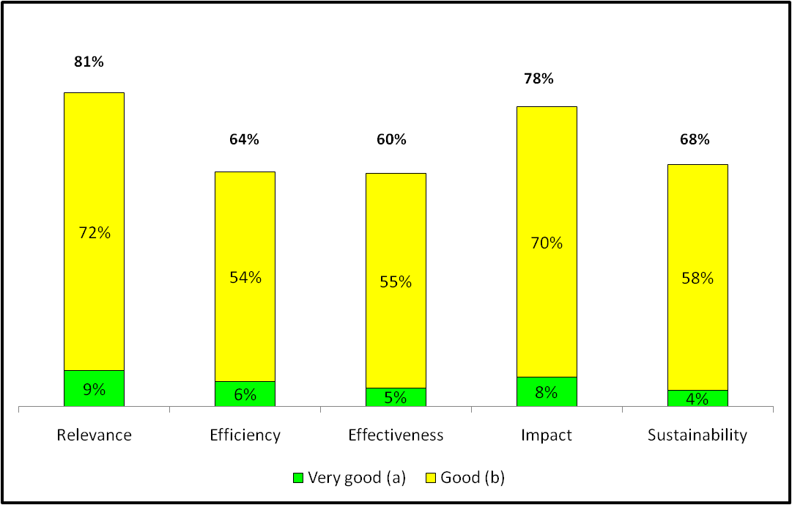
ROM assessment: Grades by evaluation criteria (2011)
Notes:
6

Slide 7
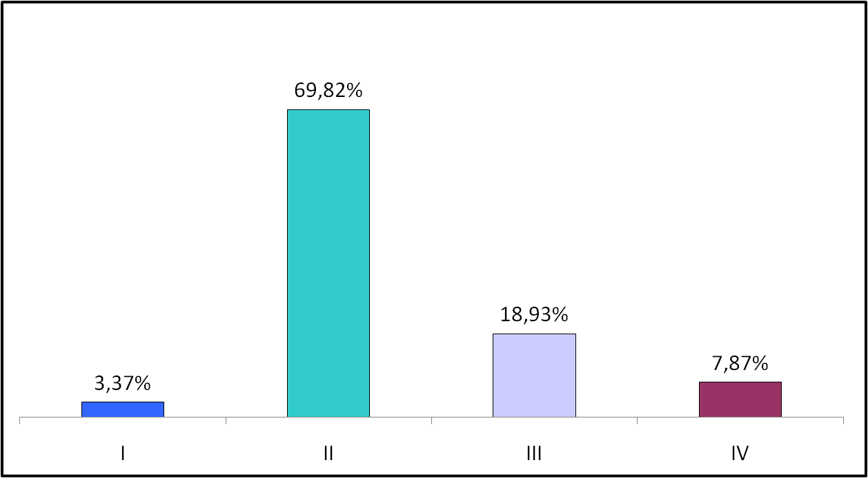
ROM assessment: Projects by performance category
Very good Good Performing with problems Major difficulties
Notes:
7

Slide 8
Reporting on EU Aid portfolio
TOOLS: PROJECT EVALUATION
INTERVENTIONS COVERED
Around 200 per year
RESULTS INDICATORS
Logframe (projects) - Sector Policy indicators (Sector Policy Support Programmes)
PERFORMANCE CRITERIA
Evaluative questions related to DAC criteria
AGGREGATION
REPORTING
No
Internal
USE
Management (EC, Partner and Beneficiaries)

Slide 9
Reporting on EU Aid portfolio
TOOLS: META EVALUATION
INTERVENTIONS COVERED
Around 10 by year
RESULTS INDICATORS
MDGs indicators at country, regional and global level - Poverty Reduction Strategy Papers (PRSP) indicators
PERFORMANCE CRITERIA
Evaluative questions related to DAC Criteria
AGGREGATION
REPORTING/COMMUNICATION
Not relevant
Publication on DEVCO website
USE
Accountability and lessons learnt (programming)

Slide 10
Further Developments
ROM Sector Policy Support Programme (SPSP)→ New format for ROM Budget Support (BS) – 2012
ROM Ex-post for project approach: Coverage +/- 200 interventions per year → Reflexion on systematic ROM final
Setting up an Operational Information Management System (PCM Platform)
  → Availability of information over the whole project/programme cycle
  → Sound base for aggregating data especially on quality and performance

