Slide 1

The Emissions Gap Report 2012
Where do we need to be in 2020 and beyond?
What do countries need to do to make it happen?
London ♦ 21 November, 2012
Joseph Alcamo
Chief Scientist, UNEP

Slide 2





Moving forward on global climate policy
  Three policy developments …
  A target (or limit) …
  Staying below an increase of 2 degrees Celsius (1.5⁰ C)
  A means to get there …
  Country pledges to control emissions (pegged to 2020)
  Durban: A plan for a climate treaty … Agreed to by 2015; into effect by 2020
  Three questions …
  Is there a gap between …
  What we are aiming for … and where we are heading ?
  Can the gap be bridged – and what will it take?
  Can we wait until 2020 to start stringent emission reductions?

Slide 3
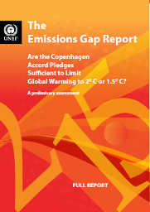

The Emissions Gap reports
2010 Cancun Climate Summit UNEP “Emissions Gap” report
United Nations Environment Programme with the European Climate Foundation & National Institute of Ecology, Mexico
2011 Durban Climate Summit UNEP “Bridging the Emissions Gap” report
United Nations Environment Programme with the European Climate Foundation & Ministry of Environment, South Africa
2012 Doha Climate Summit UNEP “Emissions Gap 2012” report
United Nations Environment Programme with the European Climate Foundation
55 scientists, 43 institutions, 22 countries
Notes:
Latest in series of reports to address the first two questions (on previous slide)
This report provides important update of first two questions and also addresses third question
This report 55 scientists …

Slide 4
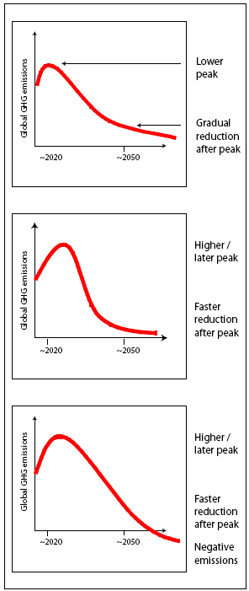
What are we aiming for?
Pathways to stay within the 2ºC target
Meeting a temperature target depends largely on cumulative emissions
Different pathways of emissions correspond to same cumulative emissions
Notes:
Important to know that meeting 2 deg target depends more on cumulative emissions than emissions in a particular year
Therefore, several pathways can lead to same cumulative emissions and can stay within the 2 deg limit.

Slide 5
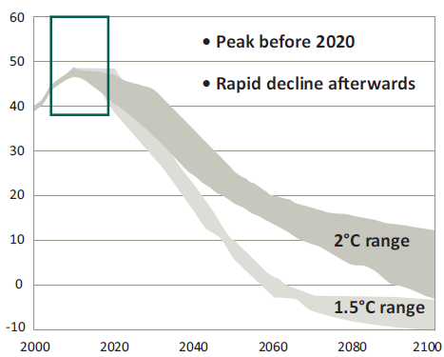
What are we aiming for?
Post-2020 goals for staying within 2ºC target
Global Greenhouse Gas Emissions
Gt/year
CO₂-equiv.
In 2030 ≈ 37 Gt CO₂e/yr (33-44)
≈ - 23% rel. to 2010 emissions
≈ 1990 emissions
In 2050 ≈ 21 Gt CO₂e/yr (18-25)
≈ - 56% rel. to 2010 emissions
≈ - 42% rel to 1990 emissions
Now (2010) ≈ 49 GtCO₂e/yr
39 emissions pathways
Likely chance of complying with 2ºC target:
Year
Notes:
This graph shows the large set of emissions pathways collected from more than 10 different groups and models.
To address the first question – What emissions level are we aiming for beyond 2020 to stay within the 2 deg target?
Now at 49, in 2030 need to be around …, in 2050 ….

Slide 6

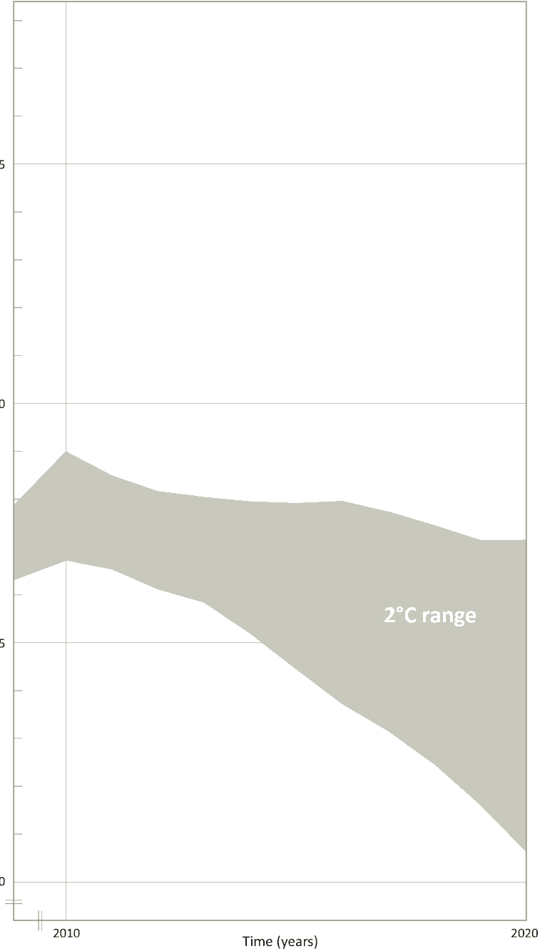
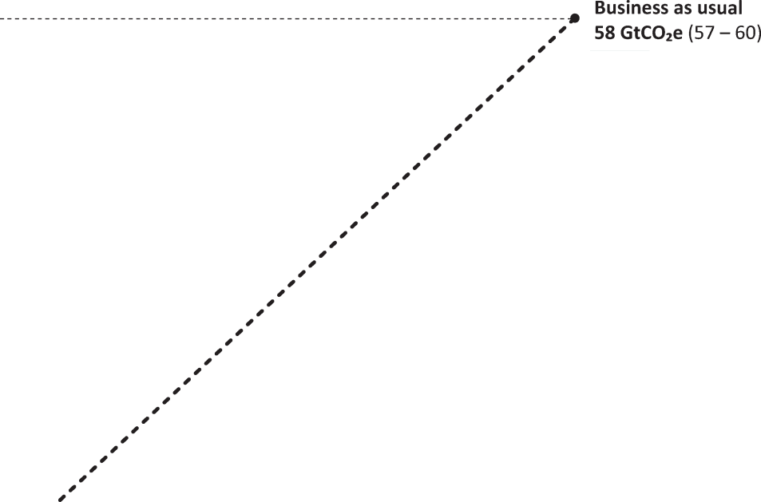
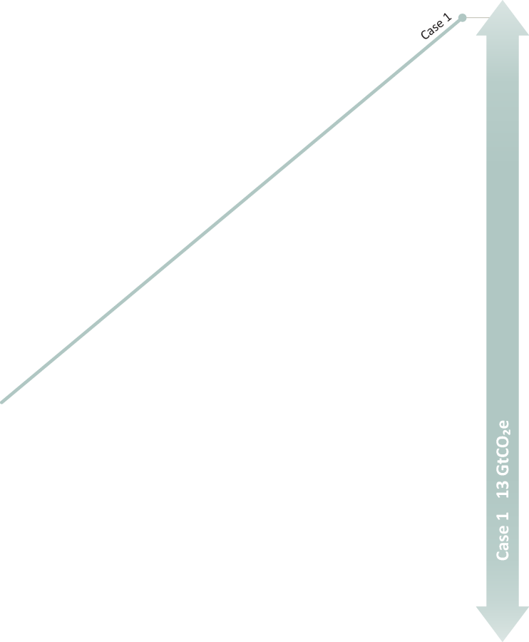
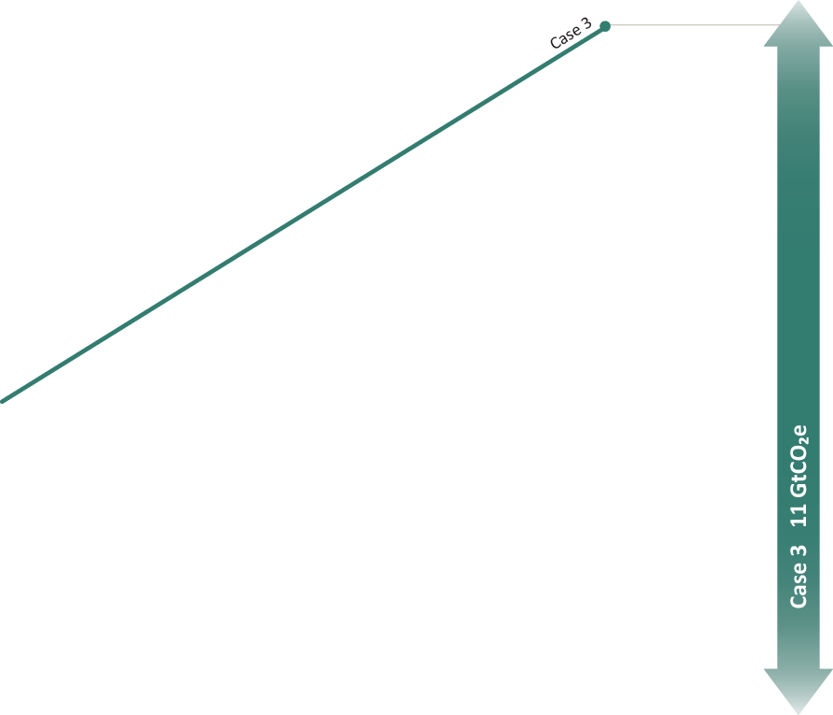
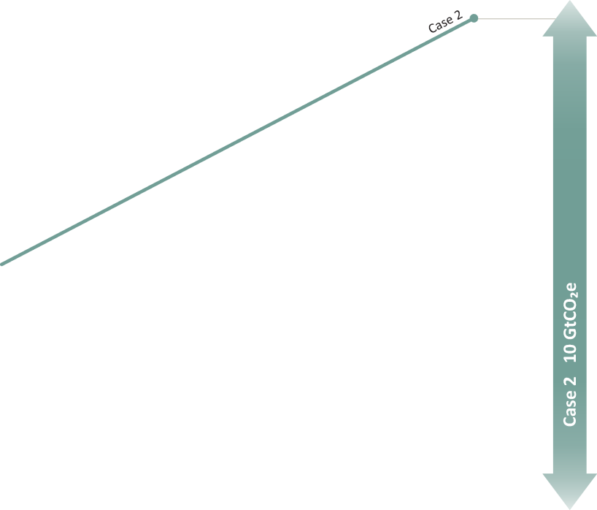
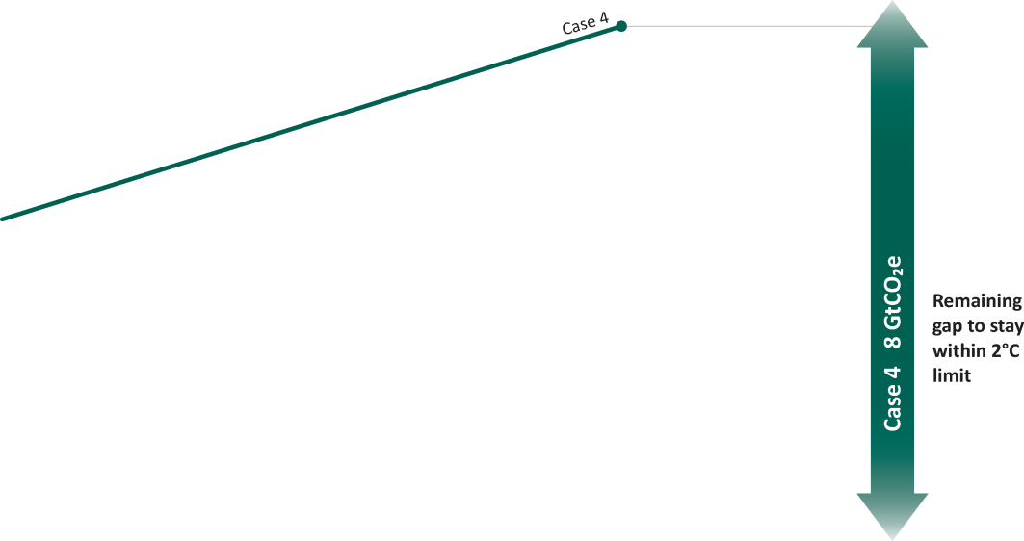
Is their a gap -- between what we are aiming for and where we are headed in 2020?
Business as usual, Gap = 14
Total Global Greenhouse Gas Emissions
Under Business-as-Usual
Gap = 14 GtCO₂e/yr
55
(Gt/year CO₂ equiv)
Under different cases of country pledges:
Gap = 8 – 13 GtCO₂e/yr
Pledge cases
Pledge cases
Under the most ambitious case:
Gap = 8 GtCO₂e/yr
50
Now:
≈ 49
Gt/year
Peak before 2020
Pledges not enough to meet the 2ºC climate target
We cannot wait
until 2020 to begin stringent emission reductions.
45
45
~44 Gt/year
To be on pathway of staying within 2ºC limit
13
10
11
8
Different pledge cases GtCO₂e/yr Gap
2010
YEAR
2020
Notes:
Let’s look at nearer future – 2020
As mentioned, climate target of 2 deg, and country pledges to reduce emissions by 2020
Is there a gap between emission levels consistent with 2 deg and emission levels expected once pledges are implemented?
Now 49, we are aiming for 44 to be on pathway of staying within 2 deg
But, depending on how pledges and rules are interpreted, emissions are expected to go in opposite direction – increase up to 52 to 58 Gt/yr
Under BAU, Gap = 14
Under different pledge cases, Gap = 8 to 13 Gt/yr
Most ambitious: 8 Gt/yr → This is about the total greenhouse gas emissions from industry in the world, a big number
Pledges not enough …
We cannot wait …
Summarizing

Slide 7
What happens if we don’t close the gap in 2020?
  If ambition of pledges not increased: trajectory to ≈ + 3.0 to 5.0ºC
  What if we start later to meet the 2.0 ºC target?
  “Later action scenarios”: Higher emissions over near term, require sharper reductions afterwards → Lower short-term costs, but …
    A bigger gamble …
    Higher costs of mitigation
    Greater climate impacts
    Reliance on non-proven technology → Negative emissions
Negative emissions through
Bioenergy + Carbon Capture and Storage

Slide 8
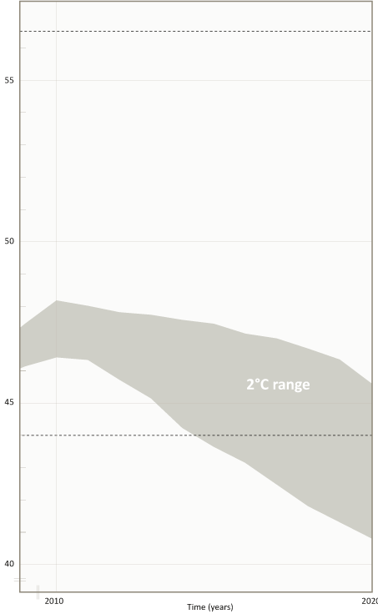









How can the 2020 gap be bridged?
Bottom-up sectoral studies
  Emission reduction potential (Gt/year equivalent CO₂)
Total Greenhouse Gas Emissions
Power
2.2 – 3.9
Industry
1.5 – 4.6
Business-as-usual
Transport
1.7 – 2.5
Buildings
1.4 – 2.9
Waste
≈ 0.8
Forestry
1.3 – 4.2
Agriculture
1.1 – 4.3
Total Emission Reduction Potential
= 17 ± 3
Gt/year CO₂e
The Gap in 2020 = 14
(relative to business-as-usual)
Gt/year CO₂e
2010
2020
  Potential in sectors big enough to bridge the gap.
Year
Notes:
Good news is that the emission reduction potential is greater than the largest estimate of the gap.

Slide 9
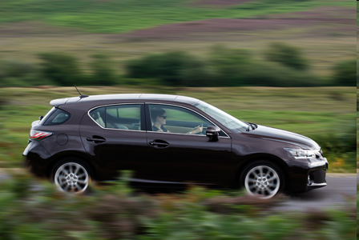
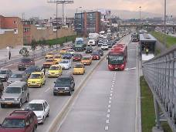
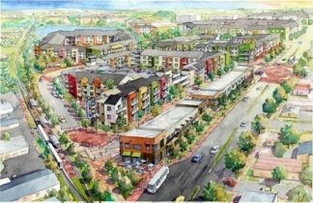
How can the 2020 gap be bridged?
Some action on the ground
Transportation
Potential: - 1.7 to - 2.5 Gt CO₂e in 2020
Reduce energy use, increase energy security, reduce traffic congestion, security, reduce air pollution
Example policies:
Vehicle Performance Standards
Japan, EU, USA, Canada, China, Australia and South Korea:
Light-duty fleets: > 50% reduction in GHG emissions by 2025 rel to 2000.
Bus Rapid Transit
16 countries
GHG emissions in Mexico City: 143 kt CO₂e/yr avoided due BRT (Metrobus) system

Slide 10


How can the 2020 gap be bridged?
Some action on the ground
Buildings
Potential: -1.4 to - 2.9 Gt CO₂e in 2020
Reduce energy use and costs, energy security, safety
Example policy:
e.g. Appliance Standards and Labels
> 75 countries
Avoided GHG emissions ≈ 125 MtCO₂e/yr (2020) from SEAD* 17 states
Potential global reductions GHG emissions: 0.7 Gt CO₂e (2020)
* Super Efficient Equipment and Appliance Deployment Initiative

Slide 11
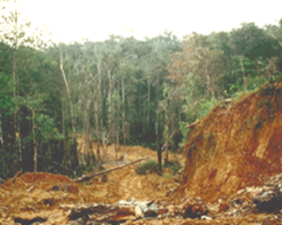
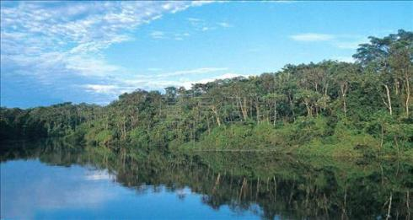

How can the 2020 gap be bridged?
Some action on the ground
Forestry – Reducing deforestation
Potential: - 1.3 to - 4.2 Gt CO₂e in 2020
Many countries, including Brazil and Costa Rica
Preservation of culture, ecotourism, biodiversity, watershed protection
Example policies:
Protected areas Brazil: 46% of Amazon, Costa Rica: 24% of land area.
Satellite-based monitoring Brazil: enforcement of deforestation policies
Economic instruments: Costa Rica: Payments for ecosystem services
Brazil: Avoided GHG emissions: ~ 0.6 Gt CO₂e (2005-2009); ~ 2.8 Gt CO₂e (2006-2011)
Costa Rica: Currently: Near zero deforestation & related emissions
Notes:
Potential being partly realized
Need to replicate and scale-up
But important to note -- These policies being realized for reasons other than climate policy
So in self-interest of countries to carry out policies that will reduce emissions

Slide 12
  Losing opportunities …
  “Lock in” of high emission technologies, structures and processes
  Currently produced energy-inefficient vehicles will still be on the road in 2020
  Energy-wasteful buildings now under construction will last 100 years
  Power plants are being constructed with fuel efficiency below what is technically feasible, and will have lifetime of >25 years

Slide 13
Conclusions
  New in this report
  Looking beyond 2020, current global emissions, consequences of not closing the gap
  For a climate agreement that begins in 2020 …
  To meet the two degree target:
  Global emissions in 2030 must return to around their 1990s level
  Global emissions in 2050, > 40% below 1990 levels, > 50% below 2010 levels
  But cannot wait until 2020 for stringent emission reductions to begin.
  To meet the two degree target:
  Global emissions already more than 10% above emissions level in 2020 consistent with 2ºC target, and growing
  Global emissions must peak before 2020
  Pledges not enough, still gap in 2020 → 8 - 13 Gt CO₂e

Slide 14
Conclusions
  The Gap can be narrowed … with action in the negotiations
  Minimizing use of surplus emission credits & land use related credits
  Pursuing more ambitious (“conditional”) pledges
  The Gap can be bridged … by realizing large potential in each sector
  Technical potential for reductions in 2020 (17 Gt CO₂e /yr ) big enough to close the gap (14 Gt CO₂e /yr)
  Emission reductions by scaling up policies that fulfil local and national self-interest: Saving energy, saving costs, reducing traffic congestion, reducing air pollution …
But “lock in” of high emission technologies, structures and processes → losing time + opportunities to close the gap.
Notes:
Potential realized by policies that fulfil other national priorities
Adopting building codes: save energy, money, and increase energy security
Establishing bus rapid transit systems: reduce congestion and air pollution
Stopping deforestation: preserve cultures, support tourism and conserve biodiversity.
Following national/local self-interest can close the gap if policies are scaled up.
Need less lock-in and more vision

Slide 15
The Emissions Gap Report 2012
Where do we need to be in 2020 and beyond?
What do countries need to do to make it happen?
London ♦ 21 November, 2012
Joseph Alcamo
Chief Scientist, UNEP

