Slide 1








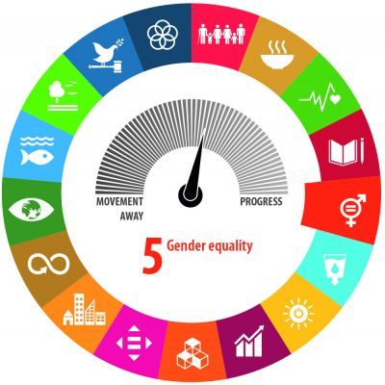






EUROPEAN
UNION
Delegation of the European Union
to Sri Lanka and the Maldives
EU GENDER ACTION PLAN III
Country Level Implementation Plan for Sri Lanka (2021-2025)
The European Union and its Member States are vigorously promoting gender equality and women empowerment in their relations with partner countries. The new EU's Action Plan on Gender Equality and Women Empowerment in External Action (2021-2025) is now operational in Sri Lanka
GAP III
GENDER ACTION PLAN III aims to accelerate progress on empowering women and girls, and safeguard women's right as Sri Lanka is signatory to key UN and ILO Conventions. It aims to contribute to empowering women, girls and young people to fully use their rights and increase their participation in political, economic, social and cultural life.
Translating the GAP III into action
Rationale for the CLIP
The Country Level implementation plan (CLIP) for Sri Lanka:
- translates the EU Gender Action Plan III into priorities and actions for the Sri Lanka, using a rights based approach.
- was prepared by EU Delegation and EU Member States including the leading CSOs operating in Sri Lanka.
The CLIP areas of engagement are based on:
- The EU Multiannual Indicative Programme (MIP) 2021-2027 for the Sri Lanka’ areas of green economy, justice and peace building, Climate changes with a particular attention to the needs and rights faced by people living in vulnerable situations.
- The national gender-related plans; the findings of the EU commissioned Gender country profile 2021 for the Sri Lanka and the Gender analysis; and consultation of member States and civil society organizations.
CLIP Instruments
CLIP - Areas of Engagement
Different instrument will be used in the implementation of the CLIP:
- Gender mainstreaming
- Targeted actions with support to the GoSL and
to projects designed and implemented by
organisations working on gender equality and
women organisations
- Dialogue with different stakeholders
- Public diplomacy campaigns
Addressing the challenges and harnessing the opportunities offered by the green transition and the digital transformation
Ensuring freedom from all forms of gender-based violence (and access to justice)
Promoting economic and social rights and empowering girls and women
Gender mainstreaming and
targeted actions
Promoting equal participation and leadership
Integrating the women, peace and security agenda
Promoting sexual and reproductive health and rights
- Screening EU bilateral programmes with a gender lens and continuing to do so to help maximise the role and capacities of women in the design, implementation and evaluation phases of the programmes. The new programmes will also encompass specific actions to empower women.
Engagement in dialogue for gender equality and women empowerment
Dialogue engaged with the GoSL through various platforms
Dialogue with national and local CSOs using the framework of the EU roadmap for engagement with civil society 2021-2024.
- Supporting women organisations and CSO projects aiming at women empowerment through various funding programmes (CSO-LA, EIDHR, EU MS funding schemes). Currently EUD SL support projects in leadership and participation, social and economic empowerment, human rights and freedom of expression. The EUD SL will continue supporting CSO projects with a focus on the priority areas identified in the CLIP.
Strategic Communication & Public Diplomacy Activities
EU MS and the EU Delegation will use public diplomacy activities to raise awareness on gender equality issues in the Sri Lanka, together with the Government, LGUs, development partners and CSOs.

