Slide 1
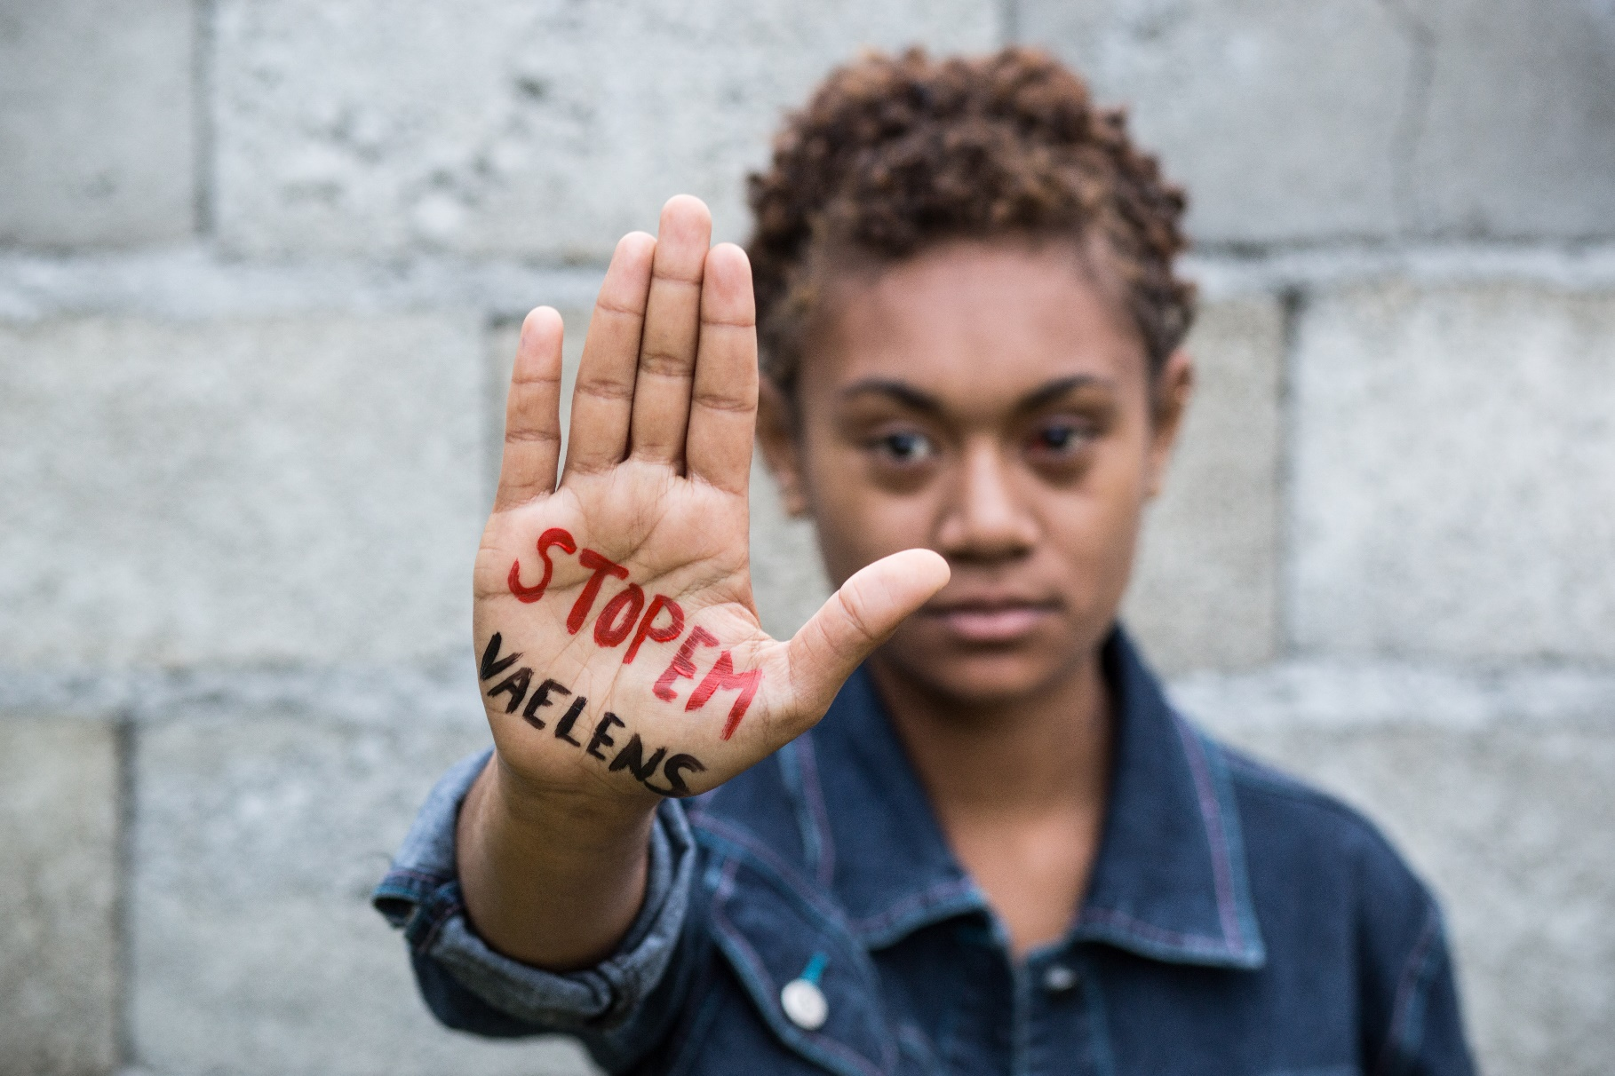
EUROPEAN
UNION
Delegation of the European Union
to the Pacific
EU GENDER ACTION PLAN III
Regional Level Implementation Plan for the Pacific (2021-2025)
The European Union and its Member States are vigorously promoting gender equality and women empowerment in their relations with partner countries. The new EU's Action Plan on Gender Equality and Women Empowerment in External Action (2021-2025) is now operational in the Pacific
GAP III
GENDER ACTION PLAN III aims to accelerate progress on empowering women and girls, and safeguard gains made on gender equality during the 25 years since the adoption of the Beijing Declaration and its Platform for Action. It aims to contribute to empowering women, girls and young people to fully use their rights and increase their participation in political, economic, social and cultural life.
Vision
Rationale for the RLIP
In line with the EU GAP III, gender action, including measures to protect vulnerable women such as those with disabilities should be mainstreamed across all priority areas of the Pacific Multi-Country Multi-Annual Indicative Programme 2021-2027. Based on lessons learnt from previous gender specific programmes in the Pacific, dedicated multi-country action with gender as its main objective will be considered.
The RLIP areas of engagement are based on:
The Pacific Gender Region Profile. It aims to describe Pacific women’s condition and rights, and assess how far Pacific governments have progressed in achieving gender equality through promoting women’s leadership and participation in the political and legislative processes; ending violence against women; enhancing women’s economic empowerment; and making gender equality central to national development planning and budgeting
Consultation
RLIP - Areas of Engagement
The RLIP benefited from the inputs and consultations with a number of individuals and institutions, at national and regional level, including EU Member States and Civil Society Organizations. Other sources consulted include online materials, national/regional reports relating to gender equality, sustainable development and human rights as well as virtual archive documentation of the EU Delegation for the Pacific.
Addressing the challenges and harnessing the opportunities offered by the green transition and the digital transformation
Integrating the women, peace and security agenda
Ensuring freedom from all forms of gender-based violence (and access to justice)
Promoting sexual and reproductive health and rights
Gender mainstreaming and
targeted actions
Promoting equal participation and leadership
Strengthening economic and social rights and the empowerment of girls and women
- AAP 2021, new Action ‘Pacific Transformative Gender Equality Programme’, contributing to the MIP Priority Area 3 ‘Fundamental Values, Human Development, Peace and Security’, Sector 3.2 Mainstreaming Gender and Addressing Violence against Women and Children (Gender marker; DAC 151 - Government & Civil Society-general).
- Screening EU bilateral programmes with a gender lens and continuing to do so to help maximise the role and capacities of women in the design, implementation and evaluation phases of the programmes. The new programmes will also encompass specific actions to empower women.
- Supporting women organisations and CSO projects aiming at women empowerment.
- Supporting existing regional programmes.
Engagement in dialogue for gender equality and women empowerment
The EU consistently promotes gender equality, empowerment of women and their increased participation in decision-making in the region through Political Dialogues with the Governments of the Pacific Islands Countries, including at highest level.
The EU also engages in exchanges with CSOs, human rights activists and other relevant stakeholders.
Public Diplomacy Activities
Meetings with multiple stakeholders, activities and campaigns at various levels, broadly covered in the regional media and social networks

