Slide 1
Knowledge Sharing Program
Shaping the Future with Korea
November 2012
Kwangchul JI
Head, Development Cooperation Policy Team
Ministry of Strategy and Finance, Republic of Korea
Notes:
1

Slide 2
Knowledge Sharing for Development
Knowledge Sharing (KS) as a Way of
Enhancing Development Effectiveness
Aid fatigue in the 1990s
Knowledge Sharing is one of the nine pillars of the G20 Seoul Development Consensus (2010).
Knowledge Sharing is referred to in the outcome document of the Fourth High Level Forum on Aid (2011), Busan Partnership for Effective Development Cooperation:
“Openness, trust, and Mutual respect and learning lie at the core of effective partnership in support of development goals, …”
Development effectiveness
Knowledge Sharing in development cooperation
Development effectiveness through KS based on Ownership & Self-help

Slide 3
Knowledge Sharing for Development
Knowledge Sharing as an Indispensible Condition for
Economic Growth and Sustainable Development in the Future
Capital and labor are not sufficient for sustainable development
“The WBG aims to fight poverty with passion and professionalism for lasting results … by producing resources, sharing knowledge, building capacity, …”
World Bank Mission Statement
“Under Jim Wolfensohn, the World Bank transformed into a “knowledge bank”, … I believe it is time for us to write the next chapter in our evolution: it is for us to become a “solutions” bank.”
- WBG President Jim Kim at the Annual Meeting (Oct., 2012)
Build up knowledge capacities in developing countries to fill up economic development gaps
Knowledge Sharing as an indispensible tool for development cooperation

Slide 4
Experience of Korea
Success, Challenges and Triumphs again
Per capita income ($)
21,695
20,000
Global Financial
Crisis
20,759
17,193
15,000
12,197
OECD
Member
10,000
Korean War
(1950-53)
Six 5-Year-Economic-
Development Plans
Military Coup in 1961
7,355
5,000
1,000(1977)
Liberation from Japanese Colonial Rule (1910-45)
Financial
Crisis
Democratization in 1987
67
79
1945
1953
1960
1970
1980
1990
1996
1998
’07
’08
’09
’10

Slide 5
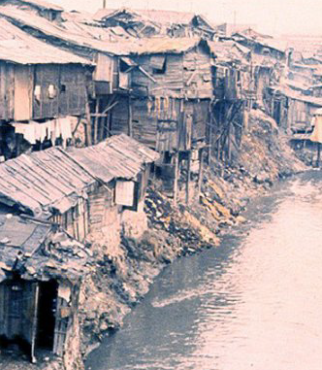

Experience of Korea: “Miracle of Han River”
What is the Secret of Korea?
Seoul, 1960
Seoul, 2010

Slide 6
Korea and Knowledge Sharing (KS)
Korea’s Remarkable Experience in Development
“Rapid, Shared Growth” [World Bank (1993)]
Invincible spirit & strong will to self-growth; 5-year economic development plan, R&D, etc.
From aid recipient country to donor country
Knowledge Sharing Program (KSP) since 2004
Korea’s rapid development wouldn’t have been possible without other countries’ help.
It was right time for Korea to contribute to the world development by sharing its unique development experience.

Slide 7

KSP: Policy Consultation & Ownership
Bilateral
Consultation
Modularization
Joint Consulting
Policy analysis
Policy solution
Database on
exemplary cases,
& best practices
Joint policy consultation with international org.
Grants, EDCF loans, and other forms of ODA
Private Sector Cooperation (PPP, etc.)
High-level dialogues and policy executors networks
7

Slide 8
KSP Framework
Government level
International
Organizations
MOSF
KSP Committee
MOFAT
MKE
& other ministries
KDI
EDCF
KOICA
Private Sectors
Operation level
Operational level
Consulting teams
Forming strategies for Knowledge Sharing
Coordinating Knowledge sharing with
linkage to other ODAs
Supervising & Funding
Evaluation
Conducting research
Consultation with partner countries
Associating with other ODA agencies
Process Monitoring
Developing Evaluation Methods
MOSF
KDI
8

Slide 9



Bilateral Consultation : Procedure
Partner country’s priority
Demand-driven manner
Feedback
Subject
Identification
Monitoring &
Evaluation
Policy
Research
Joint research team
How to apply Korea’s knowledge to local circumstances
Effectiveness
Efficiency
Usefulness
Sustainability
Policy
Recommendation
Policy dialogues
Training & Field trip
Dissemination seminars
9
Notes:
9

Slide 10
Bilateral Consultation : Demand-driven Process
Written
Demand Survey
Conducting written demand surveys on KSP consultation topics through diplomatic offices in partner countries
Project Planning
Selecting research topics with partner country’s policy practitioners
Joint Research
Joint research team with Korean & local experts
Partner Country’s Ownership
Ensuring partner countries’ ownership and leadership by reflecting demand and jointly conducting projects
KSP Projects = Demand-driven Policy Consultation
10
Notes:
10

Slide 11
Bilateral Consultation : 2011-12 Projects
2011-12 KSP was completed for 26 countries with 105 themes
(April. 5, 2011 to April 30, 2012)
Country | Project Title
Vietnam | Supporting the Establishment of Vietnam’s 2011~20 Socio-economic Development Strategy
Cambodia | Policy Agenda for Cambodia in SME, Industry and Trade
Indonesia | Supporting Indonesia’s Development Strategy in Key Policy Areas: Public Finance, Credit Infrastructure, and Water Resources Management
Uzbekistan | Strengthening Uzbekistan’s National Innovation System
Mongol | Macro Policy Framework for Sustainable Development in Mongolia
Peru | Enhancing the Competitiveness of SMEs In the Southern Economic Corridor in Peru: Some Pilot Programmes for Action
Ghana | Strengthening the Capacity of the Monitoring and Evaluation (M&E) System at All Levels of National Administration
UAE | Abu Dhabi's Major ICT Initiatives and Korea's Best Practices

Slide 12
Bilateral Consultation : Case of Dominican Republic
Objectives
Outputs
The 1st KSP (2008)
  Propose the overall export development policy to revive the export industry of the Dominican Republic.
The 2nd KSP for (2009)
  Support the preparation of the export infrastructure development.
The 3rd KSP (2009)
  Support the establishment of the Export Credit Agency (DEXIM)
The 4th KSP (2010)
  Provide assistance for the establishment of DEXIM through export credit capacity building
Establishment of DEXIM (in progress)
Capacity building for the management of export credit
Policy recommendations to stimulate export industries
Identification of 4 EDCF projects for DR (2 projects approved)

Slide 13
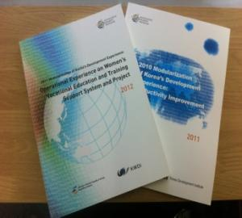
Modularization
From 2010 to 2012, 100 modularization of Korean development experience on 8 fields :
General Economy
Administration-ICT
Agriculture & Fisheries
Health & Medication
Industry & Energy
Human Resource
Land Development & Construction
Environment

Slide 14
Modularization
Main topics for 2011 Modularization :
Impact of Foreign Aid on Korea's Development
A study on the safeguarding system for the cultural heritage in Korea
Regulatory Reform and Economic Development - Korea's Experience in Regulatory Reform
Saemaul Undong (New Village Movement) and its Best Practice Cases
The Introduction of e-Government in Korea
Universal Care (National Health Care System of Korea)
Industrial Park Development Strategy and Management Practices
2013
Evaluation, E-contents, Modularization(Phase-II)

Slide 15
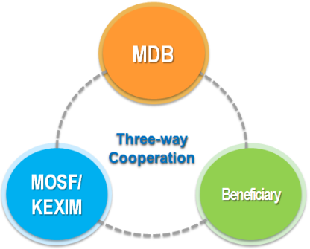
Joint Consulting
Joint Consulting with MDBs supports technical cooperation projects of MDBs by providing KSP expertise through joint activities
MOSF / KEXIM
MDBs
Korea’s Development Knowledge & Experience
Consulting know-how, expertise & global network

Slide 16
Joint Consulting : Process
MOSF
MDBs
Identify candidate projects
Agree on Annual Work Plan
Coordination
& Support
Design joint activities
Coordination & Support
Implement projects
KEXIM
KSP Consultants
Report progress
Monitor & Support

Slide 17
Joint Consulting : 2011-12 projects
2011 Joint Consulting Projects
WB | Trade in Green Goods and Technologies: Opportunities for Developing Countries (Phase1) Leadership for Development in Public Private Partnership Projects (Phase1)
ADB | Comparative Infrastructure Development Assessment of the Kingdom of Thailand and the Republic of Korea Education and Skills for Inclusive Growth and Green Jobs (Phase1) Intelligent Transportation System for Better Urban Transport (Phase1)
IDB | Design and Development of National Identification System in Jamaica Preparation of the Land Tenure Security Program in Haiti Design and Implementation of the Emerging and Sustainable Cities Platform

Slide 18
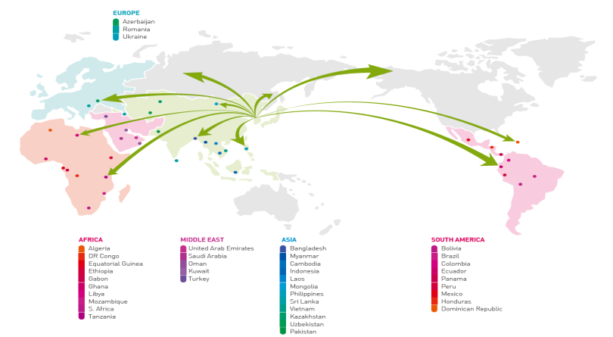
KSP up to now
Korea provided more than 440 policy consultations for
107 countries (cumulatively) up to 2012.
Romania (2012), Hungary (2013)

Slide 19
WB(WBI) –Korea(KSP) Global Partnership
International symposiums and seminars on KS
Creation of e-contents on KS (modularization, etc.)
WB branch office in Seoul for promoting KS
WB expertise and know-how on fund management (GCF)
  (GCF: Global Climate Fund will be established in Incheon Sondo, Korea)
And more …
Korean government is willing to actively participate in WB’s efforts on KS

Slide 20
The way forward
International
Organization
Knowledge Sharing Country
Strengthen
Knowledge platform
Enhance institutional
capacity for
Knowledge Sharing
Knowledge sharing
capacity building,
Financial support
Nurture qualified
development consultants
Expand sectoral
Knowledge sharing
Strong
political commitment
20
Notes:
20

Slide 21
T h a n k y o u
Kwangchul JI
gabrielj@mosf.go.kr

