Slide 1



Towards Country-led Knowledge Hubs
Accelerating Development - Scaling up Knowledge Exchange
World Bank Institute
Knowledge Exchange Practice
November2012

Slide 2
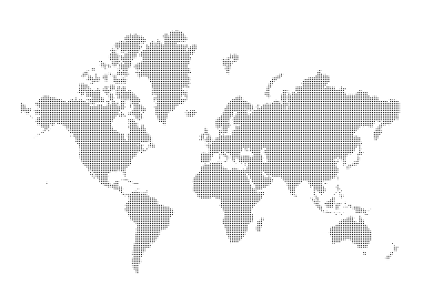
Context
A multi-polar world - Development solutions and practical experience available in all regions of the world
G20, Busan: Knowledge Exchange an effective instrument for development; should be scaled up
Many countries interested in how to better coordinate and implement Knowledge Exchange (KE)
Notes:
Recent multi-polar growth has been linked to a broad diversification of sources of knowledge. Smart knowledge sharing around development experiences and practices between Southern partners is proving as critical to spur mutual learning across national and regional boundaries.
Evidence-based compiled by the Task Team for South-South Cooperation in the run-up to Busan
G20 (Pillar 9) Options Paper on Knowledge Sharing
-→ Both of them suggest that KE is indeed an effective development instrument and should be scaled-up
WB and international development community consider Knowledge Exchange to be an effective instrument to accelerate development processes, helping to get better results faster by inspiring and equipping change agents with successful experiences from peer countries and institutions. Early evidence further suggests that Knowledge Exchange broadens the menu of development options, strengthens local ownership and leadership, and promotes endogenous capacity development.
Growing interest: these days, WB is receiving many requests from countries that want to build their institutional capacity as knowledge hubs
We need to deliver on this
What do we need to do to make KE happen ? How can we ensure they are organized in a more systematic way?

Slide 3
The Knowledge Exchange Opportunity
– A Catalyst for Development
KE links development solutions to where they are needed most
KE can accelerate development at two levels
KE complements TA and finance
Policy:
Inspiration, awareness raising, empowerment
Technical:
Innovation, skills building, practical know-how
Helps to get to more effective and sustainable development results faster by infusing tested solutions for challenging problems.
Notes:
KE have a catalytic function and can accelerate dvt processes both at policy level (inspiring leaders, creating awareness and ownership, empower governments to initiate reforms) and technical level through instilling innovative practices.
KE are not the only solution but they are a strong complement to TA and funding

Slide 4
Knowledge Hubs –
Institutionalizing Knowledge Exchange at Country and regional Levels
Development instruments and tools
Knowledge Exchange (KE)
Knowledge Hubs:
Institutions that facilitate KE at the country level
Financing, Technical Assistance, ..
Exchanging knowledge among development practitioners and leaders
Institutionalizing knowledge exchange
Notes:
After KE, let’s move one level down with Knowledge Hubs
This slide provides the context where Knowledge Hubs actually sit: in the confines of KE and KE itself is part of these various devt instruments
Key function of KH is to institutionnalize KE at country level
South-South and Triangular Cooperation (SSC and TrC)
SSC: A process whereby two or more developing countries pursue their individual or collective development through cooperative exchanges of knowledge, skills, resources and technical know-how.
South-South Knowledge Exchange (SSKE)
The practice of transferring, replicating, and scaling up of “what works” in development, through just-in-time sharing of experiences among development practitioners and leaders
Knowledge Hubs: Institutions that facilitate SSKE at the country level
An organization that shares and exchanges development experiences and models with partners from other countries.

Slide 5
What is a Knowledge Hub?
“
Knowledge Hubs are institutions or networks, dedicated to capture, share and exchange development experiences with national and international partners in order to accelerate development.
“
Notes:
Most common definition of Knowledge Hubs

Slide 6
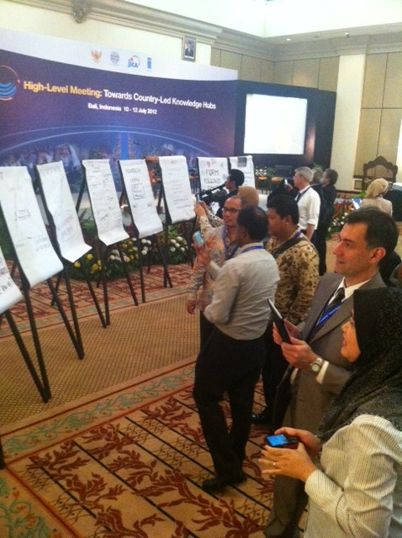

Knowledge Hubs:
Facilitating Country Expertise for Knowledge Exchange
Bali HLM, July 2012: Over 300 participants from 46 countries
Key Messages:
Knowledge hubs can scale up KE;
Not one right approach but numerous ways to develop knowledge hubs;
Questions on institutional set-up, national coordination, development of knowledge supply, KE design, funding and M&E;
Need for more peer learning among KHs, across regions and sectors.
Notes:
Main take-aways of Bali HLM «Towards Country-led Knowledge Hubs » organized in partnership with Government of Indonesia, JICA and UNDP
Over 300 participants from 46 countries joined this dialogue, many of which came from KH institutions and development cooperation agencies to both define KH and also learn from each other. They came with very practical questions on the institutionalization and operationalization of Knowledge Exchanges
Key messages are:
Country-led KH can indeed be a valuable way to scale up KE at national level, and to foster KE across countries and across regions
There are several different approaches / pathways to develop KH, all of which are very interesting and emphasize different elements of countries ‘ strategies towards KE
Participants discussed a number of questions in terms of institutional set-up, national coordination, development of KE supply, design, funding and M&E, working together with multilateral partners and so on
This was only a starting point for this agenda. Participants have clearly voiced their request to get more access to peer-learning opportunities on KH at the global level. Thus we are now working on setting-up a CoP on KH.

Slide 7
Knowledge Hubs exist at two levels
Country-level Coordination
Sector-level Coordination
Covering a country’s palette of expertise (different sectors)
Often set up or managed by MoFA, MoF or President’s Office
Tends to focus on bilateral relations and arrangements
Strong inter-institutional coordination of public sector
Strong thematic focus and expertise
Often part of line ministries or sector agencies
Part of thematic networks with national and international thematic partners
Multi-level coordination often also with specialized CSOs, private sector and academia
ABC (Brazil)
AMEXCID (Mexico)
APC (Colombia)
KDI (Korea)
SCE (Singapore)
National Development Agencies in EU12 countries
SEMARNAT, SEDESOL (Mexico)
FIOCRUZ, EMBRAPA, ABES (Brazil)
CABRI (South Africa)
CEF (Slovenia)
Solidarity Fund (Poland)
Centre for Eastern Partnership (Estonia)
Notes:
Two different kinds of KH: they operate at country-level coordination and sector-level coordination
Country -level: KH are usually sitting in close proximity of MoFA, MoF, Presidential agencies and development cooperation agencies.
Idea here is to foster strong inter-institution coordination of public sector, (hopefully also in the future with the private sector) as part of the development cooperation effort these countries are taking
Most established KH : ABC, APC, AMEXCID, KDI, Singapore Cooperation Enterprise (SCE). Nat Dvt Agencies EU12 are potential or existing KH
At Sector-level: KH are knowledge institutions that operate in a specific thematic arena and are increasingly finding themselves tasked with more KS & KE work.
Big questions that these institutions have are how do we most effectively do this ? and How can we learn better from other practices ? How can we package our own knowledge better so it can be shared with others?
Best examples of thematic KH are SEMARNAT and SEDESOL in Mexico, ABES , EMBRAPA and FIOCRUZ in Brazil, CABRI in SA

Slide 8







Analyzing country experiences and innovations
MOFCOM with AIBO
and CASS, China
AMEXCID with SERMANAT
and SEDESOL, Mexico
Singapore Cooperation Enterprise
Coordination Team and
Grand Design, Indonesia
ABC with EMBRAPA
and FIOCRUZ, Brazil
CABRI,
South Africa
Notes:
Already in the run-up to this Bali conference, we’ve done some analytical work with a number of institutions in 6 countries (Brazil, China, Indonesia, Mexico, Singapore, South Africa) and we are now finalizing an Options Paper which will be available soon.

Slide 9

Some Examples
Institutional model
Public
Private/PPP
National coordination
Centralized
Decentralized
Sources of Expertise
Mainly public
Private/non-gvnt
Funding
Mainly national
Diverse sources
Monitoring & Evaluation
Implementation
Results & impact
Notes:
This slides gives a little bit of flavor of how countries position themselves on various business axes
In terms of institutional model for example, Singapore is following an interesting PPP model approach where they work very closely with the private sector and they have identified an interesting business model around Knowledge Sharing versus countries like Brazil and Mexico for example who see Knowledge efforts very much in the public space so far.
Question of national coordination: there are centralized approaches like in Indonesia as opposed to a country like South Africa which is highly decentralized
Mexico is somewhere in between with strong national coordinating agencies and also a number of stong players at the thematic level
Sources of Expertise: where does the Knowledge come from? So far very few examples of knowledge sources coming from the private sector: most countries find it easier to capture public knowledge. Singapore is the country that has made most efforts to also capture knowledge from the private sector
Funding Mechanisms: most countries have national sources of funding. In Brazil, diverse sourcesPrivate sector, governmental agencies
M&E: most countries are focusing on outputs whereas South Africa is more outcomes driven. Indonesia somewhere in between
Options paper will go more into the details

Slide 10
Strengthening Knowledge Hubs
Institutionally
Operationally
Mandate
Institutional model
Business model
Staffing
Funding
Partnerships
Scope & quality of knowledge
Packaging of experiences
Modalities/Learning design
Connecting demand and supply
Implementation of KE
M&E
Notes:
What are the areas of learning we want to engage on with KH ? both the institutional side
Mandate, institutional model, business model , staffing, funding, partnerships
and the operational side (KE side of things): how to effectively organize KE ?
Where does knowledge come from ?
How to best package it?
What are the most effective modalities for learning ? (Art of KE, instruments and tools)
How to broker knowledge / connect demand and supply ?
How to most effectively implement (GDLN…)
How to measure results ?

Slide 11

Opportunities for Peer Learning:
A Community of Practice on Knowledge Hubs
Learn from existing Knowledge Hub approaches
Get the latest research and thinking on Knowledge Hubs
Get access to useful tools and service providers
Network with peers
Notes:
Requests from participants in Bali
CoP which we hope to launch in January. In this context, we’ll provide a space for learning, offer peer-learning activities

Slide 12

Next steps
Bali launched Core Group to promote KH: Indonesia, JICA, UNDP, WBG (other partners will join)
Paper on Institutional & Operational Options, evidence from six countries (December 2012)
Community of Practice on KH (January 2013)
Mutual learning events: Videoconferences, regional meetings, webinars (early 2013)
Follow-up HLM (2014)

Slide 13
How to join the Knowledge Hubs Community of Practice ?
Pre-register at www.know-hub.net
More information:
http://wbi.worldbank.org/sske/
Contact:
jngo1@worldbank.org

Slide 14
Thank you
More information:
http://wbi.worldbank.org/sske/
Contact:
Laurent Porte
lporte@worldbank.org

