Slide 1
Czech Development Agency and Sector Specific Cooperation Martin Náprstek Deputy Director
UNDP, WBI, EC seminar
Prague, November 26 – 27, 2012

Slide 2
Czech System of Bilateral ODA Responsibilities of Czech Development Agency (CzDA)
Identification of new development cooperation projects
Project formulation
Project implementation (through tenders for goods, services and works necessary for the implementation of projects) and monitoring
Enhancing capacities of Czech ODA stakeholders, including organising of professional trainings
Grants – cofinancing NGO projects
CzDA – an implementing agency

Slide 3
CzDA projects by country

Slide 4
CzDA projects by sector – DAC/OECD

Slide 5
Sector Specific Cooperation with the Line ministries
Czech implementing legal bodies (% of all projects 2011):
Private companies 37 %
NGOs 34 %
Universities 8 %
Organisations of the State Administration 5 %
(+ 13 % of all funds implemented by local partners in target countries and 3 % through UN system)

Slide 6
Sector Specific Cooperation with the Line ministries
Specific Czech Organisations of the State Administration are playing growing role in Sector Specific Cooperation
Usually subordinated to the Line ministries
Their „added value“ – expert knowledge, tradition, institutional background, good personal capacities...
In 2012 we have started (or expanded) our cooperation with:
Czech Office for Standards, Metrology and Testing (Min. of Industry and Trade)
State Veterinary Institute (Min. of Agriculture)
Czech Geological Survey (Min. of Environment)
Fire Rescue Service of the Czech Republic (Min. of Interior)

Slide 7
Sector Specific Cooperation with the Line ministries
Bosnia and Herzegovina: 2 projects in Government and Civil Society Sector, in total for 200 000 EUR
Ethiopia: 1 project in Disaster Prevention and Preparedness Sector, for 160 000 EUR
Georgia: 2 projects in Government and Civil Society Sector, in total for
70 000 EUR
Moldova: 1 project in Goverment and Civil Society Sector, for 100 000 EUR; 1 project in Agriculture Sector for 40 000 EUR
Mongolia: 1 project in Business and Other Services Sector, for 240 000 EUR

Slide 8
Cooperation with the Czech Office for Standards, Metrology and Testing in Mongolia
Project: Creation of national primary standard for length measurement and measurement of time and frequency in Mongolia
Implementation period: 06/2011 – 12/2013
Budget: 17.5 mil. CZK
Project goals:
Correction of standards for measuring length
Introduction of standards for measuring time
Introduction of standards for measuring frequency
Outcomes: functional and competitive laboratory providing metrological services in Mongolia
Partner organization: Mongolian Agency for Standardization and Metrology (MASH)

Slide 9
Delivery of laboratory equipment to Mongolia

Slide 10
Cooperation with Czech Office for Standards, Metrology and Testing in Bosnia and Herzegovina
Project: Support to Application of Free Trade Movement Principals and Increase of Safety for Products being Introduced to the Market in Bosnia and Herzegovina
Implementation period: 2012-2013
Implementing partner: Czech Office for Standards, Metrology and Testing
Budget: 6 mil. CZK
Project goals:
Improve the capacity level of testing laboratories in BiH (for the lifts and low voltage equipment)
Outcomes:
Increasing the capacity of selected testing laboratories
Support for implementation of new procedures in testing at all levels of state administration

Slide 11
Cooperation with Fire Rescue Service of the Czech Republic in Moldova
Project: Improvement of preparedness and expertise of Moldovan firefighters
Sector: Government and civil society
Implementation period: 2012 - 2014
Budget: 5 mil. CZK
Project goals:
Implement the instruction and training of Moldovan firefighters
Presentation of the fire protection system, integrated rescue system, crisis management and protection of the population in the Czech Republic
Outcomes:
Fire engine

Slide 12
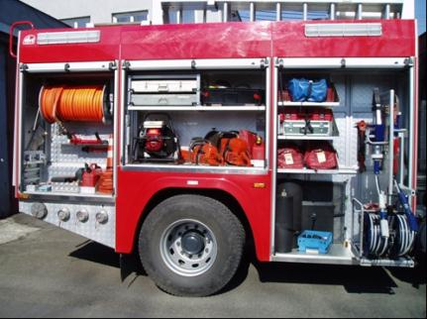
Examples of Fire Rescue Equipment to be delivered

Slide 13
Cooperation with SVI Praha in Bosina and Herzegovina
Project: Strengthening the capacity of veterinary laboratories and veterinary inspection services for implementation of National Residue Monitoring Program (NRMP) in accordance with EU standards
Implementation period: 2012-2013
Implementation partner: State Veterinary Institute
Budget: 1 947 000 CZK
Project goals:
capacity building and competencies of the institutions responsible for implementation of NRMP in BiH
Outcomes:
Increased capacity of Bosnian veterinary laboratories for analysis of residues in the NRMP
The introduction of new analytical methods for monitoring residues in BiH

Slide 14
Cooperation with Czech Geological Survey in Ethiopia
Project: Capacity building in environmental geology - mapping of geo-risk including hydrogeological condition in Dila and Hosaina areas
Implementation period: 4/2012 – 11/2014
Implementation partner: Czech Geological Survey
Budget: 15 mil. CZK
Project goals:
increasing the professional qualifications of GSE staff in field of engineering-geology
provide the material equipment needed for Geological Survey of Ethiopia in order to follow up the similar activities after the project termination
Outcomes:
methodology of studies and creation of geologic –hazard maps
publication of hydro-ecological terms glossary along with map of Asela list

Slide 15
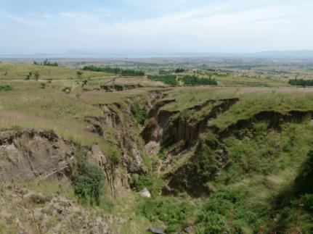
Examples of geological risks in Ethiopia (erosion)

Slide 16
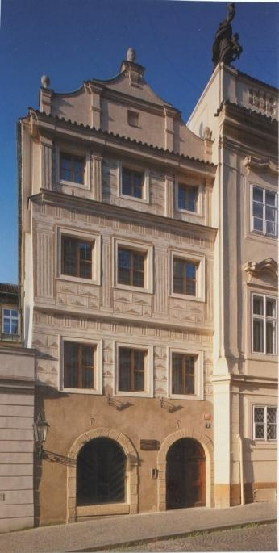
Thank You for Your Attention
Czech Development Agency
Nerudova 3
118 50 Praha 1
Tel.: +420 251 108 117
Fax: +420 251 108 225
naprstek@czda.cz, www.czda.cz

