Slide 1
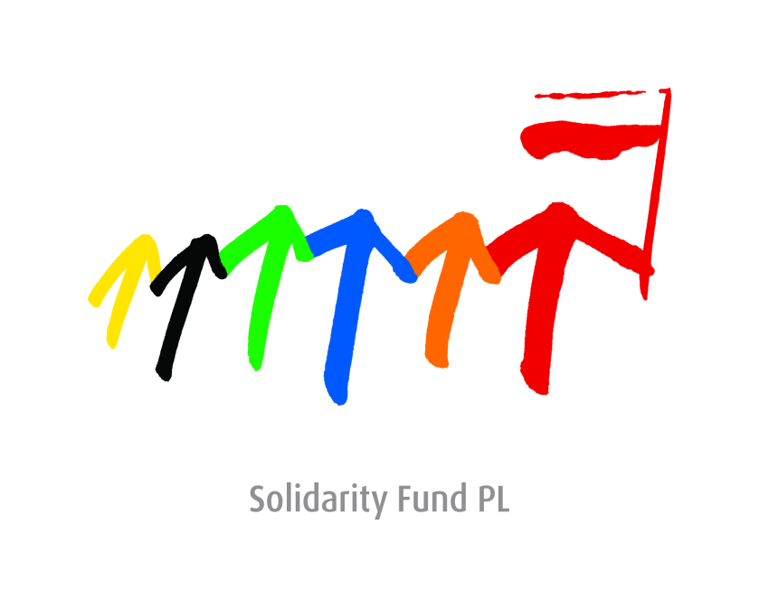

Slide 2
Solidarity Fund PL
Support for Democracy
Solidarity with engaged citizens
Polish democracy support and development
cooperation agency registered as a NGO
Established in 2001 – reconstructed in 2011 (Development Cooperation Act of 16 August 2011)
Bipartisan Council (Board of Directors) includes MP, other experts in the area of democracy support and development cooperation
Submits annual reports to the Sejm Foreign Affairs Committee and MFA

Slide 3
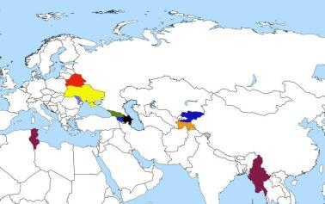
Geographical priorities
50 countries
Eastern Partnership
Tadjikistan, Kirgizstan
Tunisia,
Myanma

Slide 4
Solidarity Fund PL
€ 3,25 mln annual budget
in 2012 ~70 grants for crossborder projects (UA 31%, BY 24%)
The re-granting for NGOs:
an open grant competition for Polish NGOs’ initiatives in Belarus, Georgia, Moldova, Ukraine, Tunisia and Tajikistan.
flexible grant line which allows to react quickly to the changing political situation worldwide.
50 countries

Slide 5
Solidarity Fund PL
The Foundation pursues its objectives primarily through supporting and co-financing projects implemented by Polish non-governmental organizations. Solidarity Fund PL may also carry out its own activities.
„Privatisation and Private Entrepreneurship in Belarus“ seminar in the framework of „European Dialogue for Modernisation with Belarusian Society“
Poland-Tunisia – Support for the development of a civil society
Election observation missions in Georgia and Ukraine (OSCE/ODIHR observation mission) and International Civil Society Election Observation Mission of the parliamentary elections in Ukraine.
Information Center for Local Authorities in Moldova

Slide 6
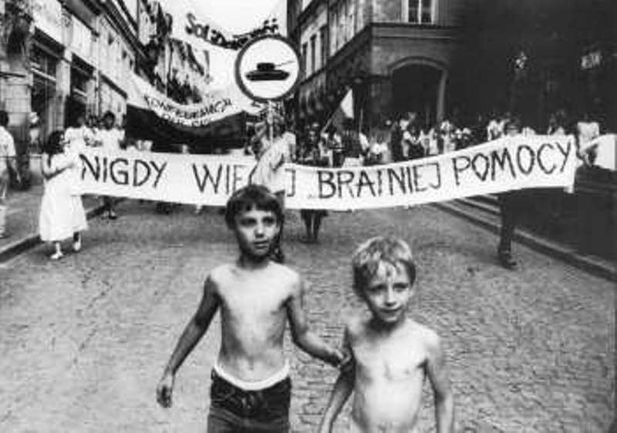
Fraternal aid
- never again

Slide 8
Belarus
€ 10 mln annualy
Independent media
(Belsat TV, ERB, Racja, printed press)
Konstanty Kalinowski Scholarship
Program for Belarusian Students
Support for civil society
(over 70 crossborder projects by Polish NGOs
Support for political prisoners
Support for Byelorussian NGOs in Poland
Initiatives within EU (Solidarity with Belarus, intelligent sanctions, Dialogue for Modernisation)

Slide 9
Areas of cooperation
Independent media
Support for engaged citizens CSO and local initiatives
Scholarship Program / Transformation Academy
Solidarity Library
Solidarity / Transformation Corp / Mentorship initiative

Slide 10
Areas of cooperation
Transformation Academy
The objectives:
to develop a team of BY leaders with knowledge and skills to plan and implement necessary reforms to achieve the modernization of Belarus,
to discuss reforms with Byelorussion society;
to establish network of practitioners volunteering to support partners in countries in transition;
to develope ICT tools to share transition experiences, list of transition experts,
enhancing institutional capacity of regional/local authorities, NGOs and other institutions involved in planning and implementation of regional/local development policy in Moldova.
increase the efficiency in the field of identification, preparation and assessment of the development projects at regional/local level.
nd fourth, because the Dialogue is perceived primarily as a process to share experience and formulate a vision of Belarus' future, the entire initiative should be employed as a vast platform for communication to as many stakeholders as possible, from European officials and experts to Belarusian NGO and government specialists. On the one hand, this exchange of opinions can become a solid first step towards building up confidence between the EU and Minsk; on the other hand, it can be used as a tool to communicate with the broader public in Belarus, who is still unaware of the European Dialogue.
Activities
30 days Academy
Internships in Germany, Poland…
On-line seminars with experts
Grant line to support local inititives to solve problems on community
Transitional justice

