Slide 1

TRUST FUND
AN EFFECTIVE TOOL FOR
ODA DELIVERY
Barbora Jungova
Czech-UNDP TF, UNDP BRC
barbora.jungova@undp.org
Zuzana Letkova
Slovak-UNDP TF, UNDP BRC
zuzana.letkova@undp.org

Slide 2
Czech and SLOVAK UNDP Trust Fund
Linked to New Partnerships (formerly Emerging Donors Initiative) regional programme as well as to UNDP country level programming
Activities has been implemented based on demand from UNDP Country offices.
Focus on systematic promotion of transitional experience of the Czech and Slovak Republics
Ensure thematic coherence of the supported activities with the bilateral Czech and Slovak ODA projects to achieve maximal efficiency and complementarity of the resources used.
UNDP BRC fully responsible for administration, programming, contracting, reporting and monitoring and evaluation of the TF contributions.

Slide 3
Czech-UNDP Trust Fund
Established in 2000 as the first example of such cooperation in Central Europe
Total contribution more than $6.4 million
Target countries: Balkan and CIS
Priority areas: good governance, environment protection, HIV prevention, socio-economic development
Forms of support: Study tours and workshops to Czech Republic, On-the-spot research, feasibility studies, individual consultations and participation of Czech experts on international projects, M&E

Slide 4
SLOVAK-UNDP TRUST FUND
Established in 2003
Largest partnership for bilateral development assistance mechanism
Total contribution $13,85 million donated (out of which 91% MFA SR)
Target countries: Central Asia, Mongolia and Afghanistan, Sub-Saharan Africa, Western Balkans, CIS
Forms of support: bi and trilateral development projects (~$11 mil.), development and global education, Slovak expertise, study tours to Slovakia, complex projects aimed at EU integration, M&E, ODA promotion and awareness raising, building ODA capacities, volunteering

Slide 5
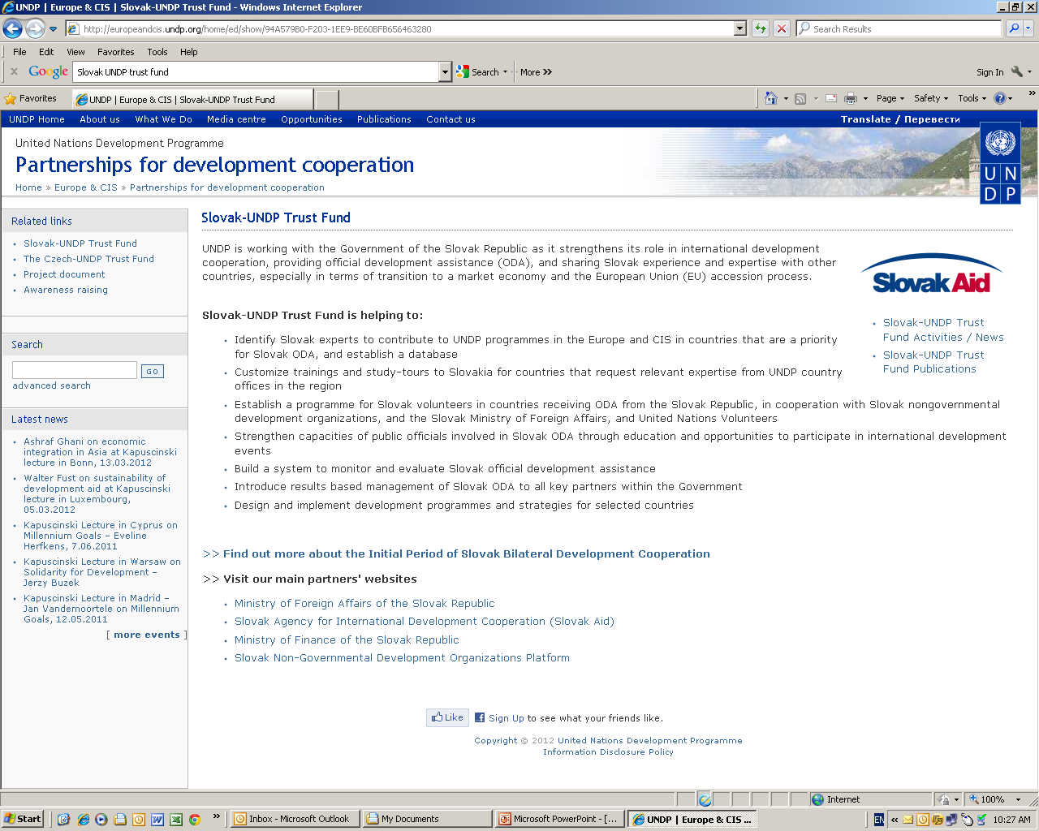
You can find more information on Slovak-UNDP Trust Fund’s Web page www.europeandicis.undp.org

Slide 6
Czech and SLOVAK UNDP Trust Fund
Current Goals
Strengthening programme support and cooperation with UNDP country offices in line with national (Czech and Slovak) ODA priorities
Sharing transitional experience
Development of new partnership modalities to strengthen national as well as target countries capacities

