Slide 1
PEFA in Latin America: the experience so far
EU Workshop
December 2012
PEFA Secretariat

Slide 2
Agenda
Introduction
PEFA in LAC
Repeat assessments
Country comparisons
Sub-national assessments

Slide 3
Agenda
Introduction
PEFA in LAC
Repeat assessments
Country comparisons
Sub-national assessments

Slide 4
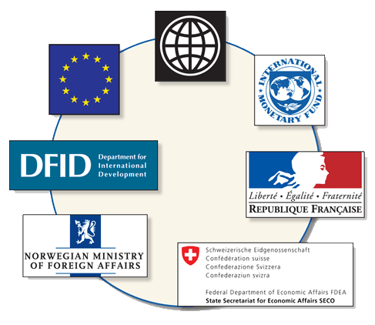
The PEFA Partners

Slide 5
Purpose of the PEFA Framework
The Framework provides:
a high level overview of all aspects of a country’s PFM systems performance (including revenue, expenditure, procurement, financial assets/ liabilities): are the tools in place to help deliver the 3 main budgetary outcomes? (aggregate fiscal discipline; strategic resource allocation; efficient service delivery)
It does not provide an assessment of :
underlying causes for good or poor performance i.e. the capacity factors
government fiscal & financial policies
Notes:
THE PURPOSE OF THIS PRESENTATION is to give you an insight into the content of the PFM Performance Measurement Framework, what it can measure, what it covers, how it measures PFM performance and how the results are presented in a report. On this basis you should be able to go on to the practical case study exercises in the next session, where you will apply the Framework
***************
The Framework measures performance by looking at the outputs from the PFM systems, but not the reasons behind performance such as institutional, organizational and human resource aspects of capacity. [It can be considered as an annual medical with your GP. It will point to weaknesses, some of which are easy to identify the cause of and remedies to, whereas other will need to be investigated by specialist who can then propose detailed measures]
The Framework does not assess the government’s fiscal and expenditure policies, but only the performance of the systems which the government needs in order to implement such policies.
It is intended to be widely applicable across countries with different levels of economic development. No reference to poverty reduction and poverty reducing expenditures because such concepts specifically related to HIPC countries and may not be used in many middle (and high) income countries (ref. testing of indicators in the UK and Norway).

Slide 6
What can countries use PEFA for?
Inform PFM reform formulation, priorities
Monitor results of reform efforts
Harmonize information needs for external agencies around a common assessment tool
Compare to and learn from peers

Slide 7
Adoption of the PEFA Framework
Very good progress – globally
290+ assessments, covering 130+ countries
Since 2010, mostly Repeat & Sub-National assessments
High country coverage in many regions
  Africa & Caribbean 90% of countries
  Latin America, Eastern Europe, Asia Pacific 50-80%
Used in many Middle Income countries
  Upper MICS: e.g. Brazil, Turkey, Belarus, South Africa
  Lower MICS: e.g. India, Kazakhstan, Ukraine, Morocco

Slide 8
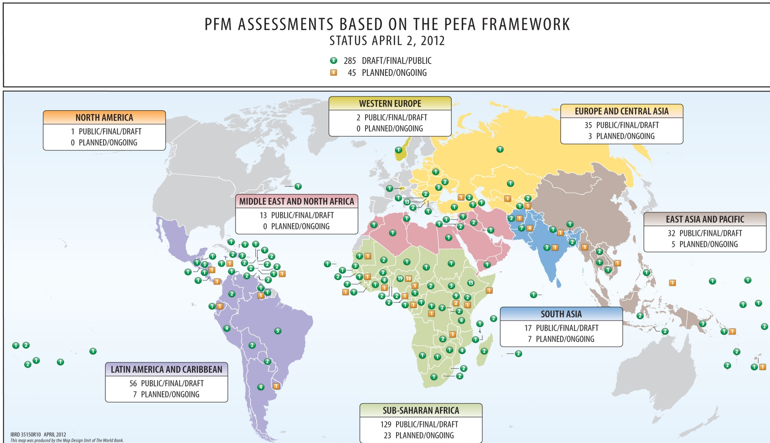
Global Roll-out of PEFA

Slide 9
PEFA assessments in LAC
2006 | 2007 | 2008 | 2009 | 2010 | 2011 | 2012
Barbados | Bolivia | Anguilla | Belize | Antigua & Barbuda | Bahamas | Turks & Caicos
Grenada | Dominica | Aruba | Bolivia | Barbados | Haiti
Honduras | Dominican Rep | Haiti | Brazil | Dominica | Honduras
Nicaragua | Guyana | Montserrat | Dominican Rep | Dominican Rep | Paraguay
St. Lucia | Jamaica | Paraguay | El Salvador | Ecuador
St. Vincent & Gren’s | St. Kitts & Nevis | Trinidad & Tobago | Honduras | Grenada
Trinidad & Tobago |  |  | Peru | Guatemala
 |  |  | St. Kitts & Nevis | Montserrat

Slide 10
Role of the Secretariat
Custodian of the Framework
Training: develops & shares training materials; selective delivery of training, mainly on a regional basis; supports training institutes
Supports PFM research: database of indicators
Dissemination: presentations; PFM blogs; PEFA Newsflashes; sharing PEFA assessment reports through website
Monitoring: Semi-annual updates of PEFA assessment status list; periodic monitoring reports; ad hoc surveys
Promotes harmonization in assessment of PFM systems
Notes:
The first change to Framework was issued January 2011 – three indicators revised
Clarification on the indicators are issued periodically.
Quality review is a core function.
Secretariat has limited capacity to deliver training. But often supporting others – e.g. co-facilitating
More than 100 assessment reports are linked to the PEFA website by hyperlinks. No direct posting because the secretariat does not own any of the reports.

Slide 11
PEFA Secretariat Quality Review
On request, free of charge, rapid feedback (10 days) for CNs/ToRs & Assessment Reports
Issues “PEFA Check” – process certification
Appraises adequacy of background info & application of performance indicators: correctly interpreted, sufficient evidence, correct scoring method?
Considers whether summary assessment brings out clear message, consistent with indicator analysis
Follow-up review – evaluates responses

Slide 12
Agenda
Introduction
PEFA in LAC
Repeat assessments
Country comparisons
Sub-national assessments

Slide 13
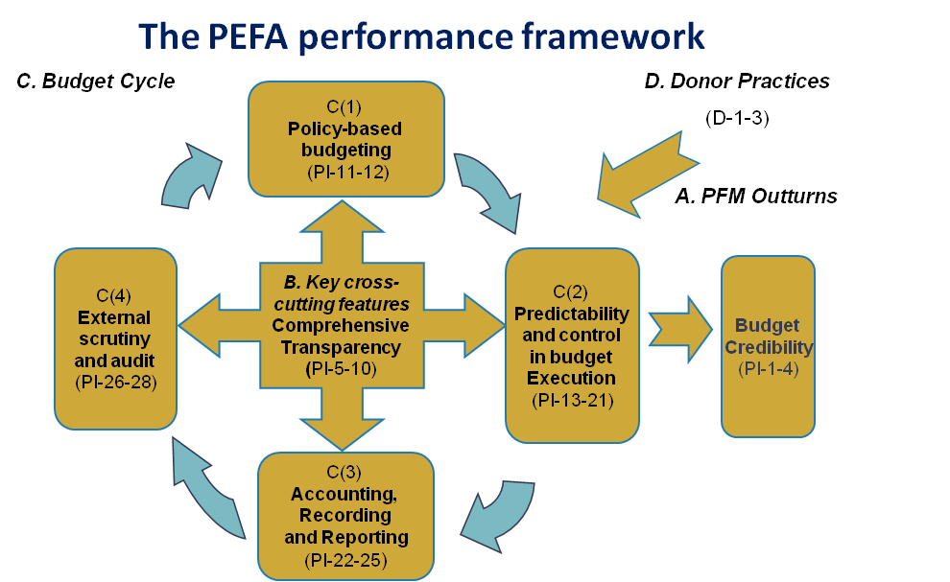
Structure of the indicator set
Notes:
This is a another way to look at the six dimensions of the indicator set. It illustrates how a budget cycle might work:
Starting with policy based budget – plans should reflect priorities/ policies of government.
Having got this the budget then needs to be executed in a predictable fashion – the best budget in the world is of no use if it cannot be executed
Similarly accounting and reporting is essential so as to inform progress in execution of the budget
External audit and scrutiny not just for ensuring integrity but also to provide feedback to policy makers on the success or otherwise of policies – this requires more than just looking at the numbers
Across all of these are comprehensiveness and transparecny – has everything been captured ?
Budget credibility indicators reflect outputs of the system as a result of the institutional and more qualitative assessment covered by the remainder of the indicator set. Understanding links between the institutional strengths/weaknesses and budget credibility is important for summarizing the assessment.
Similar for donor indicator ratings’ relations to government performance and budget credibility.
See the list of indicators on page 9 of the English/blue booklet.

Slide 14
PEFA assessments in LAC
2006 | 2007 | 2008 | 2009 | 2010 | 2011 | 2012
Barbados | Bolivia | Anguilla | Belize | Antigua & Barbuda | Bahamas | Turks & Caicos
Grenada | Dominica | Aruba | Bolivia | Barbados | Haiti
Honduras | Dominican Rep | Haiti | Brazil | Dominica | Honduras
Nicaragua | Guyana | Montserrat | Dominican Rep | Dominican Rep | Paraguay
St. Lucia | Jamaica | Paraguay | El Salvador | Ecuador
St. Vincent & Gren’s | St. Kitts & Nevis | Trinidad & Tobago | Honduras | Grenada
Trinidad & Tobago |  |  | Peru | Guatemala
 |  |  | St. Kitts & Nevis | Montserrat

Slide 15
LA: Credibility of the budget: PFM out-turns (1 – 4)
% | A | B+, B | C+, C | D+, D | NS
PI-1 | 27% | 36% | 25% | 11% | 0%
PI-2 | 25% | 20% | 41% | 14% | 0%
PI-3 | 77% | 11% | 5% | 7% | 0%
PI-4 | 14% | 39% | 16% | 14% | 16%

Slide 16
LA: Comprehensiveness & transparency (5 – 10)
% | A | B+, B | C+, C | D+, D | NS
PI-5 | 20% | 34% | 39% | 7% | 0%
PI-6 | 36% | 20% | 43% | 0% | 0%
PI-7 | 27% | 20% | 14% | 25% | 14%
PI-8 | 11% | 18% | 30% | 14% | 11%
PI-9 | 9% | 7% | 41% | 39% | 9%
PI-10 | 16% | 41% | 34% | 9% | 0%

Slide 17
LA: Policy-based budgeting (11-12)
% | A | B+, B | C+, C | D+, D | NS
PI-11 | 25% | 36% | 23% | 16% | 0%
PI-12 | 0% | 16% | 52% | 32% | 0%

Slide 18
LA: Predictability & control in budget execution (13 – 21)
% | A | B+, B | C+, C | D+, D | NS
PI-13 | 25% | 52% | 18% | 0% | 7%
PI-14 | 9% | 36% | 36% | 14% | 7%
PI-15 | 16% | 16% | 7% | 50% | 16%
PI-16 | 11% | 18% | 41% | 30% | 0%
PI-17 | 20% | 64% | 11% | 5% | 0%
PI-18 | 9% | 32% | 27% | 30% | 5%
PI-19 | 0% | 23% | 27% | 43% | 11%
PI-20 | 5% | 18% | 39% | 34% | 5%
PI-21 | 2% | 0% | 41% | 52% | 5%

Slide 19
LA: Accounting, recording & reporting (22 – 25)
% | A | B+, B | C+, C | D+, D | NS
PI-22 | 11% | 36% | 25% | 20% | 7%
PI-23 | 14% | 20% | 9% | 50% | 7%
PI-24 | 14% | 30% | 39% | 18% | 0%
PI-25 | 11% | 11% | 32% | 45% | 0%

Slide 20
LA: External scrutiny & audit (26-28)
% | A | B+, B | C+, C | D+, D | NS
PI-26 | 0% | 16% | 25% | 57% | 2%
PI-27 | 9% | 11% | 32% | 43% | 5%
PI-28 | 0% | 0% | 11% | 84% | 7%

Slide 21
LA: Indicators of donor practices (D1-3)
% | A | B+, B | C+, C | D+, D | NS
D-1 | 14% | 7% | 11% | 27% | 43%
D-2 | 9% | 5% | 16% | 48% | 22%
D-3 | 5% | 2% | 18% | 50% | 25%

Slide 22
PEFAs in LAC suggest that....
Dimension | Overview | Relevant concerns
Credibility | Reasonable | Composition
Com’hensiveness | Mixed | Fiscal risks (EBFs SNGs)
Policy-based | Very weak | Forward links
Predictability | Weak | Predictability; Procurement & Payroll; Internal control, IA
Accounting | Improving | PI-23; Financial Statements
Oversight | Very weak | SAI independence; PAC; Follow-up

Slide 23
In conclusion...........
(PFM not end in itself: SD is what matters)
PEFA is country tool (Strengthened Approach!)
Frequency of use
Publication rate 35% (!)
‘Repeat assessments’ demonstrate changes in performance (result of reform efforts?) but improvements often form not function
Weak ‘Summary Assessments’
(Lost?) Opportunities for peer learning

Slide 24
Agenda
Introduction
PEFA in LAC
Repeat assessments
Country comparisons
Sub-national assessments

Slide 25
Repeat Assessments
At March 2012, 70+ repeat assessments undertaken: 5 underway & many more planned over next year or so
Expected to continue to increase i.e. 3-4 years after baseline assessment

Slide 26
What do we want to determine?
Specific changes in system performance
What has changed?
How much?
Indicator scores will provide a crude overview of changes over time, but:
Dimensions may change differently
Performance may not always change enough to change the score (use of arrow)
So more detailed explanation required

Slide 27
Non-performance reasons why scores may change
Changes in definitions
Improved availability of or access to information
Different sampling
Different interpretation in borderline cases
Scoring methodology mistakes in previous assessment

Slide 28
If assessors find issues ...
Avoid temptation to re-rate previous assessment
Explain that:
present & previous ratings are not comparable, & why
different view in previous assessment may have influenced conclusions about direction

Slide 29
Reporting on progress made
Explain all factors that impact a change in rating indicator-by-indicator
Identify the performance change
Ensure that any reader can track the change from the previous assessment – what performance change led to the change in a rating

Slide 30
Explain changes
PI | Score 2006 | Score 2010 | Performance change | Other factors
PI-1 | C | B | Performance appears improved based on 2006: last deviations 6%, 11%, 18%, 2010: 5%, 11%, 6% | Not clear if all external project funds excluded from 2006 data but may not be significant
PI-4 (i) | A | C | May not be worse, despite reported arrears increase from 1% in 2006 to 6% in 2010. | 2006 assessment used data on pending payment orders only, not overdue invoices

Slide 31
Agenda
Introduction
PEFA in LAC
Repeat assessments
Country comparisons
Sub-national assessments

Slide 32
Country Comparisons
PEFA Framework was developed to measure progress over time in one country – not for Country Comparisons
‘Summary assessment’ to provide nuanced overview of strengths & weaknesses as basis for reform prioritization
No method to derive measure for ‘overall performance’
No attempts to create global performance list
But:
demand from Governments, Researchers & Donors

Slide 33
Country data and how to use it
Comparison of two countries must be done very cautiously:
Resembles comparison of assessments over time in one country but more complex
Technical definitions may be different
Need to carefully read each report to understand performance differences behind the scores
Consider country context, ensure comparison of like with like
Comparing scores alone can be misleading

Slide 34
Comparing groups of countries
Aggregation may be desirable: requires 3 decisions:
Conversion from ordinal to numerical scale
Weighting of indicators (generally & by country)
Weighting of countries (for country cluster analysis)
No scientifically correct/superior basis for conversion/weighting
Each user takes those decision on individual opinion
If aggregation is desired:
Be transparent on method used & discuss reasons
Sensitivity analysis to illustrate impact on findings

Slide 35
Agenda
Introduction
PEFA in LAC
Repeat assessments
Country comparisons
Sub-national assessments

Slide 36
Sub-National Assessments
Political & Admin Decentralization:
accountability; oversight
Fiscal decentralization:
Service obligations / Expenditure assignments (Central: typically, defense; SNG: typically, primary services, e.g. health) but some services split between levels of govt: also, parallel structures
Financing
Revenue assignments (often not called ‘tax’ even if it is)
Shared revenue – collected by central or SN govt
Grants from higher level government
Borrowing

Slide 37
Structural Models
Almost every country has unique structure, determined by historical/political circumstances
Variations may relate to:
  Federal vs Unitary states
  Symmetrical vs Asymmetrical federalism
  Federal units covering all vs part of a country
  Francophone vs Anglophone decentralization
Notes:
Federation – a union comprising a number of partially self-governing states (or regions or provinces or cantons) united by a central/federal government. These states typically have their own constitutions which can be amended without recourse to the federation.
Semi-autonomous states may cover all or only part of a country
Symmetrical federalism – all entities have same status versus Asymmetrical
Examples of Asymmetrical federalism – England, Scotland, Wales and Northern Ireland within the UK.
Mainland (Tanganyika) and Zanzibar within Tanzania
Part of country not covered by federal units - DC is not a state within the USA federation
Anglophone decentralisation – elected local governments mainly accountable to the local electorate
Francophone decentralisation – provincial government units governed by officials appointed by central government, mainly accountable to central government – “central government at the local level”

Slide 38
Definition of Sub-National Gov’t
GFS manual: “to be treated as institutional units, they must be entitled to own assets, raise funds, and incur liabilities by borrowing on their own account. They must also have some discretion over how such funds are spent, and should be able to appoint their own officers independently of external administrative control.”
PEFA follows this definition except for the ability to borrow on own account
Notes:
Borrowing on own account is too restrictive and would exclude many significant sub-national government units which are barred by law from borrowing (but may in practice borrow by running unauthorized overdrafts, issuing IOUs or simply build up payment arrears).

Slide 39
Purpose of assessment: adaptation
Two types of SN Assessments
One SN entity - Primary Purpose: inform entity’s reform formulation & track progress: unrelated to national assessment: Resource inputs high
Sample of entities - Primary Purpose: inform national reform formulation & donor fiduciary needs: related to national assessment: Resource inputs are lower for each entity, but high in total
For use at SN level, modifications needed to
Indicator set
Performance report

Slide 40
Modifications to PIs
Additional indicator required: HLG-1 3 dims:
Annual deviation of actual total HLG transfers from original total estimated amount provided by HLG to SN entity for inclusion in latter’s budget
Annual variance between actual & estimated transfers of earmarked grants
In-year timeliness of transfers from HLG (compliance with timetables for in-year distribution)
Audit & Legislature PIs need careful consideration to distinguish national/local oversight, & terminology aligned with local institutions

Slide 41
Modifications to PFM-PR
Essential to include careful description of :
Structure of general government, its levels & entities
Legal & regulatory framework for SN government
Intergovernmental relationship such as transfers, expenditure assignments and borrowing powers
Institutional framework/structures at SN level
Exact coverage of the SN level assessment

Slide 42
LAC SN: Credibility of the budget: PFM out-turns (1 – 4)
% | A | B+, B | C+, C | D+, D | NS
PI-1 | 17% | 25% | 25% | 33% | 0%
PI-2 | 17% | 17% | 0% | 33% | 33%
PI-3 | 33% | 17% | 0% | 17% | 33%
PI-4 | 8% | 8% | 75% | 8% | 0%

Slide 43
LAC SN: Comprehensiveness & transparency (5 – 10)
% | A | B+, B | C+, C | D+, D | NS
PI-5 | 75% | 8% | 17% | 0% | 0%
PI-6 | 58% | 17% | 0% | 25% | 0%
PI-7 | 75% | 17% | 8% | 0% | 0%
PI-8 | 42% | 0% | 25% | 0% | 33%
PI-9 | 8% | 8% | 33% | 25% | 25%
PI-10 | 17% | 50% | 33% | 0% | 0%

Slide 44
LAC SN: Policy-based budgeting (11-12)
% | A | B+, B | C+, C | D+, D | NS
PI-11 | 33% | 50% | 17% | 0% | 0%
PI-12 | 8% | 0% | 50% | 42% | 0%

Slide 45
LAC SN: Predictability & control in budget execution (13 – 21)
% | A | B+, B | C+, C | D+, D | NS
PI-13 | 8% | 33% | 0% | 0% | 58%
PI-14 | 8% | 33% | 0% | 0% | 58%
PI-15 | 0% | 8% | 0% | 33% | 58%
PI-16 | 8% | 33% | 25% | 33% | 0%
PI-17 | 17% | 83% | 0% | 0% | 0%
PI-18 | 8% | 0% | 92% | 0% | 0%
PI-19 | 8% | 33% | 25% | 0% | 33%
PI-20 | 8% | 33% | 42% | 17% | 0%
PI-21 | 8% | 0% | 42% | 50% | 0%

Slide 46
LAC SN: Accounting, recording & reporting (22 – 25)
% | A | B+, B | C+, C | D+, D | NS
PI-22 | 25% | 58% | 17% | 0% | 0%
PI-23 | 8% | 25% | 33% | 33% | 0%
PI-24 | 33% | 58% | 8% | 0% | 0%
PI-25 | 50% | 8% | 33% | 8% | 0%

Slide 47
LAC SN: External scrutiny & audit (26-28)
% | A | B+, B | C+, C | D+, D | NS
PI-26 | 0% | 33% | 42% | 25% | 0%
PI-27 | 25% | 8% | 8% | 25% | 33%
PI-28 | 0% | 25% | 8% | 33% | 33%

Slide 48
LAC SN: Indicators of donor practices (D1-3) & HLG-1
% | A | B+, B | C+, C | D+, D | NS
D-1 | 0% | 0% | 0% | 0% | 100%
D-2 | 0% | 0% | 0% | 17% | 83%
D-3 | 0% | 0% | 0% | 25% | 75%
HLG-1 | 0% | 0% | 8% | 17% | 75%

Slide 49
SN PEFA in LAC suggest that.....
Dimension | Overview | Relevant concerns
Credibility | Mixed | Arrears
Com’hensiveness | Reasonable
Policy-based | Weak | Forward links
Predictability | Weak | (no scores); Payroll; internal control & audit
Accounting | Mixed
Oversight | Weak
Donors/HLG-1 | Very weak | Transfers

Slide 50
Observations on SN assessments
Difficulties in making appropriate distinction between national & sub-national performance features
Indicator HLG-1 not included
Problems with scope of revenue indicators
Misunderstanding scope of PI-8 & PI-9(ii)
Local assessors/consultants with no prior PEFA experience

Slide 51
Thank you for your attention

