Slide 1
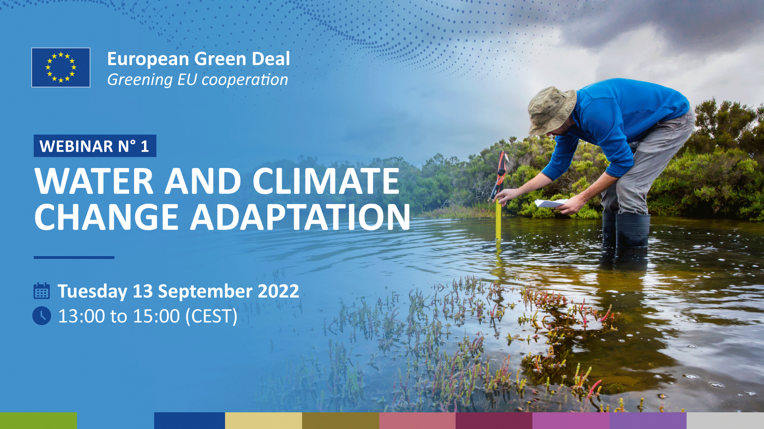
Facilitators : Murray Biedler
NDC and EU Water Facilities
Notes:
Purpose: Present yourself & tell audience what you will tell them
Thank you so much for giving me the word, Murray. My name is Martin Obermaier, I am with the EU NDC Facility which supports the INTPA F1 unit. I am here together with my colleague Philippe Chabot.
We continue the presentation with a short “setting the scene” of the linkages between water, climate change, and sustainability, and the applicable international, EU, and national adaptation frameworks in that context.

Slide 2
Series of webinars N°6: European Green Deal - Greening EU cooperation
WATER AND CLIMATE
CHANGE ADAPTATION
Facilitators : Murray Biedler
NDC and EU Water Facilities
13 September 2022

Slide 3
Agenda
Intro
Background on Water and Climate Change, Policy Frameworks
Case Study 1 EUD Lesotho with Q&A
Case Study 2 EUD Nepal with Q&A
Case Study 3 UNEP/Wetlands International Indonesia with Q&A
Survey for EUDs and Evaluation
Closing

Slide 4
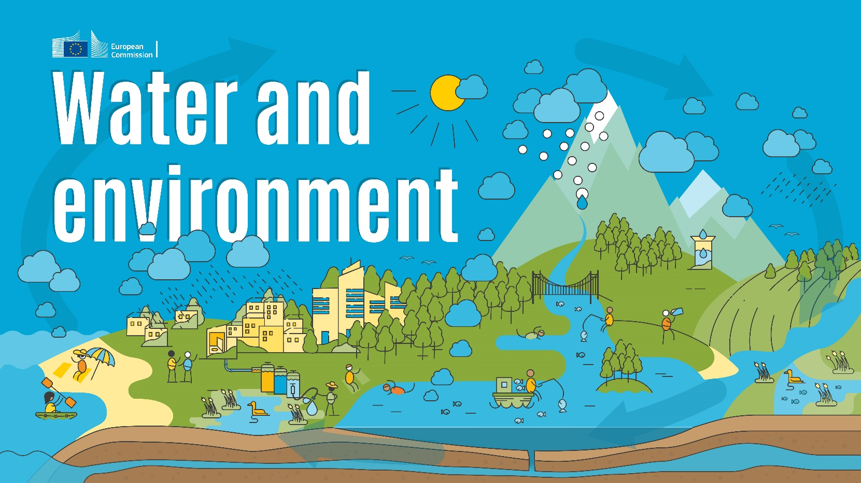
Water Situation The Cycle: Major Shifts
Water fluxes in human systems (thousand km³ per year).
Green water use 19±20%
Industrial water withdrawal 0.8±11%
Irrigation from surface water 1.9±6%
Municipal water withdrawal 0.4±12%
Irrigation from ground water 0.6±17%

Slide 5
Water Situation Infrastructure: Urgent Needs
Acceleration required to meet WASH SDG targets by 2030. Source: WHO/UNICEF JMP (2021)

Slide 6
Background on CCA and DRR
Most of the increasing impacts are water-related
  Ecosystems degradation
  GDP loss
  More frequent and extreme hydrometeorological hazards/events (esp. floods, heat/cold waves & droughts)
LDCs, SIDSs are the most vulnerable
  SDG 2 “Zero Hunger”
  SDG 6 “Clean Water and Sanitation”
  SDG 13 “Climate Action”
  SDG 14 “Life below water”
Notes:
Water is a key component for reaching the SDGs. Water is also heavily affected by increasing climate impact. Climate adaptation, therefore, needs to be integrated into water policy and practice at all levels, especially in LDCs and SIDs who are most vulnerable.
Brief recap about climate change and water, using latest IPCC AR6 report, and present applicable UN frameworks on climate change and sustainability.

Slide 7
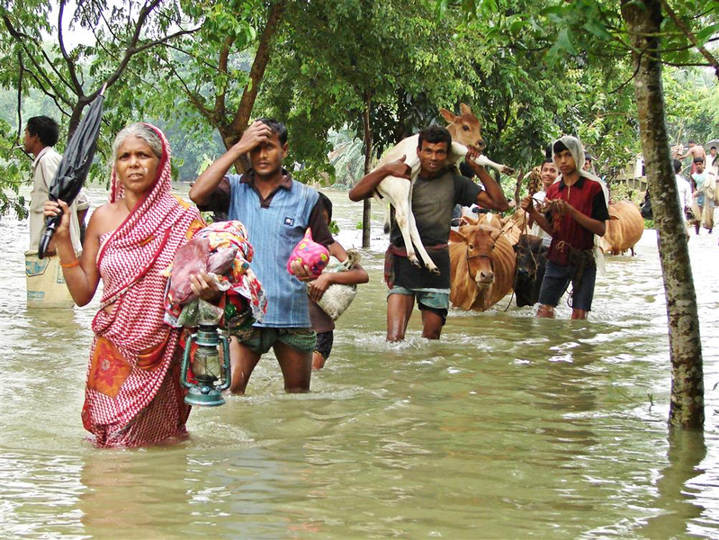
Most of the increasing impacts are water-related
800 million to 4 billion people at increased water insecurity by 2100 (IPCC, 2022)
Up to 14% GDP loss by 2050 due to water-related CC (IPCC, 2022)
In last 50 years extreme floods cause US$ 1.1 trillion economic losses and 330,389 deaths (WMO, 2021)
Notes:
Ecosystem degradation:
CC and changes in land use and water pollution are key drivers of loss and degradation of freshwater ecosystems (high confidence). In addition, precipitation and extreme weather events are linked to increased incidence and outbreaks of water-related diseases (high confidence).
Changes in water-related hazards disproportionately impact vulnerable populations such as the poor, women, children, Indigenous Peoples and the elderly in all locations, especially in the Global South, due to systemic inequities stemming from historical, socioeconomic and political marginalization.
Some 4 billion people are estimated to experience severe water scarcity.
800 million to 4 billion people at increased water insecurity by 2100
Floods are critical climate hazards identified in the adaptation components of NDCs (85 out of 137 countries for floods).
Water security is the availability of adequate and reliable water resources of acceptable quality to provide water services for all livelihood, social, and environmental activities and to maintain a
functioning water platform for growth, coupled with an acceptable level of water-related risks such as floods, droughts, and pollution to people, the environment, and economies. Water security also encompasses the ability and capacity to access (financially, socially, and legally) and use water, including in situations where there are shared waters (GWP, 2014).
The Asian Water Development Outlook (ADB and APWF, 2016) sets out five interdependent key dimensions of water security that are globally applicable:
◼ household water security – providing all people with reliable, safe water and sanitation services
◼ economic water security – the productive use of water to sustain economic growth in food production, industry, and energy sectors of the economy
◼ urban water security – creation of better water management and services to support vibrant and liveable water-sensitive cities
◼ environmental water security – supporting the health of rivers, wetlands, and freshwater ecosystems
◼ resilience to water-related disasters – resilient communities that can adapt to change and reduce risk from water-related natural disasters.

Slide 8
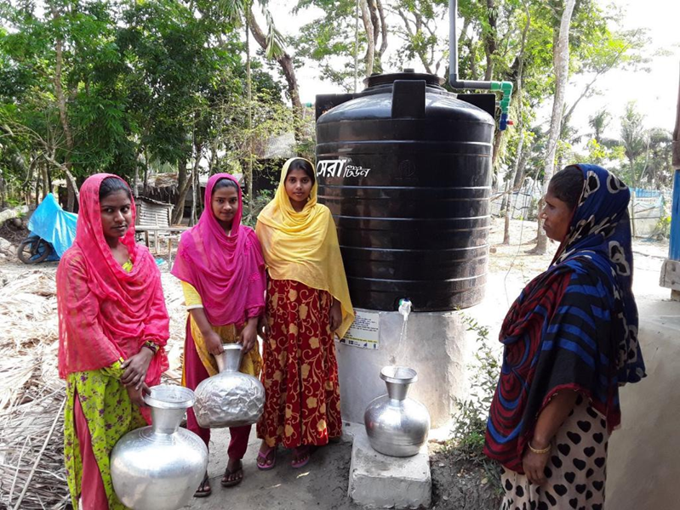
LDCs, SIDSs are the most vulnerable
SDG 2 “Zero Hunger” acute food insecurity and malnutrition under CC
SDG 6 “Clean Water and Sanitation”
SDG 13 “Climate Action”
SDG 14 “Life Below Water” healthy oceans as heat and carbon sinks, but acidification impacts fishery and livelihoods
Notes:
720 to 811 million people face hunger, & undernourishment climbs to 9.9% during COVID-19 CC to cause acute food insecurity and malnutrition as food production drops off in LMICs
Food production requires quality and availability of water, because boosting agricultural production can increase water withdrawals and worsen land and water degradation. Moreover, achieving nutrition targets requires access to clean water and sanitation.
77 percent of small-scale farms across LMICs are located in water-scarce regions, while only 37 percent have access to irrigation.

Slide 9
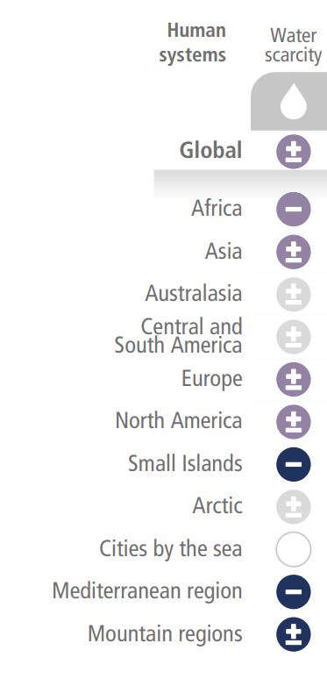
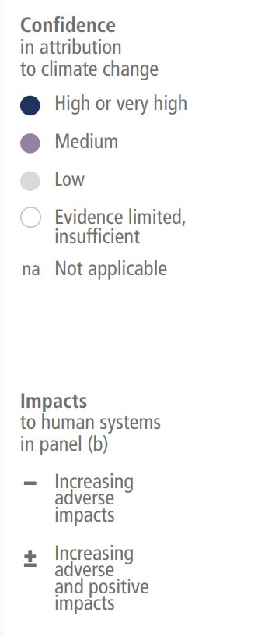
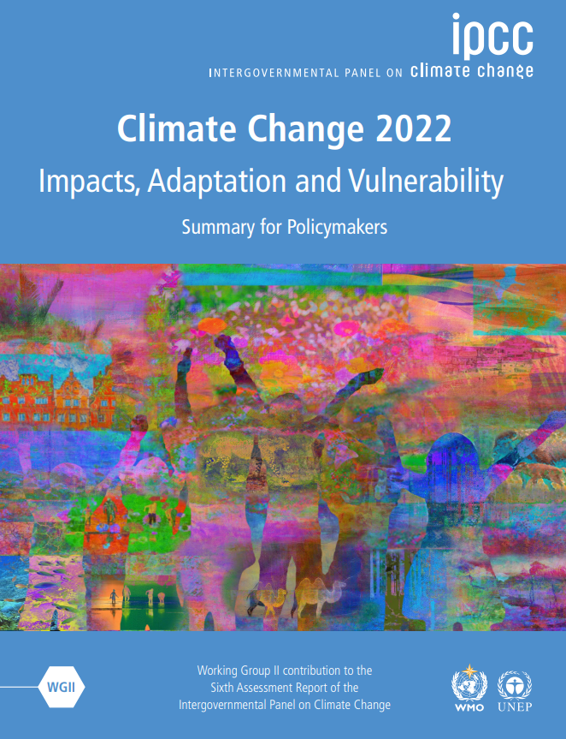
Observed climate impacts on water scarcity
Notes:
Ecosystem degradation:
CC and changes in land use and water pollution are key drivers of loss and degradation of freshwater ecosystems (high confidence). In addition, precipitation and extreme weather events are linked to increased incidence and outbreaks of water-related diseases (high confidence).
Changes in water-related hazards disproportionately impact vulnerable populations such as the poor, women, children, Indigenous Peoples and the elderly in all locations, especially in the Global South, due to systemic inequities stemming from historical, socioeconomic and political marginalization.
Some 4 billion people are estimated to experience severe water scarcity.
800 million to 4 billion people at increased water insecurity by 2100
Floods are critical climate hazards identified in the adaptation components of NDCs (85 out of 137 countries for floods).
Water security is the availability of adequate and reliable water resources of acceptable quality to provide water services for all livelihood, social, and environmental activities and to maintain a
functioning water platform for growth, coupled with an acceptable level of water-related risks such as floods, droughts, and pollution to people, the environment, and economies. Water security also encompasses the ability and capacity to access (financially, socially, and legally) and use water, including in situations where there are shared waters (GWP, 2014).
The Asian Water Development Outlook (ADB and APWF, 2016) sets out five interdependent key dimensions of water security that are globally applicable:
◼ household water security – providing all people with reliable, safe water and sanitation services
◼ economic water security – the productive use of water to sustain economic growth in food production, industry, and energy sectors of the economy
◼ urban water security – creation of better water management and services to support vibrant and liveable water-sensitive cities
◼ environmental water security – supporting the health of rivers, wetlands, and freshwater ecosystems
◼ resilience to water-related disasters – resilient communities that can adapt to change and reduce risk from water-related natural disasters.

Slide 10
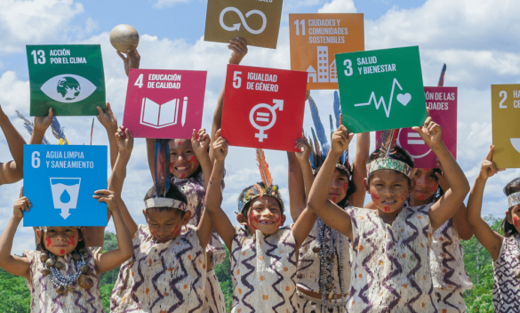
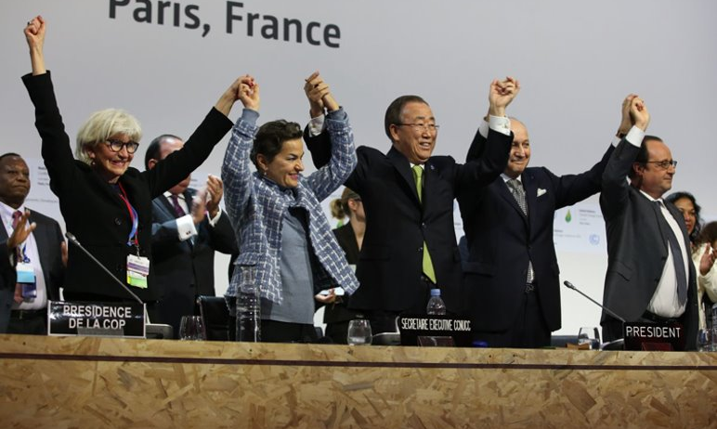
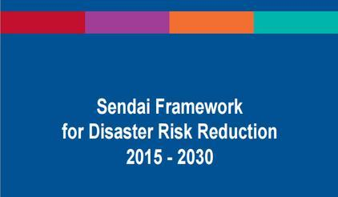

UN Frameworks
Agenda 2030 – SDGs
Paris Agreement on Climate Change
Sendai Framework for DRR 2015-2030
Post-2020 Global Biodiversity Framework

Slide 11
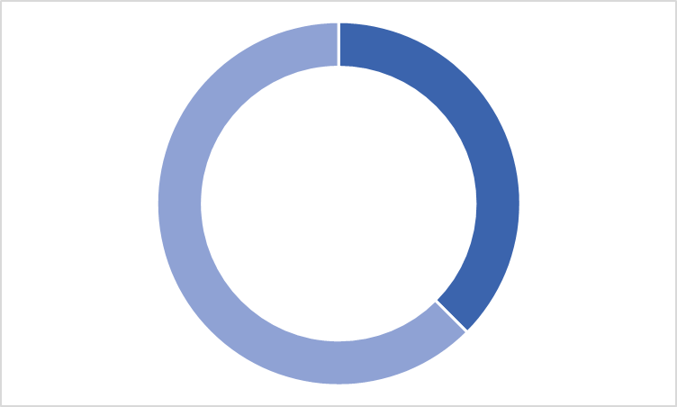
UN Frameworks
NDCs identify
water as CCA/DRR
priority
NAPs & Sendai Framework promote integration of water and CCA/DRR
CCA/DRR and water
NAPs/Sendai
60 %

Slide 12
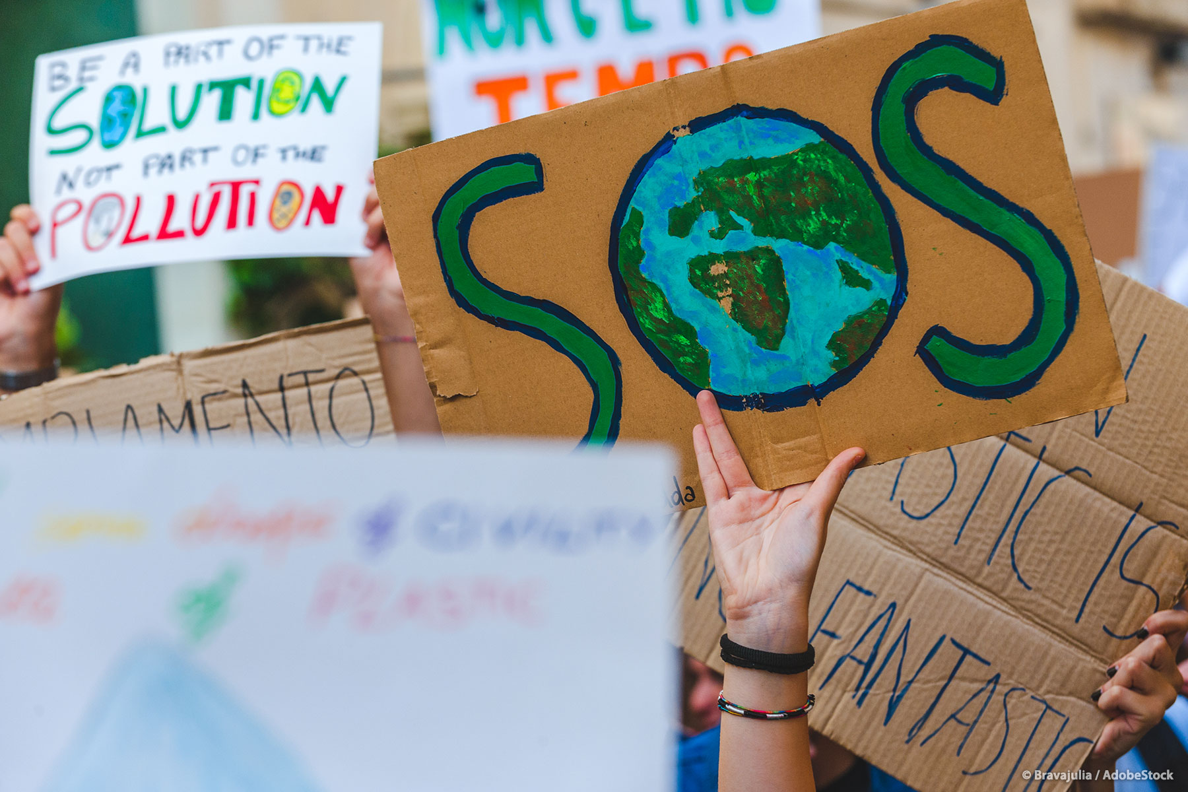
EU Green Deal
EU responses to climate change
A road map to become carbon-neutral continent by 2050
EU Adaptation Strategy (2021) as part of European Green Deal
Notes:
The EU is committed to radically cutting emissions by 2030 and becoming climate-neutral by 2050. However, the locked in impacts of past emissions mean we cannot ignore the adaptation challenge.
The EU has already taken action to boost its resilience over the past years. All Member States now have a national adaptation strategy or plan; adaptation has been mainstreamed into the EU’s policies and long-term budget.
The EU adopted its new EU Adaptation Strategy in February 2021. The strategy is a key part of the European Green Deal and it aims to realise the 2050 vision of a climate-resilient Union by making adaptation smarter, more systemic, swifter, and by stepping up international action.

Slide 13
EU Adaptation Strategy (February 2021)
Smarter adaptation by improving knowledge and managing uncertainty
More systemic adaptation through mainstreaming into all policy fields
Faster adaptation and more comprehensive adaption to manage climate risk
Stepping up international action for climate resilience through scaling up international finance and exchanges
Notes:
The EU is committed to radically cutting emissions by 2030 and becoming climate-neutral by 2050. However, the locked in impacts of past emissions mean we cannot ignore the adaptation challenge.
The EU has already taken action to boost its resilience over the past years. All Member States now have a national adaptation strategy or plan; adaptation has been mainstreamed into the EU’s policies and long-term budget.
The EU adopted its new EU Adaptation Strategy in February 2021. The strategy is a key part of the European Green Deal and it aims to realise the 2050 vision of a climate-resilient Union by making adaptation smarter, more systemic, swifter, and by stepping up international action.

Slide 14

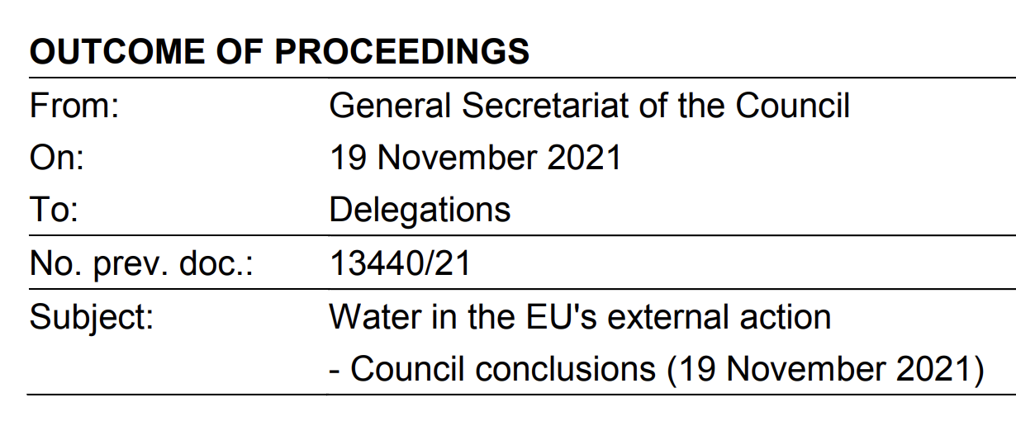
Council Conclusions on Water
Articles 1, 6, 9, 13 'The Council stresses that water actions need to be better integrated into the EU’s external action and finance in the field of climate change mitigation and adaptation, as well as through the Sendai Framework for Disaster Risk Reduction and preparedness.'

Slide 15
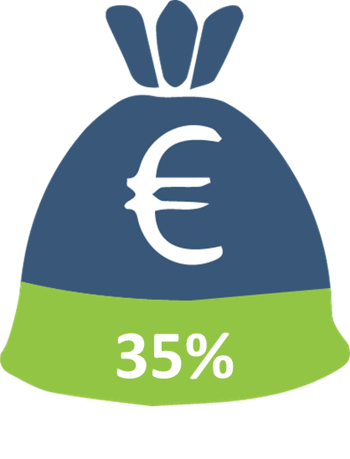

EU international climate finance (2021-2027): targets and commitments
+
=
30%
€4 bn
NDICI Regulation
SOTEU 2021
of NDICI envelope

Slide 16
EU INTPA & NEAR – CCA/DRR & Water Emerging Priorities
Improving comprehensive climate & disaster risk analyses/assessments, data/information sharing and multi-hazard early warning systems
Ensuring climate proofing of infrastructure
Increasing availability and sustainable use of freshwater
Combating droughts and floods
Enhancing coastal resilience and ocean governance
Increasing access to climate finance and disaster risk financing/transfer
MIP
2021-2027
AAP
2021-2022
AD
Rio Markers

