Slide 1


Water and Climate Change Webinar
Delegation of the European Union to Nepal
13 September 2022

Slide 2
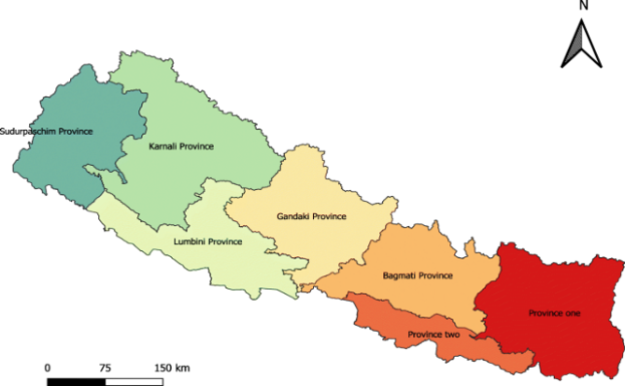
Context
Water and Sanitation
Water supply coverage has improved (91% of the population has access to basic water supply)
Challenges
Poor maintenance
Poor functionality
Poor water quality
Sanitation has improved (ODF declared country country-wide on 30/09/19; 94% of population has access to improved sanitation facilities)
Challenges
ODF slippage
Limited safely managed sanitation services.
Insufficient facilities in schools (separate toilets, menstrual hygiene management).

Slide 3
Context
Key info on Climate Change
High vulnerability to climate change
• Nepal in top 10 most affected countries.
• Warming is projected to be higher than the global average
• Number of people affected by floods could more than double by 2030.
Already significant impact
• Soil erosion, landslides, flash floods, and droughts more frequest.
• Species’ ranges shifting to higher altitudes, glaciers are melting, extreme precipitations increasing.
• Sectors most at risk: energy, agriculture, water resources, forestry and health.

Slide 4
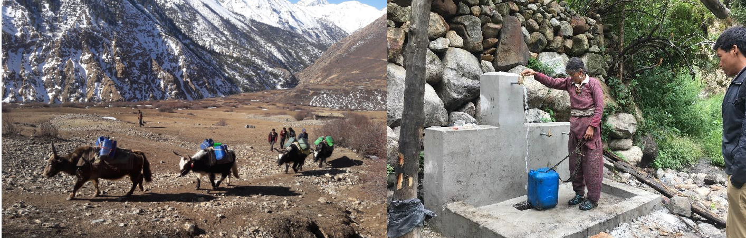
Rural Village Water Resources Management Project
Three Phases
Phase 1: 2006 to 2010. EUR 14m (83% Finland).
Phase 2: 2010 to 2016, EUR 26m (59% Finland).
Phase 3: 2016 to 2022. EU joins. EUR 70m (51% EU + Finland).

Slide 5
Evolution of result areas
Phase 1 (2006-2010) | Phase 2 (2010-2016) | Phase 3 (2016-2022
Institutional Capacity for water resources management at local level (Water Use Master Plan) | Institutional Capacity local administration for WASH and livelihood. | Community managed drinking water, sanitation, and hygiene.
Improving water services (drinking, sanitation, irrigation, energy) | Capacity of community to construct and maintain water infrastructure | Water resources-based livelihood development
Pilots on livelihood and cooperatives | Natural resources based livelihoods development | Resilience to disaster and climate change
 |  | WASH and livelihood governance
Result areas
Notes:
Phase 1: A bit of attention to DRR, little on CCA. Topic is vey much access to water

Slide 6
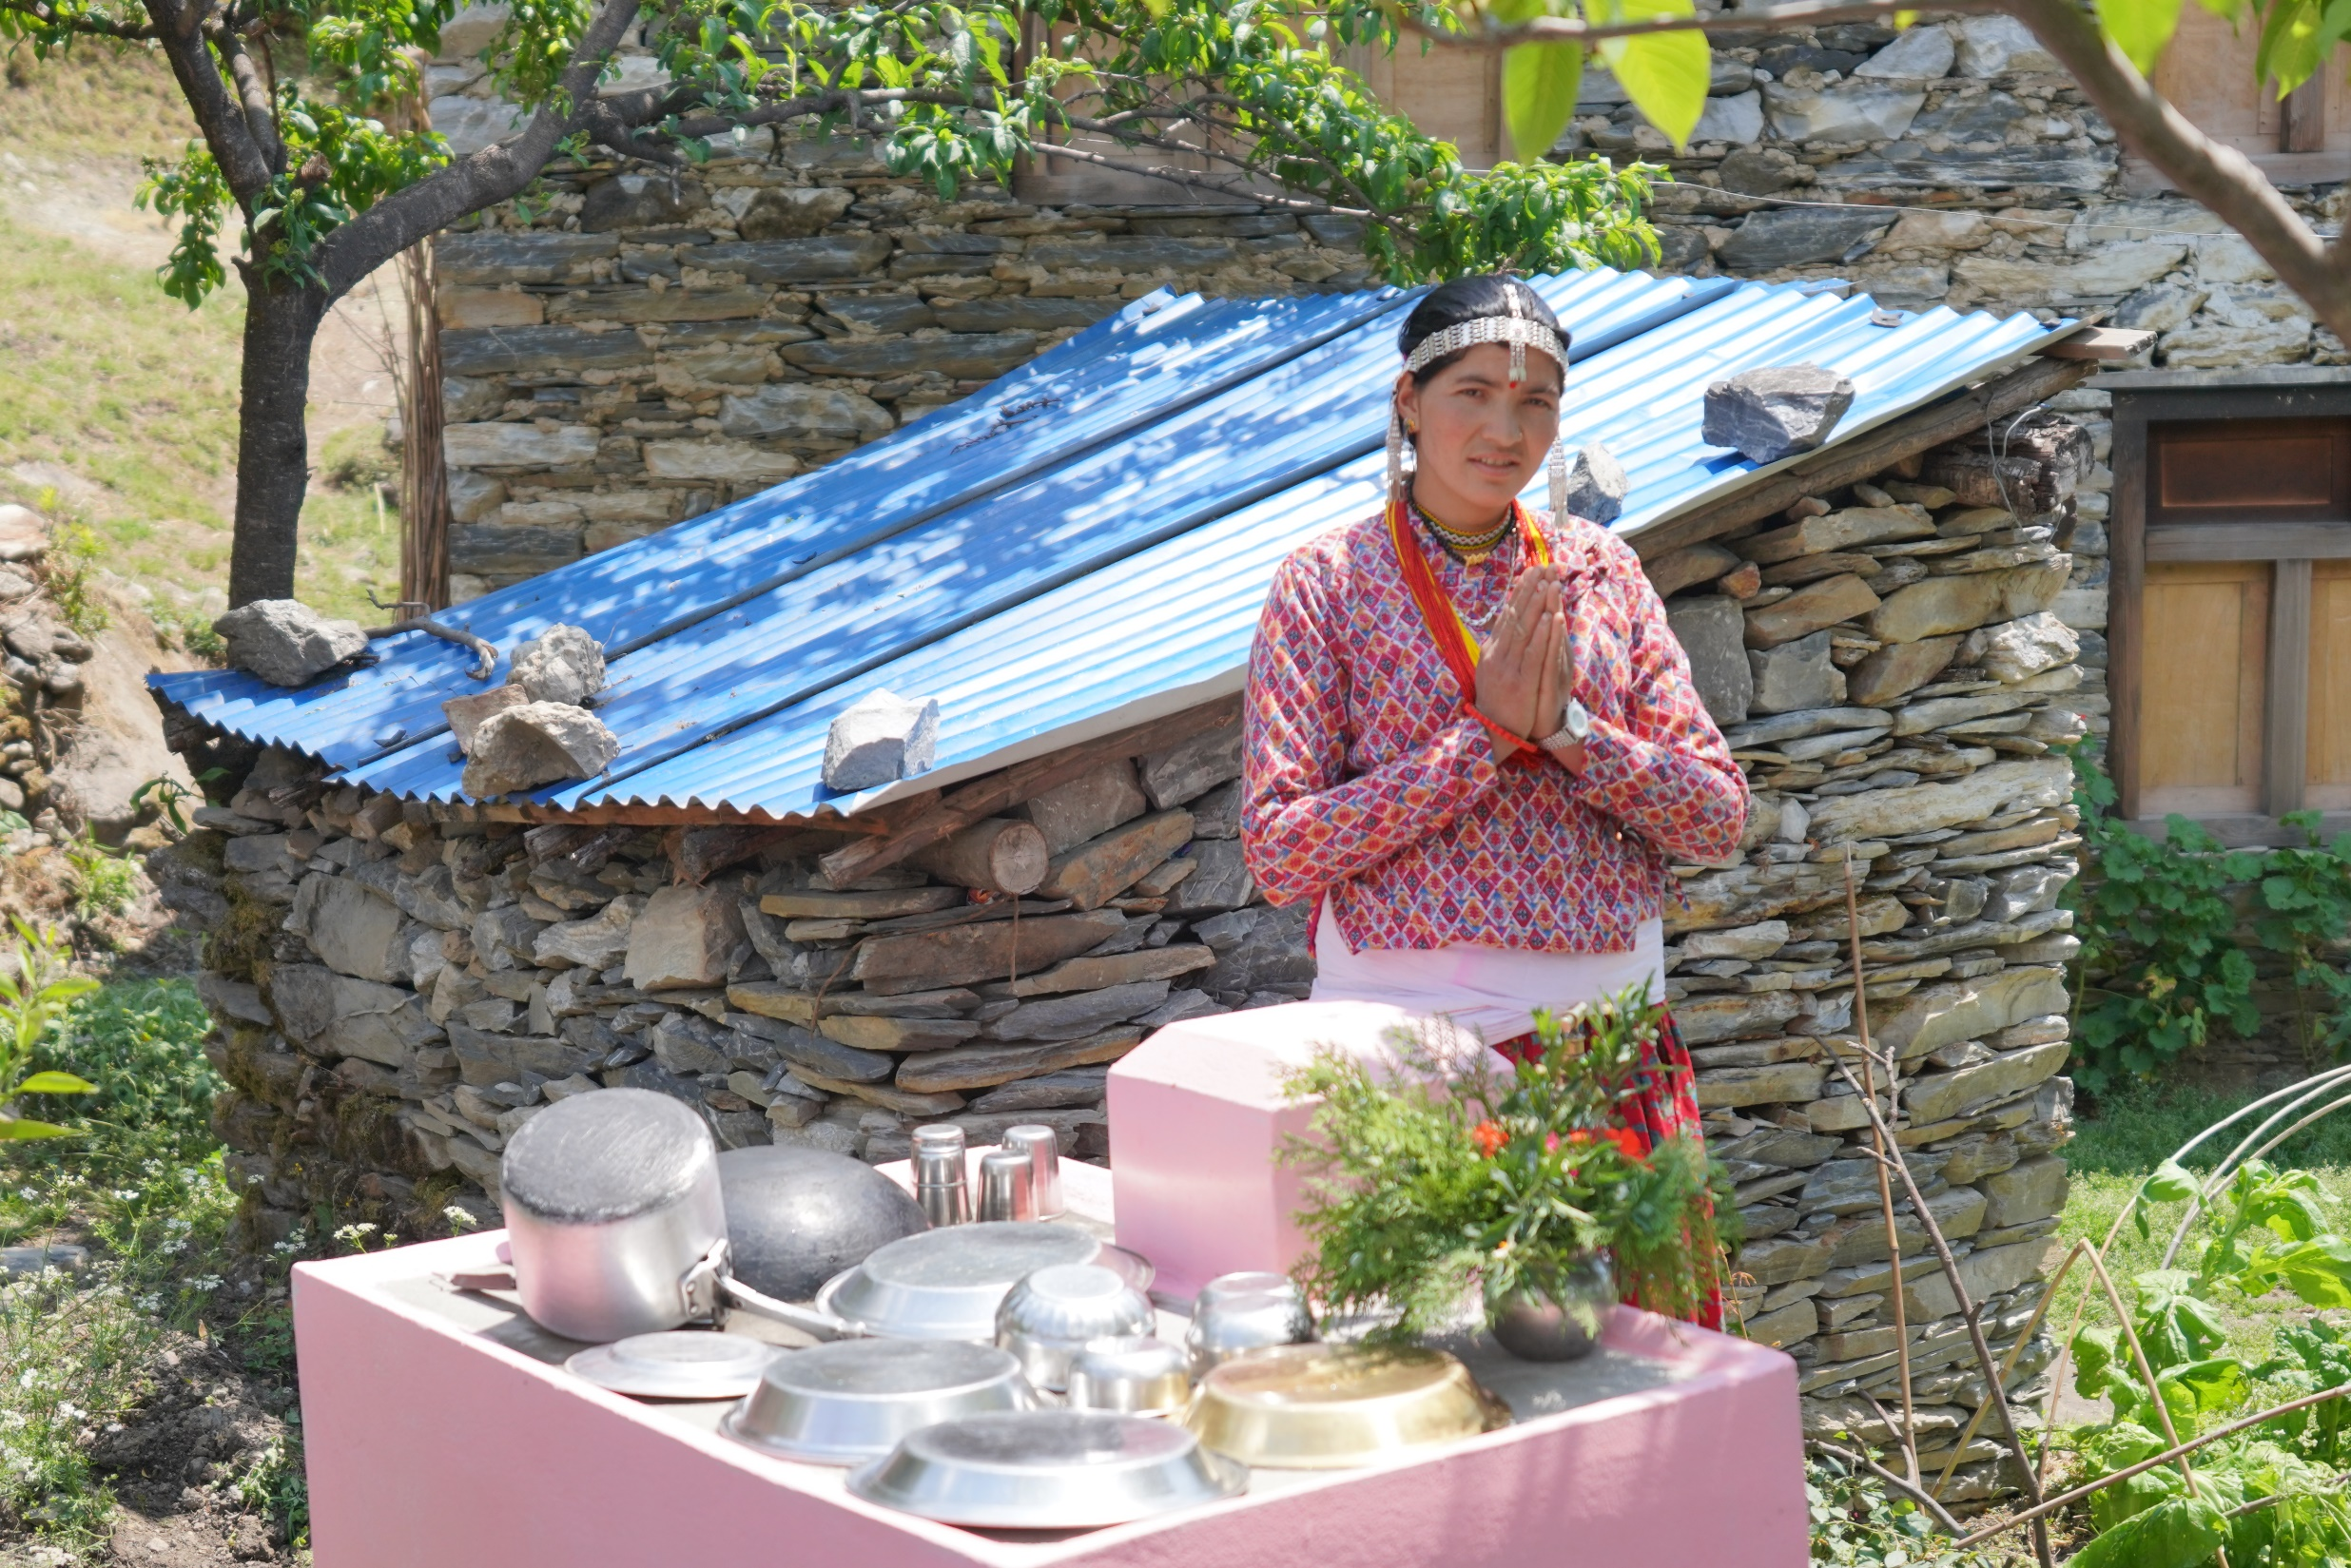
Approaches
Climate Change Adaptation: Through the wider lens of Resilience in WASH, a condition for sustainability
Integrating the three aspects of resilience as cross cutting themes in all project components:
GESI
Governance
DRR/CCA and DRM/CCA

Slide 7
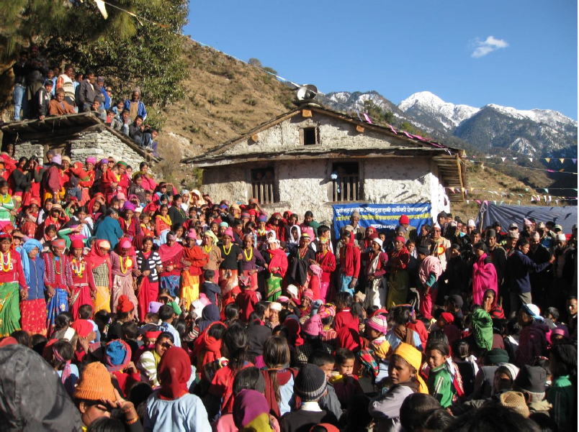
Approaches
GESI
Women and lower caste face discrimination
Taboos and discrimatory practices related to access to water.
Unfair workload.
lack of representation and equal rights.
Governance
Local government and Communities in charge, with financial contribution.
WASH board and WASH units at municipal level, Users Committees.
Public audit.
Step by step process.

Slide 8
Approaches
DRM/CCA as cross cutting
In schemes development: DRM/CCA activities included during preparation, implementation and post-construction. Compulsory Water Safety Plan with DRM/CCA component.
Livelihood area: incorporated in capacity building support (home gardening, IGA, farming methods, irrigation technologies, etc…)
In renewable energy: direct answer to CC (solar mini-grid, Improved Water Mills, Improved Cooking Stoves).
In institutional capacity building: CC part of all capacity building activities with the local governments and communities.

Slide 9
Contributing factors
Multiple Uses Systems (MUS)
Drinking water supply + irrigation + micro-hydro power + Improved Water Mills
Water Supply Schemes work better when different uses of the water available
Productive use of the water supports better maintenance, long term functionality and sustainability.
Water Safety Plans
Started with the conventional Water Safety Plan: quality and safety of water
Moved progressively to WSP+++ concept: addressing O&M and water tariff collection (+), climate change adaptation and disaster risk reduction (++), and social inclusion (+++).

Slide 10
What Next?
SUSWA (Sustainable WASH for All)
  Enabling environment, good governance and GESI
  WSP +++
  Total sanitation, 3 stars schools, dignified menstruation practices.
Local adaptation to climate change
  Broaden the good results of the resilience framework (Governance, GESI, DRM/CCA)
  Management of natural resources (land, water, forest).
  CCA adaptation as the main theme.

Slide 11
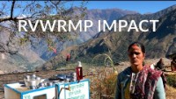
Example of Multiple Use System (MUS)

Slide 12








Keep in touch
ec.europa.eu/
europeancommission
europa.eu/
@EuropeanCommission
@EU_Commission
EUTube
@EuropeanCommission
EU Spotify
European Commission
Notes:
Delete/update as appropriate

Slide 13

Thank you
© European Union 2020
Unless otherwise noted the reuse of this presentation is authorised under the CC BY 4.0 license. For any use or reproduction of elements that are not owned by the EU, permission may need to be sought directly from the respective right holders.
Slide xx: element concerned, source: e.g. Fotolia.com; Slide xx: element concerned, source: e.g. iStock.com
Notes:
Update/add/delete parts of the copy right notice where appropriate.
More information: https://myintracomm.ec.europa.eu/corp/intellectual-property/Documents/2019_Reuse-guidelines%28CC-BY%29.pdf

