Slide 1
Upscaling community resilience through Ecosystem-based Disaster Risk Reduction (Eco-DRR)
Case study 2 Indonesia
Presentation by
Water and Climate Change Adaptation
13 September 2022
Mohammad Hasnain UNEP
Yus Noor Wetlands International

Slide 2
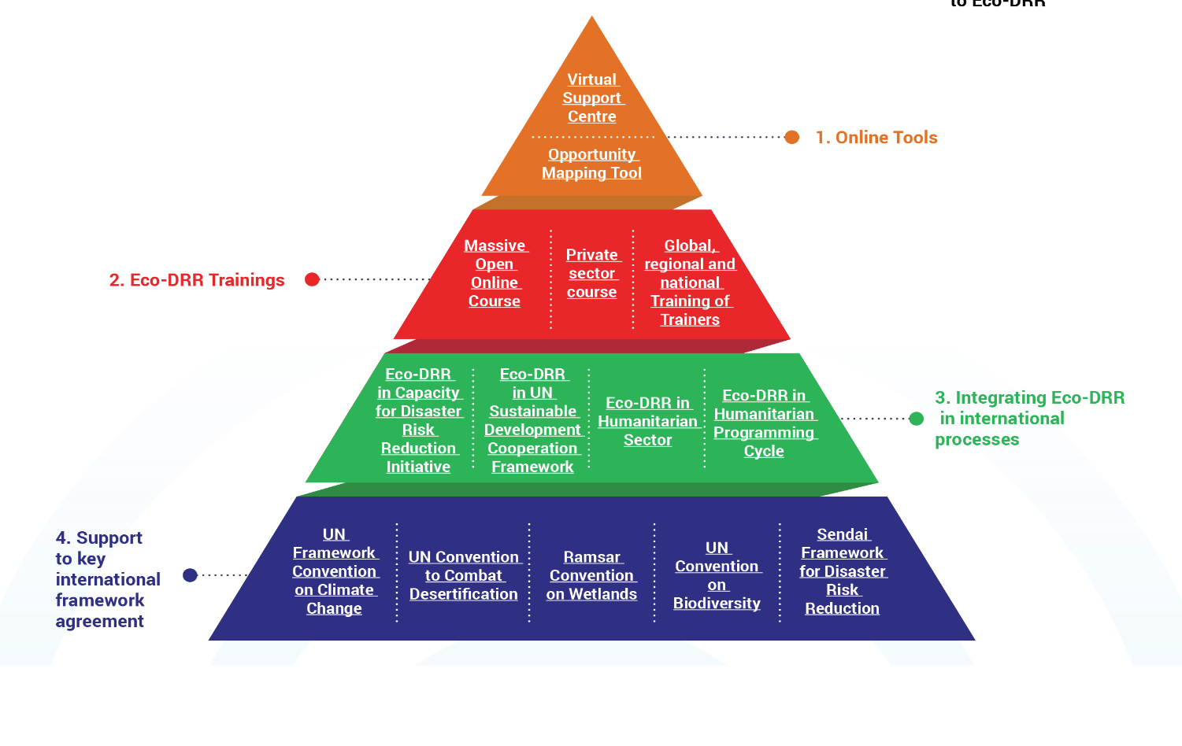
  Mainstreaming –
  Catalyse new investments in ecosystems and new Eco-DRR initiatives through capacity-building, technical guidance and advocacy
Provide online knowledge and decision-making tools
Capacity building and outreach
Advocating for integration of Eco-DRR in international processes
Supporting International framework agreements

Slide 3
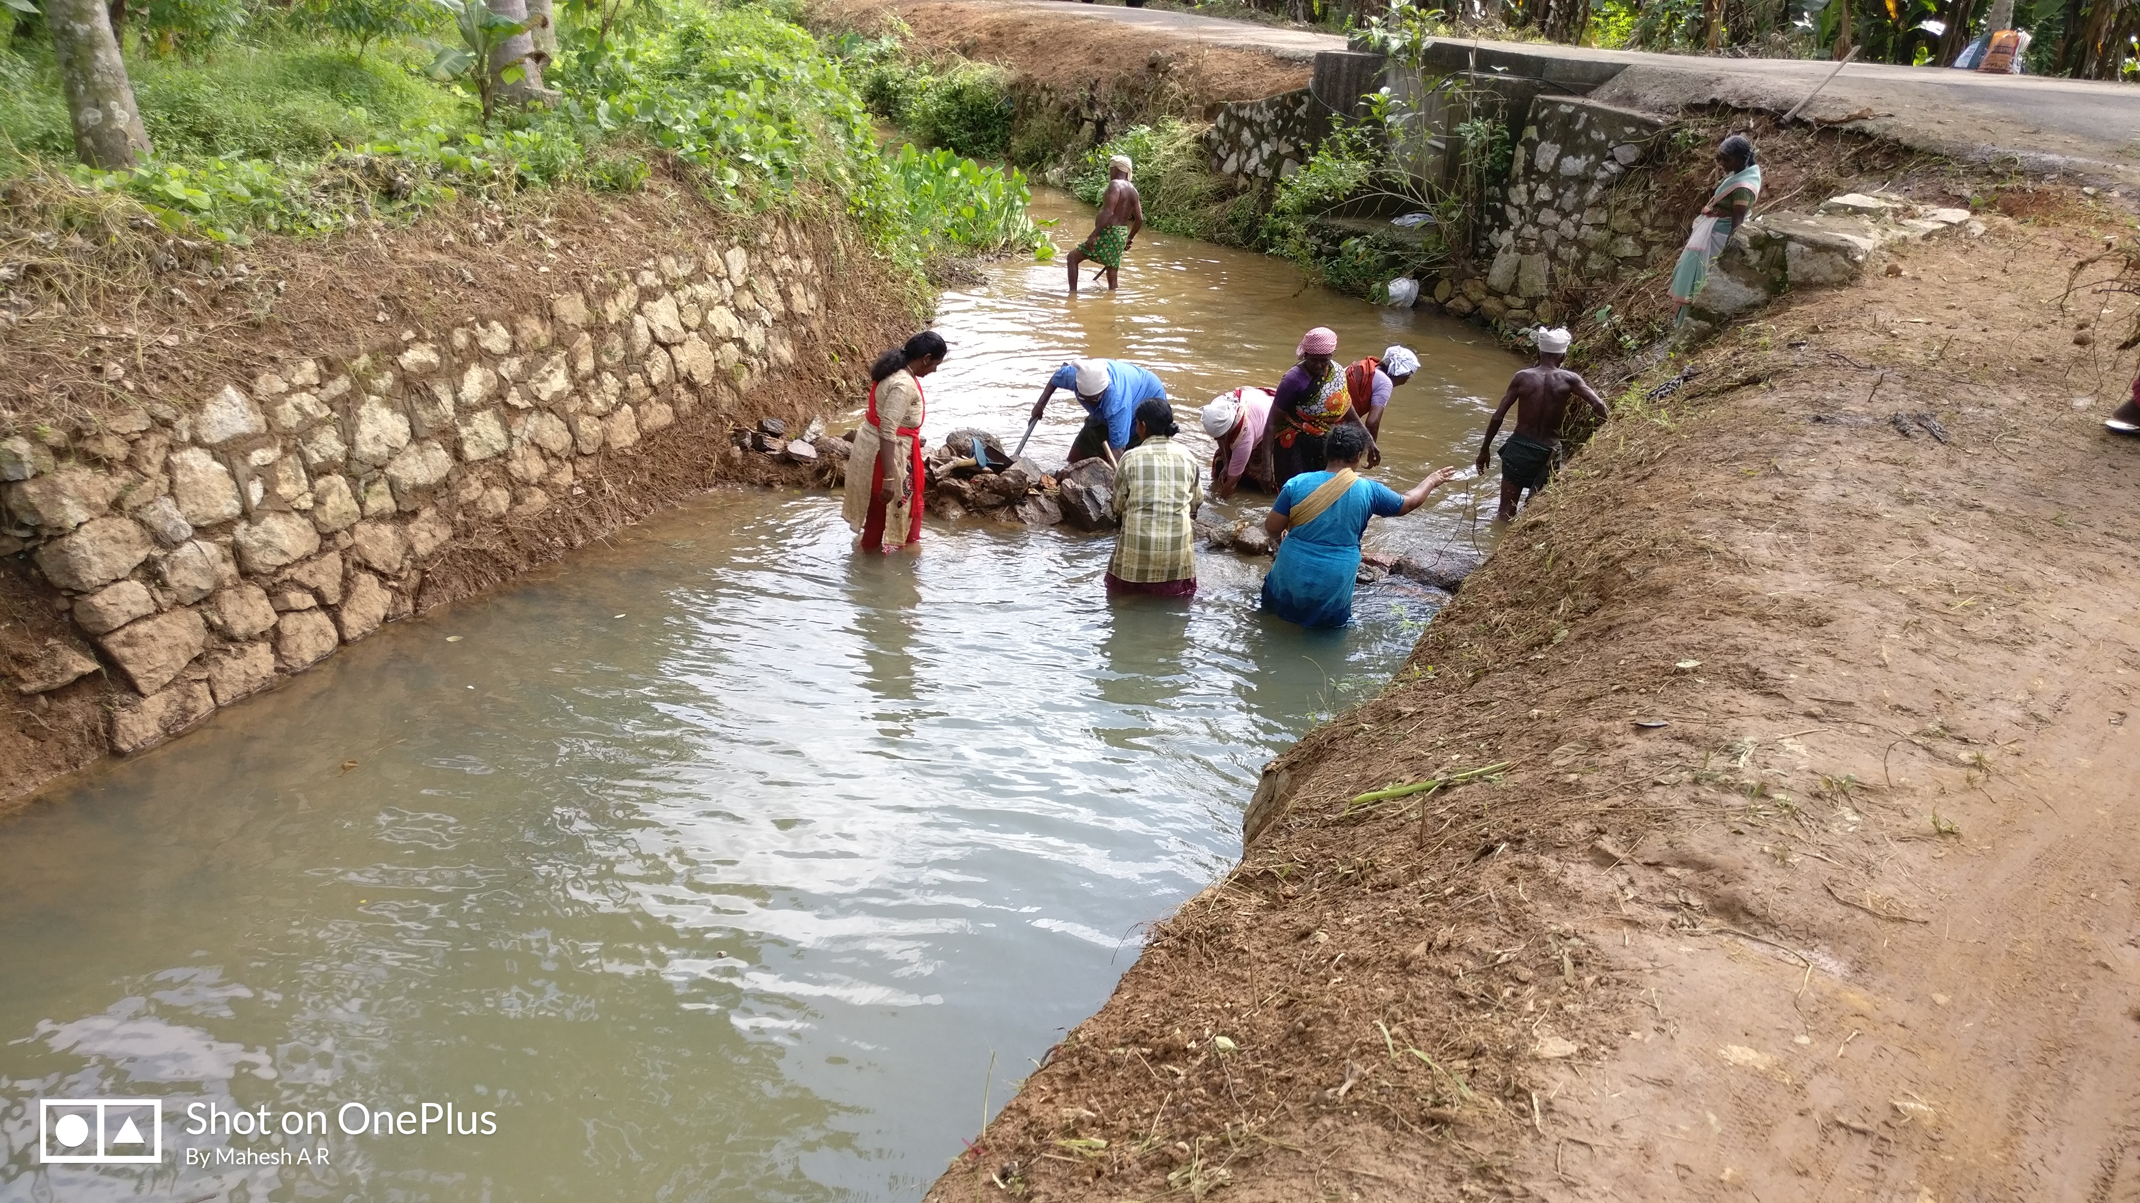
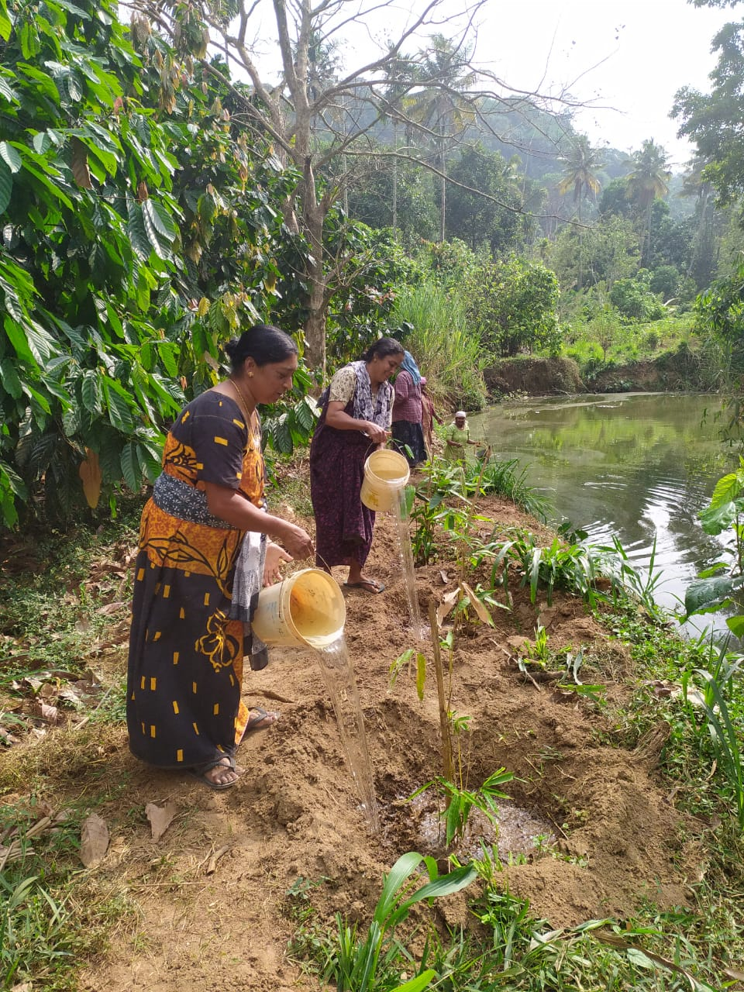
  Leveraging –
  Eco-DRR is integrated in ongoing large-scale national development programs in India
Develop targeted training for the MGNREGS at state and national level
MGNREGS NRM works to address and mitigate the main hazards in India
Eco-DRR embedded in government DRM Plans
Eco-DRR policy is being advocated at the national level

Slide 4
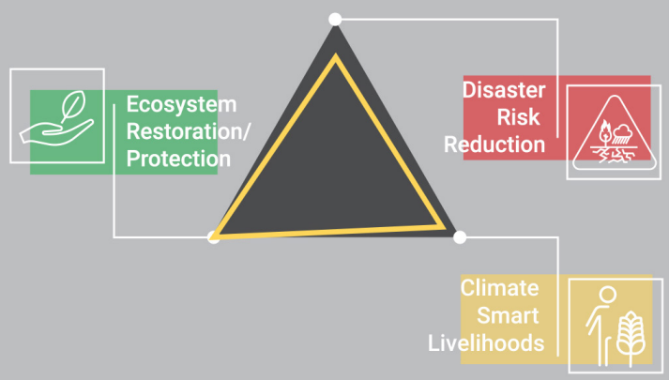
Demonstrating –
Community-based models for scaling-up Eco-DRR with local actors
Five country models: Uganda, Haiti, Indonesia, India, Ethiopia
This component is implemented by the Partners for Resilience (PfR) Consortium
Focus on three elements: ecosystem restoration; disaster risk reduction; and climate smart livelihoods

Slide 5
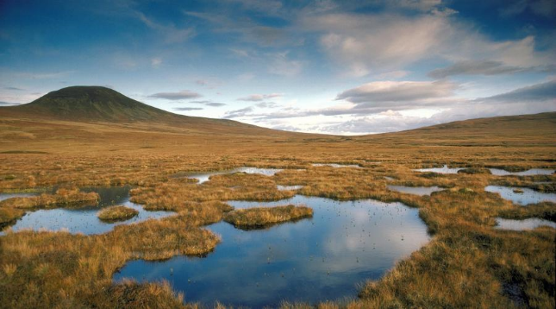
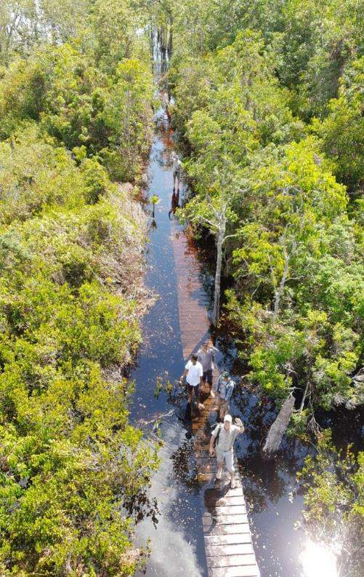
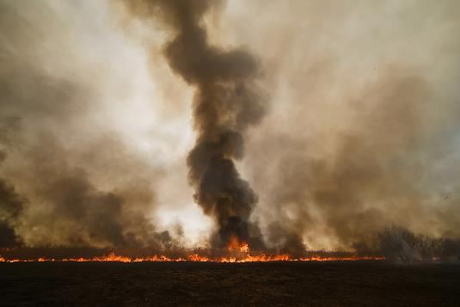
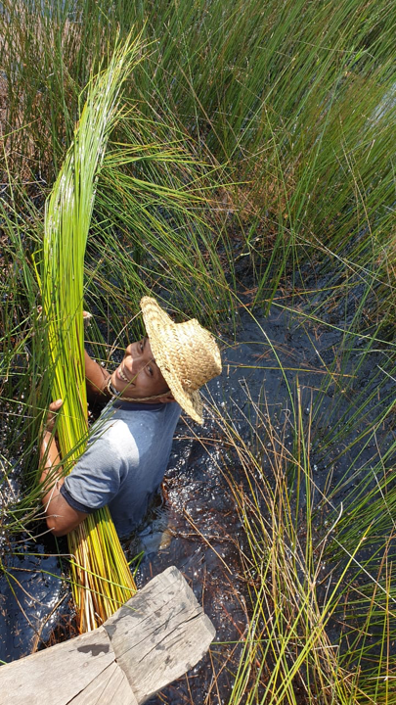
Key Peatland facts
3% of the worlds land area
contain 500GT of carbon
2x carbon stock in total global forest biomass
Peatland drainage, degradation and fires: approx. 5% of global emissions
Need to Restore 50 million hectare of peatland by 2050 to meet 1.5C target (Ramsar Global Guidelines, 2021)
Notes:
Peatlands play a crucial role in climate change mitigation & adaptation:
> Peatlands only cover 3% of the worlds land area but contain 500GigaTon of carbon. Which is twice the carbon stock in total of global forest biomass.
Emissions from peatland drainage, degradation and fires account for approx. 5% of global anthropogenic Greenhouse Gas Emissions.
This crucial role of peatlands was also stressed by The Global Convention on Wetlands, Ramsar. It urged the world that 50 million hectare of peatland needs to be restored by 2050 to meet the 1.5C target in the Paris Agreement, in the Global Guidelines for Peatland Rewetting and Restoration issued by Ramsar in 2021

Slide 6
Indonesia’s #ActsForWetlands
  BRGM mandate:
  Facilitate the acceleration of Restoration of 1.2 million hectares of peatlands and 600,000 hectares of mangrove
  and improvement of community livelihood in targeted provinces
Peatland
Restoration
Agency (BRG)
Presidential Regulation 2016
(2 mln He)
Peatland and
Mangrove Restoration
Agency (BRGM
Presidential
Regulation 2020
Applying 3Rs:
rewetting drained peatlands,
revegetating landscapes
revitalizing local communities’ socio-economic conditions
Notes:
A momentum for the restoration of degraded peatlands in this most important global peatland’s harbor is the release of Presidential Regulation (2016) to establish a dedicated Peatland Restoration Agency (BRG). This was Indonesia’s leading initiative on the coordination of peatlands restoration efforts nation-wide. As the mandate of the Agency has finished on 2020, a renewal of, an even bigger, institution established in 2020 under a Presidential Regulation, which is called the Peatland and Mangrove Restoration Agency (BRGM). The main task of this agency is to facilitate the acceleration of the restoration of 1.2 millions hectares of peatlands and 600,000 hectares of mangroves; using rewetting of drained peatlands and revegetating landscape principles, and at the same time revitalizing or improving livelihoods of communities in the targeted areas. Our project has contributed in the provision of successful field examples on the implementation of this nation-wide peatlands restoration.

Slide 7
Indonesia’s #ActsForWetlands
  Action points on
  restoration of degraded peatlands
NDC
Reducing emissions by 29% up to 41%
(vs bus as usual scenario in 2030)
  Ambitious 2030 target: 2 million ha of peatlands
Notes:
Indonesia’s commitment on global efforts on tackling climate change, especially through the sustainable management of wetlands, is expressed in the latest country’s Nationally Determined Contribution (NDC). It mentions a target under the unconditional commitment on reducing emissions by 29% (or by 41% under the conditional commitment). Furthermore it refers to restoring functions of degraded ecosystems, including wetland ecosystems like peatlands, as a necessary prerequisite for embarking on a more ambitious commitment to further reductions by 2030. On the current commitment, Indonesia has set up an ambitious target to restore 2 million ha of peatlands by 2030.

Slide 8


Indonesia’s Eco-DRR Upscaling Model
Ecosystem restoration & protection:
3R approach: Rewetting, Revegetation, and Revitalisation
Paludiculture techniques
Climate Smart Livelihoods:
Bio-rights financial schemes
Trainings on peat knowledge & diversification of livelihoods
Disaster Risk Reduction:
Hydrological monitoring: early warning tool
Community-based fire brigades
Notes:
Under the Eco-DRR program (running from 2019-2021), scalable models for community-based Eco-DRR are developed. The overall objective of the project is to increase community resilience in peat ecosystems, and enabling for sustainable development. The specific objective is to increase the ECO DRR practices in peatland ecosystem that contribute to increasing the resilience of communities. We are working in the grass root level but keep engaging with local to national level stakeholders for mainstreaming the Eco-DRR approach and model for upscaling. The Eco-DRR upscaling model includes interventions on Ecosystem Restoration/Protection, Climate smart livelihoods and Disaster Reduction. Through this approach, we are promoting the rehabilitation of peatlands through paludiculture techniques (native peat species), community engagement using financial support and conservation measures (through so-called bio-rights schemes), and encourage local communities to prevent, monitor and respond to peat fires.

Slide 9
Bio-Rights ….. Financial mechanism for interest-free conditional loans, linking nature-based solutions initiatives (we call them “packages”) and increasing people's incomes
SOP for Support
Capacity building
Proposal Notification
Livelihood
Proposal
Livelihood
Package Deal
Consultation
Fund-2 interest-free loan
Feasibility Study & Field Verification
Feasible
Contract signing & loan disbursement
Criteria
Not feasible
Maintenance
Proposal Re-development
Fund-1 grant
Criteria
Feasible
T-years
Not feasible
Package deal
Rehabilitation works
Village Regulation
Monev
Rejected Proposal
X% package deal
< x% package deal
Group saving
Loan-to-grant reward
Proportionate
loan payment
Notes:
We are using the Bio-Rights approach as a kind of bonding mechanism for interest-free conditional loans, linking nature-based solutions initiatives (we call them “packages”) and increasing people's incomes. The main goal is to increase the functionality of the ecosystem, which takes a long time. While waiting, community groups received assistance to increase their income. Group members are encouraged to fulfill the entire “package of agreement”, or at least meet a certain percentage agreed upon at the outset. If this is achieved, the conditional loan will then be converted into a grant

Slide 10
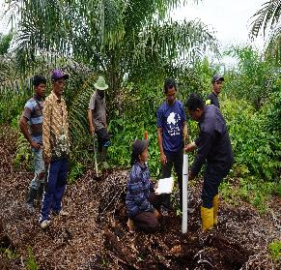
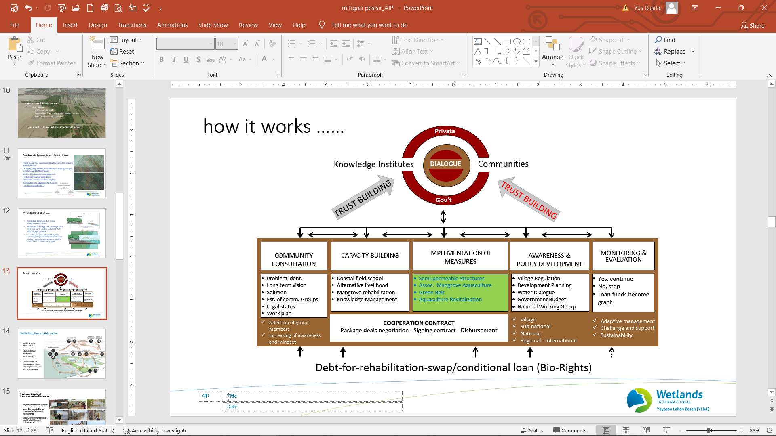
Bio-Rights … How it works
COMMUNITY CONSULTATION
CAPACITY BUILDING
IMPLEMENTATION OF MEASURES
POLICY DEVELOPMENT
MONITORING & EVALUATION
Community Group establishment & legal status
Work planning
Long-term vision
Livelihood
Peatland rehabilitation
Knowledge management
Peatland rehabilitation
DRR measures
Village regulation
Mid-term planning
Training curricula
YES, loan-to-grant
NO, proportionate loan payment
Debt-for-rehabilitation-swap /conditional loan … Bio-Rights
Notes:
Taking a Bio-Rights approach requires a systems approach, so instead of just determining specific technical solutions to address local problems, it is even more important to apply a systems approach, which means linking what happens to ecosystem and hydrological processes with social, institutional and economic processes. So apply it in a large landscape and see the possibilities of all interacting. This slide shows that the joint dialogue at the beginning of the activity is the key to the success of all work and an important factor in sustainability, through the application of adaptive management principles

Slide 11
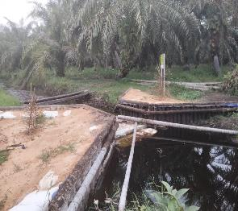
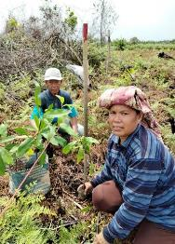
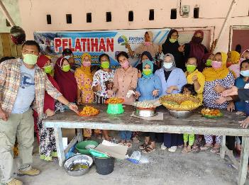
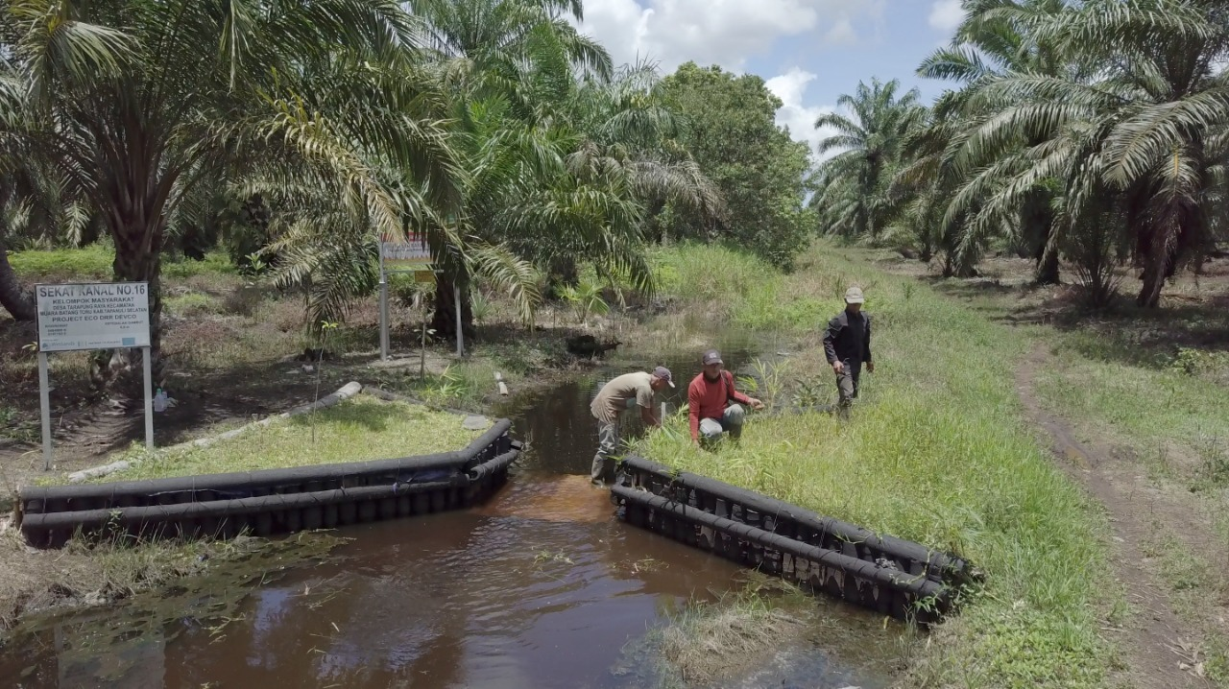
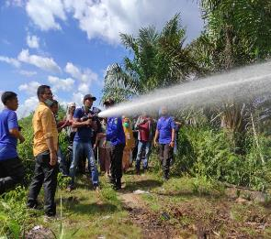
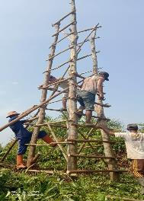
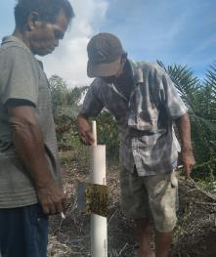
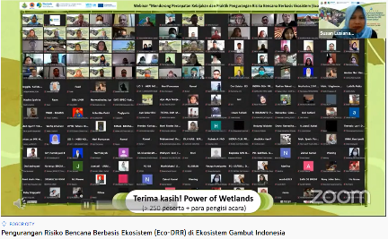
Upscaling Eco-DRR Measures
Notes:
As part of the Bio-Rights mechanism, various community-driven measures were implemented as part of the agreed actions, including 1) building of canal blocking to effectively block the water in the upstream of village, 2) Community group initiatives to monitor the planted native peat species, 3) Community participation in peat fires fighting, 4) Construction of a fires monitoring tower voluntarily built by community groups, 5) Actively conducting regular peat ground water monitoring, and 6) Training on the production of fish-based (aquaculture) food products

Slide 12
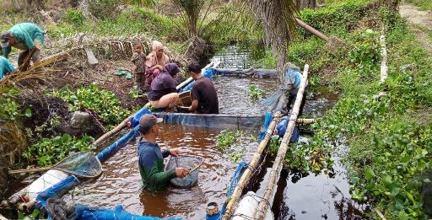
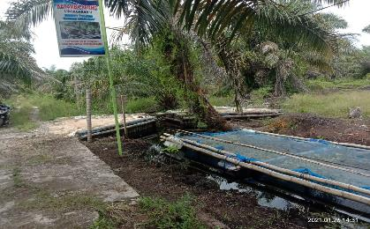
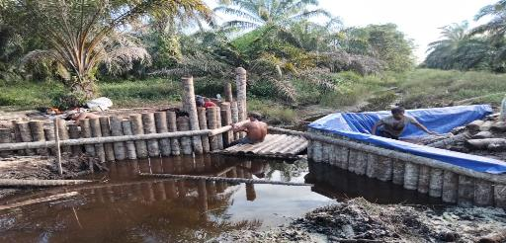
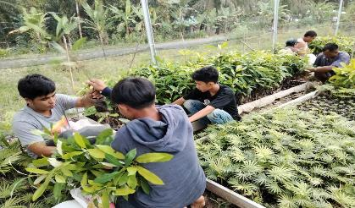
Upscaling Eco-DRR Measures: Integration of Peat Restoration (re-wetting) and floating net fish-cage
Rewetting: blocking canal using areca nut stems
Floating net cage for aquaculture placed in blocked canal
Paludiculture seedlings preparation in PME Poject in South Tapanuli- North Sumatera (IKI/BMU)
Notes:
The effectiveness of Bio-Rights approach partly determined with the attractedness of local community to be actively participated on the agreed rehabilitation measures which are integrated with the diversification and improvement of local community livelihood. The change of mindset that peatland destruction will have destructive impact to their livelihood, or on the other perspective that improved peatland ecosystem healthy will also improve their livelihood, will establish a genuine connection on the protection of natural ecosystem and voluntarily restoring the degraded one.

Slide 13
Upscaling opportunities based on project results and experiences
Direct support and engagement of District Government, including the strategic direction on the sustainability of the project
National workshop / outreach to National Peatland and Mangrove Restoration Agency (BRGM)
Actively engaged on the development of “Manual on Peatland Management without Burning” hosted by BRGM
Notes:
Identification of the relevant national initiatives in peat restoration is essential for upscaling. The project has engaged the key national agencies among others : BRGM, National DM Agency, National Development Planning Agency and Ministry of Village to share the results and model. It has been successful to advocate the model into national training programme especially on the development of peatland management without burning training manual.

Slide 14
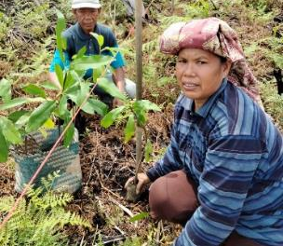
Polaria (Biorights member) monitors the planted Jelutong (native peat species)
Lesson Learned from Indonesia
Rehabilitation measures & Community livelihood
01
Bio-rights approach is an effective way to arrive at stewardship of environment by local communities
Multiple benefits
02
Upscaling the Eco-DRR model can have multiple benefits on climate, disaster, development agendas.
Upscaling of Eco-DRR
03
Strong interest from local & national stakeholders in the project’s approach as a model for upscaling of Eco-DRR
Local budgeting
Proposing multi-year biorights plans to the local government plans and budgets could be challenging within annual/single year planning system.
04
05
Policy influencing
Effective participation & local ownership in influencing policy making
Notes:
This slide presents some of the lessons learned during the project. It ranges from the effectiveness of the Bio-Rights approach on the engagement of local community on stewardship of environment, strong interest on the upscaling of ECO-DRR as a way to gain multiple benefits as well as local community and government participation on influencing policy making. We are also observing a challenge to align multiyear Bio-Rights mechanism into government’s annual budgeting system

Slide 15
What’s next?
(Inter)national exposure on the impact of the project: e.g. project approach, project effectiveness on community engagement
Community initiative sustainability with limited resources need to be upscaled with wider supports
Leverage effectiveness of collaboration between local-based implementing actors and global strategic actors to inspire and mobilize to take action on upscaling
Notes:
Our work is not completed yet. It is actually in an important period when local community and local government has started to seen the effectiveness of our intervention, not only for the environment protection’s perspective, but also more importantly for the development of sustainable livelihood, linking with the peatland protection and restoration. We appeal global support to keep the momentum alive, and to convince our local community that local action is a big matter for global efforts to tackle climate change issue.

Slide 16
Thank you
Notes:
Update/add/delete parts of the copy right notice where appropriate.
More information: https://myintracomm.ec.europa.eu/corp/intellectual-property/Documents/2019_Reuse-guidelines%28CC-BY%29.pdf

