Slide 1
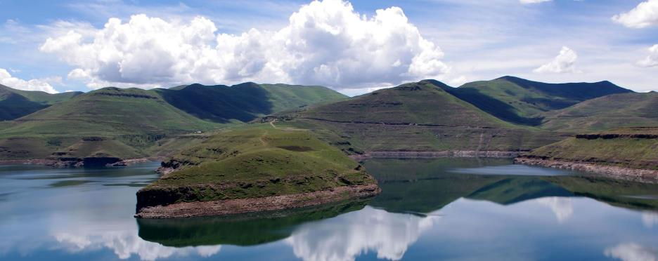
Integration of Climate Change Adaptation into IWRM programming in Lesotho
EU Action “Support to Integrated Catchment Management in Lesotho”
Silvia Sala Giner- EUD Programme Manager Water Sector

Slide 2
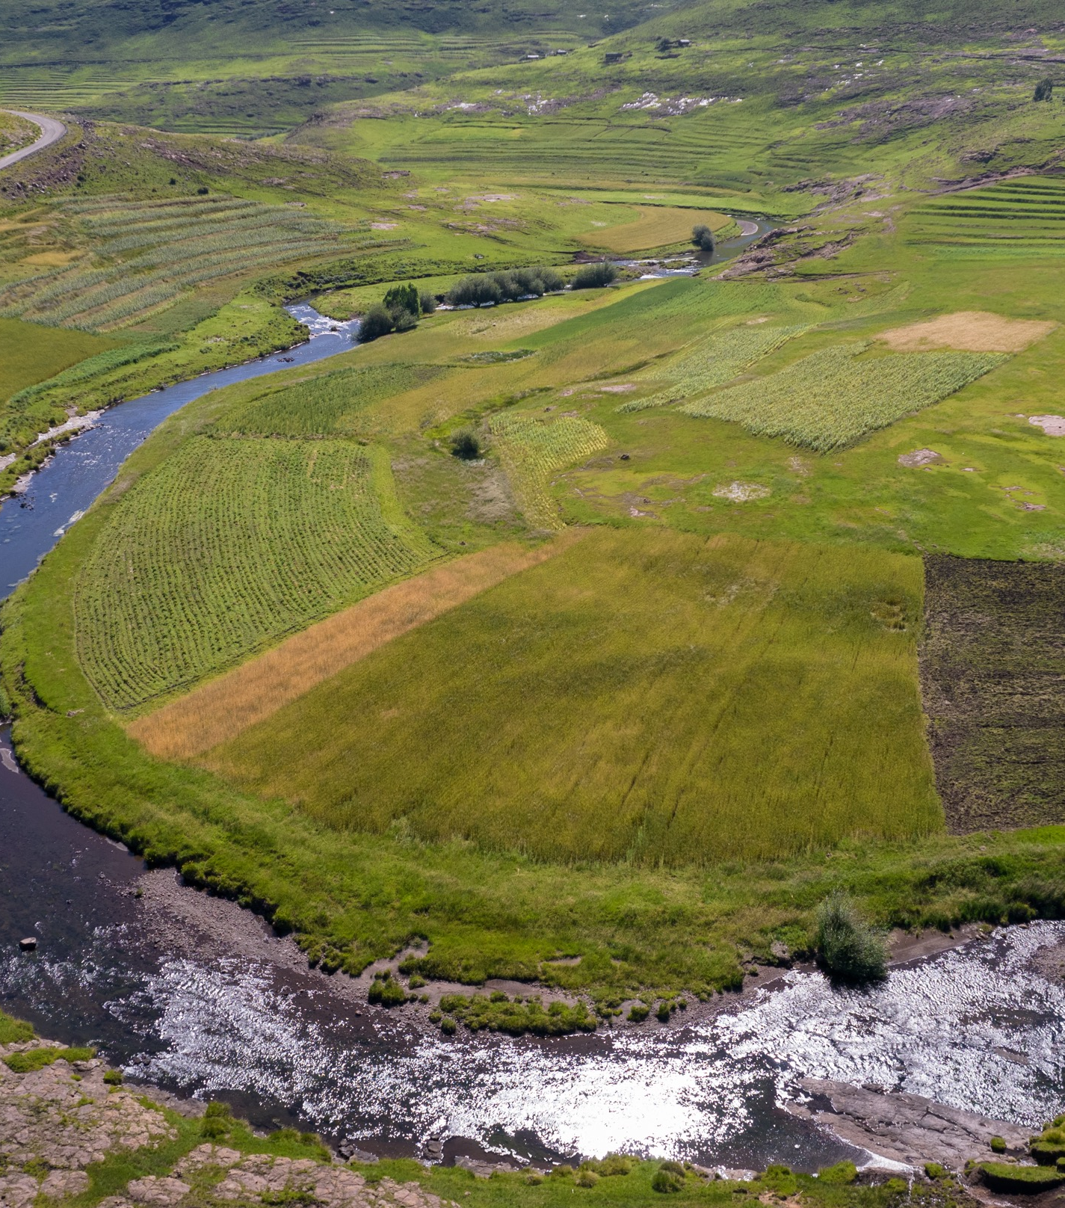
The action in a nutshell
Overall Objective
“Integrated Catchment Management (ICM) facilitates socio-economic development and adaptation to climate change in Lesotho”
Timeframe:
January 2020 to December 2023 (4 years)
Multi-Donor Action:
EUR 28 million financing by European Union
EUR 6 million financing by German Federal Ministry for Economic Cooperation and Development (BMZ)
EUR 5 million parallel financing from Government of Lesotho

Slide 3
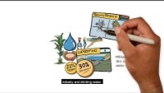
Explanatory video- ReNOKA- Relevance of ICM in Lesotho and Southern Africa

Slide 4
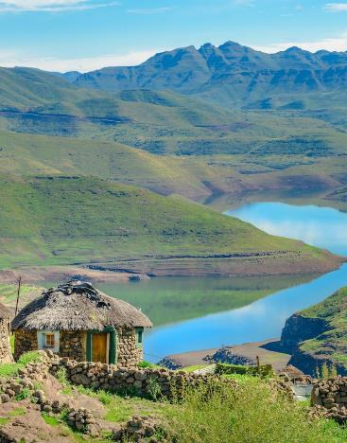
THE RELEVANCE OF ICM FOR LESOTHO AND SOUTHERN AFRICA
    Lesotho is considered the water tower of Southern Africa
  It contributes 40 percent to the Orange-Senqu basin’s annual run-off, with only 3 percent of the basin area.
  A third of the water supply to Gauteng Province – South Africa’s economic centre and home to 12 million people – comes from the Lesotho Highlands Water Project. Additional water transfers, e.g. to Botswana, are under development.
Water is Lesotho’s most important natural resource
  Aquatic ecosystems in Lesotho account for 22 percent of Lesotho’s GDP, an equivalent of USD 910 million
  30 percent of employment depend directly or indirectly on aquatic ecosystems

Slide 5
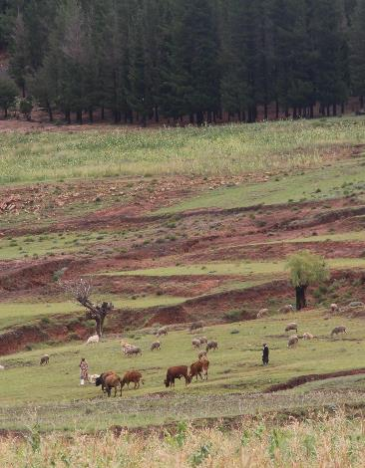
The Problem: Severe land degradation caused by unsustainable land use, exacerbated by climate change
Population growth, poverty and food insecurity have forced people into previously uninhabited areas like wetlands and mountain slopes- severe land degradation in country.
The consequences are alarming:
Lesotho’s annual depletion of natural resources is 5.9% of GNI.
Erosion leads to an annual topsoil loss of more than 2%.
The significant reduction in arable land increases food insecurity, reduces livelihood opportunities and fuels communal conflict.
Wetland degradation reduces water supply across the basin area.
Uncontrolled land degradation increasingly threatens essential infrastructure such as dams, roads and buildings.

Slide 6
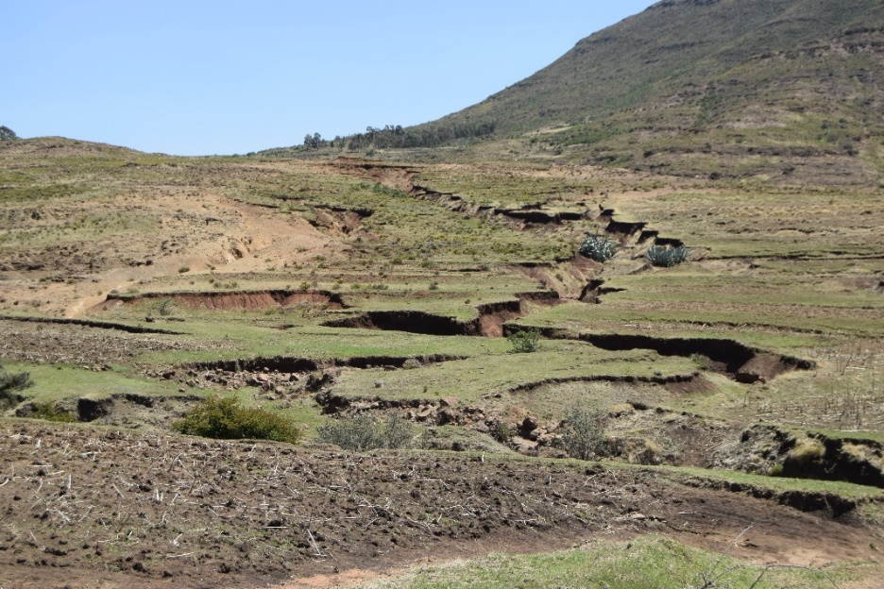
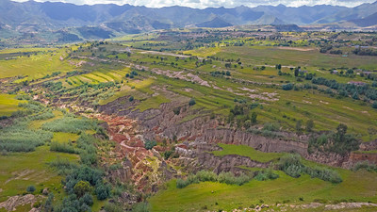
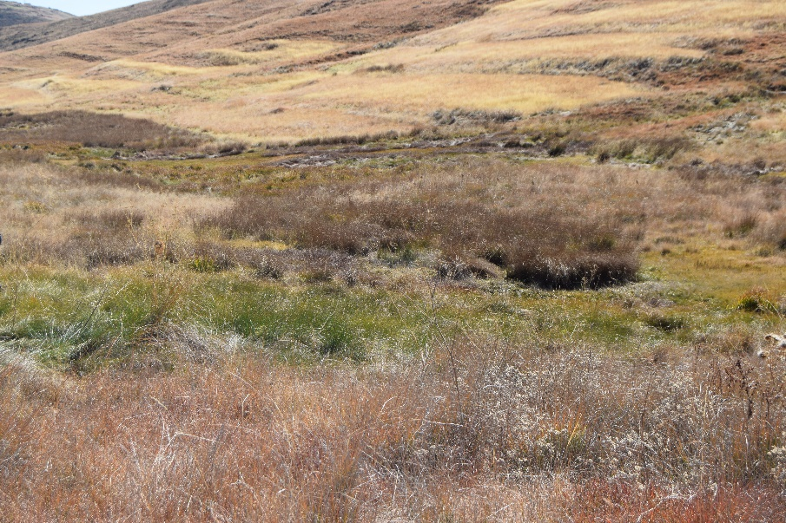
The Problem: Severe land degradation caused by unsustainable land use, exacerbated by climate change
Climate change presents an important aggravating factor.

Slide 7
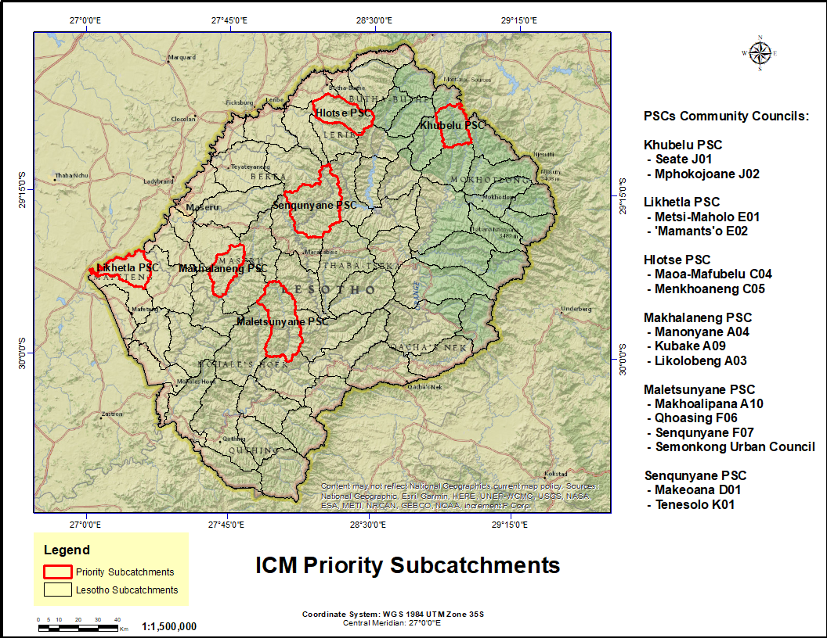
The programme approach:
A national rollout of local-level watershed improvement, supported by effective
national policies, institutions, and
skills development
The programme started operating in six priority sub-catchments, selected based on size, hydrology, agriculture and wetland area.
In subsequent years, the programme will roll out to more sub-catchments to achieve results at national scale.
Incentives will be created for communities to join the programme and for successful communities to receive additional funding for watershed improvement.

Slide 8
A multi-level programme with five interlinked outputs-
Systematic integration of CCA across the 5 outputs
Policy framework developed and applied
Effective, efficient & inclusive institutions
Capacity, skills and knowledge for ICM
ICM measures implemented
Coordination monitoring & supervision
Use of a systemic Risk-informed Development approach in the next National Strategic Development Plan
Substantive integration of land and water management aspects in Lesotho‘s NDC and NAP
Climate Risk and Vulnerability Asessments as integral component of Catchment Management Planning Processes
Development of financing architecture for strategic catchment management area plans aims to leverage climate financing (e.g. GCF)
Public awareness campaigns / social and behaviour change communication with adaptation messages aimed at land and water users
Advance climate resilience through the prioritisation of adaption actions. Focus on Ecosystem-based adaptation and nature based solutions as key measures for catchment restoration.
Collaboration with UNCDF LoCAL for local financing of adaptation measures
Land cover based assessment of the changes of critical ecosystems like wetlands and rangelands
Monitoring and reporting on adaptation targets

Slide 9
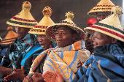
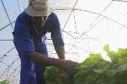
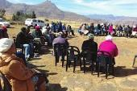
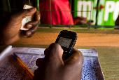
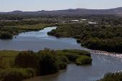
Achieving sustainable results:
An ICM movement
Involvement by ministries, traditional authorities, civil society and media.
Raising awareness and skills for a movement carried by ordinary Basotho.
Skills development
Addressing longer-term skills gaps through professional training and tertiary education.
Integration in existing structures
ICM integration in national, district and community planning processes.
Support to decentralisation in Lesotho.
Funding mobilization
Working towards progressive funding of ICM from the Nation Budget.
Funding mechanism akin to local grant facility, which can attract additional funding sources.
Regionalisation
Supporting complementary actions by other riparian states, as well as regional strategies and learning.

Slide 10
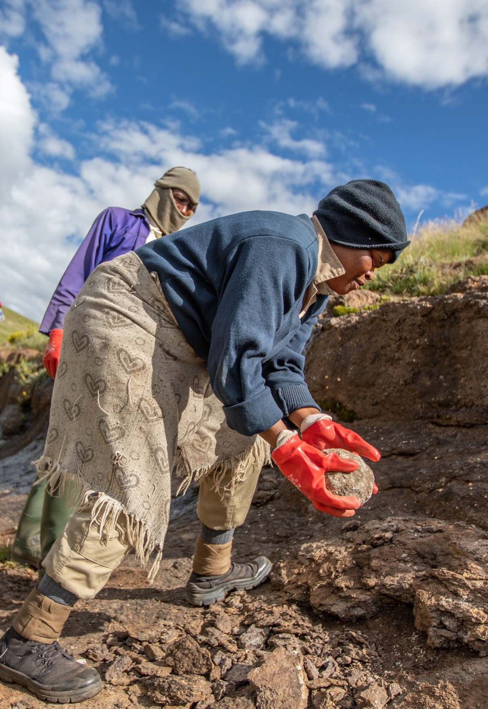
Lessons learnt
Programming for CCA is only effective when integrated into sectoral approaches to land and water management
CCA must be clearly articulated “from the top” (objective statement of Action; national development strategy of the partner country)
Assessment of specific vulnerabilities and systemic risks as well as a profound discussion on cause-impact chains with stakeholders are more relevant than precise climatic projections for effective CCA programming
Need to build human an institutional capacities for approaches such as CRVA and proper monitoring and reporting on adaption targets

Slide 11

Thank you
© European Union 2020
Unless otherwise noted the reuse of this presentation is authorised under the CC BY 4.0 license. For any use or reproduction of elements that are not owned by the EU, permission may need to be sought directly from the respective right holders.
Slide xx: element concerned, source: e.g. Fotolia.com; Slide xx: element concerned, source: e.g. iStock.com
Notes:
Update/add/delete parts of the copy right notice where appropriate.
More information: https://myintracomm.ec.europa.eu/corp/intellectual-property/Documents/2019_Reuse-guidelines%28CC-BY%29.pdf

