Slide 1
Global Gateway and
Team Europe
Policy Forum for Development
4 October 2022
Félix Fernández-Shaw, Director for Sustainable Development Policy and Coordination, DG INTPA, European Commission
#Global Gateway #Team Europe

Slide 2

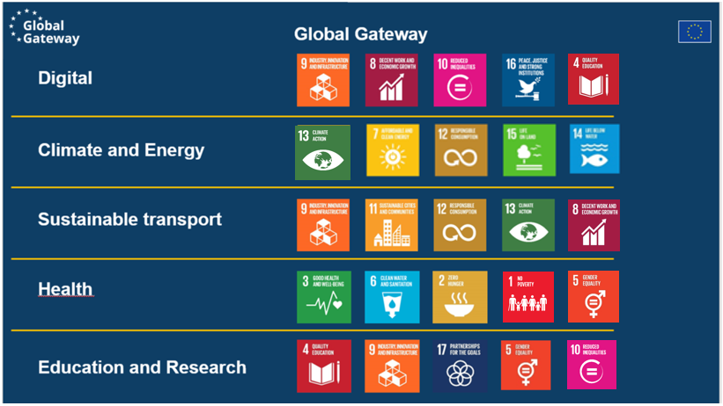
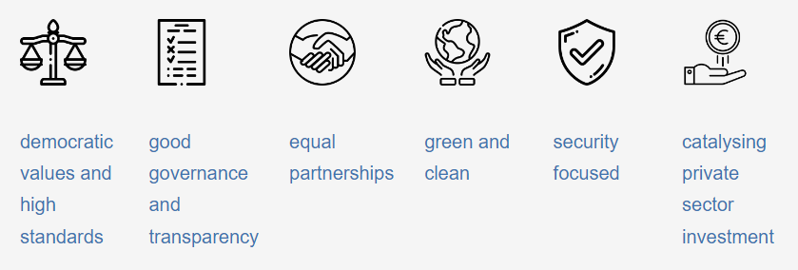
Priorities and principles
To add a picture, please move the grid elements on the side and then place back.

Slide 3
Global Gateway framework
To add a picture, please move the grid elements on the side and then place back.
Global Gateway Board
Global Gateway Board will be established to provide strategic guidance
Private sector role
Business Advisory Group, building on existing platforms and networks, will ensure intensive consultation with the private sector
Civil society
Dialogue with civil society will build on existing platforms
International fora
Global Gateway – EU and MS investment packages to be built for major summits, a priority for discussion in multilateral fora

Slide 4
Global Gateway and Team Europe approach
Democratic values, rule of law, human rights, social and workers’ rights, intellectual property;
Delivering for people requires transparency, accountability, financial sustainability, openness and a level playing field;
Public consultation and civil society involvement in potential projects;
Roots of Democracy and Sustainable Development
Civil Society crucial to any democratic system and asset in itself;
Civil Society contributes to inclusive policies, transparency and accountability, better social services and inclusive sustainable growth;
Multi-stakeholder dialogues and EU Roadmaps (country level) for engagement with CSO.
Local Authorities for enhanced governance and development
LAs support promotion and achievement of democracy, good governance at local level;
LAs have responsability in achieving sustainable development and equitable outcomes;
LAs manage and implement public policies and services on the basis of local policy-making processes.

Slide 5
Team Europe Initiatives per region
Country TEIs | Regional TEIs | Total
SSA country TEIs: 70 | Africa regional TEIs: 16 | Total: 86 TEIs in SSA
LAC country TEIs: 24 | LAC regional TEIs: 6 | Total: 30 TEIs in LAC
ASIAPAC country TEIs: 17 | ASIAPAC regional TEIs: 6 | Total: 23 TEIs in ASIAPAC
INTPA country TEIs: 111 | INTPA regional TEIs: 28 | Total: 139 in INTPA countries
Neighbourhood country TEIs: 16 | Neighbourhood regional TEIs: 3 | Total: 19 TEIs in NEAR
Total: 127 country TEIs | Total: 31 regional TEIs | Total: 158 TEIs
 |  | + 4 Global-Thematic = Total: 162 TEIs
Notes:
Speaking points:
Obviously, high traction on Teis, 162 shows that there has been a great potential in identifying common objectives and projects that deserved a European answer.
2/3 of these TEIs focus on the green deal priority, half are on human development and growth/jobs.
This is followed by around 65 on governance, 45 on digital and 20 on migration.
Green is first priority in all regions, but the other priorities differ per region.

Slide 6
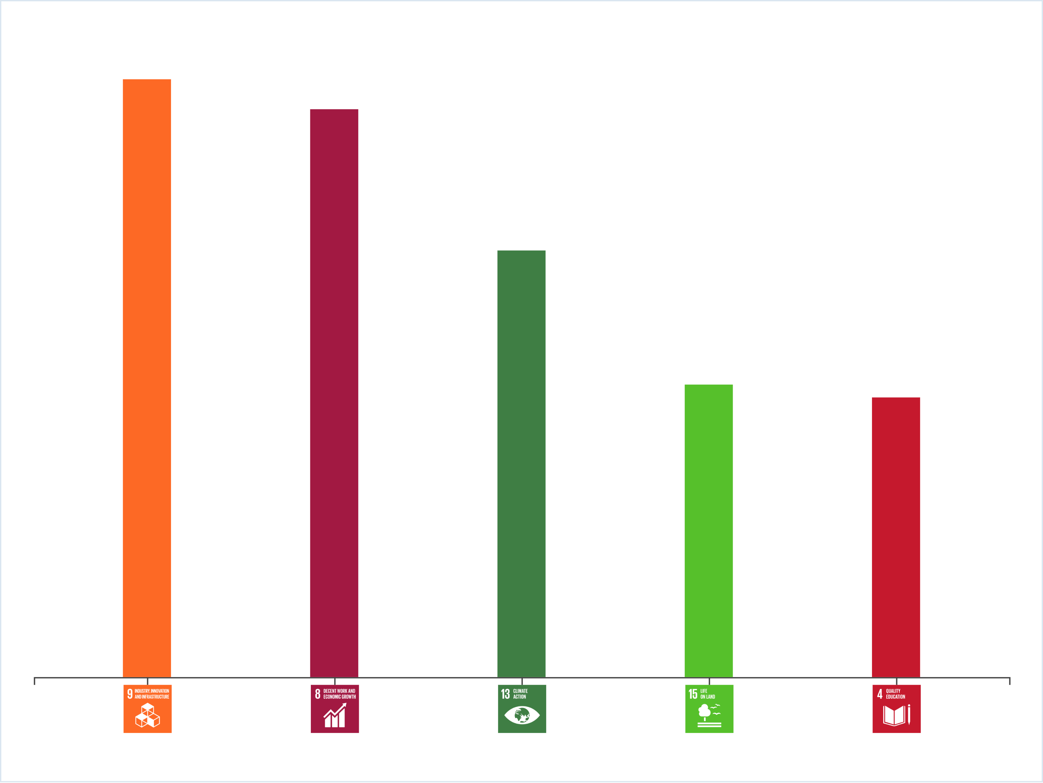
Africa: Estimated main contribution to SDGs
Estimated top-five contribution of country Team Europe Initiatives based on assessment with Sustainable Development Goals mapper.
Notes:
SDG9=Industry, Innovation, Infrastructure
SDG8=Decent Work and Economic Growth
SDG13=Climate Action
SDG15=Life on Land
SDG4= quality education

Slide 7
Mozambique
TEI E-Youth
Civil society platforms and EU Youth Sounding Board
Youth to reach their full potential to lead the socio-economic transformation of the country.
Through: Education, Employment/ Entrepreneurship and Empowerment. Digitalisation.
Joint Intervention Logic defined. Communication plan and M&E plan being drafted. Public launch under preparation.
Lead: DE. MS involved: PT, FR, BE, ES, AU, SE, FI, IE, IT and NL.
Civil society platforms consulted in the development of Team Europe Initiatives.
Creation of EU Youth Sounding Board on EU’s actions on cooperation and policies, economics and trade. Monitor actions under the TEI e-Youth. Connect and influence EU’s decisions and help making EU actions more participatory, relevant and effective for young people.

Slide 8
Africa regional
TEI Manufacturing and access to vaccines, medicines and health technologies in Africa (MAV+)
Stakeholder consultation and dialogue
De-risk investment into local pharmaceutical and biotech;
Help consolidate demand, facilitate market integration and use of locally produced goods;
Create an enabling environment by strengthening pharma and health systems, improve regulatory frameworks, African research capacities, education and skills, scientific cooperation and digital solutions to trace vaccines and medicines.
Actions at continental level in Senegal, South Africa, Rwanda and Ghana: part of EU-AU investment package
BE, BG, CZ, DE, DK, ES, FR, PL, PT, SE, + KFW, CDP.
Stakeholders including civil society consulted at Global Health Policy Forum at the European Development Days;
Bilateral meetings with civil society organisations;
Academics invited to project team meetings.

Slide 9
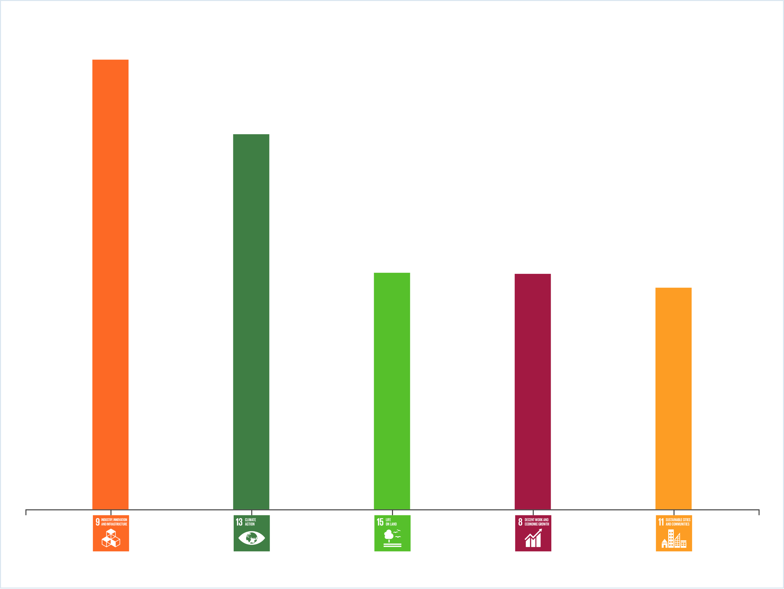
Latin America and the Caribbean:
Estimated main contribution to SDGs
Estimated top-five contribution of country Team Europe Initiatives based on assessment with Sustainable Development Goals mapper.
Notes:
SDG9=Industry, Innovation, Infrastructure
SDG13=climate action
SDG15=Life on Land
SDG8=Decent Work and Economic Growth
SDG11=Sustainable cities and communities

Slide 10
Ecuador
Civil society and local authorities as cornerstones
TEI Green Deal for Ecuador
By mirroring the European Union Ecological Transition in Ecuador, with a focus on climate-smart investments at decentralised level through:
  An institutional framework for the ecological transition and climate financing;
  A sustainable overhaul of the urban mobility sector;
  The development of low-carbon urban infrastructure projects in intermediate cities, mainly in water and sanitation and energy-efficient construction development; whilst
  Opening up the space for local communities to play a role in public policy design at local level.
EU, DE, FR, EIB
Local authorities and civil society will themselves implement and motivate a participatory governance to co-decide their local development plans and self-financing mechanisms.
Through a civil society, academia and local authority consortium.

Slide 11
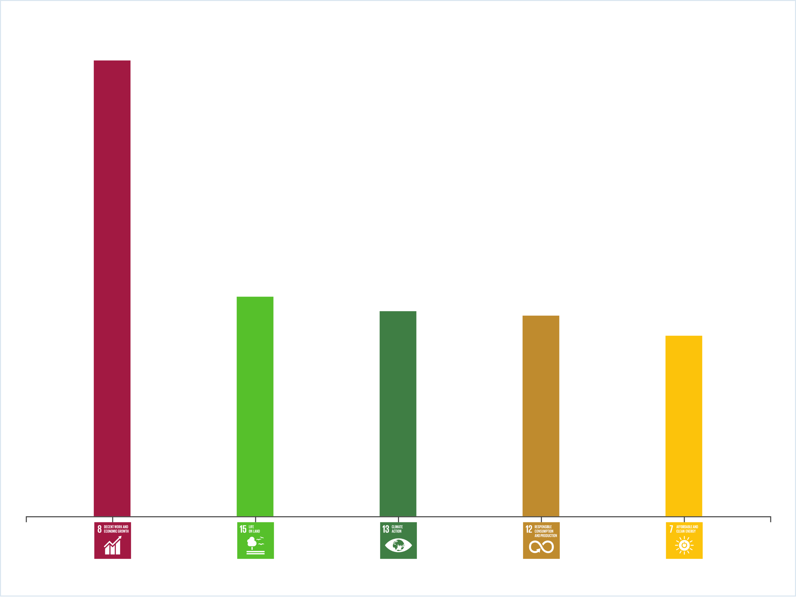
Asia, Pacific and Middle East:
Estimated main contribution to SDGs
Estimated top-five contribution of country Team Europe Initiatives based on assessment with Sustainable Development Goals mapper.
Notes:
SDG8=Indusrty, Innovation, Infrastructure
SDG15: Life on Land
SDG13=climate action
SDG12=responsible consumption and production
SDG7=affordable and clean energy

Slide 12
Bangladesh
TEI Decent work
Stakeholder consultation, involvement and accountability
Promote decent work through new employment policy, strengthening social protection, access to quality basic education, lifelong learning, working environment and good governance in labour administration;
Provided support to enhance safety, sustainability and decent work in different sectors, incl. readymade garment sector as well as COVID support to garment workers.
DE, DK, FR, NL, SE ES, IT and NO. Switzerland is also a partner.
Country assessment in consultation with national authorities, civil society, private sector;
Support designing and involvement of employment policy with Government actors (at central and local level), private sector (including employers’ and workers’ organisations) and civil society, with focus on young people, women, and vulnerable groups and include development of consultative groups for holistic policy.
Collaborate with civil society organisations to promote accountability and transparency in economic governance and advocate for human rights, due diligence standards and social dialogue.

Slide 13
Next steps
To add a picture, please move the grid elements on the side and then place back.
Focus on implementation : continued development and roll out of TEIs – majority of which implement Global Gateway
Continued dialogue with stakeholders, including civil society and local authorities
EU-AU process
  Commission-to-Commission meeting 28 November
EU-ASEAN
  Summit 14. December 2022;
EU-LAC summit
  EU-CELAC ministerial meeting 27 October 2022
  working towards a fully-fledged EU-CELAC summit in the future

Slide 14
Thanks - Questions
To add a picture, please move the grid elements on the side and then place back.
What could further improve civil society and local authorities understanding of Global Gateway?
How are you, not least national platforms, engaging EU MS in relation to GG and TE and what further potential do you see?
What issues do you see in monitoring the principles underpinning the Global Gateway approach?

