Slide 1

Customs Standards and
Trade Facilitation
Joint AUC-EC Customs and Trade Facilitation Forum:
A Customs Strategy for the Continental Free Trade Area
Brussels, 11-13 December 2012
Mr. Gaozhang ZHU
Director, Compliance & Facilitation, WCO

Slide 2

WCO’s Mission …
Improve effectiveness and efficiency of its 179 Member Customs administrations across the globe, through:
Setting international standards to facilitate cross-border trade
Securing the international supply chain
Facilitating legitimate trade

Slide 3
Role of WCO in Trade Facilitation
STANDARDS
TECHNICAL ASSISTANCE
COOPERATION
Develop and update Conventions, Recommendations, Guidelines and other tools
Support members to implement standards
Establish and develop dialogue with other int. organizations, private sector and other stakeholders

Slide 4
Customs in the 21st Century Strategy
The 10 building blocks:
Globally networked Customs
Better coordinated border management
Intelligence-driven risk management
Customs-Trade partnership
Implementation of modern working methods, procedures and techniques
Enabling technology and tools
Enabling powers
A professional, knowledge-based service culture
Capacity building
Integrity

Slide 5
Economic Competitiveness Package (ECP)
  Objectives:
  Elaboration and communication of WCO instruments and tools to stakeholders
  WCO Members correctly implementing the RKC
  Members implementing other WCO instruments and tools
  Actions:
  Promote the RKC and other instruments and tools
  Enhance cooperation among all stakeholders in int. trade
  Share best practices among Members
  Develop new tools as appropriate
  Capacity building

Slide 6
ECP Conceptual chart
Risk Management Compendium
SAFE Framework of Standards
Integrity
Transit
Authorized Economic Operator
Time Release Study Guide
Revised Kyoto Convention
SMEs
Data Model
Informal Sector
Globally Networked Customs
Single Window Compendium
Coordinated Border Management
Information Exchange

Slide 7
ECP – the way forward
  ECP Action Plan adopted by Policy Commission in December 2012
  Regional seminars/workshops
  Regional strategic plans
  Collection and sharing of best and innovative practices
  Capacity building

Slide 8
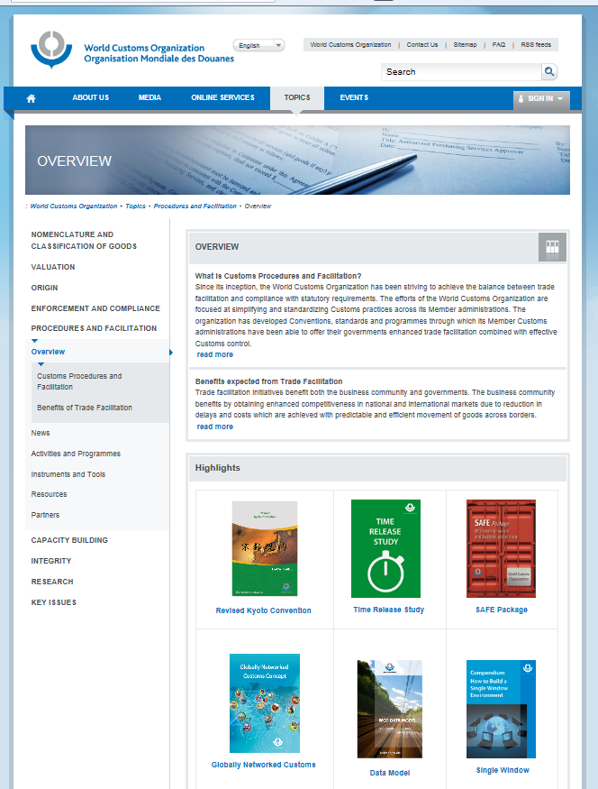
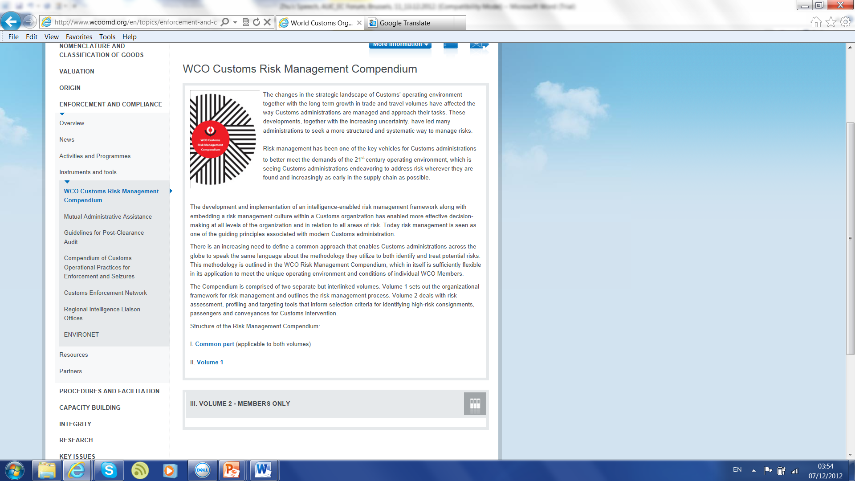
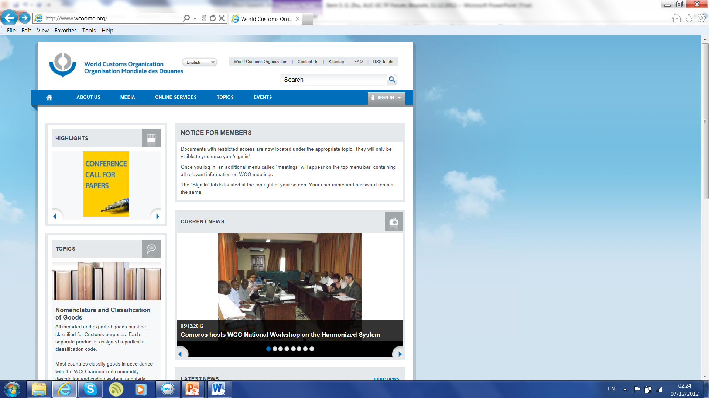
Visit the WCO web site
www.wcoomd.org

Slide 9
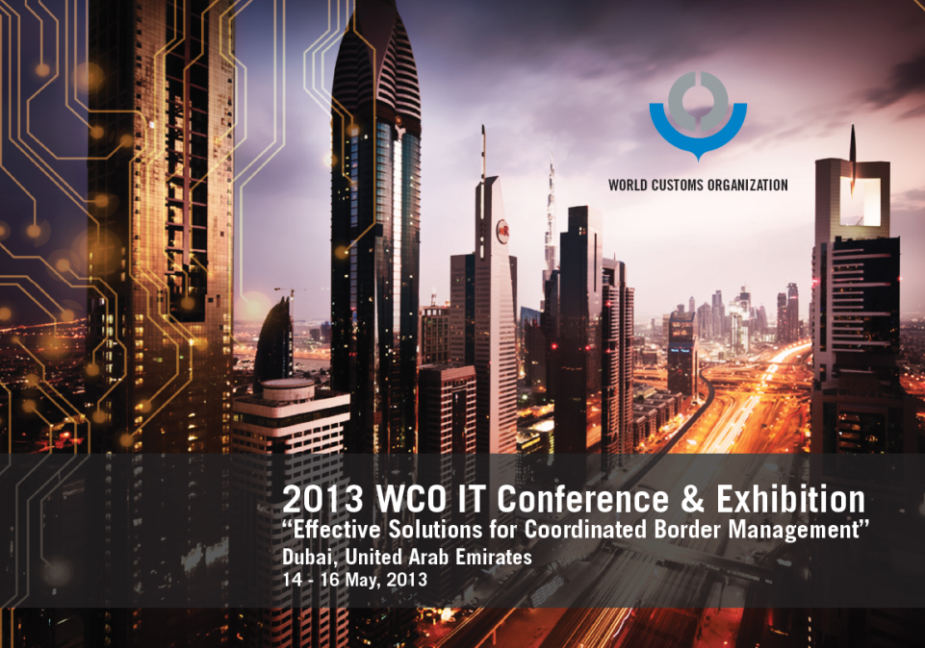
Thank you!
Mr. Gaozhang ZHU
Telephone : +32 (0)2 209 93 00
gaozhang.zhu@wcoomd.org

