Slide 1




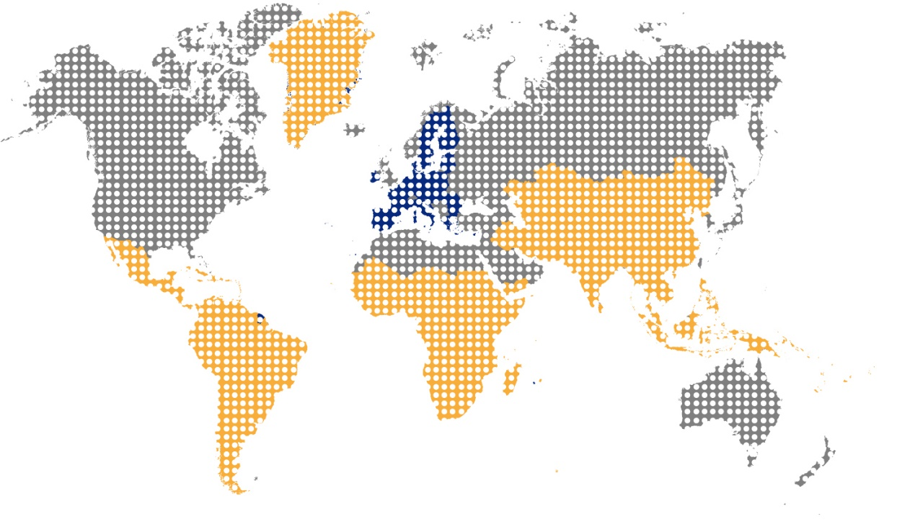
#TeamEurope
TAIEX INTPA Support to Local Autorities

Slide 2

#TeamEurope
TAIEX | TWINNING
Demand-driven and results oriented
Quick and short activities request for assistance from partner country Aligned with MIP priorities. NOT included in AAPs – centrally managed and funded Managed in HQ by DG NEAR/INTPA D1 Can trigger/support interest in further cooperation with EU as well as support other tools Both EUD and partner country can submit the application | Medium to long term interventions Included in AAPs - funded from the country allocations Managed in the EUD Can support/complement other tools (eg. TA, budget support)

Slide 3

#TeamEurope
^{TAIEX INTPA: Introduction}
WHAT IS TAIEX?
WHAT CAN TAIEX DO?
Demand-driven short-term assistance provided by EU MS public administrations to public administrations in INTPA partner countries
Exchange ideas and strengthening capacities of the public administrations in implementation of national development plans and SDGs
Sharing of EU MS best practice and peer-to-peer knowledge exchange – available from all EU MS
Policy dialogue
Sector maturity or introduction of new sector ideas
Stakeholder coordination
Give input to Programming
Contribute to budget support

Slide 4
#TeamEurope
TAIEX INTPA: Example of an activity to local authorities from the Western Blakans
TAIEX Workshop on Plastic waste management - Fight against marine pollution
Aim: strengthening local capacities of Montenegrin coastal municipalities to effectively address the large number of implementation challenges regarding preventive, mitigating and remedial measures regarding marine litter.
Experts from: 4 Experts from Belgium and Slovania
Participants: over 50 participants from costal local authorities from Montenegro
Montenegro, 11 - 12 April 2022
ACTIVITIES CAN BE ONLINE, HYBRID or IN PERSON
THEY CAN BE TARGETED FOR A SINGLE COUNTRY OR MULTIPLE

Slide 5
#TeamEurope
TAIEX INTPA: Application Process
How to apply for TAIEX assistance?
Application form
Objective – what do you want to achieve with this TAIEX event?
Target audience – who in your administration will benefit?
Main topics / content – what do you suggest to be discussed, agenda points?
Current situation – what is the situation in your administration? how is your department/institution organised? what are the challenges in your administration? what is in place (policies, laws, strategies, action plans…)?
Justification – why do you want TAIEX to support? Is there any other ongoing assistance? Have you considered any other funding options? Why now?

Slide 6
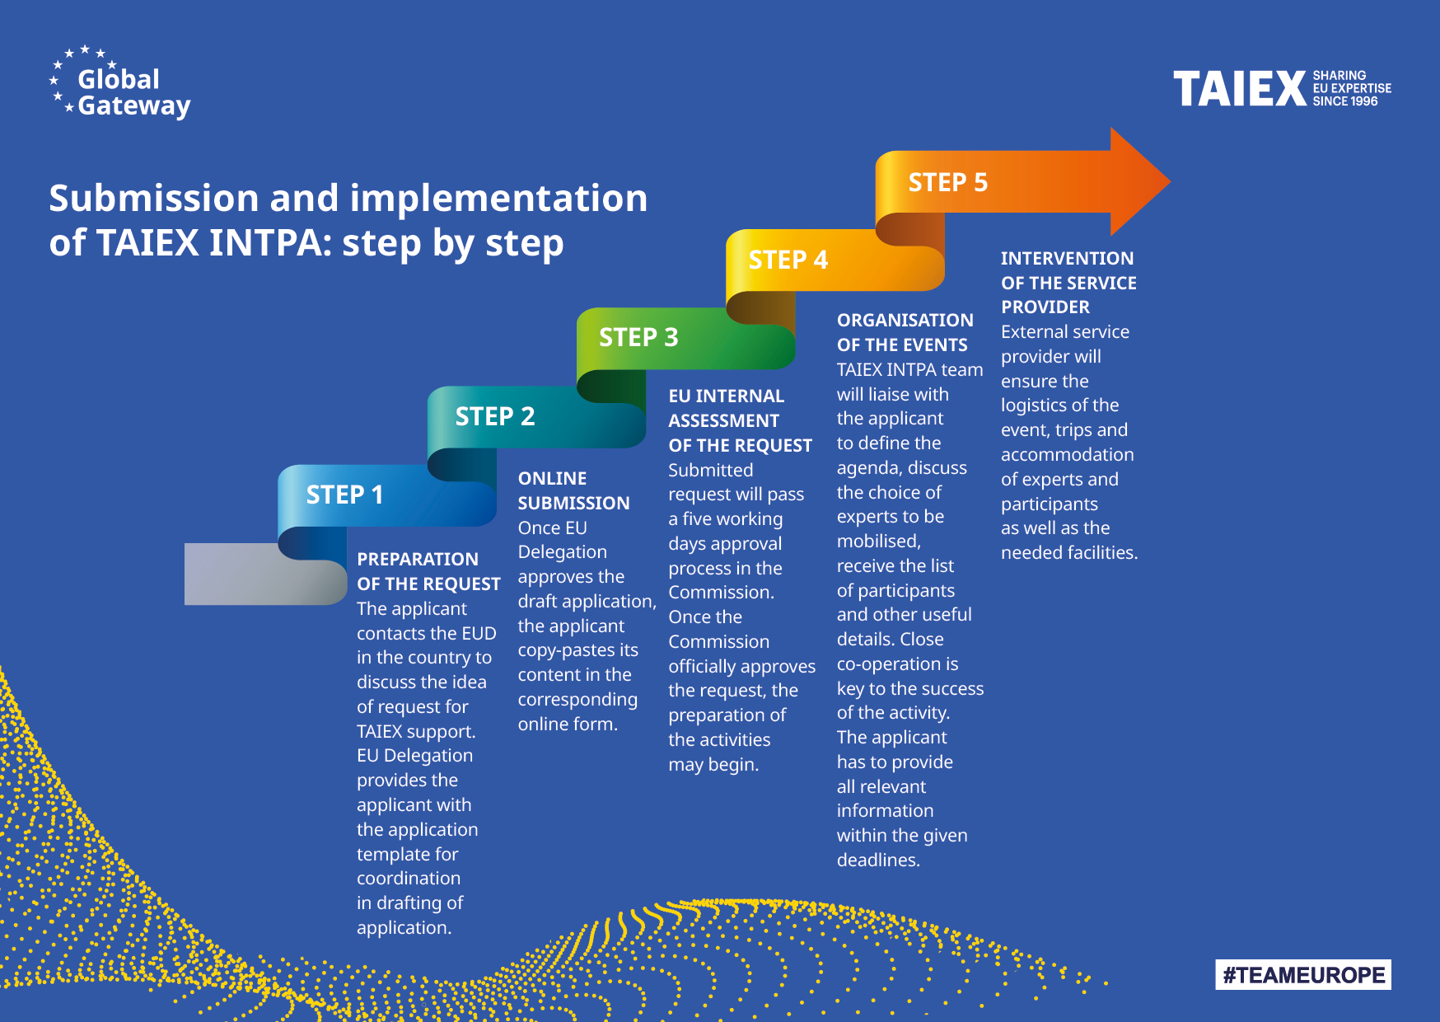

#TeamEurope
TAIEX INTPA: Application Process
ec.europa.eu/taiex/application

Slide 7
#TeamEurope
^{TAIEX INTPA: Next} ^{three months}
Activity | Country
Study visit on Technical assistance for digitisation, digital preservation and conservation of antique collections | Ecuador
Workshop on Increasing the Potential of Public Councils | Kazakhstan
Study Visit on Digital Public Policy Design and Evaluation | Dominican Republic
Support to prevent Gender Based Violence | Mauritius
Expert mission on development of Capital Market products | Tanzania
(Multi Country) Workshop Floods and droughts | El salvador
TAIEX Expert Mission on Immersive Training in Cyber Defence/Offence and Signal Intelligence | Trinidad and Tobago
Study visit on competition policies with Spain/Germany | Peru
Workshop for prosecutors and investigators of the national preventive mechanism - Series of events | Kazakhstan
Workshop on Microbiology - Series of events | Guinea-Bissau
Series of events on Reducing Corruption Risks in Criminal Justice Sector – Prosecutor’s Office | Uzbekistan
Study Visit on Exchange on CRVS system implementation by public admin | Sierra Leone
Expert Mission on Exchange on electronic voting over the internet | El Salvador
Workshop on dispute resolution, commercial arbitration, mediation and court technologies | Pakistan
Storage management for conservation of historical heritage | Sudan
Expert mission on Pension reform | Mongolia
Support to the Ministry of Education and Public Service Modernisation | French Polynesia
TAIEX INTPA Stragegic seminar between the EU and Cabo Verde on Cybersecurity | Cabo Verde

Slide 8

#TeamEurope
^{TAIEX} ^{INTPA: Examples}
Boosting Uzbekistan’s knowledge on regulatory impact assessment and systematisation of legislation
“The main advantage of TAIEX INTPA is the quick application process, access of new ideas and short term impact.”
DILAFRUZ SUFIEVA
Ministry of Justice of Uzbekistan
Making Honduras’s e-government more secure for its citizens
“The biggest benefit for us was receiving first-hand experience in e-government from European countries and receiving answers to our most pressing questions.”
POLICARPO MELARA MERCADAL Office of Presidential Affairs and Public Innovation
Increasing the participation of Sudanese students in the Erasmus+ programme
“What we liked most about our experience with TAIEX INTPA was the collaboration and that it gave our young students a chance to progress.”
AHMED FAHAD Ministry of Higher Education and Scientific Research

Slide 9
#TeamEurope
^{Contacts}
^{Where to apply}
Twinning INTPA:
near-twinning@ec.europa.eu
PRICE-MARTIC Marija (NEAR) Marija.PRICE-MARTIC@ec.europa.eu ;
DEL BIONDO Karen (INTPA) Karen.DEL-BIONDO@ec.europa.eu
TAIEX INTPA:
near-taiex-intpa@ec.europa.eu
DELGADO VAN DEMEN Michelle (NEAR)
Laura-Michelle.DELGADO-VAN-DEMEN@ec.europa.eu;
DEL BIONDO Karen (INTPA) Karen.DEL-BIONDO@ec.europa.eu
Adrien.BOURGEOIS@ext.ec.europa.eu
Remember! Applications can be submitted either by EU Delegations, Partner Country institutions or HQ, we do ask you to consult among the relevant stakeholders before submission.
Application form (europa.eu)

