Slide 1
The challenges of local and territorial development in Africa
Regional Seminar on the Territorial Approach to Local Development (TALD) for English-speaking African countries
Johannesburg, South Africa, 26-28 October 2022

Slide 2

What is the Commonwealth Local Government Forum?
CLGF
Membership body bringing together Local Government Associations, Cities/Councils and Ministries of Local Government
Members in 48 Commonwealth countries (Africa, Asia, Europe, Caribbean & Pacific)
Focus on Advocacy, Programmes, Networks and Research/Knowledge sharing
CLGF has a Framework Partnership Agreement with the EU since 2015 and has been implementing EU funded projects since 1997
Founding member of the Global Taskforce of Local and Regional Governments (GTF)
Regional offices in Ghana, Tanzania, South Africa, India, Trinidad and Tobago, Fiji

Slide 3
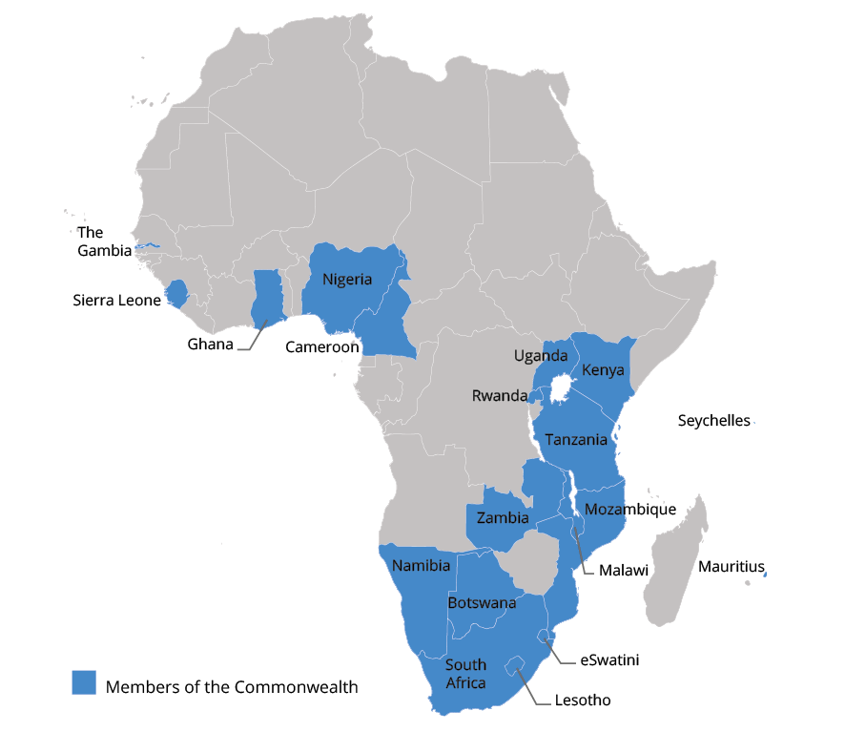
Commonwealth Africa development challenges & local priorities
The Commonwealth is made up of 56 countries, 21 of which are in Africa.
Key continental challenges:
Impact of Covid-19 (health, economy & services)
Climate change & extreme weather
Increasing inequalities & informality
Incomplete decentralisation & weak governance
Limited resources
Demographic shift (youth bulge) & internal and external migration

Slide 4

Commonwealth Africa Framing priorities for action
The Sustainable Development Goals
The 17 SDGs were agreed in 2015 as a shared blueprint for peace and prosperity for people and the planet, now and into the future. They have been integrated into national development plans both in the EU and Africa
NDICI – Global Europe
Focal areas on (1) Green Deal (2) Digitalisation (3) Economy for People (4) Migration (5) Governance, Peace & Security
AU Agenda 2063
7 Aspirations 20 Goals with a focus on: Quality of life, education & skills, Health & food security; Democratic principle, Youth & Women empowerment; Economic transformation; Capable institutions and transformative leadership

Slide 5

Localising contiental priorities
Local government has a clear role to play in over 65% of the SDGs. However, the role of local government in Agenda 2030 goes beyond its visibility in individual goals. Local government is an essential enabling agency. Local government has a role to play in implementing all the 17 SDGs
  Leaving no one behind because local and regional governments are closest to the people and are better placed to identify the needs and priorities of communities
  Unleashing the individual potential of territories to promote growth, social cohesion and environmental sustainability
  Localising national, regional and global development goals
Local government is the practical level at which Climate action and Green Growth, Sustainable livelihoods, Good governance, Youth inclusion, Women’s empowerment, Peace and Security must be rooted

Slide 6
Why work with local government ?
Local governments are political actors and not just managerial entities – they have a role in promoting and guiding development
Local government can contribute to development as partners of national government by ensuring that development initiatives efficiently and effectively target the needs and priorities of citizens
Local government service delivery is critical in ensuring social & economic growth as well as addressing poverty and inequality
Local government is the closest level of government to the community and is the practical level to leverage of partnerships (and resources) between citizens, business, local government and community-based organisations.
Both TALD and the local government system are spatially integrated in their approach to development – looking at a full system of physical, social, economic, environmental sustainability

Slide 7
CLGF’s work in promoting TALD
Local Economic Development in Southern, East and West Africa
Decentralised planning in Zambia and Zimbabwe
Localising the SDGs in Rwanda

Slide 8
Unlocking territorial potential through Local Economic Development
LED offers a comprehensive framework for ‘integrating’ and ‘localising’ multi-dimensional national and international priorities. It catalyses the identification of the pressing development challenges and strategies in a context specific way (focused on the territory)
CLGF’s recent work:
Piloted and rolled LED in 8 countries Botswana, Cameroon, Eswatini, Ghana, Sierra Leone, Uganda, Zambia and Zimbabwe
Formulated National LED frameworks and Guidelines​
Built LED capacity of 1103 elected and appointed officials​
Set up 39 LED departments/ focal points in beneficiary LAs​
Formulated 50 LED strategies with LAs across the 8 countries​
Mapped, analysed value chains, and packaged 24 catalytic projects​
Mobilised resources for catalytic projects through investment fairs
Implemented 30 demonstration projects (Eswatini 10, Sierra Leone 4, Uganda 1, Zambia 10, and Zimbabwe 5)​
Facilitated peer learning at national and regional levels​

Slide 9
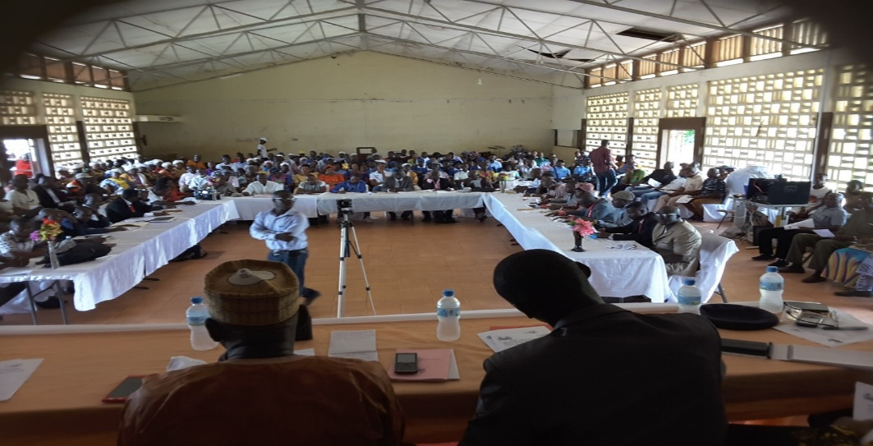
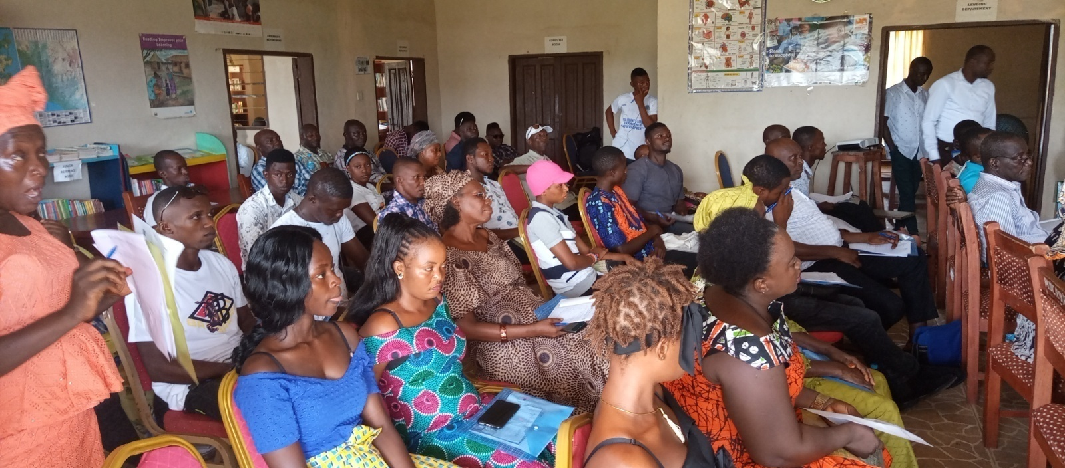
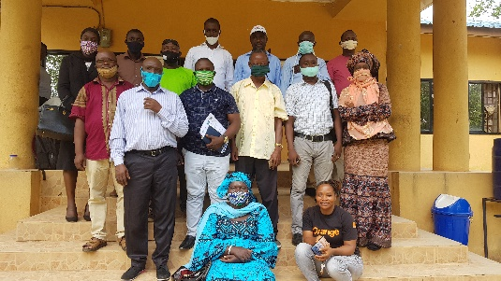
Ward Development Committee Awareness raising on LED and Procurement process, Port Loko District Council
SME training on Record Management, Bookkeeping and procurement processes, Port Loko City
Stakeholder consensus building meeting on the implementation of the Margin of preference trail, Bo City Council
Supporting SME inclusive Procurement in Sierra Leone

Slide 10
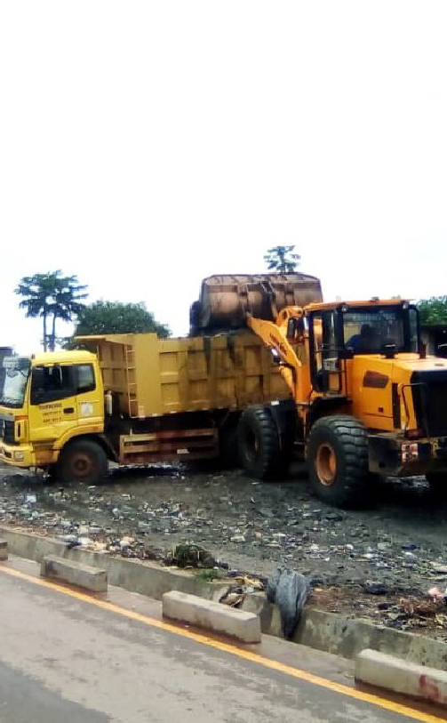

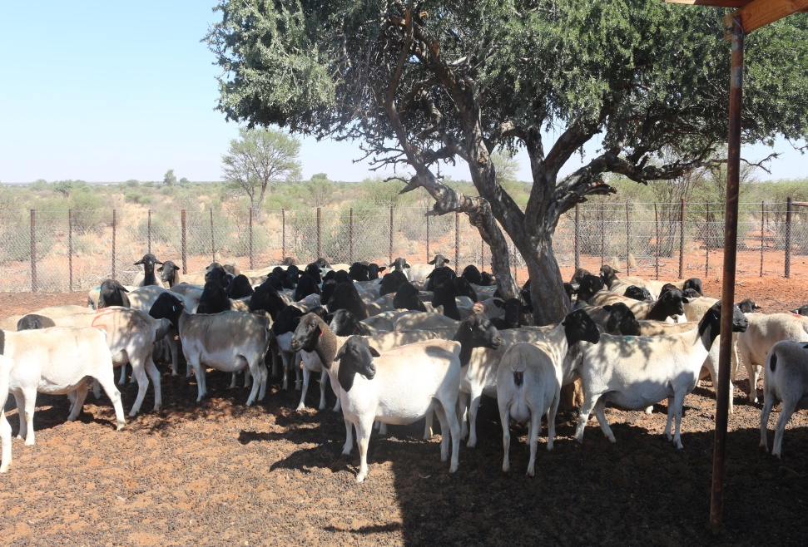
Enhancing Value Chains in Zambia & Botswana
Soya bean value chain enhancement project in Chipata Zambia
Kopala Green Waste Solutions Project, Zambia
Small livestock value chain enhancement Project, Botswana

Slide 11
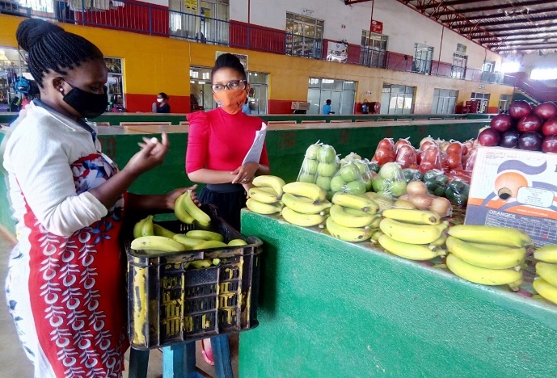
LED projects in action in Eswatini
The Tractor used to collect waste in the Matsapha Town Council and peri-urban area
Climate smart vegetable garden in Mbabane Municipal Council
Support for women entrepreneurs in 13 urban councils in Eswatini
Community contracting model in Manzini Municipal Council

Slide 12
LED Results
Increased capacity for LED planning and implementation​
Better understanding of local economies by local governments and stakeholders leading to increased investments in LED & catalytic projects​
Increased inward investments in local economies through investment promotion drives​
LED is now national policy in Botswana, Eswatini, Ghana, Zimbabwe and Zambia, and in South Africa the Small Towns Regeneration initiative has also been upscaled
Increases jobs and improved livelihoods across partner councils

Slide 13
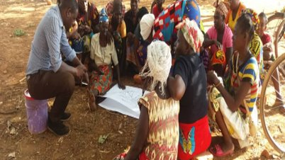
Leaving no one behind- Support for IDP planning in Zambia
Launch of IDP Guidelines
Piloted the Guidelines and provided input to the refinement
Trained 537 (188F 349M) on the IDP development process
Prepared 11 IDPs complete with LED strategies
Harmonise relationships between district stakeholders
High social inclusion in the process

Slide 14
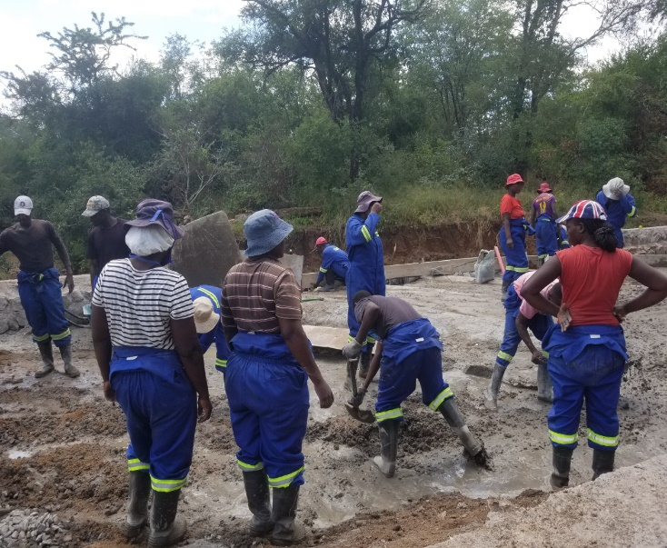
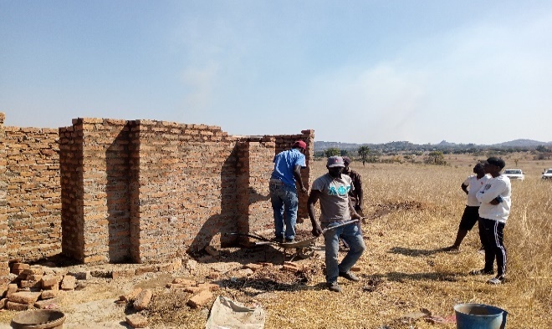
Leaving no one behind - ward planning - Zimbabwe
Preparation and Project Information Sharing
Training of Councillors on Ward Development Leadership
Training of Traditional Leaders in rural areas
Strengthening Ward Development Structures and Leaders
Ward Consultations on Social-economic Development
Development Plans with Priority Projects and Budgets
Consolidate Ward Plans into the District Integrated Development Plan
Citizens voluntarily constructing a damaged road in Chiredzi RDC, motivated by council's citizen engagement
Citizens voluntarily constructing toilets at the LED CLIC project at Nheweyembwa ward 5, Murewa RDC

Slide 15
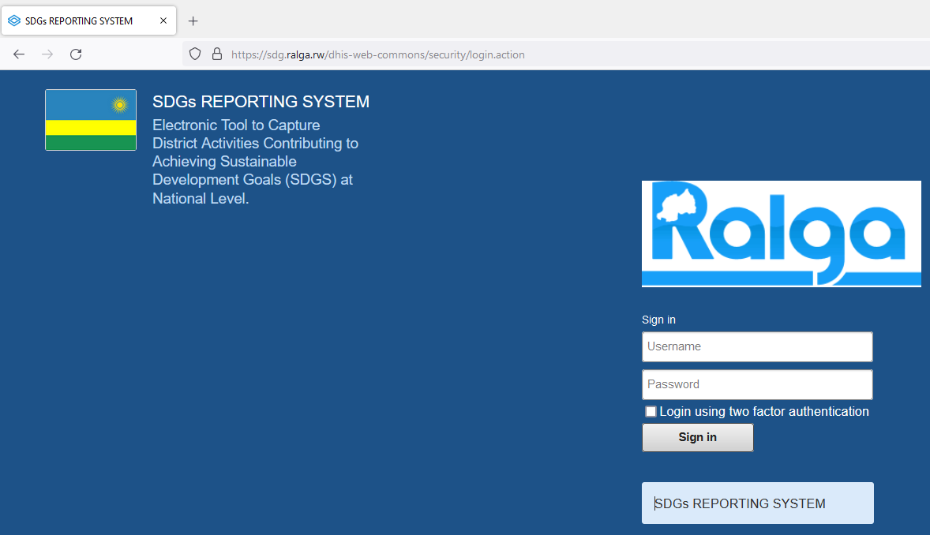
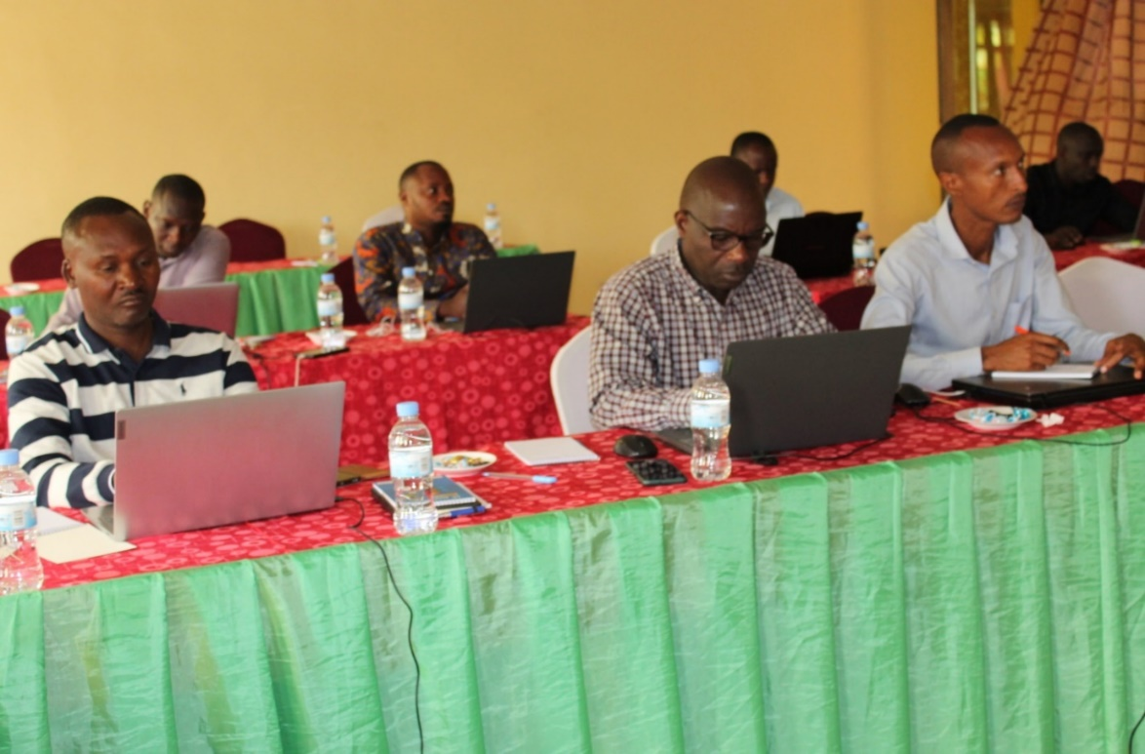
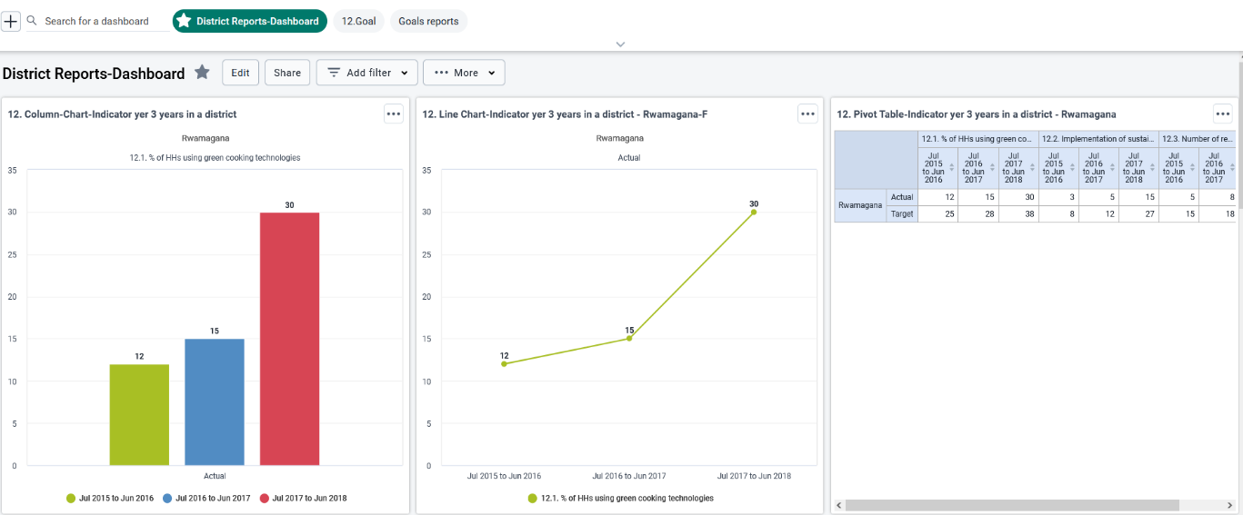
Local Government Associations’ online portal for local government SDG monitoring
Training Municipal Officers in use of SDG reporting system
District Reports Dashboard
Local Monitoring of SDG in Rwanda

Slide 16
Challenges of TALD implementation institutional
Incomplete Decentralisation
  Many countries still have incomplete implementation of their commitments with regard to powers and functions of local government can include unfunded mandates, conflicting legislation or overlap of responsibilities between LG and line Ministries
  Local governments need to be empowered through legislation and support to successfully implement TALD initiatives
Capacity appointed and elected municipal officials
  Both central and local government have limited capacity to implement TALD initiatives
  There is need to invest in sustainable capacity building approaches which are holistic and to address capacity at individual, organisational an institutional levels
  Capacity building must be an ongoing process for government officials
Institutional weaknesses
  Existing public administration systems need to be strengthened to ensure that they serve the purpose for which they were set up
    For example, with LED and IDP we had to support the setting up of multi-stakeholder institutional arrangements such as LED forums and ward committees
  Corruption and lack of due process can undermine new modalities

Slide 17
Challenges of TALD process
Coordination and Partnerships at the local level
  TALD approaches such as LED and IDP require multi levels of government and multi stakeholder – which all needs to be coordinated
  Working in partnership takes time both to build trust and capacity to work in new ways
Funding TALD approaches & resulting proposals
  TALD processes, consultations and data collecting, need additional staff and funds to undertake
  Local government and their stakeholders need support on revenue generation both to access their own source revenues & to prepare costed budgets and proposals
  There is need for investment in additional staff and technology for TALD approaches to work
Managing expectations and ensuring delivery
  Communities are always excited to work more closely with their local authorities, which raises a lot of expectations. it is important to manage citizens expectations to ensure credibility of all stakeholders and to deliver against plans and commitments
  Communities also need support to be able to participate meaningfully in development, In particular youth and women where participation is lower
  Recognising that there is often a Trust deficit going into a new way of working

Slide 18
Opportunities
The COVID-19 pandemic showed the world that working collaboratively and cooperatively is the only way results can be achieved. There is an opportunity to build on the coordination and collaboration demonstrated during the COVID pandemic. In addition the pandemic demonstrated that new working modalities and increased use of technology and digitalisation can show real results which can be capitalised on to overcome some of the challenges of TALD
CLGF members during recent regional meetings are coming to us asking for support to involve communities in development. Proposals received at the most recent Southern African regional meeting included:
  Zambia Constituency Development Fund initiatives,
  Zimbabwe Devolution process,
  South Africa District Development,
  Angola upcoming local government elections,
  Namibia LED framework and rollout,
  Mozambique implementation of Decentralisation
CLGF’s membership bringing together local Government Associations and Ministries of Local Government is well positioned to support the multi-level nature of TALD work
The Framework partnership agreements present a huge opportunity for the signatories to work with EU delegations to ensure that local governments play a role in the implementation of national, regional and continental programmes

Slide 19
Thank you
Commonwealth Local Government Forum
(CLGF)
Claire Frost
Head of Programmes
claire.frost@clgf.org.uk
Follow us on Twitter @CLGF_News
www.clgf.org.uk

