Slide 1


Program on Integrated Local Finances for Sustainable Urban Development in GKMA (PIFUD)
Presentation to the Regional Seminar on the Territorial Approach to Local Development (TALD) for English Speaking African Countries
Johannesburg, South Africa
26 – 28th October 2022

Slide 2






Project Summary
Project Name | Program on Integrated Local Finances for Sustainable Urban Development in GKMA (PIFUD)
Grant Recipient | KCCA
Implementing Entities | KCCA & FMDV
Implementing Partners | UNCDF, Cities Alliance, City of Paris, City of Johannesburg
Beneficiaries | Kampala Capital City, Entebbe, Nansana & Makindye Ssabagabo Municipalities
Project Duration | 48 Months
Start Date | December 2019
End Date | December 2023
Amount | EUR 4,158,671

Slide 3
Project Financing
Funding Source | Amount (EUR) | % Contribution
EU/EDF | 3,858,671 | 92.78
KCCA | 100,000 | 2.40
FMDV | 100,000 | 2.40
UNCDF | 100,000 | 2.40
TOTAL | 4,158,671 | 100%

Slide 4



PIFUD BUILDING BLOCKS
National Development Plan III
National Urban Policy
GKMA Physical
Development Strategy
GKMA Local Economic
Development strategy
KCCA 5-year
Strategic Plan
Municipal
Development Plans
Kampala Climate Action Plans & Revenue Mobilisation Strategies
Local Revenue Mobilisation Strategies

Slide 5
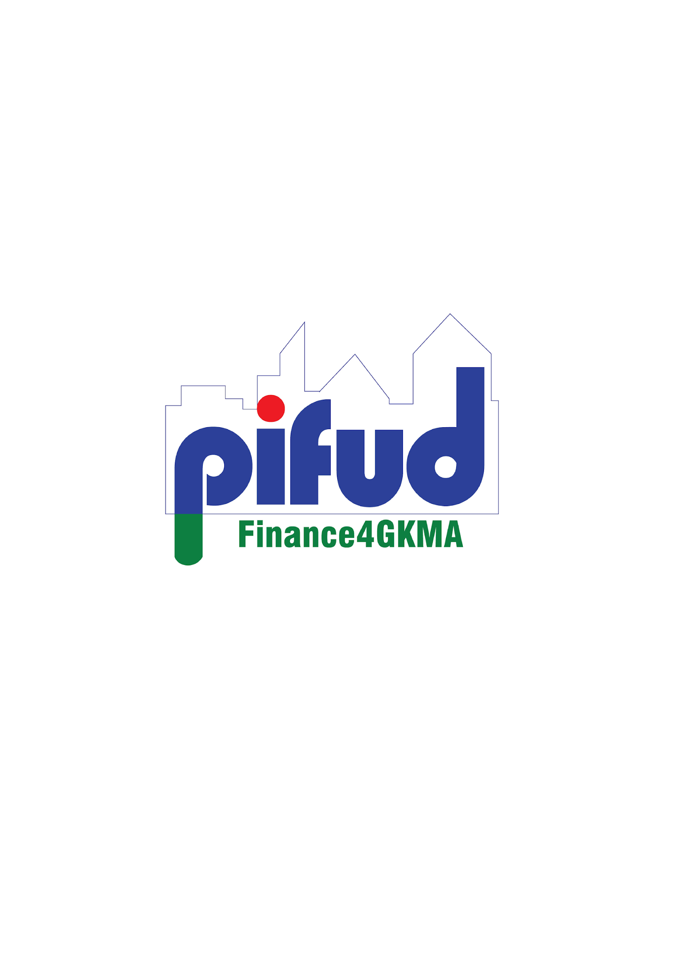
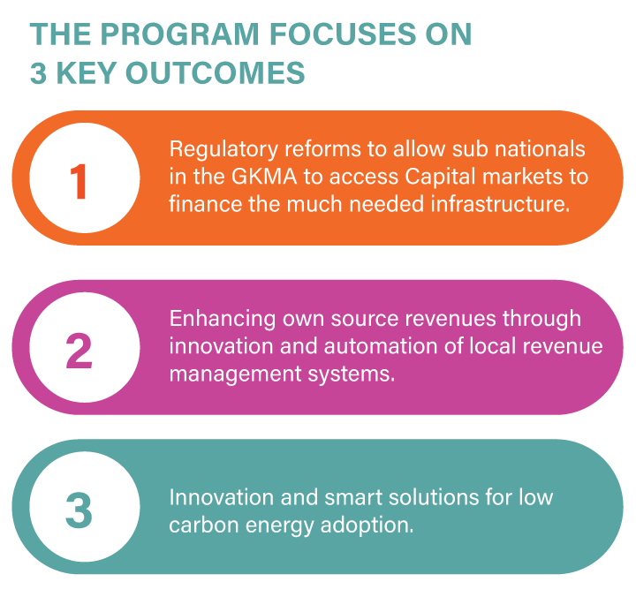
Pifud objectives
4-years programme, funded by the EU Commission
The program started in November 2019, with the signature of the MoU between KCCA and the EU
The program is co-led between KCCA and FMDV with co-financing partners: UNCDF and Cities Alliance
The programme focuses on 3 key outcomes
Work package 1
Work package 2
(incl. IRAS roll-out)
Work package 3
Work package 4

Slide 6

Workpackages
WP 1: Regulatory reforms for
Municipal Finance Enhancement
WP 3: Design a metropolitan capital investment plan
Improved creditworthiness for KCCA & GKMA Municipalities
WP 2: Own-Source Revenue
enhancement
WP 4: Small-scale investment in low-carbon energy delivery

Slide 7
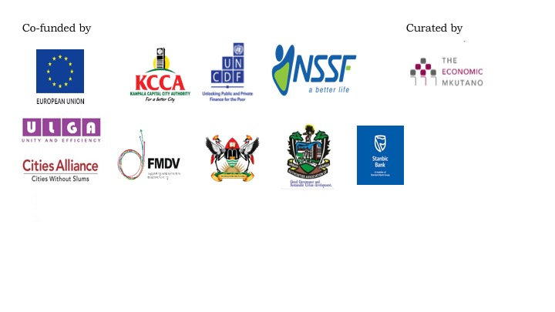
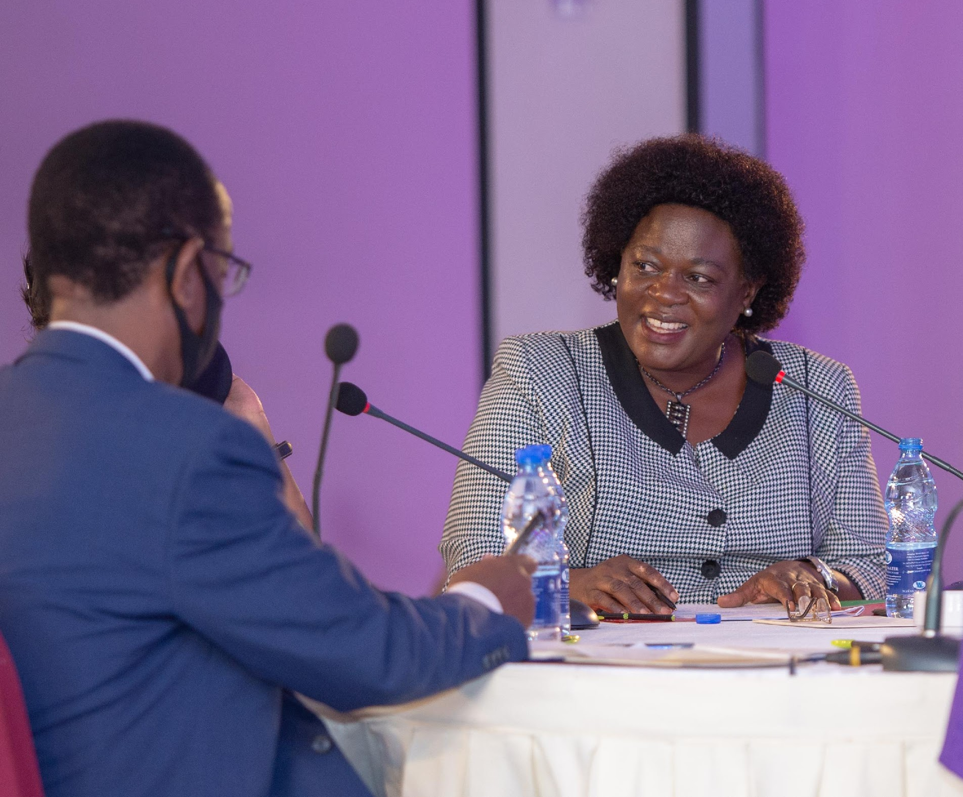
Overview Pifud achievements
WP 1: Regulatory reforms for
Municipal Finance Enhancement
Following the High level Policy Dialogue, one aide mémoire has been signed with 10 actionable commitments (November 2020)
One task force was created with the leadership of ULGA
One Cabinet Memo on ‘Alternate Financing’ for municipal finance is in progress proposing policy reforms
High Level Policy Dialogues convened
KCCA ED, Ms. Dorothy Kisaka at Economic Mkutano 2020
PPP Unit of the Ministry of Finance, Mr. Jim Mugunga

Slide 8
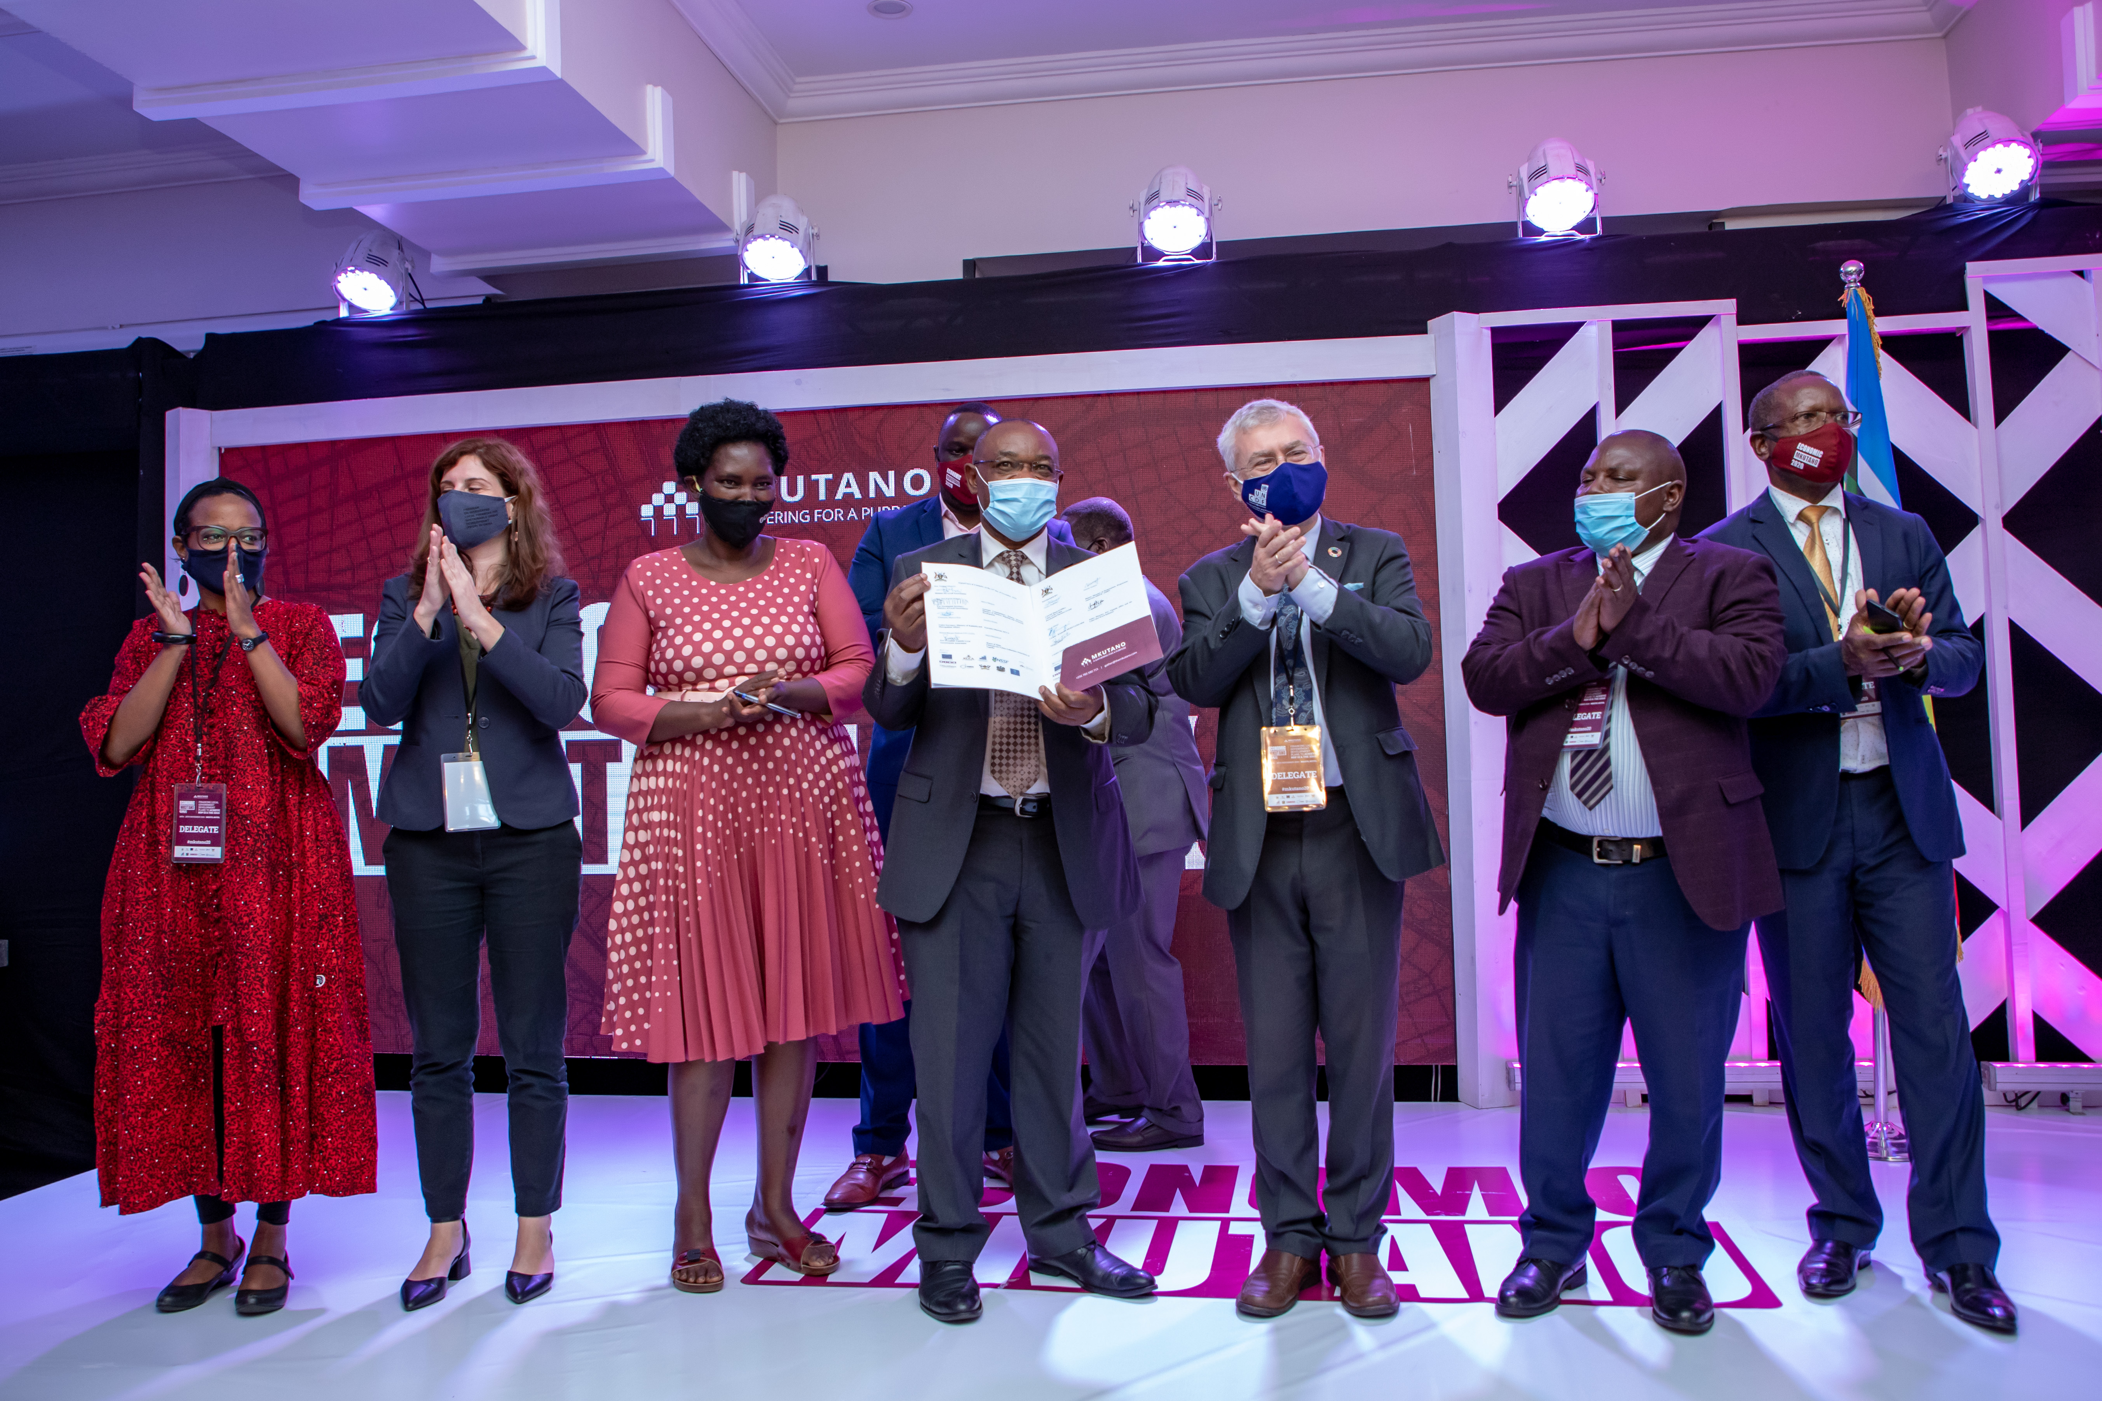
Advocacy meetings follow-up
An Inter-Ministerial Taskforce was created chaired by Ministry of Local Government
Next steps:
PIFUD to support
Drafting Cabinet memorandum on first set of policy reforms
Designing advocacy campaign for mid- and long- term policy changes
Conducting additional research on specific thematic:
  Subnational Pooled Financing mechanism
  Land-Based Financing in the GKMA
  Local Green Bonds
**** from Johannesburg took part in the workshop to share the Johannesburg experience

Slide 9
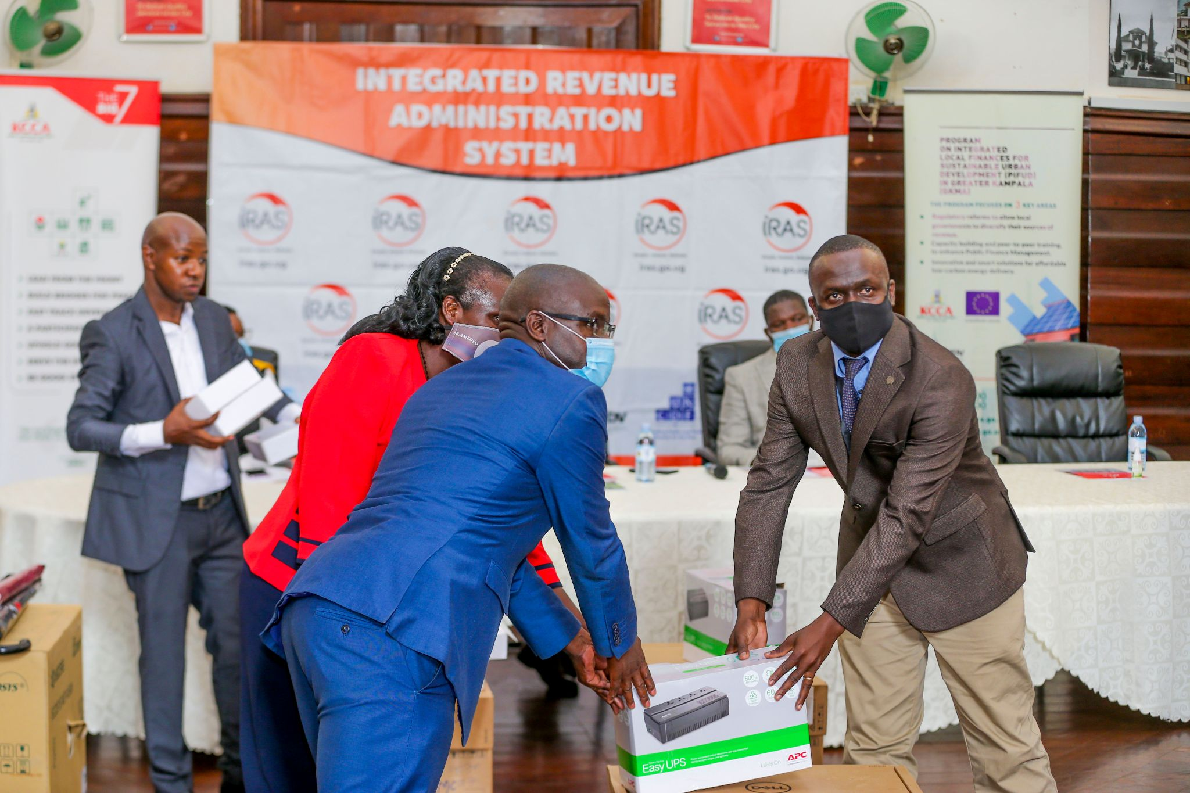
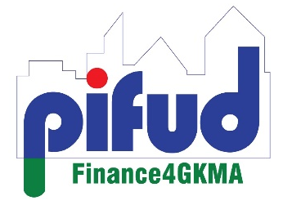
Capacities of KCCA and GKMA secondary cities own source revenue mobilization are improved
Roll-out of IRAS
WP 2: Capacities of KCCA and GKMA secondary cities own source revenue mobilization are improved
Secondary cities with revenue automation system. Comparative performance | Rollout of IRAS to the 3 beneficiary Municipalities completed New servers to handed over to LGFC. Beneficiary Municipalities provided with equipment including computers, handheld gadgets for field staff, internet network equipment In Makindye Ssabagabo x3 business registered In Nansana: +62% in taxpayers registration In 9 months FY20/21, LGs collected more than during the totality of FY 2019/2020
System development (modules)
Sensitization campaign | In collaboration with the respective LGs

Slide 10
WP 2: KCCA support to the secondary cities to document, re-engineer and automate their revenue management systems
Local Revenue Collection Performance over the last 2 years
Municipality | Total Tax Payers Registered by June 2022 | Revenue Collections per FY
 |  | 2020/2021 | 2021/2022 | % Increase
Nansana | 52,349 | 3,834,709,776 | 5,426,000,489 | 41%
Makindye Ssabagabo | 29,595 | 2,606,963,587 | 4,274,000,000 | 64%
Entebbe | 3,799 | 1,798,398,058 | 2,164,582,453 | 20%
Implementation of the IRAS system has been completed together with stakeholder sensitizations.
Installation of servers at LGFC has been completed

Slide 11
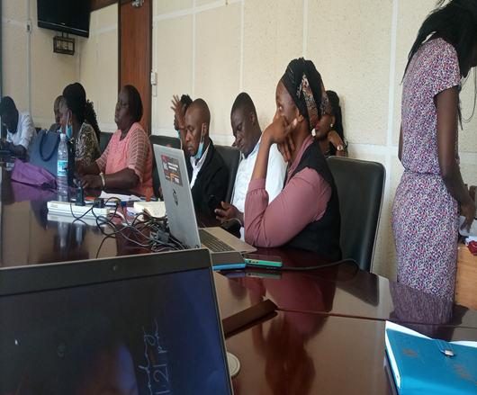
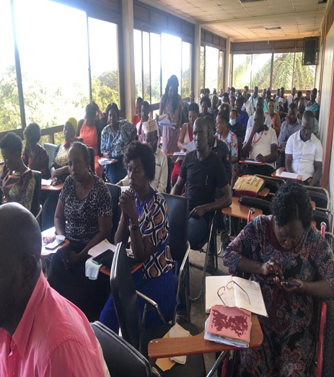
WP 2: KCCA support to the secondary cities to document, re-engineer and automate their revenue management systems
Sensitization of 86 Political heads and 39 technical staff was conducted in Entebbe Municipality

Slide 12
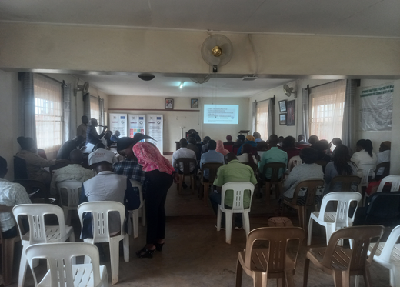
WP 2: KCCA support to the secondary cities to document, re-engineer and automate their revenue management systems
Sensitization of 185 Political heads and 89 technical staff was conducted in Makindye Ssabagabo

Slide 13
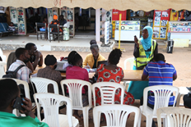
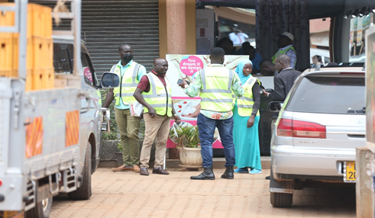
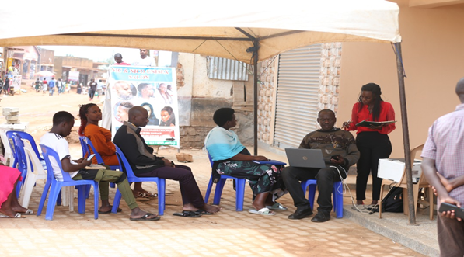
WP 2: KCCA support to the secondary cities to document, re-engineer and automate their revenue management systems
Tax payer Sensitizations in Nansana Municipality

Slide 14
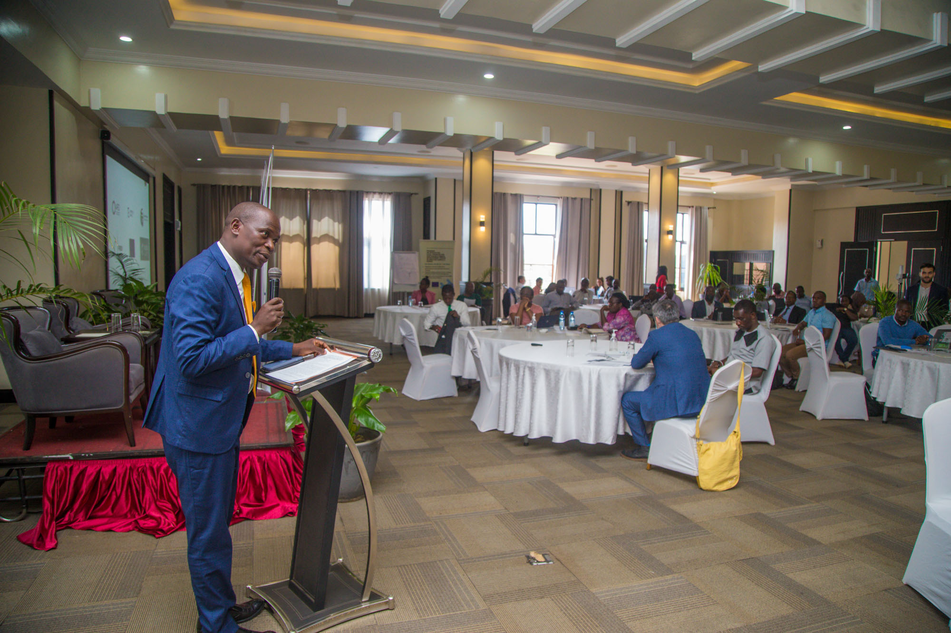
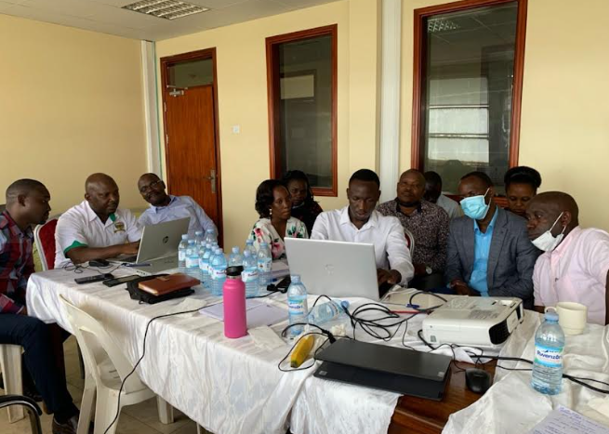
WP 3:Design of a metropolitan investment plan
A 3-day workshop on access to climate finance was conducted in May-June, in collaboration with CoMSSA

Slide 15
WP 3:Design of a metropolitan investment plan
Objective: develop a tool in order to match GKMA projects with relevant funding sources
Project profiling exercises were conducted with 8 out of 9 LGs in May 2022.
20+ projects were profiled before the workshop and the data collected was used as a basis of discussion during the May workshop
A pre-CIP template was created to prepare the baseline. This template serves as a starting point for developing a Capital Investment Plan (CIP) in a longer term
A 3-day workshop on access to climate finance was conducted in May 2022 with 60 participants.
Design of an online CIP tool is underway.
An investment forum is scheduled for February 2023 to bring together the Municipaties to pitch their projects to Financiers
A 3-day workshop on access to climate finance was conducted in May-June, in collaboration with CoMSSA

Slide 16
Workpackage 3 :
Capital Investment Plan
Inception report
ESAMI
Capacity building
Design of the
Capital Investment Plan
Political alignment/ support from MDAs
What is a
Capital Investment Plan?
  Screening of feasible capital investments
  Assess the current stage of preparedness and available funding
  Prioritize and Schedule investments over 3 - 5 years period
Identification of
financing opportunities
Annual budgeting and planning of Capital and Operating expenditure
PPF
for 3 PPPs
Pre-identification
with PPP Unit
Participatory
Fair
Coherent
Pre-
identification of projects
for IBP
for Capital markets
Revenue mobilization strategy
for UDPG support

Slide 17
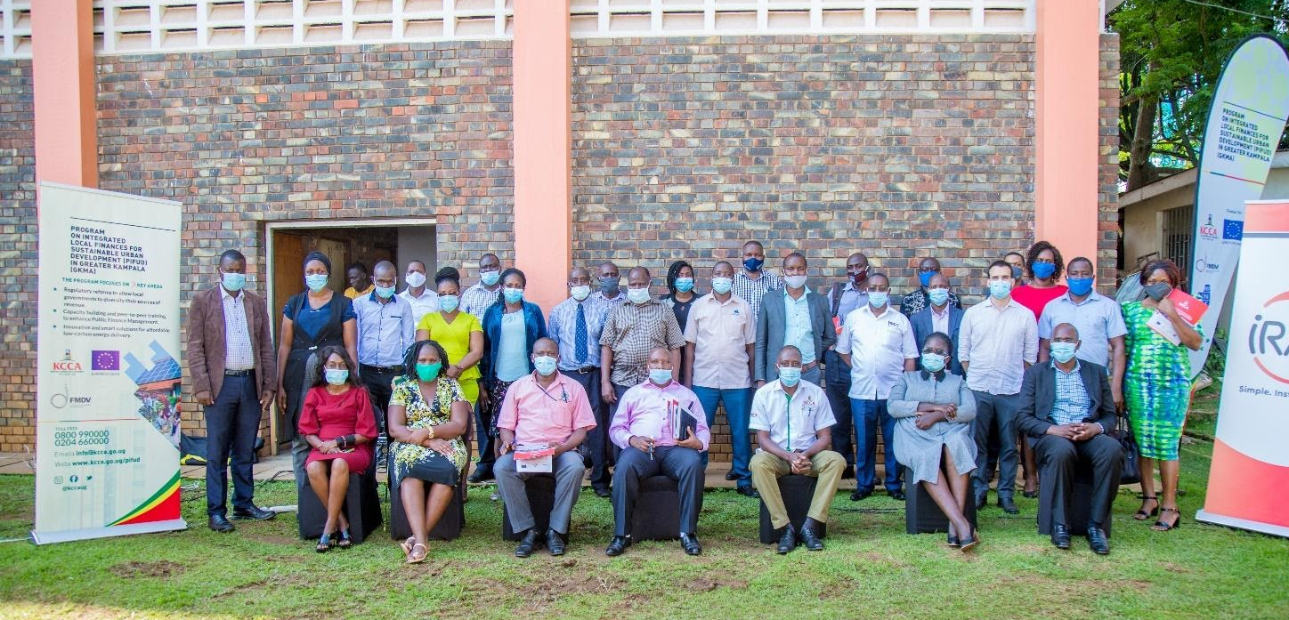
LBF and creditworthiness trainings
  A workshop on Municipal Revenue Enhancement
  Organized in August 2020 and hosted by the Entebbe municipality.
  25 participants including, district and municipal Senior Planners Commercial Office Coordinators the KCCA Revenue collection supervisor and Finance Officers; the IRAS team and champions from each municipality.
  Outcome highlighted strong interest in Land-Based Financing and improving Public communication about the value of paying taxes.
Next steps:
Draft a concept note with UN-Habitat/Global Land Tool - 3 deliverable
  By March: a policy brief (for advocacy campaign)
  From April to June: hands-on training on LBF tools – aligned with capacity building of NPA
  Tbc: A pre-feasibility studies for participating municipalities on LBF as part of revenue mobilization strategies
  Hire consultants to conduct the training

Slide 18
Work package 4 :
1. Solar power in 4 schools
2. Solar-powered e-motorcycles and charging station
3. Solar mini-grid energy system is developed in GKMA secondary cities with a private operator and local communities
WP 3:Design of a metropolitan investment plan
Living Labs _ Pilot projects on renewable energy
Solar in Schools 4 schools involved in 5 different divisions | 2. E-Mobility 4 e-bikes purchased 10+ stations operational | 3. Mini Grids – off grid communities
Completed procurement the solar panels for 2 schools in KCCA On-going procurement initiation for 2 GKMA schools | Motorcycles already operating. User feedback _ M&E Charging station to be installed soon | Identification/tender out of the sites in conjunction with the Rural Electrification Agency based on least economic option analysis Call for bids close in November 2022

Slide 19
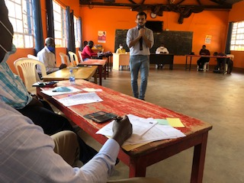

First Pilot Project based on the Living Lab Methodology
Renewable Energy in Schools for Children with Disabilities
PIFUD workshop with school management and service providers, at Ntinda School for the deafs

Slide 20
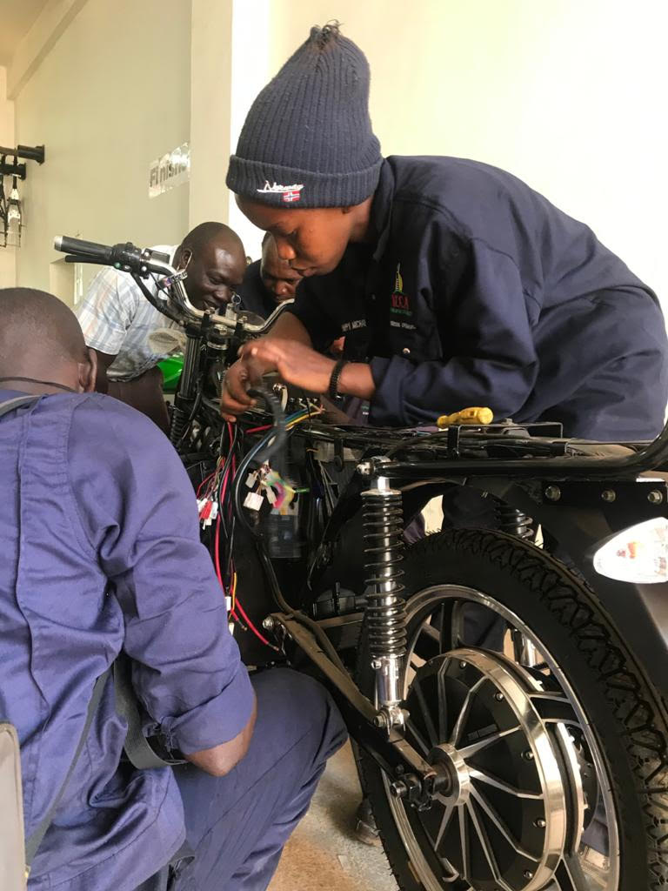
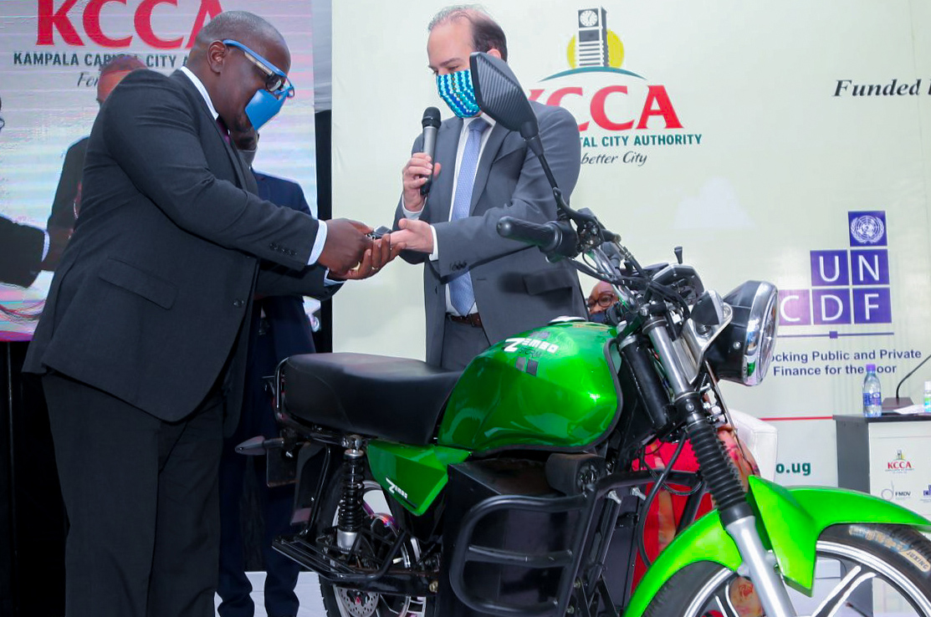
E-Mobility Pilot Project
2020
2021 onwards
March-July 2020: procurement of 4 electric motorcycles
August: Engaging the youth with business partner
- Selection process of battery swappers
- Allocation of e-motorcycles to KCCA fleet
June-September: Inception meetings with co-beneficiaries (KCCA urban division, KCCA directorates).
Design and installation of charging station
September 2020 to February 2021 Training of users (battery swappers, KCCA maintenance team and driver
By July 2021: Design a business model with agreed social, environmental and economic goals.
Next Steps
Above: GKMA engineer (f) – hands on training on a Zembo e-bike
Below: KCCA DED receives the keys from EU Head of Section Green Economy – at PIFUD Official launch ceremony in Lubaga
Between July 2021 and November 2022: testing and demonstrating concepts

Slide 21
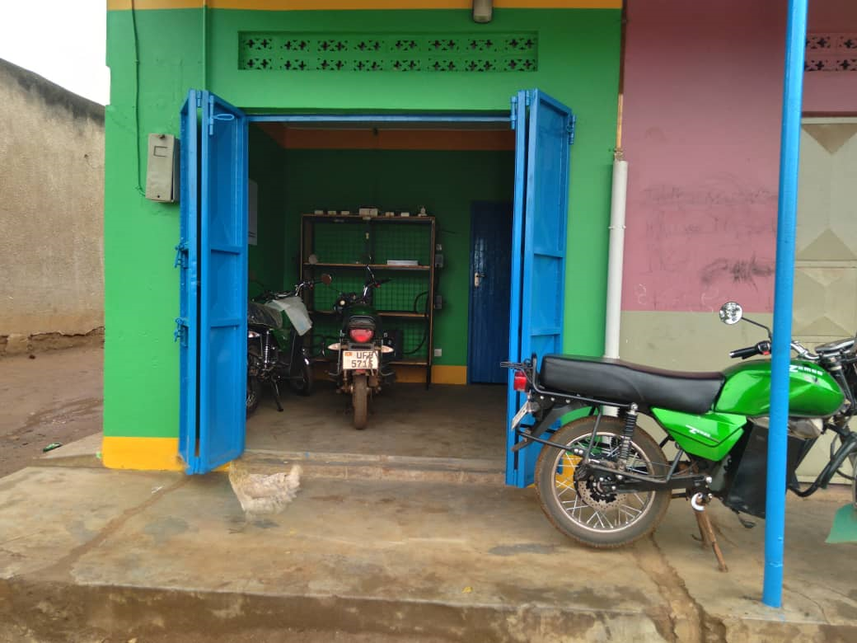
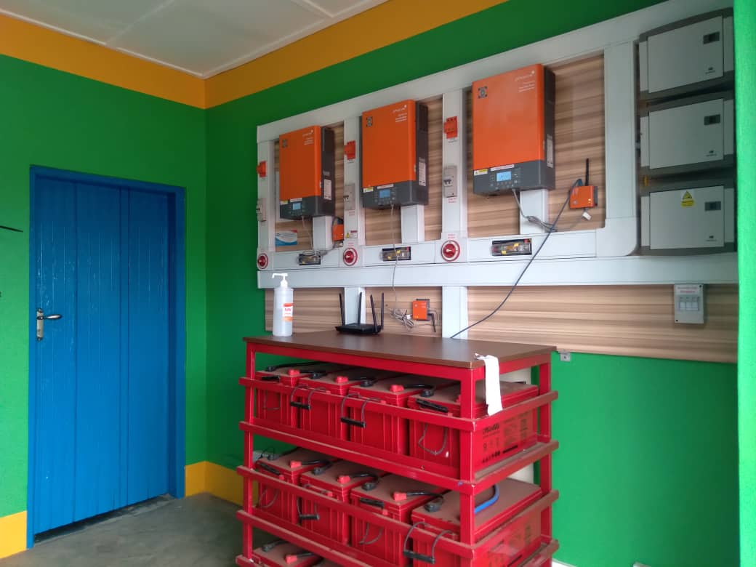
Battery Swapping Station
4 Electric motorcycles & 1 charging station were procured and integrated in the KCCA fleet. For the last 2 years, about UGX15Million (U$4,000) has been realized in savings of fuel & servicing costs.

