Slide 1

City of Johannesburg
Engagement with CoJ Management
11 October 2021

Slide 2
OPENING REMARKS
THE UNIQUENESS OF SOUTH AFRICAN URBAN
  Spatial transformation
  Local governance
COMMITMENT TO INTERNATIONAL AGREEMENTS
  Sustainable Development Goals
  New Urban agenda
  Influence on National Plans
STATE CAPABILITY AND ACCOUNTABILITY
  Policy reforms
  Politics and development
  Indicators and human experience

Slide 3
THE CASE FOR THE LOCAL
SACN AT A GLANCE

Slide 4
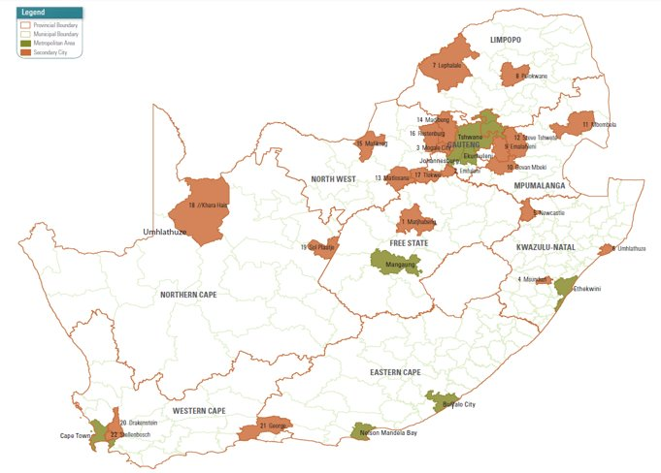
SOUTH AFRICAN URBAN- 8 METROS 33 ICMS
Notes:
The strategy is underpinned by the IUDF, South Africa’s national policy framework that is intended to guide the future growth and management of urban areas.
The IUDF aims to create a shared vision across all of society of how best to manage urbanisation and achieve spatial transformation, and includes the strategic goals of spatial integration, inclusion and access, economic vitality and effective governance.
Effective and integrated management will enable cities to translate urbanisation into greater productivity and higher rates of growth, transforming them into engines of growth.
The SACN’s strategy aims to support cities in implementing the IUDF within their unique contexts.

Slide 5
SOUTH AFRICAN URBAN-RURAL LINKAGES- IUDF INFORMANTS
Understanding the Urban-Rural Linkages
Historical contexts of 1913
Changing Context
Implications for Urban Development
Clearly defined rural policy that addresses national economic issues
The two policy frameworks (urban and rural) need to connect with each other ​
Local economic development, diversification of rural economies and development of small towns for transformation
Extractive relationship between rural and urban
Dual economy with distinct productive relations ​
Rural and urban areas are increasingly becoming inter-twined​
Farming areas and metros co-exist along the continuum with multiple types of flows and interactions occurring along the continuum​
Households’ livelihoods include both rural and urban elements ​
However, the dichotomy between rural and urban spaces still dominates the development thinking
Notes:
The strategy is underpinned by the IUDF, South Africa’s national policy framework that is intended to guide the future growth and management of urban areas.
The IUDF aims to create a shared vision across all of society of how best to manage urbanisation and achieve spatial transformation, and includes the strategic goals of spatial integration, inclusion and access, economic vitality and effective governance.
Effective and integrated management will enable cities to translate urbanisation into greater productivity and higher rates of growth, transforming them into engines of growth.
The SACN’s strategy aims to support cities in implementing the IUDF within their unique contexts.

Slide 6
SOUTH AFRICAN SPATIAL ECONOMY- IUDF INFORMANTS
State
Not realising the potential of our cities – underperforming​
De-industrialisation been a big problem​
Regulatory burdens probably not a binding constraint​
Infrastructure shortages more important (electricity, water)​
Spatial structure and transport systems also inefficient​
Access to urban labour markets could be improved​
Issues of productivity, innovation
Implications
Urban economic infrastructure​
Alignment with industrial policy​
Municipal leadership stability; engagement with economic issues – regulations and support​
Access to serviced land​
Labour market services – information, advice​
Vocational skills and work experience​
SMME support
Notes:
The strategy is underpinned by the IUDF, South Africa’s national policy framework that is intended to guide the future growth and management of urban areas.
The IUDF aims to create a shared vision across all of society of how best to manage urbanisation and achieve spatial transformation, and includes the strategic goals of spatial integration, inclusion and access, economic vitality and effective governance.
Effective and integrated management will enable cities to translate urbanisation into greater productivity and higher rates of growth, transforming them into engines of growth.
The SACN’s strategy aims to support cities in implementing the IUDF within their unique contexts.

Slide 7

Notes:
The strategy is underpinned by the IUDF, South Africa’s national policy framework that is intended to guide the future growth and management of urban areas.
The IUDF aims to create a shared vision across all of society of how best to manage urbanisation and achieve spatial transformation, and includes the strategic goals of spatial integration, inclusion and access, economic vitality and effective governance.
Effective and integrated management will enable cities to translate urbanisation into greater productivity and higher rates of growth, transforming them into engines of growth.
The SACN’s strategy aims to support cities in implementing the IUDF within their unique contexts.

Slide 8
INTEGRATED URBAN DEVELOPMENT FRAMEWORK- AIMS
Implement NUA, SDG through NDP
Mobilise all-of-society in urban management
Overcoming apartheid spatial form and promote integrated urban space
Urban development that contributes to rural development
Policy and legislation reform and development to manage rapid urbanisation
Programmes and instruments for municipalities to manage urban spaces
Cooperation of government departments within the national and provincial spheres, and between them and local government
Contribute to economic growth, job-creation and development through assisting to manage the urban environment more effectively
Alignment of spatial decisions and integration of fiscal, regulatory and support measures
Assigning functional accountability for the implementation of public interventions in urban spaces
Contribute to sector-specific policies and legislation to manage rapid urbanization effectively
Notes:
The strategy is underpinned by the IUDF, South Africa’s national policy framework that is intended to guide the future growth and management of urban areas.
The IUDF aims to create a shared vision across all of society of how best to manage urbanisation and achieve spatial transformation, and includes the strategic goals of spatial integration, inclusion and access, economic vitality and effective governance.
Effective and integrated management will enable cities to translate urbanisation into greater productivity and higher rates of growth, transforming them into engines of growth.
The SACN’s strategy aims to support cities in implementing the IUDF within their unique contexts.

Slide 9
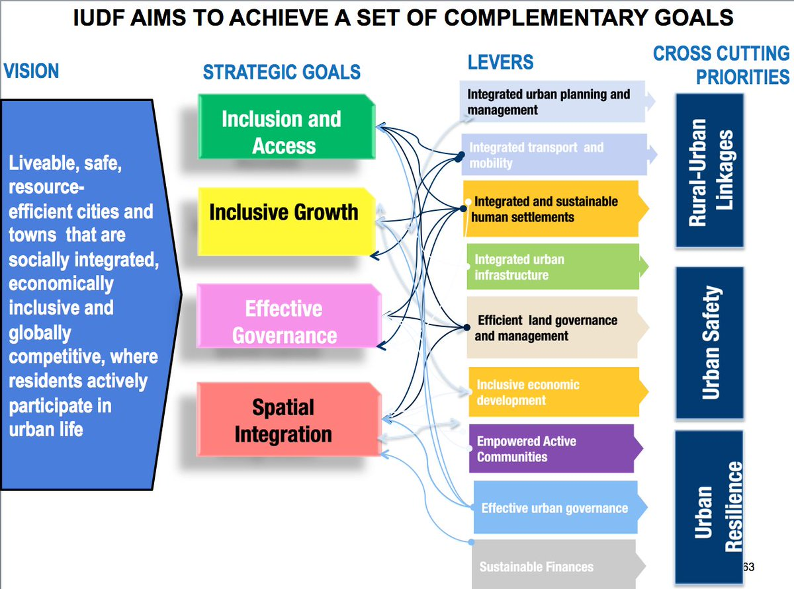
SACN STRATEGY UNDERPINNED BY IUDF
IUDF, the NDP 2030 Vision, the AU’s Agenda 2063, the NUA and the SDGs (SDG 11: Make cities inclusive, safe, resilient and sustainable), as well as the Paris Climate Agreement.
The strategy is underpinned by the IUDF, and aims to support cities in implementing the IUDF within their unique contexts.
Notes:
The strategy is underpinned by the IUDF, South Africa’s national policy framework that is intended to guide the future growth and management of urban areas.
The IUDF aims to create a shared vision across all of society of how best to manage urbanisation and achieve spatial transformation, and includes the strategic goals of spatial integration, inclusion and access, economic vitality and effective governance.
Effective and integrated management will enable cities to translate urbanisation into greater productivity and higher rates of growth, transforming them into engines of growth.
The SACN’s strategy aims to support cities in implementing the IUDF within their unique contexts.

Slide 10
SACN MANDATE TO FOSTER “TERRITORIAL DEVELOPMENT”
Promote good governance and management in South African cities.
To analyse strategic challenges facing South African cities, particularly in the context of global economic integration and national development challenges.
Collect, collate, analyse, assess, disseminate, and apply the experience of large city government in a South African context.
Promote shared-learning partnerships across all of society to support the management of South African cities.
OUR PARTICIPATING CITIES

Slide 11
A WORKING VALUE PROPOSITION TOWARDS AN EFFECTIVE URBAN
SACN OFFERING:
URBAN DEVELOPMENT
CITY MANAGEMENT
NETWORK OF CITIES
PEER TO PEER LEARNING
SACN KNOWLEDGE BASE
PARTNERSHIPS
PROGRAMME SUPPORT
ADVOCACY

Slide 12
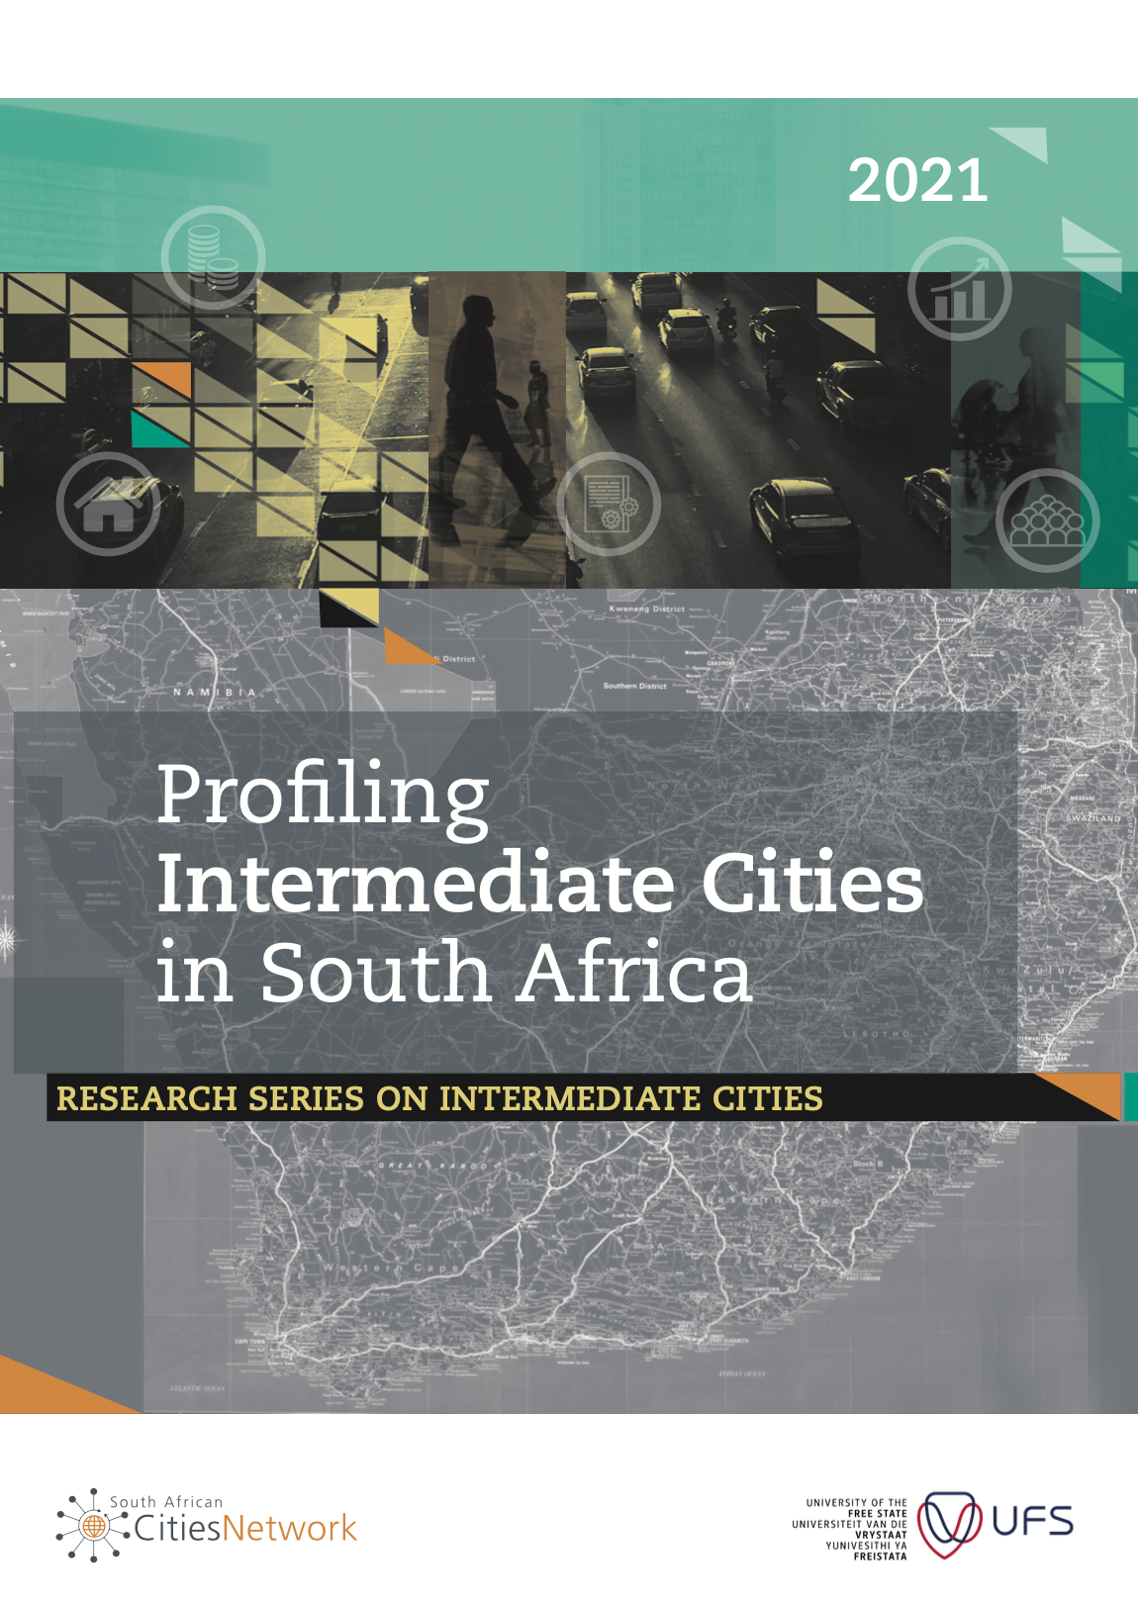
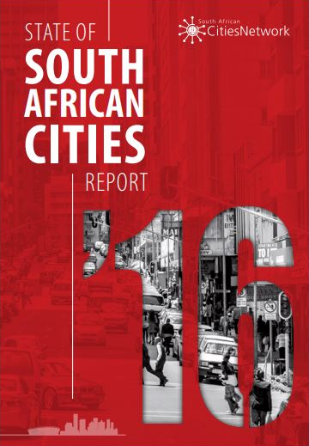
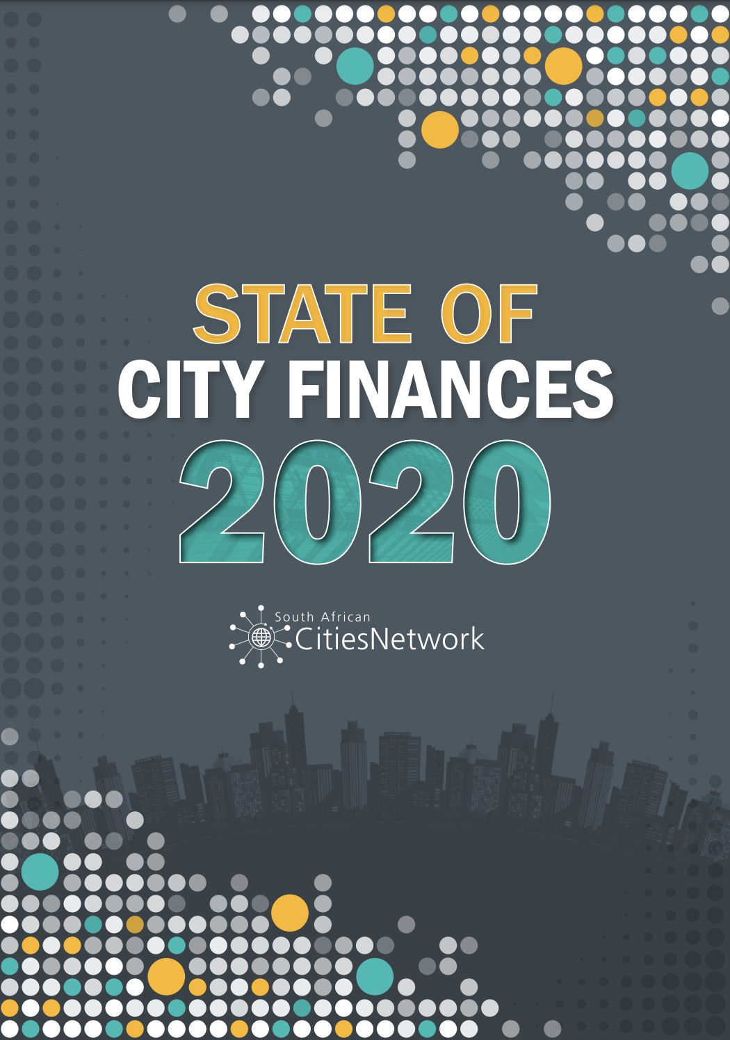

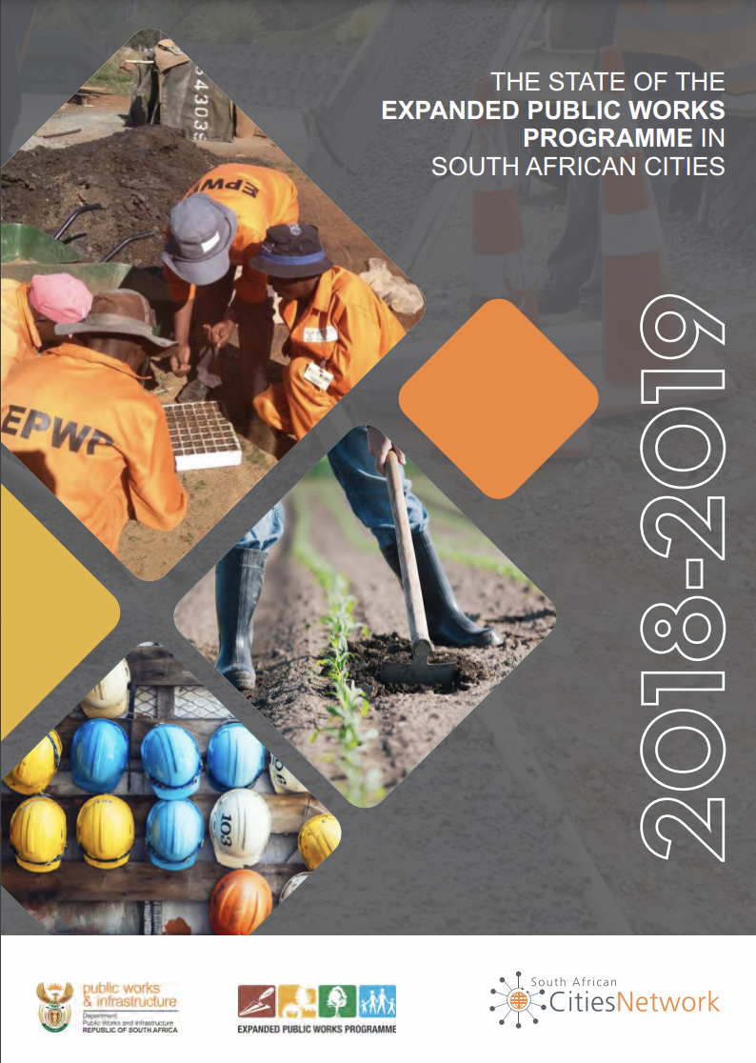
KNOWLEDGE BASE - FLAGSHIP PUBLICATIONS
State of City Finances Report
State of Crime & Safety in SA Cities
State of the Expanded
Public Works
Programme
State of the Intermediate Cities
.
State of Cities Report

Slide 13










SACN PEER-TO-PEER LEARNING PLATFORMS

Slide 14
PROGRAMMES AND THEMATIC FOCUS AREAS
SACN AT A GLANCE

Slide 15
PROGRAMMES AND THEMATIC FOCUS AREAS
Well-governed
cities
Productive
cities
Inclusive
cities
Sustainable & Resilient
cities
Rethinking urban economies
Job creation & skills development
Informal economy /township economy
Built environment integration
Urban safety
Urban youth strategies
Urban governance
Municipal Finance
Climate change adaptation
Resource Efficiency
Urban Resilience
Innovative cities
Long-term city development strategies
Urban data intelligence
IUDF
Monitoring & reporting (SoCR)
Our partnership approach is an all-of-society approach where we listen and facilitate knowledge co-creation, learning and innovation through partnerships among cities and all stakeholders.

Slide 16
NEXT STEPS
SACN AT A GLANCE

Slide 17
HOW INTERNATIONAL COMMUNITY CAN ASSSIST
Leveraging on capability development
Transversality of interventions within the Cities
Developing a regional platform for lesson sharing and practice refinement
Success will not only be measured in indicators rather in how the urban people’s lives are improved.

Slide 18


