Slide 1
Session 2:
Introduction to TALD:
Territorial Approach to Local Development
Eugène ZAPATA-GARESCHÉ
Team Leader, TALD Facility and Helpdesk, INTPA G2
REGIONAL SEMINAR FOR AFRICAN ENGLISH-SPEAKING COUNTRIES
Territorial Approach to Local Development (TALD)
JOHANNESBURG, SOUTH AFRICA, OCTOBER 26-28, 2022
Organized by the European Commission DG INTPA, Unit G2 – Local Authorities, Civil Society and Foundations

Slide 2

Why is local development important?
The concept of Local Development is not new. For decades, practitioners have paid particular attention to the so-called bottom up approach as an important way to understand and implement development policies

Slide 3
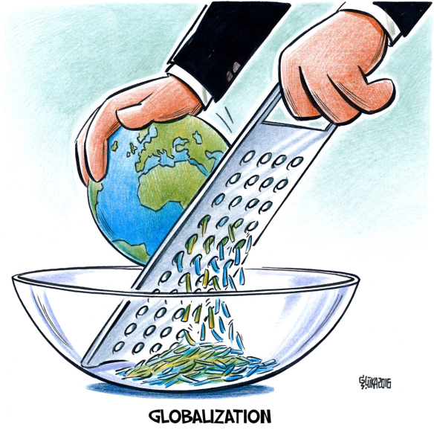
Global, Local, Territorial ?
Some scholars oppose local development to globalization. For them, globalization happens when « national economies » compete against each other for a larger share of the global « market ».
This model implies a high degree of interdependencies and reliance on the « external sectors », expecting that communities insert themselves in the global economy, by being competitive in the business created by the free flow of goods, capitals and services.

Slide 4

Increasing inequalities:
While globalization has brought about considerable economic growth and innovation to many places, one of its main shortcomings is the increase of social and economy disparities

Slide 5
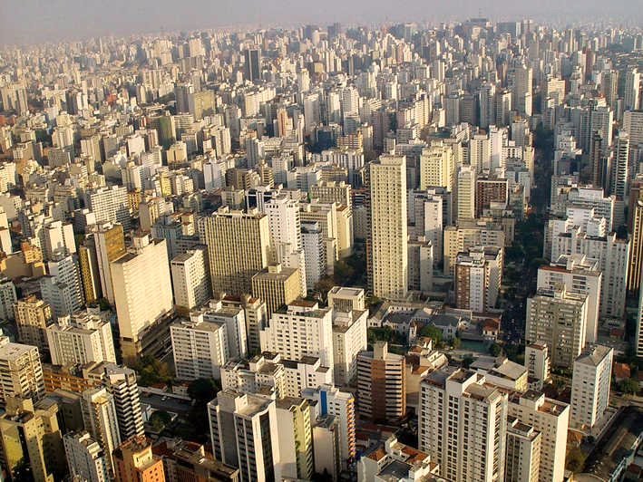
URBANIZATION
In parallel to globalization, the world has experienced in recent decades an unprecedented drive towards urbanization, which in turn has worsened disparities, expressing them acutely at territorial level

Slide 6
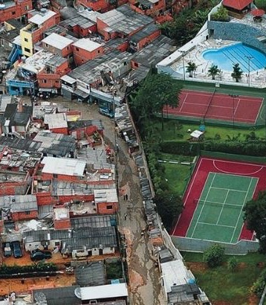
Spatial disparities:
The result is a “globalized world” composed of stronger vs weaker territories.
Decentralization policies come as a means to balance the playing field at national level

Slide 7
Decentralization:
Decentralization happens when central governments transfer powers to sub-national or local government entities.
A trend towards decentralization began since the 1950’s to try to address issues like the arrival of democratic regimes, political pluralism, preserving the unity of a Nation-State in many development countries.

Slide 8
Decentralize what?
POLITICAL DECENTRALIZATION
Competencies
(administrative decentralization)
Decision making
(strengthened local autonomy)
FISCAL DECENTRALIZATION
Spending
(redistribution of national income)
Taxing
(strengthened capacity to collect taxes)
THE PRINCIPLE OF SUBSIDIARITY

Slide 9
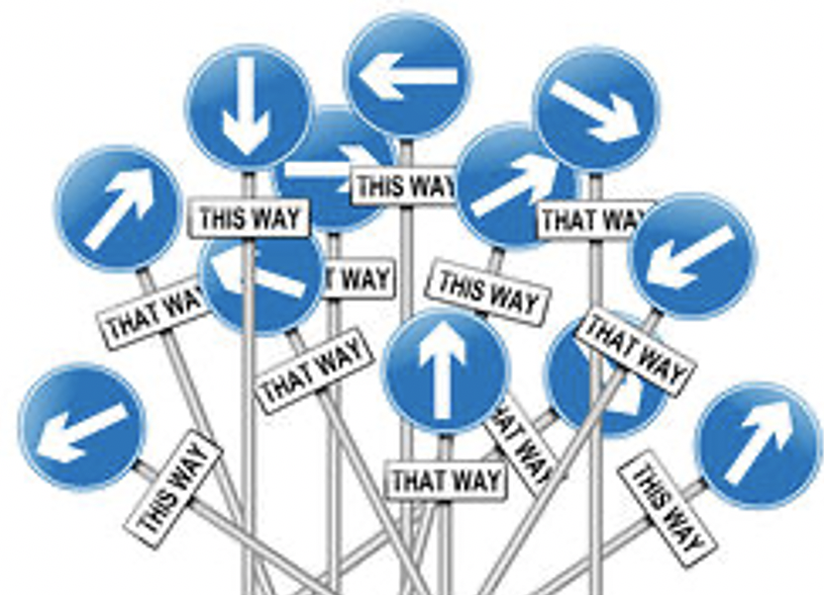
But decentralization has had insufficient results:
Decentralization efforts aiming at balancing territorial disparities have not always been succesful. A few not so positive results include:
Mono-sectoral approaches, disconnection
Short term visions, contingent on political mandates

Slide 10
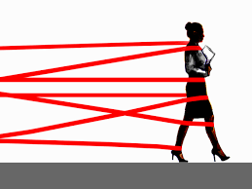
Local development plans are tailor-made to access funds from central government programs
Concurring legislation and diversity of processes brings about bureaucratic labyrinths and administrative burden

Slide 11

With insufficient results:
Vertical « Top-down » approach, central government control
Inadequate or insufficient local capacities
More responsibilities not necessarily accompanied of more resources

Slide 12
A great tool to complement Decentralisation is Territorial Development
TALD is spatially integrated development
This implies considering the physical and socio-economic traits of a particular place, regardless of its administrative boundaries or sectorial fragmentation

Slide 13

Puts the accent on the multiplicity of scales, that coexist in the same territory: local, urban, rural, metropolitan, regional, national, global, as well as on their interdependencies.

Slide 14

Why is TALD important?
It involves different kinds of actors, not only public authorities, but also private entities and CSOs.
With a high degree of autonomy to define their own development priorities.

Slide 15

Being local, TALD supports a more equitable, inclusive, just and sustainable development
TALD is respectful of local identity, local culture and the local environment

Slide 16


Do not confound:
Territorial Development is not about « localizing » the Sustainable Development Goals. TALD is born locally, its priorities are not defined, nor necessarily oriented, by others
$$≠$$
TALD

Slide 17

Territorial development is thus a development that is ENDOGENOUS based on grass-roots resources and local dynamics.

Slide 18
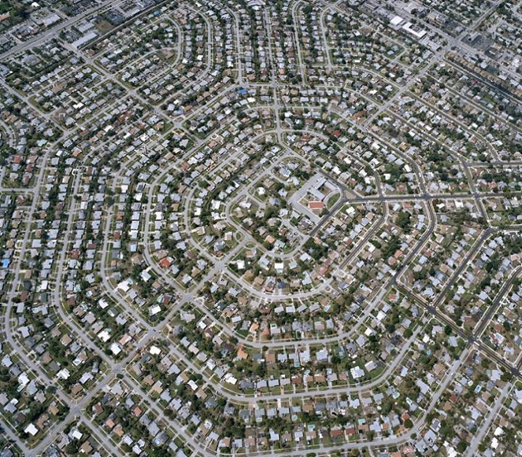
Territorial Development
is spatially integrated:
It goes beyond the typical fragmentation caused by political and administrative boundaries as well as by traditional sectorial programming.

Slide 19
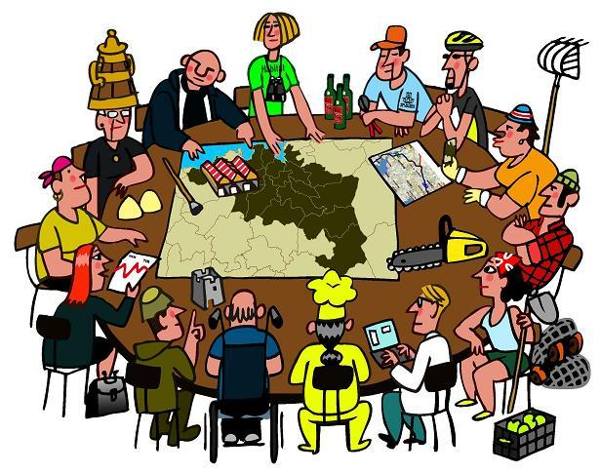
It is multilevel:
It is supported by a set of diverse actors from the private and public sectors, including the national government acting under a shared vision.

Slide 20
It is incremental:
Complementarity and coherence between the efforts of different stakeholders working in the same territory with a common vision triggers a virtuous circle:
1 + 1+ 1 = 4 !

Slide 21

In fact, TALD represents the “missing link” between decentralization reforms and the expected results of development policies.

Slide 22
So who drives TALD?
Comparative analysis of the main types of actors
CENTRAL GOVERNMENT
CIVIL SOCIETY ORGANIZATIONS
FOR PROFIT SECTOR
LOCAL AUTHORITIES

Slide 23
TALD Drivers: Comparative analysis
LOCAL MANDATE
Has the formal power to promote the social and economic well being of a local community, on top of delivering essential services
LEGAL CAPACITY
Has the capacity to enact and enforce rules, procedures and regulations
TYPE OF ACTOR
LEADERSHIP
Has the capacity to bring together and coordinate different types of local actors, sometimes with conflicting interests
PERMANENCE
Its institutional nature guarantees that it remains as a valid interlocutor for the population over time
RESPONSIVENESS
Is responsive and accountable to the needs and expectations of the local population

Slide 24
TALD Drivers: Comparative analysis
✓
X
LOCAL MANDATE
Has the legal power to promote the social and economic well being of a local community, on top of delivering essential services
LEGAL CAPACITY
Has the capacity to enact and enforce rules, procedures and regulations
CENTRAL GOVERNMENT
?
PERMANENCE
Its institutional nature guarantees that it remains as a valid interlocutor for the population over time
LEADERSHIP
Has the capacity to bring together and coordinate different types of local actors
✓
RESPONSIVENESS
Is responsive to the needs and expectations of the local population
✓

Slide 25
TALD Drivers: Comparative analysis
LOCAL MANDATE
Has the legal power to promote the social and economic well being of a local community, on top of delivering essential services
X
X
LEGAL CAPACITY
Has the capacity to enact and enforce rules, procedures and regulations
CIVIL SOCIETY ORGANIZATIONS
PERMANENCE
Its institutional nature guarantees that it remains as a valid interlocutor for the population over time
LEADERSHIP
Has the capacity to bring together and coordinate different types of local actors
?
✓
RESPONSIVENESS
Is responsive to the needs and expectations of the local population
✓

Slide 26
TALD Drivers: Comparative analysis
X
LOCAL MANDATE
Has the legal power to promote the social and economic well being of a local community, on top of delivering essential services
X
LEGAL CAPACITY
Has the capacity to enact and enforce rules, procedures and regulations
FOR PROFIT SECTOR
LEADERSHIP
Has the capacity to bring together and coordinate different types of local actors
PERMANENCE
Its institutional nature guarantees that it remains as a valid interlocutor for the population over time
?
?
?
RESPONSIVENESS
Is responsive to the needs and expectations of the local population

Slide 27
LOCAL MANDATE
Has the legal power to promote the social and economic well being of a local community, on top of delivering essential services
LEGAL CAPACITY
Has the capacity to enact and enforce rules, procedures and regulations
✓
✓
LOCAL AUTHORITIES
LEADERSHIP
Has the capacity to bring together and coordinate different types of local actors
PERMANENCE
Its institutional nature guarantees that it remains as a valid interlocutor for the population over time
✓
✓
RESPONSIVENESS
Is responsive to the needs and expectations of the local population
✓

Slide 28

Nevertheless:
These comparative advantages are only potential
Their realization will depend on the existence of the appropriate national enabling environment: an effective decentralization policy that facilitates TALD and recognizes the crucial role of local authorities in the definition of their own development future.

Slide 29
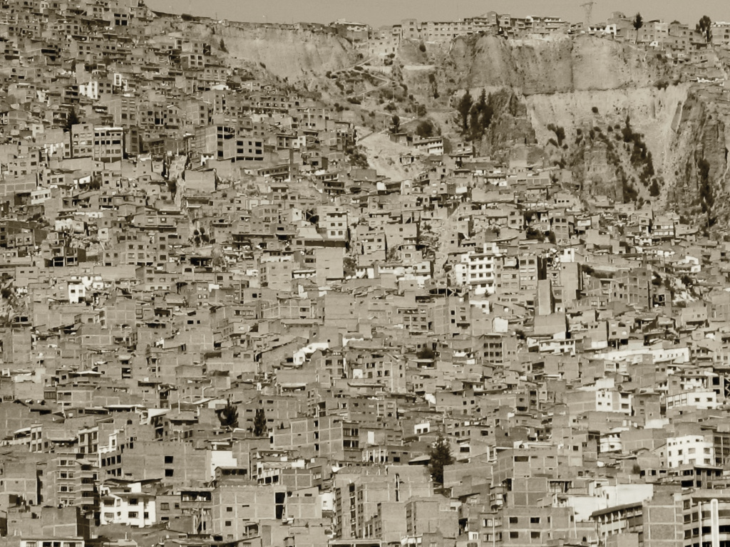
We must change the paradigm of « redistribution » for the paradigm of « endogenous development » where local authorities and local communities become the architects or their own future
LOCAL GOVERNMENTS: DEVELOPMENT ACTORS

Slide 30
Local Governments: development actors
TALD considers that local authorities are not only the « object » of national policies, but the « subjects » in their own right of an endogenous process of development policies that includes other actors, is spatially integrated and operates with a vision set in the long term.

Slide 31

The traditional definition of local authorities:
The local representation of the Nation-State
The political or institutional representatives of a local community
An administrative entity charged with providing basic services

Slide 32

Local authorities: development actors
Local authorities are political actors, capable of facilitating dialogue between the public and private sector, universities, civil society and the media
LAs are catalyzers of the social, economic, cultural and environmental capital present in a given territory

Slide 33

Local authorities: development actors
LAs are mediators amongst different, sometimes conflicting, interests
LAs are capable of spearheading local development by building on the opportunity of a « locally defined future »

Slide 34

Local autonomy and Local accountability:
2 sides of a coin that complement each other

Slide 35

What is local autonomy?
Degree of discretionary powers to make decisions about the future of a given territory
Power to initiate policies (less control ex-ante)
LAs elected in democratic elections
Enhanced administrative capacity, efficient civil service
Healthy local finances
Local fiscal and taxation powers

Slide 36
What is local accountability?
LAs are responsive to the population needs
LAs are trustworthy and legitimate in the population’s eyes
There is transparency in decision making and financial management
The population can challenge and seek modification of LAs decision and policies
LAs are obliged to report (monitor, evaluate..)
LAs recognize their public and legal responsibility to foster collective well being
LAs establish mechanisms for the participation in public life of non governmental actors

Slide 37

However, still today in most developing countries Local Authorities are often considered as « weak », « uncapable » « inefficient » institutions, not ready to take their destiny in their own hands.
LAs are conceived somewhat disrespectfully as a « lower level of government », less important, with less capacity and therefore less relevant …

Slide 38
Mainstreaming LAs through the Territorial Approach to Local Development (TALD)
A framework to orient EC aid into a new generation of projects and programs focused on local development

Slide 39
The new Neighborhood Development and International Cooperation Instrument (NDICI) – Global Europe 2021-2027 does not include a dedicated budgetary line for local authorities, BUT…

Slide 40
It encourages the EC to
mainstream Local Authorities
in geographical programmes
(national and regional)
---------
NDICI-Global Europe regulation recital 35:
“Support to local authorities under the geographic programmes should amount to indicatively at least EUR 500 000 000”.

Slide 41
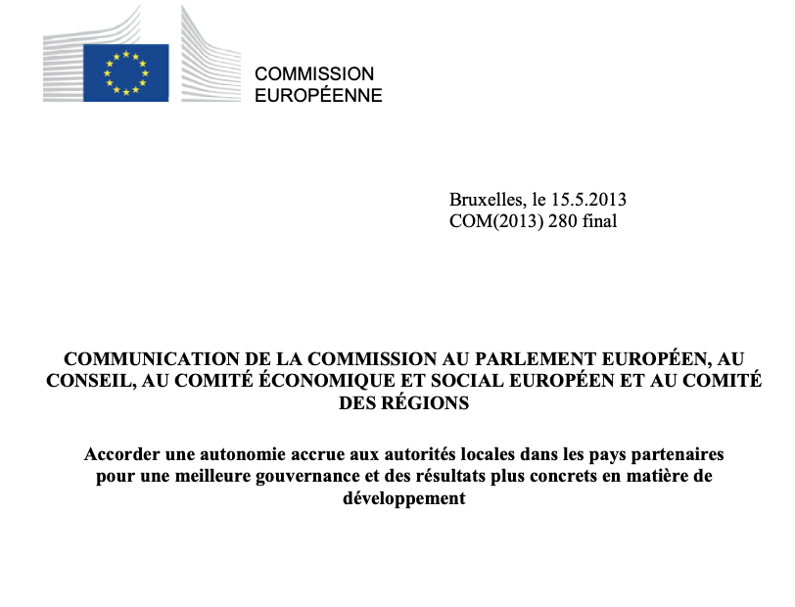

Slide 42
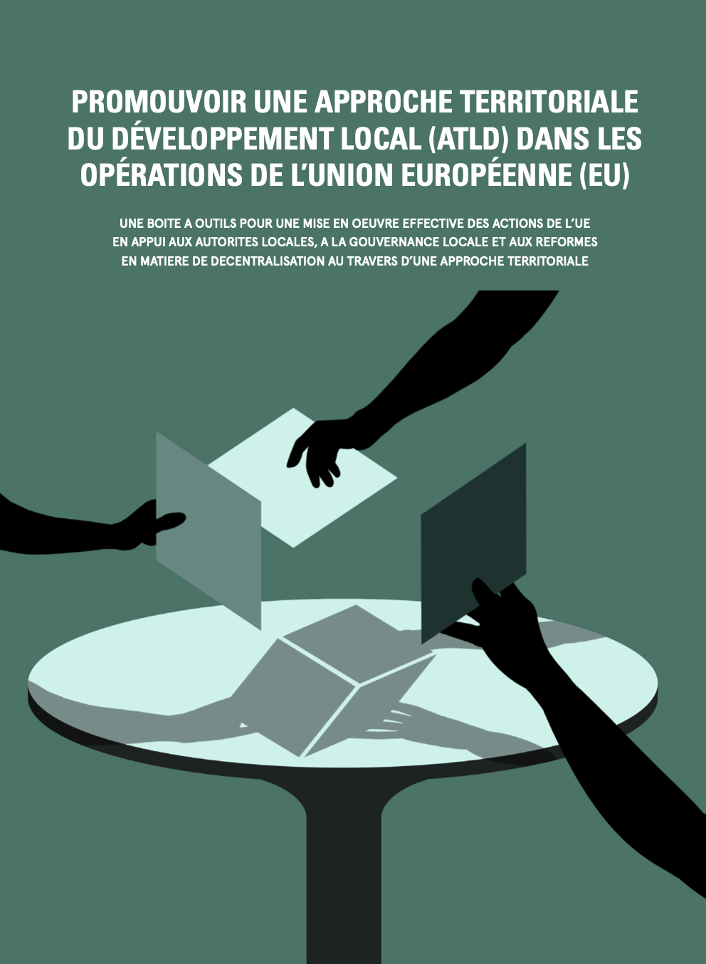
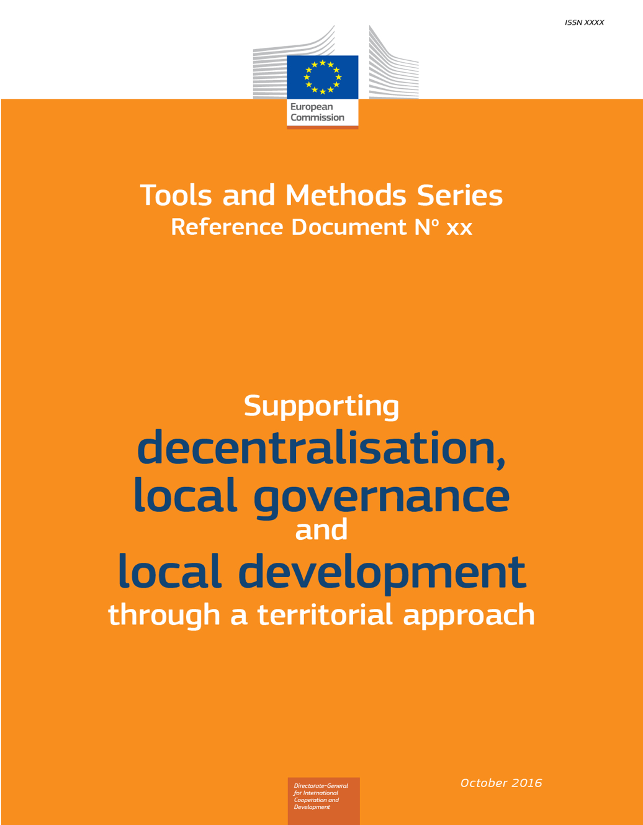
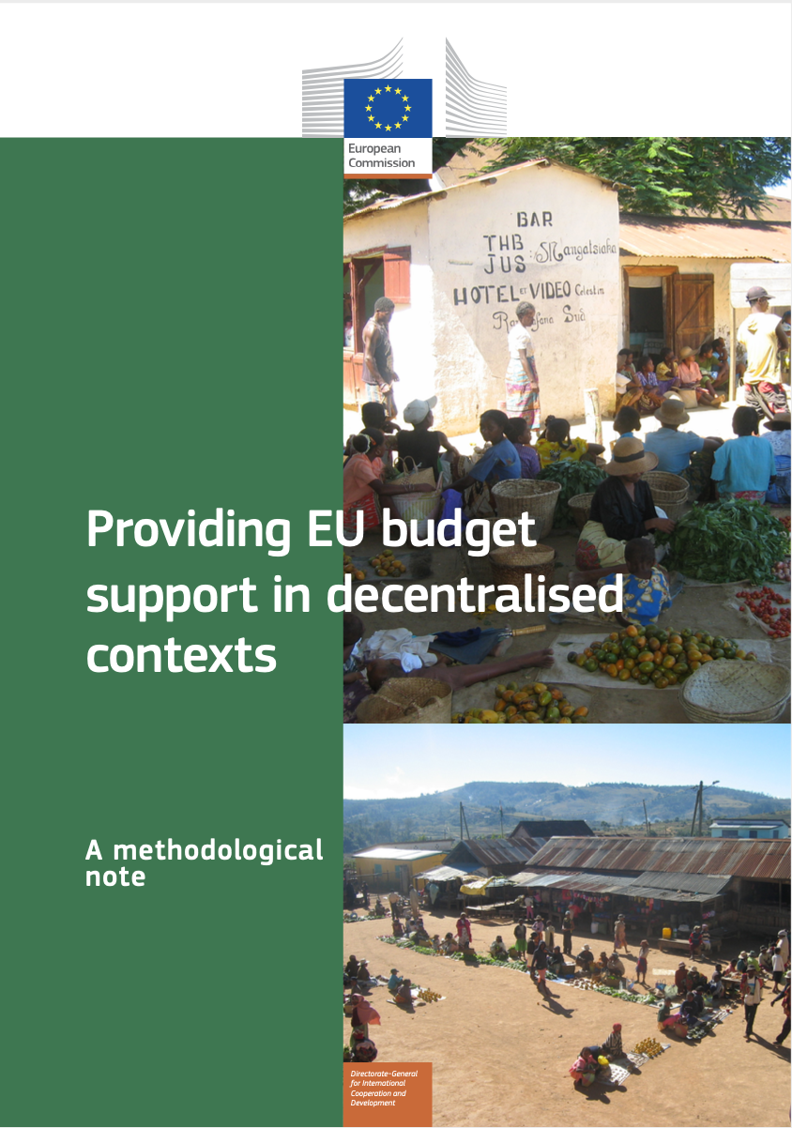

Slide 43

The aim of this seminar:
:
Introduce the concept and the importance of the Territorial Approach to Local Development as a dynamic, long-term method based on a bottom up, multi-stakeholder and multi-sectoral approach that helps to define and prioritize development strategies in a given territory.
Support EU Delegations in English-speaking African countries to use the TALD approach to integrate local governments and territorial development in multi-annual bilateral programming
Present case-studies from EU Delegations in the region and discuss the opportunities and challenges around how to establish a structured, long-term dialogue with sub-national governments (municipalities, provincial authorities, federated states, etc.) and their national associations
Present the services and type of support that EUDs can receive from DG INTPA Unit G2, the TALD Facility and Helpdesk and the EU Framework Partnership Agreements (FPAs) with global associations of LAs.

Slide 44
Thank you

