Slide 1
Session 7:
What is a Territory?
Participatory exercise
Eugène ZAPATA-GARESCHÉ
Team Leader, TALD Facility and Helpdesk, INTPA G2
REGIONAL SEMINAR FOR AFRICAN ENGLISH-SPEAKING COUNTRIES
Territorial Approach to Local Development (TALD)
JOHANNESBURG, SOUTH AFRICA, OCTOBER 26-28, 2022
Organized by the European Commission DG INTPA, Unit G2 – Local Authorities, Civil Society and Foundations

Slide 2
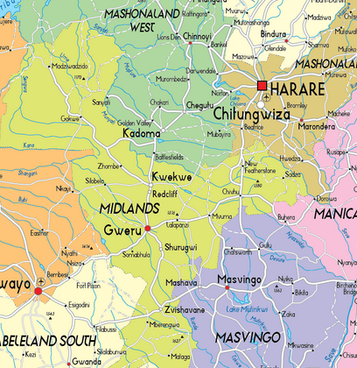
The meaning of « Territory » according to TALD
In the TALD approach a « territory » is not defined by legal or administrative boundaries

Slide 3
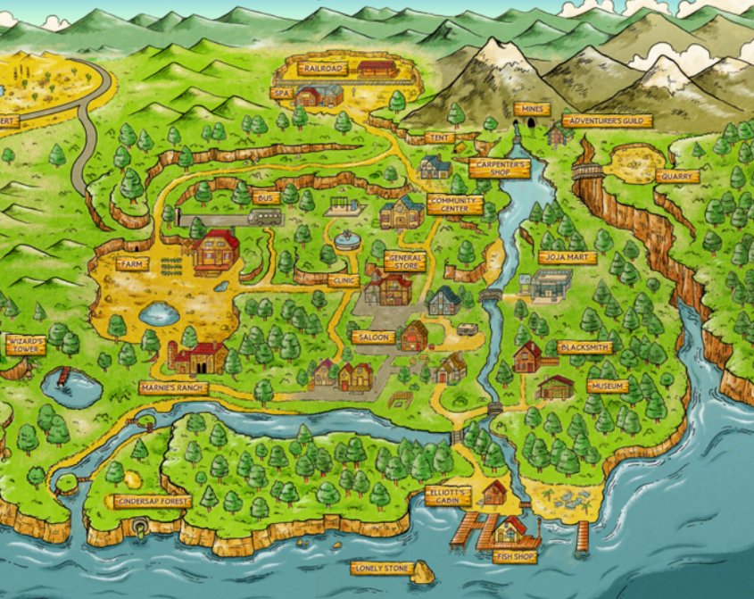
More than an « area of land under jurisdiction of a certain authority », a territory is..
A functional space where different actors coexist sharing similar challenges and thus interacting and striving for a common purpose.

Slide 4
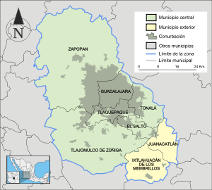
The territorial scale does not limit itself to a particular physical dimension. A territory can thus be a metropolitan area (where urban and rural zones coexist), a hydrological bassin (even across international borders), a neighbourhood or a coastal zone…

Slide 5
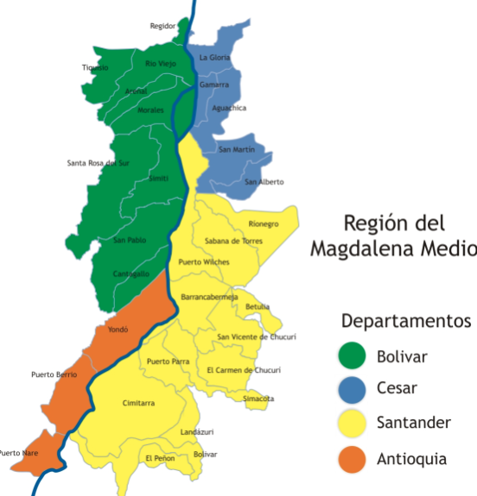
Example of river basin in Colombia
Breaking departmental
boundaries (4 departments
and supported
by 31 municipal jurisdictions

Slide 6
The Territorial approach does not only focus on « where » things happen, but most importantly on « who » and « how » development priorities are conceived and implemented

Slide 7
Instructions for the exercise:
> Each person please draw a real or imaginary territory according to the TALD approach
> Identify the main actors and factors present in this territory (these can be public, private institutions, natural assets, infrastructure…)
> Identify a challenge to be solved
> Outline an idea or opportunity for local development
> Share with your group
> Select one case per group to share with the plenary

Slide 8
Thank you

