Slide 1
Session 10:
The TALD Building Blocks
Eugène ZAPATA-GARESCHÉ
Team Leader, TALD Facility and Helpdesk, INTPA G2
REGIONAL SEMINAR FOR AFRICAN ENGLISH-SPEAKING COUNTRIES
Territorial Approach to Local Development (TALD)
JOHANNESBURG, SOUTH AFRICA, OCTOBER 26-28, 2022
Organized by the European Commission DG INTPA, Unit G2 – Local Authorities, Civil Society and Foundations

Slide 2
Where to start?
Analyze the national context
SCENARIO 1
Favorable enabling environment
SCENARIO 2
Partially favorable environment
SCENARIO 3
Decentralization stalled or merely symbolic

Slide 3

SCENARIO 3
Decentralization stalled or merely symbolic
  Controlling central government
  Localization of national sectoral policies
  Priorities decided in the capital city
  Reluctance to locally driven initiatives
  Cosmetic decentralization reform, if any
  Financial dependency from central transfers

Slide 4

SCENARIO 2
Partially favorable environment
« Formal » recognition of the developmental role of LAs
Some pilot examples in specific geographies or administrative zones
Decentralization reforms maturing
Local authorities empowering themselves
Relative fiscal autonomy

Slide 5

SCENARIO 1
Favorable enabling environment
Clear vision on developmental role of LAs
Respectful framework for local autonomy
Good progress towards fiscal and financial autonomy
Capacity of LAs to engage with international actors
Respectful intergovernmental cooperation
Active citizenship and private sector
Adequate legal framework / long-term certainty

Slide 6

TALD BUILDING BLOCKS

Slide 7

Reminder:
The Territorial Approach to Local Development (TALD)
It is a policy to be adopted in a specific country that recognizes the essential role of local authorities as the main actors in the definition, planning and implementation of local development strategies in the long term.

Slide 8

Reminder:
The Territorial Approach to Local Development (TALD)
TALD implies a certain degree of local autonomy and self-government, as well as an enabling institutional and legal environment for participatory governance and social accountability

Slide 9
Reminder:
TALD is:
Endogenous: based on local grass roots resources
Spatially integrated: goes beyond the typical fragmentation caused by political and administrative boundaries as well as by traditional sectorial programming
Multi-level: supported by a set of diverse actors from the private and public sectors, acting under a shared vision
Incremental: complementary and in coherence with the efforts of other levels of government (1+1+1=4!)

Slide 10
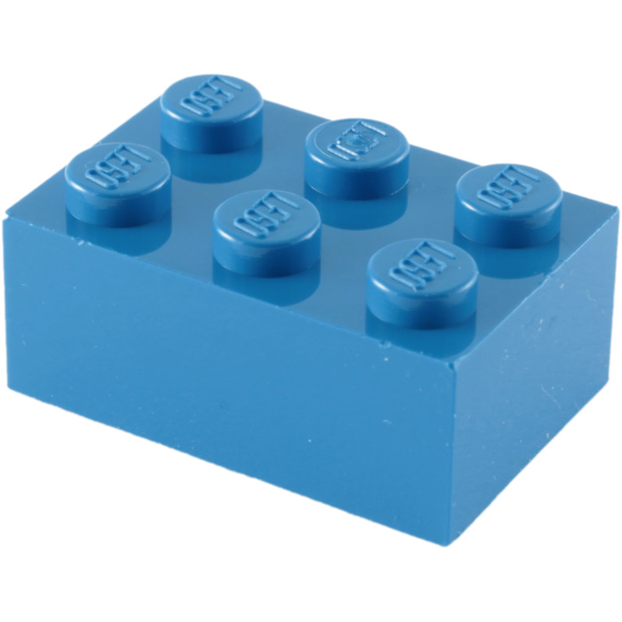
Building blocks (1) :
The menu:
National political environment:
National
URBAN AGENDA supportive of LAs
National
RURAL DEVELOPMENT policy supportive of LAs
National
DECENTRALISATION policy enhancing autonomy and accountability of LAs

Slide 11

The menu:
Building blocks (2) :
Sub-national level institutions and capacities:
Effective environmen t for inter-governmental cooperation
Local leadership and administrative capacity development
Active citizenship
and public private partnerships

Slide 12

Building blocks (3) :
The menu :
Improved local development management systems
Comprehensive scope
for local development, beyond just providing basic services
Improved systems of local development planning
Enhanced and diversified instruments of local financing: fiscal certainty, credit worthiness, contractual flexibility
Improved institutions and capacity for local development implementation

Slide 13
The Aim of Territorial Development is better
SERVICE DELIVERY
ENVIRONMENTAL MANAGEMENT
ECONOMIC DEVELOPMENT
By improving Local Development Management Systems
COMPREHENSIVE
MANDATE
LONG TERM
PLANNING
EFFICIENT
IMPLEMENTATION
STRONG FINANCES
With enabling national policies
And Subnational institutional capacity
DECENTRALI-SATION
URBAN AGENDA
RURAL DEV. POLICY
INTERGOVT. COOPERATION
CITIZENSHIP
PPP
LEADERSHIP + ADMIN CAPACITY

Slide 14

Main ideas:
Not every LA is ready for TALD
TALD is context specific, no one-size fits all
TALD is not linear, it is an iterative process
.
Notes:
Develop and implement their own policies and mobilize additional resources (involving civil society and private actors)
Improve the design and local implementation of central policies and public spending efficiency

Slide 15

Main ideas:
4. TALD needs to be monitored in order to be improved
5. TALD works better when facilitated
.
Notes:
Develop and implement their own policies and mobilize additional resources (involving civil society and private actors)
Improve the design and local implementation of central policies and public spending efficiency

Slide 16

Main ideas:
6. TALD takes time, no quantum leaps here
7. TALD is good to pilot a new:
.
Notes:
Develop and implement their own policies and mobilize additional resources (involving civil society and private actors)
Improve the design and local implementation of central policies and public spending efficiency

Slide 17

EU Thematic Priorities 2021-2027

Slide 18
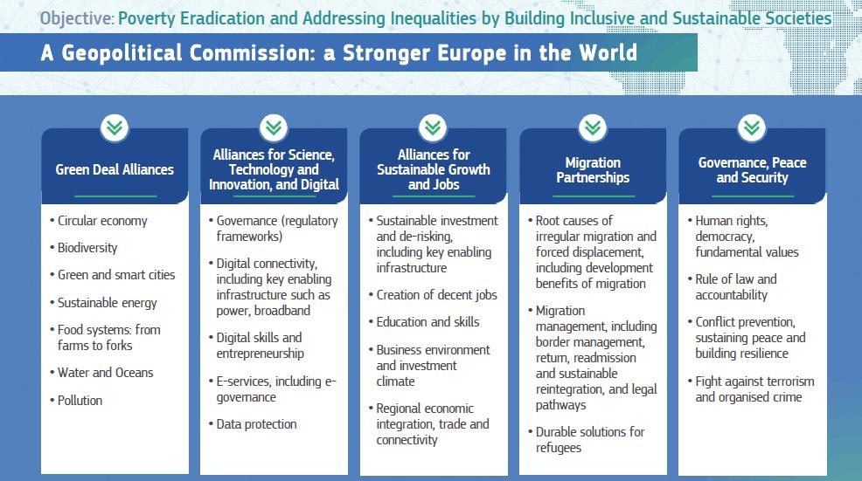

Slide 19
  EU SUPPORT TO TERRITORIAL DEVELOPMENT
POLICY DIALOGUE
Support to national policies on:
DESCENTRALIZATION URBAN AND RURAL DEVELOPMENT
THEMATIC AND GEOGRAPHIC PROGRAMMING
INCLUDING LOCAL AUTHORITIES IN COOPERATION PORTFOLIO
DIRECT SUPPORT
CALLS FOR PROPOSALS, DIRECT GRANTS, BUDGET SUPPORT
Financial and non financial support

Slide 20

Identifying the possible entry points:
SCENARIO 3
Decentralization stalled or merely symbolic
High level political/policy dialogue about the importance of TALD
Support to constitutional reforms
Support to the implementation of a national decentralization policy (work with Assoc. of LAs)

Slide 21

Identifying the possible entry points:
SCENARIO 2
Partially favorable environment
Combination of « top-down » initiatives with « bottom up » projects
Sectorial support, but in response to LA’s priorities
Work with Assoc. of LAs

Slide 22

SCENARIO 1: Favorable enabling environment
Direct support to place-based development strategies
Support to multi-stakeholder approach and cooperation
Decentralized budget support
City to City cooperation with EU
Work with Assoc. of LAs

Slide 23
The Aim of Territorial Development is better
SERVICE DELIVERY
ENVIRONMENTAL MANAGEMENT
ECONOMIC DEVELOPMENT
Technical assistance to improve municipal planning
By improving Local Development Management Systems
COMPREHENSIVE
MANDATE
LONG TERM
PLANNING
EFFICIENT
IMPLEMENTATION
STRONG FINANCES
Policy dialogue on multi-level governance
Program to support the implementation of the New Urban Agenda
With enabling national policies
And Subnational institutional capacity
DECENTRALI-SATION
URBAN AGENDA
RURAL DEV. POLICY
INTERGOVT. COOPERATION
CITIZENSHIP
PPP
LEADERSHIP + ADMIN CAPACITY

Slide 24

How to choose the right modality?
The EU has a fairly decent menu of aid modalities: calls for proposals, direct grants, budget support, decentralized cooperation, etc.
EUDs should not refrain themselves from combining several modalities, in order to achieve the desired result.
Experience shows that focusing on just one modality can be problematic, particularly when the aim is to unfold the developmental potential of a given territory.

Slide 25
In any case, EUDs should foster
collaboration between Local Governments and Civil Society
Tip:
You can include Local Governments as beneficiaries of the
Calls for Proposals for civil society organizations, or include mandatory criteria to take them into consideration when applying for EU funds

Slide 26

Work to establish
a mechanism for a more STRUCTURED DIALOGUE with the national association(s) of local governments to build trust, understanding and collaboration in the long run

Slide 27

If your MIP has not mainstreamed LAs yet
you can still do it during implementation…

Slide 28

The ART of TALD: 10 tips
1. Do not conceive LAs as simple « beneficiaries »of EC aid, but as full-fledged development partners
2. When feasible, partner and work with existing institutions and systems, even if weak or imperfect, avoiding duplications and incoherence with current policies
3. Promote continuous evaluation and learning when implementing your program or project
Notes:
28

Slide 29

4. Frame your support on the legal competences of LAs and focus on local priorities
5. Aim your efforts at achieving great opportunities and not just at solving small obstacles: stop spreading the rumor about the weaknesses of LAs
6. Change your attitude and dare to experiment new possibilities to discover, even in hard contexts. No shortcuts, no cookie-cutter approaches, each project is unique
Notes:
29

Slide 30

The ART of TALD: 10 tips
7. Avoid too many details when formulating a proposal, do not try to conceive a perfect project from the beginning
8. Prioritize effective communication, citizen and partner awareness, focus on youth and vulnerable populations
9. Be creative but also pragmatic: do not lose sight of concrete results and long-term impact
10. Give yourself a vision, dream the possible…
Notes:
30

Slide 31

Thank you

