Slide 1
VET and skills development in NAMIBIA
INTPA VET training – practical training about VET and employability opportunities
8-9-10 November 2022, Lilongwe, Malawi

Slide 2




Context: Analysis of Strengths / Weaknesses / Opportunities / Challenges
STRENGTHS
Well-developed TVET system
Many Multi-Level approaches from different actors
Long-term commitment of German DC and other donors (e.g. EU)
Synergies between stakeholders are utilized
Institutional capacity and expertise
Infrastructure and generally well-equipped public Vocational Training Centres (VTCs)
Significant contribution to digitalisation and implementation of E-Learning approaches in TVET
WEAKNESSES
Inadequate focus on community-based and private training providers
Weak linkages/cooperation of VTCs with private sector
Limited support to Training Providers focusing on marginalised and disadvantaged youth
Inconsistent implementation of the concept for further training of TVET practitioners/personnel
Low awareness of quality improvement aspects in TVET (quantity above quality)
OPPORTUNITIES
Growing awareness of eco-friendly and innovative technologies (e. g. solar, wind) “Green TVET”
Transition of TVET graduates into the labour market or higher education
Openness to innovative TVET Training Concepts and Technologies
Possibilities of international exchange programmes (ERASMUS+ new component on TVET)
CHALLENGES
Economic Environment and Corona Pandemic
Small and weak economy with an overall high and further increasing unemployment rate
High socio-economic imbalance
Lack of forecasting of skills development needs
Demographic development
Lengthy process to introduce new, relevant qualifications
Challenges with implementation of ongoing reforms in basic education (pre-vocational subjects)
Government funding for TVET Sector
Page 2

Slide 3



TVET reforms
Namibia’s Policy Environment for TVET
High political importance of TVET
Very ambitious goals in the context of the current socio-economic situation:
  To improve governance and management of the TVET sector
  To enhance the quality and relevance of TVET programmes
  To increase access and equity in TVET programmes
  To promote research, innovation and entrepreneurship in TVET and its initiatives
  To diversify sources of funding and equitable financing of TVET programmes.
Namibia Vision 2030
TVET Policy (2021)
5th National Development Plan
TVET Transformation and Expansion Strategy
Harambee
Prosperity Plan II

Slide 4
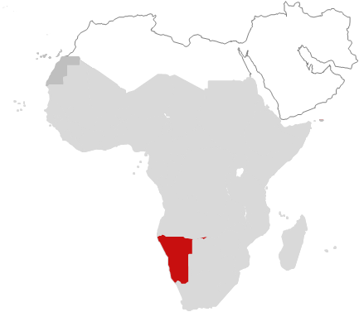

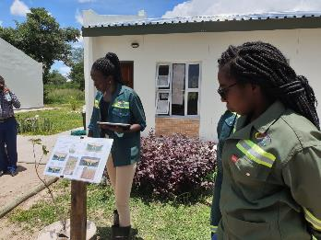
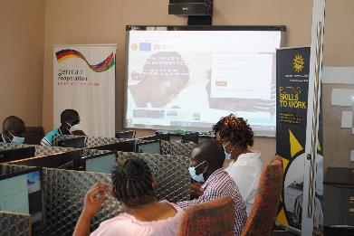
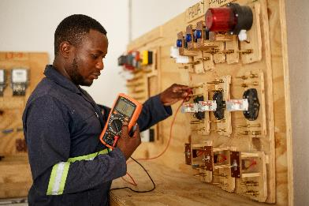

EU responses
EU – BMZ multi-donor action Implemented by GIZ:
Promotion of Vocational Education and Training ProVET II and III
Objectives: The TVET system is increasingly geared towards the needs of the labour market. It is improved pertaining to its efficient governance, labour market relevance and capacity.
Partner(s): Ministry of Higher Education, Technology and Innovation (MHETI), Namibia Training Authority (NTA), and Namibia University of Science and Technology (NUST)
Volume: EUR 26.9 million since 2012, including:
04/2018-12/2024: a BMZ-EU multi-donor Action un der the 11th EDF of EUR 8.8 million (incl. EUR 8.35 million from EU)
07/2022-12/2024: an extra EUR 6 million from BMZ for technical skills / capacity building operations
KFW: EUR 7 million in preparation - financial cooperation for TVET (financing of equipment, infrastucture, etc.)

Slide 5
Some Achievements
Implemented by GIZ:
Promotion of Vocational Education and Training ProVET II and III
BMZ-EU Multi-Donor Action:
NEV TVET Hub
Construction of 3 training workshops
  Valombola VTC, Automechatronics
  Eenhana VTC, Plumbing and Pipefitting
  Nakayale VTC, Electrical/ICT
Procurement for revised/new trades of EUR 1.17 Million plus an additional EUR 464.600,00 ICT equipment.
eLearning platform (Moodle) piloted - 14 qualifications use eLearning.
The World Skills Africa Competition (Swakopmund 2022) was successfully hosted in Namibia and supported through a financing agreement.
8 training courses and 22 short courses tailored to the needs of the labour market were implemented.
Extensive training of all management staff and liaison officers
New/Revised Qualifications
WIL (Apprenticeship)
15 new/revised qualifications are offered at 22 institutions. Among others:
Electrical General, Crops and Horticulture, Farm Machinery, Livestock, Plumbing, Solar, Automotive Mechatronics and Leatherworks.
1120 trainees (34% of whom were women) received certificates in the reformed and new qualifications.
147 employers are registered
710 apprentices are enrolled
136 graduates, 75 could keep their jobs after graduation
95 in-company mentors have been trained
Training of Trainers
77 trainers have been further qualified in the new/revised qualifications
More than 420 trainers/industry experts capacitated as Assessors, Moderators and Instrument Designers

Slide 6
Some Achievements:
BMZ-EU Multi-Donor Action:
THE HUB CONCEPT
Activity field I
Capacity Building I
Hub governance and management system developed
Unique centre development plans developed
„Toolkit“ Good Practises
NEV TVET Hub (Nakayale, Eenhana, Valombola)
Activity field IV
Equipment and Facilities upgrading Strategic equipment purchased
Building of workshops and hostels
IT structure (finance, academic, etc.) set
Solar systems
Activity field III
Training Programs, Standards and Qualifications
Tailor-made and responsive programs for local needs
Priority industry identified
E-learning programs developed
Standards for entry requirements
Activity field V
Articulation
Pathways between training programs to progress from one NQF level to the next higher level within the Hub provided (model for articulation arrangements)
Activity field II
Capacity Building II
TVET teachers/ managers
Twinning arrangements established
Activity field VI
Private sector and community involvement
Model for private sector and community engagement developed
Rebranding
Activity field VII
Promoting the image of TVET
Support for WorldSkills Africa
Rebranding

Slide 7
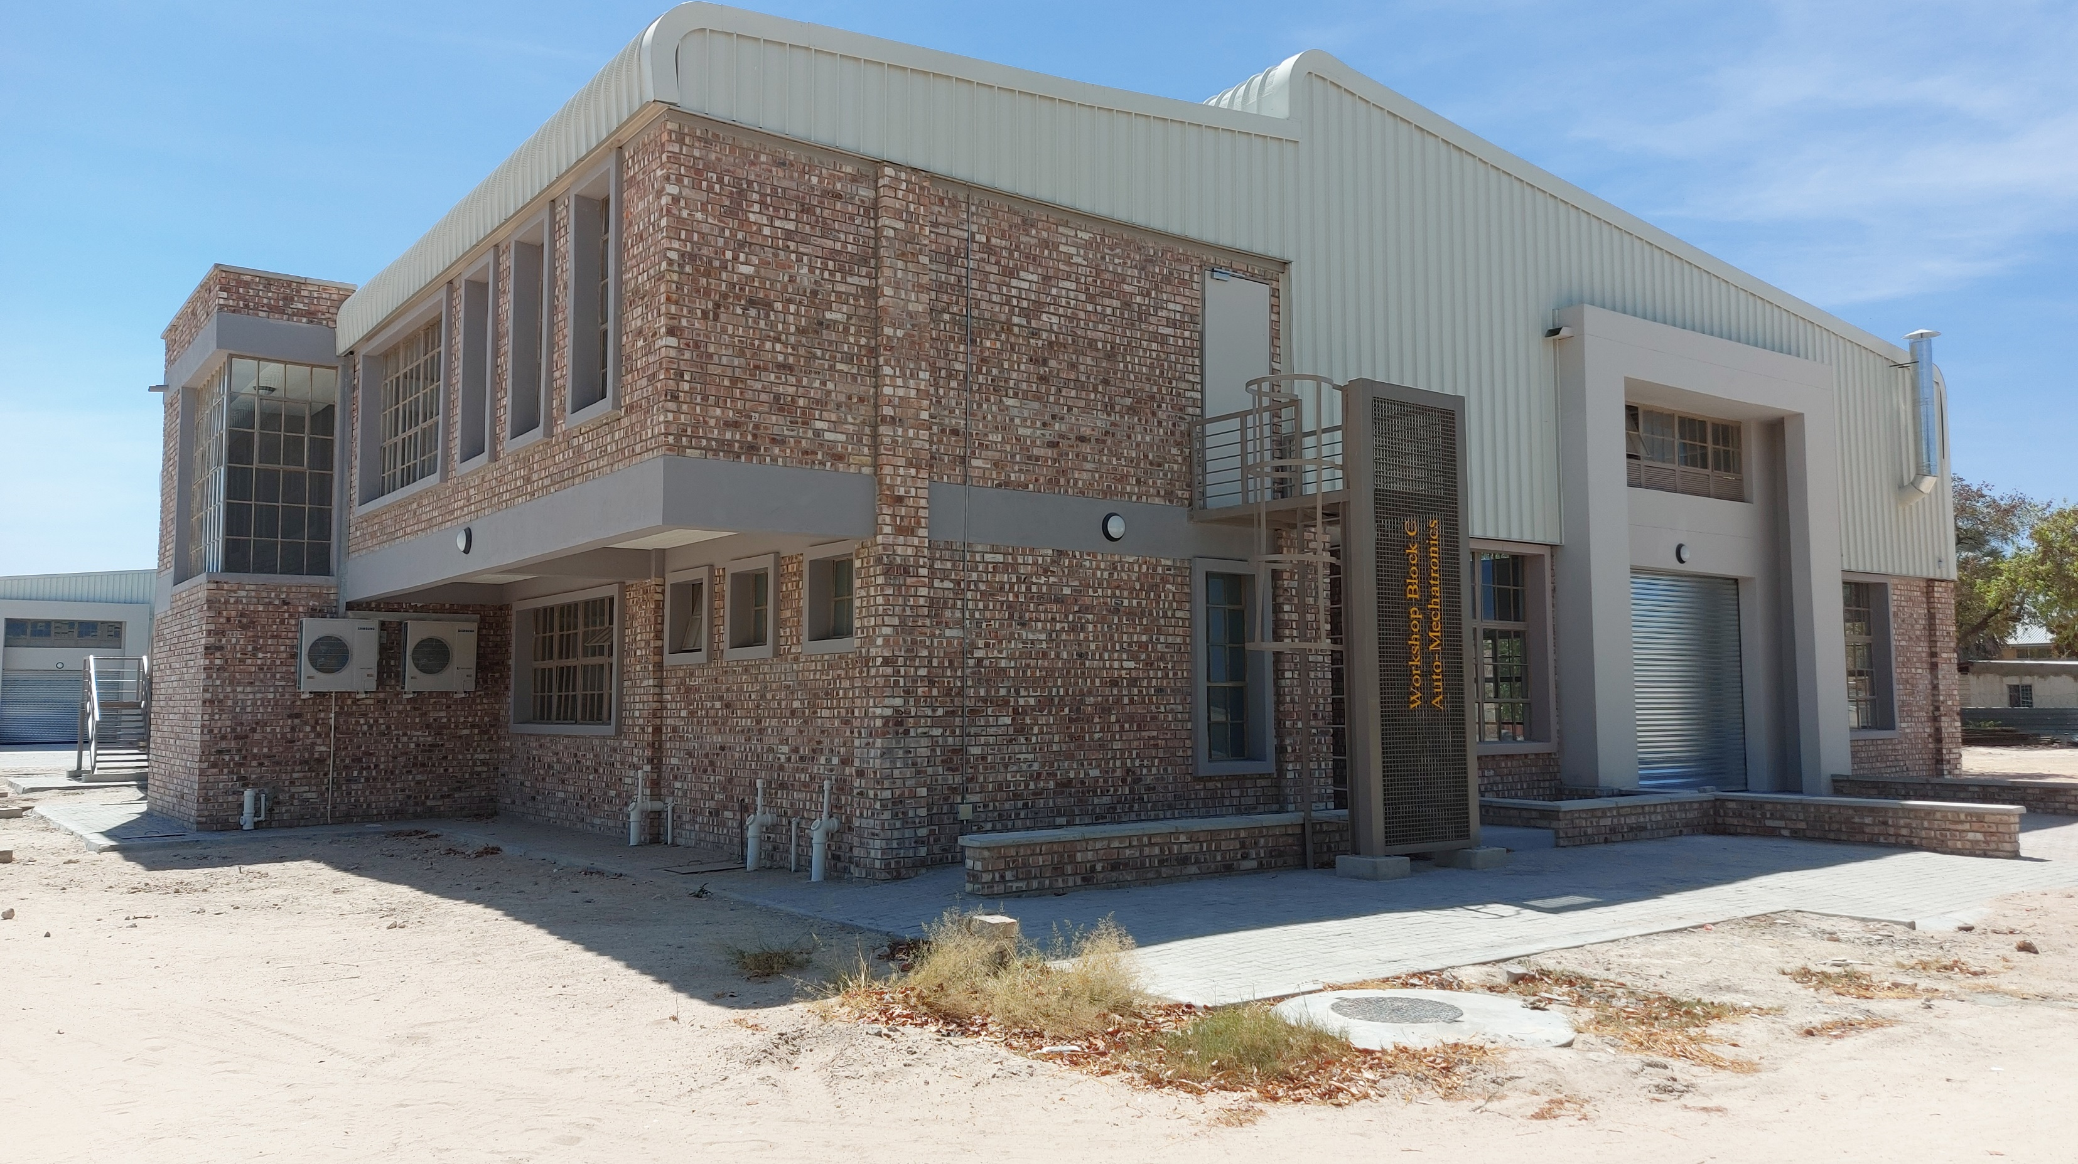
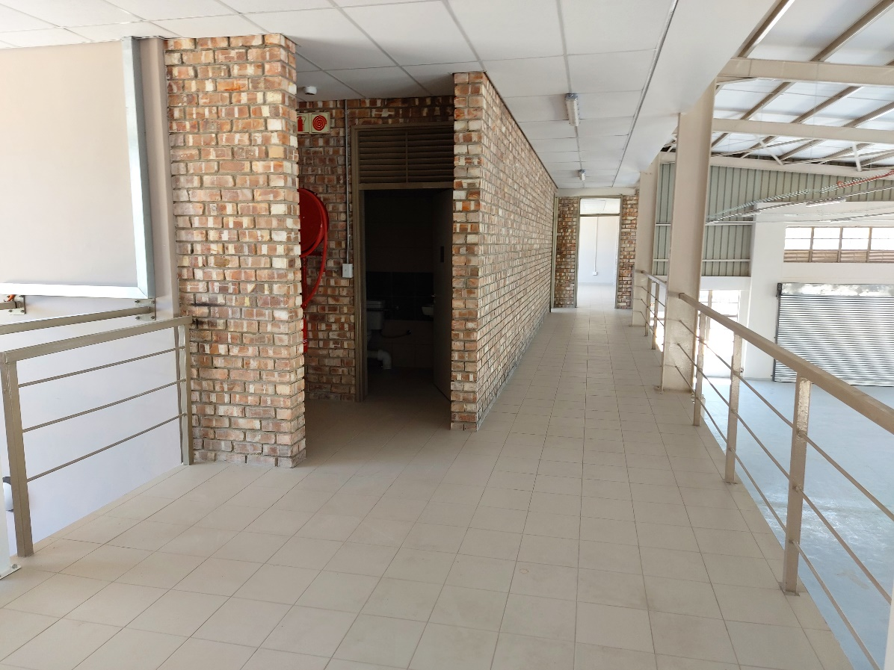
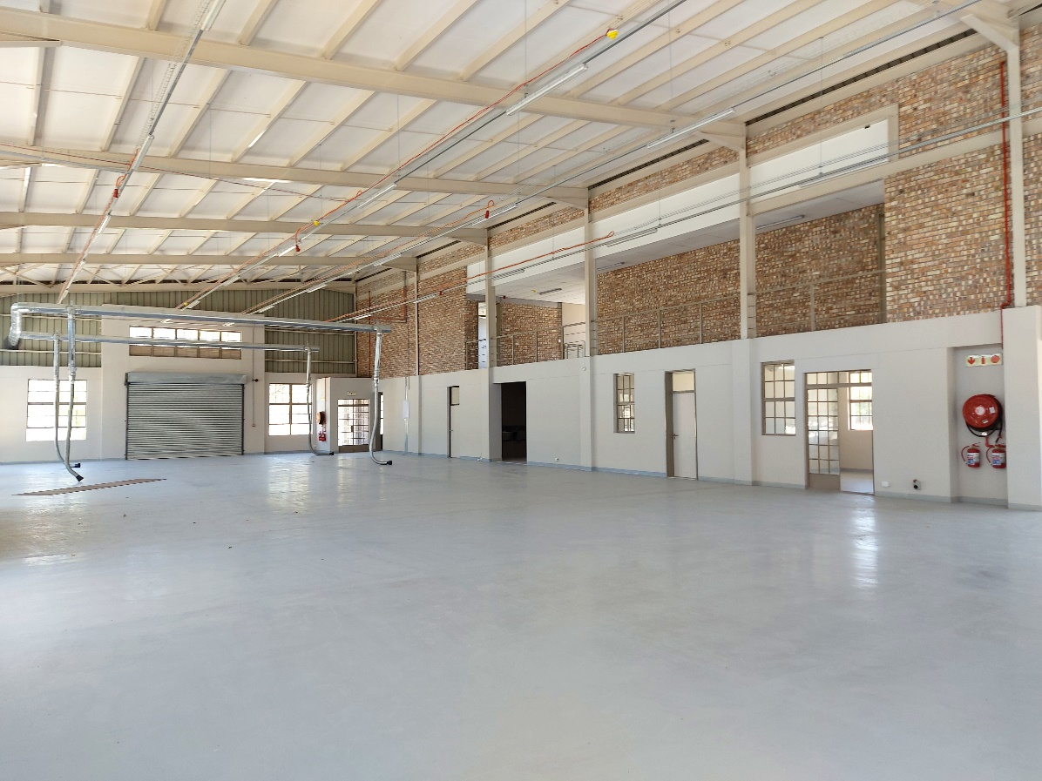
Valombola VTC
Automechatronics Workshop
Contractual requirements fulfilled and workshop handed over to NTA, inaugurated in June 2022.
Investment: EUR 562.317,00
NAD 9.500.000,00
Procurement of equipment to date: EUR 207.334,00

Slide 8
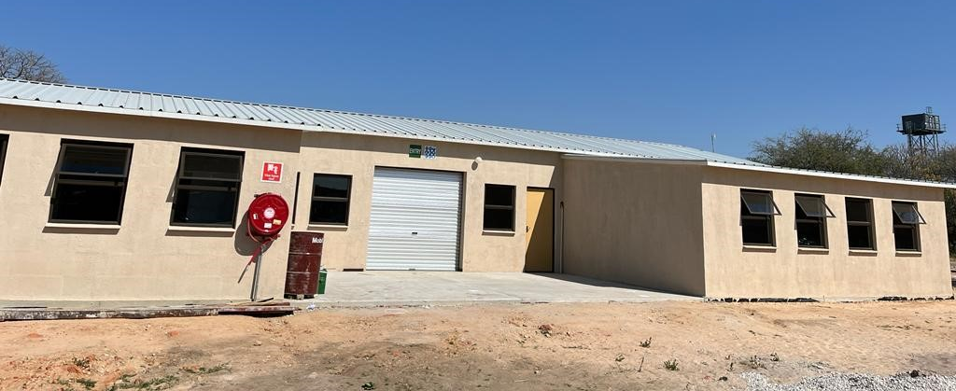
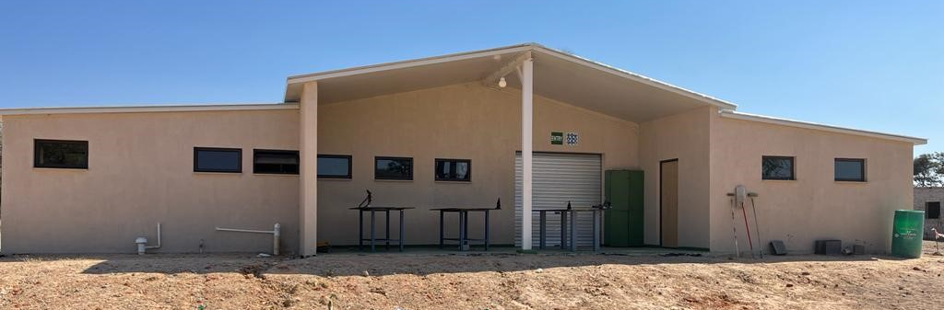
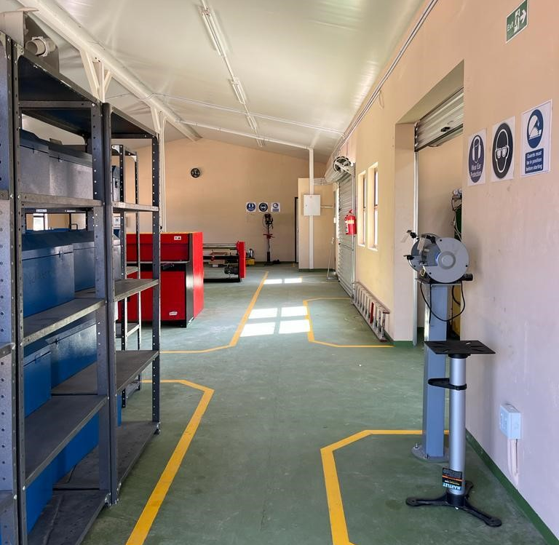
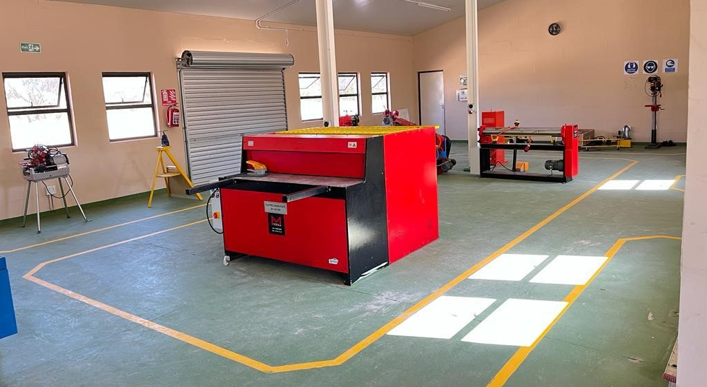
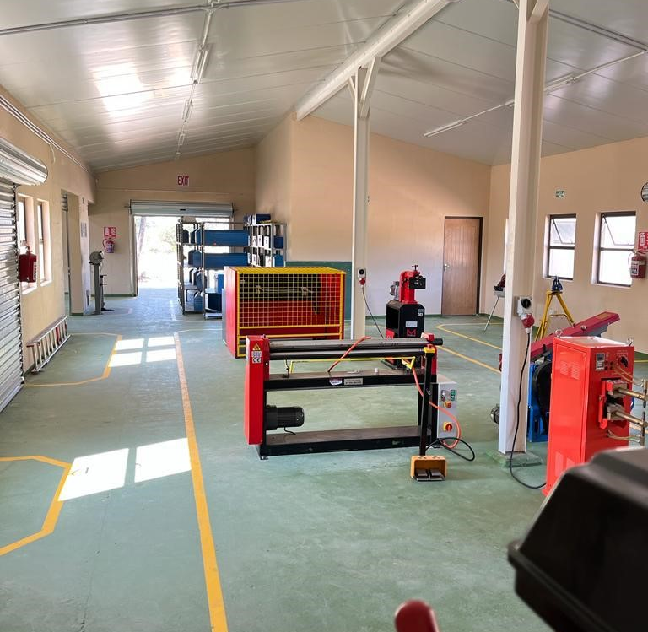
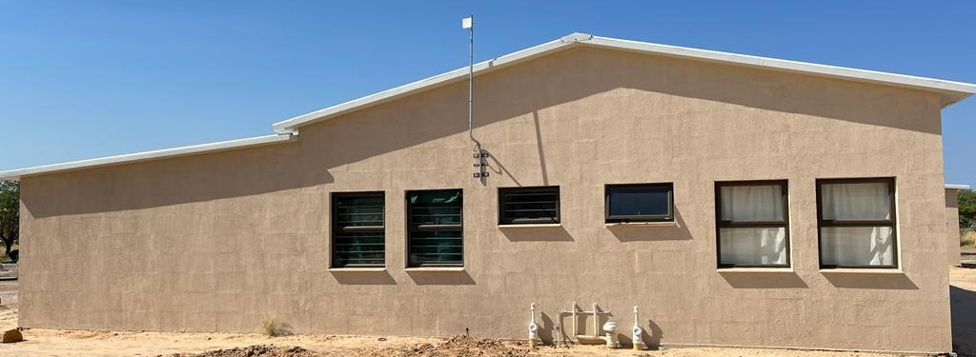
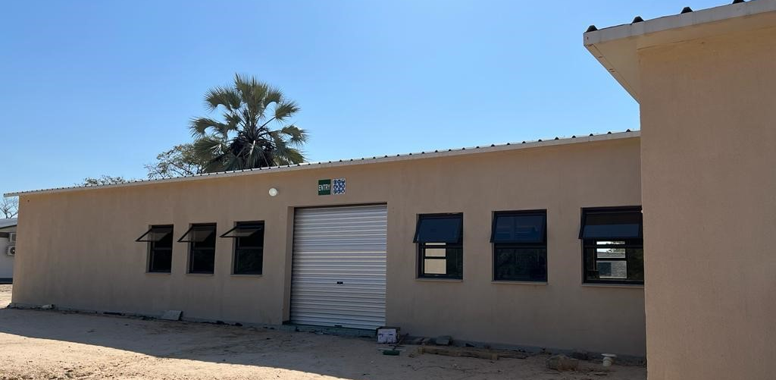
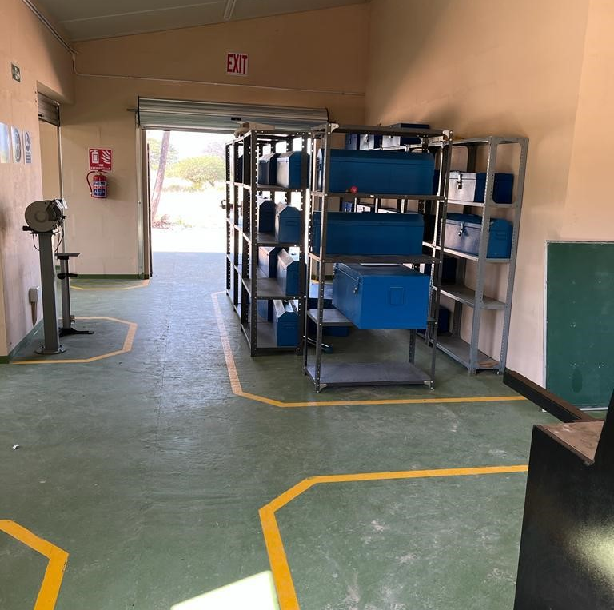
Eenhana VTC
Plumbing Workshop
This project was completed in August 2021 and handed over to the NTA. Additional building materials were procured for EVTC to create a shaded area adjacent to the workshop (to have workstations outside)
Investment: EUR 130.220,00
NAD 2.200.000,00
Procurement of equipment to date: EUR 322.000,00

Slide 9
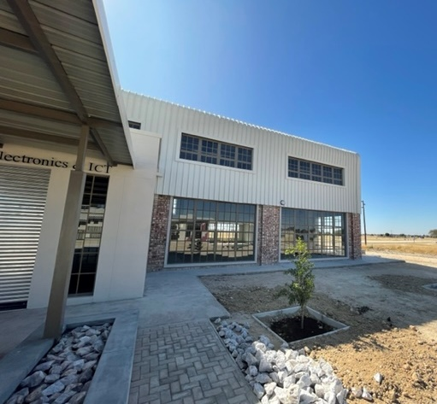
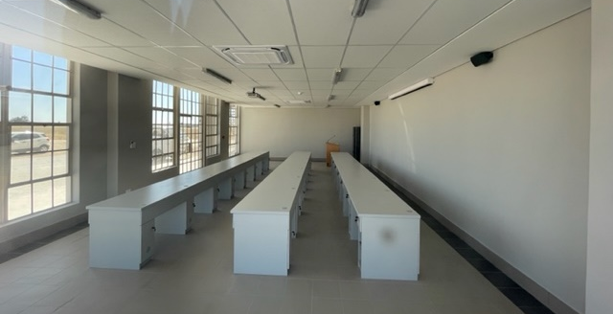
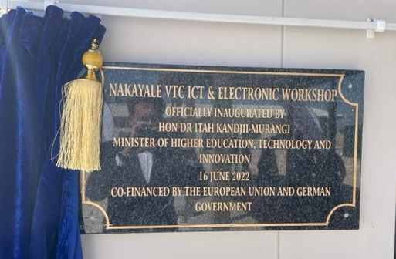
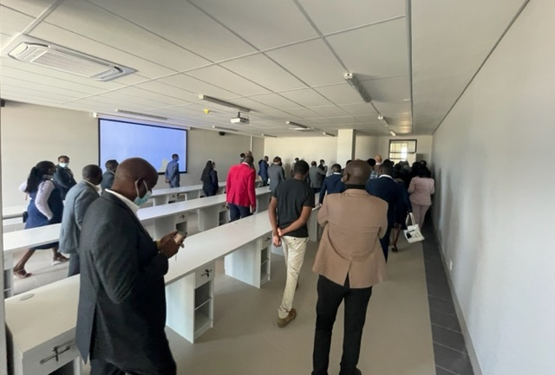
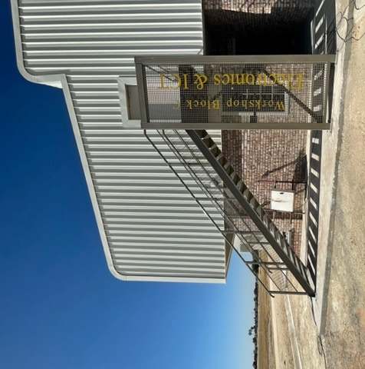
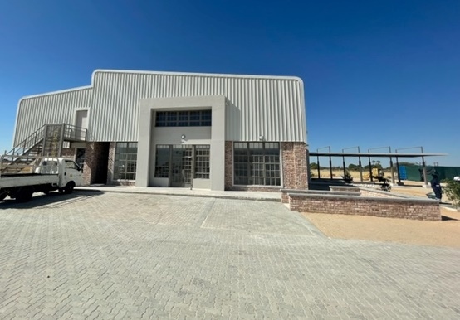
Nakayale VTC
Electrical/ICT Workshop
After the work was stopped in August 21, the new contractor could complete in June 22.
Investment: EUR 710.000,00
NAD 12.000.000,00
Procurement of equipment to date:
EUR 639.774,00

Slide 10
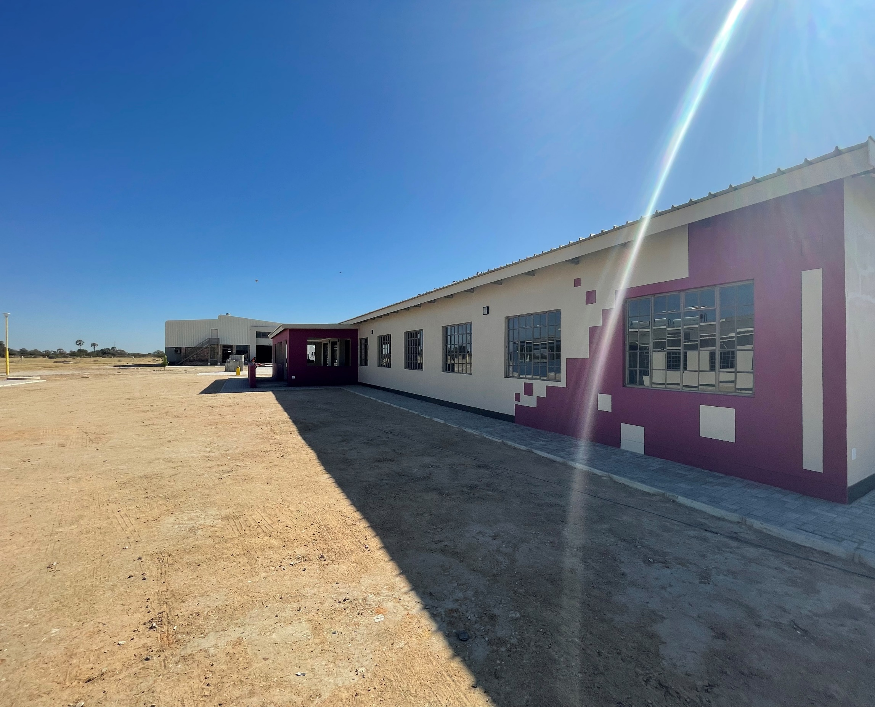
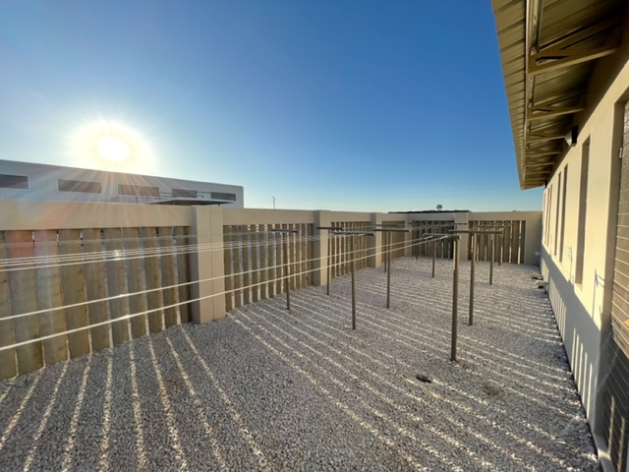
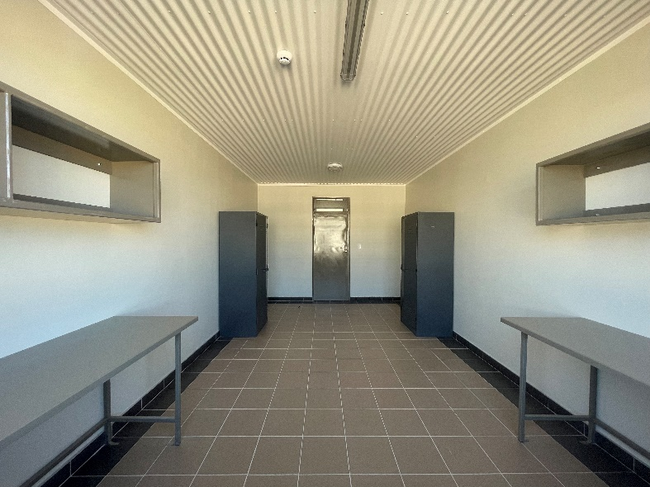
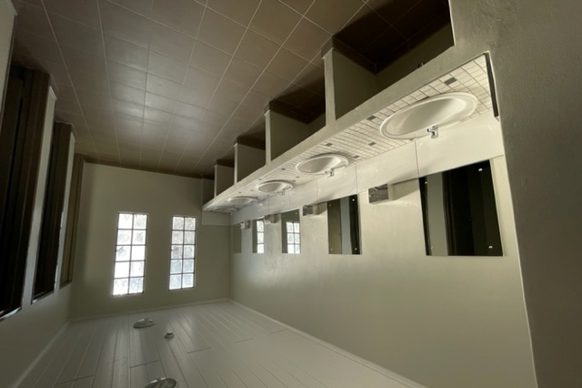
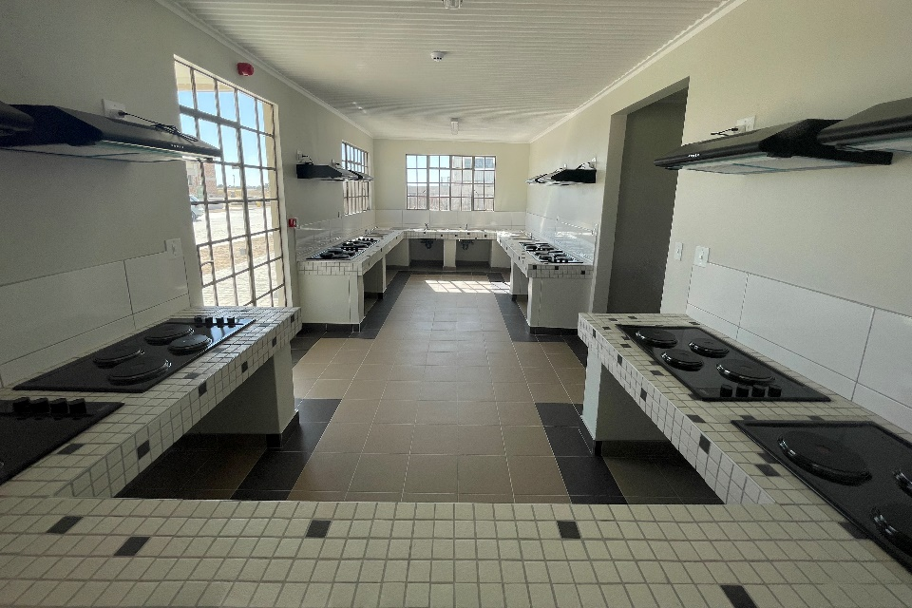
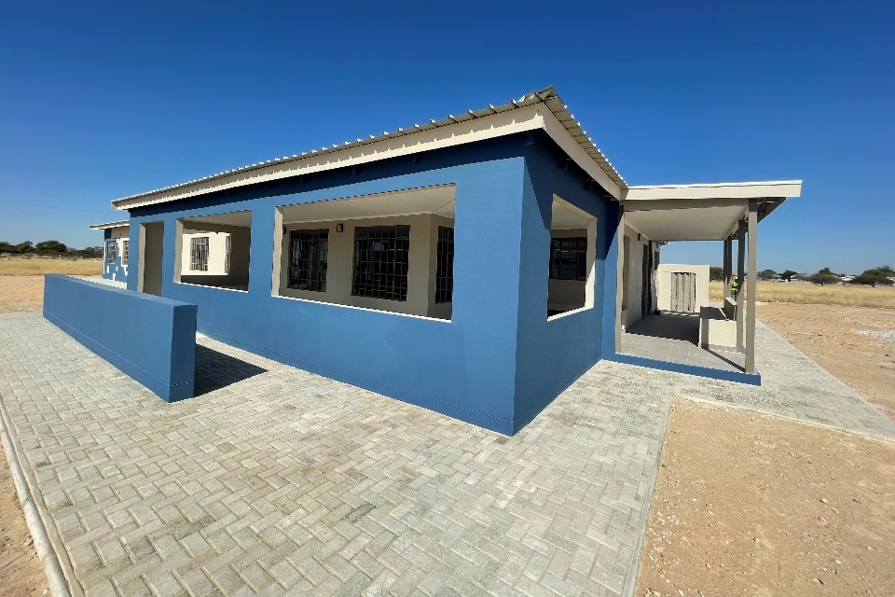
Nakayale VTC
Two Female Hostel Blocks
Completed in May and inaugurated in June 2022
Investment: EUR 674.800,00
NAD 11.400.000,00

