Slide 1
Public Private Partnership in VET on the level of Vocational Training Centers
How to generate private sector resources
Alexis Hoyaux, E2 DG-INTPA

Slide 2
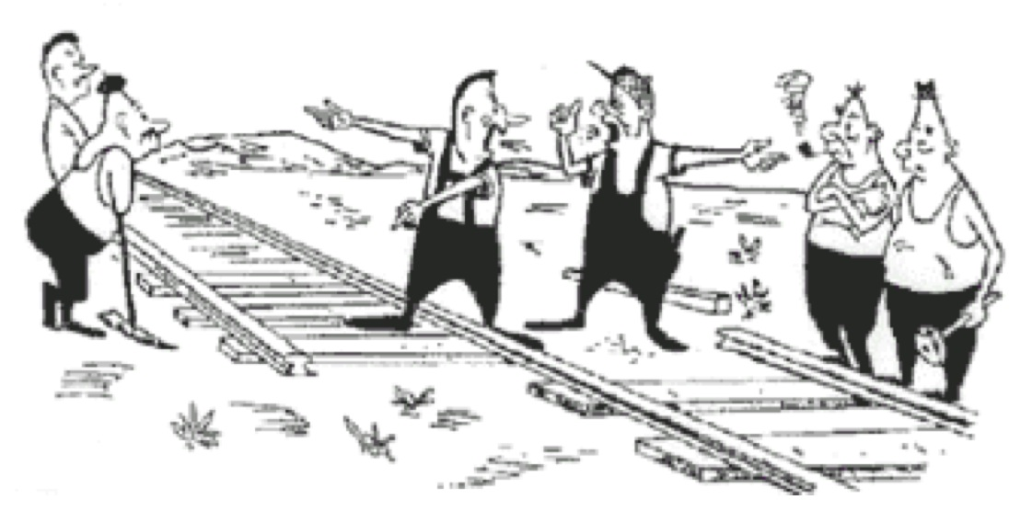
Making the point

Slide 3
Objectifs
Tip! To select one of the chapters right click on the respective hyperlink and select “Open Hyperlink”
Understand :
  The definition of PPP at the level of VTC including the modalities;
  The advantages and inconveniences ;
  The implications for TVET policies;

Slide 4
INTERVENTION METHOD
Different roles of the State
Interventionist: direct / public authority
Incentives: transfers to:
Local authorities
Independent public institutions
households, companies and VT developers
Creating partnerships
Public and private enterprises
Banks / microfinance institutions
Public and private developers

Slide 5
DIRECT INTERVENTION
General State budget
Financing professional training centres
Inclusion in general budget = management of credits
Dominant mode of action = little autonomy
Problems:
Scarce resources
Many staff, few investments and work , lack of flexibility in human resources
Lack of relation with the private sector/ companies / craftspersons
Poor involvement of actors = poor performance
Low returns / low household contribution
= Critical development of the offer and quality of training

Slide 6
STATE INCENTIVES
Transfers and subsidies
Principle: payment of direct or indirect subsidies to public and private actors to develop VT
Effective when tied to the related generation of other private resources (households, enterprises)
Financial subsidies = budget expenditure
Commitment guaranteed by bank loans
Private sector supplements with its resources
= financial contributions (infrastructure and equipment)
= human resources contributions

Slide 7
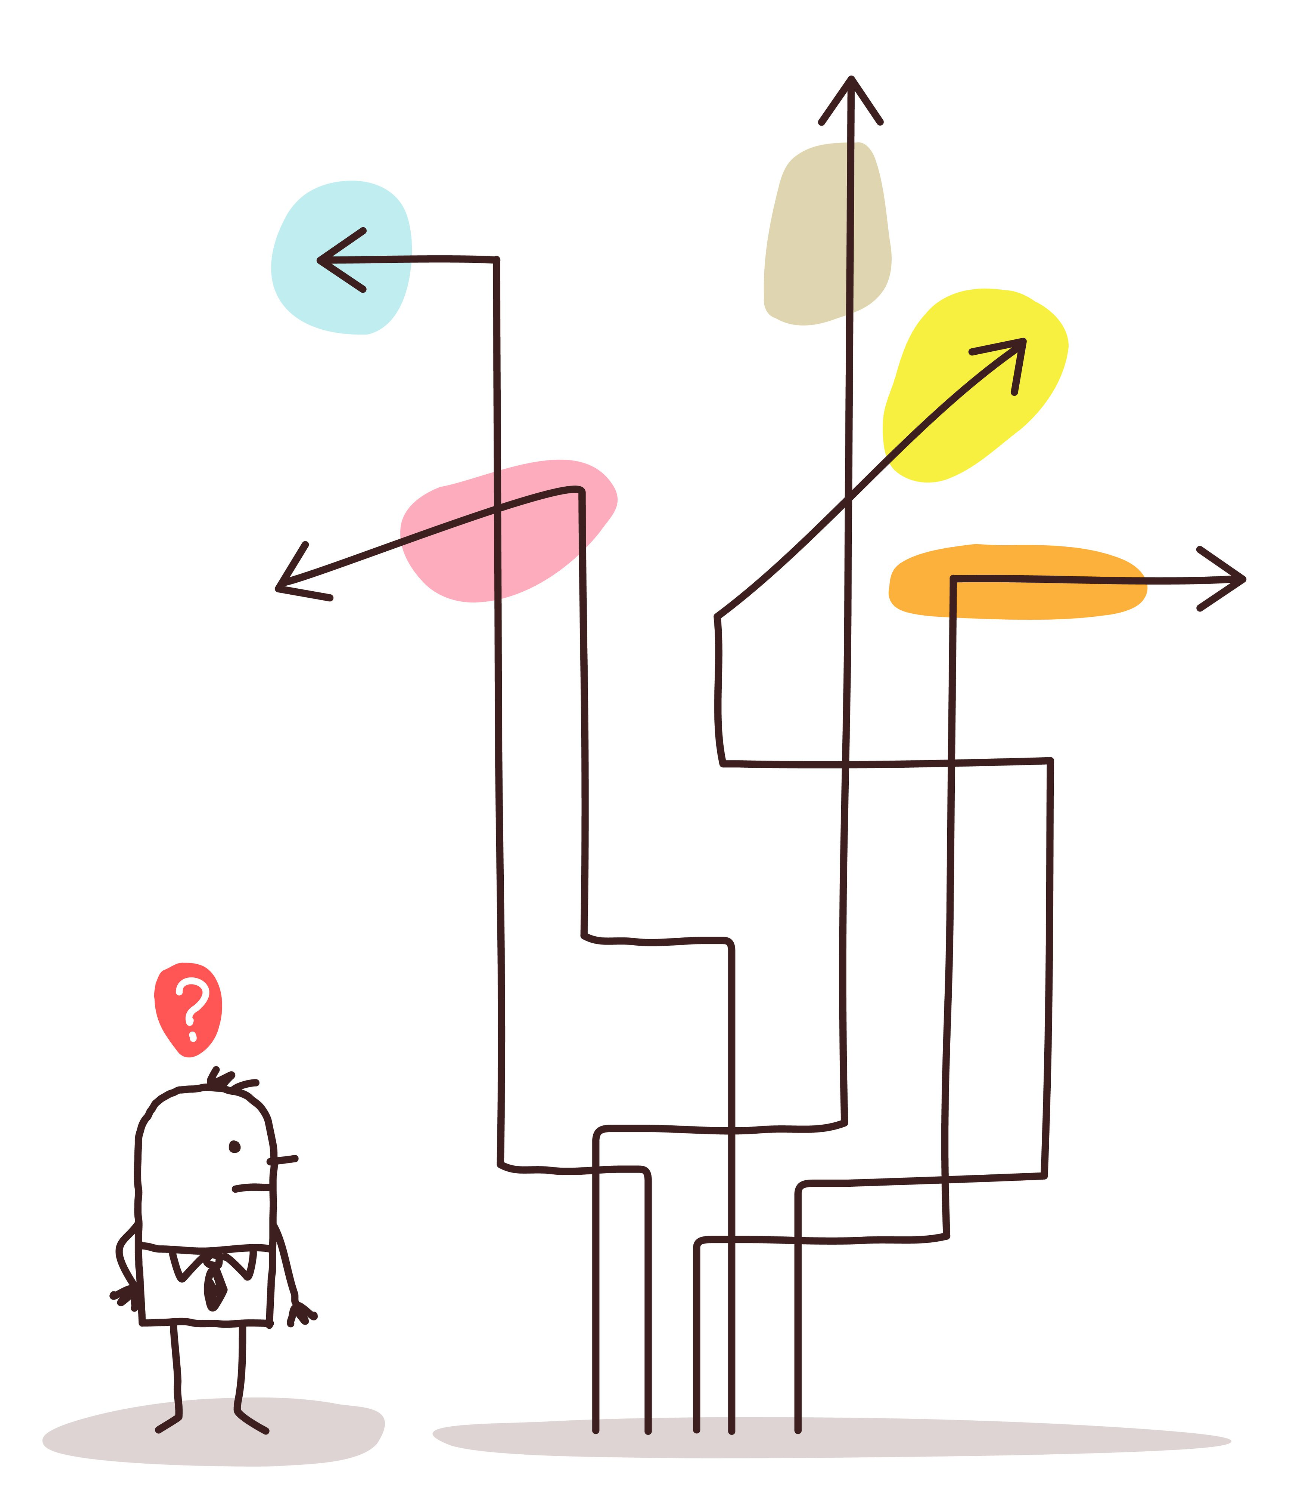
Complexity

Slide 8
Challenge for PPP
Tackle common goals and mission
Bring together different values and norms
How to overcome different cultures, ways of working and work ethos
Autonomy of VTC (good governance, pedagogy, management) according to V.Gaskov ILO

Slide 9
Different worlds
Private sector
Main focus on turn-over and profit: commercial
Time span: short (to medium) term
Training on the basis of company job (profiles)
Training is costing money: return on investment
Fast results: tomorrow rather than next week
Desire for high flexibility: no red tape (bureaucratic procedures)
Benchmarking against other businesses
Very selective in admission and enrolment
Public sector
Education is a public service (for all): non – profit
Time span: medium to long term
Broad occupational profiles as basis
Education will always cost money: public funds
Good results take time
Regulations and procedures to guarantee fair access, and opportunities for all (education is a right
Benchmarking against other countries, international bodies (e.g. European Union - EU)
Rules and regulations guarantee quality and continuity

Slide 10
PPP definition
A PPP is an arrangement between the private and the public sector, which aims to deliver public services in a more efficient manner and to generate public sector asset by making use of the private sector’s resources and expertise.

Slide 11
PPP
PPP is not an objective unto itself, but a tool to be used for the objectives of a project on job insertion or TVET strengthening
It is a way of delivering and funding public services with wider development impact

Slide 12
DPPP
A Donor (D) supports the set-up of a PPP.
DPPP can be used in the context of skills development thru the strenghtened vocational training centers: the private sector brings in equipment and know-how; the public sector provides buildings and working time; the donor as neutral entity brings partly the funding for the development objectives and the linkages with the local government
Active donors in DPPP : LuxDev,GIZ, AFD, ILO, UNIDO, ENABEL, Sida, etc

Slide 13
Two types of legal PPP at the level of VTC
An Operational PPP are private parties involved in running a public TVET service like a joint venture, under different forms of legal contracts with the national/local government with more or less responsibility for the private sector operator and remittances to be paid. The PPP is to be found in the Board of Administration and/or at the operational level in the management position .
Example: the CERMI in CVE and CFMPL in SEN

Slide 14
Examples
Simple contractualization
Public authority
Public service leasing
Public service concession
Administrative long-term lease
Build operate and transfer (BOT)

Slide 15
Besides
An educational PPP happens when private professional services upgrade and innovate public TVET Centers thru advisory services, training of trainers, T/L materials (publishers), quality assurance and accreditation where collaboration between the two sectors happens on an ad hoc base. The private sector is not the final responsible for running a public service.
Exemple : the CoC in KSV with Basic Check, ESSILOR, Pearson, Otto-Bock, Heimerer

Slide 16
50 % 50 %
A donor like GIZ thru her DPPP programme will demand that public and private contributions should complement each other for achieving common objectives. A public contribution will only be provided if the private partner would not carry out the measure without the public partner. Besides, GIZ demands the companies to make a considerable financial contribution and/or provide staff to the project, leading to a private sector contribution of at least 50% of overall costs. The interventions therefore continue beyond the duration of the project. The entreprise must have a clear commercial discernible interest in the project. Exclusively charitable projects, however, cannot be supported within the scope. The PPP project needs to be fundamentally embedded in a sustainable commitment of the company in the developing or emerging country

Slide 17
4 steps
Step 1 : identify the context, scope and purpose of the PPP with an active approach from the private sector leading to the best choice of VTC (including appropriate legal status and income generating possibilities; permanent exchange with the private sector; indepth knowledge of the local market)
Step 2: a draft business plan must be developed for the VTC based on revenues and costs

Slide 18
Next
Step 3 : for the sake of self-sustainability additional revenues streams are needed, by reducing costs (ex outsourcing some operational tasks to private companies). Some operational tasks can be taken on board by VTC staff and students like heavy equipment maintenance. Non-financial contributions by project partners need to be evaluated
Step 4: measure progress

Slide 19
Basic principles
Mutual respect
Transparency
Competitive bidding and non discrimination
Non-retroactivity of budgets
Accountability and predictability
Legitimacy
Flexibiility
Continous learning and monitoring
Equity, inclusiveness and empowerment

Slide 20
Thanks for your attention, for more information
do see alexis.hoyaux@ec.europa.eu

