Slide 1
Potential roles and responsibilities of Social Partners, employers and schools in (1) designing, (2) implementing and (3) evaluating VET programmes
Training for EU Delegations in East and Southern Africa
Lilongwe, Malawi, 8 – 10 November 2022
Stefan Thomas, ETF

Slide 2
Work-based learning is…
Learning by doing real work
  through production of real goods and services
  whether work is paid or unpaid
  may or may not be combined with school-based or centre-based learning (classroom or workshop)
  But it usually is
Borderline cases:
  WBL simulation
  Job shadowing

Slide 3
Types of work-based learning (I)
Learner is an employee
  Informal Apprenticeship
  Formal
  Apprenticeship
  On-the-job
  Learning

Slide 4
Types of work-based learning (II)
Learner is a student
  Alternance/
  Co-operative education
  Internship,
  Traineeship,
  Placement

Slide 5
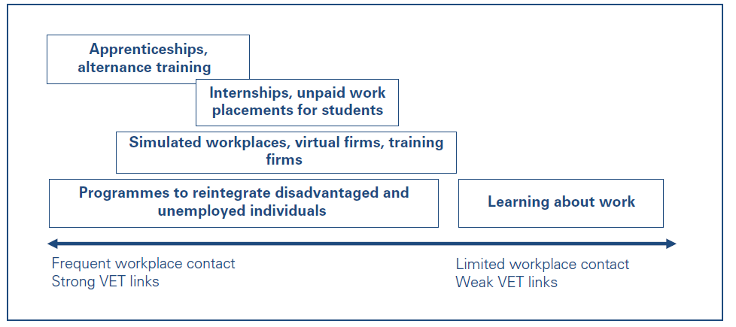
Types of work-based learning (III)

Slide 6
What are the differences?
Apprenticeships
Provide occupational skills and typically lead to a recognised qualification
Combine learning in the workplace with school-based learning in a structured way
In most cases, apprenticeships last several years
Most often the apprentice is considered an employee, and has a work contract and a salary
Traineeships and internships
Are workplace training periods that complement formal or nonformal education and training programmes
They may last from a few days or weeks to months. They may or may not include a work contract and payment

Slide 7
Why does it matter?
Good for Learners
  Improved employability
  Faster school-to-work transition
  Personal and professional development
  Better access to jobs
Good for Employers
  Higher productivity
  Technical and job-specific skills
  Efficient recruitment
  Social engagement
Good for Society
  More relevant skills
  Economic development
  Employment of less advantaged groups
  Strong links between VET and business

Slide 8
10 Critical success factors for WBL
Place of apprenticeship in the VET system
Governance structures (roles and responsibilities of key players)
Training content and learning outcomes
Cooperation among learning venues
Participation of and support to companies
Requirements and support to teachers and in-company trainers
Financing and cost-sharing mechanisms
Quality assurance
Working and learning conditions of learners
Responsiveness to the labour market
Source: CEDEFOP

Slide 9
The challenge
Public commitment to VET
High | State-centred system | Collective skills formation system
Low | Liberal system | Employer-dominated system
 | Low | High
 | Involvement of companies in VET
Source: Busemeyer, Trampusch

Slide 10
Governance: a strong link between education and employment is key
Employers’ organisations, trade unions and work councils play a crucial role
Employers have a strong influence on qualifications and assessment standards (programme design phase)*
Employers provide training (programme application phase)*
Employers are involved in learners’ assessment (programme application phase)
Employers are involved in the evaluation of results (e.g. do graduates find employment?) (feedback phase)*
*Source: Renold

Slide 11
What needs to be regulated?
Let’s look at the programme design phase:
Who will the learners be?
The purpose of the programme and the (learning) outcomes
The time learners spend in the workplace and in the classroom
The type and content of the apprenticeship contract
The financing mechanism and the learners’ wage
The roles and responsibilities of stakeholders in monitoring, supervision, assessment
How will the social partners be involved in decision making?

Slide 12
What needs to be regulated?
Let’s look at the programme application phase:
Example: ­”Checking companies’ capability, willingness, resources to train students”
Ministry department
VET Agency | X | Montenegro
Sectoral organisation
Chamber | X | Serbia
Municipality
School or Training Centre | X | Albania
Other

Slide 13
Some questions to answer…
Which institutions are already in place in your country?
Which institutions are willing to do what in your country?
What can be done jointly, e.g. by a school/training centre and a company?
Which resources are needed?
What is really feasible?
The link between education and employment is key!

Slide 14
Examples for tasks that need to be done
before work-based learning starts:
­Getting to know each other: Bringing businesses to the school or training centre, bringing students to businesses
Getting employers on board and selecting workplaces
Supporting the application and selection process of students
Matching students with employers (e.g. by using databases)
Distributing students to companies
Training of company mentors
Checking companies’ capability, willingness, resources to train students
Checking whether companies meet occupational health and safety requirements

Slide 15
Examples for tasks that need to be done
during work-based learning:
­Planning and organising the alternation between school and company, taking into account the school timetable and school holidays
Organising transport and accommodation for students
Supervising, monitoring students at the workplace
Supporting company mentors during work-based learning
Adapting school curriculum/company training plan to local industry needs
Developing personal learning plans for each student
Support the cooperation of companies, e.g. when a company cannot cover the full range of knowledge and skills that need to be learned at work

Slide 16
Examples for tasks that need to be done
after work-based learning:
Debriefing students after they have been in the workplace
Assessment of what students have learned at work
Organising students’ assessments
Hosting students’ assessments
Evaluating the cooperation between schools and companies
Developing improvement plans and a common quality approach

Slide 17
10 Critical success factors for WBL
Place of apprenticeship in the VET system
Governance structures (roles and responsibilities of key players)
Training content and learning outcomes
Cooperation among learning venues
Participation of and support to companies
Requirements and support to teachers and in-company trainers
Financing and cost-sharing mechanisms
Quality assurance
Working and learning conditions of learners
Responsiveness to the labour market
Source: CEDEFOP

Slide 18
Costs
VET Programme
Work-based learning
component*
School-based learning
component
+
In-company trainer
Professional development of in-company trainer
Facilities, training equipment, tools
Learning material
Learner‘s wage/allowance
Learner‘s insurance
Learner‘s transport
Teachers, instructors
Professional development of teachers
Facilities, equipment, tools
Maintenance
Learning material
Learner‘s insurance
Learner‘s transport
Costs related to the
VET System:
Occupational and educational standards
Inspection, supervision
Assessment
Counselling and guidance
Research
Administration
*In some countries, the work-based learning component is complemented by addtional training in inter-company training centres.

Slide 19

Example:
Elena is doing a 3-year apprenticeship programme in Technical Drawing
Costs for the company:
Elena’s salary
Time that Elena’s mentor spends on training
Learning material, equipment
Health and accident insurance
Benefits for the company:
Elena is replacing a qualified worker
  to 20% in year 1
  to 40% in year 2
  to 70% in year 3

Slide 20
Potential employer benefits
Benefits
During work-based learning
(short-term)
During and after work-based learning
(long-term)
Productive work
Savings
Other benefits
Unskilled tasks
Recruitment costs
Job familiarisation
Company- and job-specific skills
Semi-skilled/skilled tasks
Advertisement
Differences in productivity
Reduced risk of skills mismatch
Pre-selection
Further training
Reduced risk of skills shortage
Interview
Commitment of skilled personnel
Employee loyalty
Image (CSR)
Source: BiBB/GoVET

Slide 21
Balancing costs and benefits
Gross Costs
Learners’ productive work
(short-term benefit)
Net Costs
-
=

Slide 22
What influences the cost-benefit ratio?
Occupation or industry
Car repair: high cost
Retailing: low cost
Company size
Economies of scale in large companies
Duration of work-based learning
With longer training companies may recover more of their training costs
Training wages
Incentives
Benefits are harder to realise if training wages are too high, and easier if wages and allowances are low.
Government subsidies and grants can reduce costs and raise benefits

Slide 23
Duration of work-based learning
Switzerland (3-year apprenticeship)
Learning at the workplace: 75% | Learning at school: 25%
More time to get familar with the job and work processes
More time to get to know colleagues and clients
More time for productive work
Montenegro (3-year dual education)
Learning at the workplace: 40% | Learning at school: 60%

Slide 24
Improving the cost-benefit ratio for employers
Incentives
Financial incentives
Non-financial incentives

Slide 25
Financial incentives
Financial Incentives
Tax Incentives
Subsidy
Levy-fund scheme

Slide 26
Financial incentives
Financial Incentives
Universal incentives
Targeted incentives
All companies in your country are eligible for incentive payments
Incentive payments depend e.g. on size of the company, economic sector, region, type of programme offered etc.

Slide 27
Cost reimbursement & levy rebate
Firms that
do not train
VET
Fund
Levy
Firms that
do train
Cost reimbursement
Reimbursement is based on actual costs
Partial refund of the levy
and/or
Rebate

Slide 28
Exemption from the levy
Levy
Firms that
do not train
VET
Fund
Firms that
do train
Exemption from the levy

Slide 29
Non - financial incentives
  Optimise the design of work-based learning schemes
  Improve training capacities within companies (in-company trainers, training material)
  Support cooperation of companies
  Help with managerial and administrative tasks
  Preferential treatment in the award of public contracts

Slide 30
Back up: work-based learning

Slide 31
European Framework for Quality and Effective Apprenticeships
Fourteen criteria for learning and working conditions
Written contract between employer, the apprentice and the training institutions.
Learning Outcomes should be defined by employers and training institutions, ensuring both job-related skills and personal development.
Pedagogical support: close cooperation of designated in-company trainers and teachers.
Workplace component: at least 50% of the duration should take place at the workplace.
Remuneration: Apprentices should be paid and/or compensated.
Social Protection: Apprentices should be entitled to social protection including insurance.
Work, health and safety conditions: The workplace should comply with relevant rules and regulations on working conditions, in particular health and safety legislation.
Source: Council Recommendation on a European Framework for Quality and Effective Apprenticeships (2018/C 153/01).

Slide 32
European Framework for Quality and Effective Apprenticeships
Regulatory framework based on partnership and dialogue between stakeholders. This may include accreditation procedures for companies.
Involvement of social partners in the design, governance and implementation of apprenticeship schemes.
Support for companies: financial and/or non-financial support should be envisaged, enabling cost-effective apprenticeships for companies.
Flexible pathways and mobility: Apprenticeship should lead to a nationally recognised qualification. Apprenticeships should allow access to higher education and training levels. Transnational mobility should be promoted.
Career guidance and awareness raising: Learner support before and during the apprenticeship.
Transparency: Transparency and access to apprenticeship offers should be ensured.
Quality assurance and graduate tracking: There should be quality assurance of apprenticeships and tracking of employment of apprentices.

Slide 33


“Work-based learning: How ready are we?”:
https://www.etf.europa.eu/en/publications-and-resources/publications/work-based-learning-how-ready-are-we-tool-etf-partner

Slide 34

“Financing work-based learning as part of vocational education reform”:
https://www.etf.europa.eu/en/publications-and-resources/publications/financing-work-based-learning-part-vocational-education

Slide 35

“Monitoring and evaluating work-based learning in vocational education and training"
https://www.etf.europa.eu/en/publications-and-resources/publications/monitoring-and-evaluating-work-based-learning-vocational

Slide 36
Thank You!
stefan.thomas@etf.europa.eu

