Slide 1
VET and skills development in Sudan
INTPA VET training – practical training about VET and employability opportunities
8-9-10 November 2022, Lilongwe, Malawi

Slide 2
TVET in Sudan - Challenges
      No clear, comprehensive and articulated policy statement
        Separate laws, decrees and practices covering separate aspects of TVET
      Low levels of coordination resulting in fragmentation and duplication of effort
        no minimum standards for TVET premises, equipment, instructional materials or training centres
      Domination of supply forces over demand forces
        unified national curricula and final examinations limit the flexibility of TVET institutions to respond to local and state-specific labour market needs
Notes:
At the present time, TVET in Sudan has no clear, comprehensive and articulated policy statement. Rather, there is a number of separate laws, decrees and practices covering separate aspects of TVET. TVET in Sudan is characterized by:
a. Low levels of coordination resulting in fragmentation and duplication of effort. There are no minimum standards for TVET premises, equipment, instructional materials or ICT.
b. Domination of supply forces over demand forces. TVET planning and provision is academia-driven (schools, colleges and training centres) rather than being market driven. This has resulted in a mismatch between labour market needs and skills offered by TVET institutions. Another outcome is the feeling in academia that they do not need to go beyond the walls of colleges and schools to plan TVET.
c. Feeble participation on the part of the social partners (e.g. private sector, workers organisations) and lack of attention for macroeconomic and sectoral policies and their impact on employment creation through support to small and micro enterprises and the sectoral economy. To date, employer and worker representation on the governance bodies of the TVET system and institutions has been merely symbolic. Both employers and workers are represented on the boards of national TVET councils and on BoT for TVET institutions, but they are in general outnumbered by officials and civil servants, and are usually unprepared to take an effective social partner role. Employer and worker federations at the federal level are showing strong commitment to partnership with the government in developing TVET, but they have neither the expertise nor the financial capacity to become influential.
d. Little responsiveness to skill needs for the agricultural sector and the informal economy. Agriculture is the major employment sector in Sudan (employing about half of the workforce, 47 per cent in 2011) and a major source of income for Sudan (contributing 28 per cent of GDP in 2013), and there are clear opportunities to improve skills and productivity, but only about 3.8 per cent of enrolment in colleges of technology and 3.2 per cent of secondary technical training relates to agriculture. ILO recommended recognizing informal apprenticeship as a training system, and also stressed that improvement and not formalizing should be the objective, forging and/or enhancing links with the formal TVET system
e. Very few entrepreneurship programmes exist in the country, while the international experience shows that entrepreneurship can open the way to the creation of self-employment and employment, in particular in SMEs. Globally, Sudan stands at 122 in the ranking of 185 economies on the ease of starting a business. Several factors are impeding the business environment and entrepreneurship, including customs and trade regulations, tax administration, political instability and tax rates.
f. Lack of attention for the growing challenge of climate change and environmental pressures as they tackle economic growth and youth unemployment, since these are likely to change demand for skills and the pattern of employment. Sudan is facing environmental challenges related to the sustainable management of its natural resources. The management of forest resources is one of the priorities in Sudan’s integrated resource management because the rate of deforestation has risen since July 2011 to 2.2 per cent per year. Addressing forestry challenges cannot be successful without addressing the energy challenge of Sudan at the same time (UNEP 2012).
g. Labour market information (LMI) in Sudan is at a rudimentary stage. A proper, well-functioning TVET-LMI System will be able to sort, assess and classify the training capacity of enterprises (of course not only in the industrial sector), and with the strong links the TVET-LMIS can build with employers, make it possible to optimize work-based training.
h. Resources for TVET in Sudan are limited and not likely to increase in the near future. Therefore, it will be vital that resources are utilised in a cost effective manner. Strengthening partnership with employers and workers, improving efficiency in management of TVET provision, enhancing workplace learning and promoting private training provision are the main strategies to this effect. TVET institutions should also have the necessary autonomy to mobilize further resources by raising fee levels, while respecting equity, and to generate other sources of income, such as producing and selling products, and providing training and other services to local companies and communities.
A rigorous TVET policy document with clear sense of direction will also be an asset to improve productivity and competitiveness in a in a globalized economy. In addition it can facilitate assistance by international donors.

Slide 3
TVET in Sudan - Challenges
      Weak participation of the social partners (e.g. private sector, workers organisations)
        lack of attention for macroeconomic and sectoral policies and their impact on employment creation through support to small and micro enterprises
      Little responsiveness to skill needs and very few entrepreneurship programmes
        Agricultural sector - clear opportunities to improve skills and productivity, but only about 3.8 per cent of enrolment in colleges of technology and 3.2 per cent of secondary technical training relates to agriculture
      Lack of attention for the growing challenge of climate change and environmental pressures
        likely to change demand for skills and the pattern of employment, management of forrest resources etc.
Notes:
At the present time, TVET in Sudan has no clear, comprehensive and articulated policy statement. Rather, there is a number of separate laws, decrees and practices covering separate aspects of TVET. TVET in Sudan is characterized by:
a. Low levels of coordination resulting in fragmentation and duplication of effort. There are no minimum standards for TVET premises, equipment, instructional materials or ICT.
b. Domination of supply forces over demand forces. TVET planning and provision is academia-driven (schools, colleges and training centres) rather than being market driven. This has resulted in a mismatch between labour market needs and skills offered by TVET institutions. Another outcome is the feeling in academia that they do not need to go beyond the walls of colleges and schools to plan TVET.
c. Feeble participation on the part of the social partners (e.g. private sector, workers organisations) and lack of attention for macroeconomic and sectoral policies and their impact on employment creation through support to small and micro enterprises and the sectoral economy. To date, employer and worker representation on the governance bodies of the TVET system and institutions has been merely symbolic. Both employers and workers are represented on the boards of national TVET councils and on BoT for TVET institutions, but they are in general outnumbered by officials and civil servants, and are usually unprepared to take an effective social partner role. Employer and worker federations at the federal level are showing strong commitment to partnership with the government in developing TVET, but they have neither the expertise nor the financial capacity to become influential.
d. Little responsiveness to skill needs for the agricultural sector and the informal economy. Agriculture is the major employment sector in Sudan (employing about half of the workforce, 47 per cent in 2011) and a major source of income for Sudan (contributing 28 per cent of GDP in 2013), and there are clear opportunities to improve skills and productivity, but only about 3.8 per cent of enrolment in colleges of technology and 3.2 per cent of secondary technical training relates to agriculture. ILO recommended recognizing informal apprenticeship as a training system, and also stressed that improvement and not formalizing should be the objective, forging and/or enhancing links with the formal TVET system
e. Very few entrepreneurship programmes exist in the country, while the international experience shows that entrepreneurship can open the way to the creation of self-employment and employment, in particular in SMEs. Globally, Sudan stands at 122 in the ranking of 185 economies on the ease of starting a business. Several factors are impeding the business environment and entrepreneurship, including customs and trade regulations, tax administration, political instability and tax rates.
f. Lack of attention for the growing challenge of climate change and environmental pressures as they tackle economic growth and youth unemployment, since these are likely to change demand for skills and the pattern of employment. Sudan is facing environmental challenges related to the sustainable management of its natural resources. The management of forest resources is one of the priorities in Sudan’s integrated resource management because the rate of deforestation has risen since July 2011 to 2.2 per cent per year. Addressing forestry challenges cannot be successful without addressing the energy challenge of Sudan at the same time (UNEP 2012).
g. Labour market information (LMI) in Sudan is at a rudimentary stage. A proper, well-functioning TVET-LMI System will be able to sort, assess and classify the training capacity of enterprises (of course not only in the industrial sector), and with the strong links the TVET-LMIS can build with employers, make it possible to optimize work-based training.
h. Resources for TVET in Sudan are limited and not likely to increase in the near future. Therefore, it will be vital that resources are utilised in a cost effective manner. Strengthening partnership with employers and workers, improving efficiency in management of TVET provision, enhancing workplace learning and promoting private training provision are the main strategies to this effect. TVET institutions should also have the necessary autonomy to mobilize further resources by raising fee levels, while respecting equity, and to generate other sources of income, such as producing and selling products, and providing training and other services to local companies and communities.
A rigorous TVET policy document with clear sense of direction will also be an asset to improve productivity and competitiveness in a in a globalized economy. In addition it can facilitate assistance by international donors.

Slide 4
TVET in Sudan - Challenges
      Scarcity of skilled workers - TVET graduates 1.5 per cent of total labour force
      Enrolment figures indicate how small the TVET system is at the skilled worker level
        with 5,344 total graduates in 2011
      The labour market in Sudan has almost 19 graduates and 10 technologists for each skilled worker
      Informal, traditional apprenticeship in workshops and small businesses of craftsmen (MSMEs) has been known in Sudan for not less than 100 years
        needs to be improved in order to be recognized as a training system
        is cost efficient and integrated in the production process

Slide 5
TVET reforms
National Quarter Century Strategy 2007–2031
favours technological education at post-secondary level at the expense of other TVET levels, establishing a separate and closed track for TVET
TVET Policy Milestones
2001 - Vocational Training and Apprenticeship Act
2005 - National Council on Technical and Technological Education (NCTTE)
2009 - Technical and Technological Education (TTE) track
2013 - ILO work on developing a national strategy for TVET
    recommended recognizing informal apprenticeship as a training system
    improvement and not formalizing should be the objective

Slide 6
TVET reforms
Several attempts to merge the sectors of technical education and vocational training
    Main actors are affiliated to different ministries, and there are both federal and state roles in running these subsystems
    Not fruitful due to the institutional division and the competition over scarce resources between the Ministry of Education and the Ministry of Labour
    The two sectors (TTE and VET) are thus institutionally completely separate and there is no comprehensive strategy for TVET in Sudan

Slide 7
TVET reforms
However, the current TVET policies and practices do have some strengths:
SCVTA and NCTTE, are both headed by the deputy president of Sudan and at present working well together
Positive trend to involving communities in TVET
Readiness to better utilize the available material and human resources in TVET institutions
      through sharing facilities between more than one type of institution (VTCs, technical secondary schools and colleges of technology)
Notes:
However, the current TVET policies and practices do have some strengths. The two umbrella bodies, SCVTA and NCTTE, are both headed by the deputy president of Sudan, and they are at present working well together. There is a positive trend to involving communities in TVET through BoT, and there is evident readiness to better utilize the available material and human capital resources in TVET institutions, through sharing facilities between more than one type of institution (VTCs, technical secondary schools and colleges of technology).

Slide 8
EU responses – Reflections on EUD Cooperation
    Enhance governance and equity of TVET, through improved coordination and management of the TVET system
      The development of a comprehensive TVET strategy and a National Qualification Framework (NQF)
    Improve the responsiveness of TVET to the labour market
    Strengthen the role of the social partners
    Regional/multi regional level: mutual recognition of diplomas
    Protection of workers' rights and enhanced visibility initiatives
    Private sector provision of training can be expanded by creating a favourable policy environment
      streamline the regulations for accreditation and administration of private training centres
      consistent standards can be guaranteed through initial accreditation (which can be withdrawn or confirmed periodically), inspection and certification of graduates
Notes:
6. REFLECTIONS ON EU DEVELOPMENT COOPERATAION
Basically – what is our cooperation doing? And what can we do
A wide array of EU Instruments - SMS, EU TF, CSO / LA
“Soft”
α: Improvement of the information / data? possibility of links with EU bodies, entities?
Governance: Support coordination, planning etc;
Awareness Raising: gender issues? education week?
European Vocational Skills Week
β: Other studies etc that could support Sudanese TVET sector. Partnership with relevant EU based centres ?
European Training Foundation (ETF)
European Centre for the Development of Vocational Training (Cedefop)
European Association of Institutes for Vocational Training (EVBB)
"Hard"
γ: Basic rehabilitation of schools
δ: other?
7. ROLE OF EU IN GENERAL (what do we want, what can we do, policy coherence etc)
Roles for the EU are twofold; i) policy level; ii) project level – as well as some internal EU "housekeeping" issues
Proposed actions at policy level (some already being undertaken)
− Enhance governance and equity of TVET, through improved coordination and management if the TVET system and decentralization matched by an equitable sharing of national revenues;
− Improve the responsiveness of TVET to the labour market. This allows to adjust training programmes according to the identification of skill needs in the labour market. It includes the development of relevant and effective curricula and an appropriate system of testing, accreditation and certification with the active role of all social partners. Moreover, in a context of diminishing capacity of the formal sector to provide employment, self-employment and entrepreneurship can become a viable option for young people and TVET should provide these competences. There is also a need for TVET to expand beyond the traditional domains to cover most expanding economic sectors (agriculture in particular);
− Strengthen the role of the social partners, encouraging their active participation in TVET decisions. This includes an increasing attention to workplace training, making training more realistic and relevant and increasing employment opportunities. Also, private provision of training can be encouraged by streamlining the regulations regarding the establishment, accreditation and administration of private training centres.
− Upgrade the quality of delivery in existing TVET establishments. Currently, the recruitment of instructors is based especially on their academic qualifications and ignores their practical competence. This should be reversed and teachers should be provided of a national standard teaching certificate based on national examination.
− Regional/multi regional level: mutual recognition of diplomas (not only in the horn of Africa, but also in the countries where migrants tend to migrate, ie Arabic peninsula Egypt and Europe).
− Protection of workers' rights.
− Enhanced visibility initiatives
"EU internal": Host/convene EU Thematic Network of Delegation (and EU MS?); organise regional training and workshops for EU colleagues; repository of Information; etc
Annual seminars on TVET and Employment;
TVET Group in capacity4dev
Projects – (Annex 3)
Employment Promotion in Khartoum State (EPKS)
GIZ 9,072,000 EUR
July 2021 - July 2024
Khartoum State
Main activities related to vocational training
Targeting 10 VTC in Khartoum.
Develop 8 curricula for short-term courses, including entrepreneurship component.
Office management curriculum development for short term and regular courses.
Each VTC will have two courses , with a total target of 480 youth.
Provision of equipment to 10 VTCs
Provision of office IT-equipment for 10 VTCs.
Five VTCs rehabilitation needs are assessed and will be rehabilitated.
The project has 3,000,000 EUR in grants to be provided to SMEs and skilled workers to start/scale-up their economic activities.

Slide 9
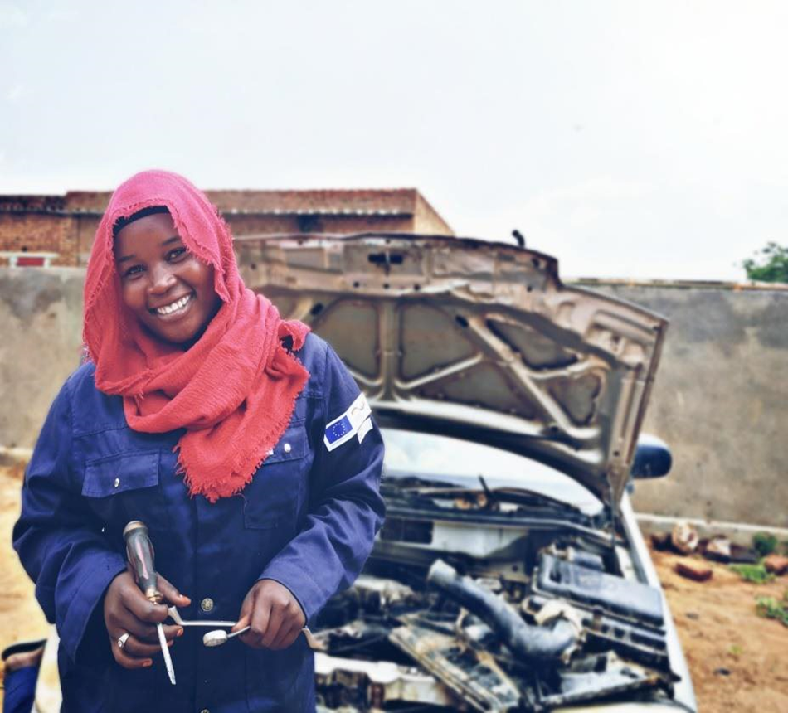
EU responses
Youth Employment and Skills (YES) - March 2020 - Dec. 2023
EU 15 Mio. EUR, GIZ 3 Mio. EUR
Region: Darfur- Elfashir, Nyala and Genina
  Main activities:
    Provision of short market oriented courses of 2 months to 1000 beneficiaries.
    Provision of long term 12 months courses on three skills, including:
          Solar panel installations and maintenance
          Plumbing
          Food processing
    Job placement and carrer counselling: Organising Job fairs in Nyala and Elfashir
Notes:
Youth Employment and Skills (YES)
GIZ 17,885,000 EUR
March 2020 - Dec. 2023
Darfur- Elfashir, Nyala and Genina
Main activities related to vocational training
Provision of short courses of 2 month to 1000 beneficiaries.
Provision of long term 12 months courses on three skills , including :
- Solar panel installations and maintenance.
- Plumbing.
- Food processing.
Organising Job fairs in Nyala and Elfashir.
4 coordination bodies are formed, including in Khartoum state.
Construction of a VTC in Elfashir with a total cost of 3,748,798 EUR.
Rehabilitation of the TSS in Nyala was done and equipment is provided. Also, TSS of boys in Elfashir is done. Rehabilitation measures include ensuring accessibility for people with disabilities.
Governance
Recognition of Prior Learning
Training on taxonomy
Facilitation training session with SCVTA

Slide 10
Thank you for your attention!
Do you have questions?
INTPA VET training – practical training about VET and employability opportunities
8-9-10 November 2022, Lilongwe, Malawi

Slide 11
Sudan context – Some hard hitting facts
      High overall unemployment rate at 18.5% (49.5% urban young people, 57.9% young women)
      High unemployment among those with higher (tertiary) education at 23%
      High illiteracy rate in the labour force (overall 34.7%)
      Informal economy creates the majority of jobs
      Access to training and employment is particularly challenging for vulnerable groups
      No agreement for recognition of skills beyond the Sudanese borders
Notes:
“Generational catastrophe” with the number of out-of-school children doubling from 3.5 million before the Corona pandemic to 6.9 million in 2022.
The food crisis has plunged a quarter of the population (11.7 million) into acute food insecurity (crisis and emergency levels).
Public services, notably health, education and agriculture, continue to be chronically underfunded. According to recent UNICEF estimates, the number of out-of-school children which used to be 3.5 million before the Corona pandemic has now increased to 6.9 million (more than a third of the school age population). This “generational catastrophe” translates into increased levels of child labour and child marriage and has the potential to fuel further irregular migration and militia enrolment as well as the reactivation of dormant terrorist cells.
In addition to the food crisis, 16 out of 18 states in Sudan are heavily affected by floods. As of 13 September 2022, 125 people have lost their lives. 286,000 people are affected, 68,000 homes were destroyed or damaged and the rainy season is not over yet.
− High overall unemployment rate at 18.5% (37.0% women, 43.7% urban women, 33.8 % young people, 49.5% urban young people, 57.9% young women). High unemployment among those with higher (tertiary) education, at 23%, a high illiteracy rate in the labour force (overall 34.7 per cent. 44.1 per cent of all the population living below the poverty line) .
High overall unemployment rate at 18.5%
High unemployment among those with higher (tertiary) education, at 23%
High illiteracy rate in the labour force (overall 34.7 per cent)
Informal economy creates the majority of jobs
Access to training and employment is particularly challenging for vulnerable groups
No agreement for recognition of skills beyond the Sudanese borders
High overall unemployment rate at 18.5% (37.0% women, 43.7% urban women, 33.8 % young people, 49.5% urban young people, 57.9% young women). High unemployment among those with higher (tertiary) education, at 23%, a high illiteracy rate in the labour force (overall 34.7 per cent. 44.1 per cent of all the population living below the poverty line).
Scarcity of qualified Sudanese skilled workers with a good work ethic. TVET graduates made up 1.5 per cent of the total labour force. As a result, they recruit foreign workers. According to the Ministry of Labour, there were 77,483 foreign workers in Sudan in 2013.
Enrolment figures indicate how small is the TVET system at the skilled worker level (with 5,344 total graduates in 2011) and how tiny the private VTC sector is (with only 180 graduates in 2011). The labour market in Sudan really has almost 19 graduates and 10 technologists for each skilled worker.
Informal economy creates the majority of jobs.
Informal, traditional apprenticeship in workshops and small businesses of craftsmen (MSMEs) has been known in Sudan for not less than 100 years. It needs to be improved in order to be recognized as a training system. Informal apprenticeship is cost effective and it is integrated in the production process.
Access to training and employment is particularly challenging for vulnerable groups, women, people with disabilities, refugees and, to a certain extent, IDPs. There is still only slight attention to gender, employment, wages, geographic (rural/urban), youth/adult, and education disparities.
The data on migrant Sudanese workers reveals that almost 87 per cent of those who migrated in the last six years are working in Saudi Arabia, followed by Libya 4.6 per cent, the United Arab Emirates (UAE) 2.9 per cent, Qatar 2.4 per cent, Kuwait 2.0 per cent and Oman 0.4 per cent, while only 0.7 per cent migrated for work elsewhere.
There is no agreement for recognition of skills beyond the Sudanese borders. This is the case for most countries in the region.
Sudan Labour Force Survey (SLFS), carried out by the Ministry of Human Resource Development and Labour (MoHRDL) and the International Labour Organization (ILO) in 2011.
1.8 per cent of all male and 0.8 per cent of all female, 2.0 per cent of all urban and 0.6 per cent of all rural workers. Roughly 30–35 per cent of TVET graduates in the labour force lived in rural areas.
MoLAR, 2014.
Informal jobs are more precarious, and that workers in this sector are not protected by labour legislation. Child labour tends to be more prevalent in the informal than the formal segment. Workers in the informal sector are not protected by minimum wage legislation, and wages tend to be lower on average than for the same types of job in the formal segment. Informal-sector jobs provide no social security, and safety at work is less observed.
According to the estimation of the president of the small Scale Enterprise Chamber of Employers’ Federation the present number of informal apprentices country-wide is around 100,000 trainees, while that of formal apprentices does not exceed 5,000 trainees’ (DSRI and ILO, 2014: 8).
women’s Labour Force Participation Rate is at 28.9 per cent, UNESCO 2016.
The Asylum Regulation Act of 2014 regulates all matters related to refugees and asylum seekers, however, formal rules are interpreted differently throughout Sudan.
The majority of migrant Sudanese are working in agriculture and animal husbandry (35.14 per cent), followed by crafts (28.1 per cent), machine operators and assembly (13.3 per cent), technicians (5.9 per cent), specialists and science staff (8.4 per cent) and management (0.3 per cent).

Slide 12
Sudan context – Some hard hitting facts
      Least developed and fragile country (UN)
      40% of the population is below 14 years
      50% of the population lives below the poverty line, with 8% in extreme poverty
      HDI 2019 – Sudan 170 out of 188 countries
      20% of the active population is unemployed
      Agriculture remains the main source of employment
      Urban informal sector is estimated to account for an equivalent of more than 60% of GDP.

Slide 13
Sudan context – Some hard hitting facts
      Education Crisis:
      Number of out-of-school children doubling from 3.5 million before Covid to 6.9 million in 2022
      “Generational catastrophe” that translates into
        increased levels of child labour and child marriage
        potential to fuel further irregular migration and militia enrolment
        reactivation of dormant terrorist cells
Notes:
“Generational catastrophe” with the number of out-of-school children doubling from 3.5 million before the Corona pandemic to 6.9 million in 2022.
The food crisis has plunged a quarter of the population (11.7 million) into acute food insecurity (crisis and emergency levels).
Public services, notably health, education and agriculture, continue to be chronically underfunded. According to recent UNICEF estimates, the number of out-of-school children which used to be 3.5 million before the Corona pandemic has now increased to 6.9 million (more than a third of the school age population). This “generational catastrophe” translates into increased levels of child labour and child marriage and has the potential to fuel further irregular migration and militia enrolment as well as the reactivation of dormant terrorist cells.
In addition to the food crisis, 16 out of 18 states in Sudan are heavily affected by floods. As of 13 September 2022, 125 people have lost their lives. 286,000 people are affected, 68,000 homes were destroyed or damaged and the rainy season is not over yet.
− High overall unemployment rate at 18.5% (37.0% women, 43.7% urban women, 33.8 % young people, 49.5% urban young people, 57.9% young women). High unemployment among those with higher (tertiary) education, at 23%, a high illiteracy rate in the labour force (overall 34.7 per cent. 44.1 per cent of all the population living below the poverty line) .
High overall unemployment rate at 18.5%
High unemployment among those with higher (tertiary) education, at 23%
High illiteracy rate in the labour force (overall 34.7 per cent)
Informal economy creates the majority of jobs
Access to training and employment is particularly challenging for vulnerable groups
No agreement for recognition of skills beyond the Sudanese borders
High overall unemployment rate at 18.5% (37.0% women, 43.7% urban women, 33.8 % young people, 49.5% urban young people, 57.9% young women). High unemployment among those with higher (tertiary) education, at 23%, a high illiteracy rate in the labour force (overall 34.7 per cent. 44.1 per cent of all the population living below the poverty line).
Scarcity of qualified Sudanese skilled workers with a good work ethic. TVET graduates made up 1.5 per cent of the total labour force. As a result, they recruit foreign workers. According to the Ministry of Labour, there were 77,483 foreign workers in Sudan in 2013.
Enrolment figures indicate how small is the TVET system at the skilled worker level (with 5,344 total graduates in 2011) and how tiny the private VTC sector is (with only 180 graduates in 2011). The labour market in Sudan really has almost 19 graduates and 10 technologists for each skilled worker.
Informal economy creates the majority of jobs.
Informal, traditional apprenticeship in workshops and small businesses of craftsmen (MSMEs) has been known in Sudan for not less than 100 years. It needs to be improved in order to be recognized as a training system. Informal apprenticeship is cost effective and it is integrated in the production process.
Access to training and employment is particularly challenging for vulnerable groups, women, people with disabilities, refugees and, to a certain extent, IDPs. There is still only slight attention to gender, employment, wages, geographic (rural/urban), youth/adult, and education disparities.
The data on migrant Sudanese workers reveals that almost 87 per cent of those who migrated in the last six years are working in Saudi Arabia, followed by Libya 4.6 per cent, the United Arab Emirates (UAE) 2.9 per cent, Qatar 2.4 per cent, Kuwait 2.0 per cent and Oman 0.4 per cent, while only 0.7 per cent migrated for work elsewhere.
There is no agreement for recognition of skills beyond the Sudanese borders. This is the case for most countries in the region.
Sudan Labour Force Survey (SLFS), carried out by the Ministry of Human Resource Development and Labour (MoHRDL) and the International Labour Organization (ILO) in 2011.
1.8 per cent of all male and 0.8 per cent of all female, 2.0 per cent of all urban and 0.6 per cent of all rural workers. Roughly 30–35 per cent of TVET graduates in the labour force lived in rural areas.
MoLAR, 2014.
Informal jobs are more precarious, and that workers in this sector are not protected by labour legislation. Child labour tends to be more prevalent in the informal than the formal segment. Workers in the informal sector are not protected by minimum wage legislation, and wages tend to be lower on average than for the same types of job in the formal segment. Informal-sector jobs provide no social security, and safety at work is less observed.
According to the estimation of the president of the small Scale Enterprise Chamber of Employers’ Federation the present number of informal apprentices country-wide is around 100,000 trainees, while that of formal apprentices does not exceed 5,000 trainees’ (DSRI and ILO, 2014: 8).
women’s Labour Force Participation Rate is at 28.9 per cent, UNESCO 2016.
The Asylum Regulation Act of 2014 regulates all matters related to refugees and asylum seekers, however, formal rules are interpreted differently throughout Sudan.
The majority of migrant Sudanese are working in agriculture and animal husbandry (35.14 per cent), followed by crafts (28.1 per cent), machine operators and assembly (13.3 per cent), technicians (5.9 per cent), specialists and science staff (8.4 per cent) and management (0.3 per cent).

Slide 14
Sudan context – Some hard hitting facts
      Nutrition crisis
      A quarter of the population (11.7 million) into acute food insecurity
      11 out of the 18 states in Sudan experiencing Global Acute Malnutrition (GAM)
      5.5 million people in need of humanitarian assistance
      Environmental factors exacerbate the humanitarian crisis, contributing to displacement and food insecurity
      16 out of 18 states in Sudan are heavily affected by floods
      1.7 million displaced people (ECHO) in Darfur alone
Notes:
“Generational catastrophe” with the number of out-of-school children doubling from 3.5 million before the Corona pandemic to 6.9 million in 2022.
The food crisis has plunged a quarter of the population (11.7 million) into acute food insecurity (crisis and emergency levels).
Public services, notably health, education and agriculture, continue to be chronically underfunded. According to recent UNICEF estimates, the number of out-of-school children which used to be 3.5 million before the Corona pandemic has now increased to 6.9 million (more than a third of the school age population). This “generational catastrophe” translates into increased levels of child labour and child marriage and has the potential to fuel further irregular migration and militia enrolment as well as the reactivation of dormant terrorist cells.
In addition to the food crisis, 16 out of 18 states in Sudan are heavily affected by floods. As of 13 September 2022, 125 people have lost their lives. 286,000 people are affected, 68,000 homes were destroyed or damaged and the rainy season is not over yet.
− High overall unemployment rate at 18.5% (37.0% women, 43.7% urban women, 33.8 % young people, 49.5% urban young people, 57.9% young women). High unemployment among those with higher (tertiary) education, at 23%, a high illiteracy rate in the labour force (overall 34.7 per cent. 44.1 per cent of all the population living below the poverty line) .
High overall unemployment rate at 18.5%
High unemployment among those with higher (tertiary) education, at 23%
High illiteracy rate in the labour force (overall 34.7 per cent)
Informal economy creates the majority of jobs
Access to training and employment is particularly challenging for vulnerable groups
No agreement for recognition of skills beyond the Sudanese borders
High overall unemployment rate at 18.5% (37.0% women, 43.7% urban women, 33.8 % young people, 49.5% urban young people, 57.9% young women). High unemployment among those with higher (tertiary) education, at 23%, a high illiteracy rate in the labour force (overall 34.7 per cent. 44.1 per cent of all the population living below the poverty line).
Scarcity of qualified Sudanese skilled workers with a good work ethic. TVET graduates made up 1.5 per cent of the total labour force. As a result, they recruit foreign workers. According to the Ministry of Labour, there were 77,483 foreign workers in Sudan in 2013.
Enrolment figures indicate how small is the TVET system at the skilled worker level (with 5,344 total graduates in 2011) and how tiny the private VTC sector is (with only 180 graduates in 2011). The labour market in Sudan really has almost 19 graduates and 10 technologists for each skilled worker.
Informal economy creates the majority of jobs.
Informal, traditional apprenticeship in workshops and small businesses of craftsmen (MSMEs) has been known in Sudan for not less than 100 years. It needs to be improved in order to be recognized as a training system. Informal apprenticeship is cost effective and it is integrated in the production process.
Access to training and employment is particularly challenging for vulnerable groups, women, people with disabilities, refugees and, to a certain extent, IDPs. There is still only slight attention to gender, employment, wages, geographic (rural/urban), youth/adult, and education disparities.
The data on migrant Sudanese workers reveals that almost 87 per cent of those who migrated in the last six years are working in Saudi Arabia, followed by Libya 4.6 per cent, the United Arab Emirates (UAE) 2.9 per cent, Qatar 2.4 per cent, Kuwait 2.0 per cent and Oman 0.4 per cent, while only 0.7 per cent migrated for work elsewhere.
There is no agreement for recognition of skills beyond the Sudanese borders. This is the case for most countries in the region.
Sudan Labour Force Survey (SLFS), carried out by the Ministry of Human Resource Development and Labour (MoHRDL) and the International Labour Organization (ILO) in 2011.
1.8 per cent of all male and 0.8 per cent of all female, 2.0 per cent of all urban and 0.6 per cent of all rural workers. Roughly 30–35 per cent of TVET graduates in the labour force lived in rural areas.
MoLAR, 2014.
Informal jobs are more precarious, and that workers in this sector are not protected by labour legislation. Child labour tends to be more prevalent in the informal than the formal segment. Workers in the informal sector are not protected by minimum wage legislation, and wages tend to be lower on average than for the same types of job in the formal segment. Informal-sector jobs provide no social security, and safety at work is less observed.
According to the estimation of the president of the small Scale Enterprise Chamber of Employers’ Federation the present number of informal apprentices country-wide is around 100,000 trainees, while that of formal apprentices does not exceed 5,000 trainees’ (DSRI and ILO, 2014: 8).
women’s Labour Force Participation Rate is at 28.9 per cent, UNESCO 2016.
The Asylum Regulation Act of 2014 regulates all matters related to refugees and asylum seekers, however, formal rules are interpreted differently throughout Sudan.
The majority of migrant Sudanese are working in agriculture and animal husbandry (35.14 per cent), followed by crafts (28.1 per cent), machine operators and assembly (13.3 per cent), technicians (5.9 per cent), specialists and science staff (8.4 per cent) and management (0.3 per cent).

Slide 15
EU responses – Lessons learned
    TVET is at the heart of EU Development policy and strategy
    Vocational Training has to be embedded within the socio-economic context of policy dialogue, to help establish an active partnership between governments, employers and workers
    International best practices demand that any action must include mechanisms for anchoring efforts in institutional structures
    The importance of a holistic approach cannot be underestimated
    While ensuring and addressing structural changes in the medium to long term, any action must also produce tangible results in the short term, given the large number of unqualified and unemployed youth
    Supporting women and people with disabilities to contribute to the social and economic development is a priority
Notes:
EU: TVET is at the heart of EU Development policy and strategy, as indicated in the communication "Increasing the impact of EU Development Policy: an agenda for change". The current programmes and interventions are also aligned with the EU communication "A Stronger Role of the Private Sector in Achieving Inclusive and Sustainable Growth in Developing Countries", "Rethinking Education: Investing in skills for better socio-economic outcomes" and "A Decent Life for All";
5. LESSONS LEARNED
Vocational Training has to be embedded within the socio-economic context of policy dialogue, to help establish an active partnership between governments, employers and workers. This can lead to a higher degree of national consensus on the possible directions of TVET system development. Lessons learnt in different contexts worldwide show that strengthening collaborative ties and involvement of the private sector, no matter how weak it still may be, is a key success factor in increasing the absorption rate of graduates into the local economy. Not only the training content and its standardisation, but also the certification of competencies, the facilitation of job placement and the on-the-job training need private sector involvement. This action will not only ensure that skills trainings are geared towards market needs. It will also strengthen private sector entities such as local business associations and their members to become more competitive and create additional employment.
International best practices demand that any action must include mechanisms for anchoring efforts in institutional structures. The development of a comprehensive TVET strategy and a National Qualification Framework (NQF) will need further co-ordinated long-term efforts by donors before such outcomes can be implemented at the level of institutions offering vocational training.
The importance of a holistic approach cannot be underestimated. TVET initiatives have integrated components related to social cohesion, labour demand, the inclusion of vulnerable groups into the labour market, private sector development (MSMEs) and rural and environmental development. To avoid the sedimentation of a non-coherent TVET system a more strategic integration between different initiatives is highly recommended.
While ensuring and addressing structural changes in the medium to long term, any action must also produce tangible results in the short term, given the large number of unqualified and unemployed youth. To this end formal TVET structures have to be enhanced and informal training opportunities in workshops and MSMEs have to be professionalised through the introduction of standards and certifications.
Supporting women and people with disabilities to contribute to the social and economic development is a priority. Lessons learnt show the need to specifically address cultural barriers preventing the participation of women and people with disabilities in vocational training and employment from the very beginning of projects implementation

Slide 16
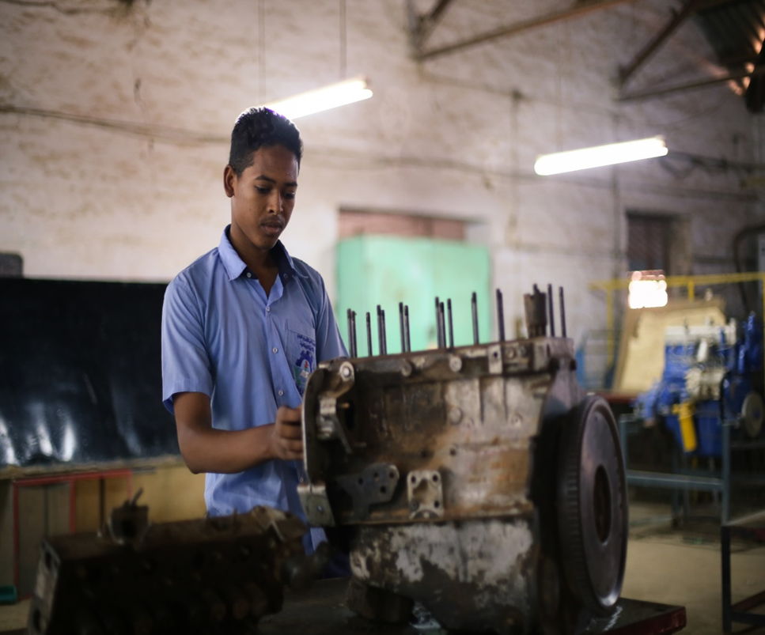
EU responses - EUD AND BMZ CO-FUNDED PROJECTS
Employment Promotion in Khartoum State (EPKS) - July 2021 - July 2024
GIZ 9,072,000 EUR
Region: Khartoum State
Main activities:
    Targeting 10 VTC in Khartoum.
    Develop 8 curricula for short-term courses, including entrepreneurship component
    Office management curriculum development short term and regular courses
    Each VTC will have two courses, with a total target of 480 youth
    Provision of equipment to 10 VTCs
    Provision of office IT-equipment for 10 VTCs
Notes:
EU: TVET is at the heart of EU Development policy and strategy, as indicated in the communication "Increasing the impact of EU Development Policy: an agenda for change". The current programmes and interventions are also aligned with the EU communication "A Stronger Role of the Private Sector in Achieving Inclusive and Sustainable Growth in Developing Countries", "Rethinking Education: Investing in skills for better socio-economic outcomes" and "A Decent Life for All";
5. LESSONS LEARNED
Vocational Training has to be embedded within the socio-economic context of policy dialogue, to help establish an active partnership between governments, employers and workers. This can lead to a higher degree of national consensus on the possible directions of TVET system development. Lessons learnt in different contexts worldwide show that strengthening collaborative ties and involvement of the private sector, no matter how weak it still may be, is a key success factor in increasing the absorption rate of graduates into the local economy. Not only the training content and its standardisation, but also the certification of competencies, the facilitation of job placement and the on-the-job training need private sector involvement. This action will not only ensure that skills trainings are geared towards market needs. It will also strengthen private sector entities such as local business associations and their members to become more competitive and create additional employment.
International best practices demand that any action must include mechanisms for anchoring efforts in institutional structures. The development of a comprehensive TVET strategy and a National Qualification Framework (NQF) will need further co-ordinated long-term efforts by donors before such outcomes can be implemented at the level of institutions offering vocational training.
The importance of a holistic approach cannot be underestimated. TVET initiatives have integrated components related to social cohesion, labour demand, the inclusion of vulnerable groups into the labour market, private sector development (MSMEs) and rural and environmental development. To avoid the sedimentation of a non-coherent TVET system a more strategic integration between different initiatives is highly recommended.
While ensuring and addressing structural changes in the medium to long term, any action must also produce tangible results in the short term, given the large number of unqualified and unemployed youth. To this end formal TVET structures have to be enhanced and informal training opportunities in workshops and MSMEs have to be professionalised through the introduction of standards and certifications.
Supporting women and people with disabilities to contribute to the social and economic development is a priority. Lessons learnt show the need to specifically address cultural barriers preventing the participation of women and people with disabilities in vocational training and employment from the very beginning of projects implementation
6. REFLECTIONS ON EU DEVELOPMENT COOPERATAION
Basically – what is our cooperation doing? And what can we do
A wide array of EU Instruments - SMS, EU TF, CSO / LA
“Soft”
α: Improvement of the information / data? possibility of links with EU bodies, entities?
Governance: Support coordination, planning etc;
Awareness Raising: gender issues? education week?
European Vocational Skills Week
β: Other studies etc that could support Sudanese TVET sector. Partnership with relevant EU based centres ?
European Training Foundation (ETF)
European Centre for the Development of Vocational Training (Cedefop)
European Association of Institutes for Vocational Training (EVBB)
"Hard"
γ: Basic rehabilitation of schools
δ: other?
7. ROLE OF EU IN GENERAL (what do we want, what can we do, policy coherence etc)
Roles for the EU are twofold; i) policy level; ii) project level – as well as some internal EU "housekeeping" issues
Proposed actions at policy level (some already being undertaken)
− Enhance governance and equity of TVET, through improved coordination and management if the TVET system and decentralization matched by an equitable sharing of national revenues;
− Improve the responsiveness of TVET to the labour market. This allows to adjust training programmes according to the identification of skill needs in the labour market. It includes the development of relevant and effective curricula and an appropriate system of testing, accreditation and certification with the active role of all social partners. Moreover, in a context of diminishing capacity of the formal sector to provide employment, self-employment and entrepreneurship can become a viable option for young people and TVET should provide these competences. There is also a need for TVET to expand beyond the traditional domains to cover most expanding economic sectors (agriculture in particular);
− Strengthen the role of the social partners, encouraging their active participation in TVET decisions. This includes an increasing attention to workplace training, making training more realistic and relevant and increasing employment opportunities. Also, private provision of training can be encouraged by streamlining the regulations regarding the establishment, accreditation and administration of private training centres.
− Upgrade the quality of delivery in existing TVET establishments. Currently, the recruitment of instructors is based especially on their academic qualifications and ignores their practical competence. This should be reversed and teachers should be provided of a national standard teaching certificate based on national examination.
− Regional/multi regional level: mutual recognition of diplomas (not only in the horn of Africa, but also in the countries where migrants tend to migrate, ie Arabic peninsula Egypt and Europe).
− Protection of workers' rights.
− Enhanced visibility initiatives
"EU internal": Host/convene EU Thematic Network of Delegation (and EU MS?); organise regional training and workshops for EU colleagues; repository of Information; etc
Annual seminars on TVET and Employment;
TVET Group in capacity4dev
Projects – (Annex 3)
Employment Promotion in Khartoum State (EPKS)
GIZ 9,072,000 EUR
July 2021 - July 2024
Khartoum State
Main activities related to vocational training
Targeting 10 VTC in Khartoum.
Develop 8 curricula for short-term courses, including entrepreneurship component.
Office management curriculum development for short term and regular courses.
Each VTC will have two courses , with a total target of 480 youth.
Provision of equipment to 10 VTCs
Provision of office IT-equipment for 10 VTCs.
Five VTCs rehabilitation needs are assessed and will be rehabilitated.
The project has 3,000,000 EUR in grants to be provided to SMEs and skilled workers to start/scale-up their economic activities.

Slide 17
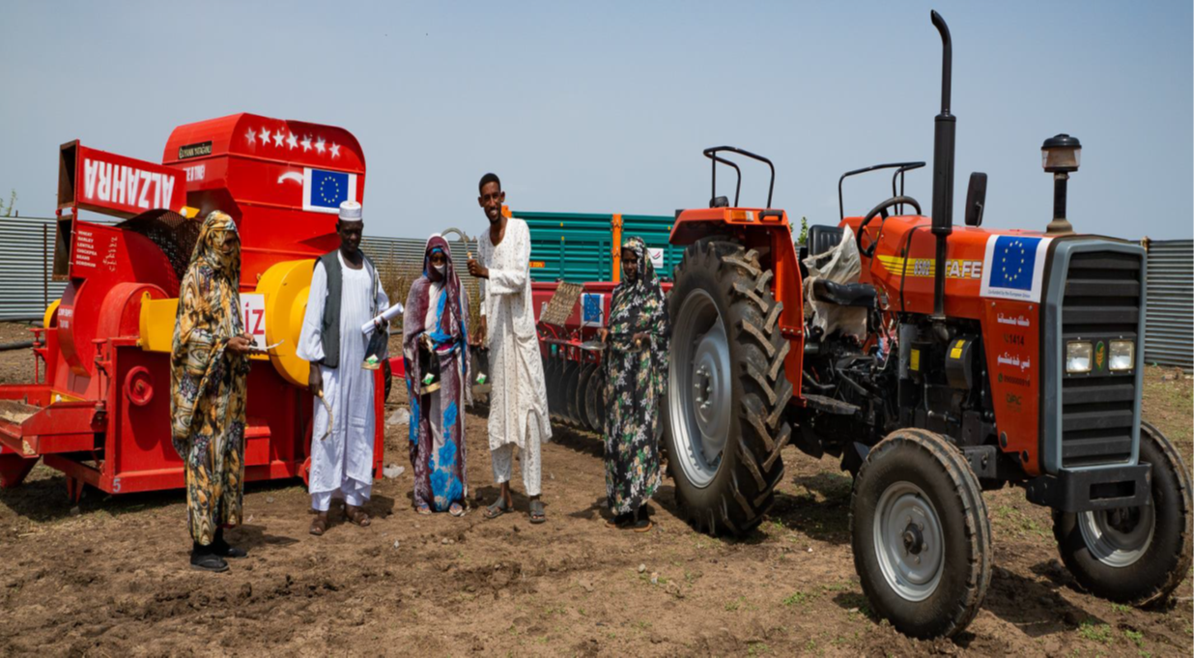
EU responses - EUD AND BMZ CO-FUNDED PROJECTS
Integrated Measures to promote rural-urban value addition and Employment IMPROV-East Sudan - October 2019 - June 2023
GIZ 9,600,000 EUR
Region: Kassala and Gaddarif
Main activities:
    Farmer Field School (FFS) establishment
    Assessment of at least 5 and upgrade of at least 2 value chains in close collaboration with farmers
    Introducing 5 innovations in selected value chains and train farmers
    Support the Integration of measures of climate smart agriculture by farmers
    Support the establishment or strengthen existing farmer associations
Notes:
Integrated Measures to promote rural-urban value addition and Employment IMPROV-East Sudan
GIZ 9,600,000 EUR
October 2019 - June 2023
Kassala and Gaddarif
Main activities related to vocational training
Farmer Field School (FFS) establishment.
Assessment of at least 5 value chains and upgrade of at least 2 value chains in close collaboration with farmers.
Introducing 5 innovations in selected value chains and train farmers.
Support the Integration of measures of climate smart agriculture by farmers.
Support the establishment or strengthen existing farmer associations.

Slide 18
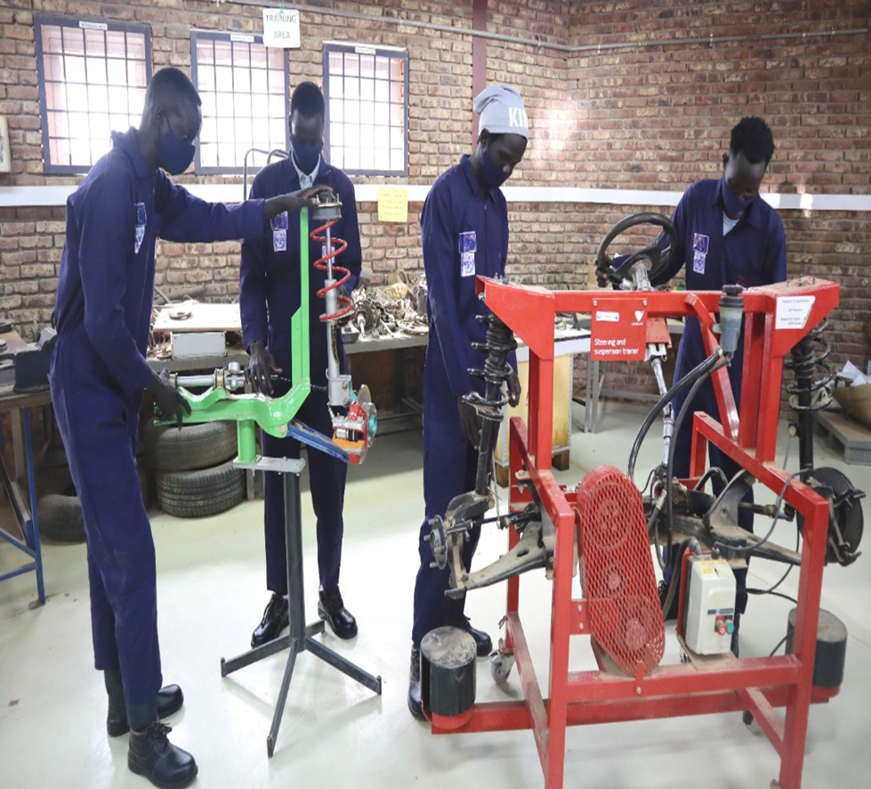
EU responses - EUD FUNDED PROJECTS
Employment and Entrepreneurship Development for Migrant Youth Refugees, Asylum seekers and Host communities in Khartoum State -(EEDK) - 1 April 2017 to 31 December 2022
UNIDO 3,443,200 EUR
Region: Khartoum State
Main activities:
Provision of office equipment and training of instructors and managers
Review of the 2010 CBT approach against corresponding national occupational quality standards
Establishment and activation of job placement units in TVCs
Provide market-relevant training to approximately 2,500 in the four ( Karari, Haj Yousif, El-Halfaya,and Mayo)
Each VTC at least have 5 skills courses in addition to the technical English and Entrepreneurship.
Notes:
UNIDO 3,443,200 EUR
1 April 2017 to 31 December 2022
Khartoum State
Main activities related to vocational training
Provision and maintenance of workshops equipment.
Provision of office equipment.
Training Of Instructors and managers.
Review of the 2010 CBT approach against corresponding national occupational quality standards.
Establishment and activation of Job placement units in TVCs.
Provide market-relevant training to approximately 2,500 in the four ( Karari, Haj Yousif, El-Halfaya,and Mayo)
Each VTC at least have 5 skills courses in addition to the technical English and Entrepeuship.

Slide 19
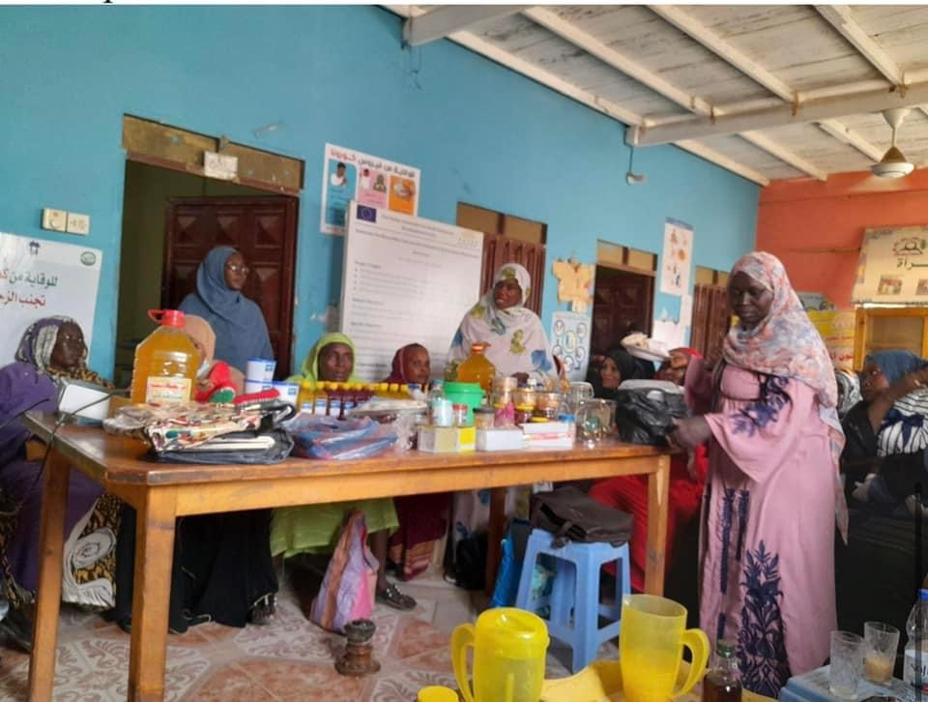
EU responses - EUD FUNDED PROJECTS
WE-RISE! Women’s Empowerment for Resilience, Inclusion, Sustainability and Environment - 1 Feb. 2021 to 29 Feb. 2024
AICS 12,728,000 EUR
Region: Red Sea , Kassala , El-gaddarif
Main activities:
      Identify the women and women with disabilities organizations to link with producers’ initiatives, youth organization and local association for promoting participation and social innovation.
      Identify and incept vocational and skills trainings opportunities for young women and men at risk of social exclusion.
    Total beneficiaries 23,000
Notes:
WE-RISE! Women’s Empowerment for Resilience, Inclusion, Sustainability and Environment
AICS 12,728,000 EUR
1 Feb. 2021 to 29 Feb. 2024
Red Sea , Kassala , El-gaddarif
Main activities related to vocational training
Identify the women and women with disabilities organizations to link with producers’ initiatives, youth organization and local association for promoting participation and social innovation.
Identify and incept vocational and skills trainings opportunities for young women and men at risk of social exclusion.
Total beneficiaries 23,000 .

