Slide 1
An introduction to skill needs assessments
Olga Strietska-Ilina, Area Lead ”Skills Strategies for Future Labour Markets”, ILO, Geneva
Alice Vozza, Skills Specialist, ILO-Pretoria DWT
Naomy Lintini, Chief Technical Advisor, SIFA, ILO-Pretoria
Patrick Makondesa, Project Coordinator, ILO- Malawi

Slide 2





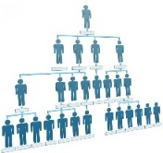

World is changing
Global drivers of change
Technology &
Innovation
Education attainment
Which jobs?
Which tasks?
Which skills and qualifications?
Work organization
Skills as
A buffer
An enabler
Notes:
The world as we know it is evolving rapidly. How are global drivers of change affecting the way we work? What is the impact of each drivers of change on the labour market? Which jobs, which task, what skills and qualifications do I need to remain employable? In the following slides, we will explore in detail each driver of change.

Slide 3
Technology and innovation
Many estimates on susceptibility of jobs to automation
Some argue – potentially all;
Asia(ASEAN) - around 56% (ILO 2016);
Half in advanced economies (Frey, Osborne 2013);
More modest estimates – 14%-20% (CEDEFOP /OECD)
Automatable ≠ Will be automated
IoT, 3D printing,
Robotics
Job creation potential/learning opportunities
Automation is unlikely to destroy all occupations
Changes in the types and number of tasks in most occupations (changes within occupations)
Realization of job creation opportunities will depend on ensuring that workers can move to newly created jobs (transition by reskilling/upskilling)
Accelerating
Pace of
change
Digital Technologies
Unprecedented
AI, Machine learning
Notes:
Technology development and innovation has brought about disruptive changes in the way we work. At the same time, it has automated and simplified certain processes, shaping the future of work. Its impact is not restricted solely to high-tech industries but also in other areas such as services and customer care. It has brought about a greater demand for higher level skills and accelerated the rate of change of skills demand. New technologies related to industry 4.0 and digitalization are being embraced by many governments as key pillars of their countries future economic development. Numerous estimates have been produced on the susceptibility of jobs to automation with some being more dire as compared to others. Given the number of estimates available, this implies that predicting the exact number of jobs susceptible to automation is no easy task.
It is likely that automation will not destroy all occupations but rather, the underlying skills required, job task for similar jobs of today in the future would differ. Its important to realize that yes, jobs will be loss but at the same time, new jobs will be created as a result of technological changes as well as the shift towards a green and sustainable economy. The goal is to enable individuals to fill these roles through reskilling and upskilling, to work alongside machines so as to reap the benefits that technological change brings.

Slide 4
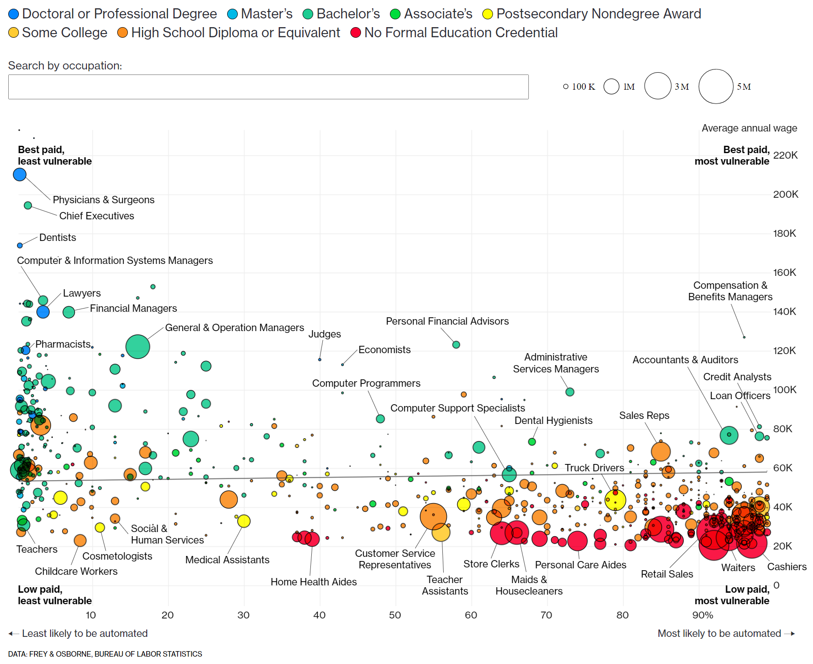
Technology and innovation:
Skills impact
Which skills will secure jobs?
    STEM skills at all levels
    ICT and coding skills
    Skills that help to adopt, operate and maintain technologies
    Skills that help to create a business case, market and manage technologies adoption
    Creativity
    Social skills (interaction, care)
    Non-automatable high-manual dexterity tasks
Notes:
As seen from the scatter plot on the right, occupations on the left of the plot are the least vulnerable to automation while for those on the right, the probability of automation is high. The color of the bubbles represent the modal education attainment of that occupation. It is observed that occupations that require higher level of educational qualifications (in this case, occupations that are green, light blue and dark blue – mostly clustered to the left), have a higher degree of specialized task and skills and are less routine have lesser probability of being automated. In contrast, occupations (on the right of the bubble plot) that require a lower level of educational qualifications such as waiters, drivers, sale representatives that are more routine, have a higher probability of being automated. A separate study by the Asian Development Bank in 2018 showed that the demand for jobs requiring non-routine cognitive task has grown faster than for routine and manual jobs (ADB 2018). It also finds trends in wages indicate that non-routine cognitive skills have an increased premium.

Slide 5
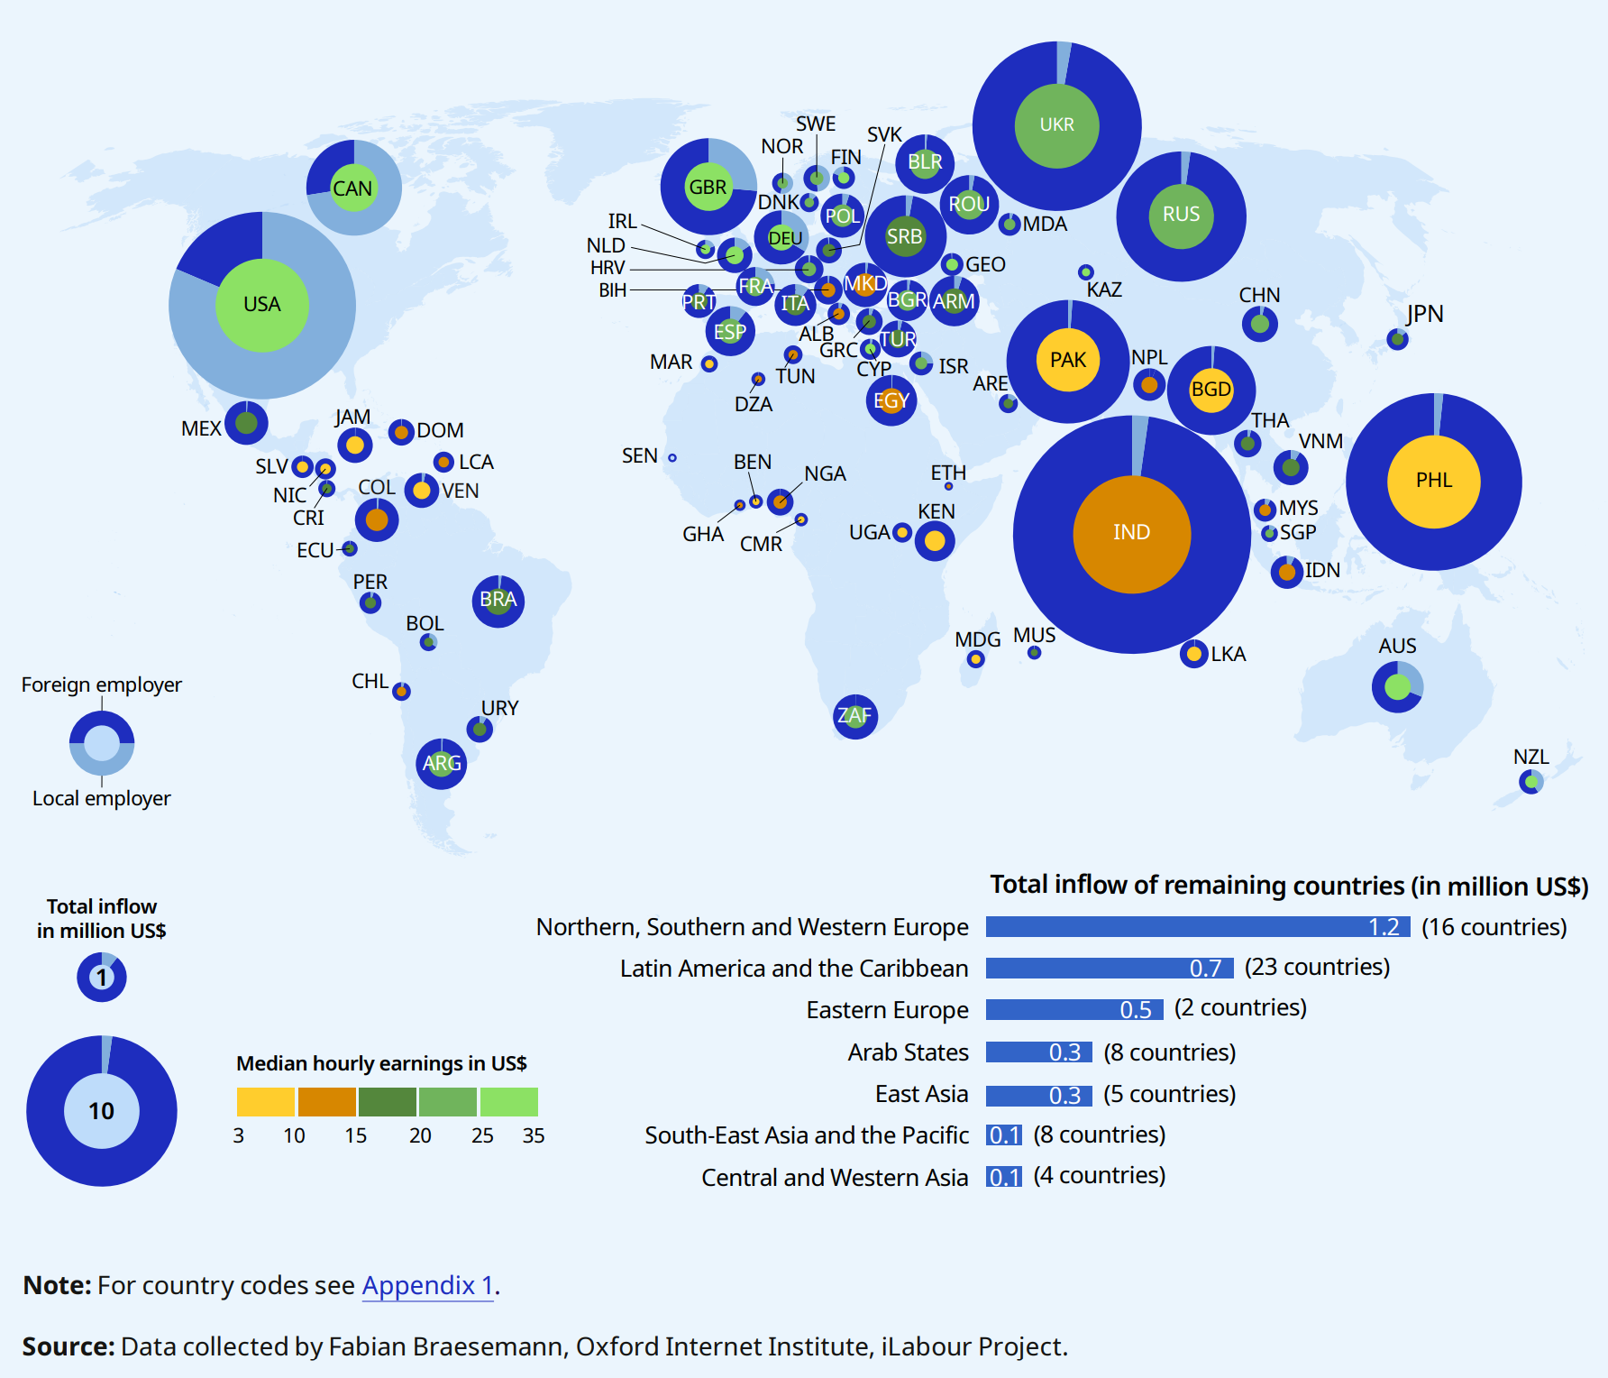
Digitalisation, work organisation and COVID-19
Outsourcing of task on a freelance platform
across countries,
inflow or work and earnings, 2019
Rise of the gig economy
Who is responsible for skills development?
Changes in organizational structures as businesses shift towards the future of work
Flatter organization structures
  Greater demand for individuals with interpersonal skills
Remote working arrangements
Rise in remote learning
New skills requirements
Source: WESO - ILO (2021)
Notes:
Accelerated by the COVID-19 pandemic, there has been a rise in digital platforms such as Uber, Lyft, and Deliveroo in various industries for example, transportation and the delivery of food – contributing to the rise of the gig economy due to its flexibility in working hours and place of work. These platforms serves as intermediaries between clients and workers. The rise in numbers could also be amplified by COVID-19 which lead to the retrenchment of workers previously employed in the accommodation and food services and aviation industry. A survey by Ernest and Young of contingent workers (a subset of gig workers) found that 2 in 3 workers belief that the benefits of contingent work outweigh the downside always or most of the time. With an increase in the number of individuals having some form of employment in the gig economy, this begs the question of who is responsible for skills development of these workers? From the survey, only 52% of contingent workers receive training from their employer. In the long run, this could hamper the skills development of the existing workforce, resulting in skills mismatches.
As seen from the map on the right, the size of the bubbles represent the total inflow in millions of US dollars. The pie chart for each country shows whether the demand for work comes from within the country or from abroad. It can be seen that the demand for work largely originates from Australia, Canada, Germany, New Zealand, the United Kingdom of Great Britain ,Northern Ireland and the US. A large proportion of this work is performed in developing countries particularly in India (US $26 million) which accounts for 20% of the total market. The color in the pie chart reflects the median hourly wages which is higher in developed countries. However, the geographical location where the tasks are completed is related not only to the price level but also to skill requirements, both technical, language, operating cost and the availability of IT infrastructure.
Next, workforce and businesses are shifting towards the future of work, e.g companies are introducing flatter organization structures resulting in a greater demand for skills such as teamwork, initiative, interpersonal communication skills and management skills. With the massive increase in remote work arrangements, employers have better access to a bigger pool of talents with diverse skills which open up more opportunities for job seekers or employees, facilitating a movement of skills around the world. For example, employers based outside the large cities can attract and source talents more easily and the workers may not necessarily have to live in major urban areas to get better jobs. It also has great potential to offer people with disabilities, women, young people and migrant workers flexible opportunities to participate in the labour market. On the downside, remote working reduces the opportunities of workers to engage in informal activities that takes place through in-person interactions with colleagues at the workplace.
Productivity and competitiveness challenges results in employers adapting new business practices. For instance, the adoption of participative management strategy or another similar term, industrial democracy refers to the concept where employees actively participate in an organization decision making process as opposed to. This results in changing hiring preferences of organizations.

Slide 6
Globalization and trade
Skills important for economic efficiency
Skills important for socially inclusive outcomes
Skills also important for smooth transition
   Achieving economically efficient outcomes from trade/GVCs including growth and productivity gains
   Skills are one of the principal enablers of economic growth
   Appropriate skills development policies are key to helping firms expand their export activities;
   They are also key helping workers who lose their jobs make a smooth and rapid transition to new jobs with equal and higher wages
 Determining the employment and distribution outcomes of change driven by globalization and trade
Notes:
The availability of skills in an economy is important for 3 broad reasons – for economic efficiency, for a smooth transition and for socially inclusive outcomes. On economic efficiency, skills are required in order to obtain efficient outcomes from trade as its one of the principal enablers of economic growth. Skills also enable a smooth transition where the availability of skill development funding or opportunities allow firms to expand the variety and complexity of their export activities. Such opportunities also allow workers who lost their jobs to make a smooth and rapid transition to new jobs with equal and higher wages. Skills are also important for socially inclusive outcomes to ensure that no groups of workers are marginalised.

Slide 7
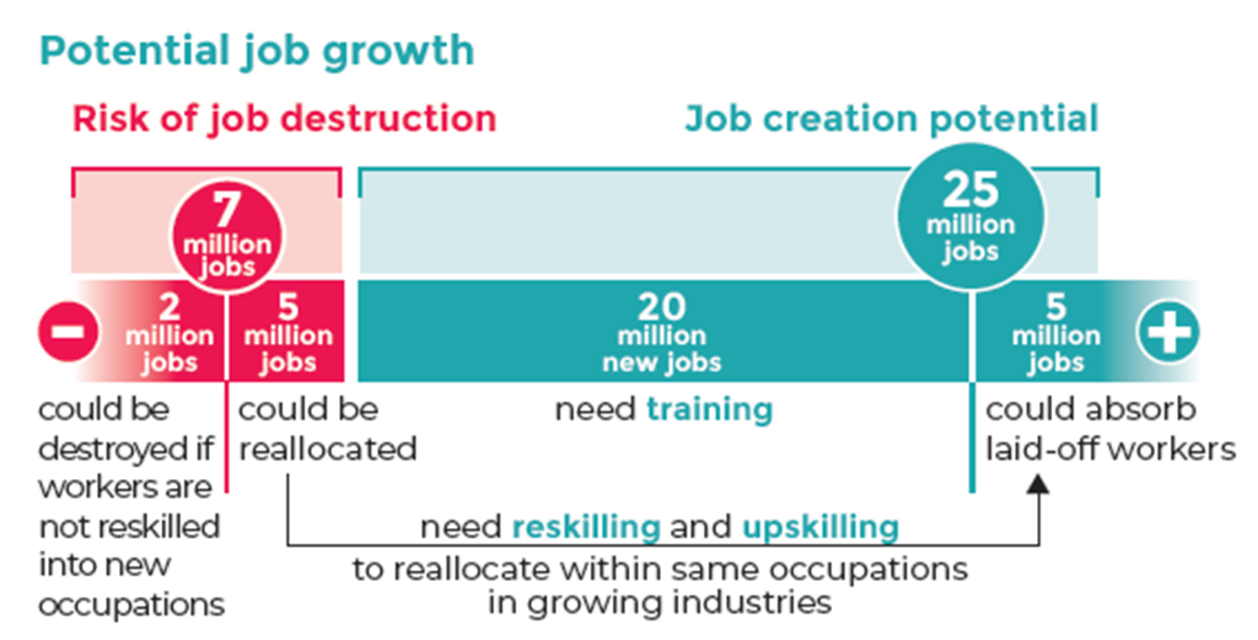
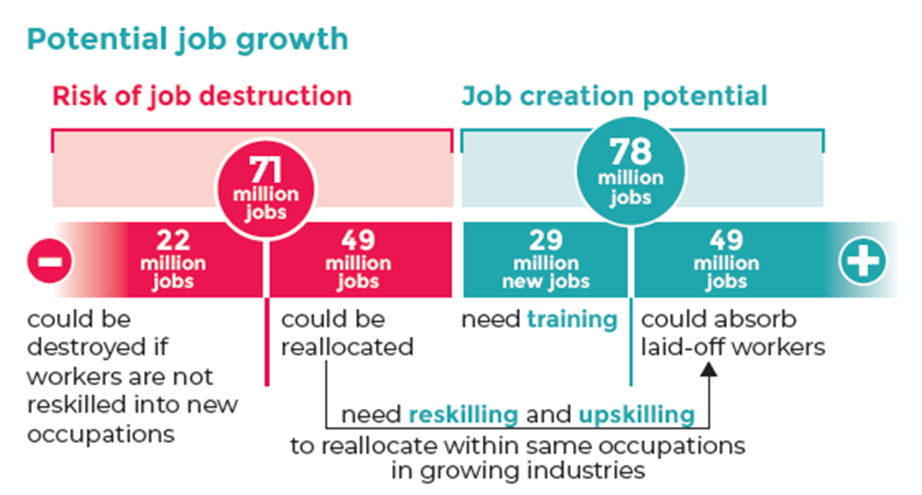
Climate Change
Energy sustainability scenario, 2030
Circular economy scenario, 2030
Sources: ILO (2019) & Skills for a Greener Future. Infographic (2019).
Notes:
Another important global driver of change is climate change and environmental degradation which is an existential treat to the world. The demand for new jobs to facilitate the green transition drives the demand for new skills. The urgent need for action to alleviate the effects of climate change is highlighted by the ‘Conference of the Parties’ where the parties refer to Governments who have signed the UN Framework Convention of Climate Change meet annually to discuss how to jointly address climate change as well as the Paris Agreement, a bottom up approach where countries themselves decide how much they will reduce their emissions by a certain year to keep the rise in global temperatures to well below 2 degrees above pre-industrial levels. In an ILO publication released in 2019 titled “Skills for a greener future: A global view”, based on quantitative analysis and empirical research across 32 countries, a multi-regional input-output model as well as skills scrapped from big data was used to understand the demand for an occupation, what type of skills would be required based on two scenarios – the Energy sustainability scenario as well as the circular economy scenario. The energy sustainability scenario sees larger increases in the construction, electrical machinery manufacturing and copper mining sectors with decreases in the petroleum refinery and extraction, coal mining and coal based electricity generation sectors. The circular economy scenario represents a model for sustainability in resource use and consumption which supports a shift from the extract-manufacture-use-discard mentality to embracing recycling, repair, reuse, remanufacture and longer durability of goods. Its important to note that in either scenario, job creation outpaces job destruction. In the barplots shown, green refers to job creation and red refers to job disruption. For the energy sustainability scenario, of the 7 million jobs at risk of disruption, less than 1/3 of the jobs vacancies have no similar vacancies in other industries. More than 2/3 of the remaining jobs at risk of job destruction could be reallocated to similar jobs in other industries. This shift in occupational skill needs will require a complex set of policy measures, including massive investment into reskilling and upskilling through private and public sector investment, active labour market policies, career guidance, targeted training measures to promote gender balance and measures to facilitate workers’ mobility and their social protection.
Notes:
For example, if global electricity production from solar energy is to increase by 59 per cent by 2030, as assumed in the energy sustainability scenario, skills demand in solar installation, solar panel manufacturing, and the mining and processing of silicon will increase

Slide 8
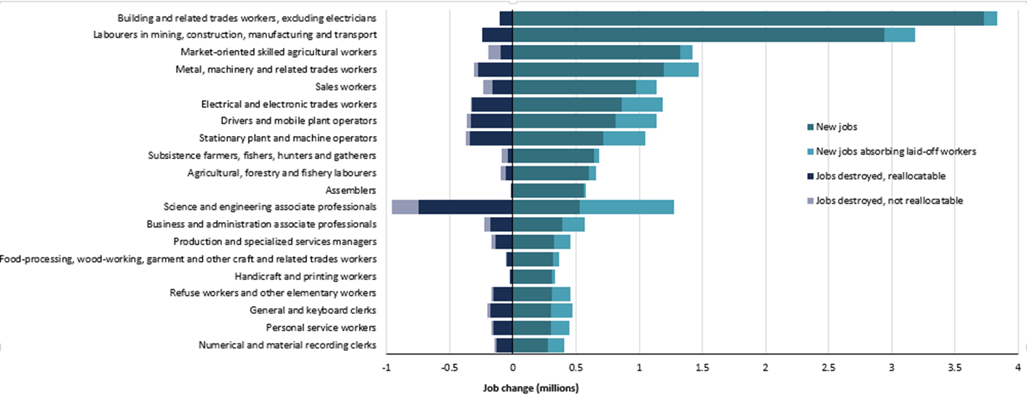
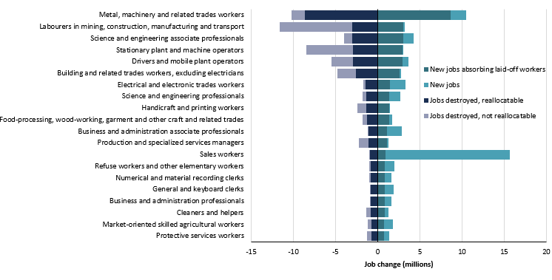
Energy sustainability scenario, 2030
Circular economy scenario, 2030
Source: ILO (2019) Skills for a Greener Future.

Slide 9
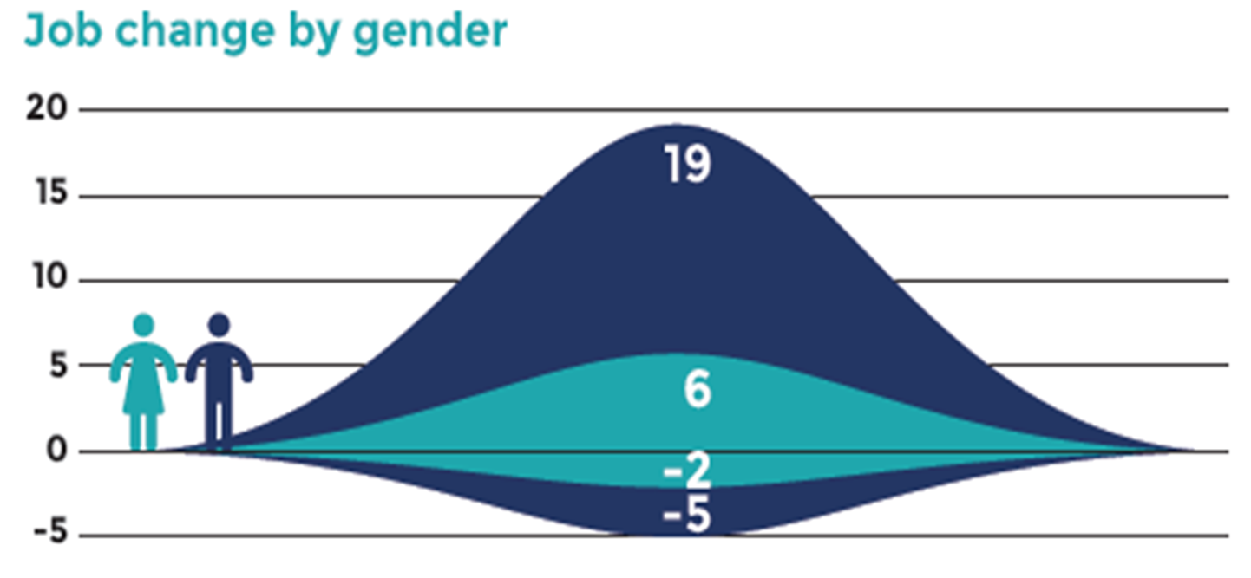
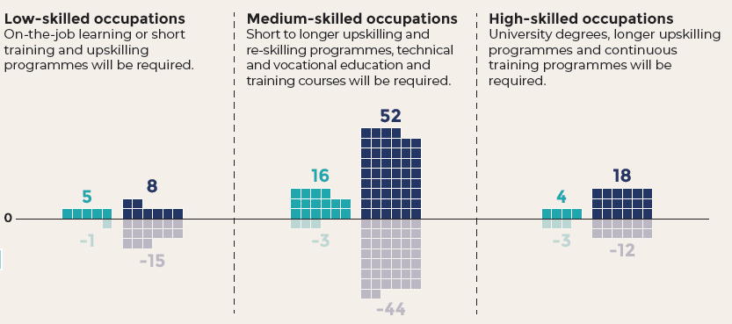
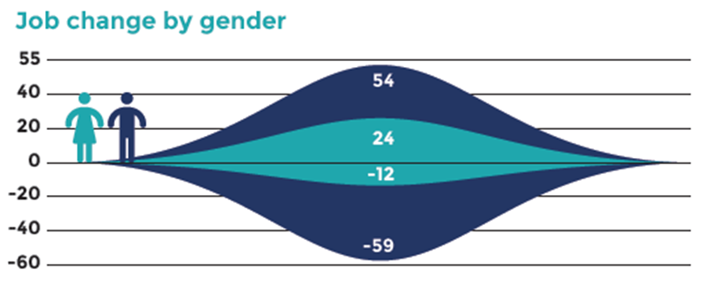
Jobs created and destroyed in a global circular economy scenario, by gender, 2030 (millions)
Energy sustainability scenario, 2030
Circular economy scenario, 2030
Reskilling measures required at all skill levels
Medium-skilled occupations sees the most job creation and reallocation
Overall net employment effects is positive
Greatest need of upskilling and reskilling for men
Gender disparities to persist
Sources: ILO (2019) & Skills for a Greener Future. Infographic (2019).
Notes:
In both scenarios, retraining needs is distributed across all skill levels with most job creation and reallocation concentrated in mid-skill occupations. The greatest need of upskilling and reskilling will be for male-dominated occupations as seen from the plots on the right. As such, men in mid-skilled occupations would have the greatest need of upskilling and reskilling to allow them to tap into new job opportunities. This could potentially partly offset the global trend in which skill-biased technological change (for e.g through automation of routine task) leading to what is known as the hallowing out of mid-skill occupations which explains the growing income inequalities observed. Also, the plots suggest that gender stereotypes are likely to persist where females would get only a fraction of the jobs created, unless measures are taken to train females with the relevant skills so that they can benefit from the potentially created jobs.
In summary, the transition to environmentally sustainable and inclusive economies and societies cannot take place if the skills demanded by new jobs are not available in the labour market. The transition is therefore conditional on investment in training to develop skills to meet new requirements and avoid skills mismatches. Forward-looking skills strategies are necessary to train young people and reskill the current workforce to meet the skills needs of the new jobs generated in the transition process in expanding/new sectors.
Actual progress on the transition to a more environmentally sustainable economy is not without problems. Key constraints on green jobs growth, including poverty, low incomes and informal employment (especially in developing countries), which can force people into environmentally detrimental activities; weak policies and enforcement of regulations; and weak markets for green goods and services owing to inadequate government support.

Slide 10
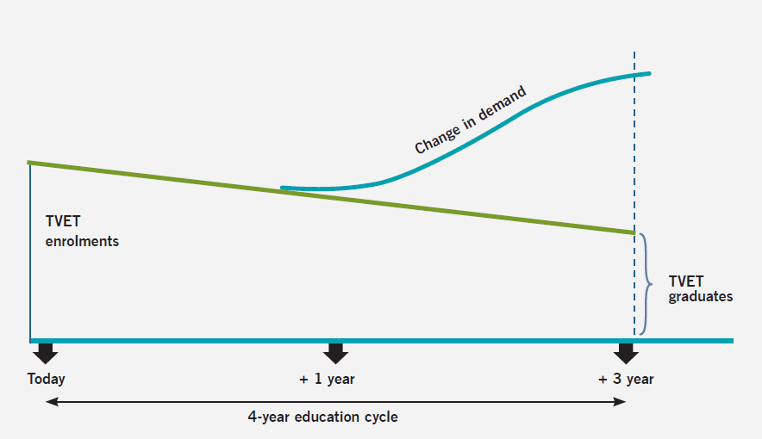
Changing demand for skills is faster than training delivery
TVET : Technical, Vocational Education and Training
Notes:
The horizontal axis represents the typical education timeframe of 4 years while the vertical axis represents the demand of graduates.
However, as the pace in the demand for skills is way faster than the delivery of education and training i.e the supply of available skills, this leads to a persistent gap as observed in the plot on the vertical axis.
This is mainly due to the time required to design, finalise content of training courses and have it implemented in training institutions due to the legal processes involved. The issue is further complicated by the relevancy of such skills after the candidate spends a great among of time within the education cycle. As such, this supports the development of a dynamic, accurate skill needs anticipation system to predict future skill needs to minimise the issue of skills mismatch and to inform the design of training and development systems.

Slide 11
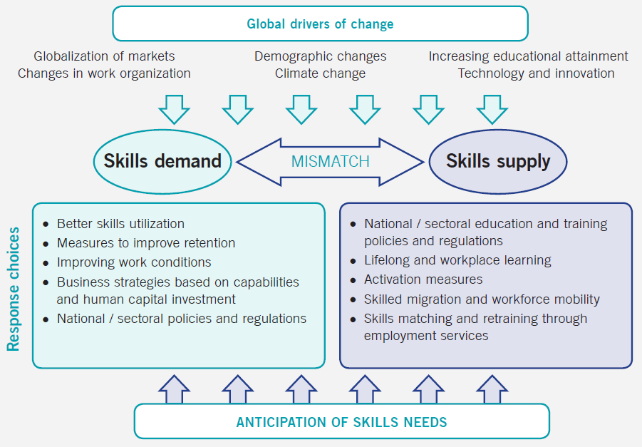
Notes:
The image here provides an overview of what we have been discussing so far with global drivers of change influencing both skills demand and skills supply, leading to skill mismatches which needs to be addressed through the anticipation of skills needs. Prolong skills mismatches has negative consequences for individuals, employers and more broadly, on the country. For individuals, should they take up a job less that what they are qualified for, perhaps with lower wages, this leads to low job satisfaction, loss of motivation resulting in lower productivity. For companies, there would be economic losses as additional resources would be required to retrain workers should there be high turnover, also, as a result of lower productivity, this would be harmful to competitiveness and could affect the quality of outputs. For the country, this would affect foreign investments, reducing a countries global competitiveness. There would also be public cost of unemployment benefits and contribute to lower tax revenues which would adversely affect spending on education and infrastructure, adversely affecting a countries regional competitiveness.
Skills mismatches could be either short-term or long-term qualitative. For the former, its temporary arising due to the existence of imperfect information (e.g not all workers find jobs matching their qualifications nor do firms find the perfect candidate). Long-term mismatches is more structural due to changes in qualifications or skills demand in jobs which are not or poorly reflected in the worker’s education and training. Some may ask, is a perfect match between skills demand and skills supply even possible? A certain level of mismatch will always exist. The focus is to minimise the problem and its consequences for the economy, society, enterprises and individuals through the anticipation of skills needs by influencing both skills demand and supply.
I’d like to highlight that while these general trends are likely to influence skills demand and supply all over the world, the extent and nature of change will be different in different country contexts, as local drivers of change also affect labour market outcomes. Coordination and implementation mechanisms should be adjusted and tailored to suit the specificity of each country’s institutional setting and skills challenges.

Slide 12
Skill needs assessment &
anticipation
Policy Cycle
Evaluation of training outcomes & their relevance to the labour market needs
Skills development policy & Curriculum design & Competency standards
Monitoring of training relevance
Skills development
(delivery)
Notes:
The policy cycle begins with the anticipation of skill needs involving discussions with individuals, businesses, training organizations and governments into what type of jobs and the accompanying skills are required for the labour market in future. Do note that the aim of skill needs anticipation is not to answer questions such as “How many welders trained to a certain level/with certain qualifications will be needed at this location and time?”. Instead, the goal is to provide information to all labour market actors about potential future skills needs and imbalances, so that they can make decisions, develop measures and take actions with a view to meeting the needs and avoiding the imbalances. It is focused on providing guidance, preparedness and flexibility, and supporting more effective operation of labour markets. The outcome would inform the design of competency standards and of training curricula followed by the delivery and monitoring of training relevance through employer/worker surveys or through labour market indicators. Finally, key stakeholders would come together to evaluate if the strategy is working and if any improvements could be made.
Given the constant and accelerating pace of change, skills development strategies will be obliged to ensure the continual renewal of skills over the life cycle. This will require focusing on ways to manage the different transitions that individuals will face (for example, moving from the informal to the formal economy or from the manufacturing to the services sector), so that they successfully enter the labour market, reskill and re-engage in employment throughout their careers. This life-cycle approach raises fundamental questions about the respective responsibilities of governments, workers and enterprises in making choices about when and how to reskill and retrain. Moreover, it requires a solid financing concept – and in particular a decision about the sources of the necessary funding. In this context, it is equally relevant to consider the appropriate mix of public and private investment in all phases of delivery.

Slide 13
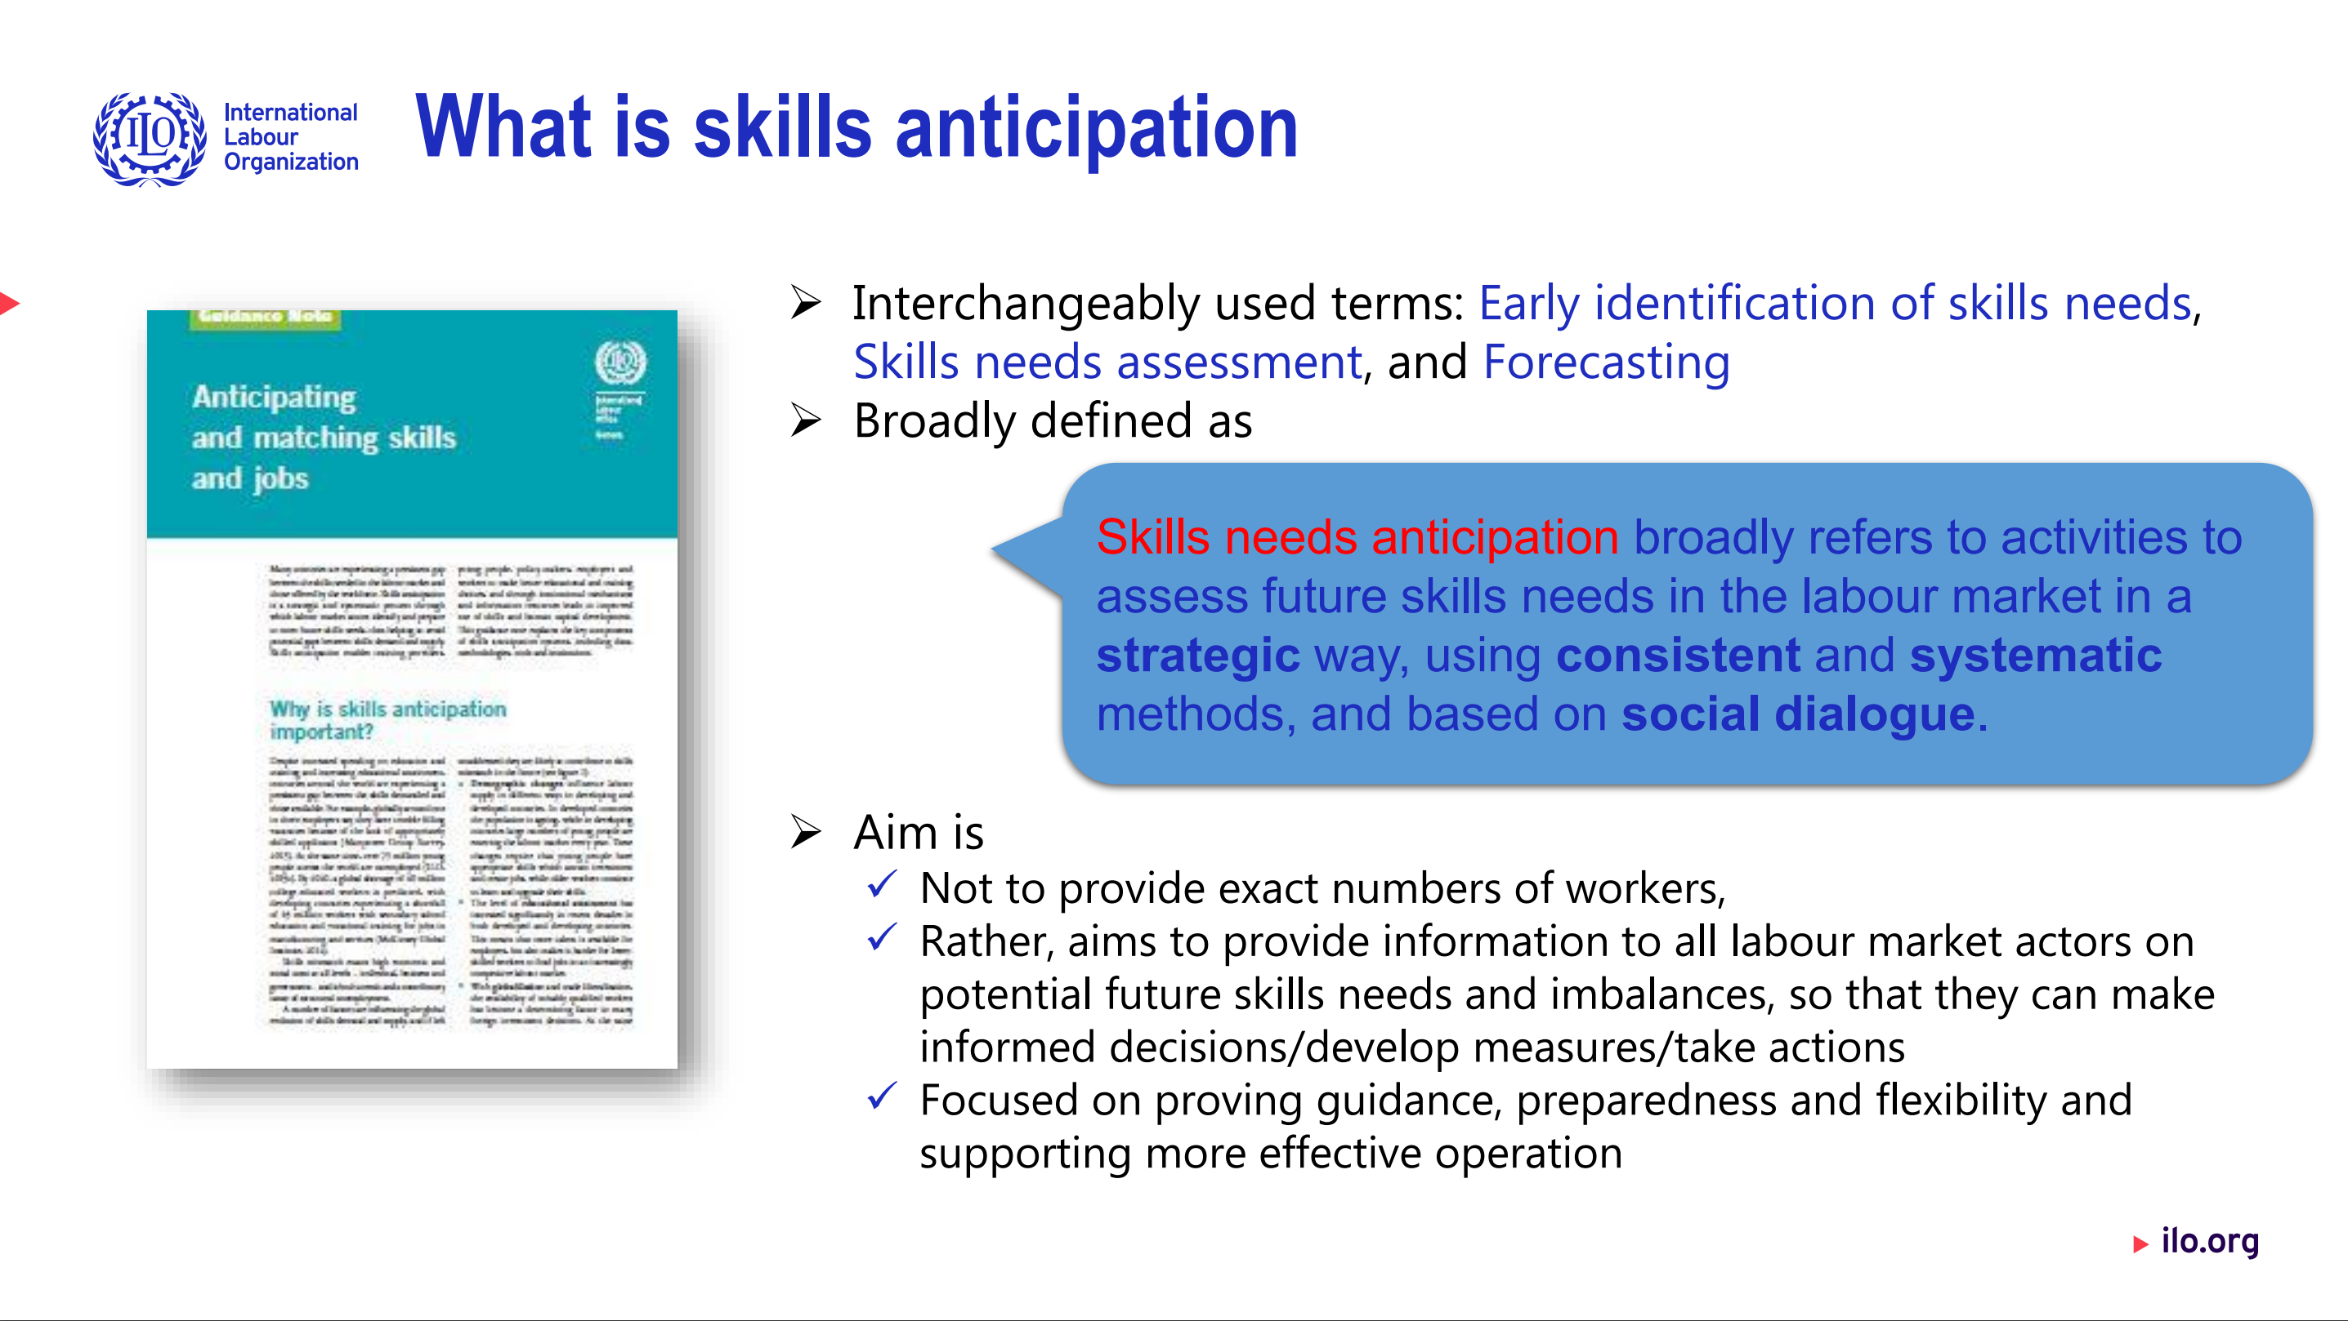
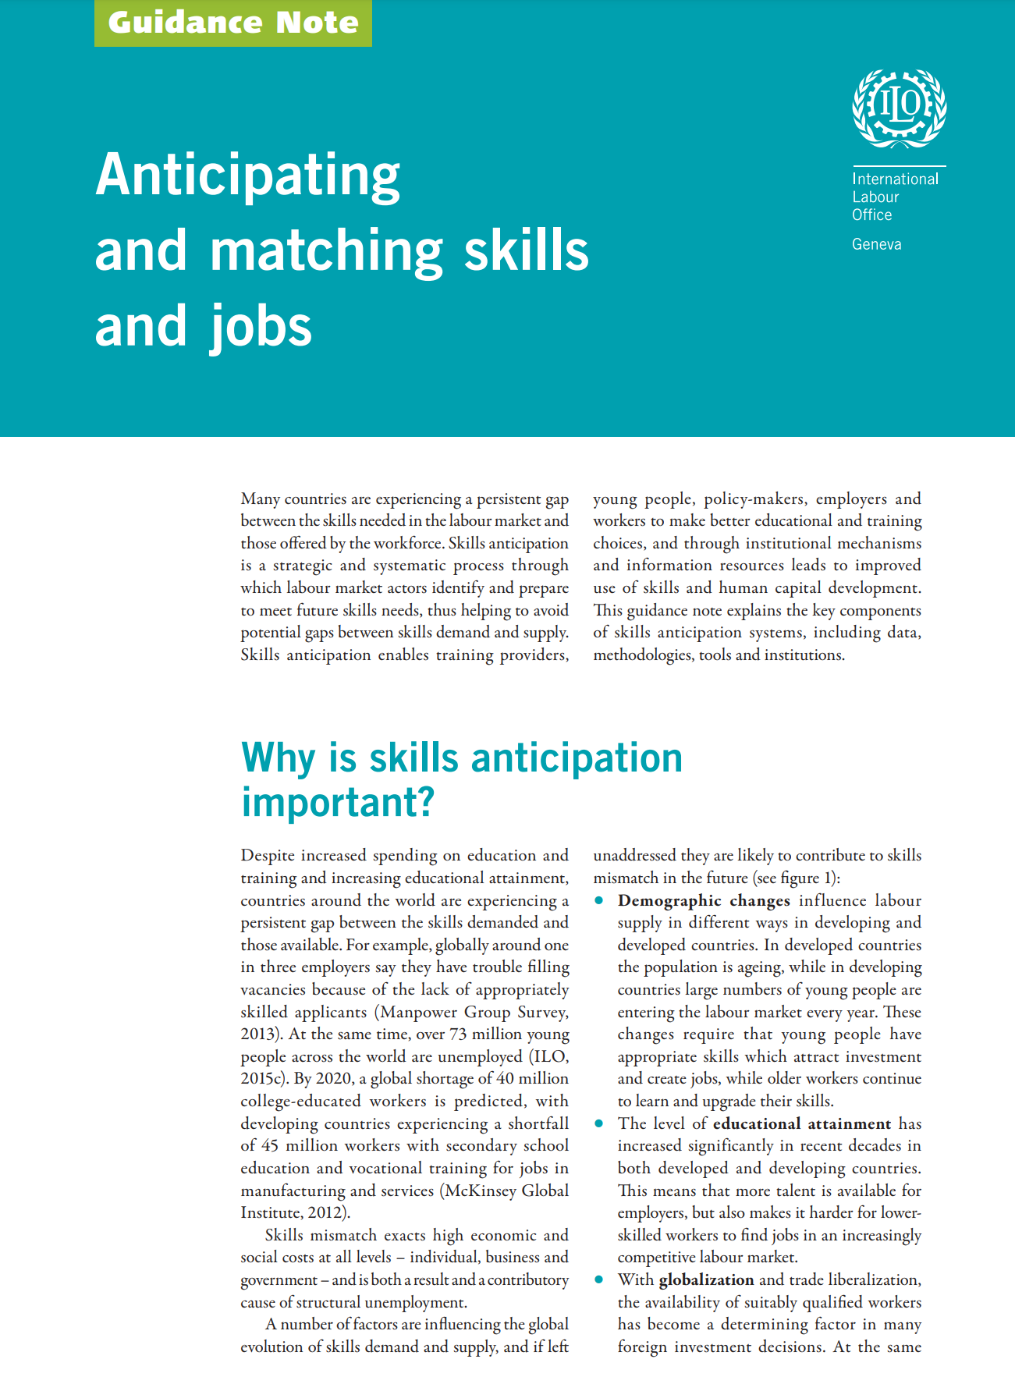


Slide 14
Labour market information system (LMIS)
Labour market information system (LMIS)
Skill needs
assessment
and anticipation
Institutions
(soc. Dialogue)
Any information concerning the size and composition of the labour market, the way it functions, its problems, opportunities and employment-related intentions of its actors.
Analytical capacity
Tools
Data

Slide 15
Skills Initiative For Africa (SIFA)
Skills Anticipation Component
Improve responsiveness of TVET to labour market skill needs
Build Capacities for skills anticipation and matching in AU Member States
Improve employability of young Africans
What we set out to achieve……

Slide 16
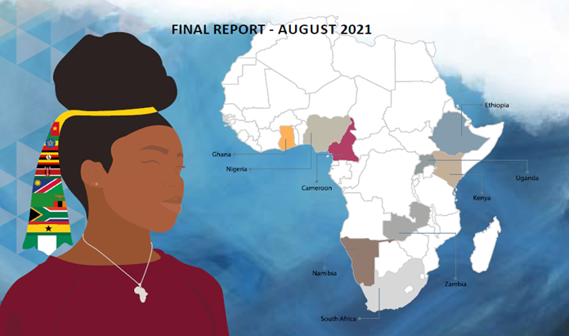
How we did it….......

Slide 17

Continental Level
Raised awareness about importance of skills anticipation and matching
Continental Conference on Skills Anticipation
Conference Communique with recommendation to AU and Member States
New articles, Videos and Media Cards, Interview on importance and relevancy of skills anticipation
Ministerial Statement AUC, AUDA-NEPAD and partners are urged to support “Member States in strengthening capacities for collecting, analysing, interpreting and disseminating skills anticipation-related data”.

Slide 18
Multi-Country capacity development interventions
Sector Based skills Anticipation methodology (STED)
Understanding and Measuring Skills Mismatch
Understanding Skills Anticipation and its links to LMIS

Slide 19
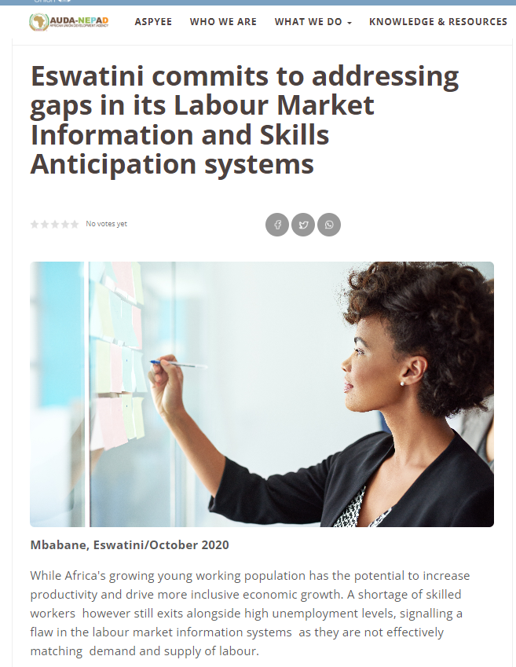
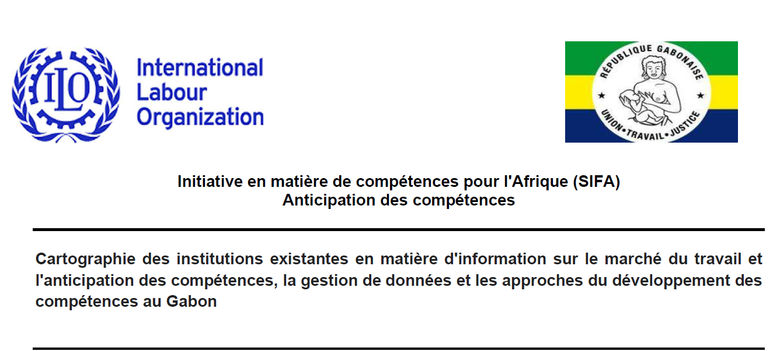
Situation Analysis
Country-level Interventions
Review existing data sources, practices, capacities, and institutional arrangements for labour market information and skills anticipation
Provide concrete recommendations and support towards improvement of existing systems and structures

Slide 20
Country level Task Teams and Action Plans to strengthen skills anticipation practices at country level
Established country level Inter-ministry and Tripartite-plus Task Team
Consultative and participatory development of National Action Plans in strengthening skills anticipation practices and process

Slide 21
Capacity Development (governance, data sources methods, analysis
Capacities in AU, AUDA-NEPAD and member states for skills anticipation and matching enhanced
Demonstration and piloting STED-sector based skills anticipation
and Rapid Skills Assessments
Good Practice and Knowledge sharing
Raise awareness and secure high level buy in and owernership
Establish National Task Teams promote dialogue and coordinated approach to skills anticipation
Situation Analysis and
Roadmaps
for
strengthening skills anticipation practices
Bringing it all together

Slide 22
Methods

Slide 23
What are the financial
resources available?
Key Research Questions
At which level should
the research be undertaken?
What are your
research objectives?
Macro, Micro, Mezzo, National economy, sector, region
Who will be
a primary user of
the findings?
What time span of skill
needs anticipation is required?
Short/Medium/Long-term
Trend/Current need
Who will perform
research, data collection
and analysis
Which method to undertake?
Frequency of skill needs
assessments?
Who are our
target groups?

Slide 24
Level of question | Type of question | Some key headline questions | Type of methodology
Jobs | Quantitative | How many direct jobs now and in the future? | Quantitative, Qualitative
 |  | How many indirect jobs now and in the future?
 |  | How many induced jobs now and in the future?
Occupations /skills | Qualitative | What occupations? How they should be defined? What are the boundaries between occupations? | Qualitative
 | Quantitative | How many people in each occupation? What is the resulting demand for skills? | Quantitative, Qualitative
 | Qualitative | What skills and competencies? How do these relate to occupations? | Qualitative
Education and training | Qualitative | What information sources of skills are available? What types of education and training are needed? How can they be provided? | Qualitative
 | Quantitative | What is the existing stock of people with the right skills? What is the current flow of newly trained people? What is the future demand for people with these skill sets? | Quantitative, Qualitative

Slide 25
Quantitative
Modelling
Big or Real-time data
Focus Groups
Delphi Surveys
Methods & Approaches for Skills Need Anticipation
Establishment Skills Survey
Tracer Studies
Scenario Development & Foresight
Combination of Methods & Approaches

Slide 26
Skills anticipation methods and their policy use
Quantitative models and Forecasts
Feed into major policy reforms with a long term impact (e.g. education, employment, economic development, demographic and social policies)
Can feed into long term policy development in various areas
Foresights, Delphi surveys & scenarios
Inform qualification standards’ development; skills development programmes; sector development strategies
Sectoral approach
Employers’ skills survey
Can be used in planning/designing short term training courses (qualification/requalification) and activation measures
Tracer studies
Big data and real-time data
Provide feedback for curriculum development, link education and work, inform potential students, career guidance
Can be used as real time statistics as an addition to «small» data or a qualitative survey
May inform training and competency standards design as well as policy

Slide 27
Is there an ideal approach? Pros and cons
Alternative approaches | Advantages | Disadvantages
National level (macro), quantitative, model-based projections | Comprehensive (typically all sectors); consistent; transparent; quantitative. | Data-hungry; costly; not everything can be quantified. May give a false impression of precision/certainty.
Skills surveys of employers | Direct user/customer involvement; easy to set-up and carry out. | May be very subjective; inconsistent; costly; can too easily focus on the margins rather than skill gaps within the current workforce; limited reliability of information on future
Tracer studies / graduate surveys | Ability to provide useful information for improving planning and programming relatively low cost, easy execution. | Demand for detailed information about sample groups, confined to workers’ early market experience and findings may be biased.
Big real-time data | Promising potential: real time – no time lag, low cost, resolves the problem of regularity of surveys, no need to «collect» data. | Data quality issue, data coverage, privacy, cleanliness.
Notes:
Use after Jigsaw if necessary – debriefing

Slide 28
Is there an ideal approach? Pros and cons
Alternative approaches | Advantages | Disadvantages
Scenarios and foresights | Strong on sectoral or other specifics; can be used when limited data available. Helps us to avoid unpleasant surprises, make better decisions today inspire, engage and enable shared action. | Risk of inconsistent across sectors, areas, etc.; can be constructed as the “official future”; people may not be able to suspend their disbelief. May suffer from cultural/cognitive myopia; cannot be validated.
Delphi-style methods | Holistic; applicable in situation with limited data availability. A possibility to avoid large group gatherings - virtual participation; handles single or multiple questions; brings together large number of experts and different opinions. | Time-consuming process; labour intensive; participant expertise may influence results.
Focus groups /round tables | Useful to improve and develop ideas; strong tools to validate preliminary results/ideas/tools/strategies. | Importance of moderator is often underestimated; opinions can be biased (group thinking effect); participants may be reluctant to share some opinions in a group.
Sectoral approaches | Sector is crucial to understand the key drivers of change Clear stakeholders - Easier to facilitate coordination among all relevant stakeholders and social dialogue Reduce complexity and scope of interventions | Partial, especially when it comes to quantitative modelling Engagement of SMEs,SMEs in rural and remote areas and coverage of informal and unorganised sector is a challenge
Notes:
Use after Jigsaw if necessary – debriefing

Slide 29
ILO’s sectoral approach:
Skills for Trade and Economic Diversification (STED)

Slide 30
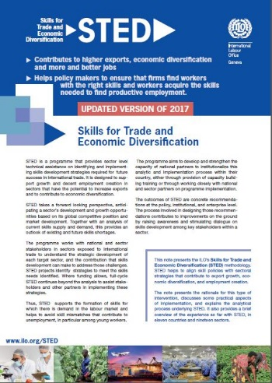

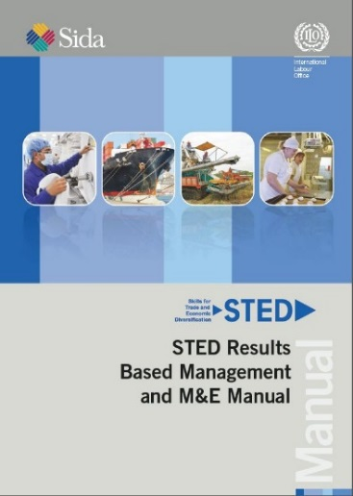

STED– Skills for Trade and Economic Diversification
STED – Skills for Trade and Economic Diversification
ILO’s sector-based methodology to provide strategic guidance on integrating skills development into policies to strengthen traded sectors
Combination of strategic analysis and social dialogue
Holistic and strategic focus on skills

Slide 31
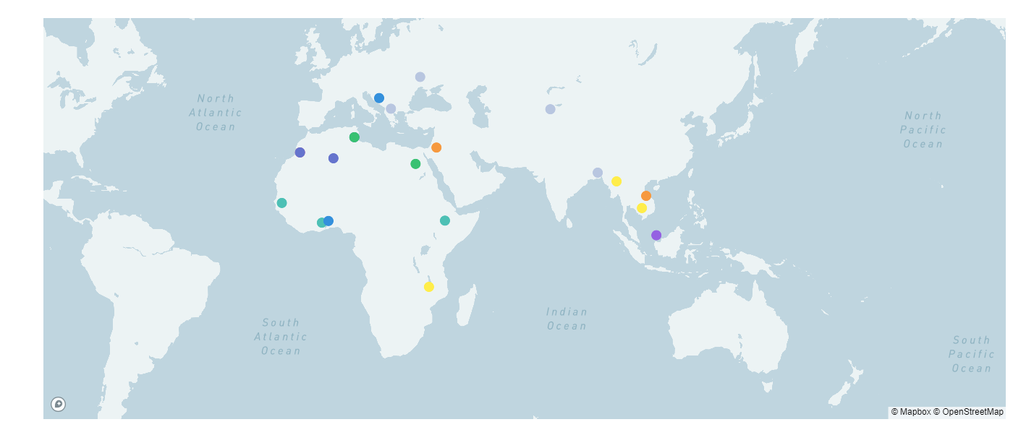
Locations of STED development cooperation
(24 countries, 50 sectors)
North Macedonia
- Tourism
- Food Processing
Bosnia & Herzegovina
- IT sector
Ukraine
- Metal Industry
- Tourism
Kyrgyzstan
- Garments
Tunisia
- Dates
- Technical plastics
- Metallurgy
- Food processing
Bangladesh
- Agro Processing
- Pharmaceuticals
Jordan
- Pharmaceuticals
Food processing
Chemicals & Cosmetics
Leather & Garments
Myanmar
- Tourism
- Vegetable & fruits
Algeria
Viet Nam
Tourism
Livestock (pigmeat)
Morocco
IT Offshoring
BCC sector
Automotive
Egypt
- Furniture
- Food Processing
Cambodia
- Food Processing
- Light Manufacturing
Senegal
Digital sector
Togo
Transport & Logistic
Ethiopia
Garments/textiles
Agro-processing
Malaysia
-Agro-Processing
-Construction
Ghana
Agriculture
Hospitality & Tourism
Construction
-ICT sectors
Malawi
- Oilseeds
Horticulture
Dairy
On-going SIFA project
Zimbabwe (Horticulture Sector)
Tanzania (Beef Sector)
Eswatini (Horticulture Sector)
Ghana (Garments and Textiles)
Indonesia
-Seafaring
-International Logistics
-Ship building
RBTC funded
Russia-funded
EU-funded
UK funded
KOICA-funded
Pilot countries
SIDA-funded
AFTIAS funded
Norway funded
Notes:
Since the launch of STED in 2010, we have worked in more than 20 countries in 40 sectors. Work could be conducted for 2 sectors in parallel per country. Existing work in Algeria, Morocco, Tunisia and Malaysia (Food processing and Construction Sector).

Slide 32
Typical STED problem Analysis
Growing markets (e.g. ACFTA)
Domestic
Export markets- regional, global
Competition from other firms within country, region and from developed countries
In domestic markets
In export markets
Firms need to upgrade to
Maintain current position relative to competitors (domestic and foreign) who are upgrading
Add more value – higher quality, different products/services, progression along value chain, different customers/markets …
Range of bottlenecks, but skills typically a major contributor to these
Skills development system barriers
Addressing these issues for a sector can contribute to wider system reform, using mechanisms such as:
  Sector skills strategies,
  sector skills councils,
  skills anticipation systems,
  curriculum reform,
  funding reform,
  high quality apprenticeships …

Slide 33
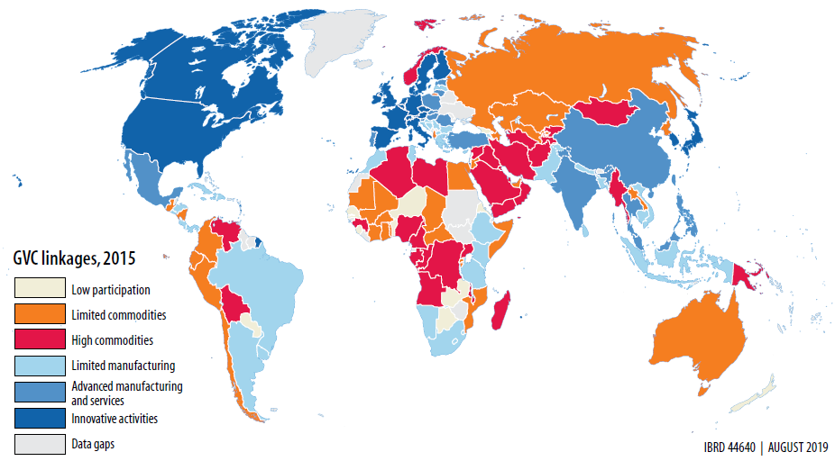
Map of Participation in GVC, 2015
Globalization and trade
Source: World Development Report (WDR) 2020
Notes:
The map on the left shows the participation in GVC linkages in 2015. It is observed that participation in GVCs or even regional GVCs differs across regions and sectors. Many producers in Africa and Latin America are at the base of value chains and produce primarily agricultural goods and natural resources, like cocoa and copper. Some producers in South Asia and East Africa have broken into simple manufacturing tasks, like garments, while others in South and East Asia as well as Eastern Europe are engaged in more advanced tasks in electronics and services. And a few in North America, Western Europe, and East Asia are generating innovation and innovative goods and services.
As seen from the scatter plot on the right, all industries have seen increasing participation in GVCs, comparing 1995 against 2011 with the greatest increase observed for Coke and refined petroleum.
Note : The participation in GVC measure reflects the share of world exports that flow through at least two borders. For each industry year, it is computed as the share of GVC exports in total international exports.

Slide 34
What is Distinctive about STED?
Skills
(Anticipation, Implementation)
Need for collaboration is especially strong
•exposure to change
•potential for inclusiveness
Sector –effective level for
•analysing & anticipating skills needs
•taking actions on these
•similar skills needs
•similar occupations
•similar E&T providers
To great extent
•similar technologies
•Similar forms of WO
Trade,
Industrial
Strategy
STED
Sectoral
Approach
Stakeholder /
Tripartite
Approach
It combines a sectoral approach to skills with trade & industrial perspective, and social dialogue

Slide 35
STED Development Logic
STED Exercise
Multi-stakeholder, public-private governance of STED process
Sector selection
Sector skills diagnosis and strategy
Mobilization of implementation
Developing the right skills
Strengthens Business Capabilities of Target Sectors
Greater Productivity & Market Competitiveness
More Sales in Traded Markets
More Employment in Decent Jobs
Indirect Objective
Scaling, institutionalizing and maturing skills governance through:
Public-private institutional arrangements for skills governance (such as Sector Skills Councils and National Skills Council, along with inter-ministerial collaboration)
Technical capacity in skills analysis and anticipation (such as national skills anticipation technical unit)
Practical collaboration between employers and providers of education and training (curriculum, work-based learning, teaching skills, workplace learning …)
Tradable sectors also entry-point to domestically-traded sectors, raising productivity, increasing employment formality, facilitating structural change

Slide 36

STED Key Partners
Key stakeholders
Government (Cross-Ministerial)
Employers
Workers
Education and training providers
Other sectoral stakeholders
Development partners and Donors
In food value chains, for example, includes
food safety regulators, food export promotion
agencies, agricultural research centres, aggregators,
advice services, university researchers …

Slide 37
STED Approach
1. STED Start-up Phase
Sector prioritization and selection
2. STED Diagnostic Phase
Sector skills strategy
3. STED Implementation Phase
Support for recommendations
Practical implementation under STED initiative
Identified skills needs
National and sectoral context
Address some of priority skills needs identified
Ownership by partners
Strategic analysis
Social dialogue & engagement
4. Project governance, Capacity building and Institutionalization

Slide 38




Full- STED: Analytic and Implementation process
STED Start up
STED Diagnostic phase
STED Implementation phase
Desk Research
Output document(s):
Report(s) on desk research
Analysis and
Synthesis
Output document(s):
Report(s) on STED analysis
Initial Education / Training (including Workplace-based)
Provision of Continuing Education / Training
Competency frameworks Curriculum development Course development Course piloting
Capacity development: Ed/Training Provider Employers Institutions
Planning, skills anticipation and Labour Market Information
System reform
Choosing
Sectors
Output document:
Note on sector selection
Survey of Employers
Output document(s):
Report(s) on sector survey
Conclusions,
Recommendations and Validation
Output document(s):
Finished STED report(s)
Consultation and capacity development with national constituents – government, employers, workers
Skills Supply Study
Output document(s):
Report(s) on supply study
STED Technical and Policy Workshop
Output document(s):
Report on Workshop
Interviews with
Experts & Partners
Output document(s):
Report(s) on interviews
Consultation and capacity development with sector stakeholders
(employers, workers, government, education and training providers etc.)
through steering committees and/or stakeholder workshops

Slide 39
Rapid STED: Analytic and Implementation process
STED Start up
STED Diagnostic phase
STED Implementation phase
Initial Education / Training (including Workplace-based)
Provision of Continuing Education / Training
Competency frameworks Curriculum development Course development Course piloting
Capacity development: Ed/Training Provider Employers Institutions
Planning, skills anticipation and Labour Market Information
System reform
Choosing
Sectors
Output document:
Note on sector selection
Desk Research and initial consultations
Output document(s):
Skills for Trade and Economic Diversification background paper
Companion document for strategic skills recommendations / Sector Skills Strategy
Consultations, filling information gaps and validation
Output document (s):
Sector Strategic Skills Recommendations /
Sector Skills Strategy
Document
(Concise document setting out diagnosis and strategic skills recommendations for the sector)
STED Rapid Technical and Policy Workshop
Output document(s):
Initial outline draft of diagnosis and strategic skills recommenda-tions for the sector
Final validation of Sector Strategic Skills Recommendations / Sector Skills Strategy Document
Consultation and capacity development with national constituents – government, employers, workers
Consultation and capacity development with sector stakeholders
(employers, workers, government, education and training providers etc.)
through steering committees and/or stakeholder workshops

Slide 40
STED Analytic/
Diagnostic Framework
Stage 0: Choice of sectors
Sector
Selection
Sector
Characterisation
Business
Environment
Stage 1: Sector position and outlook
Envisioning the Future
Stage 2: Business capability implications
Stage 4: How many workers by skill type?
Gap in Business Capabilities Required to Achieve Objectives
Stage 3: What type of skills?
Implications for Types of
Skills Needed
Modelling Employment and Skills Demand
Stage 5: Skills supply gap
Skills
Supply
Gap between Skills Supply and Types of Skills Needed
Gap between Skills Supply and Numbers Needed
Stage 6: Proposed responses
Proposed Response to
Future Skills Needs

Slide 41
Rapid STED process
1. Desk research and initial consultations on the sector & its skills needs
2. STED Technical and Policy Foresight Session
3. Drafting and consultation on Sector Skills Strategy
4. Skills Strategy Validation
Background research
available statistics
existing strategy documents & studies
initial consultations
skills supply
Focus group discussions in industrial parks
Foresight session
Duration: 2 days
Participants are key
Good facilitator(s)
Output: Initial outline of a sector skills strategy
Drafting & consultation
Iterative process
Refine and agree the conclusions and recommendations.
Draft and finalize a skills strategy
Resulting strategy is approved by the project steering mechanism.
Validation
Wider consultations
Implementation planning for the strategy is developed

Slide 42
STED Lessons learned
    National and sectoral development strategies
    Strong ownership and involvement
    Cross-ministerial collaboration
    Social dialogue
    Build on existing systems and reform processes
    Make better use of existing resources and better targeting
    Targeted interventions: Example of Empowering women farmers
    Sustainability
      Capacity building
      Building institutional mechanisms
      Mainstreaming & scaling up pilot projects
      Implementation by national, sectoral partners and development partners

Slide 43
STED Process Lessons learned
Institutionalizing STED and Skills anticipation
Develop/strengthen institutional framework for a better balance between skills supply and current & future labour market demand
  Need to take into account existing structure
  Various elements: functions, levels, institutions, clients, coordination
  Clear roles and needs of the institutions involved
  To ensure effective dialogue for more responsive skills development
  Funding mechanisms

Slide 44
STED diagnostic phase implemented in
Eswatini (horticulture) Ghana (Textile and Garments), Tanzania (Beef), Zimbabwe (Horticulture)
Sector Background study
Desk Research and Consultations
Output document(s):
STED Sector background paper
Companion document for strategic skills recommendations
Sector Strategic
Skills identification and
Recommendations
Document
Short document setting out
diagnosis
and
strategic skills recommendations
for the sector
STED Foresight Policy Workshop
Output document(s):
Draft
of diagnosis
and
strategic skills recommendations
for sector’s development
Validation
and
improvement
of
Strategic
Skills Recommendations
Adopted Sector
Skills Strategies
Consultation and capacity development with sector and national partners and stakeholders
(National Task Teams and Key Sector Players and Training Providers)

Slide 45
MALAWI context:
In 2013, Malawi began to implement the National Export Strategy NES (2013 – 2018) with the purpose of increasing and stabilizing national income, as well as economic and employment growth.
The NES identified access to skills as a major challenge to businesses realizing their growth and export potential in Malawi's priority export clusters
The Ministry of Trade and Industry requested ILO to support the implementation of the National Export Strategy.
The ILO in 2015 conducted STED study in the Horticulture and Oilseed sectors, of which the report was published in February 2016 with the following major recommendations:
At the Training System Level – reorganise existing training and education institutions to respond to Industry needs
At the Sector Level – explore other sources of skills supply beyond existing training and education institutions
At National Policy level - disseminate important strategies and institutionalise important labour related exercises, such as skills anticipation processes linked to skills development
At the enterprise level – Retraining and/or upskilling to ensure enhanced skills in the workforce

Slide 46
STED Implementation Approaches – Curriculum Development
The identified skill gaps in the horticulture value chain were addressed in various ways which included development of the Edible Horticulture Curriculum:
Consultation of the TEVET stakeholders which included the following –
    Individuals, organizations and collaborating partners drawn from
      Universities, TVET Institutions, Industries, Ministry of Agriculture, Research Institutions
Curriculum developed based on the CBET approach (Competency Based Education and Training)
    It is a standard based modular and has a system of continuous and summative assessment.
Curriculum was piloted in 2 TVET Institutions
    It is now scaled to most TVET Institutions in the country
    This is the first Agri TVET curriculum in Malawi
    Work Integrated Learning (WIL)
Curriculum development in Organic Agriculture is being developed led by the Ministry of Agriculture in response to TEVET strategy to bring TVET in Secondary and Primary schools using CBET approaches
    The following Institutions are engaged in the development of the curriculum – Ministry of Education, LUANAR, Ministry of Labour, Malawi Institute of Education, Ministry of Agriculture, Ministry of Trade, ECAM and MCTU as well as enterprise based organizations in the horticulture sector and practicing organic Agriculture
    The curriculum included the online manuals for workplace trainers targeting interventions at the enterprise level as well as responding to COVID 19 challenges

Slide 47
STED Implementation Approaches – Informal Sector
The sector approach was implemented through the engagement of Bvumbwe Agriculture Research Station (BARS) – a research wing of the Ministry of Agriculture.
Training Manuals were developed following the identified skills gap in the Value Horticulture chain –
    Manuals were pre tested with the local farmers to adapt to their environment.
Agriculture Extension Development Officers (AEDOs) and lead Farmers Trained as TOTs
    Manual translated into local language to allow flexibility in its use.
    Program mainstreamed in the Agriculture training extension services, reaching out to local farmers
Trained Farmers connected to aggregator farmers
    Promotion of market linkages
    Capacity to maintain quality of the products
    Enterprises became instrumental in providing hands on experience to local farmers
Achieved 80% import substitution of horticulture products
    The major chain stores including Shoprite reduced import of vegetables from South Africa as local farmers through the aggregator farmers are managing the supply with both quality and quantity being achieved as per requirements.

Slide 48
STED Implementation Approaches – Institutionalization
The National level interventions included the institutionalization of the STED approaches to national TVET stakeholders.
National STED task team established –
    The task team is led by the Ministry of labour and have the following composition.
      Ministry of Labour, TEVETA, Ministry of Finance, Ministry of Trade and Industry, Ministry of Agriculture, ECAM, MCTU, and selected enterprises in the selected value chain, National Planning Commission.
      The team received training in STED approaches by the ILO
Malawi STED Guide developed and adopted by stakeholders
    Ministry of labour being the custodian of the developed guide.
    Guide being championed by the Department of Planning in the Ministry of Labour.
First Institutionalised STED study – STED in the Dairy Sector
    Led and championed by the Ministry of Finance and Economic Planning
    Dairy STED study report owned by the Ministry of Finance and Economic Planning and used by different stakeholders in the Dairy sector
MAFE Farms developed into a Dairy skills development Hub through the implementation of the Dairy STED report
    Ministry of Labour in collaboration with TEVETA visited the hub and processes under way to strengthen and recognise the hub by TEVETA, So far MAFE farm as a hub has already trained over 250 Dairy Farmers around Mpemba area in Blantyre in collaboration with the Ministry of Agriculture using the upgraded informal apprenticeship approaches.

Slide 49
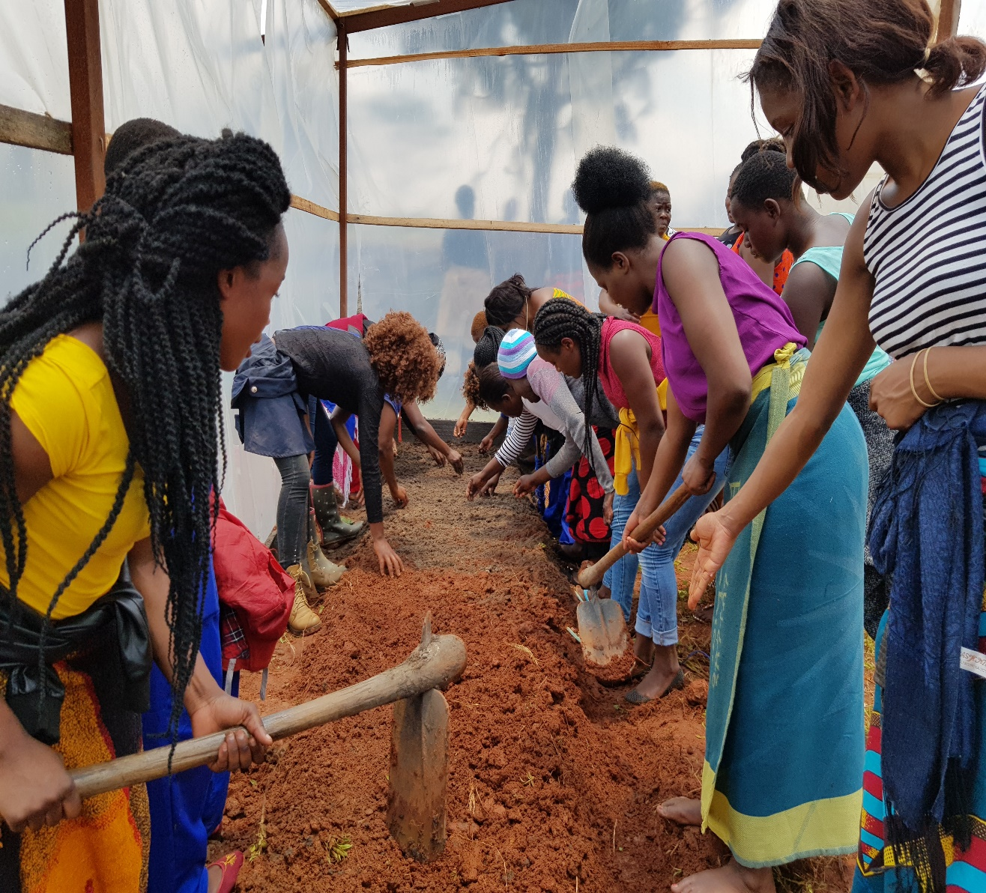
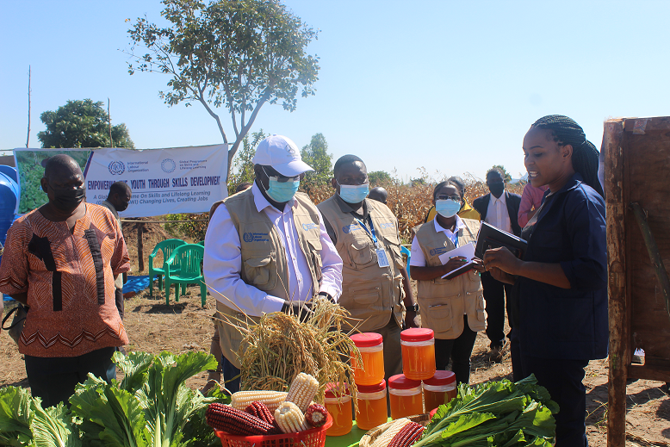
STED Implementation in Pictures – Developing Youth Entrepreneurs, Creating Jobs!

Slide 50
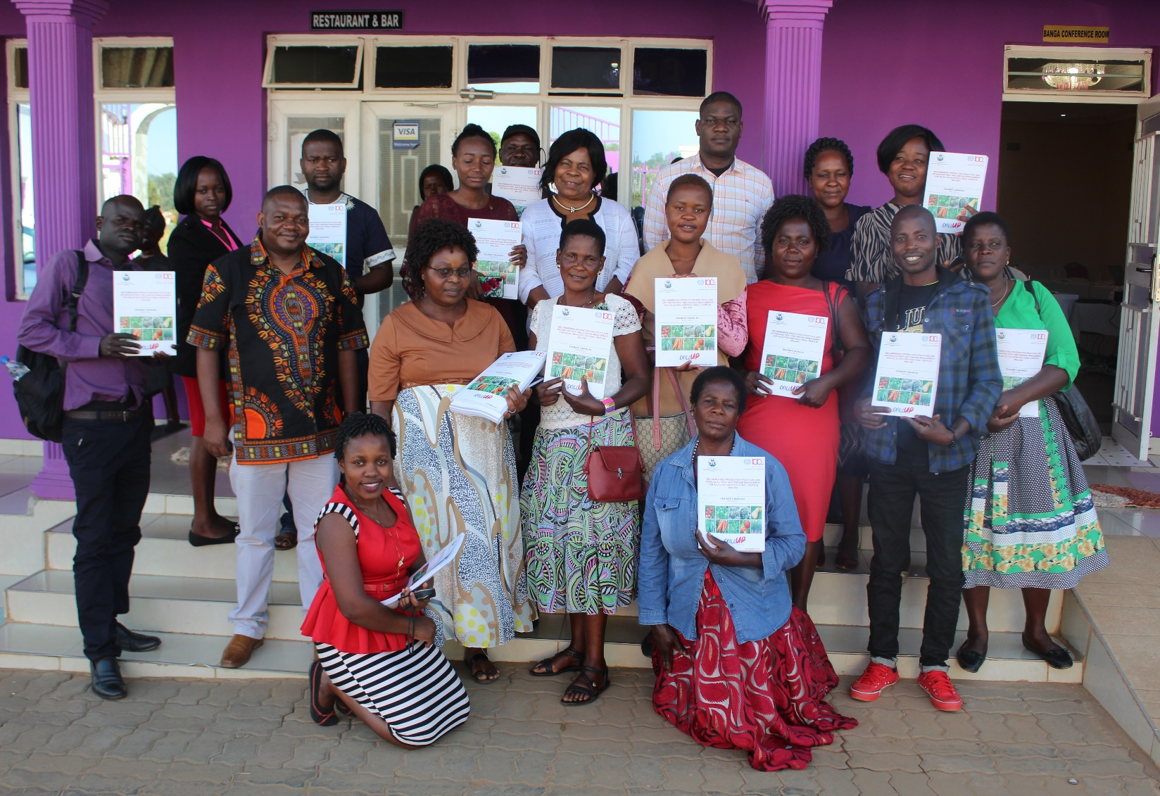

STED Implementation in Pictures – Institutionalizing Training in MOA – AEDOs and Learning on the Job – a WIL candidate at Roseberry Farms (Aggregator Farmer)

Slide 51

Skills Technology Foresight
Developed in 2014.
Built on the foresight experiences in Brazil, China, the Czech Republic, Germany, India, Japan, Korea, Romania and Russia
Targets sectors exposed to large technological changes
Interactive. Based on social dialogue
Change management tool
Piloted in Armenia food processing and ICT/Precision Engineering and in Vietnam metal processing. Used in Tanzania, Tunisia and South Africa.
Rapid foresight is used in Russia and Kazakhstan for identifying future skills and jobs (Atlas of New Jobs) and in sectoral foresights

Slide 52
Skills Technology Foresight session: the central element
Analysis of gap between required & available TVET & HE programs for skills provision
Study
1
2
3
4
5
TRENDS
HARD & SOFT TECHNOLOGIES
WORK TASKS +
WORK
environment
SKILLS DEMAND
RECOMMEN-DATIONS FOR TVET & HE
CONSTRAINTS AND OPPORTUNITIES:
planned / committed investment
infrastructure availability
industrial policies
cultural & social barriers
to adoption
Analysis of gap between demanded & available skills

Slide 53
The ideal list of participants in the foresight session
Private sector (40-50% of participants):
  representatives of leading employers in the industry;
  small innovative businesses (start-ups or the like);
  leading sectoral suppliers and other value-chain industries;
employers’ organisations and trade unions;
relevant governmental and regulatory bodies (policy makers) (20-30%);
educational sector representatives (20-30%):
  higher educational institutions;
  TVET institutions;
  informal/non-formal education providers and other education and training providers;
  designers of education, qualifications, competency standards, curricula etc.
human resources management and skills development experts;
research and development institutions, analytical entities, business strategy consultants;
futurists and prospective labour market experts,
students
Mandatory participants are marked in blue

Slide 54
Technology foresight of future skills in Armenia
Sectors:
Food processing
ICT/ Precision engineering
2 foresight sessions each of about 30 participants
Roadmapping
(2016, 2020, 2030):
Identify soft and hard technologies, drivers of change, work tasks, technical and core skills.
Validation.
Resuts and findings:
Social dialogue and implementing committees established with sectors’ ownership of findings
Map of the future and a vision created
20 demanded skills and jobs of the future identified
5 programmes for two sectors proposed to improve relevance of training (e.g. retention of workers, collaboration with diaspora, on-the-job training)

Slide 55

Greening TVET and skills development

Slide 56

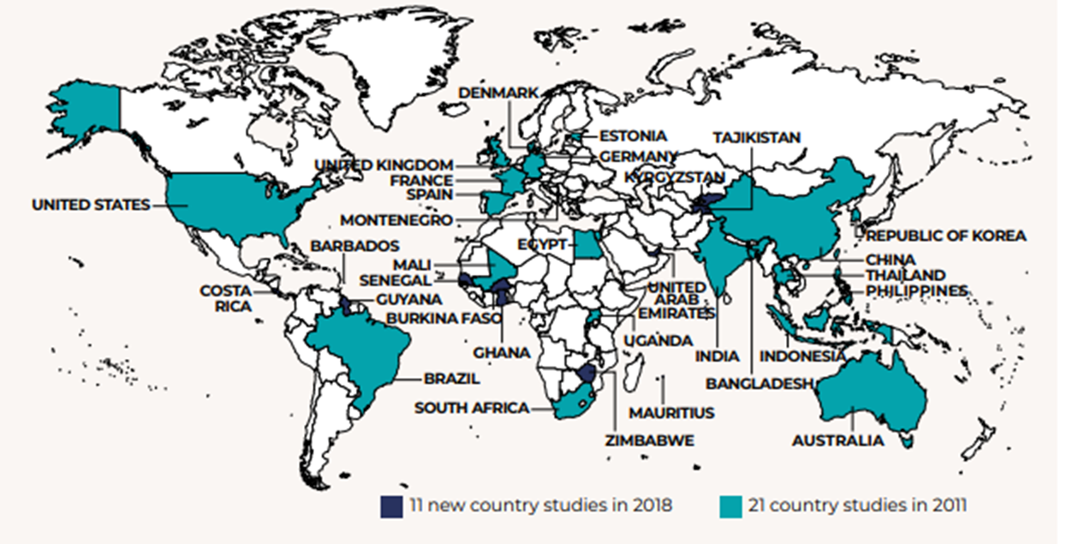

ILO Global Research: Skills for a Greener Future
Second round: 32 countries

Slide 57
Climate Change
Energy sustainability scenario, 2030
Circular economy scenario, 2030
Sources: ILO (2019) & Skills for a Greener Future. Infographic (2019).
Notes:
Another important global driver of change is climate change and environmental degradation which is an existential treat to the world. The demand for new jobs to facilitate the green transition drives the demand for new skills. The urgent need for action to alleviate the effects of climate change is highlighted by the ‘Conference of the Parties’ where the parties refer to Governments who have signed the UN Framework Convention of Climate Change meet annually to discuss how to jointly address climate change as well as the Paris Agreement, a bottom up approach where countries themselves decide how much they will reduce their emissions by a certain year to keep the rise in global temperatures to well below 2 degrees above pre-industrial levels. In an ILO publication released in 2019 titled “Skills for a greener future: A global view”, based on quantitative analysis and empirical research across 32 countries, a multi-regional input-output model as well as skills scrapped from big data was used to understand the demand for an occupation, what type of skills would be required based on two scenarios – the Energy sustainability scenario as well as the circular economy scenario. The energy sustainability scenario sees larger increases in the construction, electrical machinery manufacturing and copper mining sectors with decreases in the petroleum refinery and extraction, coal mining and coal based electricity generation sectors. The circular economy scenario represents a model for sustainability in resource use and consumption which supports a shift from the extract-manufacture-use-discard mentality to embracing recycling, repair, reuse, remanufacture and longer durability of goods. Its important to note that in either scenario, job creation outpaces job destruction. In the barplots shown, green refers to job creation and red refers to job disruption. For the energy sustainability scenario, of the 7 million jobs at risk of disruption, less than 1/3 of the jobs vacancies have no similar vacancies in other industries. More than 2/3 of the remaining jobs at risk of job destruction could be reallocated to similar jobs in other industries. This shift in occupational skill needs will require a complex set of policy measures, including massive investment into reskilling and upskilling through private and public sector investment, active labour market policies, career guidance, targeted training measures to promote gender balance and measures to facilitate workers’ mobility and their social protection.
Notes:
For example, if global electricity production from solar energy is to increase by 59 per cent by 2030, as assumed in the energy sustainability scenario, skills demand in solar installation, solar panel manufacturing, and the mining and processing of silicon will increase

Slide 58
Jobs created and destroyed in a global circular economy scenario, by gender, 2030 (millions)
Energy sustainability scenario, 2030
Circular economy scenario, 2030
Reskilling measures required at all skill levels
Medium-skilled occupations sees the most job creation and reallocation
Overall net employment effects is positive
Greatest need of upskilling and reskilling for men
Gender disparities to persist
Sources: ILO (2019) & Skills for a Greener Future. Infographic (2019).
Notes:
In both scenarios, retraining needs is distributed across all skill levels with most job creation and reallocation concentrated in mid-skill occupations. The greatest need of upskilling and reskilling will be for male-dominated occupations as seen from the plots on the right. As such, men in mid-skilled occupations would have the greatest need of upskilling and reskilling to allow them to tap into new job opportunities. This could potentially partly offset the global trend in which skill-biased technological change (for e.g through automation of routine task) leading to what is known as the hallowing out of mid-skill occupations which explains the growing income inequalities observed. Also, the plots suggest that gender stereotypes are likely to persist where females would get only a fraction of the jobs created, unless measures are taken to train females with the relevant skills so that they can benefit from the potentially created jobs.
In summary, the transition to environmentally sustainable and inclusive economies and societies cannot take place if the skills demanded by new jobs are not available in the labour market. The transition is therefore conditional on investment in training to develop skills to meet new requirements and avoid skills mismatches. Forward-looking skills strategies are necessary to train young people and reskill the current workforce to meet the skills needs of the new jobs generated in the transition process in expanding/new sectors.
Actual progress on the transition to a more environmentally sustainable economy is not without problems. Key constraints on green jobs growth, including poverty, low incomes and informal employment (especially in developing countries), which can force people into environmentally detrimental activities; weak policies and enforcement of regulations; and weak markets for green goods and services owing to inadequate government support.

Slide 59
How to Green TVET and skills development: A practical guidance tool
Going green in training
Developing and implementing green curricula
Assessment packages to support greener learning
Designing competency standards for greener jobs
Towards a greener campus
A practical guidance tool for greening TVET, competency standards, curricula, training and assessment to be piloted in several countries in 2022
Piloting countries (2021-2022):
Cambodia, Ghana, Zimbabwe, Zambia, Thailand, Guyana and the Philippines
Greening TVET: an overview
Greening the professional development of teachers / in-company trainers
Mainstreaming: from piloting to the whole system
Sensitizing employers
How to support greening of skills for the informal economy
Notes:
Using the tool:
Use as a stand-alone document or as part of coaching
Overall diagnosis is key but sections can be used independently
For all countries, but especially lower-income countries
Ambitious and inclusive

Slide 60
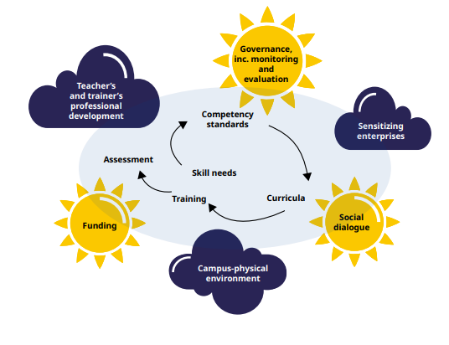
Key elements for greening TVET
A journey, not a destination
A normative process
Taking a long-term view
Holistic – relevant to every job
Systematic – covers all elements of TVET
TVET playing a lead role in greening the economy
Inclusive but aiming high!
Sources: ILO (2022), Greening TVET and Skills development: A practical guidance tool

Slide 61
Contents of the ‘how-to’ sections
Key learning points
Knowledge or ‘theory’ component
Self-assessment tools
Inspiring practical examples
Hints and tips
Checklists
Links to useful resources
Notes:
Benefits of the tool
- provides practical 'how-to' guidance
- flexibility: can be used on its own or with coaching
- deals systematically with all TVET elements
- Holistic and process-based approach, not just looking at content

Slide 62
A journey, not a destination
A normative process
Taking a long-term view
Holistic – relevant to every job
Systematic – covers all elements of TVET
TVET playing a lead role in greening the economy
Inclusive but aiming high!
Overview of process of
greening competency standards

Slide 63








ZIMBABWE
1. Curricula development
2. Training of Trainers
3. Training of students (1,500)
Renewable Energy
Agriculture
Biogas System Installer
Domestic Solar PV System Installation and Maintenance Mechanic
Solar Sales and Marketing Agent
Solar Agro-Processor
Climate-Smart Market Gardener
14 (4F) Teachers
27 (4F) Teachers
12(5F) Teachers
12 (6F) Teachers
12 (8F) Teachers

Slide 64


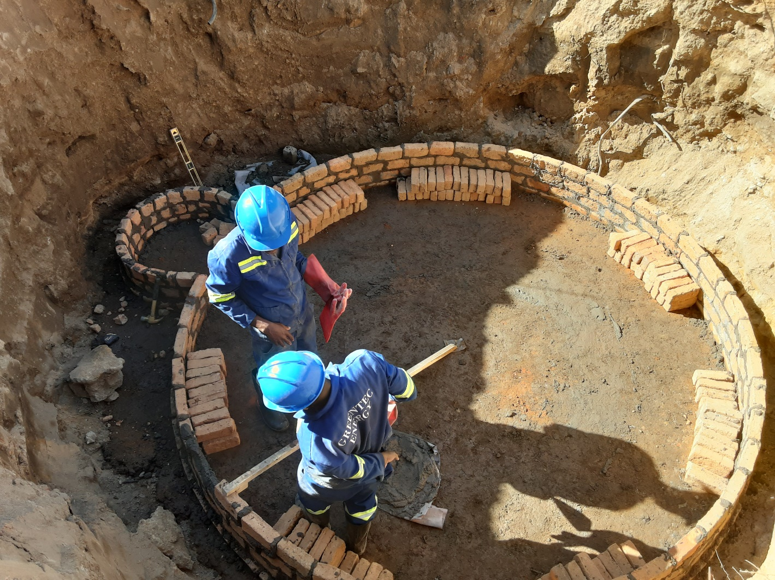






Greening TVET & Skills Development | Work-based Learning
TVET Institutions and Private Sector Partnerships
Role of work-based learning

Slide 65
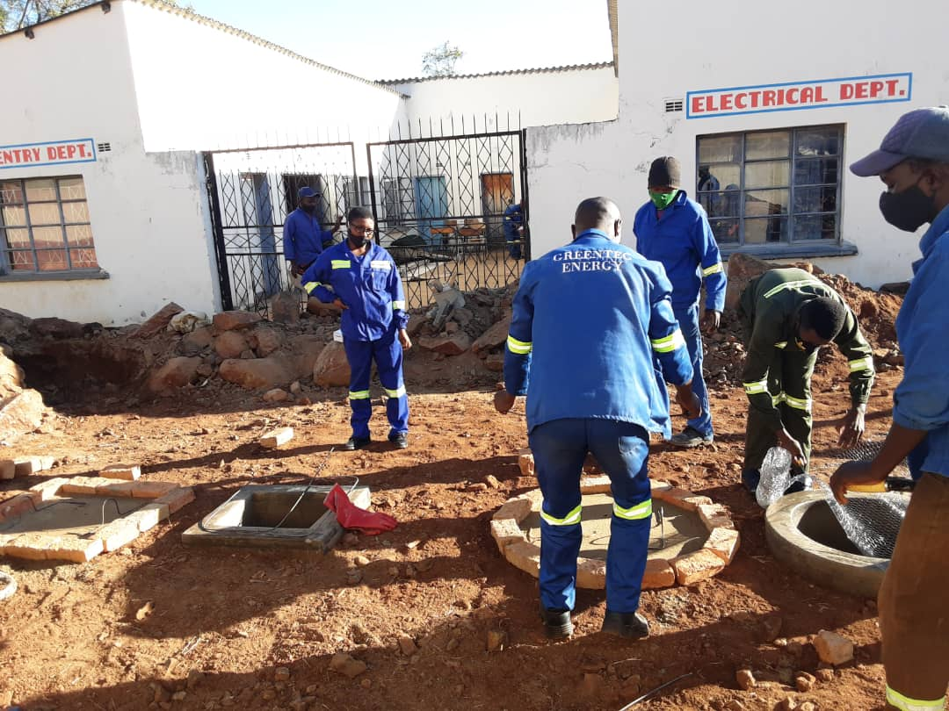
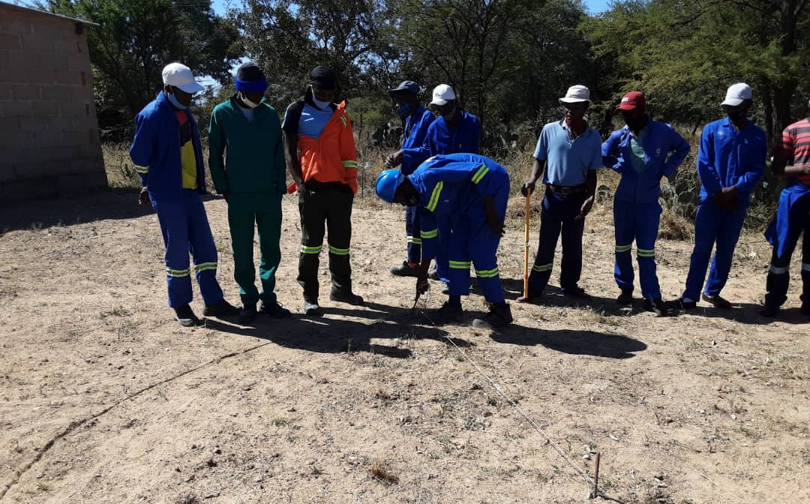

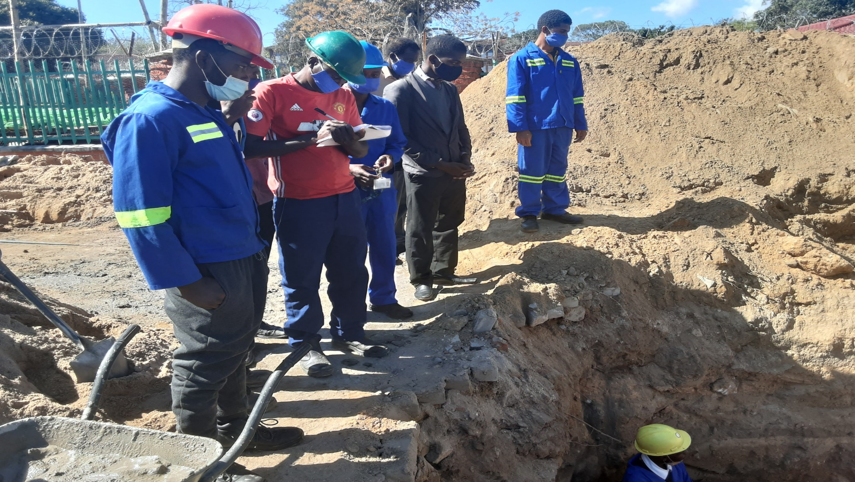
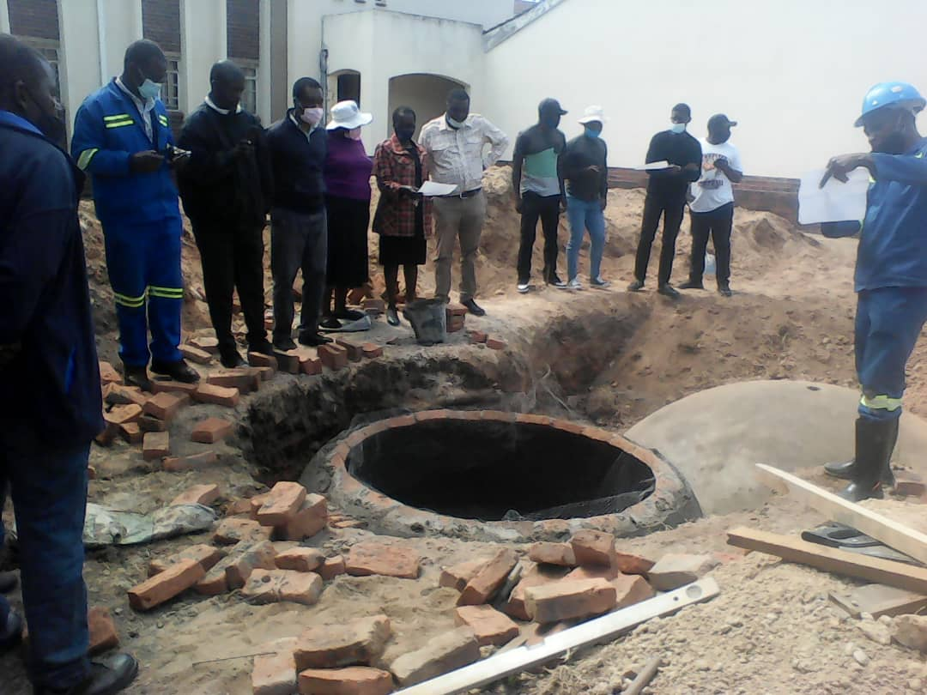
Tabudirira VTC-Mutoko
Avoca VTC-Plumtree
Mutare Polytechnic College
Kwekwe Polytechnic College

Slide 66


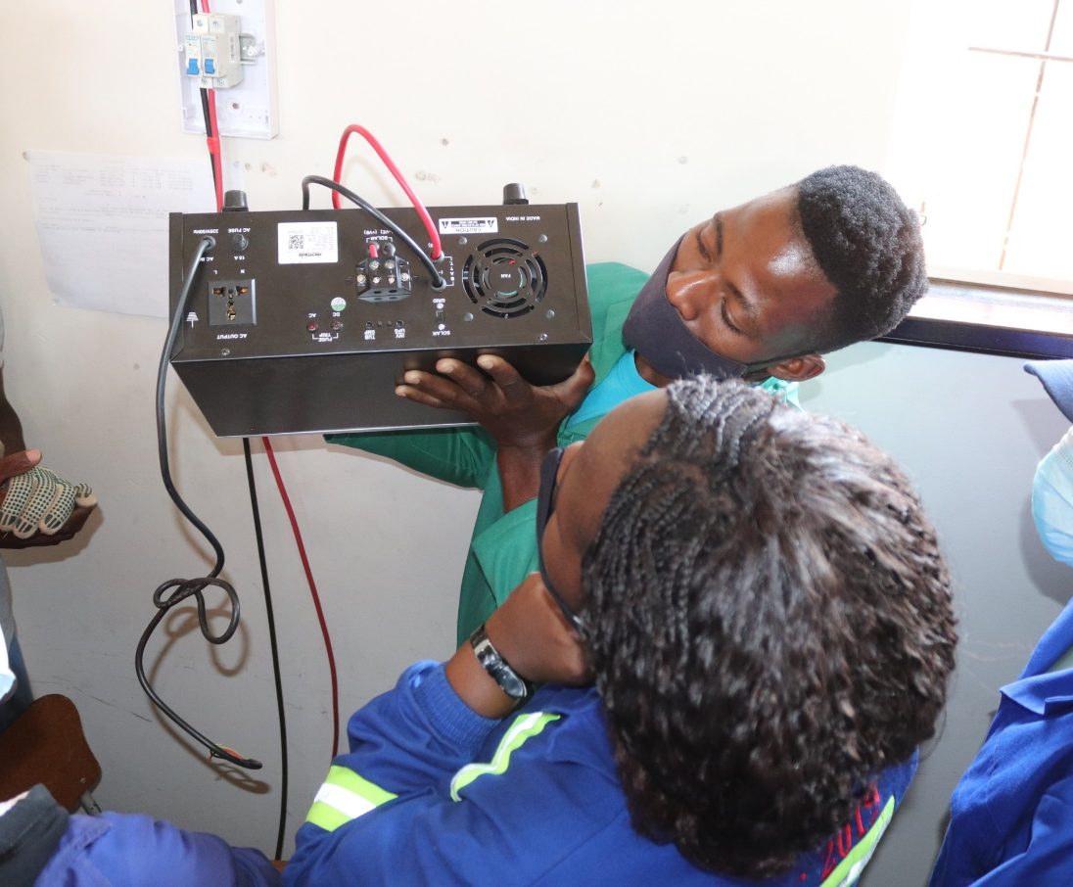

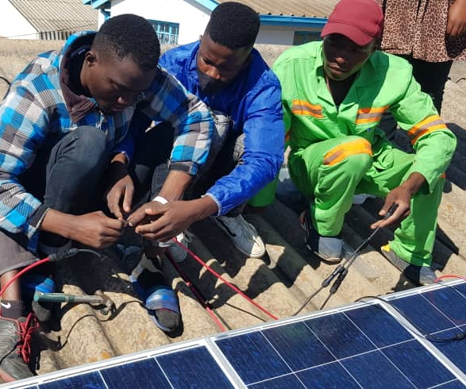

Slide 67
CONCLUSION:
A good system for skills needs anticipation and better matching
PES
Subnational
Could be centralised or decentralised
Sectoral
Government
Occupation
Micro
Coordinated
Combine complementaryelements and policies (policy coherence)
Macro
Short-term
Training
Provider
Sector
Skills
Councils
Sustainable
Global
Individuals
Always shared by a number of institutions
Local
Administration
Based on social dialogue
Company
Researchers
Mid-/
long-term

Slide 68
Country case 1: Eswatini (developing a skills needs anticipation system)
Introduction by a testimonial (Naomy): mapping of skills anticipation and adoption of a national action plan
Group to discuss ingredients and steps needed to build a sustainable skills anticipation system
Elements to be considered:
  Inputs into policy making
  Consolidation of skills anticipation task force
  Strengthening of LMIS, what is missing
  Coordination (inter-ministerial, public-private, etc.)
  Social dialogue
  Further capacity building, where is it needed
  Stakeholders to be involved, inputs and role of private sector

Slide 69
Country case 2: Malawi (implementing and institutionalising STED)
Introduction by a testimonial (Patrick): lessons learned from STED in horticulture and on-going work in the diary sector
Group to discuss and propose a long term sustainability strategy in terms of the methodology and its application
Elements to be considered:
  Research capacity in the country
  Linking research findings to policy making
  Funding elements
  Role of different stakeholders
  Impact on the sector competitiveness, job creation, enterprise development
  Partnerships to be put in place

Slide 70
Country case 3: Zambia (Greening TVET system)
Testimonial (Alice) to present the EU-funded project logframe (4 sectors)
Group to discuss and propose actions to mainstream greening into skills anticipation and curricula development
Elements to be considered:
  Sector selection, value chain approaches
  Governance mechanisms
  Skills needs anticipation approaches
  Capacities to be developed
  Institutions to be involved
  How to stimulate public and private collaboration

Slide 71
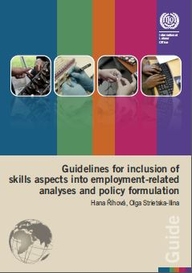
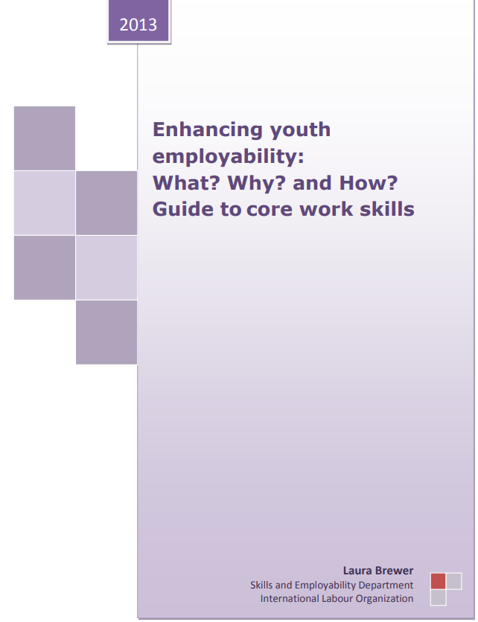
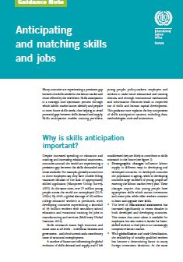
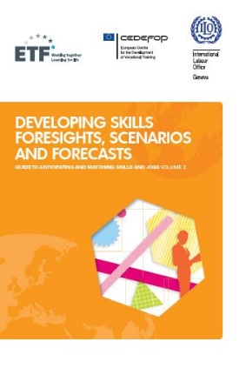



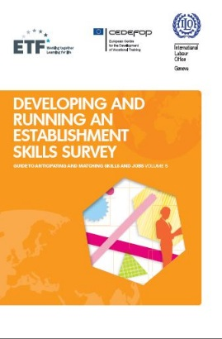

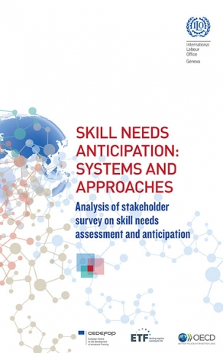

ILO skills anticipation and matching tools:
Generic tools and knowledge products
Notes:
We have published several generic tools and knowledge products from the guidance note on skills anticipation and matching on the left to tools to guide one to implement foresights, scenarios and forecast, running an establishment survey, carrying out tracer studies which we implemented with our European partners. On the right are more specific products and research papers.

Slide 72

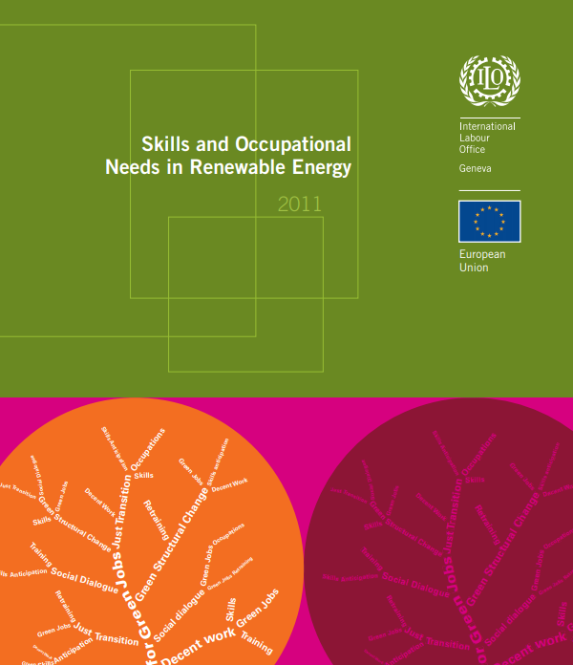


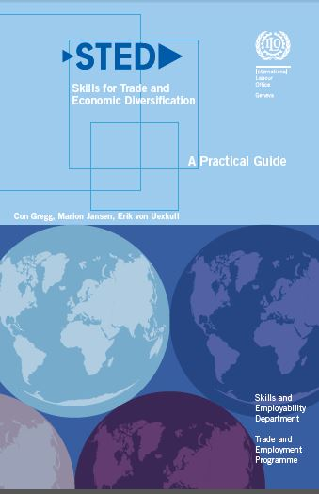
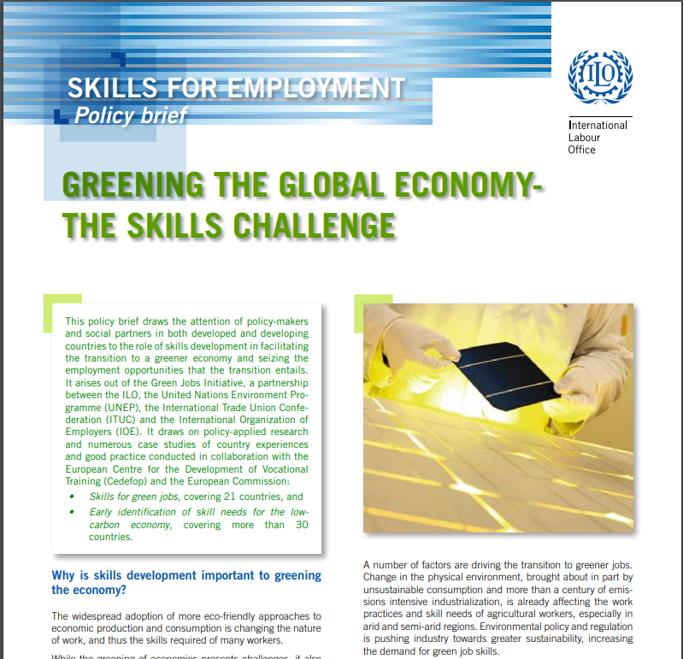
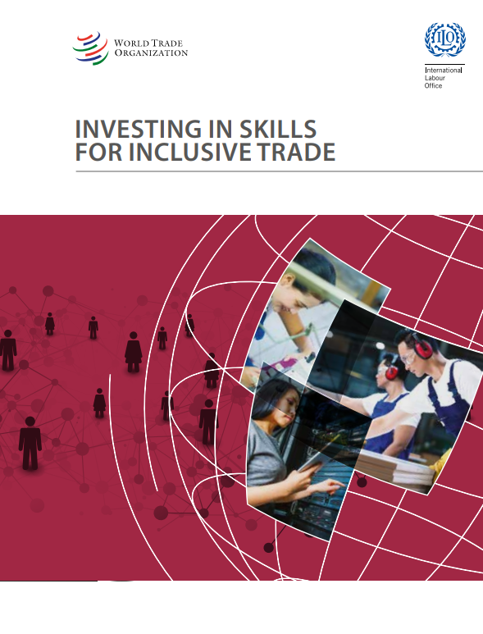


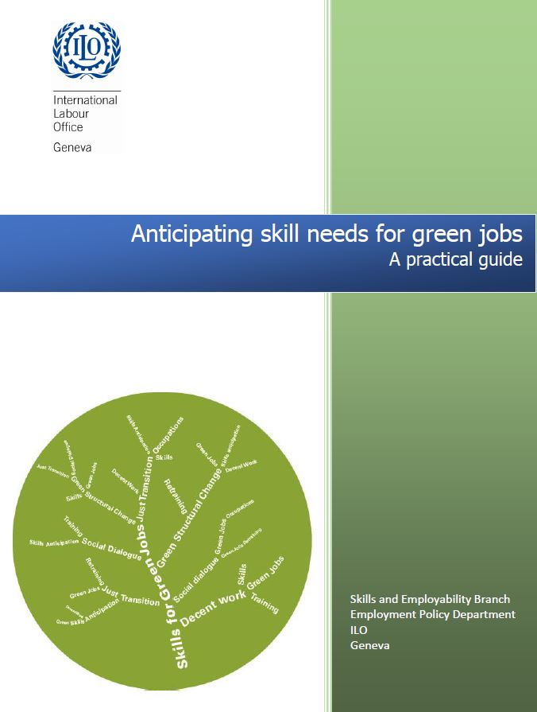
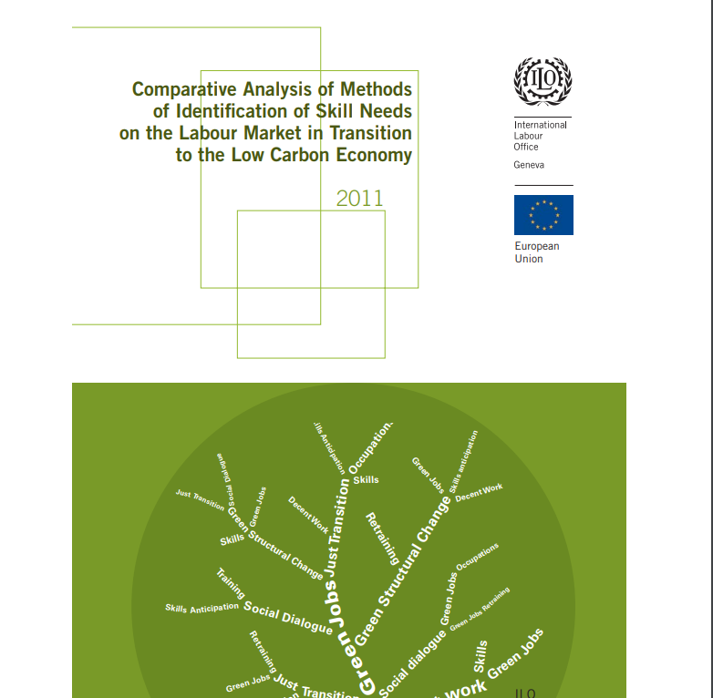

ILO skills anticipation and matching tools:
Specific policy / megatrend driven
Notes:
Next, we have a family of tools that are very specific to certain policies. For example, STED skills for trade and economic diversification which is basically a sectoral based tool. The guidelines for rapid assessment of reskilling and upskilling is a new tool which provides guidance on assessing skill needs in response to covid-19. It includes questionnaires for employers and individuals and provides an indicative list of key informants to contact to facilitate the data gathering process The output from conducting a rapid assessment is a report that makes a clear analysis, identifies priority areas for action, and proposes options for addressing these action areas. We also have a family of tools on future skill needs to facilitate a green transition, skills for a greener future. Some of the insights generated had been covered in the earlier part of this presentation.

Slide 73
Rapid assessments

Slide 74
Summary of main findings and recommendations
IMPACTS OF THE PANDEMIC
RESPONSES TO PANDEMIC
EMERGING SKILLS NEEDS
RECOMMENDATIONS
Large fall in both employment and hours worked,
Costs associated with sharp drop in demand have not been borne equally
Increased demand in employment and for some sectors: (Ex: IT sector)
Temporary reprieves for some sectors (ex. Textiles in SA)
Pursuit of new domestic markets being sought (Ex: Tourist industry in Namibia)
Providing O&H skills
Switching to working from home
IT and digital skills
O&H skills related social distancing and hygiene standards
More general sets of skills to handle workload
Job/occupation technical skills
Some mention green skills
Making training online and into blended learning formats
Promoting availability of online training
Incentivizing certain groups to participate training
Providing skills which have economic value (resilience)
Establishing and strengthening processes for SA and identification

Slide 75
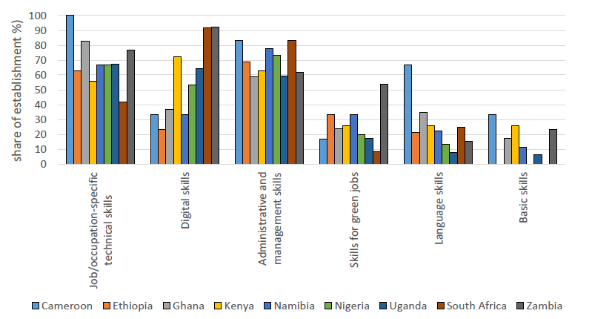
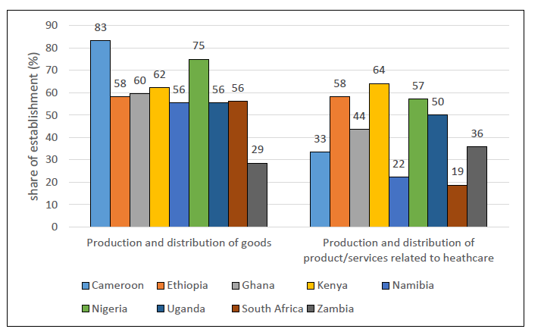
Reskilling and Upskilling needs, perspectives of employers
The share of establishment reporting specific types of training needed to take up COVID-19 opportunities
Types of opportunities in the next 12 months
Source: RSA: Survey of Employers, 2021

Slide 76
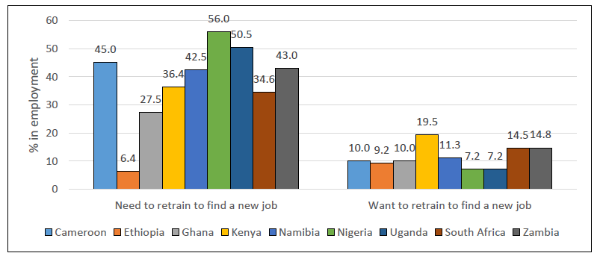
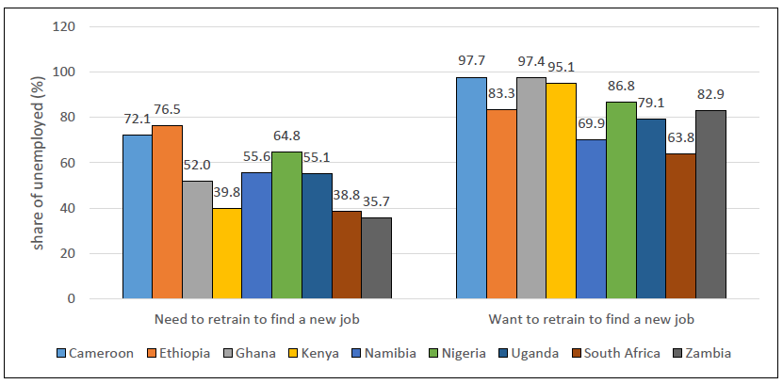
Necessity and willingness of people to retrain
to find a new job
Employed
Unemployed
Source: ILO Rapid Skills Assessment of COVID's Impact: Survey of Individuals

Slide 77
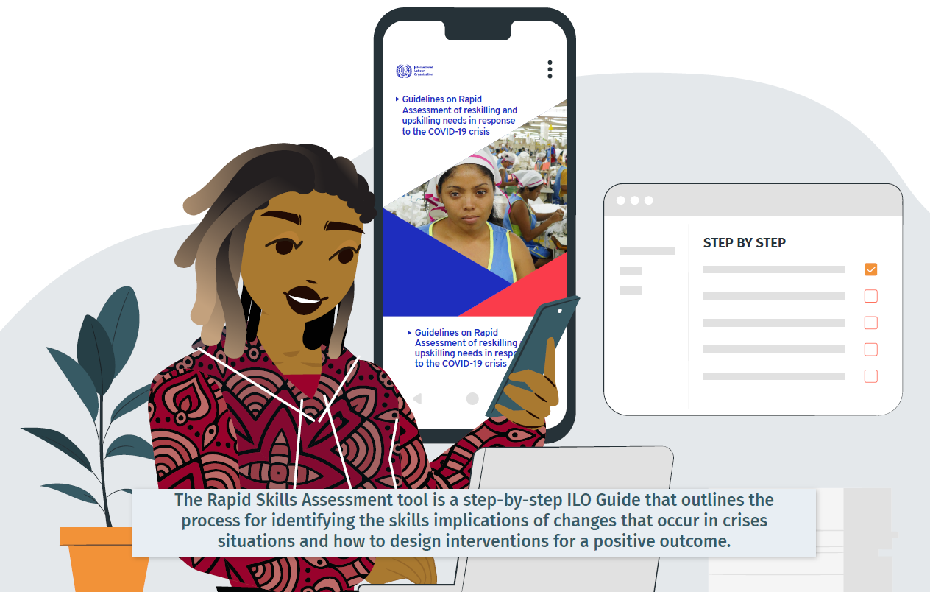


Rapid Skills Assessments
Responding to Impact of COVID 9 on Labour market
Assess skill and labour needs in credible and timely manner,
Identify priority areas for action, and develop actionable recommendations for addressing areas of need
Ensure affected businesses and individuals are active participants in formulation of required policies and strategies
Provide informed recommendations for follow-up action by
  Education and skills development system,
  Public and Private Employment Services
Assessments in eight Countries - Cameroon, Ghana, Kenya, Namibia, Nigeria, South Africa, Uganda and Zambia

Slide 78
Thank you for your attention!
www.ilo.org/skills
www.skillsforemployment.org

