Slide 1
TRAINING FOR RURAL ECONOMIC EMPOWERMENT (TREE)
Alice Vozza
Skills and Lifelong Learning Specialist
Eastern and Southern Africa
ILO, DWT CO Pretoria

Slide 2
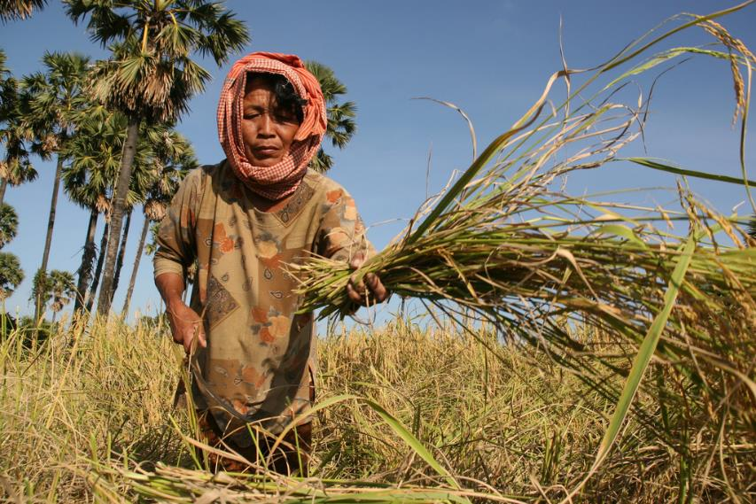
Why?
Most informal economy workers and entrepreneurs live in rural areas, often in extreme poverty and insecurity
ILO Rural policy brief
https://www.ilo.org/wcmsp5/groups/public/---ed_emp/documents/publication/wcms_182737.pdf

Slide 3
What is TREE?
Training for Rural Economic Empowerment (TREE) is a methodology for promoting the economic empowerment of the rural poor.
Implemented in 20 countries: Bangladesh, Benin, Burkina Faso, RCA, Congo, RDC, Egypt, Indonesia, Liberia, Madagascar, Mozambique, Niger, Pacific Island, Pakistan, Philippines, Sri Lanka, Timor-Leste, Tunisia, Vietnam et Zimbabwe.
TREE’s strength is its comprehensive and community-based approach to developing and delivering training programmes.
Designed specifically for people in less developed, fragile and vulnerable contexts where access to services and economic opportunities is limited
Target audience

Slide 4
What makes TREE different from conventional vocational training programmes?
it identifies potential income generating activities and assesses local economic opportunities before determining training needs
it involves the local community and social partners at all stages
it ensures post-training support for beneficiaries to initiate sustainable income-generating activities, including access to technologies; access to financial services; helping in the formation of groups, associations and cooperatives; among other business development interventions
designed to build on existing employment-creation programmes or targets
Skills training + Establishment of local enterprises + Community development
Focus

Slide 5
What makes TREE different from conventional vocational training programmes?
TREE usually targets areas experiencing the highest rates of poverty, informality and unemployment in a country, with a focus on fragile contexts
It builds the capacity of local governments, training providers and private sector partners to implement the methodology
A wide range of groups can benefit from the TREE methodology, specifically marginalized groups. Depending on the implementation strategy and target areas, these can include rural men and women, unemployed youth, people with disabilities, women and men with HIV/AIDS, ethnic minorities, refugees, demobilized soldiers, and men and women in crisis situations

Slide 6
TREE and empowerment through a multi-level approach
MACRO
LEVEL
Promoting a wider enabling environment is required for community-based development initiatives
Macro
Meso
Micro
MESO
LEVEL
Design and delivery of appropriate training programmes and provision of post-training support
MICRO
LEVEL
Identification of employment and income-generating opportunities
Question
What levels of interventions can be easily identified in your country?

Slide 7
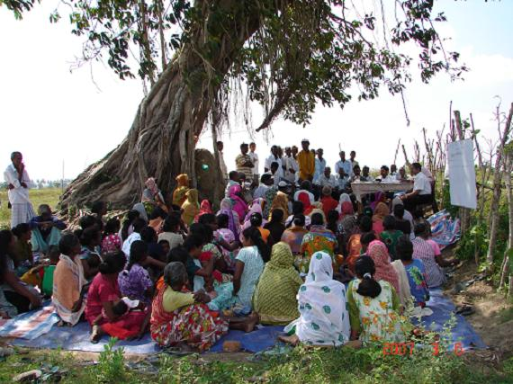
TREE processes and mainstreamed elements
LOCAL ECONOMIC DEVELOPMENT, FOCUS ON INCLUSION
The methodology consists of a set of processes that guide the identification and implementation of income-generation opportunities and their articulation to local development initiatives.

Slide 8
Mobilization and empowerment of the partners and target groups is the key driving force
Institutional organization and planning
Economic opportunities and training needs assessment
Training design,
Organization and delivery
Post-training support for micro-enterprise development and wage employment
Monitoring and documentation
Initial assessment of policy environment and needs
Collection and analysis of information and assessment of labour market demand
Design content and develop curricula
Facilitating access to wage or self-employment
Impact assessment
Orientation of stakeholders and partners
Selection of trainees and training of trainers
Tracer studies
Socio-economic profile of the community and community mobilization
Support to small business start-up
Institutional engagement and further capacity development
Establishing appropriate TREE management and governance systems
Identification of economic opportunities and training needs assessment
Delivery of training
Facilitating access to credit, advisory services, marketing, technology, etc.
Continued training in the workplace
Documentation of results, lessons learned, etc.
Capacity building
Developing feasibility studies and training proposals
Support to formation of groups
Follow-up to TREE graduates
Gender and disability mainstreaming and mobilization and participation of target groups in local development
Performance monitoring mechanism

Slide 9
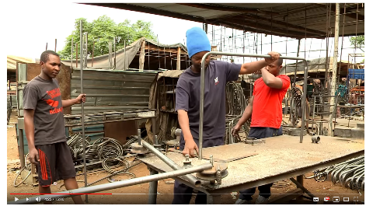
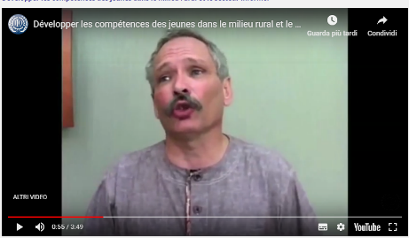
The TREE of life: Skills for Youth Employment and Rural Development Programme
Breaking Through Poverty:
the TREE Project
in the Philippines
Tree programme in Benin and Burkina Faso (French)
https://www.youtube.com/watch?v=I_3UAMtEGrM
https://www.youtube.com/watch?v=QRcUA_kGISQ
https://www.youtube.com/watch?v=HbSCNGXljCs
https://www.youtube.com/watch?time_continue=55&v=uuAPC9dPbh0
Notes:
French: https://www.youtube.com/watch?time_continue=55&v=uuAPC9dPbh0
Zimbabwe EN: https://www.youtube.com/watch?v=I_3UAMtEGrM
Philippines EN: https://www.youtube.com/watch?v=QRcUA_kGISQ
Mozambique PT: Meet women entrepreneurs from Cabo Delgado: https://www.youtube.com/watch?v=HbSCNGXljCs

Slide 10
Key factors for planning and implementing TREE
In implementing a TREE programme the following factors are to be considered:
Mobilizing communities and partner organizations
from the steering committee at national level and the local committee at local level
Providing training in line with economic opportunities
identify economic opportunities and then organize related trainings
TREE within existing vocational training systems
Integrate TREE methodology in vocational training systems (programmes, teaching methods, training based on economic opportunities, post-training support)
Developing an integrated network of post-training support services ensuring that new businesses formalize
Promoting decent work and equal opportunities, through training and post-training services
Notes:
Communities and partners at national level will be in the steering committee
Communities and partners at local level will be in the local committee

Slide 11
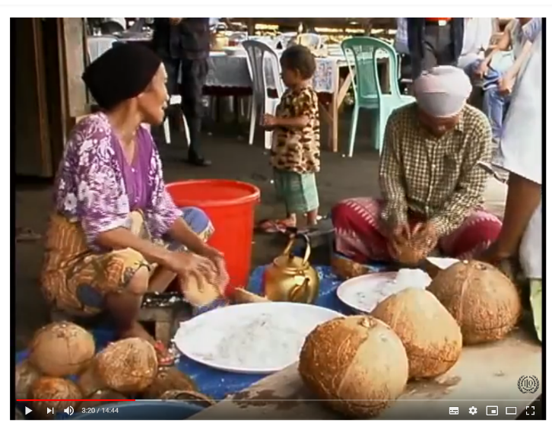
Institutionalization of TREE in the Philippines
Applicability of TREE in the Mindanao region
Comprehensive approach to employment or self-employment and rural economic development
From training tool to strategy for rural or local economic development
Continuous utilization of TREE tools and methodology by training providers in the region:
TESDA-ARMM
Other vocational training providers
ILO can play a mediation role in coordinating stakeholders
Breaking Through Poverty: The TREE Project in the Philippines
https://www.youtube.com/watch?v=QRcUA_kGISQ

Slide 12
TREEpedia
The TREEpedia digital tool makes the TREE methodology more user-oriented, accessible and easier to share.
It includes a summary of the methodology (26 pages), 6 instructional videos and over 60 hands-on tools to support its implementation and any community-based rural development programmes.
Link

