Slide 1
Sectoral skills bodies
Olga Strietska-Ilina
Senior Skills and Employability Specialist
Area Lead ”Skills Strategies for Future Labour Markets”
ILO, Geneva
Alice Vozza
Skills and Lifelong Learning Specialist
Eastern and Southern Africa
ILO, DWT CO Pretoria

Slide 2
Sector skills councils or bodies
  Sectoral skills bodies have a long history in many countries. They vary according to:
•
coverage -
industry scope, sectoral or transversal
•
focus -
initial or continuing TVET or both
•
mandate - advisory,
technical,
legal responsibilities
•
members - bipartite, tripartite, multipartite, industry representation
•
bodies, secretariats
structure - committees, working groups, councils, independent
•
funding - public, private, donor,
levy
•
institutional relationships - roles and responsibilities
Structures and roles vary considerably!
Most countries have some regulatory or oversight body responsible for quality assurance and the place of SSBs in that overall system must be negotiated on the basis of social dialogue

Slide 3
Examples of institutional structures
▪
Independent bodies registered as non-for profit organisations or under company law :
‘training councils’, ‘training advisory boards’, ‘skills councils’ with staff and a governing
board; (South Africa, New Zealand)
▪ Committees within an industry association or employer’s body ‘training councils’, ‘training
advisory boards’, ‘skills councils’ with sector representatives and a shared private sector
secretariat (Jordan, Netherlands)
▪ Committees and working groups within government entities ‘training councils’, ‘training
advisory boards’, ‘skills councils’ with sector representatives and a shared public sector
secretariat (Botswana, Bangladesh)
5

Slide 4
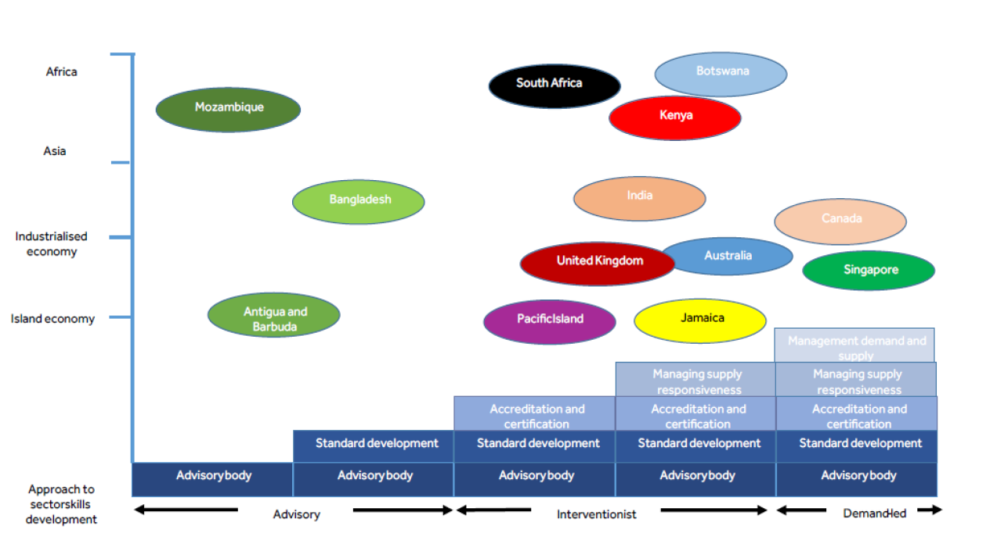
Mapping sector skills bodies
Source: Powell, M. (2016) Mapping Sector Skills Development Across the Commonwealth
6

Slide 5
What do sectoral bodies deliver?
International experience shows that sectoral bodies can provide a wide range of services:
• quantitative and/or qualitative labour market analysis
•
skills needs forecasting
• preparing occupational or qualification standards and curriculum
• policy advice on lifelong learning, VET or skills issues
• brokering partnerships between employers and institutions
•
coordinate training providers
•
careers guidance and promotion of TVET and skills development
•
training and assessment services for workers and employers
•
funding of training
• managing sectoral funds
• managing government programs
7

Slide 6















Funding of Sectoral Bodies
Sources
Type
Example
Government
core funding and project funding for long-
Advisory bodies such as New Zealand,
funded
term sector initiatives
Canada
Operational support
HRD Committees Botswana
Government
Grants for short-term targeted responses
New York Garment Industry Corporation
funded
Skills funds
Short-term flexible funding for identified
National Workforce Development Fund
priorities. Shared government and
Australia
industry funding
Private sector –
independent sectoral
Levy based on sector-wide labour
body administered
agreements Netherlands
Private sector, government administered
Skills Development Fund Singapore
Start-up loans
Accelerated development of a private
National Skills Development Corporation
training market
India
14

Slide 7
How are sectoral approaches evolving?
▪ whilst country variations exist, formalised independent sector-specific bodies with a broad remit
are growing, developing organically or as a consequence of specific state or donor
interventions
▪ permanent and independent bodies have established roles in many countries: South Africa,
Denmark, Brazil, India, Namibia etc
▪ new bodies being established in Vietnam, Ghana, Ethiopia, Bangladesh, Malaysia, Cambodia,
Malawi, Jordan, Indonesia
▪
in mature systems, roles and level of government support is changing: UK, Australia,
Netherlands, New Zealand, Canada
▪
in Europe, 22 of 28 EU countries have sector skills bodies and are now regional bodies are
being piloted
3

Slide 8

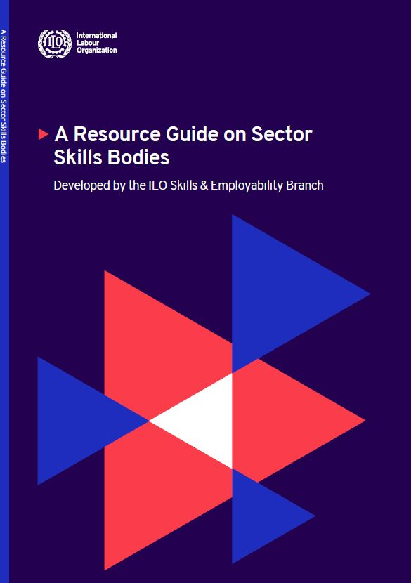
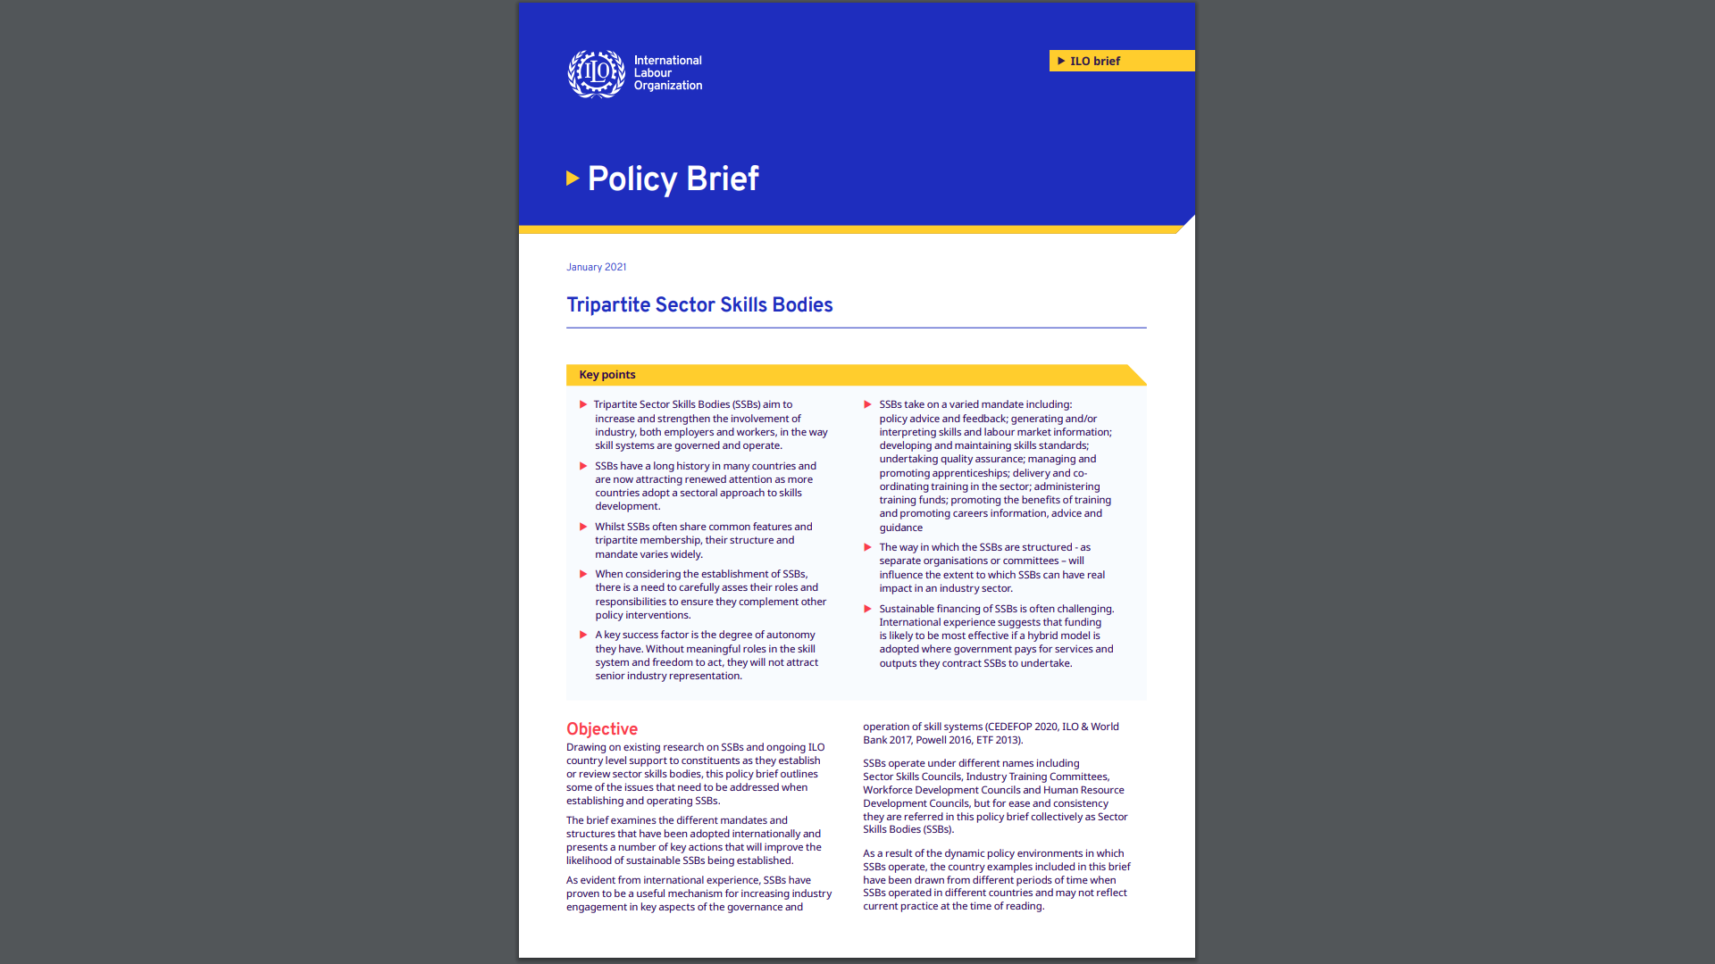
Useful resources on Engagement of Social Partners in Skills Systems https://www.ilo.org/skills/areas/skills-policies-and-systems/WCMS_547522/lang--en/index.htm

Slide 9


ILO resources
Links:
www.skillsforemployment.org
Quality Apprenticeships (ilo.org)
Upgrading apprenticeship systems in the informal economy (ilo.org)
Key Resources formal and informal apprenticeships
    2022 (upcoming). SIFA Guidance Tool for Apprenticeships Development in Africa
    2022. How to strengthen informal apprenticeship systems for a better future of work? Working paper, Geneva, ILO, https://www.ilo.org/wcmsp5/groups/public/---ed_emp/---emp_ent/documents/publication/wcms_837761.pdf
    2020. ILO Toolkit for Quality Apprenticeships - Volume 2: Guide for Practitioners https://www.ilo.org/global/topics/apprenticeships/publications/toolkit/WCMS_748751/lang--en/index.htm
    2019. Intermediary organizations in apprenticeship systems https://www.ilo.org/skills/pubs/WCMS_725504/lang--en/index.htm
    2018. Recognition of Prior Learning RPL Package https://www.ilo.org/skills/pubs/WCMS_626246/lang--en/index.htm
    2017. ILO Toolkit for Quality Apprenticeships - Vol. 1: Guide for Policy Makers https://www.ilo.org/skills/pubs/WCMS_607466/lang--en/index.htm
    2015. Assessing skills in the informal economy. A resource guide for small industry and community organizations https://www.ilo.org/global/docs/WCMS_343183/lang--en/index.htm
    2012. Upgrading informal apprenticeship. A resource guide for Africa https://www.ilo.org/skills/pubs/WCMS_171393/lang--en/index.htm
    2011. Skills for Employment Policy Brief Upgrading Informal Apprenticeship Systems https://www.ilo.org/employment/Whatwedo/Publications/WCMS_167162/lang--en/index.htm

Slide 10
Sector skills bodies:
The case of Ghana

Slide 11





Sector skills bodies in Ghana
As part of STED implementation, the Commission for Technical and Vocational Education and Training (COTVET) has taken steps to establish a network of Sector Skills Bodies in priority sectors.
Autonomous bodies, tripartite plus, overseen by a government body and in effect ‘licenced’ to fulfil certain roles as detailed in their TOR.
Implementation of 11 Sector Skills Bodies, development of skills strategies for these sectors supported by STED
Quality assurance (a number have sought to assume this role -review the accreditation submissions of training providers- by including it in their sector skills action plans, teachers registers and industry endorsed assessors)
The 2018-2022 TVET
Transformation Plan
sets out the
establishment of
Sector Skills
Councils to increase
employers’ voice in
the TVET system

Slide 12

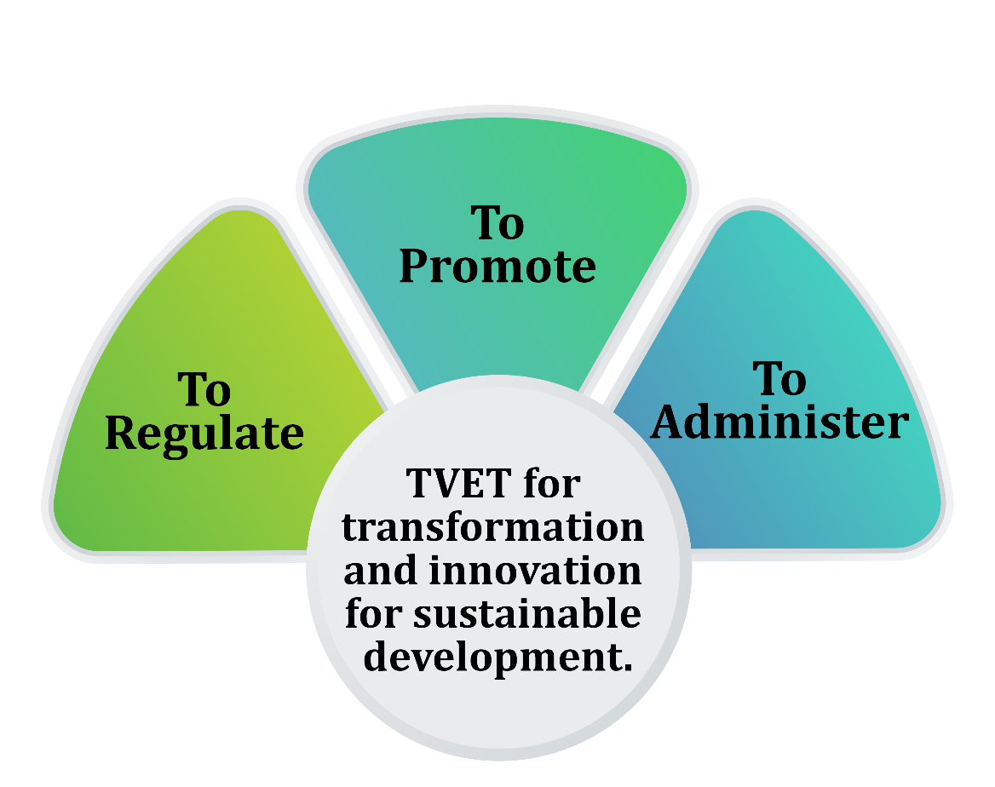
MANDATE OF THE COMMISSION

Slide 13
PROCESSES TOWARDS ESTABLISHING SSBs ILO STED APPROACH
No | Processes | Objective | Lead Partner(s)
1 | Social Dialogue | Secure key stakeholders buy-in and support for the development of an option paper on piloting SSBs | CTVET/ILO
2 | Profiling Potential Sectors | Prioritize sectors with economic prospects and export potential | CTVET/ILO
3 | Development of TOR | To provide focus for the operations of the SSBs | CTVET/ILO
4 | STED/SNA Workshop | Understand key drivers of change and its implications for skills anticipation and approaches to development for priority sectors with export potential | ILO
5 | Sector Strategy Development | Develop short term sector specific strategies | ILO
6 | Study visit | Learn from other countries experiences | GIZ/ILO
7 | Capacity of SSBs | Strengthen and make the SSBs functional (ToR) | GIZ/ILO/CTVET/SIFA

Slide 14
Name of SSB | Status | Support
Tourism and Hospitality | Established | ILO
Agriculture, Agribusiness, Agro Processing | Established | ILO/GIZ
Construction | Established | GIZ
Energy (Oil &Gas; Renewable Energy) | Established | ILO; GIZ
Information Communication Technology | Established | GIZ
Pharmaceuticals | Established | AHK
Automotive | Established | AHK
Health Care | Established | Ford Foundation
Textile and Apparel | Established | Ford Foundation
Logistics and Transportation | Established | Ford Foundation
Beauty and Wellness | Established | CTVET

Slide 15
Name of SSB | Status | Support
Telecom | Not yet established
Metal | Not yet established
Media and Entertainment | Not yet established
Security and Safety | Not yet established
Banking and Finance | Not yet established
Strategic Manufacturing | Not yet established
Environmental, Sanitation and Waste Mgmt. | Not yet established
Earthmoving & infrastructure building | Not yet established
Electronics, Automation and Electrical | Not yet established
Machine and Equipment Manufacturing | Not yet established
Wood and Forestry | Not yet established

Slide 16










Functions of SSBs - TOR
Outline career
Make recommendations to CTVET
Produce demand-
pathways, develop
to ensure that qualifications,
driven, robust labour
occupational
curriculum and learning materials
market and skills
standards and
reflect the occupational standards
intelligence
assessment
and that learning materials are
also widely accessible

Slide 17







Functions of SSBs - TOR
Develop sector skills strategies, including
Facilitate initial training of young people
funding recommendations and the
and skills upgrading for existing workers,
formation of Public and Private Partnerships
through apprenticeships, internships,
(PPPs) and feed into national and regional
mentorships and other work based
TVET strategies
development programmes

Slide 18






Functions of SSBs - TOR
Advocate and facilitate greater
Advocate for government and
linkages between skills
other incentives to encourage
attainment, professional
industry to invest in skills
standards, payment regimes
development and TVET
and the TVET system

Slide 19
CAPACITY BUILDING MEASURES IMPLEMENTED SO FAR
ILO STED Approach to Skills Development
Skills Needs Anticipation
Leadership and Governance of SSB
Labour Market Information and its implication for Skills Development
Development of Sector Strategies
Development of Proposal for Funding
Greening Concepts and Skills for Emerging Green Jobs
Competency Based Curriculum Development Processes
Quality Apprenticeship
Recognition of Prior Learning

Slide 20
CHALLENGES:
Funding (DPs, Government, industries)
Commitment of time by Stakeholders (Industries)
Capacity building
BENEFITS:
Deeping collaboration and partnership between CTVET, academia and industry (Internships, Workplace Experience Learning and Dual TVET)
Involvement of industry trade experts in curriculum development
Representation of industry experts on technical committees and Boards for skills development
4

Slide 21
When do sectoral bodies succeed?
▪ when there is a genuine need to tackle skills issues in a sector
▪ when there is trust between stakeholders and motivation to
work together
▪ when technical assistance is available to support them
▪ when adequate time is given for them to mature, develop
capacity and produce results
▪ when they have a clear and meaningful role in the system that
affects positive change
▪ when they are adequately funded
7

Slide 22
Conclusion
•
the work of sector skills bodies can improve the relevance of TVET and
skill systems where they can articulate labour market need, where their
advice is taken seriously and where they have real influence
•
roles and responsibilities must be meaningful
•
their potential mandate can be broad their responsibilities considerable
and their impact significant
•
systems of governance must be rigorous and potential conflicts of interest
must be avoided
•
success depends on broad support and commitment industry and
government
8

