Slide 1




Relevant skills
for all
Vocational Education & Training
VET TOOLBOX II in MALAWI
Project Briefing
9th November 2022
<
<
Implemented by
Co-funded by

Slide 2

Objectives
Give and overview of British Council’s TEVET work
Outline the VET Toolbox Project
Outline a model for investment and opportunity driven project design
Highlight some of the fundamental questions and issues around VET project design model

Slide 3
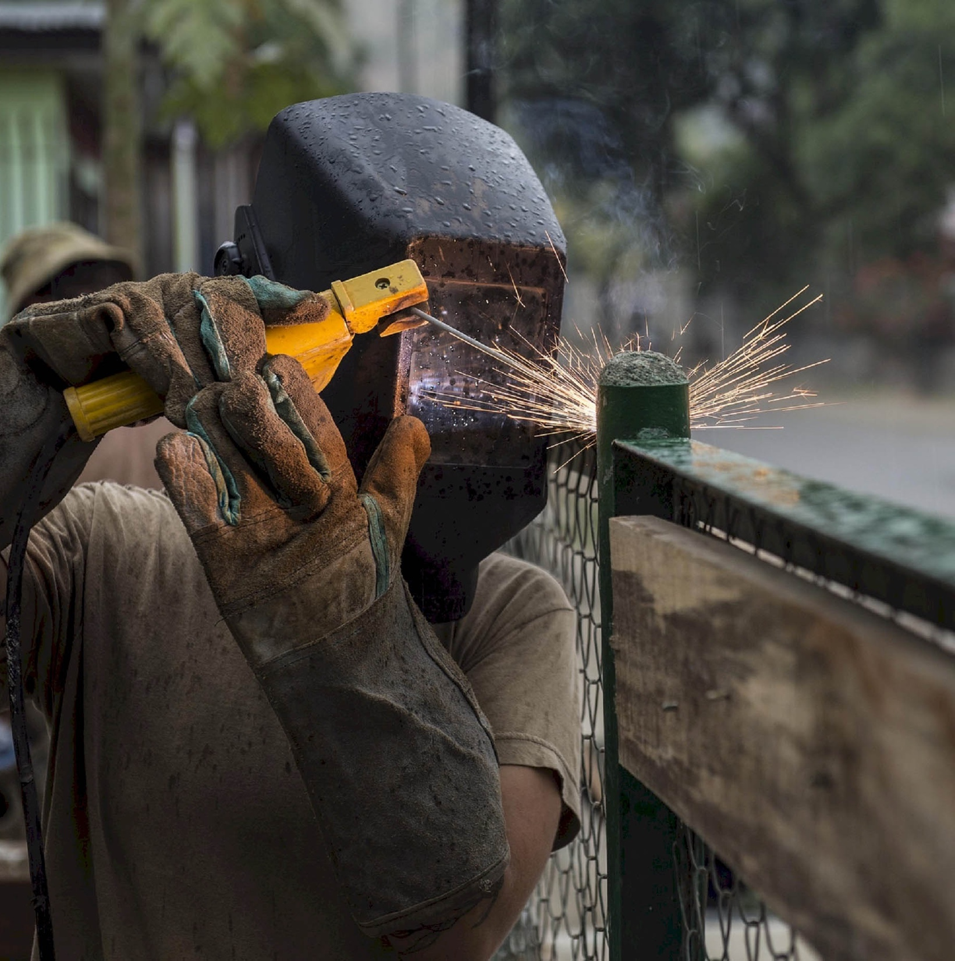

Introduction
VET Toolbox
#relevantskillsforall
As leading European agencies
for international cooperation,
we have joined in one partnership to support
demand-driven and inclusive
vocational education and training.
We are co-funded by the
European Union (€ 30 million) and by the
German Government BMZ (€ 1.750.000).

Slide 4

Four services
1. REQUEST-BASED TECHNICAL SUPPORT
2. FUNDING OF INNOVATIVE PILOT PROJECTS
3. SHARING KNOWLEDGE & TOOLS
4. SUPPORTING THE POSITIVE EFFECTS OF EUROPEAN INVESTMENTS
We offer technical assistance
through short-term interventions that build VET system capacities.
We fund initiatives through a call for proposals to promote inclusion of disadvantaged and vulnerable groups in VET.
We share best practices, methods and tools on a web-based platform and regional seminars to stimulate learning and encourage networking, dialogue and the exchange of experiences.
We flank European investments to help improve local benefits and address skills gap.
€
15 million (EU) + 500.000 (BMZ)
€
15 million (EU) + 1.250.000 (BMZ)
October 2017 – September 2022
September 2020 -August 2024

Slide 5

Our objectives and result areas
OVERALL OBJECTIVE
SPECIFIC OBJECTIVE
RESULTS AREAS
Support human capital needs of value & supply chain development and investment programmes in selected countries in Sub-Saharan Africa.
Enhanced delivery of demand-driven skills development and VET, catering for investment needs in selected countries in Sub-Saharan Africa; through targeted skills development and VET programmes.
1. Facilitating public-private
dialogue and development of PPPs
2. Skills development –
Support of VTIs to deliver training
in line with investment needs
3. Stimulate VET reform through capturing lessons learned and promote good practice models

Slide 6
How did we Design the Project(s)?
Opportunities Mapping
What Opportunities are out there?
Opportunities Exploration
Which Opportunity is the best?
Country Action Plan
How do we implement?
Implementation
Can we achieve our Objectives?

Slide 7
Relevant skills
for all
Vocational Education & Training
Group Activity
<
<
Implemented by
Co-funded by

Slide 8





Group Event
Divide into 3 groups
Pick a country for each group
Pick a sector
Agriculture
Energy
Transport
ICT
Fashion

Slide 9
Group Event
Answer the following:
      Why did you choose the sector?
      What are some major investments happening in the sector?
      Are new jobs being created? How many?
      What skills are needed for these investments?
      Does your country VET system have the capacity to supply these skills?
      Is there any public-private dialogue in the sector?

Slide 10
Opportunities Mapping - Overview
To undertake desk research and scoping to long-list then shortlist the projects in Malawi most likely to deliver maximum local impact, particularly as regards decent job creation, on the basis of objective consideration of the evidence
Three projects shortlisted and presented to the National Advisory Board in April 2022:
  Shire Valley Transformation Programme
  Malawi Mozambique Interconnector Project
  Nacala Corridor Road Project
All three projects approved to be stress tested in Opportunities Exploration work and no alternative projects put forward

Slide 11



Opportunities Exploration Overview
A supply side analysis was conducted to ascertain which of the pre-selected investment areas held the most opportunities for TVET graduates. This exercise helped us to prioritise investment areas which would generate the most value and create the most jobs for TVET graduates. The three pre-selected investment areas are summarised below
Shire Valley Transformation Programme
Malawi Mozambique interconnector
Nacala Corridor Road Project
Transforming smallholder farming to commercial farming in the Shire Valley.
the construction of a large scale irrigation infrastructure, including a 130km irrigation canal;
Will form nine Smallholder Owned Commercial Farm Enterprises (SOCFEs);
Value chain and Agribusiness Development
Potential to create up to 18,000 jobs over a long term
Providing Malawi with reliable electricity
Will interconnect the Mozambique and Malawi transmission systems
construction of a 218km, 400 kV high voltage alternating current transmission line, grid connections, and associated infrastructure
Scheduled to be completed in October 2023.
Skills demand is minimal (30 skilled persons) because the distance of the interconnection on the Malawi side is only 76km in length.
Providing Malawi with an improved road transport linkage to the port of Nacala
Nacala Road Corridor Development Project only covers 55km of road which represents one-third of 1% of the country’s total road network.
476 skilled workers needed

Slide 12
Opportunities Exploration Recommendation
Largest current and anticipated job creation potential (up to 18,000 jobs by end of SVTP)
Good alignment with government and EU support priorities (agricultural commercialisation)
Agri-TEVET skills demands are unmet (e.g. mechanisation, processing etc.)
SVTP has a relatively clear timeline that can allow easy integration of a training program.
The SVTP is a 14-year programme continuing to 2031; as such the demand for skills will remain over the years ahead.
Why?
We chose the Shire Valley Transformation Programme

Slide 13
Country Action Plan Overview
Project overview
To be delivered in the Chikwawa and Nsanje Districts of Southern Malawi
The project will establish and pilot a framework for developing skilled human resources to support agricultural commercialisation through the SVTP. It will establish a dialogue mechanism between employers and training providers and use this to inform the development of needs-based, practical training on an ongoing basis.
Key implementation partners: British Council, SVTP management committee, Technical, Entrepreneurial and Vocational and Educational Training Authority (TEVETA), Selected Commercial Farm Enterprises in the Shire Valley, Selected Vocational Training Institutes and the EU
Implementation from October 2022-September 2024

Slide 14
Country Action Plan Overview
Objectives and outcomes
Overall expected impact
The project contributes to the sustainable development of the agriculture sector in Malawi, demonstrating strengthened capacities of different stakeholders to respond to current and future skills needs in the sector and in other core areas related to the move towards commercial farming.
Employers and training providers will engage more effectively together on an ongoing basis to support the development of needs-based training within the agricultural sector which will help graduates have the skills needed by employers
Trained graduates will be inserted into jobs within the agricultural sector
The dialogue mechanism will support the development of work placements, matching trainees with work opportunities
Good practice models will inform policy, helping to build wider, deeper, sustainability change, including in the area of inclusion

Slide 15
Country Action Plan Overview
Key targets
400 people trained in practical placements
Up to 4 VET centres with increased capacity
280 people in decent jobs
Up to 20 VET trainers trained

Slide 16

How did we Develop the Country Action Plan?
Timeline
June 2022 – Presentation of Opportunities Exploration Report to National Advisory Board, feedback on and approval of intervention in Shire Valley Transformation Project, Malawi
June 2022 – Technical workshops, follow-up interviews and research, design of draft high-level Country Action Plan
July 2022 – Submission to EUD and VET Toolbox Hub for review
August 2022 – Feedback from EUD and VET Toolbox Hub
September 2022 – Country Plan submitted to EU, consultancy team procured

Slide 17

Project Implementation Plan
Timeline
Sep 2022 – Project implementation begins
Jan 2023 – Scoping work, including skills needs assessment completed, selection of VTIs, selection of cooperatives
Feb 2023 - Project launch event
Feb 2023 - Design of support, tools and CBT capacity building programme completed and pilot workplace learning models agreed
Mar 2023 – Capacity building, tools development, longer occupational standards and curriculum development and shorter/modular course design begins and PP Dialogue Mechanism operational
June 2023 – Enhanced training offer developed
August 2023 – Capacity building of trainers completed
September 2023 – Enhanced training programmes start
November 2023 – Work placement programme begins
March 2024 – Job placements start
August 2024 – MEAL work completed and lessons and training of trainers cascaded
August 2024 – Policy recommendations identified
September 2024 – Policy dialogue event held

Slide 18
Other TEVET Projects
British Council Malawi is going to be providing technical assistance on the Zantchito (Skills for Jobs) Programme funded by the EU from 2023 – 2026
We have a Going Global Partnerships Programme which implements TEVET in multiple countries

Slide 19
Relevant skills
for all
Vocational Education & Training
Questions and Discussion
<
<
Implemented by
Co-funded by

