Slide 1
TRAINING FOR RURAL ECONOMIC EMPOWERMENT (TREE)
Julien Magnat
Skills and Lifelong Learning Specialist
ILO, DWT Regional Office for Asia and Pacific

Slide 2
Rural employment and informality – reality check
At the global level, persons living in rural areas (_______) are twice as likely to be in informal employment as those in urban areas (________).
The largest differences in rural/urban informal employment are in the Arab States.
Agriculture is the industry sector with the highest level of informal employment (_________%) around the world.
80.0 per cent / 43.7 per cent
40.0 per cent / 22.7 per cent
True
False
53.6 per cent
73.6 per cent
93.6 per cent
ILO (2018). Women and men in the informal economy: A statistical picture, p. 20. Available at:
http://www.ilo.org/wcmsp5/groups/public/---dgreports/---dcomm/documents/publication/wcms_626831.pdf
Notes:
We can put colourful flashcards for each participant on the table, and quickly ask them to raise the corresponding colour to the answer they think is right.
Q1 – Correct answer is option A
At the global level, persons living in rural areas (80.0 per cent) are twice as likely to be in informal employment as those in urban areas (43.7 per cent).
Q2- correct answer is False
The largest differences are in the Americas, Asia and the Pacific, and Europe and Central Asia (table 1.7).
Q3 – correct answer is C
Agriculture is the industry sector with the highest level of informal employment (93.6 per cent) around the world. The industry (57.2 per cent) and service (47.2 per cent) sectors are relatively less exposed to informality, especially the service sector in the Arab States and Asia and the Pacific.
However, when informal employment is the main source of employment, especially in emerging and developing countries, a high level of informality is observed in all sectors (table 1.8).

Slide 3
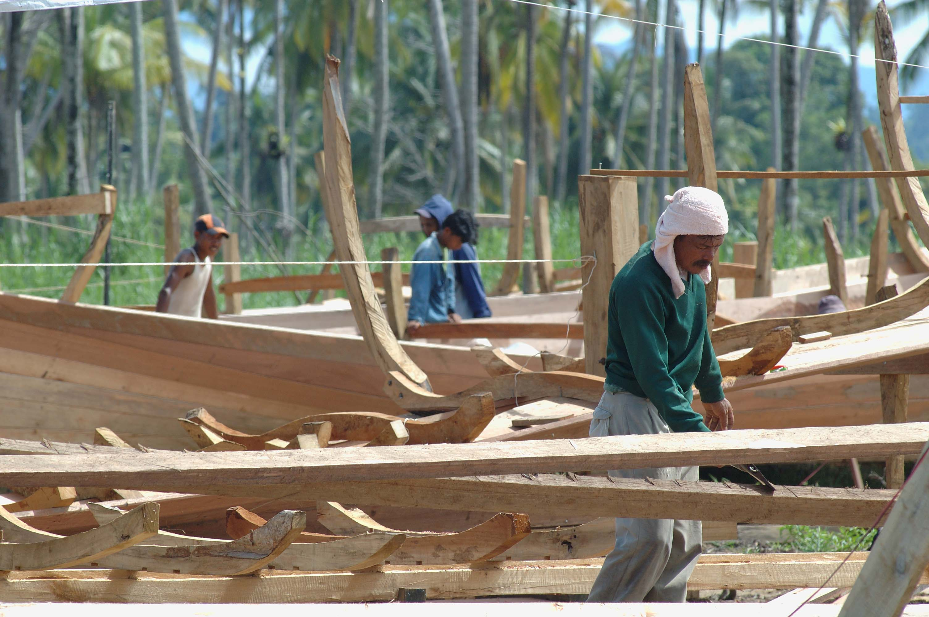
Rural employment and informality
“Most informal economy workers and entrepreneurs live in rural areas, often in extreme poverty and insecurity.
(ILO, Rural policy brief)
WHY ACTION IS NEEDED?
Additional resources:
ILO Rural policy brief, p. 1
https://www.ilo.org/wcmsp5/groups/public/---ed_emp/documents/publication/wcms_182737.pdf
Notes:
ILO, Rural policy brief, p.1.
Info from policy brief:
A comprehensive and integrated approach to moving out of informality is essential to address the multiple dimensions of social and economic exclusion that stifle the potential of rural inhabitants and their communities.
Informality and poverty overlap significantly, particularly in rural settings.
The last 60 years of development strategies have shown that growth does not reduce poverty unless associated with improved employment opportunities and conditions of employment, and the elimination of informality, especially in rural areas.
The problems of informality are exacerbated in rural areas due to weak socio-economic infrastructure, remoteness from national institutions and basic services, limited income opportunities and poor legal protection, all of which make rural economies more vulnerable to shocks and risks.
Gender dimensions in rural informality are strong and linked to persistent socio-cultural constraints that limit girls’ access to education and training compared to boys, resulting in fewer economic opportunities in adulthood, and creating multiple obstacles to the economic and social participation of women, to their becoming organized and acquiring bargaining power. All this makes it difficult for women to access the formal economy, and perpetuates inter-generational poverty.

Slide 4
What is TREE?
Training for Rural Economic Empowerment (TREE) is a methodology for promoting the economic empowerment of the rural poor.
TREE is a development approach that ensures poor women and men gain a resource they will never lose that is skills and knowledge that they can apply to improve their incomes and take a more active role in shaping their communities.
What does empowerment mean for you?
What type of skills and knowledge would poor women and men require in your country?
Food for thought
Notes:
Empowerment can be described as the process of building capacities to exercise control over one’s life.
TREE seeks to empower the rural poor by: helping them to increase their ability; providing them with additional skills and other support needed; providing communities with opportunities.
Food for thought (5 minutes): ask participants to reflect individually on the two questions:
identify 1 key word related to their understanding of empowerment. Write key word on post-it and paste on board.
On another post-it ask them to identify 1 concrete measure that could relate to skills and knowledge required to uplift poor women and men in each participants’ country.

Slide 5
What makes TREE different from conventional vocational training programmes?
it identifies potential income generating activities and assesses local economic opportunities before determining training needs
it involves the local community and social partners at all stages
it ensures post-training support for beneficiaries to initiate sustainable income-generating activities, including access to technologies; access to financial services; helping in the formation of groups, associations and cooperatives; among other business development interventions
designed to build on existing employment-creation programmes or targets
Focus
Skills training + Establishment of local enterprises + Community development
Notes:
The Training for Rural Economic Empowerment (TREE) is a programme developed by the Skills and Employability Department of the ILO and conceptualized under the principles of community-based training.
It promotes income generation and local development, emphasizing the role of skills and knowledge for creating new economic and employment opportunities for the poor, the underemployed, the unemployed, informal economy workers and the otherwise disadvantaged, towards sustained economic activities. There are diverse groups within the population who can benefit and these include women and men with HIV/AIDS, with disabilities, those coming from ethnic minorities and others.
*****
Underemployed includes persons who even though they worked or had a job during the reference week, they were willing and available to work better or more adequately.
Unemployed covers people who are: out of work, want a job, have actively sought work in the previous four weeks and are available to start work within the next fortnight; or out of work and have accepted a job that they are waiting to start in the next fortnight.
Disadvantage refers not just to economic factors, such as income poverty, or lack of experience in and poor understanding of the formal job market, but also social factors such as gender, racial, ethnic or migrant back-ground, and geographical isolation with poor access to quality education and job opportunities.
The TREE methodology consists of a set of processes, which are distinct but coherently linked, to guide the articulation of local development initiatives and the identification and implementation of income generation opportunities.
These processes aim to systematically identify employment and income-generating opportunities at the community/local level; design and deliver appropriate training programmes; and provide the necessary post-training support

Slide 6
Empowerment through a multi-level approach
TREE is a methodology for promoting the economic empowerment of the rural poor by addressing ideally three levels of intervention.
MICRO
LEVEL
Identification of employment and income-generating opportunities
Macro
Meso
Micro
Design and delivery of appropriate training programmes and provision of post-training support
MACRO
LEVEL
MESO
LEVEL
Promoting a wider enabling environment is required for community-based development initiatives
Knowledge buzz
Can you associate each level of intervention with the appropriate action?
Notes:
In Madagascar, examples of interventions at the three levels:
Macro: A wider enabling environment is required for community-based development initiatives (ex: working with the Vakinankaratra authority to avoid overlap of ILO project with MCA project in Antsirabe, Madagascar)
MCA or Millenium Challenge Account was an American programme which operated in the same region as the ILO project
Meso: Design and delivery of appropriate training programmes through training centres or other training providers (ex: training organization at the training center as CFITC, or in enterprise at Cottonline in Antsirabe, Madagascar)
Micro: Identification of employment and income-generating opportunities (ex: survey concerning training opportunities and employment in the sub-prefectures of Yaloke and Boda, Centrafrica)

Slide 7
TREE processes and mainstreamed elements
The methodology consists of a set of processes that guide the identification and implementation of income-generation opportunities and their articulation to local development initiatives.
Processes are inter-dependent but do not need to be applied in a too linear manner.
PROCESS 1. Institutional organization and planning
PROCESS 2. Identification of economic opportunities and training needs assessment
PROCESS 3.
Training design, organization and delivery
PROCESS 4. Post-training support for microenterprise development and wage employment
PROCESS 5. Monitoring, evaluation and documentation
GENDER – GREEN TRANSITION
DISABLED PERSONS AND OTHER SOCIALLY EXCLUDED GROUPS
LOCAL ECONOMIC DEVELOPMENT
Notes:
For example, in Central Africa, they started with process 2, then a part of process 3. And now they are undertaking process 1. Ask Christine and François for background info on Central Africa. → in Central Africa, TREE programme starts with TREE Training of Trainers from institutions. Those institutions with the trainers become partners of the TREE programme
Governance, processes, activities and tools
Process 1- Institutional organization and planning:
Define the target groups and geographical area based on transparent criteria
Establish national and local governance systems
Develop the capacity of organizations to truly participate, direct and take on responsibility
Process 2- Community assessment and planning, identification of economic oppotunities, tranining needs assessment
Assess the current and potential prospects for employment and income generation, through jobs and self employment.
Identify corresponding training and post-training needs.
TOOLS
community profile survey;
consumer demand survey;
market opportunities survey
suggested terms of reference for consumer demand survey, market opportunity surveys and feasibility study;
feasibility study form and examples;
training needs assessment form;
training needs assessment form for people with disabilities;
training proposal form.
Process 3- Plan, design and deliver training
Training is tailor-made to meet the needs of men and women who want to pursue income generating activities or wage employment, and is delivered where and how it meets trainees’ needs.
Training plans include specific vocational skills and other skills such as literacy, basic money management, assertiveness; curricula, hands on practice; materials and equipment.
TOOLS
training guide for courses;
training course form;
terms of reference for training instructors and basic instruction techniques;
trainer’s guide on how to prepare skills training syllabus;
sample form for skills-training;
registration form for skills training beneficiary;
training progress report;
end of training report;
graduation report.
Process 4- Provide post-training support to help securing sustainability of economic activities
The programme includes elements required to bridge into successful outcomes:
Job search and placement where salaried employment is the goal,
Links to credit and marketing assistance and other support services for self employment,
Formation of groups for ongoing mutual support.
TOOLS
example of plan for post-training support;
potential sources of credit for micro-enterprises;
assessing the capacity of a micro-finance institution;
credit guarantee funds;
post-training monitoring and visit forms for microenterprises
(start-up, production, marketing, finance);
modalities of group operations;
TOR for savings and credit groups.
Process 5- Monitoring, evaluation and documentation
programme performance monitoring plan;
programme performance evaluation plan;
monitoring how gender and disability have been mainstreamed;
monitoring training delivery;
monitoring graduates after training;
monitoring and assessing micro-enterprise creation projects;
monitoring groups and associations;
documenting the experience.
TOOLS
performance data table;
programme performance monitoring plan (form and sample);
training programmes monitoring;
how to conduct tracer studies
tracer study report form;
assessment instrument for self-employment and small business enterprise projects;
how to assess corporate community groups.

Slide 8
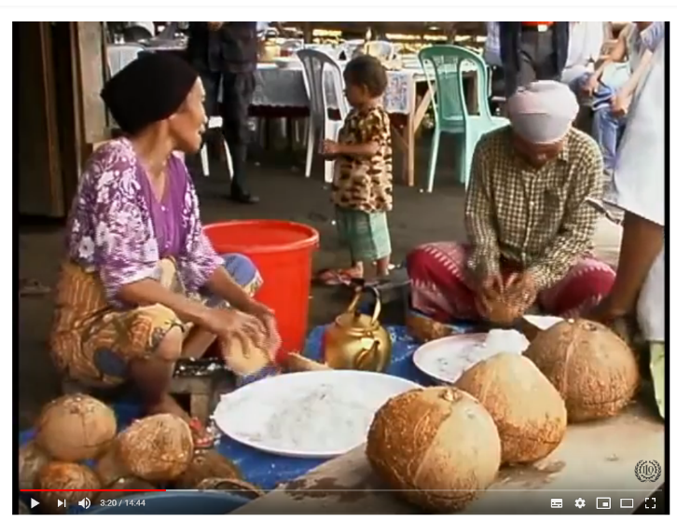
Institutionalization of TREE in the Philippines
Applicability of TREE in the Mindanao region
Comprehensive approach to employment or self-employment and rural economic development
From training tool to strategy for rural or local economic development
Continuous utilization of TREE tools and methodology by training providers in the region:
TESDA-ARMM
Other vocational training providers
Breaking Through Poverty: The TREE Project in the Philippines
https://www.youtube.com/watch?v=QRcUA_kGISQ
Notes:
Could watch from minute 10:34
Two-pronged approach in community-based training via TREE in the Philippines beneficiary areas:
Delivering training to rural communities with scarce or no formal qualifications and limited access to formal vocational training + post-crisis strategy
Current legal impediment: Government line agencies (e.g. TESDA, DTI, DepED)) are not mandated and equipped with skills to pursue integrated project implementation of TREE. In fact, the successful end users of the comprehensive TREE methodology are not the government partner agencies but the private NGOs/Foundations that were organized and trained in the Projects.
TESDA-ARMM – The Technical Education and Skills Development Authority in the Autonomous Region in Muslim Mindanao (TESDA-ARMM) have continuously utilized the TREE tools and methodology. As a regional version of the Community-based Training for Enterprise Development (CBTED) program of TESDA-National, and in order to develop a local identity the regional office introduced the Skills Training for Employment in the Autonomous Region in Muslim Mindanao (STREAM).
Other vocational training providers – Meanwhile most if not all of TESDA-Registered vocational training institutions in the ARMM and nearby regions in Mindanao, totalling more than 300, are using tools and training packages developed under in the TREE-related projects and approved as training recommendations of the training authority.

Slide 9
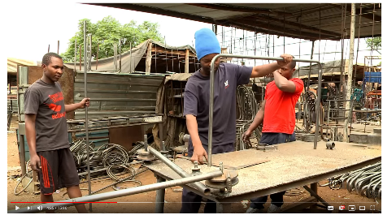
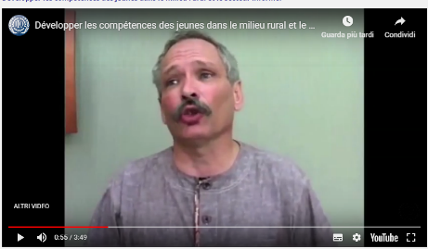
Some videos of TREE applications
The TREE of life: Skills for Youth Employment and Rural Development Programme
Breaking Through Poverty:
the TREE Project
in the Philippines
Développer les compétences des jeunes dans le milieu rural et le secteur informel
https://www.youtube.com/watch?v=I_3UAMtEGrM
https://www.youtube.com/watch?v=QRcUA_kGISQ
https://www.youtube.com/watch?time_continue=55&v=uuAPC9dPbh0
Notes:
French: https://www.youtube.com/watch?time_continue=55&v=uuAPC9dPbh0
Zimbabwe EN: https://www.youtube.com/watch?v=I_3UAMtEGrM
Philippines EN: https://www.youtube.com/watch?v=QRcUA_kGISQ
Mozambique PT: Meet women entrepreneurs from Cabo Delgado: https://www.youtube.com/watch?v=HbSCNGXljCs

Slide 10
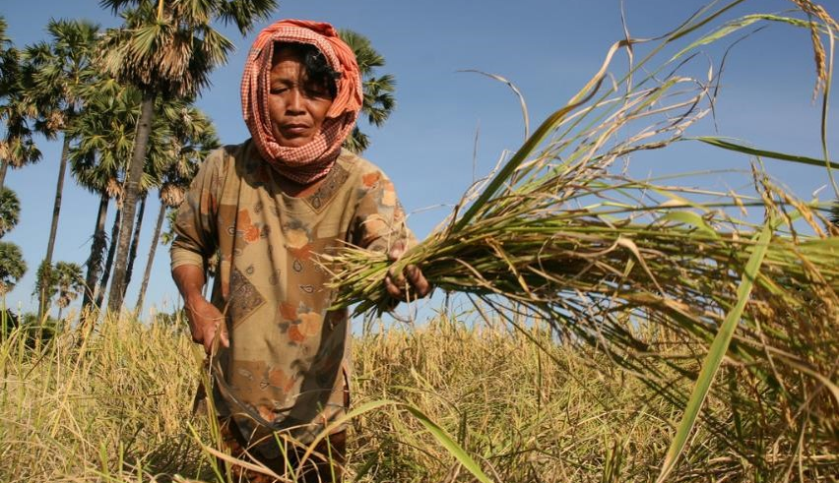
TREEpedia
The TREEpedia digital tool makes the TREE methodology more user-oriented, accessible and easier to share.
It includes a summary of the methodology (26 pages), 6 instructional videos and over 60 hands-on tools to support its implementation and any community-based rural development programmes.
Link

Slide 11
Structure of TREE methodology
Volume I
Volume II
Volume III
Volume IV
Volume V
Volume VI
Volume VIII
Volume VII
TREE consists of eight volumes in two parts:
Part 1 – Vol. I- VI
Part 2 – Vol. VII - VIII
Notes:
Volume I summarizes the different processes of TREE;
Volume II discusses details of institutional organization and
planning;
Volume III presents the systematic identification of potential economic opportunities and an assessment of training needs prior to designing any training programme;
Volume IV covers training design, organization and delivery;
Volume V discusses the needed post-training support to ensure that training carried out leads to employment;
Volume VI covers monitoring, evaluation and documentation.
Volume VII presents strategies to apply for a gender-responsive TREE;
Volume VIII is about including people with disabilities in the TREE programme.

