Slide 1
Rural Employment Promotion (REP) project
Khairul Islam
Project Manager, REP
Vientiane, Lao PDR
Advancing social justice, promoting decent work

Slide 2
Context
Jobless growth
Seasonality, informality and underemployment
Subsistence agriculture
Gender inequality
Migration
Covid 19 impact
Poorly functioning market systems

Slide 3
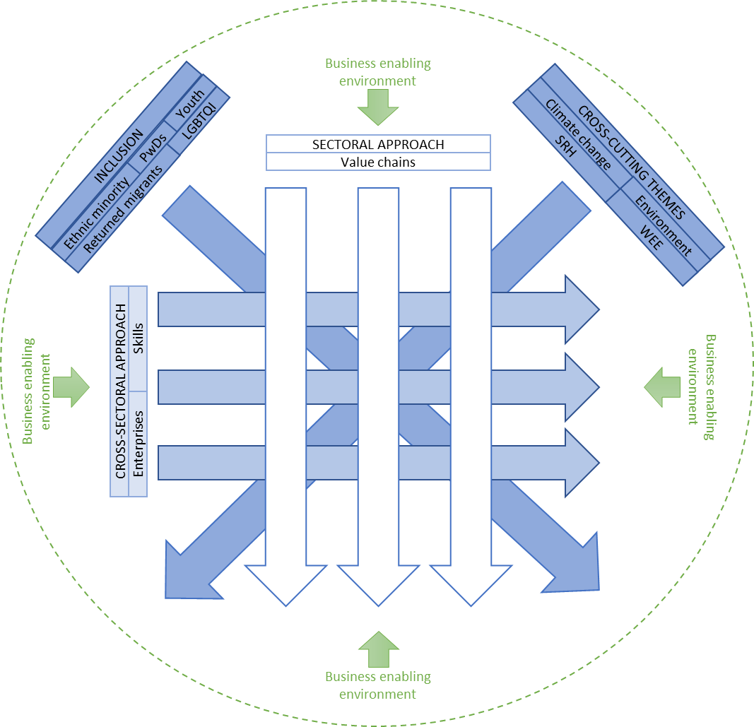
REP implementation strategy
TREE

Slide 4
Groundnut: The market system(s)
A case from Sri Lanka
The overall problem
Low supply with inferior quality from local production
Supporting functions
Information
Skills and capacities
Underlying causes to poor performance
Poor knowledge on production techniques and post-harvest management
Lack of access to quality seeds
lack of access to appropriate irrigation facilities
Poor access to finance
Lack of access to farm machineries
Lack of trust for large businesses from outside
R&D
Infrastructure
Finance
Informing and communicating
Technology
Input supply
Production
Collection
Processing
Distribution
Intervention
Improve farm productivity and product quality
Setting and enforcing rules
Regulations
Informal rules and norms
Standards
Laws
Rules and regulations
Intervention strategy: market led solutions
Develop/strengthen commercially viable solution provider to address underlying causes to poor performance
Value chain and market systems, adapted from Springfield Centre

Slide 5
Changes/impact
Farmers’ end
Improved access to technical advisory services
Improved access to better quality inputs
Improved access to market
Company’s end
Direct sourcing from farmer
Access to better quality groundnut
Loyal supplier-base
Sufficient volume to open a processing plant
41%
160%
514%
151%
105%
Yield
Acreage
Income
Farmers
Sourcing

