Slide 1
An introduction to skill needs assessments
Olga Strietska-Ilina, Area Lead ”Skills Strategies for Future Labour Markets”, ILO, Geneva
Jordi Prat Tuca, Regional Coordinator – Skills for Prosperity in Southeast Asia, ILO Regional Office for Asia and the Pacific

Slide 2







World is changing
Global drivers of change
Globalisation
and trade
Degitalisation
Which jobs?
Which tasks?
Which skills and qualifications?
Labour mobility
Work organization
COVID-19
Skills as
A buffer
An enabler
Notes:
War and conflict
Energy prices
Rising inflation

Slide 3
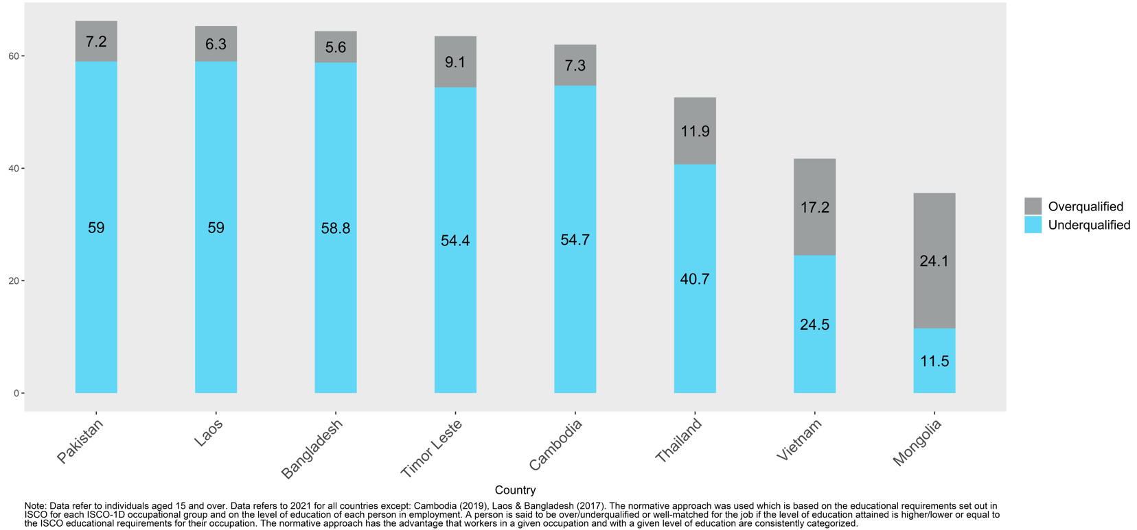
Over- and underqualification of workers in selected countries

Slide 4
Technology and innovation
Many estimates on susceptibility of jobs to automation
Some argue – potentially all;
Asia(ASEAN) - around 56% (ILO 2016);
Half in advanced economies (Frey, Osborne 2013);
More modest estimates – 14%-20% (CEDEFOP /OECD)
Automatable ≠ Will be automated
IoT, 3D printing,
Robotics
Job creation potential/learning opportunities
Automation is unlikely to destroy all occupations
Changes in the types and number of tasks in most occupations (changes within occupations, augmentation by techs)
Realization of job creation opportunities will depend on ensuring that workers can move to newly created jobs (transition by reskilling/upskilling)
Accelerating
Pace of
change
Digital Technologies
Unprecedented
AI, Machine learning
Notes:
Technology development and innovation has brought about disruptive changes in the way we work. At the same time, it has automated and simplified certain processes, shaping the future of work. Its impact is not restricted solely to high-tech industries but also in other areas such as services and customer care. It has brought about a greater demand for higher level skills and accelerated the rate of change of skills demand. New technologies related to industry 4.0 and digitalization are being embraced by many governments as key pillars of their countries future economic development. Numerous estimates have been produced on the susceptibility of jobs to automation with some being more dire as compared to others. Given the number of estimates available, this implies that predicting the exact number of jobs susceptible to automation is no easy task.
It is likely that automation will not destroy all occupations but rather, the underlying skills required, job task for similar jobs of today in the future would differ. Its important to realize that yes, jobs will be loss but at the same time, new jobs will be created as a result of technological changes as well as the shift towards a green and sustainable economy. The goal is to enable individuals to fill these roles through reskilling and upskilling, to work alongside machines so as to reap the benefits that technological change brings.

Slide 5
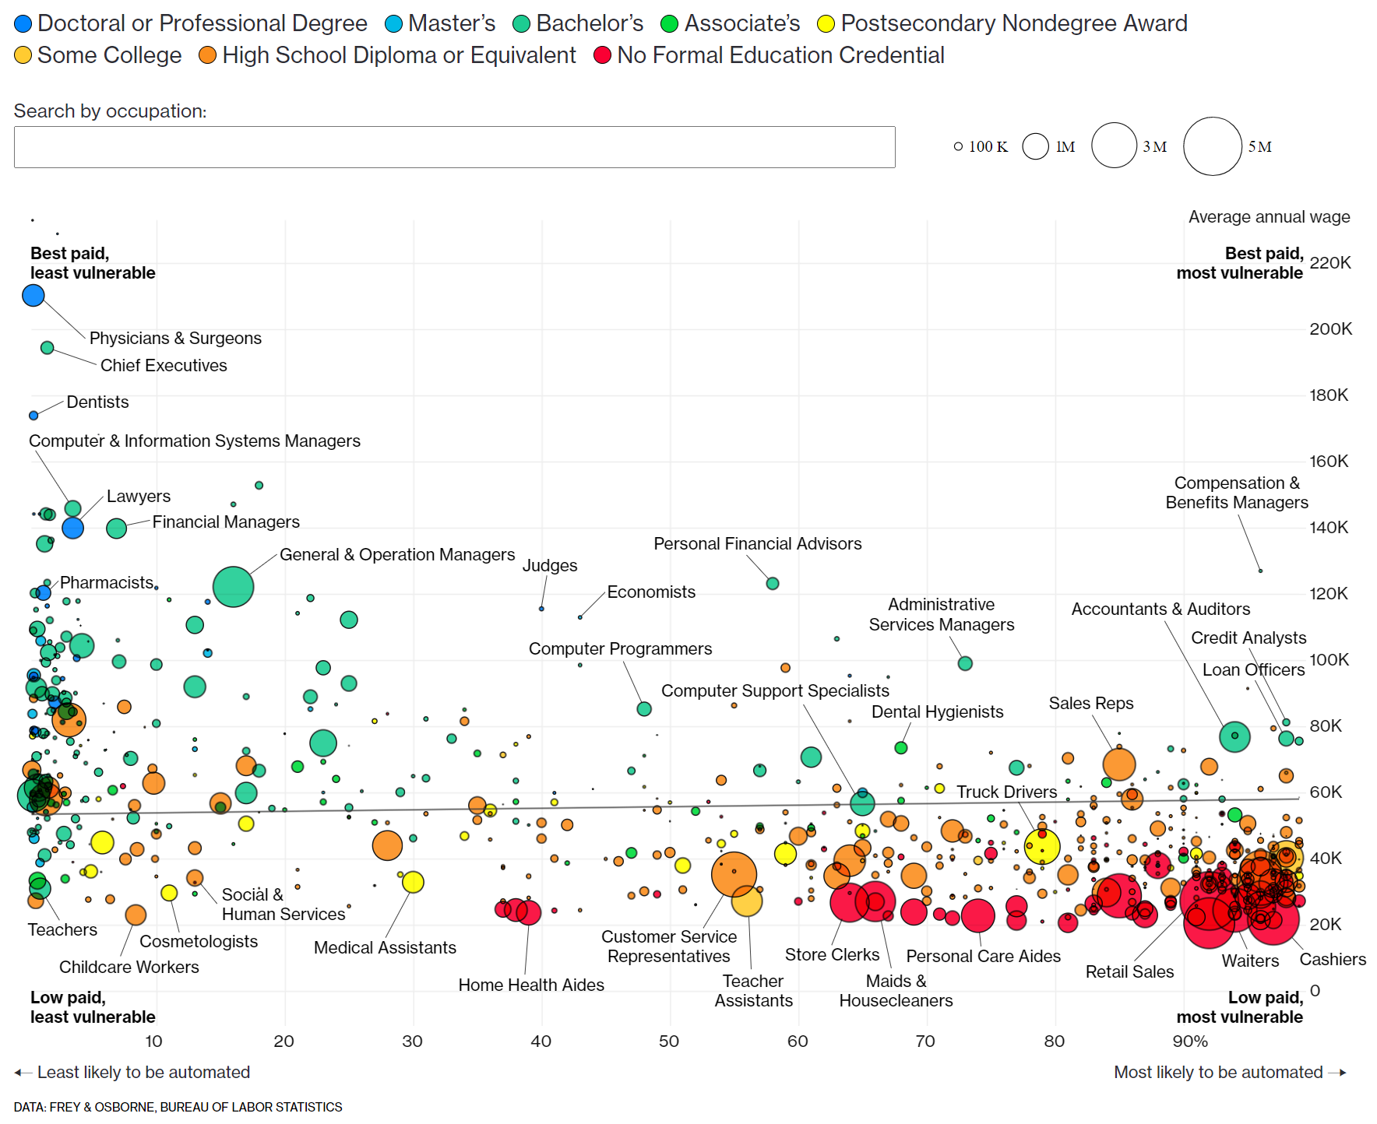
Technology and innovation:
Skills impact
Which skills will secure jobs?
    STEM skills at all levels
    ICT and coding skills
    Skills that help to adopt, operate and maintain technologies
    Skills that help to create a business case, market and manage technologies adoption
    Creativity
    Social skills (interaction, care)
    Non-automatable high-manual dexterity tasks
But is any job secure vis-à-vis AI?
The disruption dictates unpredictability
Notes:
As seen from the scatter plot on the right, occupations on the left of the plot are the least vulnerable to automation while for those on the right, the probability of automation is high. The color of the bubbles represent the modal education attainment of that occupation. It is observed that occupations that require higher level of educational qualifications (in this case, occupations that are green, light blue and dark blue – mostly clustered to the left), have a higher degree of specialized task and skills and are less routine have lesser probability of being automated. In contrast, occupations (on the right of the bubble plot) that require a lower level of educational qualifications such as waiters, drivers, sale representatives that are more routine, have a higher probability of being automated. A separate study by the Asian Development Bank in 2018 showed that the demand for jobs requiring non-routine cognitive task has grown faster than for routine and manual jobs (ADB 2018). It also finds trends in wages indicate that non-routine cognitive skills have an increased premium.

Slide 6
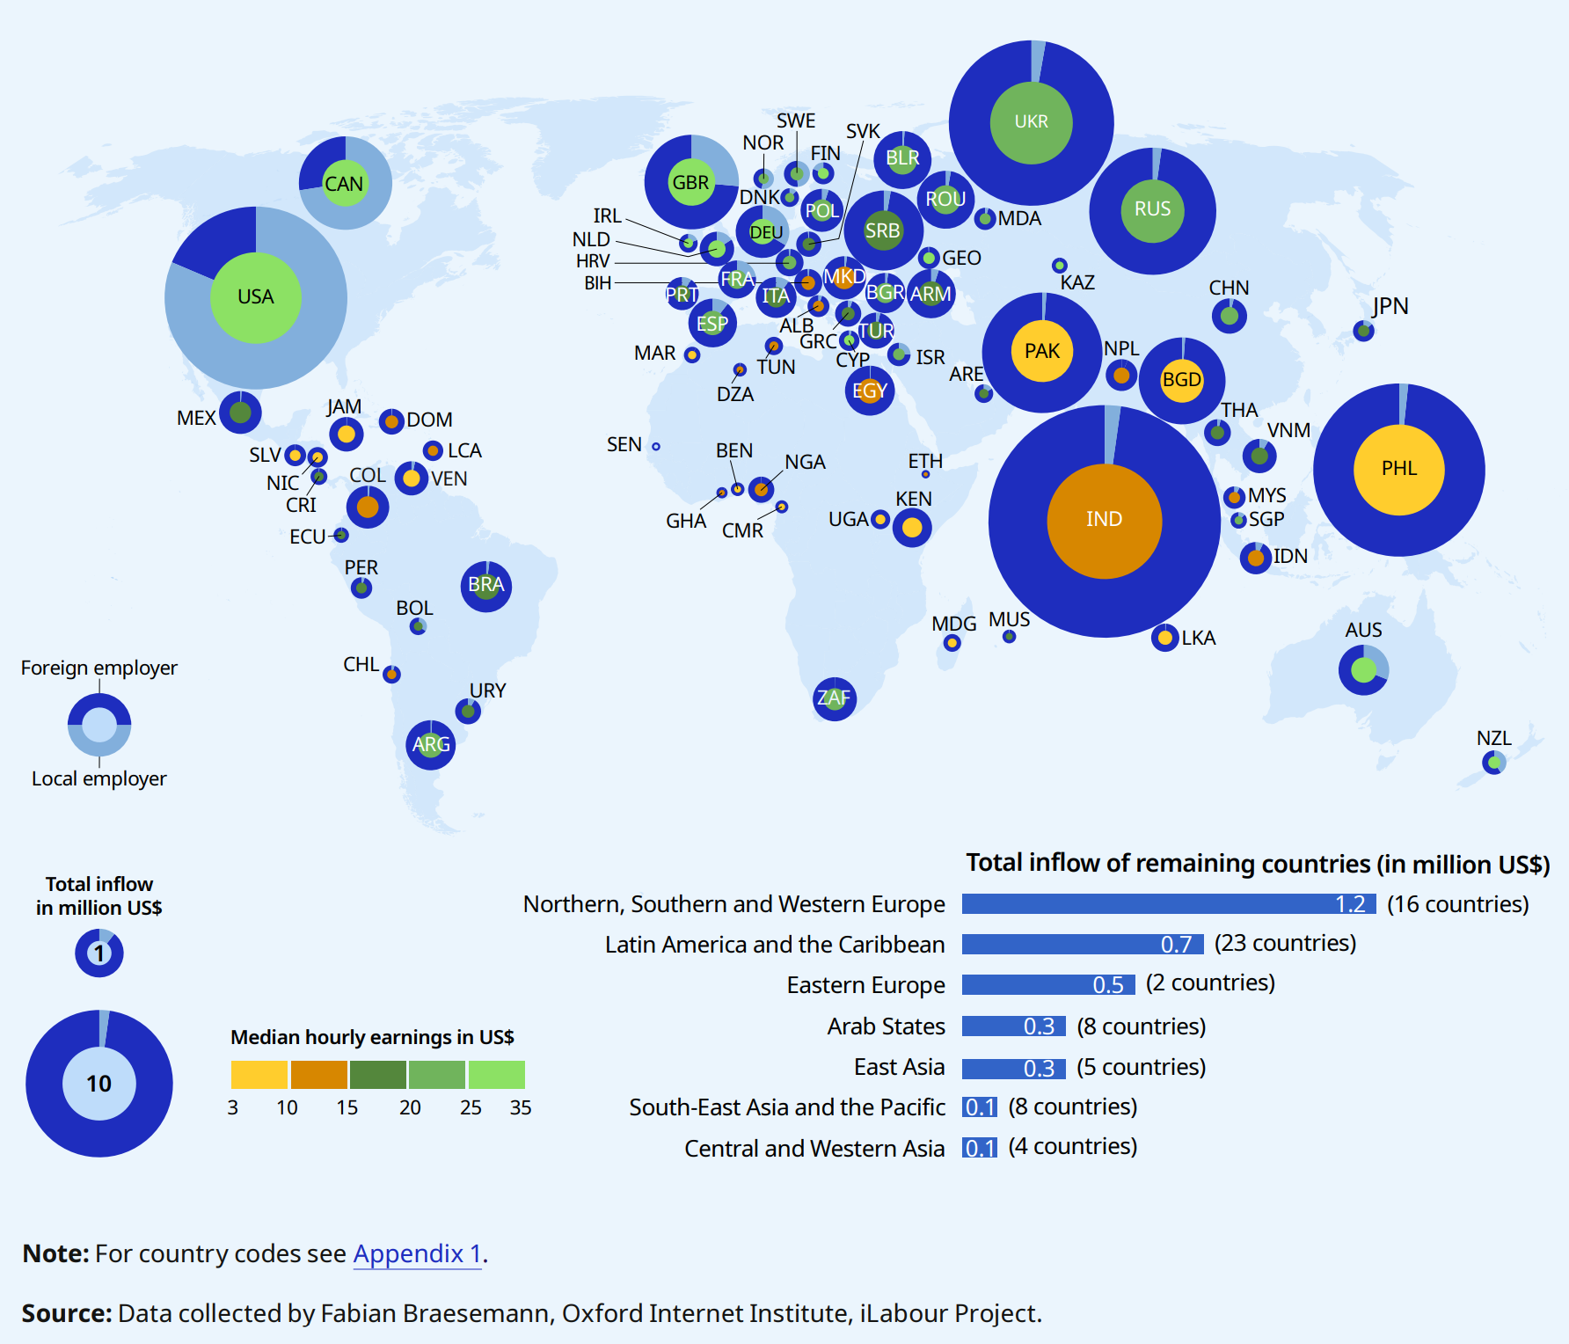
Digitalisation, work organisation and COVID-19
Outsourcing of task on a freelance platform
across countries,
inflow or work and earnings, 2019
Rise of the gig economy
Who is responsible for skills development?
Changes in organizational structures as businesses shift towards the future of work
Flatter organization structures
  Greater demand for individuals with interpersonal skills
Remote working arrangements
Rise in remote learning
New skills requirements
Source: WESO - ILO (2021)
Notes:
Accelerated by the COVID-19 pandemic, there has been a rise in digital platforms such as Uber, Lyft, and Deliveroo in various industries for example, transportation and the delivery of food – contributing to the rise of the gig economy due to its flexibility in working hours and place of work. These platforms serves as intermediaries between clients and workers. The rise in numbers could also be amplified by COVID-19 which lead to the retrenchment of workers previously employed in the accommodation and food services and aviation industry. A survey by Ernest and Young of contingent workers (a subset of gig workers) found that 2 in 3 workers belief that the benefits of contingent work outweigh the downside always or most of the time. With an increase in the number of individuals having some form of employment in the gig economy, this begs the question of who is responsible for skills development of these workers? From the survey, only 52% of contingent workers receive training from their employer. In the long run, this could hamper the skills development of the existing workforce, resulting in skills mismatches.
As seen from the map on the right, the size of the bubbles represent the total inflow in millions of US dollars. The pie chart for each country shows whether the demand for work comes from within the country or from abroad. It can be seen that the demand for work largely originates from Australia, Canada, Germany, New Zealand, the United Kingdom of Great Britain ,Northern Ireland and the US. A large proportion of this work is performed in developing countries particularly in India (US $26 million) which accounts for 20% of the total market. The color in the pie chart reflects the median hourly wages which is higher in developed countries. However, the geographical location where the tasks are completed is related not only to the price level but also to skill requirements, both technical, language, operating cost and the availability of IT infrastructure.
Next, workforce and businesses are shifting towards the future of work, e.g companies are introducing flatter organization structures resulting in a greater demand for skills such as teamwork, initiative, interpersonal communication skills and management skills. With the massive increase in remote work arrangements, employers have better access to a bigger pool of talents with diverse skills which open up more opportunities for job seekers or employees, facilitating a movement of skills around the world. For example, employers based outside the large cities can attract and source talents more easily and the workers may not necessarily have to live in major urban areas to get better jobs. It also has great potential to offer people with disabilities, women, young people and migrant workers flexible opportunities to participate in the labour market. On the downside, remote working reduces the opportunities of workers to engage in informal activities that takes place through in-person interactions with colleagues at the workplace.
Productivity and competitiveness challenges results in employers adapting new business practices. For instance, the adoption of participative management strategy or another similar term, industrial democracy refers to the concept where employees actively participate in an organization decision making process as opposed to. This results in changing hiring preferences of organizations.

Slide 7
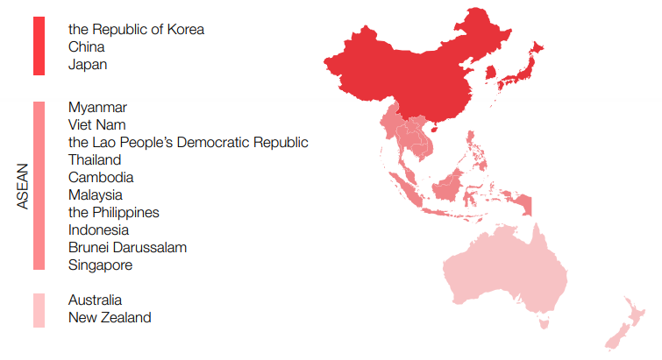
The Regional Comprehensive Economic Partnership (RCEP): a free trade agreement promoting economic integration among the 15 East Asian and Pacific nations
Entered into force on 1 January 2022
Source: UNCTAD 2021
Notes:
Many agreements – regional and sub-regional.
ASEAN, the Pacific Island Forum – PIF, South Asian Association for Regional Cooperation - SAARC, the Bay of Bengal Initiative for Multi-Sectoral Technical and Economic Cooperation - BIMSTEC, Indian Ocean Rim Association – IORA… Also external … EU-ASEAN Strategic Partnership
The trade noodles of Asia.

Slide 8
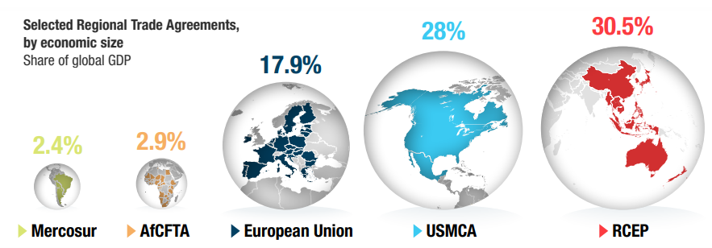
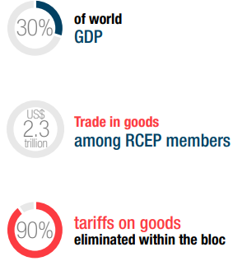
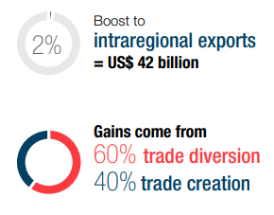
Source: UNCTAD 2021
Notes:
A key aspect of the RCEP is tariff concessions. The agreement is expected to ultimately eliminate tariffs on more than 90 per cent of goods traded within the bloc. In addition, it allows for significant discretion in the form of postponements. The implementation period is 20 years, it allows for exemptions for sensitive and strategic sectors, and some distinctions among members. The agreement goes beyond tariff concessions and encompasses other areas of cooperation to foster regional integration among its members. For instance, by setting up a time limit for the release of goods at customs, and by harmonizing rules of origins so as facilitate businesses to take advantage of the preferential terms of the agreement.
RCEP will further advance trade relationships among signatory members, especially for those not
previously regulated by any trade agreement. By enhancing market access conditions, largely by
reducing tariffs and implementing trade facilitation measures, RCEP countries are a step closer to
becoming a regional trading bloc. Additionally, its impact on international trade is expected to be
significant. The economic size of the emerging bloc and its trade dynamism will make it a centre of
gravity for global trade.

Slide 9
Globalization and trade: why skills?
Skills important for economic efficiency
Skills important for socially inclusive outcomes
Skills also important for smooth transition
Notes:
The availability of skills in an economy is important for 3 broad reasons – for economic efficiency, for a smooth transition and for socially inclusive outcomes. On economic efficiency, skills are required in order to obtain efficient outcomes from trade as its one of the principal enablers of economic growth. Skills also enable a smooth transition where the availability of skill development funding or opportunities allow firms to expand the variety and complexity of their export activities. Such opportunities also allow workers who lost their jobs to make a smooth and rapid transition to new jobs with equal and higher wages. Skills are also important for socially inclusive outcomes to ensure that no groups of workers are marginalised.

Slide 10
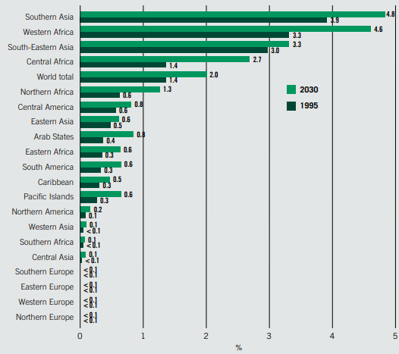
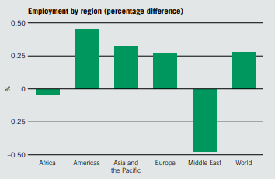
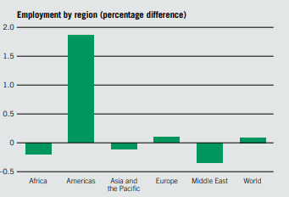
Climate Change
Working hours lost due to heat stress
Employment change by region, 2030 (%) - two scenarios
Transition to Renewable Energy
Transition to Circular Economy
Sources: ILO (2018) WESO
Notes:
Circular economy scenario
This scenario, summarized in figure 2.3, explores the employment impact of a sustained 5 per cent annual increase in recycling rates for plastics, glass, wood pulp, metals and minerals, replacing the direct extraction of the primary resources for these products. This scenario also models growth in the service economy, which, through rental and repair services, reduces ownership and replacement of goods at an annual rate of 1 per cent.15 Under the circular economy scenario, worldwide employment would grow by 0.1 per cent by 2030 in comparison with a business-as-usual scenario. This is equivalent to around 6 million more jobs in an economy that adopts certain tenets of the circular economy, such as recycling and the service economy. Employment growth is led by growth in services and waste m
These employment gains, driven for example by recycling services, offset employment losses in mining and manufacturing (where losses are expected to be around 50 and 60 million jobs, respectively). This is largely due to the replacement of the extraction of primary resources and the production of metals, plastics, glass and pulp by the recycling and reprocessing of secondary metals, plastics, glass and pulp. Table 2.4 shows the sectors most affected by the adoption of the circular economy. This sectoral reallocation leads to different effects in the various regions, with employment growth driven mostly by increases in Latin America and the Caribbean (over 10 million jobs) and Europe (around 0.5 million jobs). In contrast, net employment losses are expected in Asia and the Pacific (around 5 million jobs), Africa (around 1 million jobs) and the Middle East (around 200,000 jobs) if no action is taken to promote economic diversification. By benefiting jobs in services, and if the gender distribution across sectors remains similar, the circular economy will rise the female share of employment and highly skilled jobs. However, it will also result in a small increase in the numbers of own-account and contributing family workers, highlighting the importance of decent work policies to complement policies to promote the circular economy.anagement, with some 50 and 45 million jobs, respectively.

Slide 11
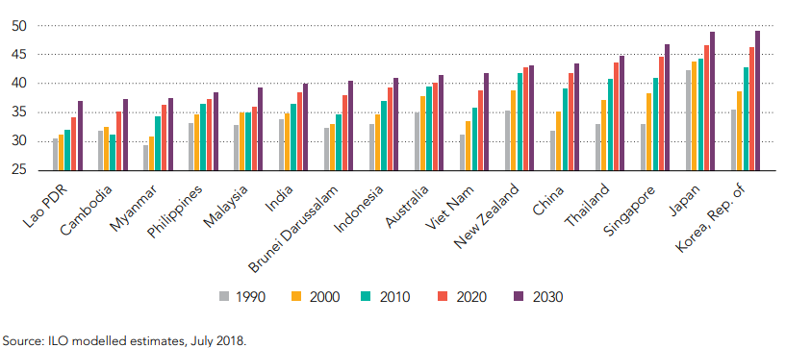
Median age of the labour force (years), 1990–2030

Slide 12
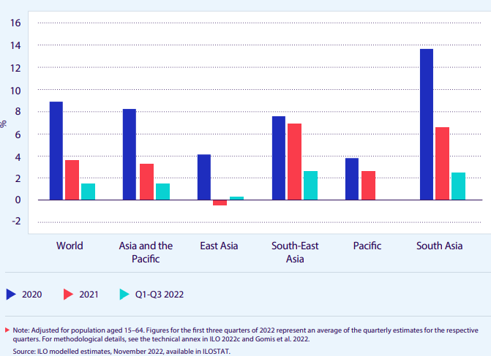
The COVID-19 caused unprecedented disruption on the labour market
Working hour losses relative to the 2019 fourth quarter level, A&P region, 2020–22 (%)
Skills development has a key role in
the immediate response to the economic crisis,
in getting people back to work as well as
in building resilience and implementing longer-term recovery strategies. COV
Globally
8.6% in 2020 =
245 mln jobs lost
Notes:
The labour market recovery in the region has been slow.
Closures of workplaces (partial, recommended, compulsory) were still affecting a large number of workers – end of 2022.

Slide 13
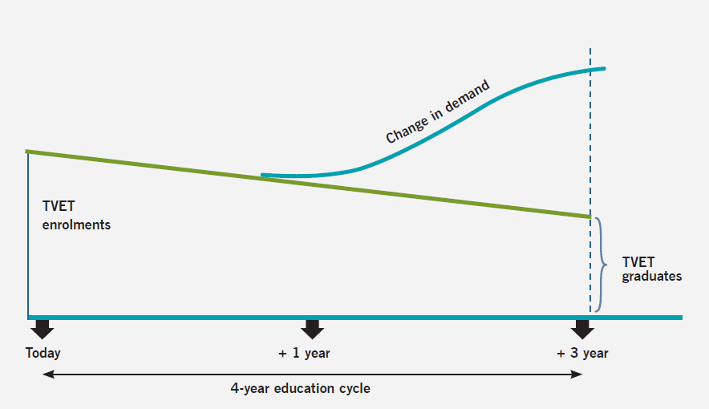
Changing demand for skills is faster than training delivery
TVET : Technical, Vocational Education and Training
Notes:
The horizontal axis represents the typical education timeframe of 4 years while the vertical axis represents the demand of graduates.
However, as the pace in the demand for skills is way faster than the delivery of education and training i.e the supply of available skills, this leads to a persistent gap as observed in the plot on the vertical axis.
This is mainly due to the time required to design, finalise content of training courses and have it implemented in training institutions due to the legal processes involved. The issue is further complicated by the relevancy of such skills after the candidate spends a great among of time within the education cycle. As such, this supports the development of a dynamic, accurate skill needs anticipation system to predict future skill needs to minimise the issue of skills mismatch and to inform the design of training and development systems.

Slide 14
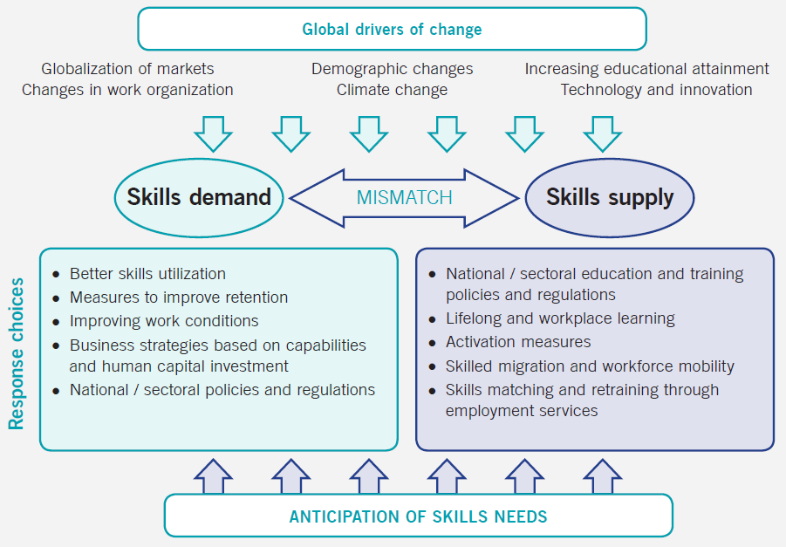
Notes:
The image here provides an overview of what we have been discussing so far with global drivers of change influencing both skills demand and skills supply, leading to skill mismatches which needs to be addressed through the anticipation of skills needs. Prolong skills mismatches has negative consequences for individuals, employers and more broadly, on the country. For individuals, should they take up a job less that what they are qualified for, perhaps with lower wages, this leads to low job satisfaction, loss of motivation resulting in lower productivity. For companies, there would be economic losses as additional resources would be required to retrain workers should there be high turnover, also, as a result of lower productivity, this would be harmful to competitiveness and could affect the quality of outputs. For the country, this would affect foreign investments, reducing a countries global competitiveness. There would also be public cost of unemployment benefits and contribute to lower tax revenues which would adversely affect spending on education and infrastructure, adversely affecting a countries regional competitiveness.
Skills mismatches could be either short-term or long-term qualitative. For the former, its temporary arising due to the existence of imperfect information (e.g not all workers find jobs matching their qualifications nor do firms find the perfect candidate). Long-term mismatches is more structural due to changes in qualifications or skills demand in jobs which are not or poorly reflected in the worker’s education and training. Some may ask, is a perfect match between skills demand and skills supply even possible? A certain level of mismatch will always exist. The focus is to minimise the problem and its consequences for the economy, society, enterprises and individuals through the anticipation of skills needs by influencing both skills demand and supply.
I’d like to highlight that while these general trends are likely to influence skills demand and supply all over the world, the extent and nature of change will be different in different country contexts, as local drivers of change also affect labour market outcomes. Coordination and implementation mechanisms should be adjusted and tailored to suit the specificity of each country’s institutional setting and skills challenges.

Slide 15
Skill needs assessment &
anticipation
Policy Cycle
Evaluation of training outcomes & their relevance to the labour market needs
Skills development policy & Curriculum design & Competency standards
Monitoring of training relevance
Skills development
(delivery)
Notes:
The policy cycle begins with the anticipation of skill needs involving discussions with individuals, businesses, training organizations and governments into what type of jobs and the accompanying skills are required for the labour market in future. Do note that the aim of skill needs anticipation is not to answer questions such as “How many welders trained to a certain level/with certain qualifications will be needed at this location and time?”. Instead, the goal is to provide information to all labour market actors about potential future skills needs and imbalances, so that they can make decisions, develop measures and take actions with a view to meeting the needs and avoiding the imbalances. It is focused on providing guidance, preparedness and flexibility, and supporting more effective operation of labour markets. The outcome would inform the design of competency standards and of training curricula followed by the delivery and monitoring of training relevance through employer/worker surveys or through labour market indicators. Finally, key stakeholders would come together to evaluate if the strategy is working and if any improvements could be made.
Given the constant and accelerating pace of change, skills development strategies will be obliged to ensure the continual renewal of skills over the life cycle. This will require focusing on ways to manage the different transitions that individuals will face (for example, moving from the informal to the formal economy or from the manufacturing to the services sector), so that they successfully enter the labour market, reskill and re-engage in employment throughout their careers. This life-cycle approach raises fundamental questions about the respective responsibilities of governments, workers and enterprises in making choices about when and how to reskill and retrain. Moreover, it requires a solid financing concept – and in particular a decision about the sources of the necessary funding. In this context, it is equally relevant to consider the appropriate mix of public and private investment in all phases of delivery.

Slide 16
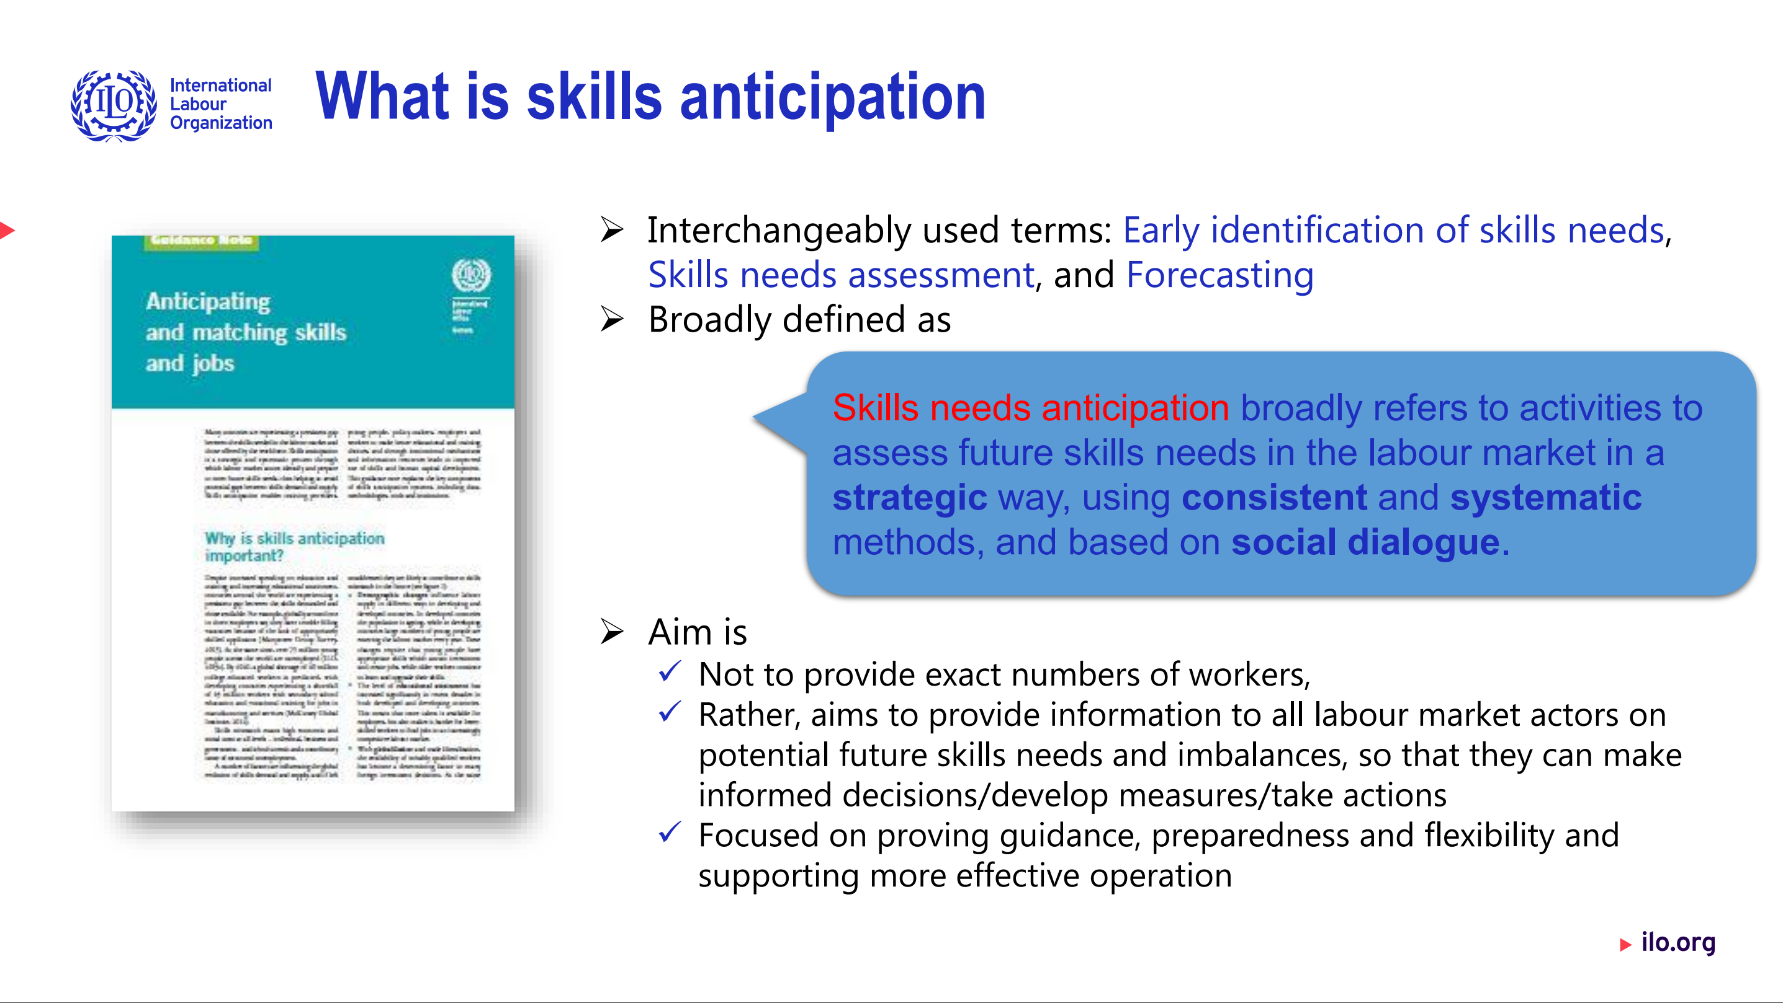
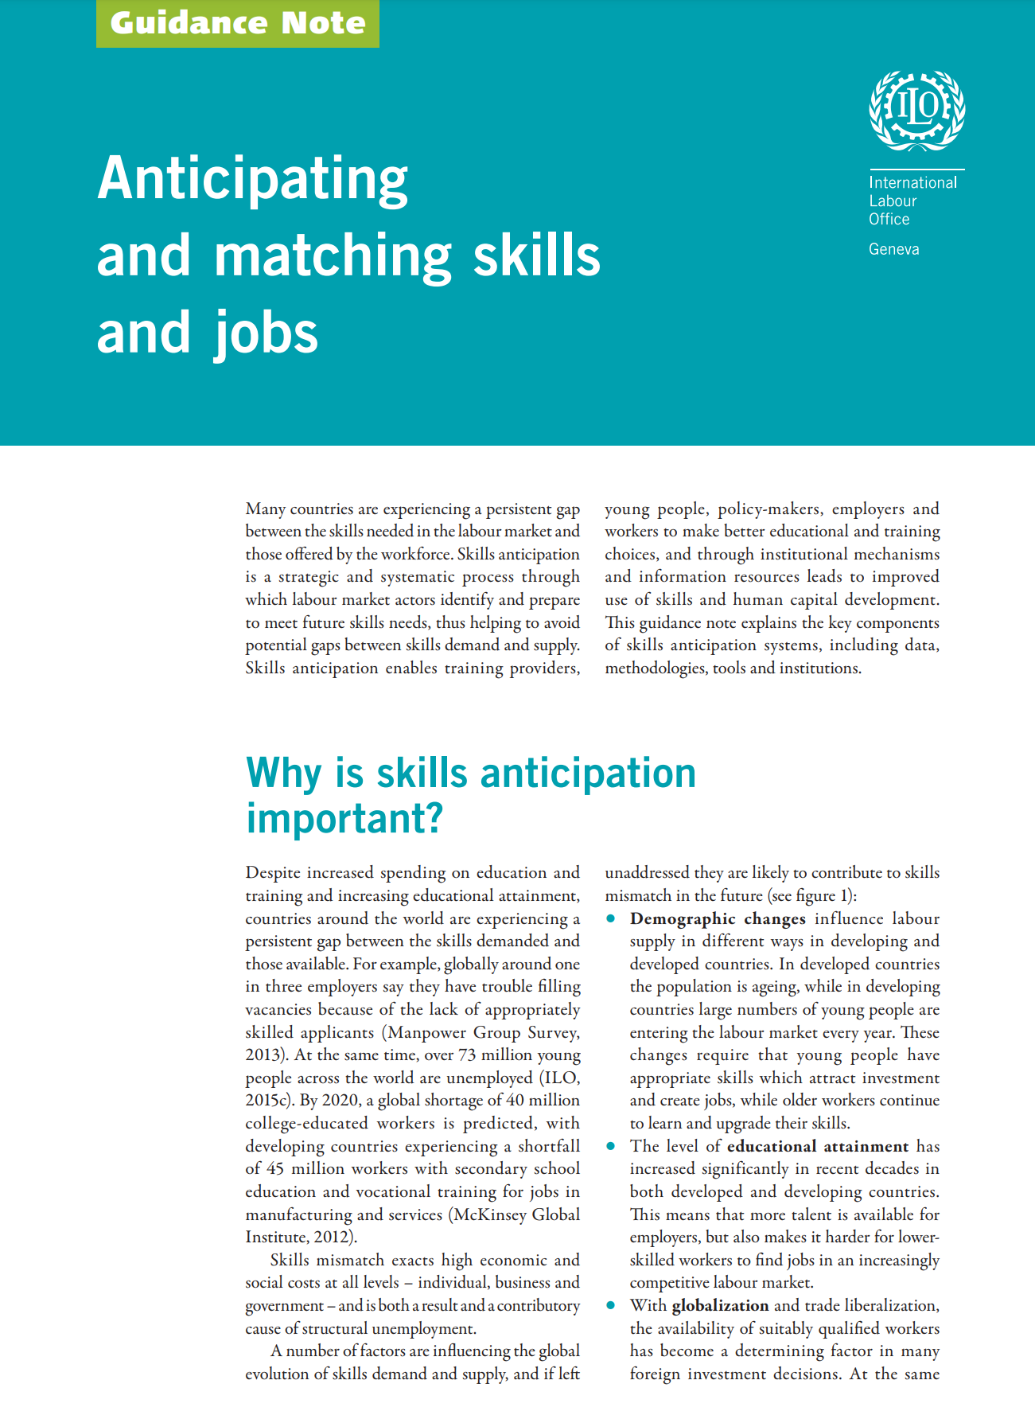


Slide 17
Labour market information system (LMIS)
Labour market information system (LMIS)
Skill needs
assessment
and anticipation
Institutions
(soc. Dialogue)
Any information concerning the size and composition of the labour market, the way it functions, its problems, opportunities and employment-related intentions of its actors.
Analytical capacity
Tools
Data

Slide 18
Examples of a project intervention on skill needs anticipation system and related LMIS

Slide 19

LMI for skills anticipation
Case studies from South-East Asia

Slide 20
Case study on Strengthening Labour Market Information Systems in ASEAN for Better Skills and Employment Policies

Slide 21

    ILO programme approach
    Improved knowledge and understanding on how to develop effective labour market information for skills anticipation and job creation.
    Evidence-based recommendations in selected thematic areas such as skills anticipation and matching with the objective to facilitate tripartite policy dialogue.
    Provision of relevant data on the impact of the COVID-19 crisis and automation on selected labour markets and in particular reskilling and upskilling needs of businesses and workers to improve skills development policies and provision.
    Technical guidance in the development of national action plans or strategies for improvement of the labour market information for skills anticipation and development of a common ASEAN vision.

Slide 22
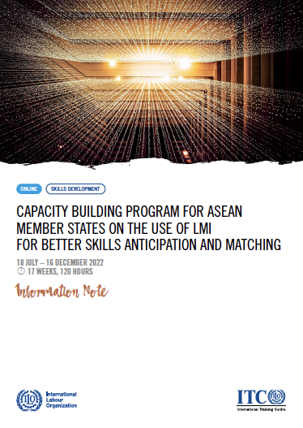
Capacity development and knowledge sharing series delivered by the ILO
    Target audience included stakeholders in ASEAN Members States involved in the production, processing, governance, use, and dissemination of LMI.
    Featured case studies and good practices, including from the region.
    Combined lectures by experts and practitioners, course work, and interaction through an engaging online learning platform.
    Engagement of participants is directed to the creation of linkages and exchanges between representatives of different countries, in view of also fostering South-South cooperation in the field of LMI for Skills development and TVET.

Slide 23
Learning outcomes
Participants improve their understanding of:
Intro to LMIS
Labour statistics, their main sources and uses
The main components and functions of an LMIS
Skills anticipation and matching
Drivers of change with regards to skills demand
Underlying principles and functioning of different approaches
Big Data for skills anticipation
Lessons learned and good practices
Big Data sources for skills identification
Challenges in using Big Data for labour market intelligence
Sectoral approaches
Sectoral methods and approaches to skills needs identification
Sectoral governance, the role of Sector Skills councils
Skills and workforce inclusion
Data and methods for inclusion
Policies for inclusion of informal actors, inclusion in TVET
LMI uses for skills policies
Institutional arrangements for the use of LMI in policy formulation, monitoring and evaluation
Specific service-oriented uses of LMI from a skills matching and anticipation perspective

Slide 24
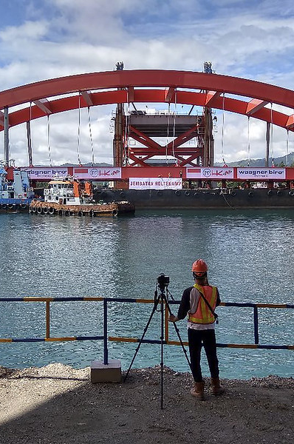
    Regional mapping of LMI for skills and employment policies in ASEAN
The overall objective is to produce a region-wide assessment of gap areas and good practices in terms of labour market information systems for skills anticipation in ASEAN Member States (AMS).
    At the level of each AMS: what are the gap areas in the collection, processing, use of LMI for skills anticipation? What good practices exist in the region for anticipating and matching skills?
    What regional and national level initiatives and programmes have been implemented in recent years or are underway?
    What priorities and strategies are needed to enhance institutional capacity to use LMI for skills anticipation at the national level within the region?

Slide 25
Regional mapping structure
    1. Governance, institutional arrangements and coordination mechanisms
    Mapping of institutions and institutional arrangements.
    2. Inputs and statistical infrastructure
    Data collection, compilation, processing and storage – data sources (LFS, other household surveys, establishment surveys, administrative records, tracer studies, employment skills surveys, Big Data, etc.).
    3. Analytical capacity and outputs
    Links analytical capacity or LMI analysis, including both quantitative (e.g., occupational or skills forecasts) and qualitative outputs (e.g., labour market intelligence reports, skills foresight).
    4. Uses, functions and dissemination
    How are the system’s outputs used? What challenges do they help address? and by who/what actors and decision-makers?
    5. Policy options and recommendations
    Identification of priority areas and strategies to address capacity gaps.

Slide 26
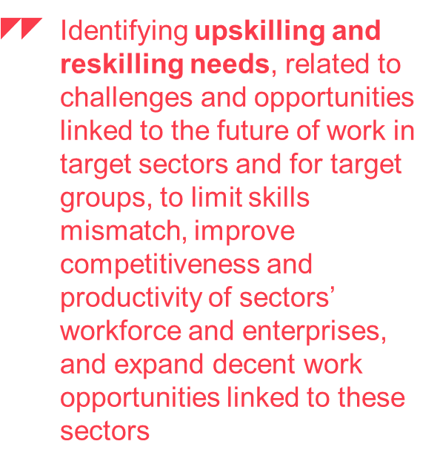
Rapid skills needs assessment as sectoral approach
1. Make businesses and individuals whose future depends on skills development present, visible, and active in policy formulation.
2. Produce rapid assessment in a credible and timely manner, with clear analysis priority areas for action and recommendations.
3. Mobilize follow-up action through education and training providers, Public Employment Services and other institutions, with support from key actors such as industry, qualification bodies, relevant ministries and development partners.
Advancing social justice, promoting decent work

Slide 27
How the ILO process looks like:
Literature review + initial data analysis
Sector selection report (draft)
Survey development and implementation (draft)
Data analysis from all sources and initial findings
Stakeholder consultations
Finalization of sector selection and survey questionnaires
Stakeholder consultations/ validation
Survey implementation
FGDs on initial findings
Final report and dissemination activities

Slide 28
Methods

Slide 29
Level of question | Type of question | Some key headline questions | Type of methodology
Jobs | Quantitative | How many direct jobs now and in the future? | Quantitative, Qualitative
 |  | How many indirect jobs now and in the future?
 |  | How many induced jobs now and in the future?
Occupations /skills | Qualitative | What occupations? How they should be defined? What are the boundaries between occupations? | Qualitative
 | Quantitative | How many people in each occupation? What is the resulting demand for skills? | Quantitative, Qualitative
 | Qualitative | What skills and competencies? How do these relate to occupations? | Qualitative
Education and training | Qualitative | What information sources of skills are available? What types of education and training are needed? How can they be provided? | Qualitative
 | Quantitative | What is the existing stock of people with the right skills? What is the current flow of newly trained people? What is the future demand for people with these skill sets? | Quantitative, Qualitative

Slide 30
Skills anticipation methods and their policy use
Quantitative models and Forecasts
Feed into major policy reforms with a long term impact (e.g. education, employment, economic development, demographic and social policies)
Can feed into long term policy development in various areas
Foresights, Delphi surveys & scenarios
Inform qualification standards’ development; skills development programmes; sector development strategies
Sectoral approach
Employers’ skills survey
Can be used in planning/designing short term training courses (qualification/requalification) and activation measures
Tracer studies
Big data and real-time data
Provide feedback for curriculum development, link education and work, inform potential students, career guidance
Can be used as real time statistics as an addition to «small» data or a qualitative survey
May inform training and competency standards design as well as policy

Slide 31
Is there an ideal approach? Pros and cons
Alternative approaches | Advantages | Disadvantages
National level (macro), quantitative, model-based projections | Comprehensive (typically all sectors); consistent; transparent; quantitative. | Data-hungry; costly; not everything can be quantified. May give a false impression of precision/certainty.
Skills surveys of employers | Direct user/customer involvement; easy to set-up and carry out. | May be very subjective; inconsistent; costly; can too easily focus on the margins rather than skill gaps within the current workforce; limited reliability of information on future
Tracer studies / graduate surveys | Ability to provide useful information for improving planning and programming relatively low cost, easy execution. | Demand for detailed information about sample groups, confined to workers’ early market experience and findings may be biased.
Big real-time data | Promising potential: real time – no time lag, low cost, resolves the problem of regularity of surveys, no need to «collect» data. | Data quality issue, data coverage, privacy, cleanliness.
Notes:
Use after Jigsaw if necessary – debriefing

Slide 32
Is there an ideal approach? Pros and cons
Alternative approaches | Advantages | Disadvantages
Scenarios and foresights | Strong on sectoral or other specifics; can be used when limited data available. Helps us to avoid unpleasant surprises, make better decisions today inspire, engage and enable shared action. | Risk of inconsistent across sectors, areas, etc.; can be constructed as the “official future”; people may not be able to suspend their disbelief. May suffer from cultural/cognitive myopia; cannot be validated.
Delphi-style methods | Holistic; applicable in situation with limited data availability. A possibility to avoid large group gatherings - virtual participation; handles single or multiple questions; brings together large number of experts and different opinions. | Time-consuming process; labour intensive; participant expertise may influence results.
Focus groups /round tables | Useful to improve and develop ideas; strong tools to validate preliminary results/ideas/tools/strategies. | Importance of moderator is often underestimated; opinions can be biased (group thinking effect); participants may be reluctant to share some opinions in a group.
Sectoral approaches | Sector is crucial to understand the key drivers of change Clear stakeholders - Easier to facilitate coordination among all relevant stakeholders and social dialogue Reduce complexity and scope of interventions | Partial, especially when it comes to quantitative modelling Engagement of SMEs,SMEs in rural and remote areas and coverage of informal and unorganised sector is a challenge
Notes:
Use after Jigsaw if necessary – debriefing

Slide 33
ILO’s sectoral approach:
Skills for Trade and Economic Diversification (STED)

Slide 34
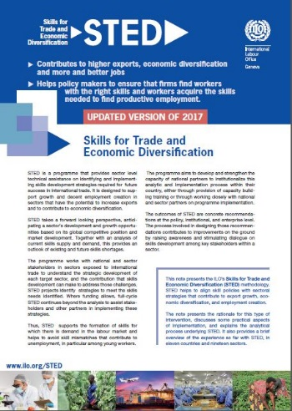

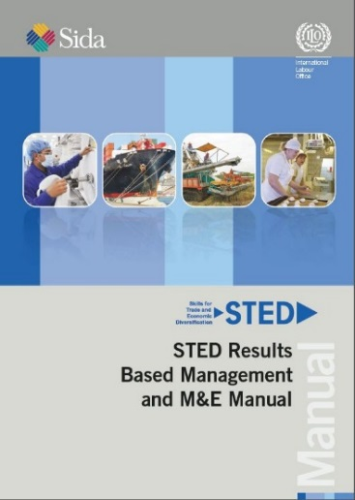

STED– Skills for Trade and Economic Diversification
STED – Skills for Trade and Economic Diversification
ILO’s sector-based methodology to provide strategic guidance on integrating skills development into policies to strengthen traded sectors
Combination of strategic analysis and social dialogue
Holistic and strategic focus on skills

Slide 35
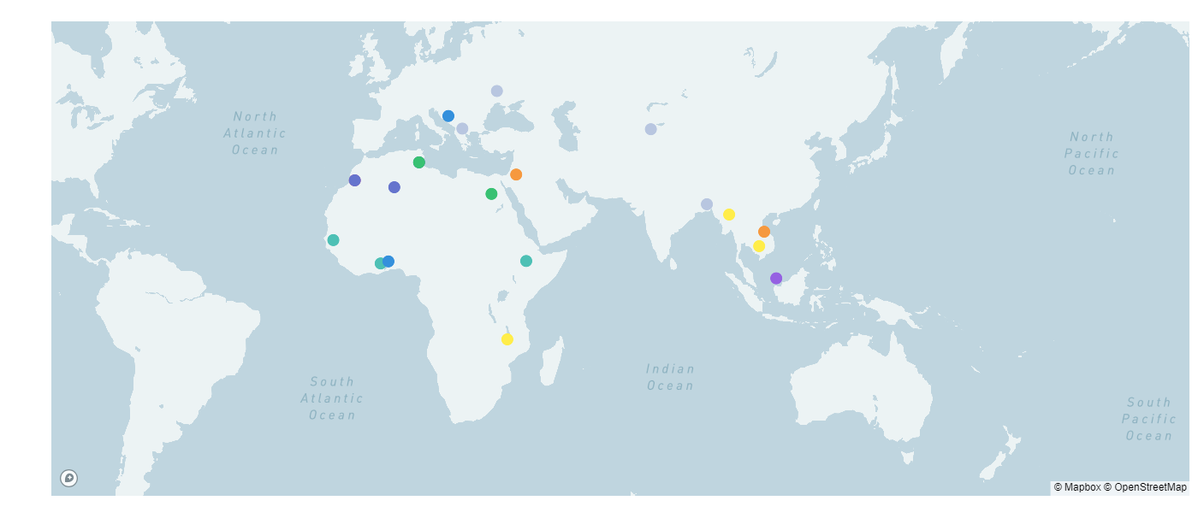
Locations of STED development cooperation
(24 countries, 50 sectors)
North Macedonia
- Tourism
- Food Processing
Bosnia & Herzegovina
- IT sector
Ukraine
- Metal Industry
- Tourism
Kyrgyzstan
- Garments
Tunisia
- Dates
- Technical plastics
- Metallurgy
- Food processing
Bangladesh
- Agro Processing
- Pharmaceuticals
Jordan
- Pharmaceuticals
Food processing
Chemicals & Cosmetics
Leather & Garments
Myanmar
- Tourism
- Vegetable & fruits
Algeria
Viet Nam
Tourism
Livestock (pigmeat)
Morocco
IT Offshoring
BCC sector
Automotive
Egypt
- Furniture
- Food Processing
Cambodia
- Food Processing
- Light Manufacturing
Senegal
Digital sector
Togo
Transport & Logistic
Ethiopia
Garments/textiles
Agro-processing
Malaysia
-Agro-Processing
-Construction
Ghana
Agriculture
Hospitality & Tourism
Construction
-ICT sectors
Malawi
- Oilseeds
Horticulture
Dairy
On-going SIFA project
Zimbabwe (Horticulture Sector)
Tanzania (Beef Sector)
Eswatini (Horticulture Sector)
Ghana (Garments and Textiles)
Indonesia
-Seafaring
-International Logistics
-Ship building
RBTC funded
Russia-funded
EU-funded
UK funded
KOICA-funded
Pilot countries
SIDA-funded
AFTIAS funded
Norway funded
Notes:
Since the launch of STED in 2010, we have worked in more than 20 countries in 40 sectors. Work could be conducted for 2 sectors in parallel per country. Existing work in Algeria, Morocco, Tunisia and Malaysia (Food processing and Construction Sector).

Slide 36

Skills Development for Trade, Employability and Inclusive Growth: The STED Approach - YouTube

Slide 37
Typical STED problem Analysis
Growing markets (e.g. ACFTA)
Domestic
Export markets- regional, global
Competition from other firms within country, region and from developed countries
In domestic markets
In export markets
Firms need to upgrade to
Maintain current position relative to competitors (domestic and foreign) who are upgrading
Add more value – higher quality, different products/services, progression along value chain, different customers/markets …
Range of bottlenecks, but skills typically a major contributor to these
Skills development system barriers
Addressing these issues for a sector can contribute to wider system reform, using mechanisms such as:
  Sector skills strategies,
  sector skills councils,
  skills anticipation systems,
  curriculum reform,
  funding reform,
  high quality apprenticeships …

Slide 38
What is Distinctive about STED?
Skills
(Anticipation, Implementation)
Need for collaboration is especially strong
•exposure to change
•potential for inclusiveness
Sector –effective level for
•analysing & anticipating skills needs
•taking actions on these
•similar skills needs
•similar occupations
•similar E&T providers
To great extent
•similar technologies
•Similar forms of WO
Trade,
Industrial
Strategy
STED
Sectoral
Approach
Stakeholder /
Tripartite
Approach
It combines a sectoral approach to skills with trade & industrial perspective, and social dialogue

Slide 39
STED Development Logic
STED Exercise
Multi-stakeholder, public-private governance of STED process
Sector selection
Sector skills diagnosis and strategy
Mobilization of implementation
Developing the right skills
Strengthens Business Capabilities of Target Sectors
Greater Productivity & Market Competitiveness
More Sales in Traded Markets
More Employment in Decent Jobs
Indirect Objective
Scaling, institutionalizing and maturing skills governance through:
Public-private institutional arrangements for skills governance (such as Sector Skills Councils and National Skills Council, along with inter-ministerial collaboration)
Technical capacity in skills analysis and anticipation (such as national skills anticipation technical unit)
Practical collaboration between employers and providers of education and training (curriculum, work-based learning, teaching skills, workplace learning …)
Tradable sectors also entry-point to domestically-traded sectors, raising productivity, increasing employment formality, facilitating structural change

Slide 40

STED Key Partners
Key stakeholders
Government (Cross-Ministerial)
Employers
Workers
Education and training providers
Other sectoral stakeholders
Development partners and Donors
In food value chains, for example, includes
food safety regulators, food export promotion
agencies, agricultural research centres, aggregators,
advice services, university researchers …

Slide 41
STED Approach
1. STED Start-up Phase
Sector prioritization and selection
2. STED Diagnostic Phase
Sector skills strategy
3. STED Implementation Phase
Support for recommendations
Practical implementation under STED initiative
Identified skills needs
National and sectoral context
Address some of priority skills needs identified
Ownership by partners
Strategic analysis
Social dialogue & engagement
4. Project governance, Capacity building and Institutionalization

Slide 42




Full- STED: Analytic and Implementation process
STED Start up
STED Diagnostic phase
STED Implementation phase
Desk Research
Output document(s):
Report(s) on desk research
Analysis and
Synthesis
Output document(s):
Report(s) on STED analysis
Initial Education / Training (including Workplace-based)
Provision of Continuing Education / Training
Competency frameworks Curriculum development Course development Course piloting
Capacity development: Ed/Training Provider Employers Institutions
Planning, skills anticipation and Labour Market Information
System reform
Choosing
Sectors
Output document:
Note on sector selection
Survey of Employers
Output document(s):
Report(s) on sector survey
Conclusions,
Recommendations and Validation
Output document(s):
Finished STED report(s)
Consultation and capacity development with national constituents – government, employers, workers
Skills Supply Study
Output document(s):
Report(s) on supply study
STED Technical and Policy Workshop
Output document(s):
Report on Workshop
Interviews with
Experts & Partners
Output document(s):
Report(s) on interviews
Consultation and capacity development with sector stakeholders
(employers, workers, government, education and training providers etc.)
through steering committees and/or stakeholder workshops

Slide 43
Rapid STED: Analytic and Implementation process
STED Start up
STED Diagnostic phase
STED Implementation phase
Initial Education / Training (including Workplace-based)
Provision of Continuing Education / Training
Competency frameworks Curriculum development Course development Course piloting
Capacity development: Ed/Training Provider Employers Institutions
Planning, skills anticipation and Labour Market Information
System reform
Choosing
Sectors
Output document:
Note on sector selection
Desk Research and initial consultations
Output document(s):
Skills for Trade and Economic Diversification background paper
Companion document for strategic skills recommendations / Sector Skills Strategy
Consultations, filling information gaps and validation
Output document (s):
Sector Strategic Skills Recommendations /
Sector Skills Strategy
Document
(Concise document setting out diagnosis and strategic skills recommendations for the sector)
STED Rapid Technical and Policy Workshop
Output document(s):
Initial outline draft of diagnosis and strategic skills recommenda-tions for the sector
Final validation of Sector Strategic Skills Recommendations / Sector Skills Strategy Document
Consultation and capacity development with national constituents – government, employers, workers
Consultation and capacity development with sector stakeholders
(employers, workers, government, education and training providers etc.)
through steering committees and/or stakeholder workshops

Slide 44
STED Analytic/
Diagnostic Framework
Stage 0: Choice of sectors
Sector
Selection
Sector
Characterisation
Business
Environment
Stage 1: Sector position and outlook
Envisioning the Future
Stage 2: Business capability implications
Stage 4: How many workers by skill type?
Gap in Business Capabilities Required to Achieve Objectives
Stage 3: What type of skills?
Implications for Types of
Skills Needed
Modelling Employment and Skills Demand
Stage 5: Skills supply gap
Skills
Supply
Gap between Skills Supply and Types of Skills Needed
Gap between Skills Supply and Numbers Needed
Stage 6: Proposed responses
Proposed Response to
Future Skills Needs

Slide 45
STED case studies
Indonesia and Malaysia

Slide 46

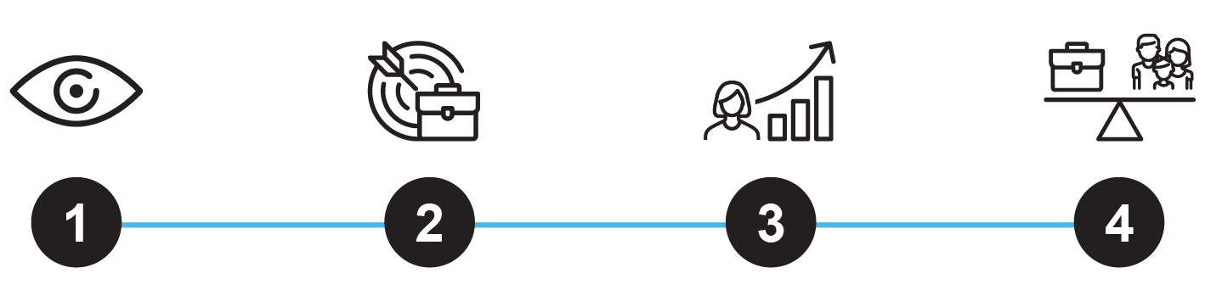


Skills development & TVET system - Today’s challenges in Indonesia and Malaysia
Governance and coordination
Complex institutional arrangements and weak inter-ministerial coordination
Industry engagement
Limited participation of employers in the design and delivery of skills development
Quality
Low teachers’ capacities and outdated standards, qualifications, and curricula
Financing
Inadequate funding and financial incentives for training providers, individuals, and enterprises
Access and participation
Barriers remain to access, participation, and transition of vulnerable groups

Slide 47




ILO Skills for Prosperity programme approach in Indonesia and Malaysia
Equity &
Social Inclusion
2. Quality
3. Relevance
4. Financing
Increase access and participation of disadvantage groups to training, labour market and entrepreneurship opportunities
Improve quality of skills and TVET systems by strengthening qualifications, teachers’ capacity and curricula development
Increase relevance of skills and TVET systems through industry-led skills development approaches
Improve financing mechanisms through public and private collaboration and greater employers participation

Slide 48
Policy and national context
Indonesia
Malaysia
    Legislation
    Presidential Decree 68, 2022 on the National Strategy for Revitalization of TVET.
    Regulation 5/2022 on formation of National TVET Coordination team.
    Presidential Decree 16, 2022 on Indonesian Maritime Policy, accelerating the implementation of the World Maritime Axis Vision
    Legislation
    National TVET Masterplan towards a Develop Nation and 12th Malaysia Plan (2021-2025)
    TVET 4.0 Framework 2018-2025 and Strategic Plan for Polytechnic and Community College 2018-2025
    Establishment of a Government-Industry TVET Coordination Body (GITC)
To what extent are the skills systems aligned to realize the vision of Indonesia and Malaysia becoming a prosperous, inclusive and sustainable economy?
Are skills mismatches that are holding back growth in key economic sectors identified?
How can the policy framework support improved human development capacity in key economic sectors?

Slide 49
STED – Implementation process followed
Sectoral situational analysis
STED
workshop
Sectoral skills strategy
Development of an integrated and shared vision for the sector:
    Future market drivers
    Current and future skills needs
    Role of education and training institutions

Slide 50
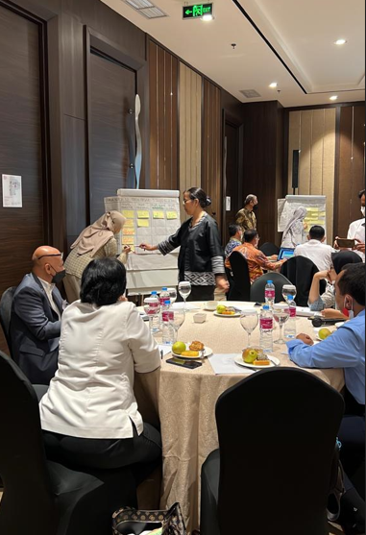
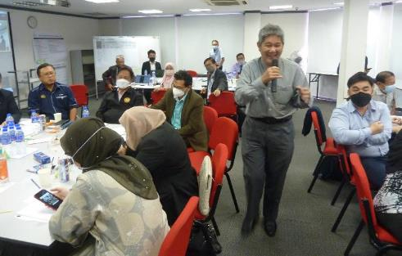
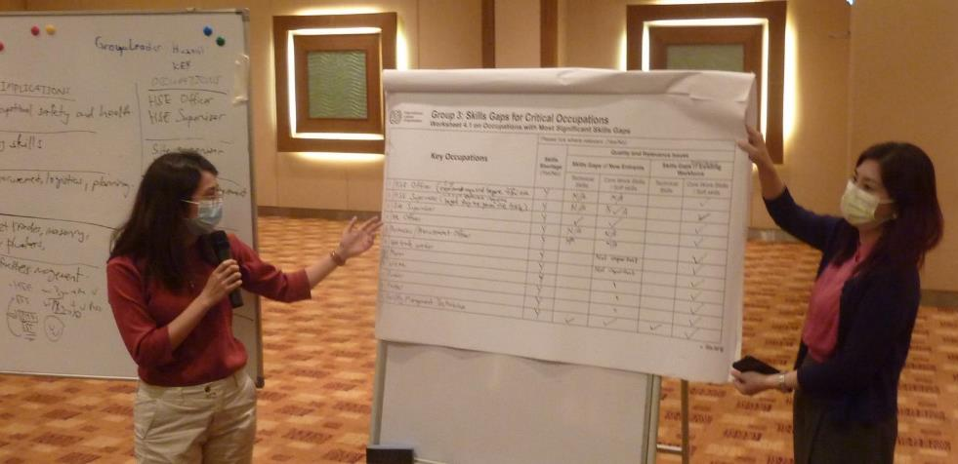
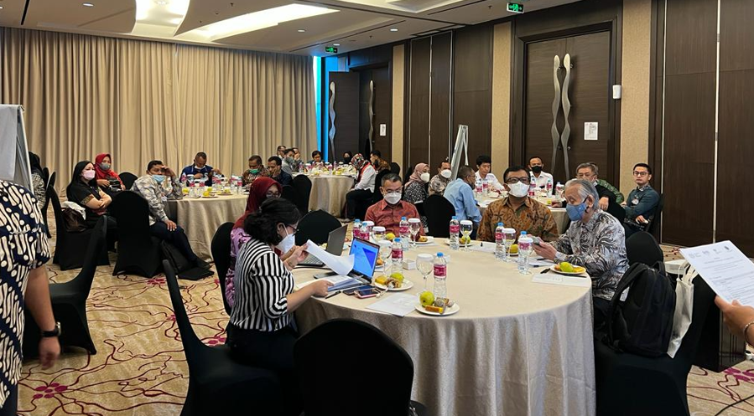
Industry Skills Foresight for construction, food-processing and maritime sectors
    Participants included relevant ministries and public agencies, employers and business membership organizations, workers’ organizations, and education and training providers.
    Co-hosted by the ILO along with government and employers' organizations.
    Fostered public-private collaboration.
    Developed capacities of employers’ organizations and promoted leadership of sectoral skills bodies.

Slide 51
STED results
    Policy options and recommendations
    Agreed on the urgent need to establish and/or strengthen sectoral skills bodies.
    Identified urgent need for improved labour market information and skills needs intelligence.
    Identified critical needs in the training provision.
    Sectoral skills problems articulated, and possible solutions discussed.
    Identified challenges in the school-to-work and labour transitions.
    Follow-up action plans proposed.
    5 Sectoral & sub-sectoral skills assessment reports on skills supply and demand.
    >50 skills-related recommendations made by local stakeholders with specific roles and responsibilities assigned to them.
    5 Sectoral & sub-sectoral skills strategies developed and validated by national and sectoral stakeholders.

Slide 52
STED – Implementation process
    What worked well?
    The methodology facilitates engagement with multiple ministries, employers, workers and education sector.
    Clear structure helps stakeholders to focus on their contribution to the skills system.
    Enhances inter-ministerial collaboration and alignment with current policy priorities.
    Supports active involvement of employers in the anticipation and matching of future skills needs.
    Consensus reached on challenges and opportunities would not be addressed through more quantitative methods.
    Participation of HE and TVET providers helps adapt the supply side.
    What needs to be considered?
    Industry engagement and leadership are critical for success. ILO is well-positioned to lead the process along with its constituents.
    More questions around skills anticipation are raised, thus further opportunities for ILO intervention arise.
    It is qualitative, so needs to be combined with ILO quantitative methods and technical assistance.
Notes:
Methodology supports engagement with multiple ministries, industry workers and education sector
Ministerial collaboration and alignment with policy
Facilitating through TVET institutions
Mix of facilitators and consultants from different backgrounds
Gets to blockages and opportunities that would not be identified through more quantitative methods
Clear structure helps stakeholders to focus on the skills system rather than their roles within the system.
Facilitating in a more remote location

Slide 53

Skills Technology Foresight
Developed in 2014.
Built on the foresight experiences in Brazil, China, the Czech Republic, Germany, India, Japan, Korea, Romania and Russia
Targets sectors exposed to large technological changes
Interactive. Based on social dialogue
Change management tool
Piloted in Armenia food processing and ICT/Precision Engineering and in Vietnam metal processing. Used in Tanzania, Tunisia and South Africa.
Rapid foresight is used in Russia and Kazakhstan for identifying future skills and jobs (Atlas of New Jobs) and in sectoral foresights

Slide 54
Skills Technology Foresight session: the central element
Analysis of gap between required & available TVET & HE programs for skills provision
Study
1
2
3
4
5
TRENDS
HARD & SOFT TECHNOLOGIES
WORK TASKS +
WORK
environment
SKILLS DEMAND
RECOMMEN-DATIONS FOR TVET & HE
CONSTRAINTS AND OPPORTUNITIES:
planned / committed investment
infrastructure availability
industrial policies
cultural & social barriers
to adoption
Analysis of gap between demanded & available skills

Slide 55
The ideal list of participants in the foresight session
Private sector (40-50% of participants):
  representatives of leading employers in the industry;
  small innovative businesses (start-ups or the like);
  leading sectoral suppliers and other value-chain industries;
employers’ organisations and trade unions;
relevant governmental and regulatory bodies (policy makers) (20-30%);
educational sector representatives (20-30%):
  higher educational institutions;
  TVET institutions;
  informal/non-formal education providers and other education and training providers;
  designers of education, qualifications, competency standards, curricula etc.
human resources management and skills development experts;
research and development institutions, analytical entities, business strategy consultants;
futurists and prospective labour market experts,
students
Mandatory participants are marked in blue

Slide 56
Technology foresight of future skills in Armenia
Sectors:
Food processing
ICT/ Precision engineering
2 foresight sessions each of about 30 participants
Roadmapping
(2016, 2020, 2030):
Identify soft and hard technologies, drivers of change, work tasks, technical and core skills.
Validation.
Resuts and findings:
Social dialogue and implementing committees established with sectors’ ownership of findings
Map of the future and a vision created
20 demanded skills and jobs of the future identified
5 programmes for two sectors proposed to improve relevance of training (e.g. retention of workers, collaboration with diaspora, on-the-job training)

Slide 57
Rapid assessments of reskilling and upskilling needs

Slide 58
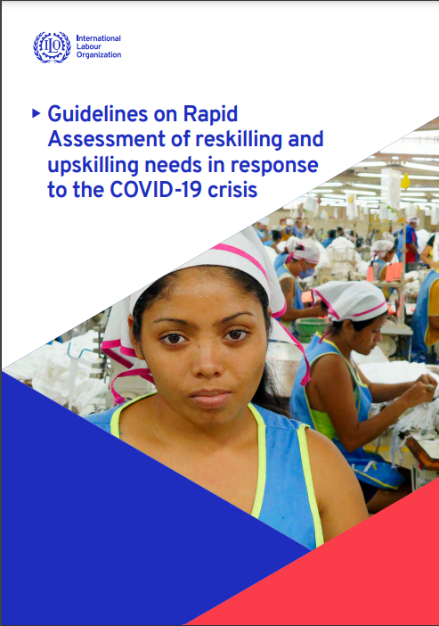
Target areas
Guidelines on Rapid Assessment of reskilling and upskilling needs in response to the COVID-19 crisis
Sectors in which COVID-19 has a significantly negative impact on employment in terms of quantity and quality of jobs
Sectors and occupations in which COVID-19 increases demand for skills
Groups of individuals needing training, reskilling and upskilling

Slide 59

Locations of rapid assessments
Tunisia
Algeria
Kuwait
Morocco
Ethiopia
Cambodia
Ghana
Kenya
Nigeria
Uganda
Cameroon
Zambia
Namibia
Eswatini
South Africa
El Salvador

Slide 60
Methodological approach
Background reading
by Rapid Assessment technical team
Survey of enterprises
in target sector(s)
Survey of individuals I
in target group(s)
Consultations and in-depth interviews
with key responsible organizations, policy-makers, social partners and other stakeholders

Slide 61
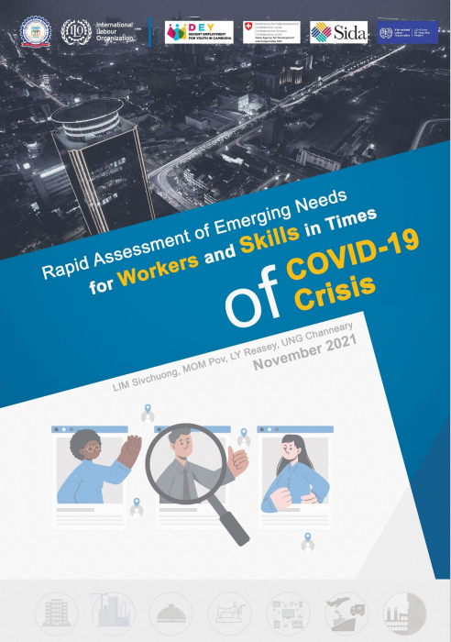
ILO –National Employment Agency (NEA) Rapid Assessment in Cambodia
Sivchuong, L., Pov, M., Reasey, L., & Channeary, U. (2021). Rapid assessment of emerging needs for workers and skills in times of the COVID-19 crisis. National Employment Agency, Phnom Penh, Cambodia.

Slide 62
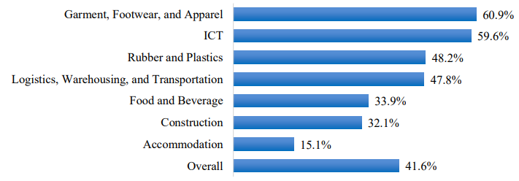
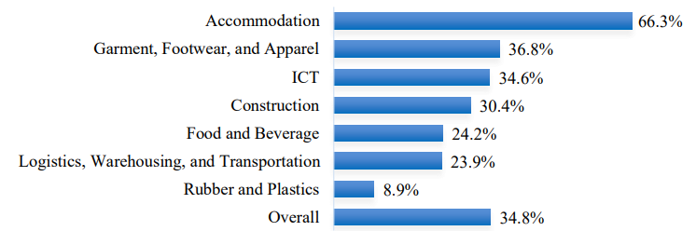
Employment impact
Share of establishments with employment losses by sector
Share of establishments with employment gains by sector
Across sectors 35% of establishments reported employment losses, the highest loss rate in construction (46%)
Source: Sivchuong, L., Pov, M., Reasey, L., & Channeary, U. (2021). Rapid assessment of emerging needs for workers and skills in times of the COVID-19 crisis. National Employment Agency, Phnom Penh, Cambodia.

Slide 63
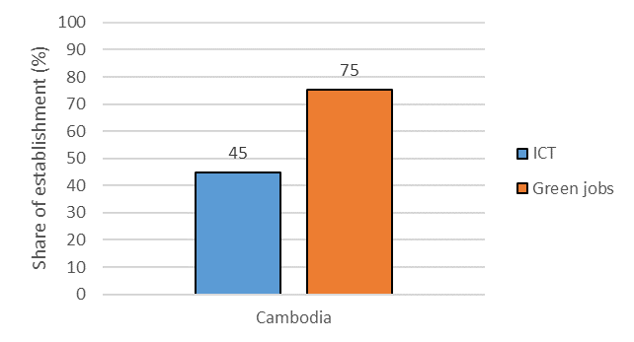
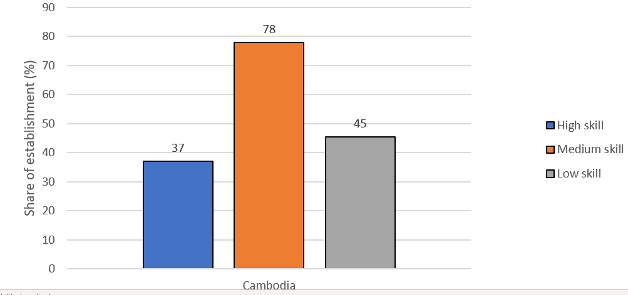
Skills sought
Introduced ICT or experienced movement towards green jobs
Share of firms by occupations where there will be recruitment opportunities when the recovery begins
Source: Sivchuong, L., Pov, M., Reasey, L., & Channeary, U. (2021). Rapid assessment of emerging needs for workers and skills in times of the COVID-19 crisis. National Employment Agency, Phnom Penh, Cambodia.

Slide 64
Skills sought
Non-job specific
Top growing occupations per sector were identified
e.g. Accommodation
Cleaners and Helpers
Client Information Workers
Sales Workers
Cooks
Waiters and Bartenders
Electrical Equipment Installers and Repairers
e.g. Construction
Construction Labourers
Engineering Professionals
Sales Workers
Cleaners and Helpers
Finance Professionals
Administrative and Specialized Secretaries
Problem solving / troubleshooting
Time management
Monitoring and operations
Coordination
Quality control
Languages (English, Chinese)
Basic digital skills
Data management
Software skills
Source: Sivchuong, L., Pov, M., Reasey, L., & Channeary, U. (2021). Rapid assessment of emerging needs for workers and skills in times of the COVID-19 crisis. National Employment Agency, Phnom Penh, Cambodia.
Notes:
The results show that low-skilled workers were more likely to lose their job during the pandemic permanently and that most firms will aim to recruit medium-skilled workers in the future. Difficulties in recruitment are mainly due to skills mismatch and a lack of training institutions. Under-skilling is mainly relevant to medium-skilled occupations due to new roles and ineffective training. Overall, the firms' outlook on the future is positive as firms expect an increase in employment and, in 2021, businesses are back to almost 80% of their business capacity. Policies to boost the post-pandemic recovery should focus mostly on small businesses and the accommodation sector, as they were hit harder by the pandemic and recovered more slowly.

Slide 65
Reskilling and upskilling needs assessment – Indonesia and Vietnam
Capacity development and sustainability
The ILO approach involves provision of technical assistance, particularly in the survey design process, and capacity building of national public bodies in the implementation of the surveys and other data collection mechanisms, and in the analysis of data collected. This ensures that the tools developed are aligned with international best practices, but also reflect national context and priorities, and can be replicated (for other sectors and over time).
Consistency with standard classification systems/ taxonomies and using complementary sources of LMI
It is considered crucial for the skills needs assessment to tap into existing labour market information (LMI) available sources. The different sources of LMI available in the country provide information that can be analysed to cross-validate as well as to complement data collected using the surveys and consultations implemented in the assessment.
Stakeholder involvement, and data and knowledge sharing
The approach engages ILO constituents and social partners (including representatives of employers, workers, skills, and employment service providers) throughout the process, from data collection to knowledge sharing and dissemination of findings. This ensures that priorities are well-identified and targeted, that data collection tools are effective, and results are useful, but also establishes new avenues for coordination and sharing of data and information.

Slide 66

Main findings and recommendations from all RAs
IMPACTS OF THE PANDEMIC
EMERGING SKILLS NEEDS
RECOMMENDATIONS
Large fall in both employment and hours worked,
Low-skilled workers were more likely to lose their job during the pandemic permanently
Relatively higher (medium)
IT and digital skills
Green
O&H skills related social distancing and hygiene standards
More general sets of skills to handle workload, work organization (including teleworking), monitoring, teams’ operations
Troubleshooting
Support to reskilling and developing specific training programmes
Training in soft skills, OSH
Expand PES operations
Promoting availability of online training
Incentivizing certain groups to participate training and support SMEs in the hard-hit sectors
PPPs

Slide 67
CONCLUSION:
A good system for skills needs anticipation and better matching
PES
Subnational
Could be centralised or decentralised
Sectoral
Government
Occupation
Micro
Coordinated
Combine complementaryelements and policies (policy coherence)
Macro
Short-term
Training
Provider
Sector
Skills
Councils
Sustainable
Global
Individuals
Always shared by a number of institutions
Local
Administration
Based on social dialogue
Company
Researchers
Mid-/
long-term

Slide 68
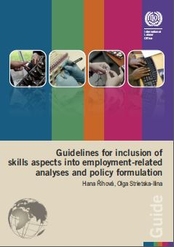
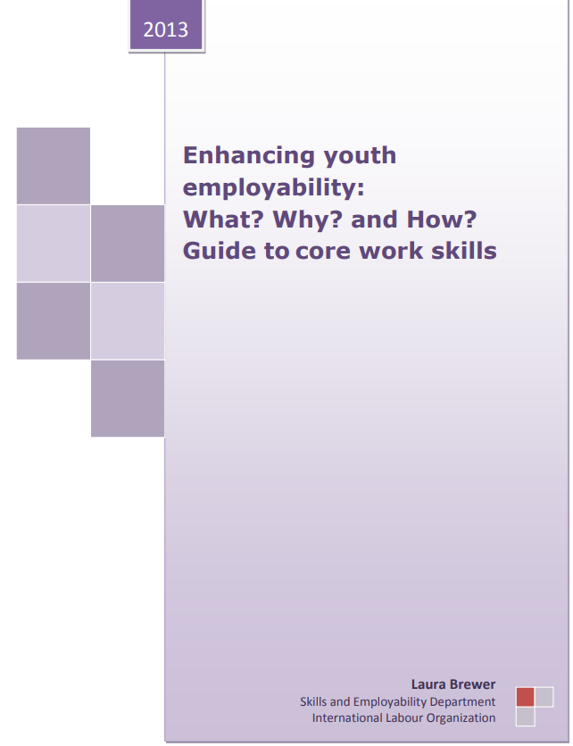
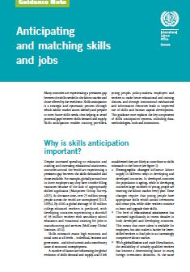
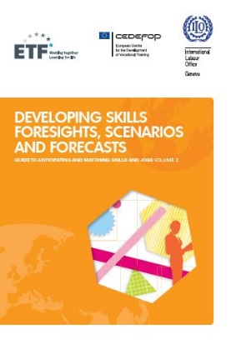



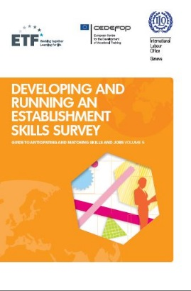

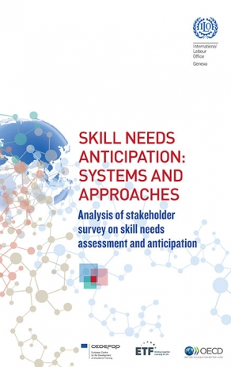

ILO skills anticipation and matching tools:
Generic tools and knowledge products
Notes:
We have published several generic tools and knowledge products from the guidance note on skills anticipation and matching on the left to tools to guide one to implement foresights, scenarios and forecast, running an establishment survey, carrying out tracer studies which we implemented with our European partners. On the right are more specific products and research papers.

Slide 69




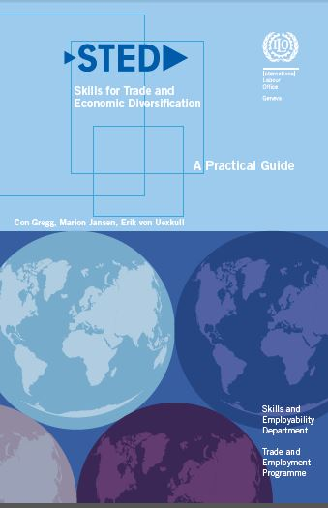
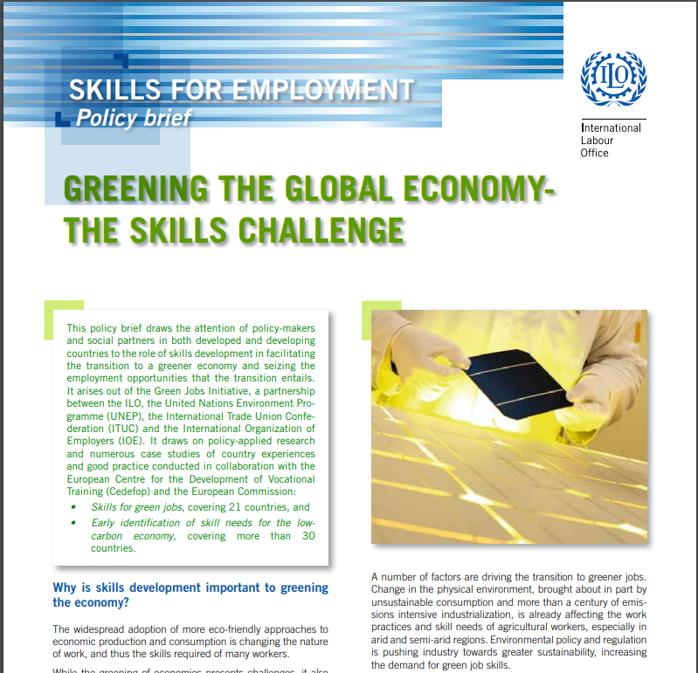
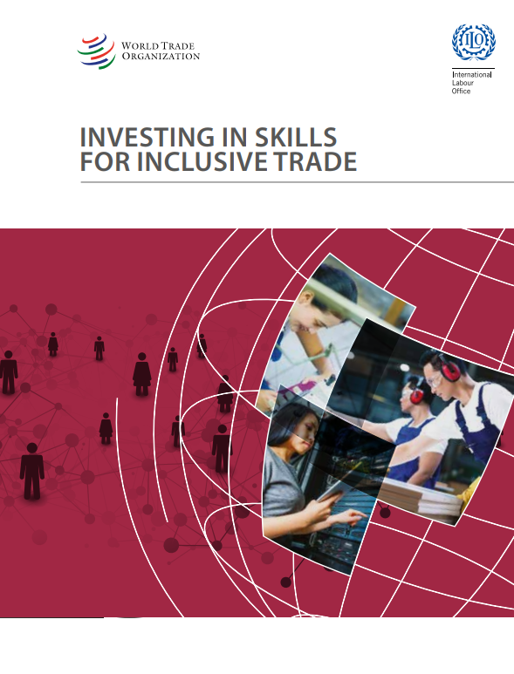


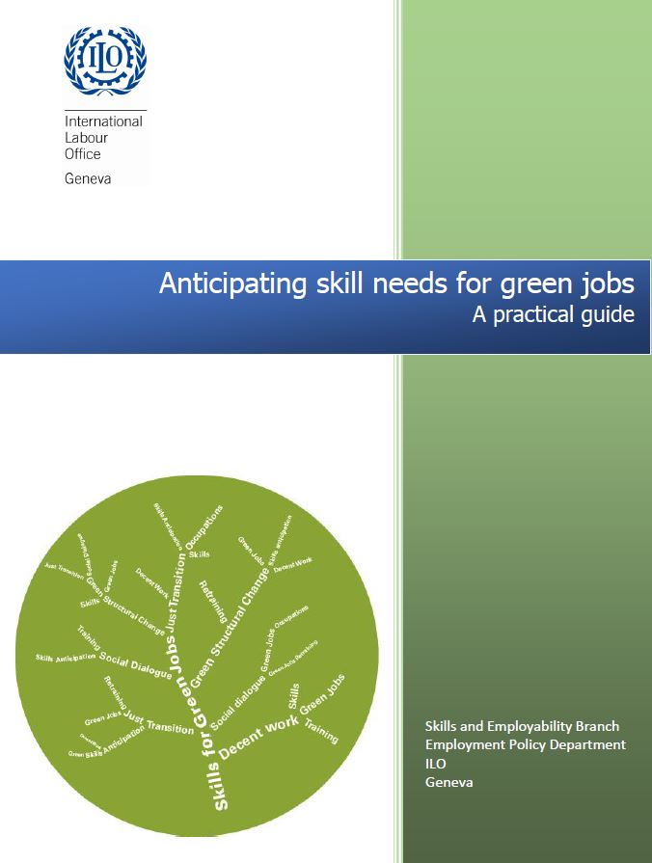
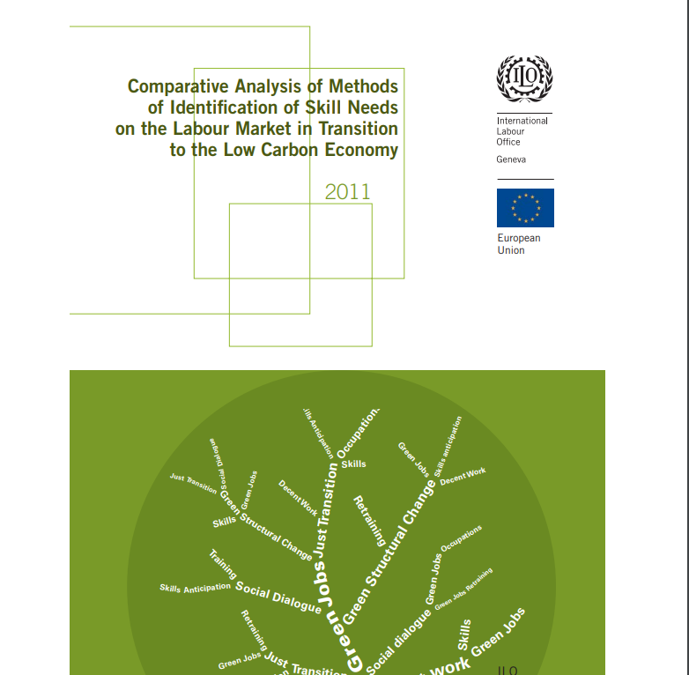

ILO skills anticipation and matching tools:
Specific policy / megatrend driven
Notes:
Next, we have a family of tools that are very specific to certain policies. For example, STED skills for trade and economic diversification which is basically a sectoral based tool. The guidelines for rapid assessment of reskilling and upskilling is a new tool which provides guidance on assessing skill needs in response to covid-19. It includes questionnaires for employers and individuals and provides an indicative list of key informants to contact to facilitate the data gathering process The output from conducting a rapid assessment is a report that makes a clear analysis, identifies priority areas for action, and proposes options for addressing these action areas. We also have a family of tools on future skill needs to facilitate a green transition, skills for a greener future. Some of the insights generated had been covered in the earlier part of this presentation.

Slide 70
Thank you for your attention!
www.ilo.org/skills
www.skillsforemployment.org

Slide 71
Group exercise

Slide 72
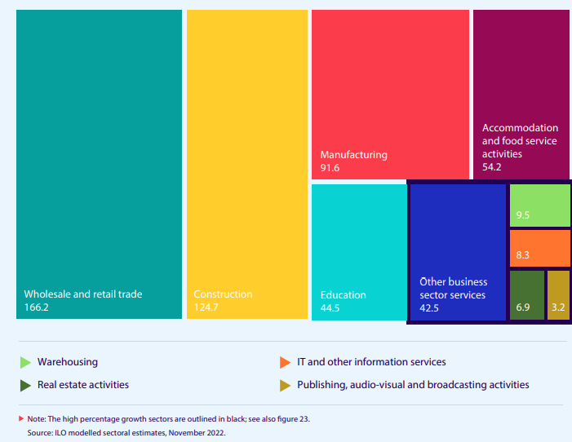
Employment increase (millions), top five sectors in nominal growth and top five sectors in percentage growth, Asia and Pacific, 1991–2021
Notes:
Also,
Textiles, garment and footware
Electronics
Metallurgy
Car manufacturing
Other

