Slide 1
ILO Bangladesh Skills Projects 2007 – 2023 Resource Materials - Hyperlinks
Lotte Kejser, CTA, ILO Skills 21 project, Bangladesh,

Slide 2
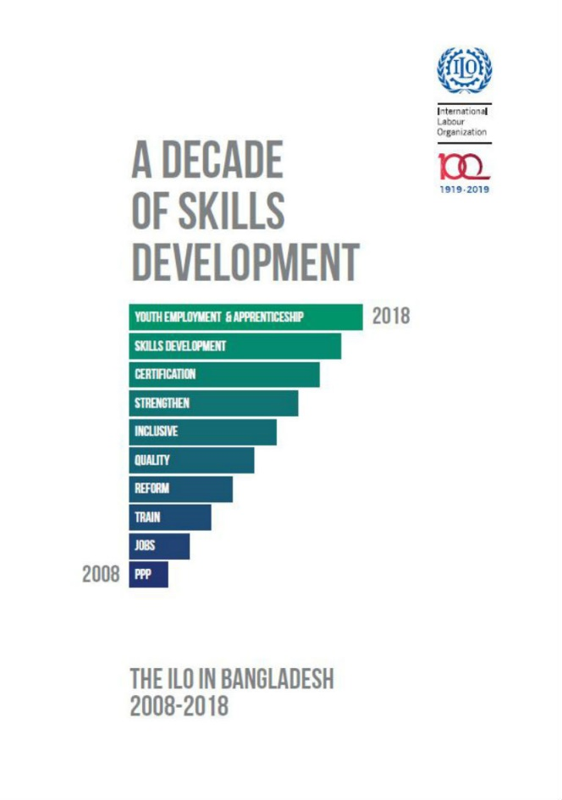
ILO Projects on Skills Development in Bangladesh 2007-2023 (till date) – hyperlinks to resource materials
TVET-Reform project (2007-2015) (EU) 17.7 million USD
B-SEP project (2014-2019) (Canada) 16.1 million USD
Skills 21 project (2017-2023) (EU) 21.7 million USD
Overview publication
A Decade of Skills Development: The ILO in Bangladesh 2008-2018

Slide 3
TVET – Reform project 2007-2015 (EU)
The goal was to ensure Bangladesh’s competitiveness in the global market and increase the numbers of skilled workers in response to market demand by improving the quality of vocational education and training.
Priority Sectors
Transport (Ship Building), Leather, IT, Agro-Food, Tourism & Hospitality
Achievements
National Skills Development Policy 2011, National Technical and Vocational Qualifications Framework (NTVQF), National Quality Assurance System, Registered Training Organization (RTO), Industry Skills Council
Funding Partner
European Union

Slide 4
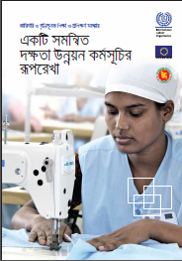
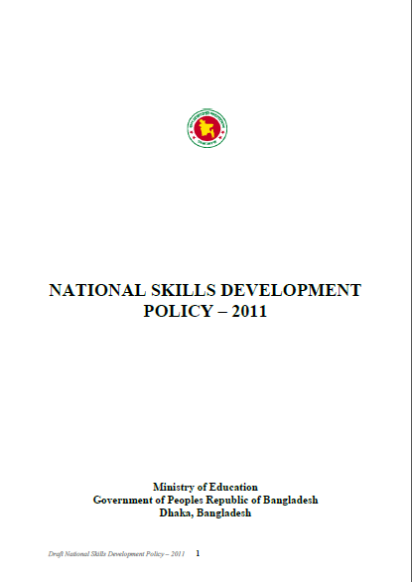
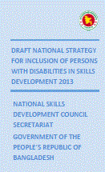
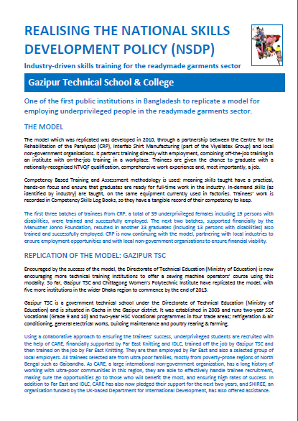
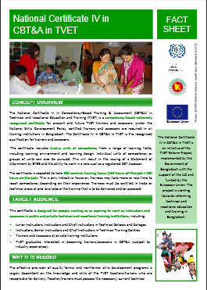
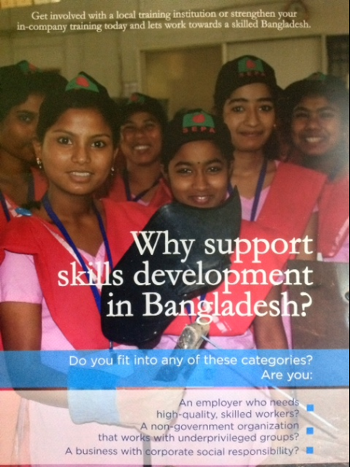
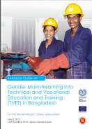
Knowledge products of TVET- Reform project
National Skills Development Policy 2011
Bangladesh Skills Vision 2016
The National Skills Development System in Bangladesh (2015)
National Strategy for Promotion of Gender Equality in TVET
National Skills Quality Assurance System (NSQAS)
Recognition of Prior Learning (RPL)
Resource Guide on Gender Mainstreaming into TVET in Bangladesh
NTVQF Implementation Manual
Implementing Competency-Based Training (CBT) in Bangladesh

Slide 5
B-SEP project 2014-2019 (Canada)
B-SEP project was supporting Government efforts to strengthen and deepen skills reform in Bangladesh to build skilled workforce, improve productivity and enhance economic growth.
Priority Sectors Agro-Food, Tourism & Hospitality, Pharmaceuticals, Ceramics, Furniture
Achievements Strengthen Recognition of Prior Learning (RPL), Implementation of 5% quota for enrolment of persons with disability in TVET Institutes, National Strategy for Gender Equality in TVET, Public Private Partnerships, Employment Support Services and Career Guidance Cell
Funding Partner The Government of Canada

Slide 6
Knowledge products of B-SEP project
Skills for Green Jobs in Bangladesh
Breaking gender barriers in the World of Work
Good practices for inclusion of persons with disabilities
Apprenticeship programmes to boost productivity and employability: Good practices, replication steps and way forward
Employment Support Services (ESS) and Career Guidance Cells (CGC) for a smooth school-to-work transition: Good practices, replication steps and way forward
Promoting entrepreneurs to create Green Jobs: Good practices, replication steps and way forward
Public-Private Partnerships benefit TVET institutes and industry alike: Good practices, replication steps and way forward
Recognition of Prior Learning Certification for self-learned skills: Good practices, replication steps and way forward
Guidebook: Implementation of Public-Private Partnership in TVET
Highlights of the Bangladesh Skills for Employment and Productivity (B-SEP) Project, 2014-19
Disability inclusion in the Bangladesh skills system
Including persons with disabilities in Technical and Vocational Education and Training
The competitive advantage of hiring persons with disabilities

Slide 7
Skills 21 project 2017-2023 (EU)
The project seeks to increase productivity and employment opportunities for young people through supporting the development of an inclusive technical and vocational training system responding to the needs of the labour market.
Priority Areas Quality, Access, Governance and Management of TVET and skills development system
Achievements Bangladesh National Qualifications Framework, National Skills Development Policy 2022, E-Campus for TVET, Green TVET Campuses, Teachers’ Professional Development, National TVET Awareness Campaign Strategy and Action Plan, Model TVET Institutes, Centre for Skills Excellence, Entrepreneurship Development Training, Industry Institute Linkages
Funding Partner European Union
Videos: Motion Graphics on Skills 21: Empowering citizens for inclusive and sustainable growth (ilo.org)
The voices of beneficiary: Our impact, Their voices: Skills training: Tayaba Khanam Era's testimony (ilo.org)

Slide 8
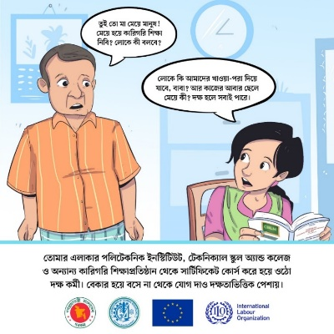
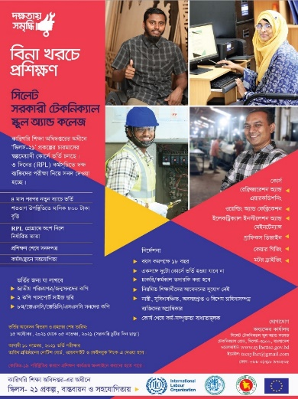
Knowledge products of Skills-21 project
Bangladesh National Qualifications Framework
https://www.ilo.org/dhaka/Whatwedo/Publications/WCMS_872937/lang--en/index.htm
Skills 21 Occupational Needs analysis
https://www.ilo.org/dhaka/Whatwedo/Publications/WCMS_736055/lang--en/index.htm
IMAB Guidance
https://www.ilo.org/dhaka/Whatwedo/Publications/WCMS_736050/lang--en/index.htm
Quality Improvement Plan
https://www.ilo.org/dhaka/Whatwedo/Publications/WCMS_736048/lang--en/index.htm
MIS Review Report
https://www.ilo.org/dhaka/Whatwedo/Publications/WCMS_735709/lang--en/index.htm
TVET Situation Analysis
https://www.ilo.org/dhaka/Whatwedo/Publications/WCMS_735704/lang--en/index.htm Increasing public awareness through comics
https://www.ilo.org/dhaka/Whatwedo/Publications/WCMS_833422/lang--en/index.htm
TVET awareness campaign materials
https://www.ilo.org/dhaka/Informationresources/Publicinformation/features/WCMS_833442/lang--en/index.htm

Slide 9
Knowledge products of Skills-21 project
Greening TVET guideline
https://www.ilo.org/dhaka/Whatwedo/Publications/WCMS_815337/lang--en/index.htm
Greening TVET brief
https://www.ilo.org/dhaka/Whatwedo/Publications/WCMS_815302/lang--en/index.htm
Career dictionary
https://www.ilo.org/dhaka/Whatwedo/Publications/WCMS_760031/lang--en/index.htm
Facilitators notes (Career Guidance)
https://www.ilo.org/dhaka/Whatwedo/Publications/WCMS_760032/lang--en/index.htm
Student’s workbook
https://www.ilo.org/dhaka/Whatwedo/Publications/WCMS_760033/lang--en/index.htm
Brief on TVET delivery management
https://www.ilo.org/dhaka/Whatwedo/Publications/WCMS_766039/lang--en/index.htm
Brief on issues related to overseas employment on NSDP
https://www.ilo.org/dhaka/Whatwedo/Publications/WCMS_765062/lang--en/index.htm
Brief on policy actions to improve teachers quality
https://www.ilo.org/dhaka/Whatwedo/Publications/WCMS_764044/lang--en/index.htm

Slide 10
Knowledge products of Skills-21 project
Recommendations on develop industry’s role
https://www.ilo.org/dhaka/Whatwedo/Publications/WCMS_763427/lang--en/index.htm
Brief on NSDP through gender lenses
https://www.ilo.org/dhaka/Whatwedo/Publications/WCMS_763426/lang--en/index.htm
COVID-19 response plan for TVET
https://www.ilo.org/dhaka/Whatwedo/Publications/WCMS_759932/lang--en/index.htm
Webinar report on RPL
https://www.ilo.org/dhaka/Whatwedo/Publications/WCMS_757257/lang--en/index.htm
NSDP recommandations from dialogue
https://www.ilo.org/dhaka/Whatwedo/Publications/WCMS_751875/lang--en/index.htm

Slide 11
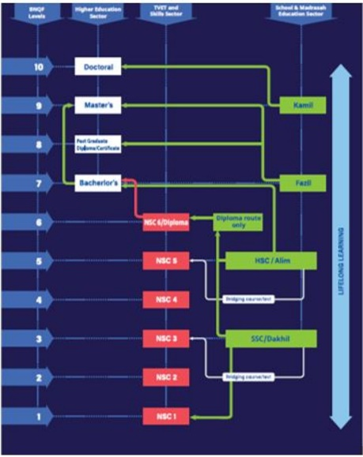
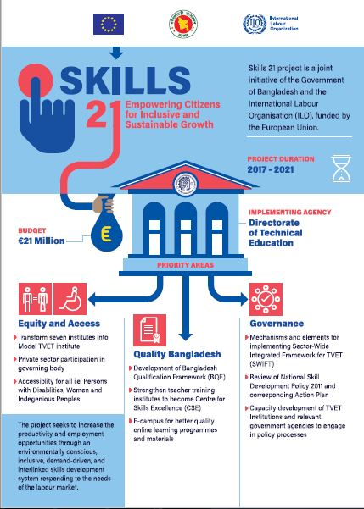
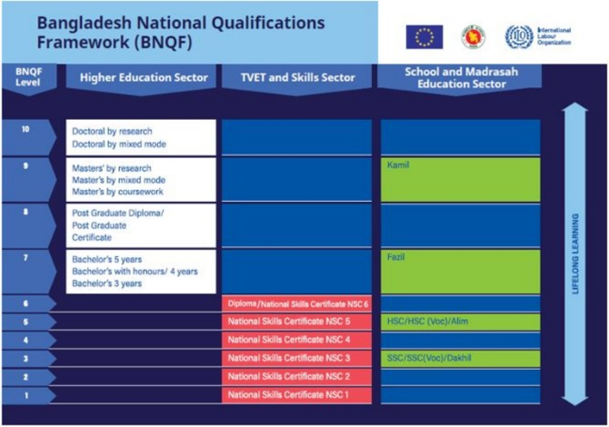
Knowledge products of Skills-21 project - Infographics
Skills 21 project – https://www.ilo.org/dhaka/Informationresources/Publicinformation/newsletters/WCMS_754324/lang--en/index.htm
Model TVET Institutes- https://www.ilo.org/dhaka/Informationresources/Publicinformation/newsletters/WCMS_746759/lang--en/index.htm
Centre for Skills Excellences- https://www.ilo.org/dhaka/Informationresources/Publicinformation/newsletters/WCMS_746764/lang--en/index.htm
SWIFT – https://www.ilo.org/dhaka/Informationresources/Publicinformation/newsletters/WCMS_755969/lang--en/index.htm
BNQF pathways- https://www.ilo.org/dhaka/Informationresources/Publicinformation/newsletters/WCMS_755967/lang--en/index.htm
BNQF structure- https://www.ilo.org/dhaka/Informationresources/Publicinformation/newsletters/WCMS_755966/lang--en/index.htm

Slide 12
Stories from Skills 21 project -beneficiaries’ case stories and testimonies of intervention impact
Mastering the sewing machine with dwarfism
Wiring dreams to earn more
Child marriage didn’t stop Reshma to become an entrepreneur
Recognition of skills transformed Shahadat’s life
When the vision is clear strategy is easy
Jubel's story of persistence and success
From Fahmida’s creative hands to the international fashion stage
How skills training transformed Taslima’s life
Skills training turned Sujan Marma's life around
Market relevant quality skills training ensures employment
Skills training makes Rubaya dreaming of becoming an entrepreneur

Slide 13
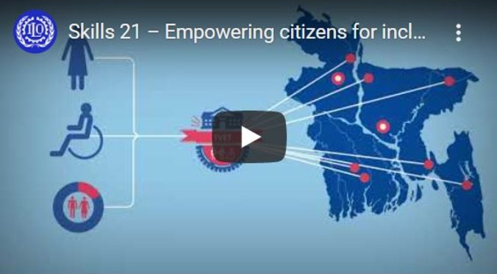
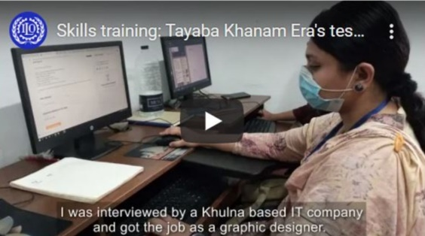
Videos from Skills 21 project
Skills 21 motion graphics- https://www.ilo.org/dhaka/Informationresources/Publicinformation/videos/WCMS_813658/lang--en/index.htm Campaign (Impact) videos and TVC- https://www.ilo.org/dhaka/Informationresources/Publicinformation/videos/WCMS_820524/lang--en/index.htm https://www.youtube.com/watch?v=LmZKWcQ7o24&list=PL8itJ-8Cfpczt1bUcPJxqfDI9LCI0Ox9R&index=2&t=35s https://www.youtube.com/watch?v=6i1DzmyxEAQ&list=PL8itJ-8Cfpczt1bUcPJxqfDI9LCI0Ox9R&index=4&t=2s https://www.youtube.com/watch?v=L2hdPLfqHlc&list=PL8itJ-8Cfpczt1bUcPJxqfDI9LCI0Ox9R&index=3 Skills 21 showcased in ILC 2021- https://www.youtube.com/watch?v=KigOPYVeeE0 Webinar on WYSD 2020- https://www.facebook.com/watch/?v=66813828071280

Slide 14
Videos from Skills 21 project -beneficiaries’ case stories and testimonies of intervention impact
Abdul Motaleb Sarker, Plumber, Gaibandha - https://www.youtube.com/watch?v=kWSK9Hnc73g
Khadija Hossain, Instructor, Khulna - https://www.youtube.com/watch?v=nU3Zy7e5Y7U
Rozen Patro, Electrician, Sylhet- https://www.youtube.com/watch?v=nppfi7tIJeo
Ahad, Returnee Migrant, Sylhet - https://www.youtube.com/watch?v=VpxW7IzEY4g&list=PL8itJ-8Cfpczt1bUcPJxqfDI9LCI0Ox9R&index=10
Abdul Shukkur, Wood machine operator, Kaptai- https://www.youtube.com/watch?v=iDstGEvUCLE&list=PL8itJ-8Cfpczt1bUcPJxqfDI9LCI0Ox9R&index=8
Moushumi, Sweing Machine Operator, Gaibandha - https://www.youtube.com/watch?v=dJWnhLCjDN8&list=PL8itJ-8Cfpczt1bUcPJxqfDI9LCI0Ox9R&index=7

Slide 15
Videos from Skills 21 project -beneficiaries’ case stories and testimonies of intervention impact
Ainul Huq Jubel, Graphic Designer, Sylhet - https://www.youtube.com/watch?v=7Fr71vWrXxs&list=PL8itJ-8Cfpczt1bUcPJxqfDI9LCI0Ox9R&index=13&t=12s
Tayaba Khanam Era, Graphic Designer, Khulna - https://www.youtube.com/watch?v=P7CmWYniO0Y&list=PL8itJ-8Cfpczt1bUcPJxqfDI9LCI0Ox9R&index=15&t=4s
Sukumar Tanchangya, Welder Kaptai - https://www.youtube.com/watch?v=FvlixIyJmeA&list=PL8itJ-8Cfpczt1bUcPJxqfDI9LCI0Ox9R&index=9&t=3s
Monarul Islam, Electrician, Gaibandha - https://www.youtube.com/watch?v=W-YofjO4Px0&list=PL8itJ-8Cfpczt1bUcPJxqfDI9LCI0Ox9R&index=6

Slide 16
THANK YOU!

