Slide 1
Digitalisation and digital skills
Regional training/workshop/technical advice event EUD’s
March 2023
DG-INTPA

Slide 2
Connecting.
Example
The pictures in this examples are placeholders. When using pictures, make sure to add, when necessary, the correct accreditation.
What & why?
Intervention strategies & priority areas
Digital competences & ICT specialist skills
Digital transformation of teaching & learning
Digital technologies for education sector governance
5 enabling factors
Mobilising INTPA’s Toolbox for digital education & skills

Slide 3
What & why?

Slide 4
Digital transformation of education
What we teach: Digital competences and ICT specialist skills
How we teach & learn: Digital transformation of teaching and learning
How we govern & manage: Digital technologies for education sector governance
Enabling factors: Internet connectivity & devices; Teachers’ digital competences; Strategic planning & leadership; Knowledge generation; Digital rights & principles.
Notes:
Digital education is not just about digital for teaching and learning, but also about digital competences and skills, ánd about making use of digital technologies to support education sector governance

Slide 5
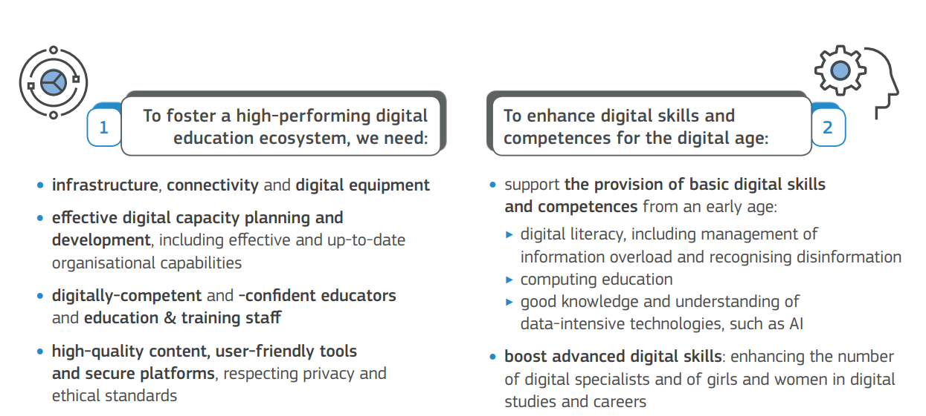
Building on
Notes:
Digital skills
Enabling factors/ building blocks
Digital technologies to advance inclusive and high quality education

Slide 6
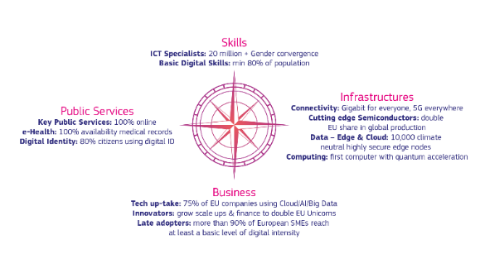
Deliver on Global Gateway priorities
Digital
The EU will offer digital economy packages (including digital skills) to promote of a human-centric model of digital development and tackle the global digital divide
Education
The EU will invest in quality education, including digital education, with a special focus on girls and women and vulnerable groups
The EU is uniquely positioned as a global partner for education & trusted partner for digital
Notes:
Allows us to deliver on global gateway priorities given that digital education and skills are priorities in themselves,
but also because digital education and skills allow us to contribute to promoting a human-centric digital transformation that leaves no one behind;
and can be leveraged to advance inclusive and quality education

Slide 7
Priority areas & intervention strategies

Slide 8
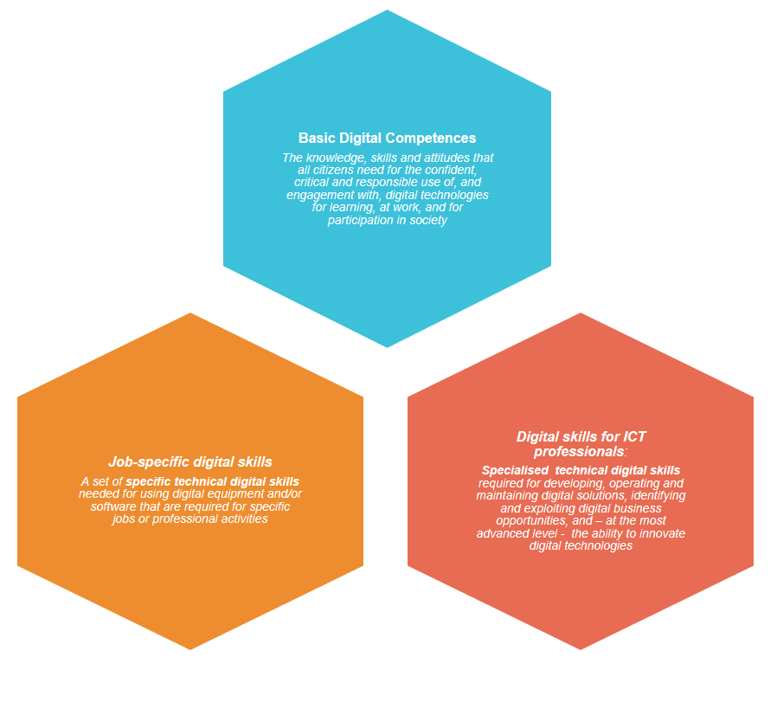
Digitally empowered citizens & a digitally skilled workforce
E.g. all citizens should be able to create digital content on digital platforms (i.e. skill) and be open to and respectful of the views of people on the internet even if they differ from one’s own views (i.e. attitude).
E.g. a mechanic needs to be able to work with on-board diagnostics tools, a graphic designer needs to be able to work with visual design software packages, etc.
E.g. a programmer needs to be able to adapt or develop code for a new software application, a cybersecurity expert needs to be able evaluate risks and implement security techniques, etc.
Notes:
Digital competence involves the confident, critical and responsible use of, and engagement with, digital technologies for learning, at work, and for participation in society.
We also consider digital competences to be a foundational learning skill allowing learners to grasp digital opportunities for lifelong learning.
Digital (technical) skills for employment in the digital economy and traditional sectors which increasingly make use of digital technologies (e.g. a mechanic using electronic diagnostic tools)

Slide 9
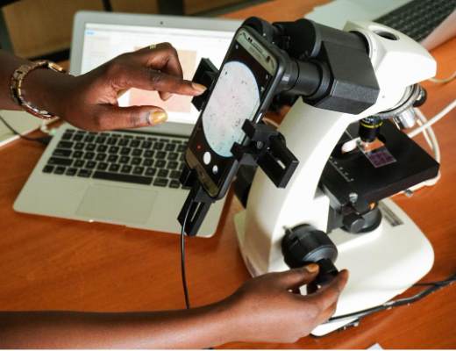
Digitally empowered citizens & a digitally skilled workforce
Empower every learner with basic digital competences
Teach basic digital competences & job-specific digital skills for (self-) employment
Recognise alternative learning trajectories for ICT specialist skills
Provide (post-) graduate programmes for ICT specialists & innovators
Notes:
Digital competence involves the confident, critical and responsible use of, and engagement with, digital technologies for learning, at work, and for participation in society.
We also consider digital competences to be a foundational learning skill allowing learners to grasp digital opportunities for lifelong learning.
Digital (technical) skills for employment in the digital economy and traditional sectors which increasingly make use of digital technologies (e.g. a mechanic using electronic diagnostic tools)

Slide 10
2. Digital technologies for inclusive & quality education
Leverage EdTech for active & learner-centred blended learning
Mobilise EdTech to increase access & facilitate inclusion
Provide high quality & locally relevant digital education content
Design & implement sustainable EdTech solutions with and for the users that fit within the existing ecosystem and protect digital rights
Notes:
Not just encourage the use of digital for teaching and learning to be up to date in the digital age, but make sure these to improve learning outcomes, e.g. by making use of interactive games in the classroom for and to advance inclusion, e.g. by making use of assistive technologies
Ensure it is done right: high quality content, user-centered and digital rights are protected

Slide 11
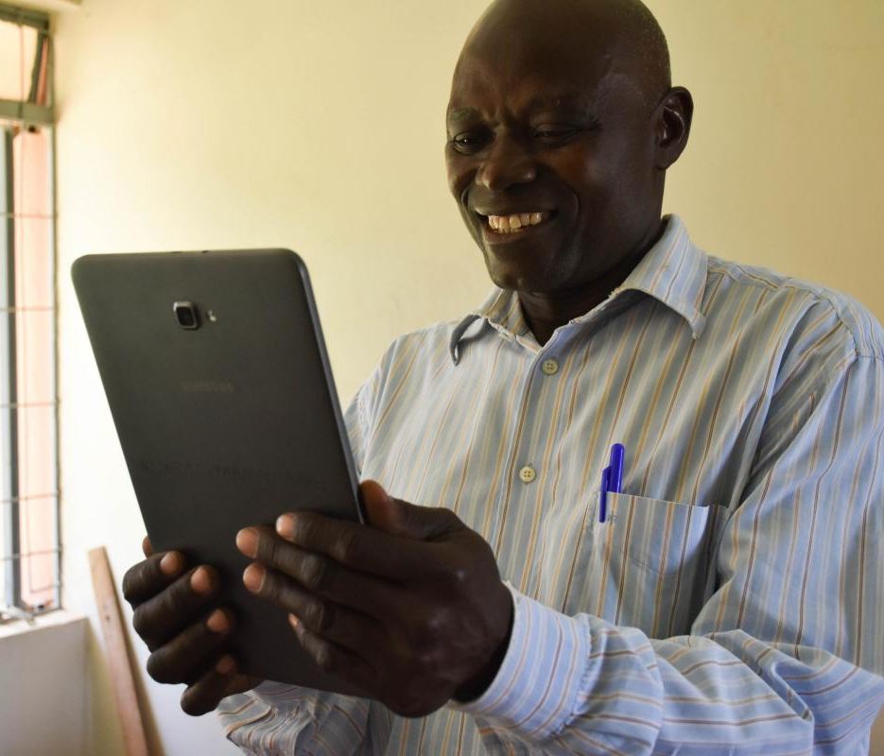
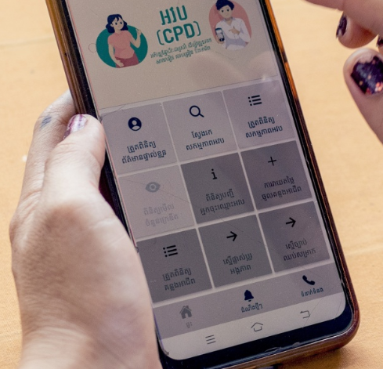
3. Digital for effective and efficient education sector governance
Integrated EMIS & LMIS for data-driven decision making
Leverage digital assessments to award portable digital credentials
Facilitate administrative tasks & processes
Notes:
Collecting and analysing data, facilitating adminstrative process, etc.

Slide 12
Enabling Factors
Promote access to internet connectivity & devices/ equipment
Strengthen teachers’ digital competences
Support awareness, 360° strategic planning & leadership at all levels
Promote research & peer-to-peer exchanges to scale up
Respect, protect & promote digital rights & principles

Slide 13
Mobilising INTPA’s Toolbox for digital education & skills

Slide 14
DG INTPA’s Toolbox
& Team Europe
Strenghtening enabling factors through regional & global actions
Mobilising expertise & building on EU best practices to implement programming
Positioning the EU as a global partner for digital education
Leveraging a policy first approach for budget support, EFSD+ & GPE
Promoting a whole-of-Europe approach for Digital Education cooperation
Notes:
Regional & global actions: Regional Initiative, Meaningful Connectivity indicators, Erasmus+
Mobilise expertise & EU best practices for national MIPs: Digital skills in SSA & Asia: 70-75%, in LAC: 50% Digital for learning & teaching in SSA & Asia: 30%, in LAC: 25%
Policy first approach across different modalities: Budget support, GPE & EFSD+
Team Europe: D4D Hub WG Digital Skills & education, proposals for Council recommendations on digital skills & enabling factors, multi-lateral fora

Slide 15
Thank you!
Example
The pictures in this examples are placeholders. When using pictures, make sure to add, when necessary, the correct accreditation.

