Slide 1
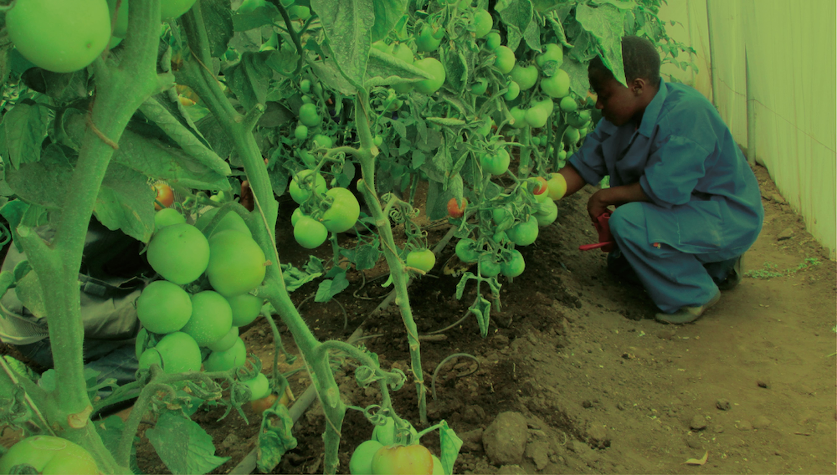
Greening TVET and skills development

Slide 2

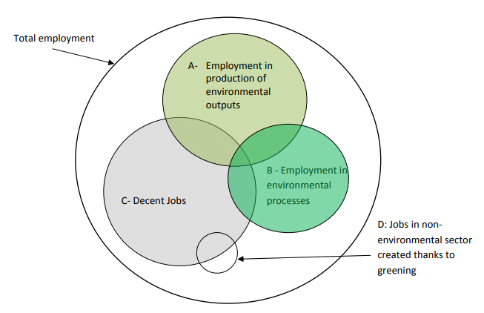
What is a green job?
ILO Green Jobs definition:
Green jobs are decent jobs that contribute to preserve or restore the environment, be they in traditional sectors such as manufacturing and construction, or in new, emerging green sectors such as renewable energy and energy efficiency.
Green jobs help:
Improve energy and raw materials efficiency
Limit greenhouse gas emissions
Minimize waste and pollution
Protect and restore ecosystems
Support adaptation to the effects of climate change
The 19th ICLS agreed on the statistical definition for
the measurement of green jobs

Slide 3
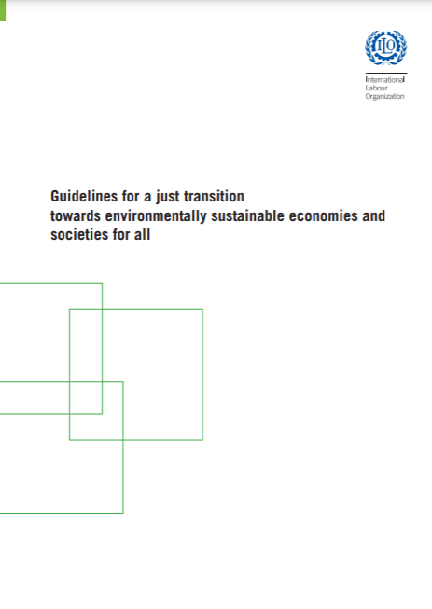
What is just transition?
ILO Just Transition Framework
In 2015, the ILO adopted the policy guidelines for a just transition towards environmentally sustainable economies and societies for all.
Skills development & ALMPs
Key policy areas to address the environmental, economic and social sustainability.
Macroeconomic and growth policies
Industrial and sectoral policies
Enterprise policies
Skills development
Occupational safety and health
Social protection
Active labour market policies
Rights
Social dialogue and tripartism

Slide 4
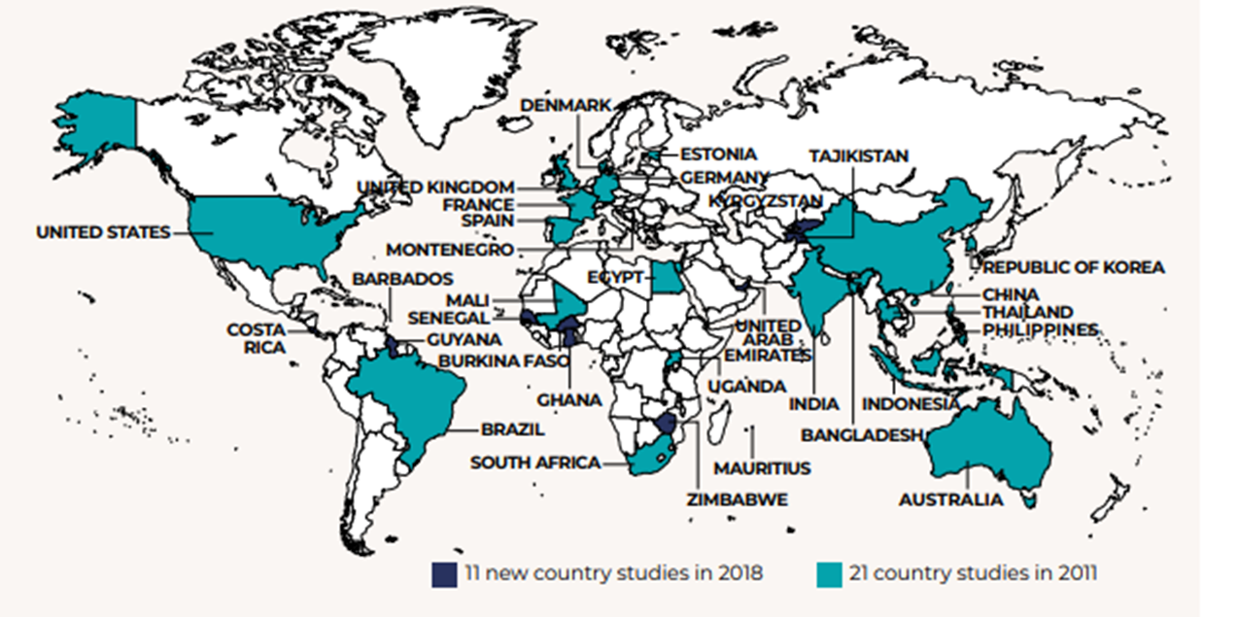

ILO Global Research: Skills for a Greener Future
Second round: 32 countries

Slide 5
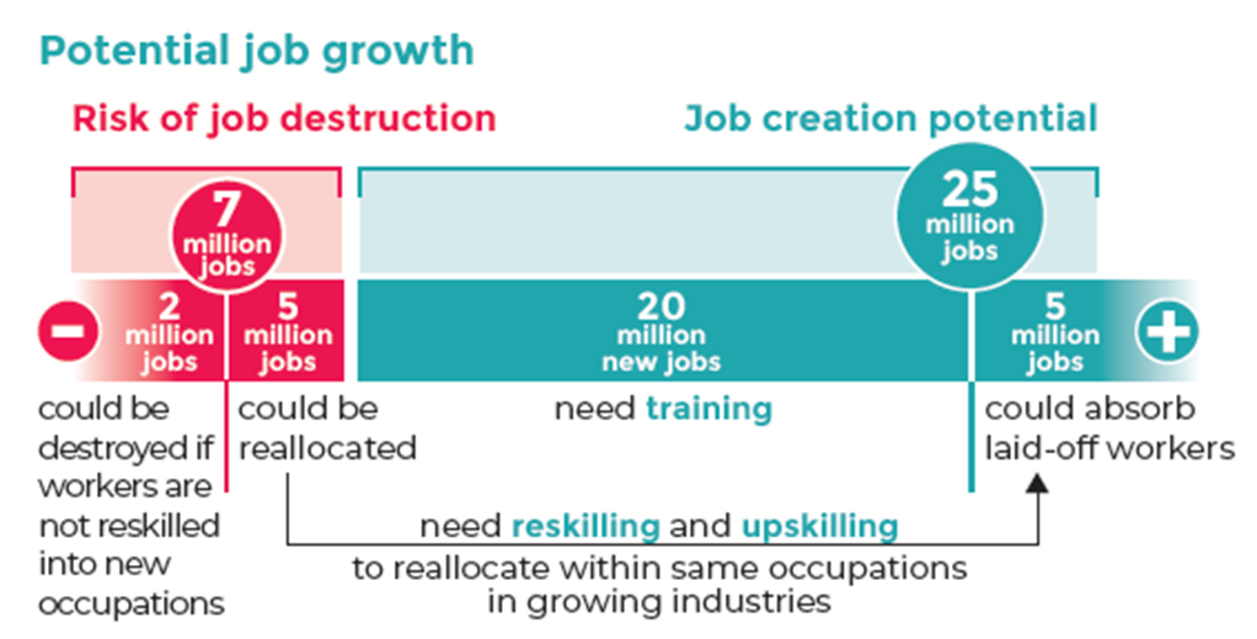
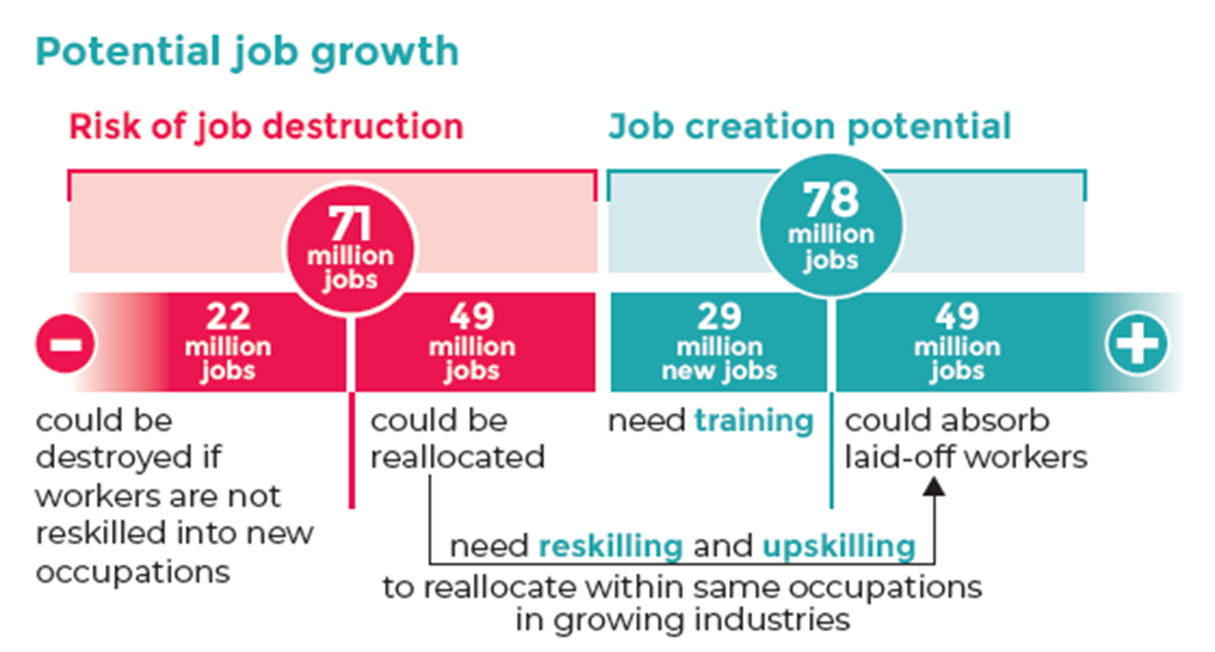
Policy scenarios 2030:
Paris agreement and jobs
Energy sustainability scenario, 2030
Circular economy scenario, 2030
Sources: ILO (2019) & Skills for a Greener Future. Infographic (2019).
Notes:
Another important global driver of change is climate change and environmental degradation which is an existential treat to the world. The demand for new jobs to facilitate the green transition drives the demand for new skills. The urgent need for action to alleviate the effects of climate change is highlighted by the ‘Conference of the Parties’ where the parties refer to Governments who have signed the UN Framework Convention of Climate Change meet annually to discuss how to jointly address climate change as well as the Paris Agreement, a bottom up approach where countries themselves decide how much they will reduce their emissions by a certain year to keep the rise in global temperatures to well below 2 degrees above pre-industrial levels. In an ILO publication released in 2019 titled “Skills for a greener future: A global view”, based on quantitative analysis and empirical research across 32 countries, a multi-regional input-output model as well as skills scrapped from big data was used to understand the demand for an occupation, what type of skills would be required based on two scenarios – the Energy sustainability scenario as well as the circular economy scenario. The energy sustainability scenario sees larger increases in the construction, electrical machinery manufacturing and copper mining sectors with decreases in the petroleum refinery and extraction, coal mining and coal based electricity generation sectors. The circular economy scenario represents a model for sustainability in resource use and consumption which supports a shift from the extract-manufacture-use-discard mentality to embracing recycling, repair, reuse, remanufacture and longer durability of goods. Its important to note that in either scenario, job creation outpaces job destruction. In the barplots shown, green refers to job creation and red refers to job disruption. For the energy sustainability scenario, of the 7 million jobs at risk of disruption, less than 1/3 of the jobs vacancies have no similar vacancies in other industries. More than 2/3 of the remaining jobs at risk of job destruction could be reallocated to similar jobs in other industries. This shift in occupational skill needs will require a complex set of policy measures, including massive investment into reskilling and upskilling through private and public sector investment, active labour market policies, career guidance, targeted training measures to promote gender balance and measures to facilitate workers’ mobility and their social protection.
Notes:
For example, if global electricity production from solar energy is to increase by 59 per cent by 2030, as assumed in the energy sustainability scenario, skills demand in solar installation, solar panel manufacturing, and the mining and processing of silicon will increase

Slide 6
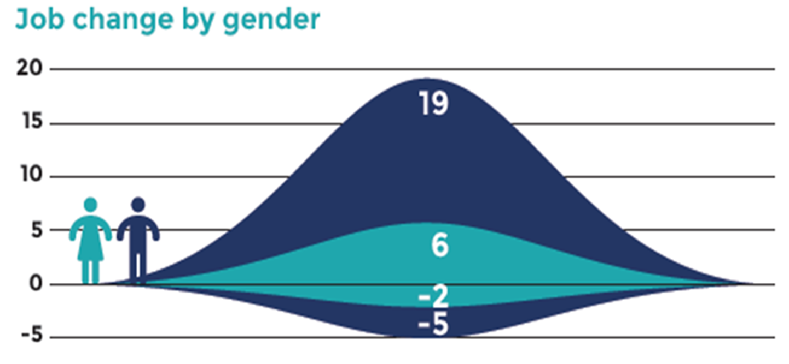
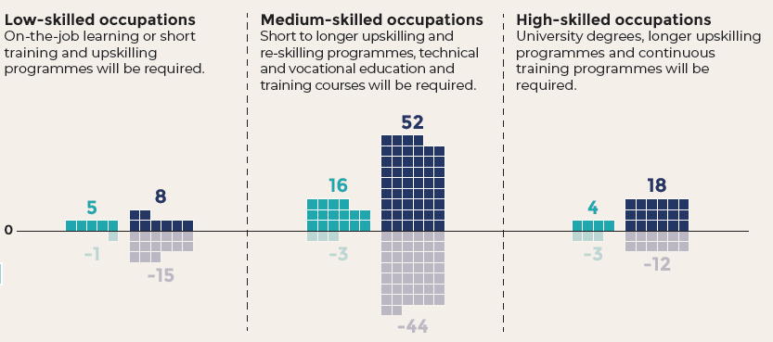
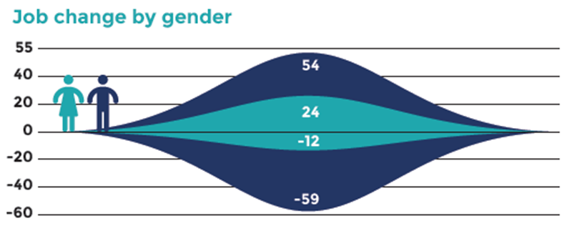
Jobs created and destroyed in a global circular scenario, by gender, 2030 (millions)
Energy sustainability scenario, 2030
Circular economy scenario, 2030
Reskilling measures required at all skill levels
Medium-skilled occupations sees the most job creation and reallocation
Greatest need of upskilling and reskilling for men
Overall net employment effects is positive
Gender disparities to persist
Sources: ILO (2019) & Skills for a Greener Future. Infographic (2019).
Notes:
In both scenarios, retraining needs is distributed across all skill levels with most job creation and reallocation concentrated in mid-skill occupations. The greatest need of upskilling and reskilling will be for male-dominated occupations as seen from the plots on the right. As such, men in mid-skilled occupations would have the greatest need of upskilling and reskilling to allow them to tap into new job opportunities. This could potentially partly offset the global trend in which skill-biased technological change (for e.g through automation of routine task) leading to what is known as the hallowing out of mid-skill occupations which explains the growing income inequalities observed. Also, the plots suggest that gender stereotypes are likely to persist where females would get only a fraction of the jobs created, unless measures are taken to train females with the relevant skills so that they can benefit from the potentially created jobs.
In summary, the transition to environmentally sustainable and inclusive economies and societies cannot take place if the skills demanded by new jobs are not available in the labour market. The transition is therefore conditional on investment in training to develop skills to meet new requirements and avoid skills mismatches. Forward-looking skills strategies are necessary to train young people and reskill the current workforce to meet the skills needs of the new jobs generated in the transition process in expanding/new sectors.
Actual progress on the transition to a more environmentally sustainable economy is not without problems. Key constraints on green jobs growth, including poverty, low incomes and informal employment (especially in developing countries), which can force people into environmentally detrimental activities; weak policies and enforcement of regulations; and weak markets for green goods and services owing to inadequate government support.

Slide 7
What is a green skill?
In reality, skills for the green transition are a combination of basic (environmental awareness), core (soft) and a wide range of technical skills
Even the environmnetal products and services per se require a wide range of differrent skills

Slide 8
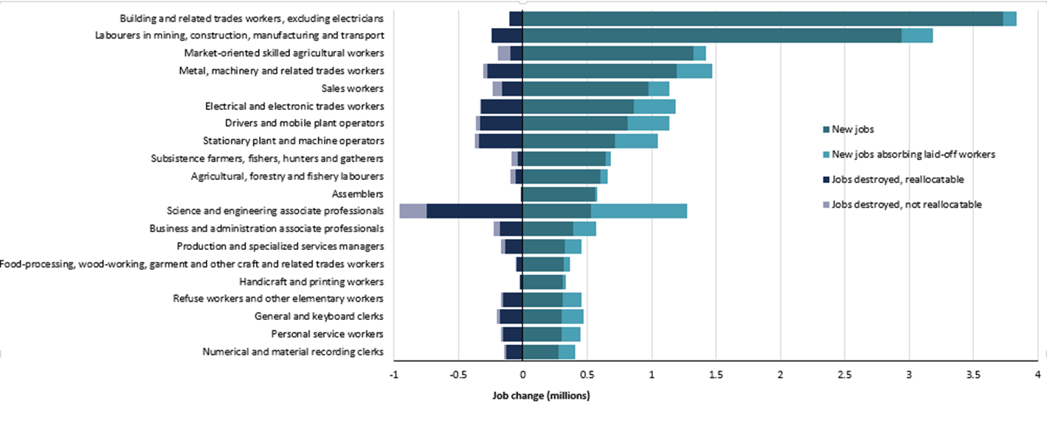
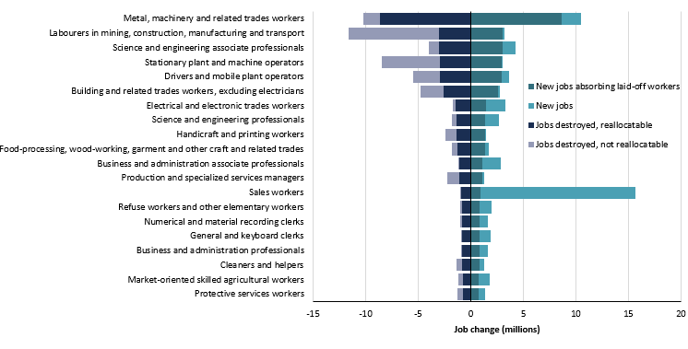
Energy sustainability scenario, 2030
Circular economy scenario, 2030
Source: ILO (2019) Skills for a Greener Future.

Slide 9
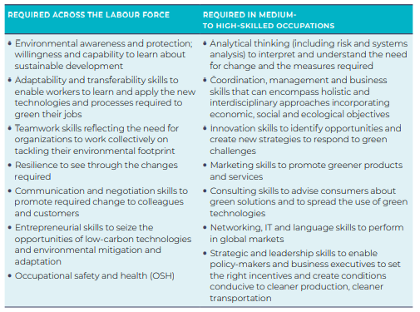
Main core skills required for green jobs, by level of occupation
Sources: ILO (2019) & Skills for a Greener Future.

Slide 10
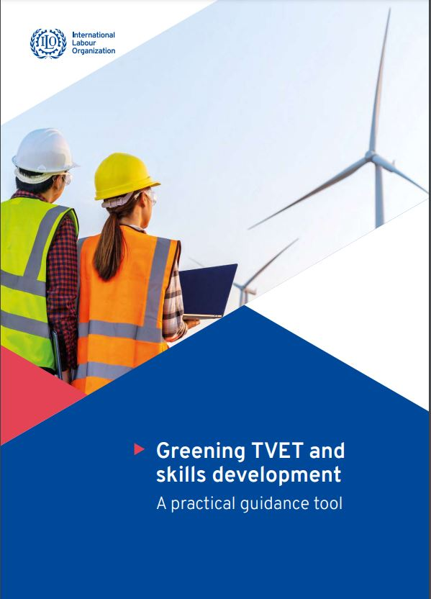
Going green in training
Developing and implementing green curricula
Assessment packages to support greener learning
How to green TVET and skills development: A practical guidance tool
Designing competency standards for greener jobs
Towards a greener campus
A practical guidance tool for greening TVET, competency standards, curricula, training and assessment to be piloted in several countries in 2022
Piloting countries (2021-2022):
Cambodia, Ghana, Zimbabwe, Zambia, Thailand, Guyana and the Philippines
Greening TVET: an overview
Greening the professional development of teachers / in-company trainers
Mainstreaming: from piloting to the whole system
Sensitizing employers
How to support greening of skills for the informal economy
Notes:
Using the tool:
Use as a stand-alone document or as part of coaching
Overall diagnosis is key but sections can be used independently
For all countries, but especially lower-income countries
Ambitious and inclusive

Slide 11
Contents of the ‘how-to’ sections
A journey, not a destination
A normative process
Taking a long-term view
Holistic – relevant to every job
Systematic – covers all elements of TVET
TVET meant to drive the change in greening the economy
Inclusive
Key learning points
Knowledge or ‘theory’ component
Self-assessment tools
Inspiring practical examples
Hints and tips
Checklists
Links to useful resources
Notes:
Benefits of the tool
- provides practical 'how-to' guidance
- flexibility: can be used on its own or with coaching
- deals systematically with all TVET elements
- Holistic and process-based approach, not just looking at content

Slide 12
Overview of process of greening competency standards
Notes:
Greening video
Cambodia STED 4 competency standards
https://www.ilo.org/global/about-the-ilo/mission-and-objectives/features/WCMS_631366/lang--en/index.htm

Slide 13
Greening TVET campuses:
Bangladesh Skills 21 project

Slide 14
Objective:
Promote green market-driven skills training, green practice and entrepreneurship support services in TVET institutes
  Identified a range of green initiatives to be introduced at the TVET institutes
  Trained 30 TVET officials on greening TVET to develop and implement the action plan
  Develop and implement green action pan
  Developed Greening guidelines for the TVET institutes
  Incorporate green elements in business model and operational plans
  Green incubation centres
  Identified employment opportunities for graduates trained in skills for green jobs and green enterprises
  Identified green elements to be incorporated competency standards for three qualifications (Welding, Refrigeration & Air Conditioning and Sewing Machine Operation)
  Recommended Bangladesh Technical Education Board to revise the qualification packages through developing green standards, curricula, learning materials and assessment tools.
Activities:
Notes:
Benefits of the tool
- provides practical 'how-to' guidance
- flexibility: can be used on its own or with coaching
- deals systematically with all TVET elements
- Holistic and process-based approach, not just looking at content

Slide 15
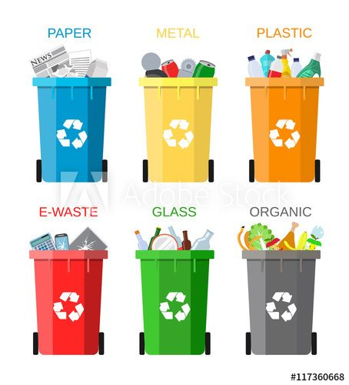
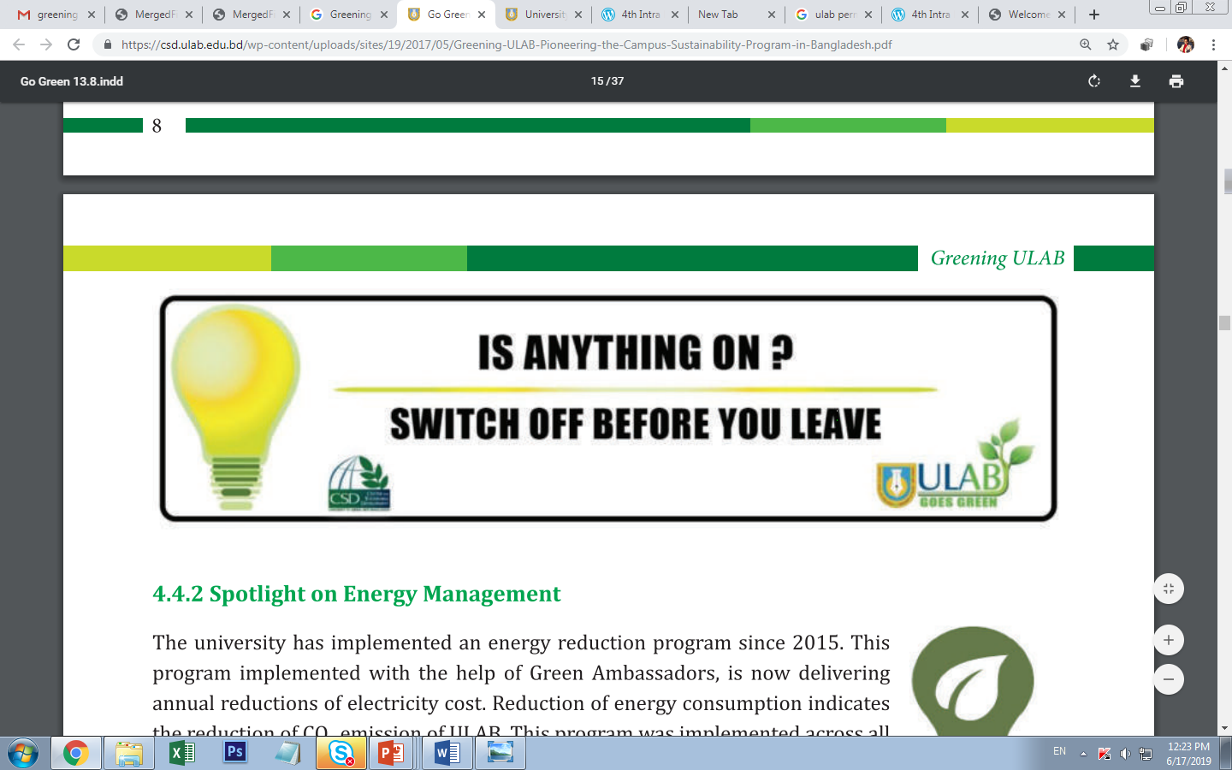
Greening Guidelines Framework
greening the campus,
greening the curriculum and training,
greening research,
greening the community and workplace,
greening the institutional culture

Slide 16
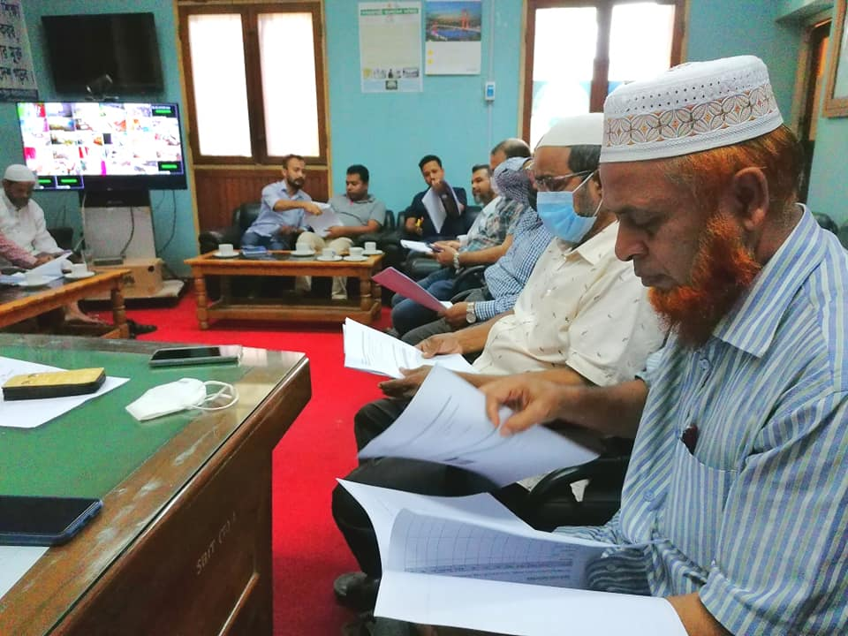
The Action Plan for greening TVET institutes
establishment of green committee,
efficient use of energy,
creating rooftop garden,
waste management,
green infrastructure development,
formation of green club,
use of ecofriendly product and transportation,
rainwater storage,
celebration of environment related days,
capacity development of staff on green management and
material development on green communication.

Slide 17
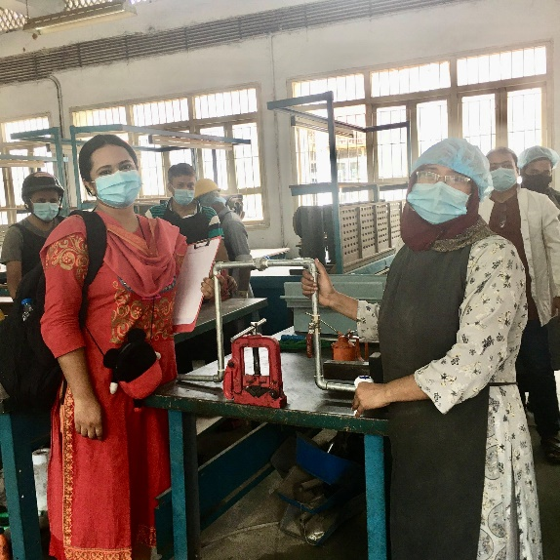
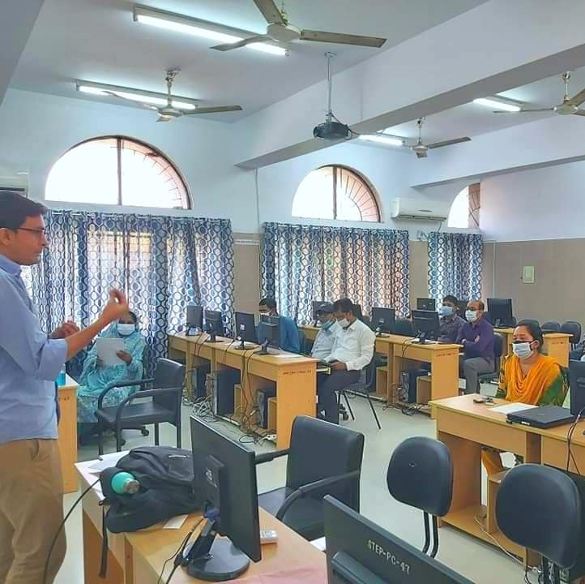
The business incubation centres
Infrastructure related services include efficient use of energy, waste management and rightly handling of hazardous substances.
Business services promote green entrepreneurship and use of eco-friendly products.
Financing services include brokering and/or providing financial services such as equity, credit, and guarantee to the entrepreneurs willing to create/start a green business,
In the people connectivity segment emphasizes on appointment of mentors knowledgeable on green business and economy and promotion of circular economy (i.e., reducing waste and pollution, reusing materials, recycling the recyclable goods and creating green jobs).

Slide 18
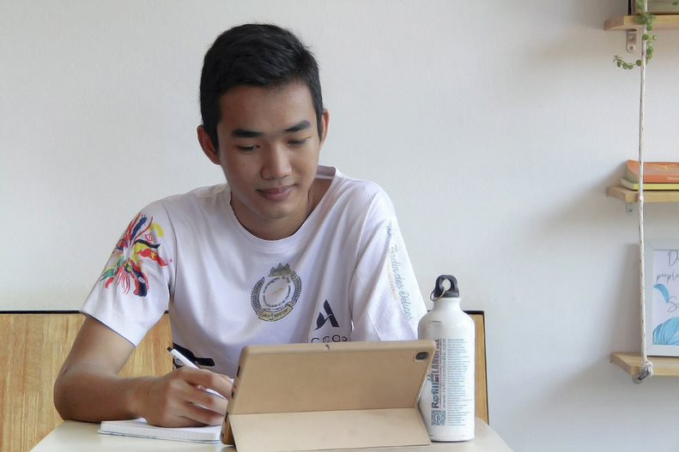
ILO coaching program on how to Green TVET
      Who : TVET, social partners and environment stakeholders
          Policy makers and operational TVET school teams
      What : Macro-Meso-Micro
          Priorization of jobs/trainings to be greened
          Greening of Competency standards
          Greening of curricula and training packates
          Greening of assessment packages
          Development of national green TVET policies
          Toward a greener campus
          Training teachers and in company trainers
          Upskilling
          Sensitizing employers
      How : Applied capacity building
          Step by step coaching, learning by doing
          Long term tutoring/coaching
          Care sector and logistic sector to start
Notes:
And ILO has very practical / step by step solution to support countries in an integrated way to support green transformation of TVET

Slide 19
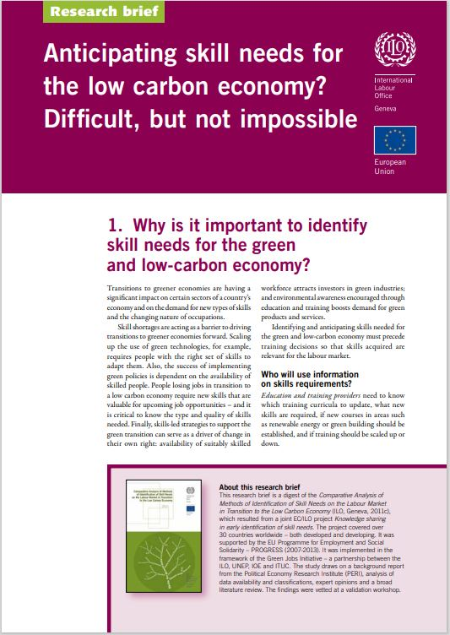

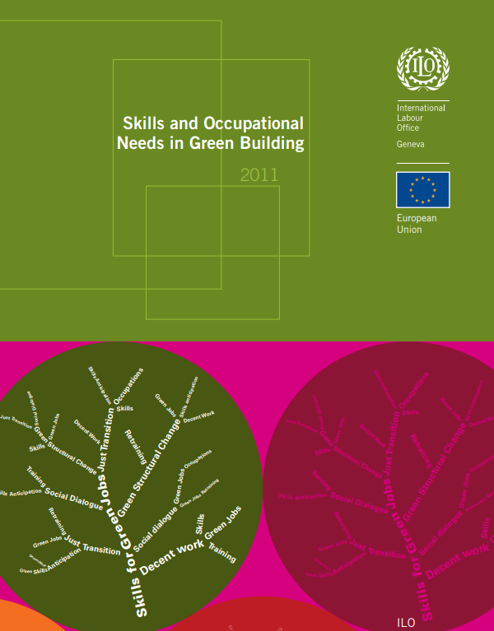
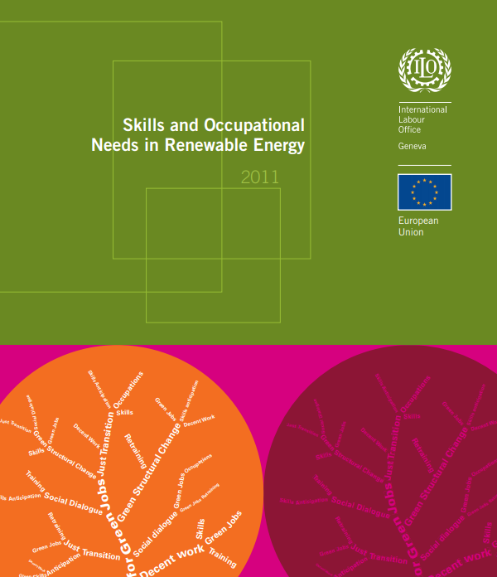
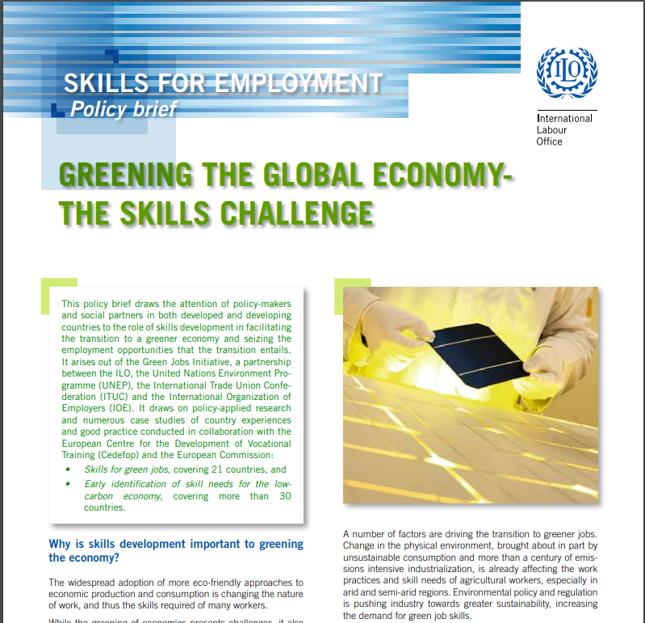
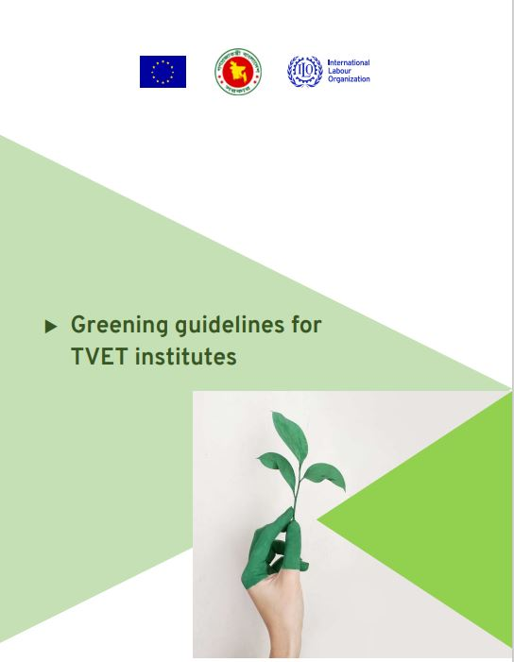
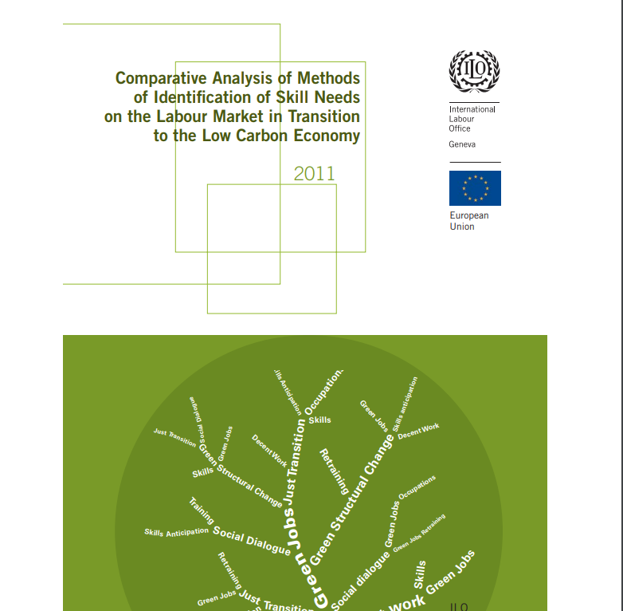
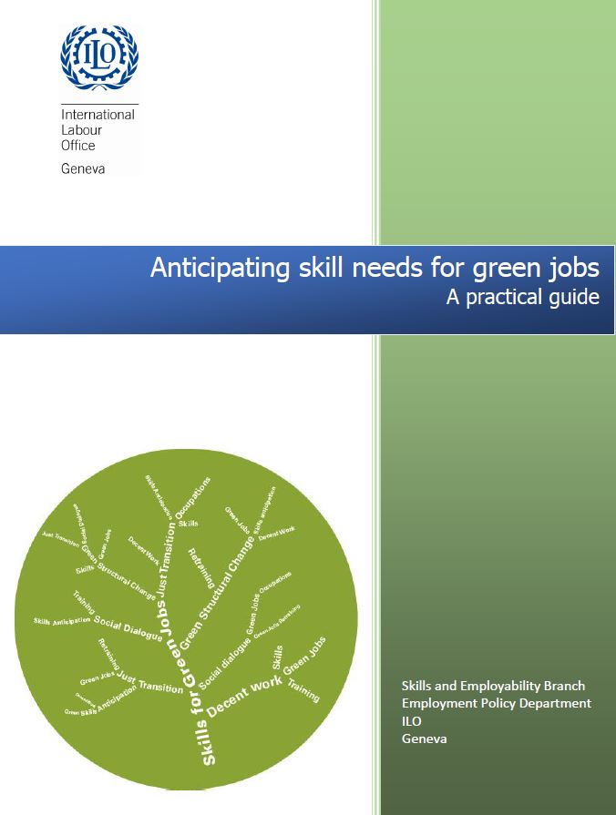
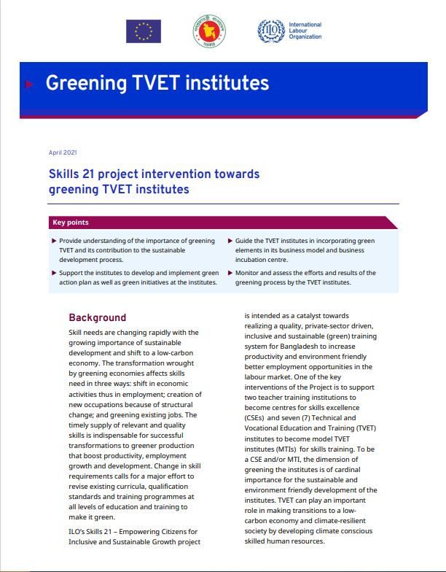
ILO Key resources

