Slide 1
Development Cooperation : Solar Energy is Happening – Are we ready?
Challenges, Opportunities, Options – the example of Kenya
Michael Franz
EUEI PDF Liaison Office Brussels

Slide 2
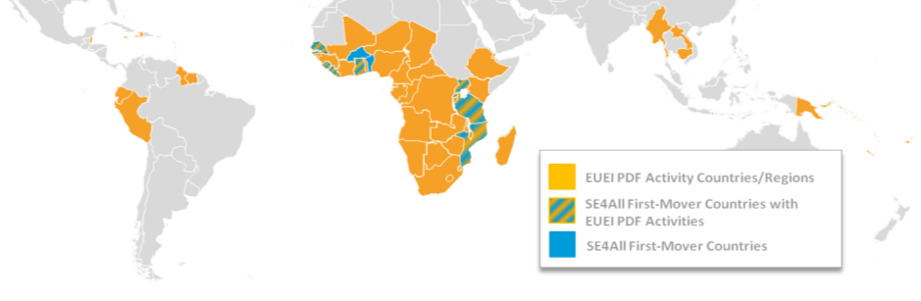







Background on EUEI PDF
An instrument of the EU Energy Initiative
Founded in 2005 by EU Member States and the EC
International team, hosted by GIZ
Objectives
Improve the policy and regulatory environment for private investments
Build institutional and thematic capacity for effective partner structures
Activities
Service line 1: Energy Policy and Strategy Development
Service line 2: Support to the Africa-EU Energy Partnership (AEEP)

Slide 3
Structure
How does the presentation work?
Key messages
Basic Country Background
Policy & Regulatory Framework
  In Focus: Small Scale On Grid Renewable Energy
Market Segments and – Status
  In Focus: On-Grid Solar PV
Outlook: Kenya as a Growth Market

Slide 4
Structure
How does the presentation work?
Key messages
Basic Country Background
Policy & Regulatory Framework
  In Focus: Small Scale On Grid Renewable Energy
Market Segments and – Status
  In Focus: On-Grid Solar PV
Outlook: Kenya as a Growth Market

Slide 5
How does the presentation work?
Judgements / assessments in the presentatation are my personal opinion and don’t necessarily reflect the views of my organization
The example chosen here is Kenya - the analysis and lessons apply also for other countries
I won’t go into all the details on all the slides, information is partly for reference
Please interrupt! Points of clarification at any time!
Discussion after the presentation

Slide 6
Key Messages
Dramatic cost reductions in solar PV are making it increasingly economically viable, also for improved access to energy in Africa
These market trends have “overtaken” both policy & regulatory frame-works as well as development instruments - we’re losing opportunities!
Frameworks for solar PV illustrate very well how “conventional power” is still dominating and that there is no “level playing field”
Where viability is achieved, we can and should design focused interventions to “break the ice” and jump-start market uptake

Slide 7
Basic Country Background

Slide 8
Basic Country Background – Solar Demand Drivers
Country-specific | Population: ~40 Mio. / Population growth: 2.5% p.a. GDP (PPP, 2011): 71 billion US$ (), world rank 83 GDP per capita (PPP, 2011): 1,700 US$, world rank 195 GDP growth (2011): 4.3%, world rank 90 Regional “powerhouse”, dynamic business / policy environment
Similar in other African countries | Low electrification rate: 15-20 % High growth of electricity demand : 5-8% p.a. Relatively high electricity prices (17-22 USc/kWh) Low reliability and security of supply Large share of thermal power, subject to price fluctuation + hydro power variability → strong electricity price fluctuations

Slide 9
Basic Country Background – Energy Sector
Total Final Energy Consumption
Source: IEA (2009)

Slide 10
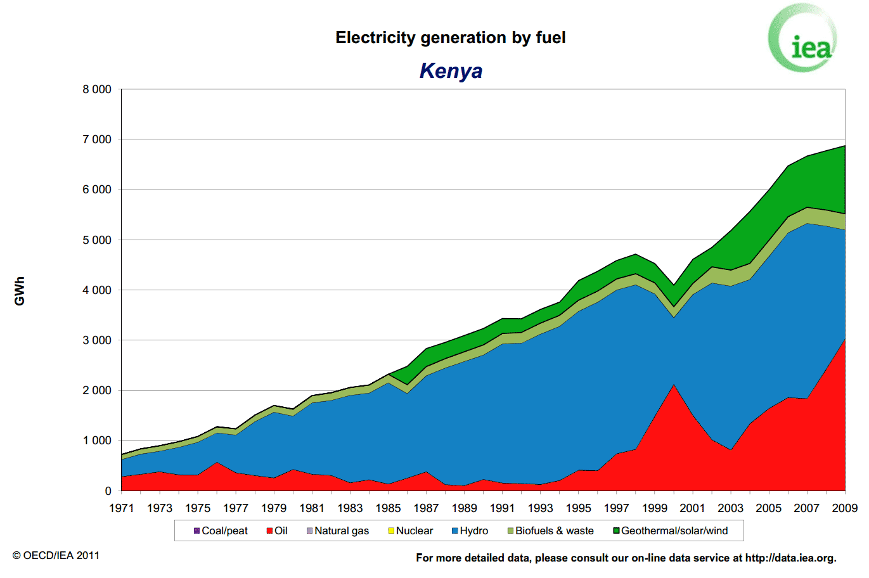
Basic Country Background – Energy Sector
Source: IEA (2009)

Slide 11
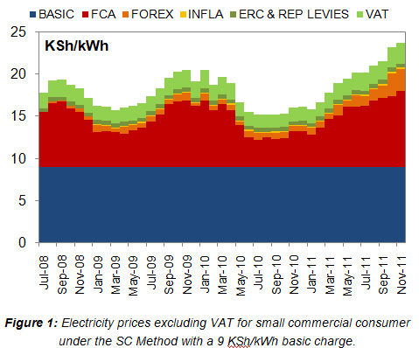
Basic Country Background – Electricity Prices
Different customer categories, different prices
Fuel costs are passed through to customers
High volatility, driven by hydro shortage, thermal generation, fuel prices
Transparent, cost-covering prices (!)
Exchange rate: varies between 100 KSh / EUR and 130 KSh / EUR
Source: GIZ 2011

Slide 12
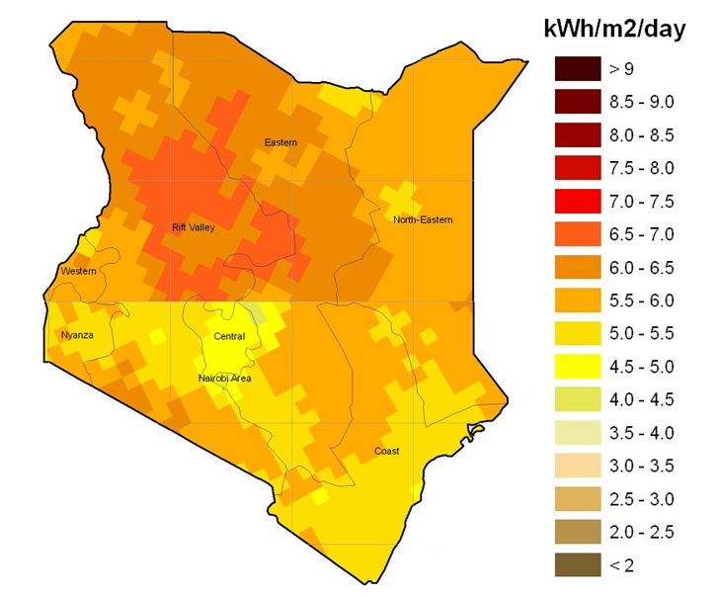
Basic Country Background – Solar Potential
Global Horizontal Solar Radiation in Kenya (Annual Average), Source: SWERA

Slide 13
Policy & Regulatory Framework

Slide 14
Policy & Regulatory Framework – GoK Priorities
Traditional focus: electricity and petroleum sector
Electricity: least-cost, conventional, centralized coordination and implementation
Sources (long-term): geothermal, coal, imports, nuclear (~80%); others
Rural electrification: grid extension / densification, hybridization, marginally: mini-grids
Other “access” market segments (traditional biomass / cooking energy, pico-lighting, small / decentralized RE)
  Receive marginal (but growing) attention and policy support
  Have been largely explored by civil society / private sector (informal)

Slide 15
Policy & Regulatory Framework
Institutional landscape: Electricity
Political guidance
Government
Ministry of Energy (MoE)
On-grid
Off-grid
Government
Regulation
Government
Energy Regulatory Commission (ERC)
Rural Electrification Authority (REA)
Coordination & implementation of rural electif.
Parastatal
Generation
Kenya Electricity Generation Company (KenGen)
Parastatal
Transmission
Kenya Electricity Transmission Company (KETRACO)
Transmission, distribution, mini-grid operation
Kenya Power and Lighting Company (KPLC)
Independent Power Producers (IPP)
Parastatal
Private
Generation
Consumers
Consumers

Slide 16
Policy & Regulatory Framework
Institutional landscape: „Energy Access“
Political guidance
Government
Ministry of Energy (MoE)
Government
Regulation
Government
Energy Regulatory Commission (ERC)
Kenya Bureau of Standards (KEBS)
Setting & Enforcing Standards
Energy Product / Service Providers (Private Sector, NGO, Donors)
Consumers

Slide 17
Policy & Regulatory Framework
Policies, Laws, Regulations
Planning
Least Cost Power Development Plan (LCPDP)
Rural Electrification Masterplan
Update 2009
Policy
Sessional Paper No. 4 fo 2004 on Energy
National Energy Policy (2012) DRAFT
Law
Energy Act 2006
Regulations
Feed-In Tariffs Policy (2008, 2010)
Small Scale Grid Connected RE Framework update (2012)
Kenya Electricity Grid Code
Various „Electric Power Rules“
Various „Renewable Energy Regulations“ (drafts)
Electricity Tariffs

Slide 18
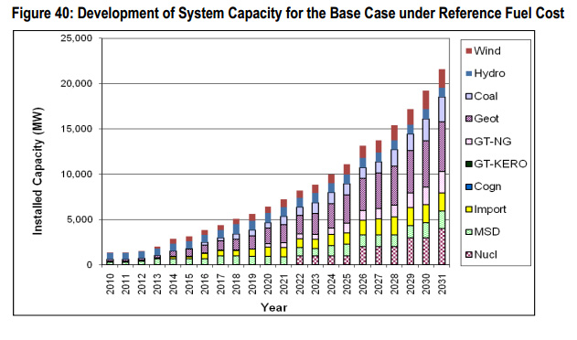
Policy & Regulatory Framework
In Focus : the „unlevel“ playing field for small-scale renewable energy (SSRE)
Least Cost Power Development Plan (LCPDP)
Basis for long-term power sector planning
Until 2031, installed capacity to increase by 20 GW
Mix of generation sources; strong reliance on
  Geothermal
  Nuclear
  Coal
  Import
Source: LCPDP 2011-2030

Slide 19
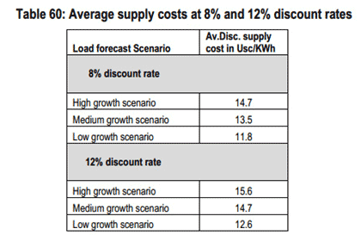
Policy & Regulatory Framework
In Focus : the „unlevel“ playing field for small-scale renewable energy (SSRE)
Least Cost Power Development Plan (LCPDP)
Table shows average discounted supply costs based on two discount rates, and three load growth scenarios
11.8 US$c / kWh = most optimistic scenario, i.e. low discount rate, low growth
Source: LCPDP 2011-2030

Slide 20
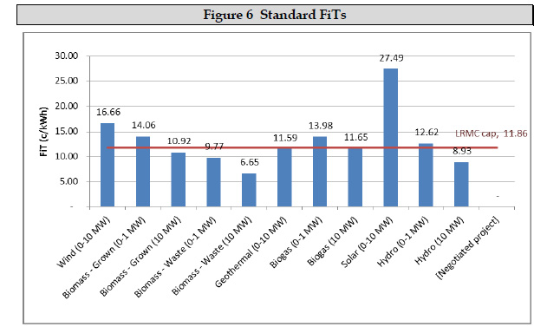
Policy & Regulatory Framework
In Focus : SSRE – the „Long Range Marginal Cost“-CAP
SSRE Study (DRAFT by ECA consultants, funding: World Bank)
Review of 2008 / 2010 Feed-in Tariff (FiT) Policies
Technology-specific FiT, US$, 20 years duration (= „normal“)
Assumed discount rate: 18% (=market in Kenya)
Where FiT exceed the LRMC of 11.86 US$c, FiT will be capped
Source: ECA-study 2012

Slide 21
Policy & Regulatory Framework
In Focus : SSRE – Interpretation
LCPDP (conventional power, heavy donor support) assumes 8 %/ 12 % discount rate, SSRE FiT assumes 18% → influences viability assumptions!
„Business as usual“ reflects institutional preferences: „big is beautiful“
LCPDP relies on key assumptions
  No consideration of external cost / benefits
  Stable oil price at 90 US$ / barrel, stable coal price
  All capacity comes online as planned (risks: electricity import, nuclear)
  Illustrates the absence of a level playing field for small-scale renewable energy
  Result of distortive effects of subsidies (e.g. on interest rates) for conventional power / absence of subsidies for renewable energy

Slide 22
Policy & Regulatory Framework
Summary
Process:
  Historically top-down; lack of accessibility / participation / transparency
  But: improving, decisions are taken, high reliability / predictability
Lack of capacity (workload!), “belief-systems”, path dependency, and donor focus lead to relatively narrow sectoral focus (on conventional energy)
  Partly unrealistic projections regarding cost, implementation timeframes and external risks associated with conventional energy
Sector planning is based on misperceptions and viability assumptions arising from un-leveled playing field → Decentralized small / meso renewables marginalized, however: clear positive trend since 2008 onwards

Slide 23
Market Segments and – Status

Slide 24
Market Segments and – Status
Overview
Traditional market for small solar systems, private and institutional
Small, young markets in off-grid mobile base station supply, tourism; also tenders for hybridization of existing mini-grids
Market is relatively static, fragmented, high degree of competition; very substantial quality issues
Little experience, little capacity with “modern” / large solar PV systems
All existing market segments are largely unregulated, although regulation is underway

Slide 25
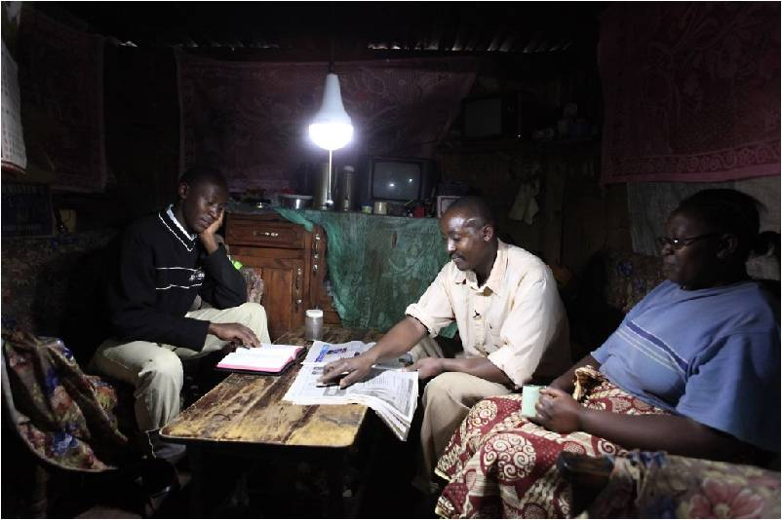
Pico-PV
© Total TATS

Slide 26
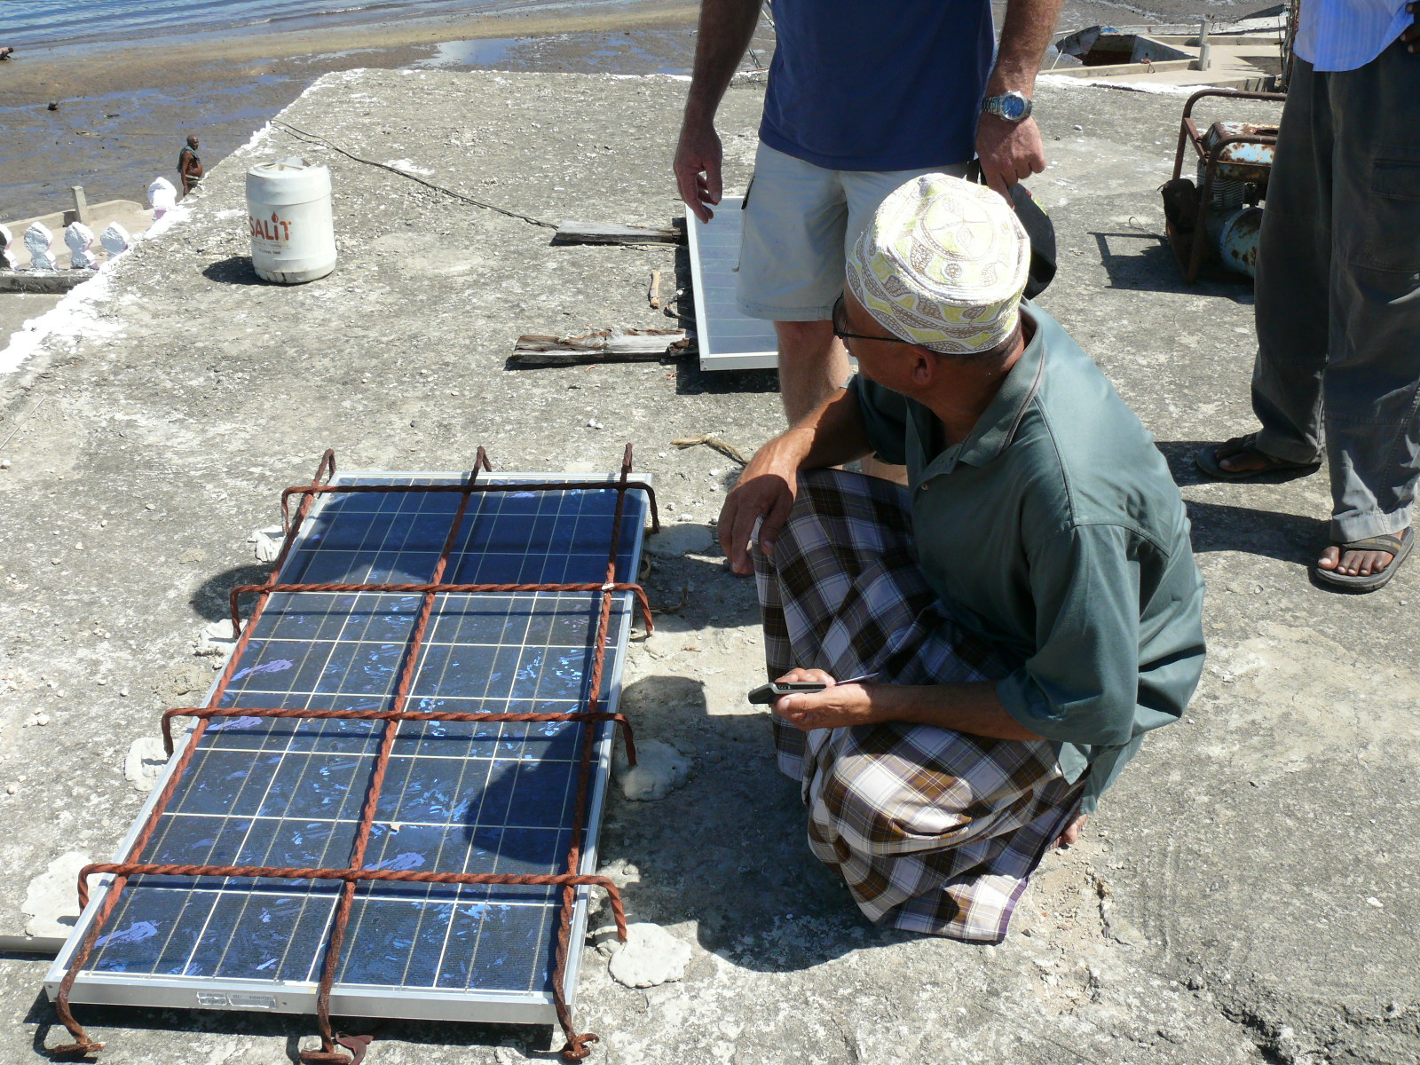
Solar Home System

Slide 27
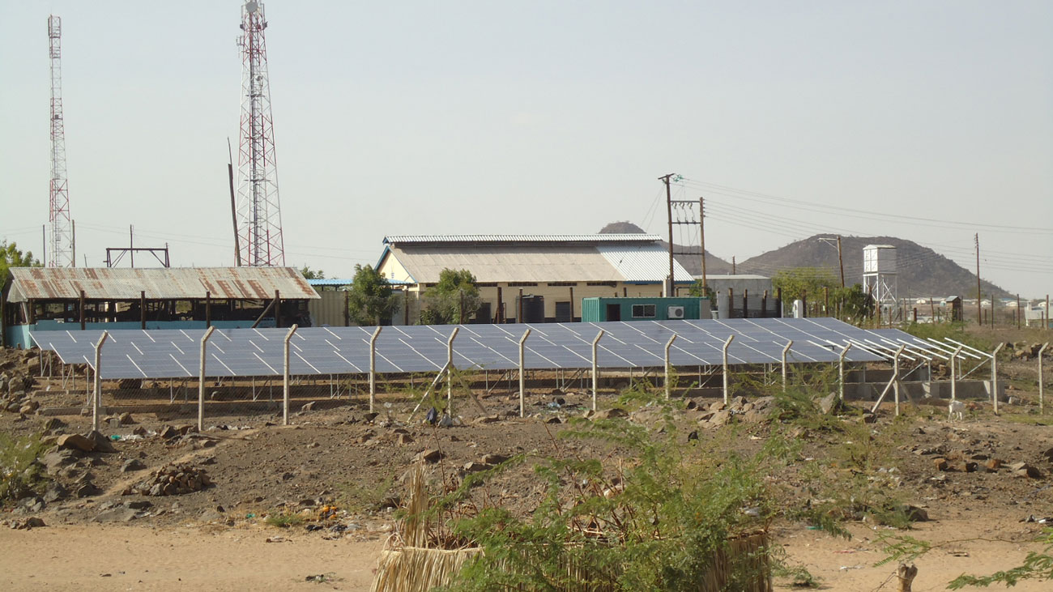
KPLC, Lodwar Mini-Grid, 60 kWp

Slide 28
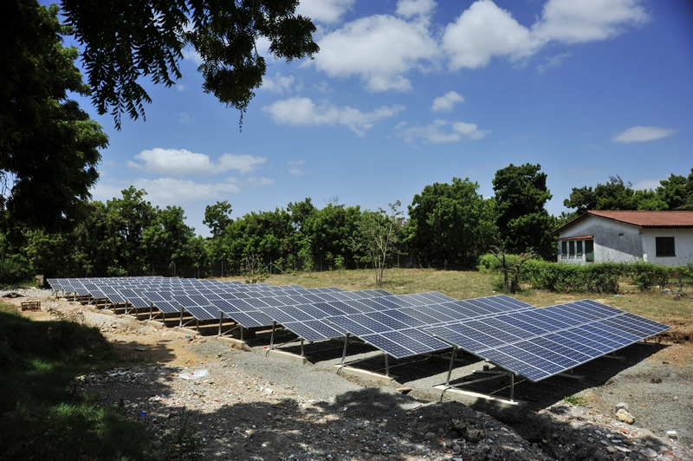
SOS Children’s Village 60 kW, on-grid
© GIZ

Slide 29
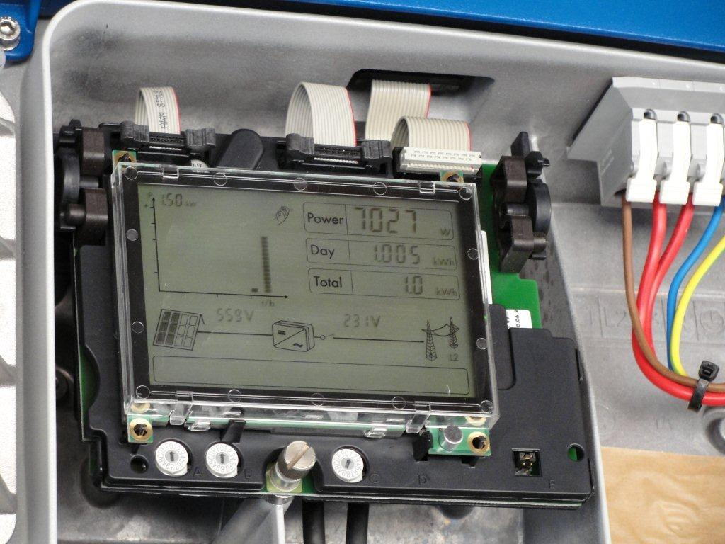
SOS Children’s Village 60 kW
First ever kWh of solar electricity in the Kenyan grid!
© GIZ

Slide 30
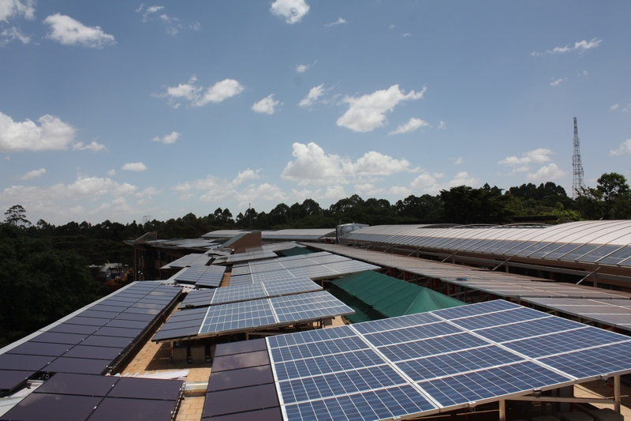
UNEP 515 kW, on-grid
© GIZ

Slide 31
Policy & Regulatory Framework
Market Segments and – Status: Overview
 | Decentralized / Off-Grid |  |  |  |  |  | On-Grid
 | Solar Water Heating | Pico PV | Solar Home Systems | Small PV Systems | Solar Pumping | Mini-grid | PV-Net-Metering | PV-IPP
Current state of market development (1-3) | 2 | 1 | 3 | 2 | 1 | 1 / X (no concessions) | X (no regulation) | 1
Growth potential (1-3) | 2 | 3 | 2 | 2 | 2 | 2 | 3 | 3
Energy user / customer | All | Households, Productive | Households, Productive | Households, Productive, Institutions | Productive | All | All | All
Typical Volume in Wp | n/a | < 10 Wp | < 120 Wp | < 25 kWp | < 30 kWp | < 500 kWp | < 500 kWp | > 500 kWp
Typical Volume in € | n/a | <50 € | <500 € | < 80,000 € | < 100,000 € | < 5,000,000 € | < 1,250,000 € | > 1,250,000 €
Regulatory needs | Standards | Standards | Standards | Standards / procurement | Standards | Standards / procurement / concession | Standards / net-metering regulation | Standards / FiT (or equivalent)
Regulatory complexity (1-5) | 1 | 1 | 1 | 2 | 2 | 2 / 3 (concession) | 2 | 3
Business models | Retail | Retail / Lease | Retail | Retail / ESCO | Retail | Retail / ESCO / Utility | Retail / ESCO | Retail / IPP
Business complexity (1-3) | 1 | 1 / 2 | 1 | 2 | 1 | 1 / 2 / 3 | 1 / 3 | 1 / 3
Source: own illustration

Slide 32
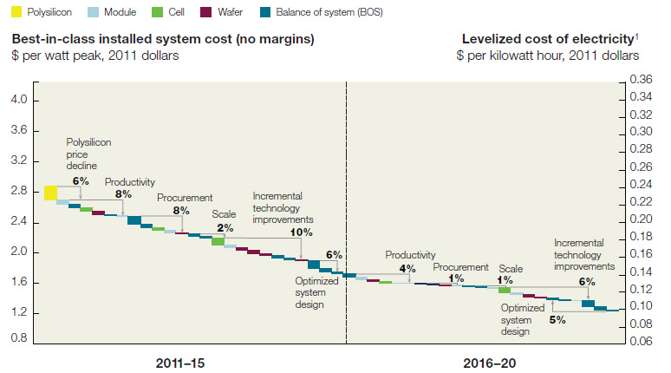
Market Segments and – Status
In Focus: on-grid PV
Substantial and continued reduction of solar PV cost (2006-2012: -65%)
Source: McKinsey 2012

Slide 33
Market Segments and – Status
In Focus: Grid-connected solar PV in Kenya
Competitiveness of on-grid PV in Kenya
Ranges in graph reflect a) customer categories, b) solar scenarios (Annex 1)
Grid LCOE probably to slightly increase in 2011 prices
PV LCOE will further reduce, as technology & market mature
Grid parity: now / within 1-2 years
Grid parity outlook for levelised grid and solar PV costs (LCOE!) in Nairobi (worst case!)
Source: GIZ 2011
*exchange rate see Annex 2

Slide 34
Market Segments and – Status
In Focus: Grid-connected solar PV in Kenya - The game is changing!
Solar PV prices have reduced dramatically, further reduction is anticipated, though slower price decline
Alternative / conventional power supply costs are likely to remain stable (inflation adjusted) or increase (with inflation)
Due to the scalability of solar PV, self supply (on-/off-grid) is likely to be a huge growth market
Light-handed regulation (net-metering, low-voltage “power transport”) is needed to “enable” the on-grid-”self-supply” market

Slide 35
Outlook

Slide 36
Outlook: Challenges and Opportunities
Challenges
Private sector remains largely sidelined, sector predominantly procurement
Policy & planning: solar PV still perceived as unviable, market information not up to date, PV not reflected in sector planning
Know-How: new markets, new products; quality! (products / services)
Partner: needed for know-how transfer; reliability, readiness for technology transfer by partners (→ EU companies’ advantage over int. competitors)
Framework: less “make” PV viable, but rather to unleash viability in the market; both policy as well as process
Financing: specific needs of (front loaded) solar PV investments; lack of experience in know-how in FI’s, high interest rates

Slide 37
Outlook: Challenges and Opportunities
Opportunities
Environmental benefits, where fossil fuels are substituted
Energy Access:
  Off-grid: solar appliances directly at end-user level, increased access
  On-grid:
    Increased supply / stability, reduced system losses / power cuts
    Interaction with hydro-power (dispatchable hydro for peak supply, solar PV to “fill the dams”) – up to 25%, i.e. 350 MW (???)
Decentralized value addition, employment & income through installation, operation and maintenance
As market volume grows, local manufacture / assembly becomes realistic

Slide 38
Outlook: Stimulating Growth Markets
Needs: Interventions by market segment and type (RECP-approach)*
 | Policy Frameworks | International (EU-AF) Partners | Project Preparation & Financing | Capacity building
Pico-PV | Standards | - | End-users Distributors | Business Financing
SHS | Same (i.e. same type, NOT same interv.) | Same | Same | Same + Technical
Mini-grids | Standards Tenders (quality) Concessions | Technology Project development / operation | Bankability Project financing | Business Technical Financing
Net-metering | Standards Regulation | Same | Same | Same
IPP | Same | Same | Same + FiT premium | Same
*RECP = Renewable Energy Cooperation Programme, under Africa-EU Energy Partnership, see Annex 2

Slide 39
Outlook: Stimulating Growth Markets
Existing Solar Market Interventions (here: KE), and New Proposals
 | Existing Intervention | Proposed additional / complementary Intervention | Approx. Volume
Sector Planning | AfD-support to LCPDP | TA: Coherent inclusion of RE in LCPDP TA: “RE Master Plan” (possibly merge with LCPDP) | 0.5 M EUR
Pico-PV* | Lighting Africa, GIZ | FA: re-financing of MFI’s | >10 M EUR
SHS* | - | TA: vocational training FA: re-financing of MFI’s | 5 M EUR >10 M EUR
Mini-grids* | SREP / World Bank | TA/FA: Mini-grid Market Development Programme | 10 M EUR
Net-metering* | - | TA/FA: “10.000 Rooftop Programme” | 15 M EUR
IPP* | World Bank; EDFI’s; AFD /–RTAP | TA/FA: GET FIT TA/FA: AFD credit line / RTAP scale-up | >20 M EUR >30 M EUR
*Perspective for blending instruments

Slide 40
Outlook: Stimulating Growth Markets
Summary & Key Messages
Solar PV has been regarded as “toys”, as unviable (too small, to pricey)
Playing field between solar (small / meso renewables in general) and conventional power sources is not level
Despite this: Technological & market advances, maturing technology → new viability and opportunities emerge, in particular self-supply
New opportunities for PV are not (yet) on the radar of govts and donors
“Solar Will Come” – how soon, how much, how efficient, how beneficial?
→ Need for focused action, targeting specific market segments with an integrated & comprehensive set of support interventions, towards developing sustainable markets

Slide 41
Thank you for your attention
Questions & constructive feedback are always welcome
Michael Franz michael.franz@euei-pdf.org

Slide 42
Annex 1
Cost of on-grid PV in Kenya (Q3 2011, since then approx. -25%)
CAPEX & OPEX |  | Solar PV technology costs
CAPEX CIF |  | 2530 EUR/ kW_{p} (system size 30-100 kW_{p})
O&M expenses |  | 50.6 EUR/kW_{p}/year (2% of CAPEX)
Location |  | Solar PV financing costs
 |  | Private investor | Commercial investor
LCOE (20 years) in Nairobi |  | 27.18 c€/kWh | 30.81 c€/kWh
LCOE (20 years) in Kisumu |  | 21.01 c€/kWh | 23.82 c€/kWh
Nairobi Capacity factor (Average annual insolation of 5.01 kWh/m2/day [NASA] and a Performance Ratio of 75%) Kisumu Capacity factor (Average annual insolation of 6.48 kWh/m2/day [NASA] and a Performance Ratio of 75%) KES/EUR: 120 | 15.66% 20.25% | Calculation inputs: Capital structure: 50% debt, 50% equity Cost of equity: 10% Cost of debt: 10% (no tax-shield considered) Discount rate: 10% | Calculation inputs: Capital structure: 50% debt, 50% equity Cost of equity: 15% Cost of debt: 10% (no tax-shield considered) Discount rate: 12.5%
Source: GIZ 2011

Slide 43
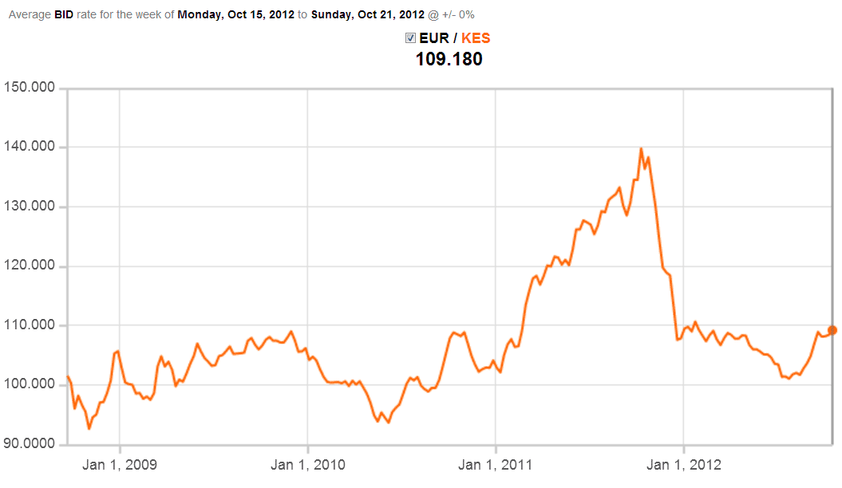
Annex 2
Exchange rate Kenya Shilling / EURO (2009-2012)
Source: http://www.oanda.com

Slide 44

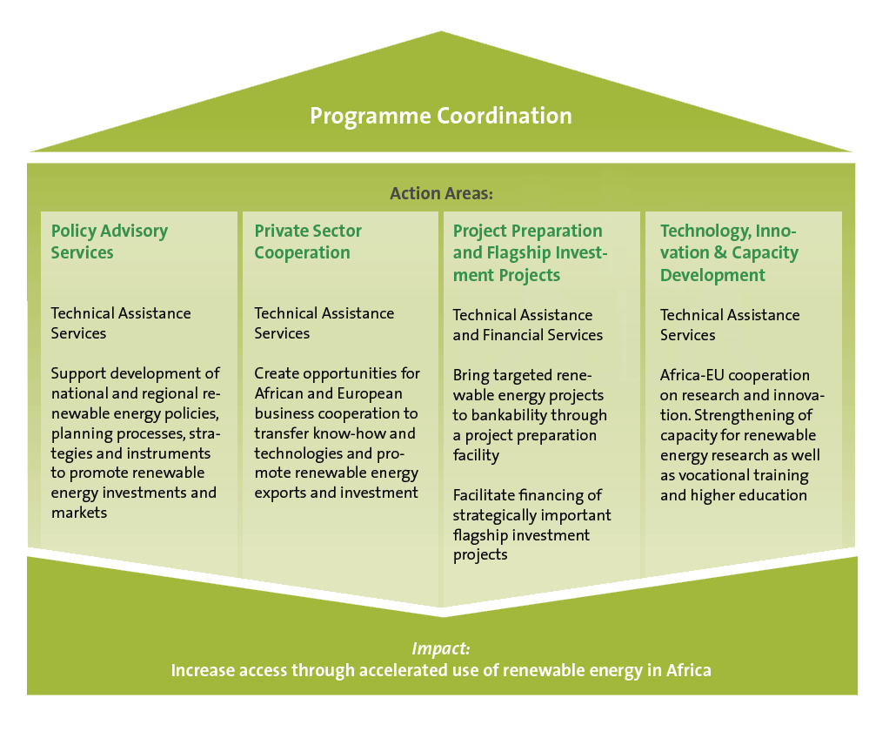
Annex 3
Renewable Energy Cooperation Programme (RECP) – Overview
Programme with integrated interventions for RE Market development
Instrument of the Africa-EU Energy Partnership (AEEP)
Launched at AEEP-High-Level meeting in 2010
Currently in start-up phase, funding from EC, implemented by AFD and EUEI PDF

