Slide 1
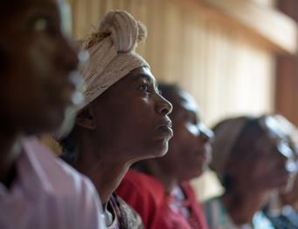
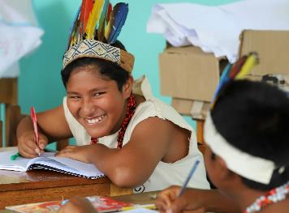
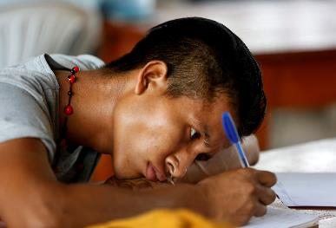
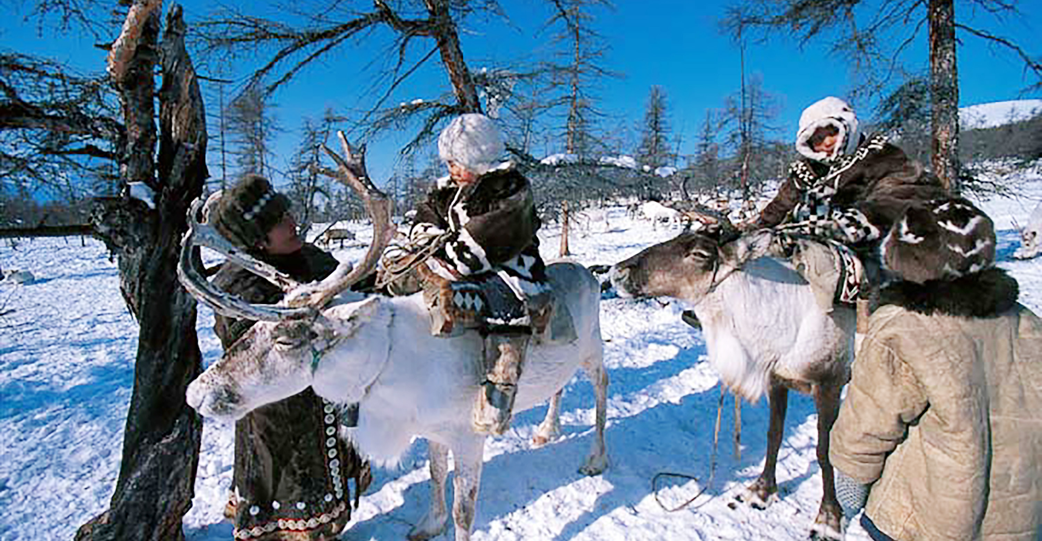
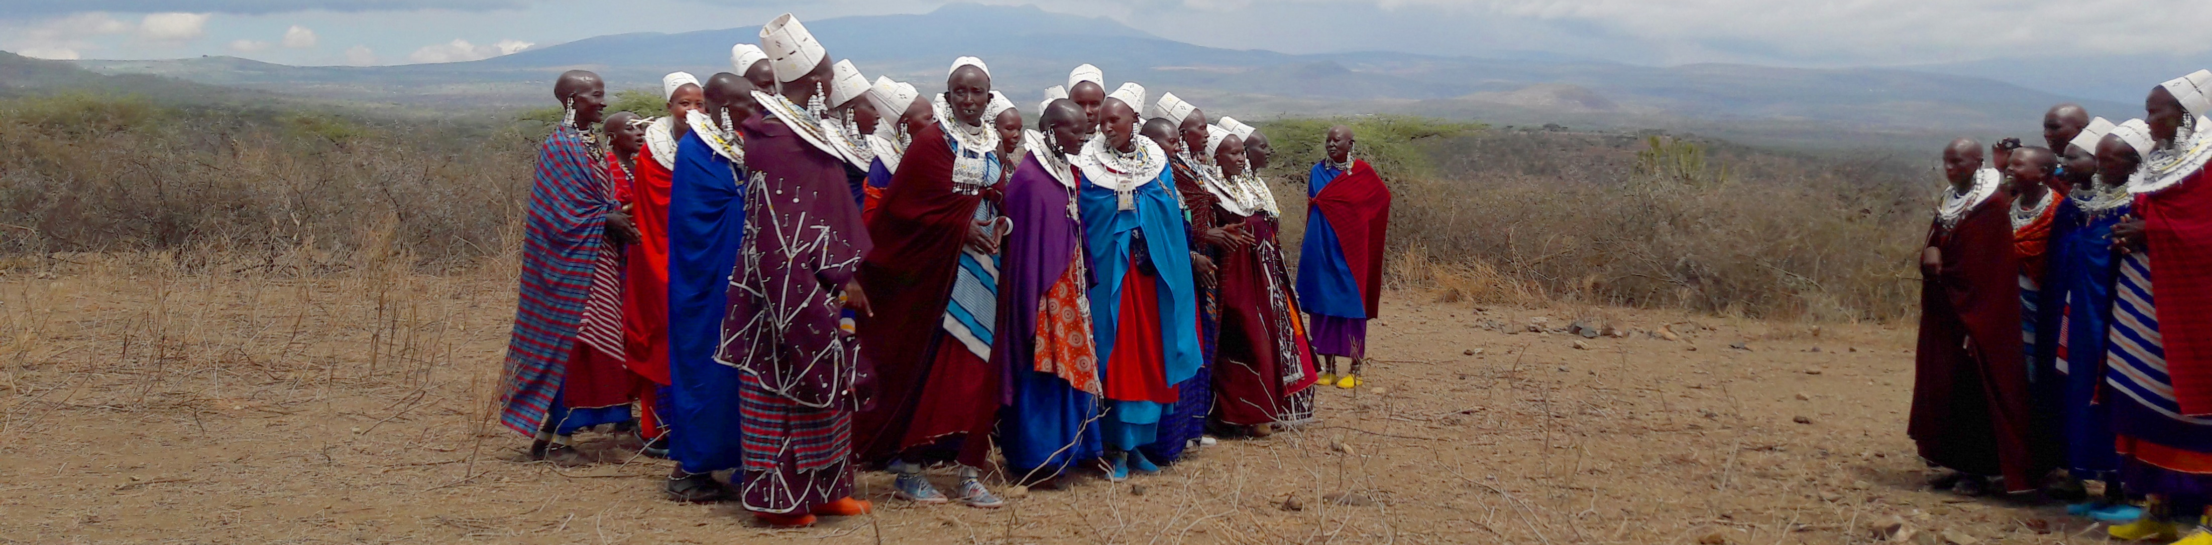
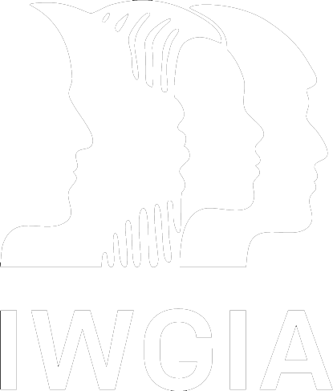
Situation of Indigenous Peoples’ Rights
Notes:
Hi, my name is Dwayne Mamo and I’m the Documentation and Communications Manager for IWGIA, the International Work Group for Indigenous Affairs.
We are a global human rights non-profit organisation based in Copenhagen and have been working directly with local Indigenous Peoples organisations around the world and with local leadership since 1968.

Slide 2
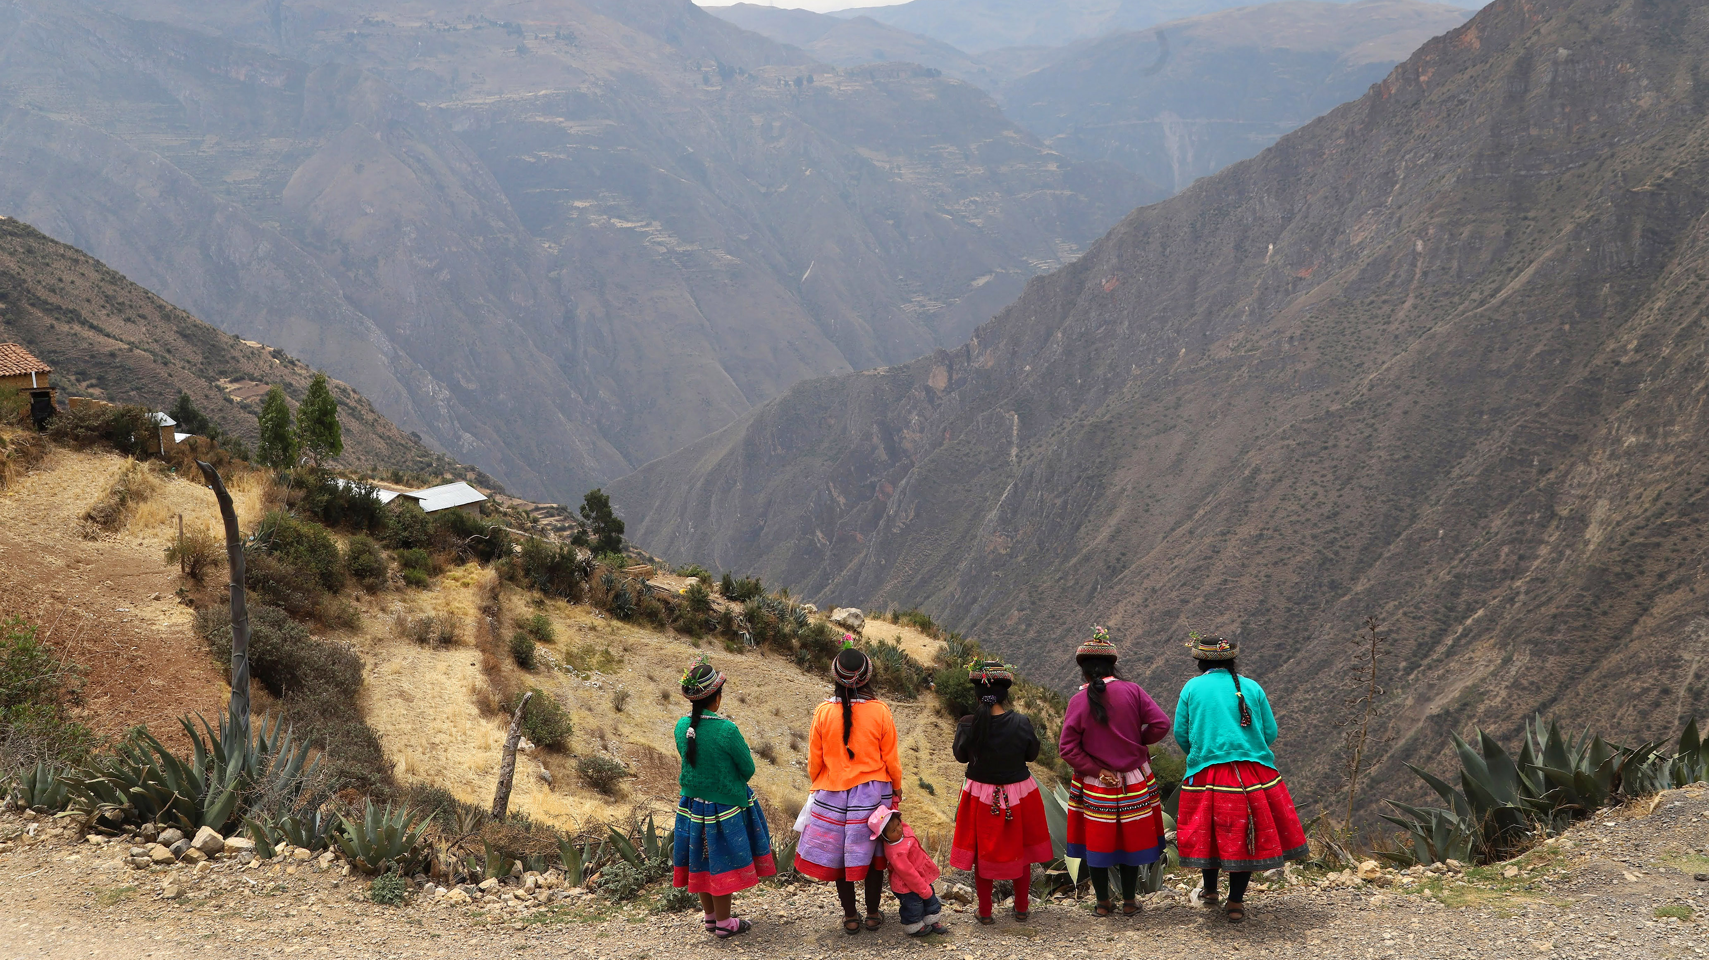
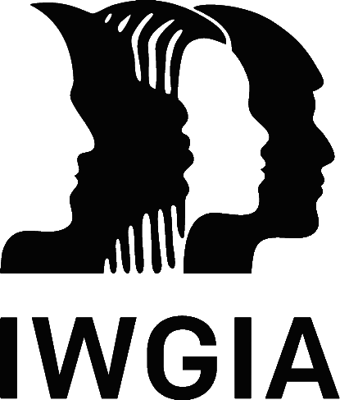
476 million Indigenous Peoples worldwide
6% of the world’s population
More than 19% of the world’s extreme poor
5,000+ distinct Indigenous communities
Speak 4,000+ languages

Slide 3
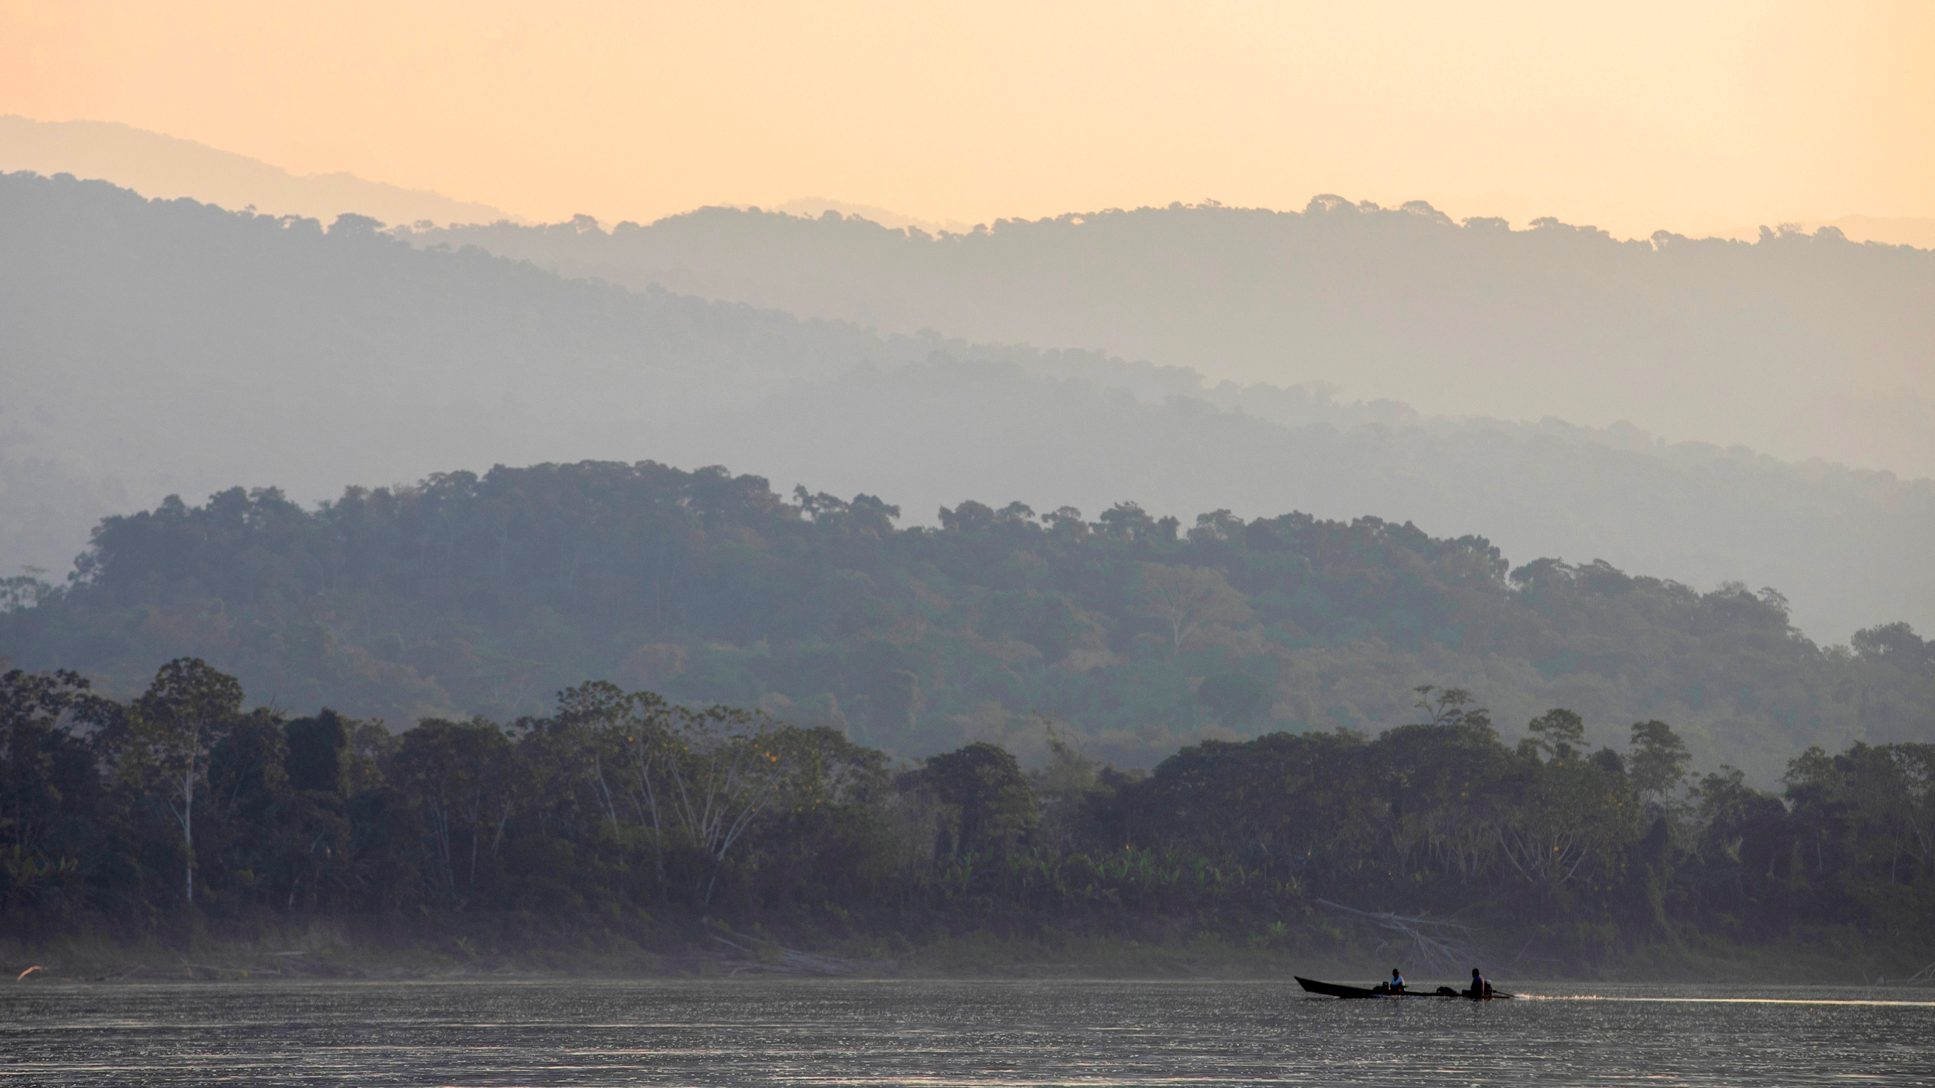
Indigenous Peoples’ lands & territories constitute at least
28% of the global land surface
including
unique ecosystems & vital biodiversity

Slide 4
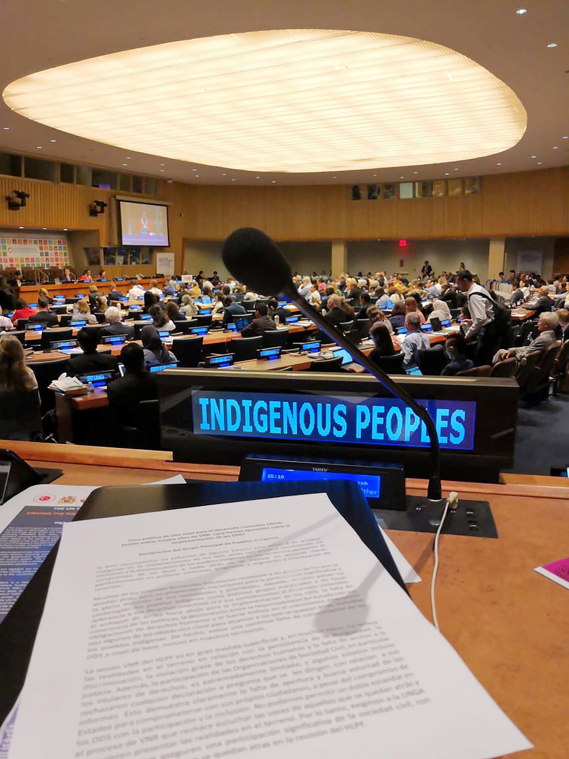
Indigenous Peoples’ rights recognised in
ILO Convention 169 on Indigenous and Tribal Peoples (1989)
and
UN Declaration on the Rights of Indigenous Peoples (2007)
Notes:
IPs can fight for their rights and recognition through the primary legal framework of ILO169 and the UNDRIP, through various mechanisms and processes: ACHPR, IAHRS, UNPFII, EMRIP, UNSRIP, etc.
Five EU Member States have ratified ILO Convention No 169 -- Denmark (1996), The Netherlands (1998), Spain (2007), Luxembourg (2018) and Germany (2021) -- and the EU expressed its endorsement of the UNDRIP, which has been adopted by 148 UN Member States.
2022 was an important year globally for Indigenous Peoples as it marked the 15th anniversary of the adoption of the UNDRIP, the most comprehensive instrument to ensure the minimum standards of recognising, promoting and protecting Indigenous Peoples’ rights.
What makes this unique is that it recognises IPs collective rights as opposed to other human rights instruments that focus on individual rights.
However, 15 years on, there is a wide gap between what the UNDRIP guarantees and how States actually ensure these rights are protected.

Slide 5
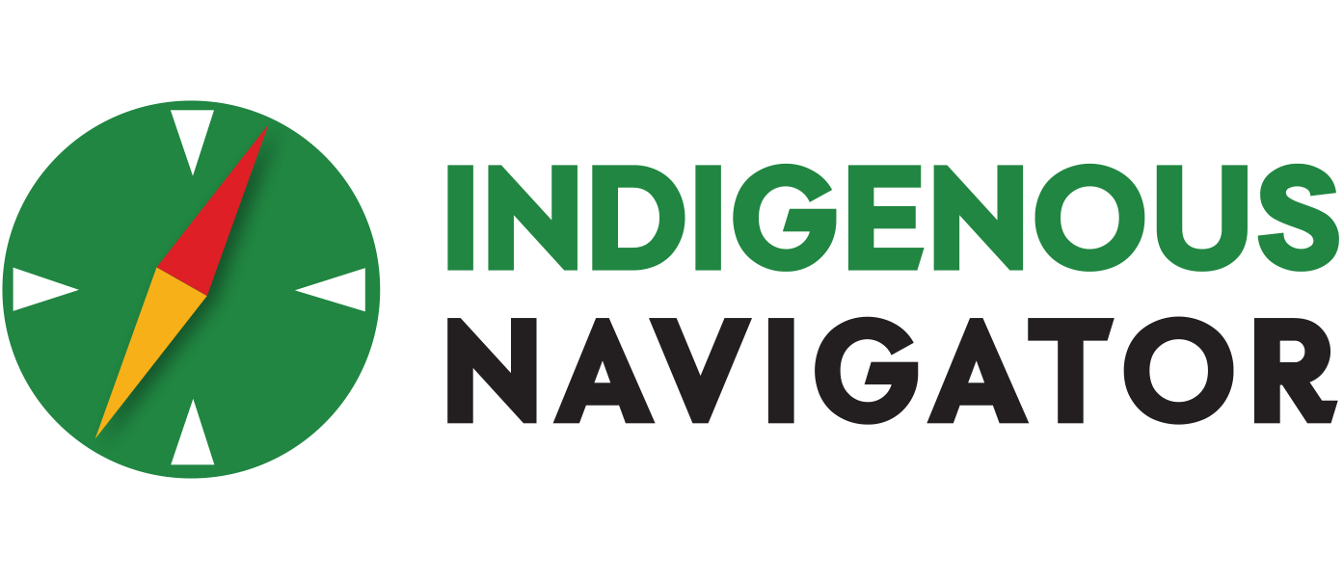
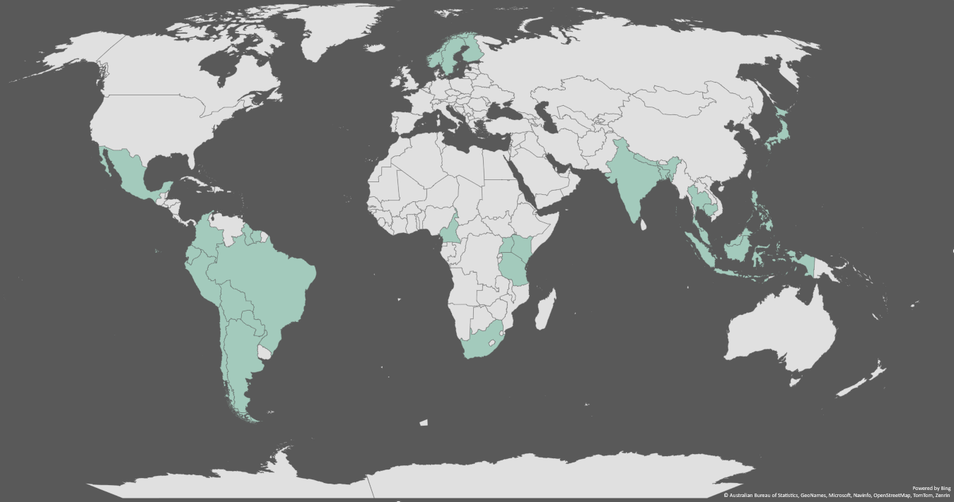

Notes:
Because of this gap it makes it increasingly important to monitor implementation. One way Indigenous Peoples do so is through the global initiative called The Indigenous Navigator, of IWGIA is one of the founding members
The Navigator, which is funded by the EU, and is carried out in 28 countries in over 300 Indigenous communities, is a set of tools for and by Indigenous Peoples to systematically gather their own data and use it for multiple purposes.
One such purpose is as a community-based framework for monitoring such instruments as the UNDRIP or SDGs, for example, where IPs generate data and documentation that empower them to demand respect and implementation of their rights.

Slide 6
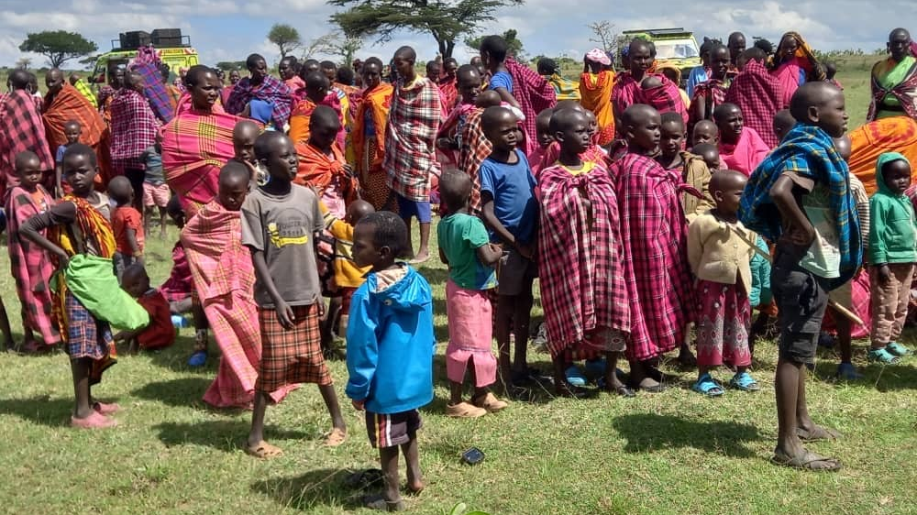
Land dispossession
Eviction
Criminalization
Harassment
Detention
Arrest
Systemic discrimination
Killing
Notes:
Monitoring these rights is critical as the human rights situation of Indigenous Peoples is worsening.
The rise of autocratic and populist leaders, and a shrinking civic space for organisations addressing human rights issues, combined with existential threats from state and corporate actors – often in the form of large development projects, extractive industries and expansion of national parks and protected areas – continues to pose increased risks to the well-being, land tenure security and survival of Indigenous Peoples.
Climate change further exacerbates violations of Indigenous Peoples’ land and autonomy rights and, in some cases, their cultural and physical survival as they live on lands with some of the highest reserves of fossil fuels, minerals and forests.
Confronted with growing global demand for these natural resources, increased deforestation, and so-called green solutions to global climate change and biodiversity loss – including conservation efforts – Indigenous Peoples’ rights to own and control their own lands and resources and to determine their own futures are significantly constrained and often completely denied.
As they fight to defend their lands, they are labelled an obstacle to development or progress and face oppression, something that has become increasingly visible and violent, which is paradoxical given the centuries of knowledge they hold for the sustainable use of their lands.

Slide 7
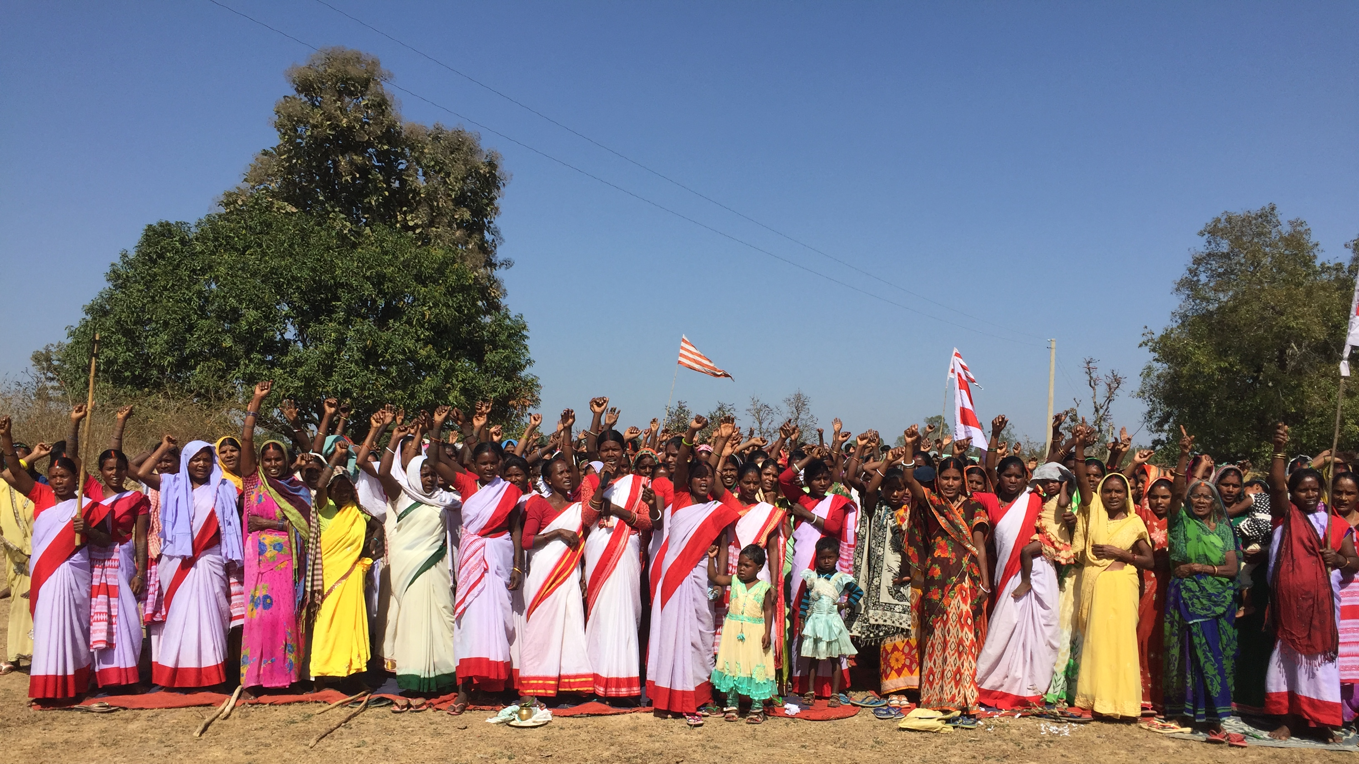
Convention on the Elimination of All Forms of Discrimination Against Women (CEDAW)
General Recommendation 39
specific recommendation on Indigenous women and girls
Notes:
Next I would like to speak a bit about Indigenous women, one of the main focus areas of IWGIA.
Indigenous women play crucial roles in their communities as breadwinners, caretakers, knowledge keepers, leaders and human rights defenders.
After nearly 20 years of collective actions and advocacy, the Indigenous women's movement succeeded in getting CEDAW to develop a specific recommendation on Indigenous women and girls, which was adopted on 26 October as General Recommendation 39.
The recommendation promotes the voices of Indigenous women and girls as agents of change and leaders both inside and outside their communities and addresses the different forms of intersectional discrimination frequently committed by State and non-State actors.
The adoption of GR39 is not only important for the explicit protection it guarantees Indigenous women and girls worldwide but is also a significant and inspiring example of what collective and concerted efforts by a large, dedicated group can achieve in the face of seemingly endless obstacles.

Slide 8
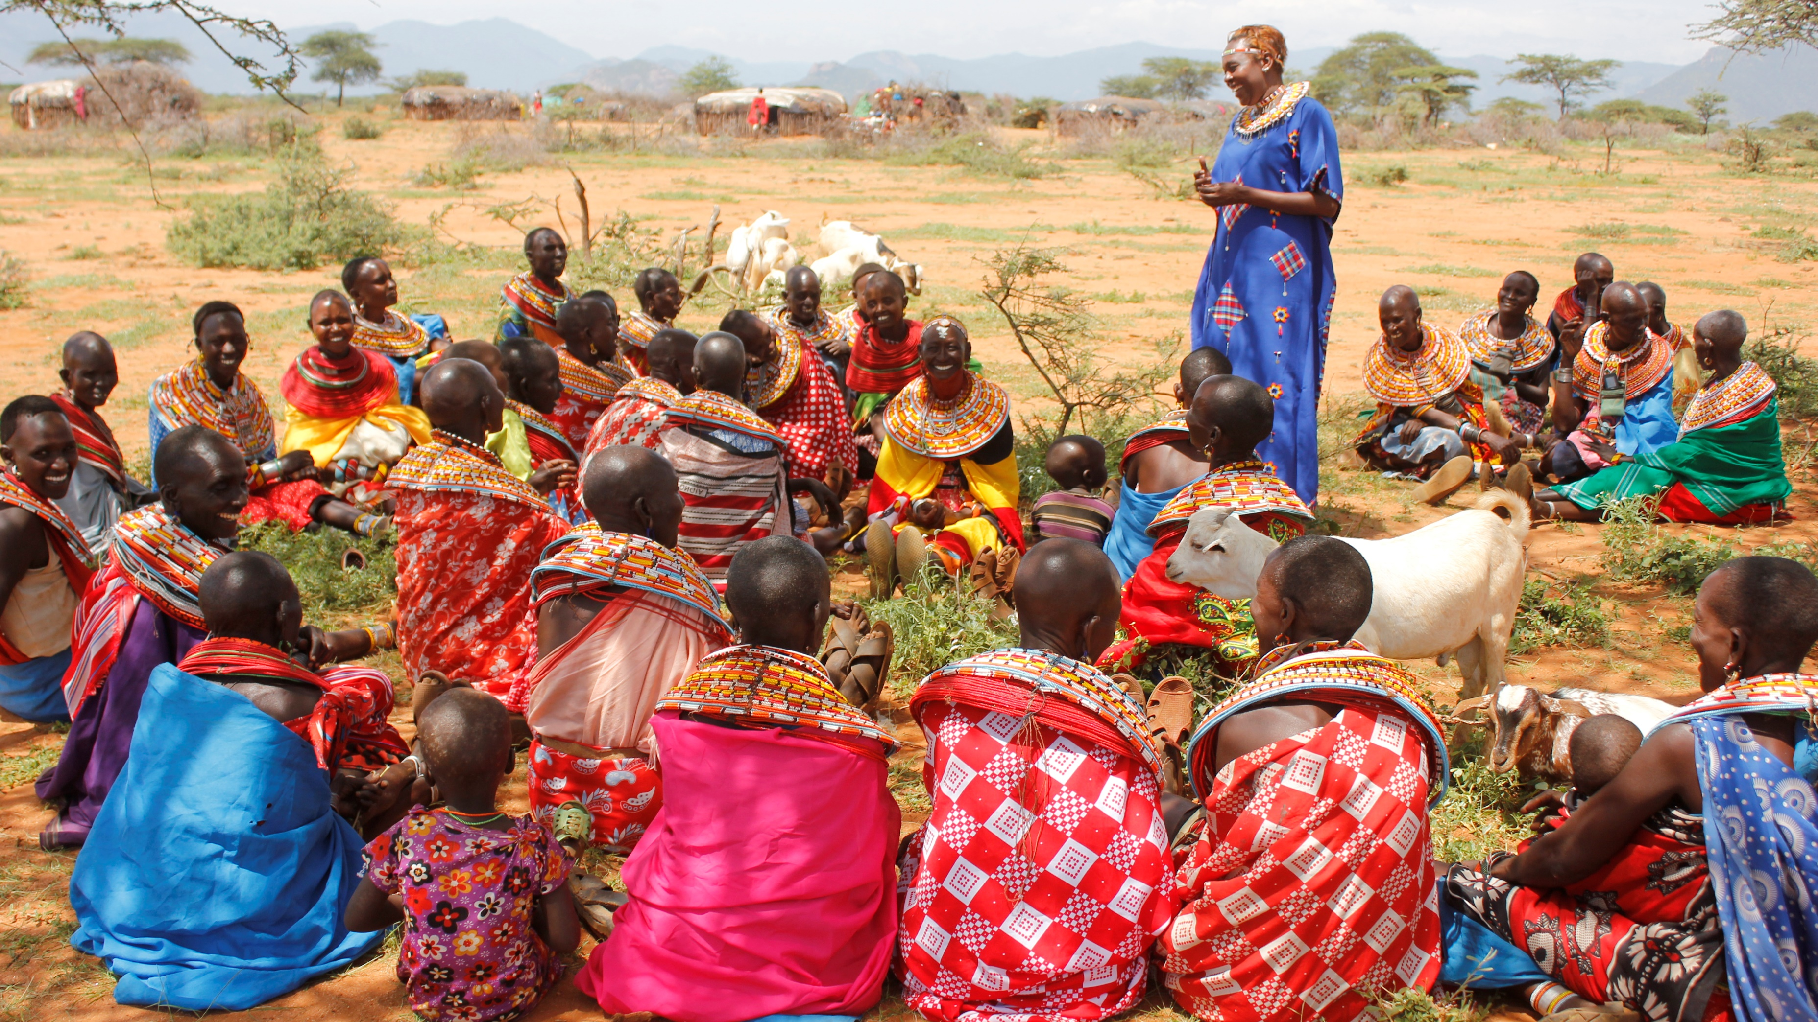
Sexual violence
Rape
Trafficking
Under-represented
Left out of decision-making
Politically targeted
Forced sterilization
Killing
Notes:
Because while Indigenous woman have made such a significant advance, the reality remains that they are massively under-represented, disproportionately negatively affected by the decisions made on their behalf without their valuable input, and all too frequently the victims of violence and sexual assault.
Violence against Indigenous women and girls occurs in contexts such as during armed conflicts and militarization of their territories, during the implementation of development, investment and extractive projects, as well as in conservation efforts.
In several countries noted in the upcoming edition of The Indigenous World, such as Bangladesh, India, Myanmar, Nepal, Kenya, the Philippines and Thailand, the militarization of and conflict over Indigenous land has led to gang-rape, sexual enslavement, forced labour, trafficking and the killing of Indigenous women and girls.
In Nepal for instance, Indigenous women and girls amount to almost 80% of the total of trafficked persons, although the proportion of Indigenous Peoples in Nepal is only officially 37%.

Slide 9
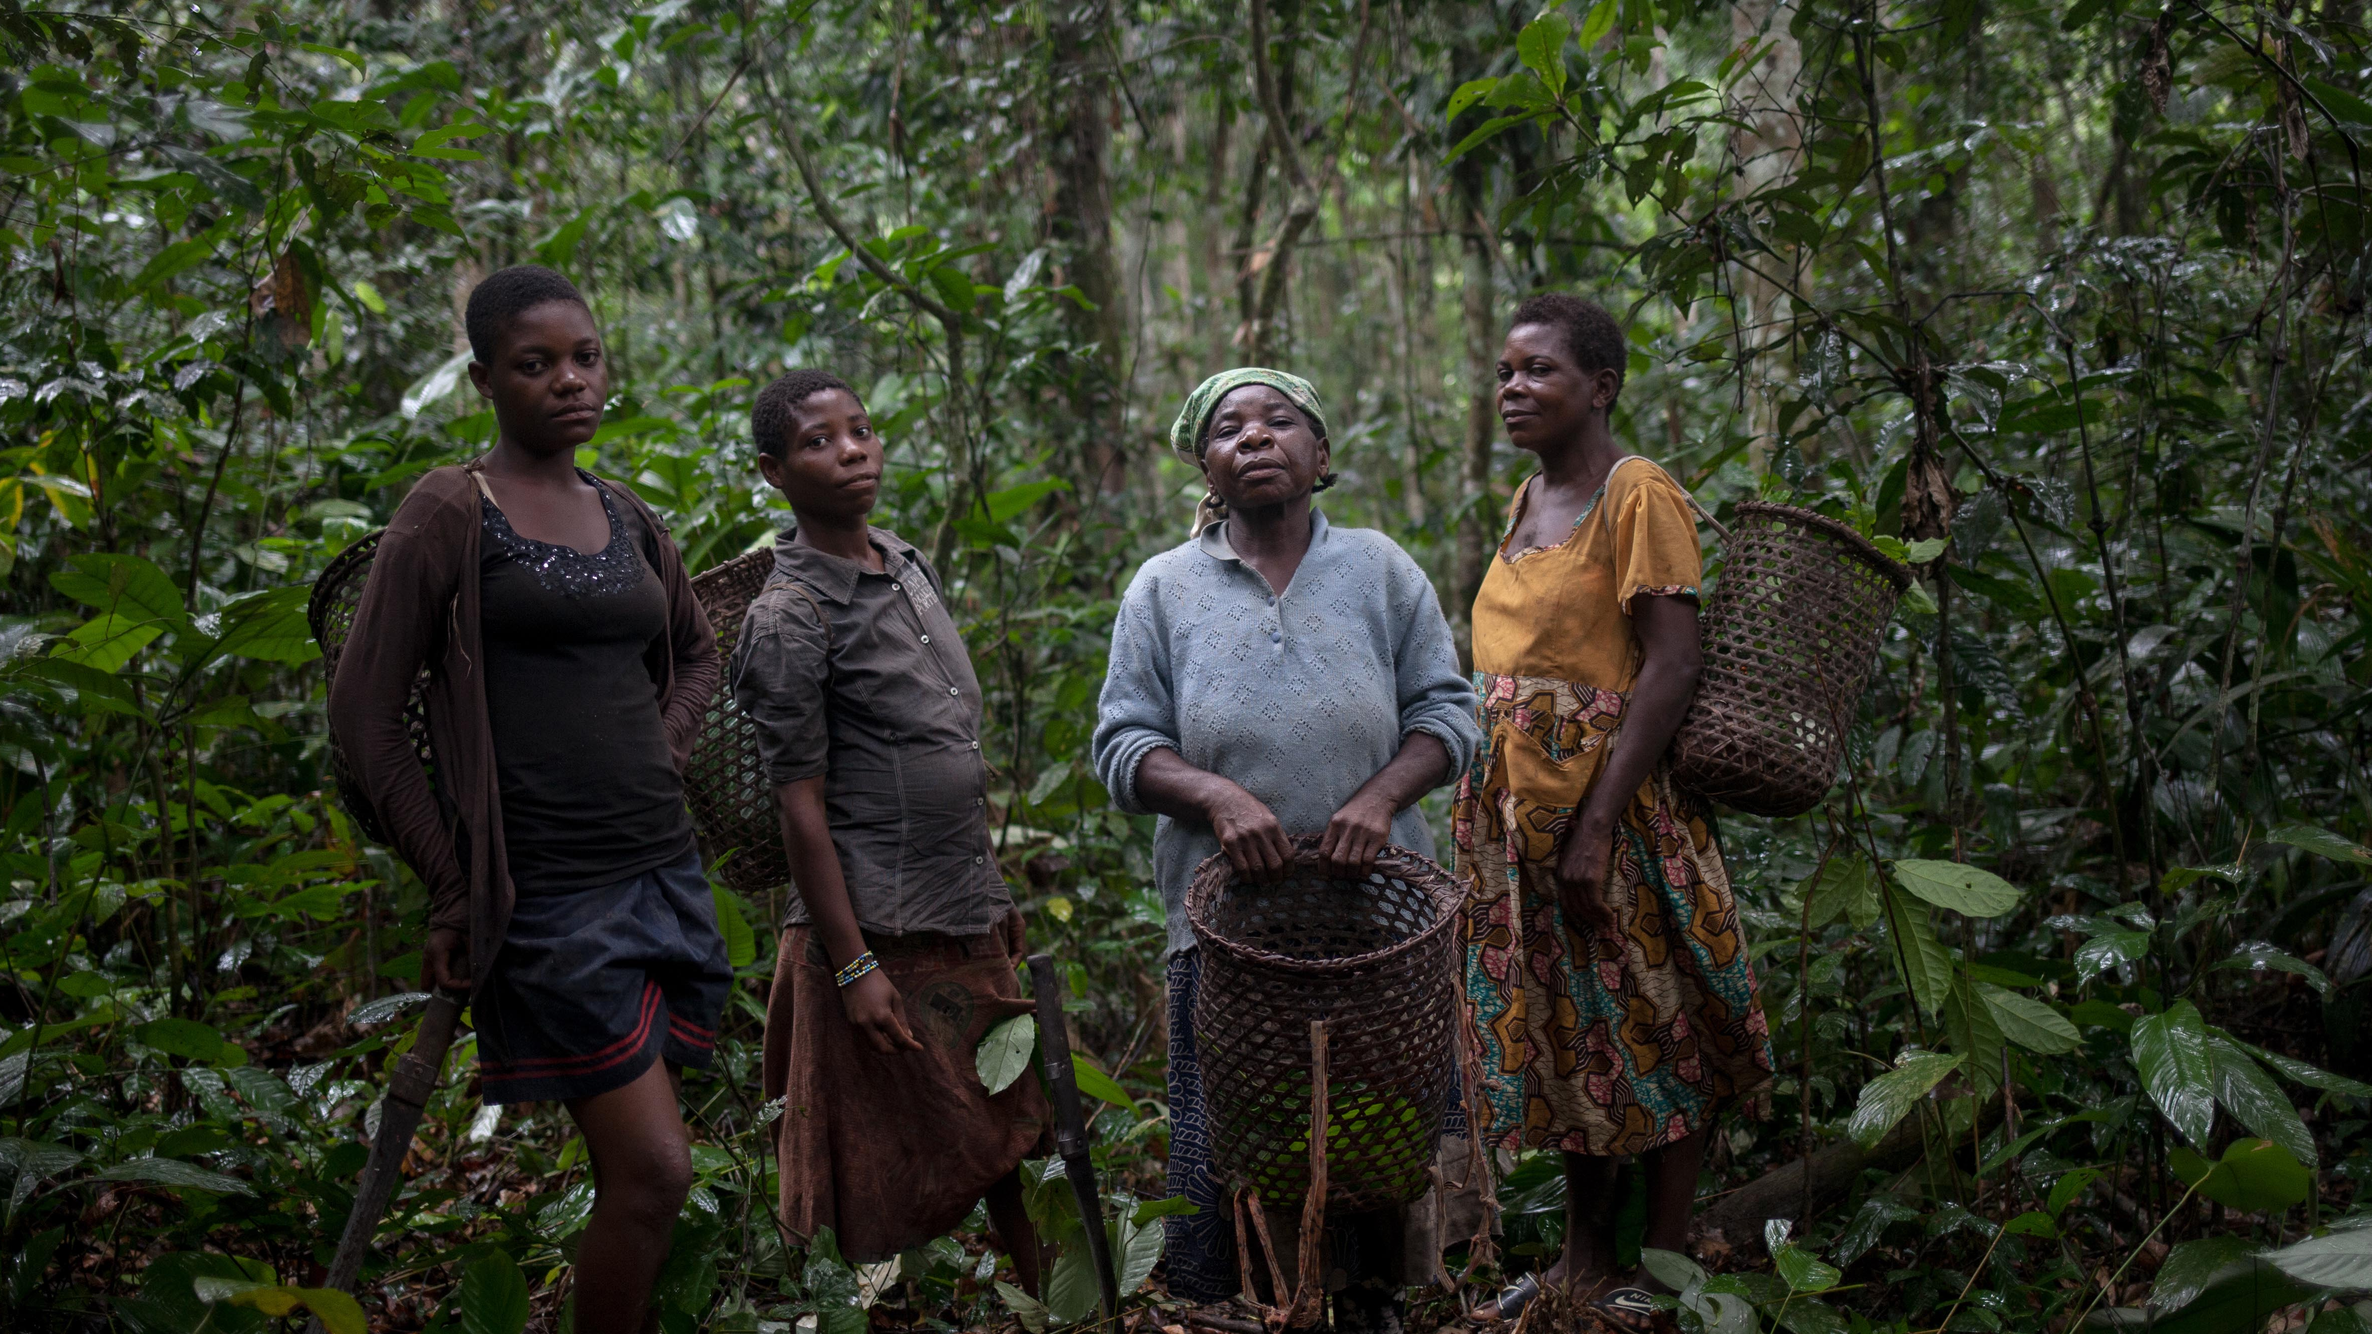
Fortress conservation
Wildlife | People
Notes:
So how does this all manifest in what we’re hear to discuss today?
For too long, the important voices of Indigenous Peoples have not been heard and their land, territory and resource rights have been ignored when vital decisions are taken regarding the future of our planet.
In recent years, this has started to change and Indigenous Peoples have achieved increasing recognition for the vital role they play in ensuring the sustainable use and management of their land, territories and resources.
In fact, an emerging consensus recognises that respecting Indigenous Peoples’ rights is one of the most effective means in the fight against climate change.
Despite this, Indigenous Peoples’ rights continue to be violated in global climate action.
What we see is that State-owned and controlled conservation or protected areas often employ an outdated tactic of fortress conservation, what I like to the “wildlife in, people out” model. As we report in the Indigenous World 2023, this is still the way conservation is viewed and practised in countries such as Bangladesh, Cameroon, Chile, India, Nepal, Tanzania, Thailand, Tunisia and Uganda, to name but a few.
This is a very damaging misunderstanding of what conservation can be.
And what it does is give governments the impetus to demarcate areas as conservation areas and evict people, often Indigenous, at will. When this happens, it is often done violently, without notice, without the involvement of those being evicted, and without any plans to rehabilitate and rehouse the displaced.
Governments, supported by international conservation corporations, form partnerships seemingly for the benefit of nature but with detrimental effects for Indigenous Peoples who are losing their rights and access to the lands, territories and resources they have protected and depended on for millennia.

Slide 10
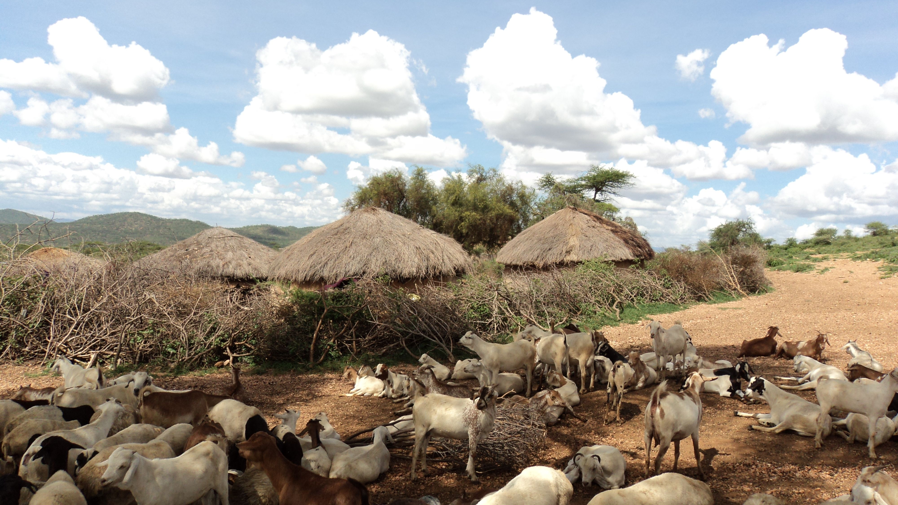
Tanzania
Loliondo division, Ngorongoro District
Notes:
One glaring example of State-controlled conservation gone wrong is taking place all over Tanzania where the government continues to expand conservation and protected areas further and further into Indigenous ancestral lands, regardless of the human cost.
In June 2022, the government moved ahead with its plan to create a 1,502 km² game reserve – Pololeti Game Reserve – by sending in a 700-strong paramilitary group to demarcate the land, which led to severe violence causing hundreds to flee into hiding.
Dozens of people were injured and one police officer was killed, leading to the arrest of 24 Indigenous persons, many of them leaders, on conspiracy to murder charges that were eventually dropped due to lack of evidence but were seen as a tactic to silence voices.
Nevertheless, 240 homesteads were demolished, leaving 600 women, children and young men homeless and, since the establishment of the reserve, more than 11,000 head of livestock have been confiscated for grazing on the traditional grazing lands.

Slide 11
Notes:
This is a picture of some of those 600 displaced women and children.
Similarly, Ruaha National Park in Tanzania is slated to expand again, even though when it was last increased in 2008 officials announced that there would be no further growth.
This next phase will lead to the relocation of several villages.
In previous phases, government-led relocations were done without proper planning or FPIC and Indigenous communities fear the same will happen again.
As was the case in the Ngorongoro Conservation Area in 2022 where 3,000 Maasai were relocated to another village, creating land-use conflicts between existing villagers and the newcomers.

Slide 12
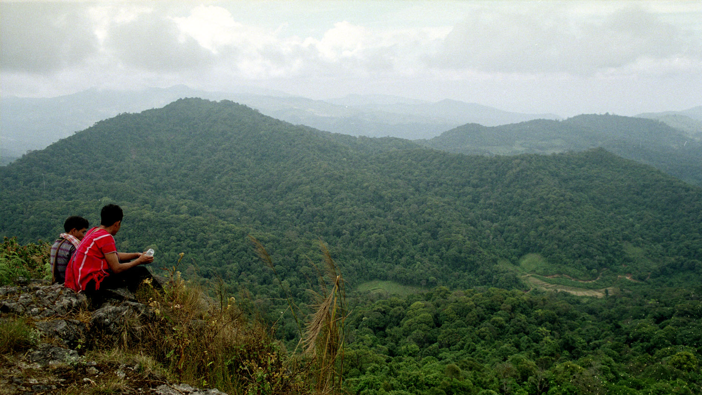
Cambodia | Thailand | Laos
Notes:
In Cambodia, the government is continuing to implement forest conservation (REDD+) projects without the involvement or FPIC of Indigenous Peoples. Further, an important law on protected areas that enshrined Indigenous Peoples’ rights to lands was amended in 2022 to replace the term “Indigenous Peoples” with “local communities”, which now denies Indigenous Peoples in the country their collective land rights as peoples, as guaranteed in the UNDRIP.
In Thailand, the government continues to use fortress conservation, which has led to conflicts between Indigenous Peoples and the government as well as the criminalisation of Indigenous Peoples who carry out traditional, sustainable activities in protected areas. In 2022, there were 1,502 legal cases against community members for practicing their traditions on their lands as they have for centuries.
In Laos, one-third of the country is made up of 23 protected biodiversity areas in which over 840,000 people, including Indigenous communities, live who are heavily dependent on the natural resources therein. But their lives are being threatened by the creation of so-called Totally Protected Zones that will restrict human access, as outlined in new agreements in 2022 between government officials and security forces.

Slide 13
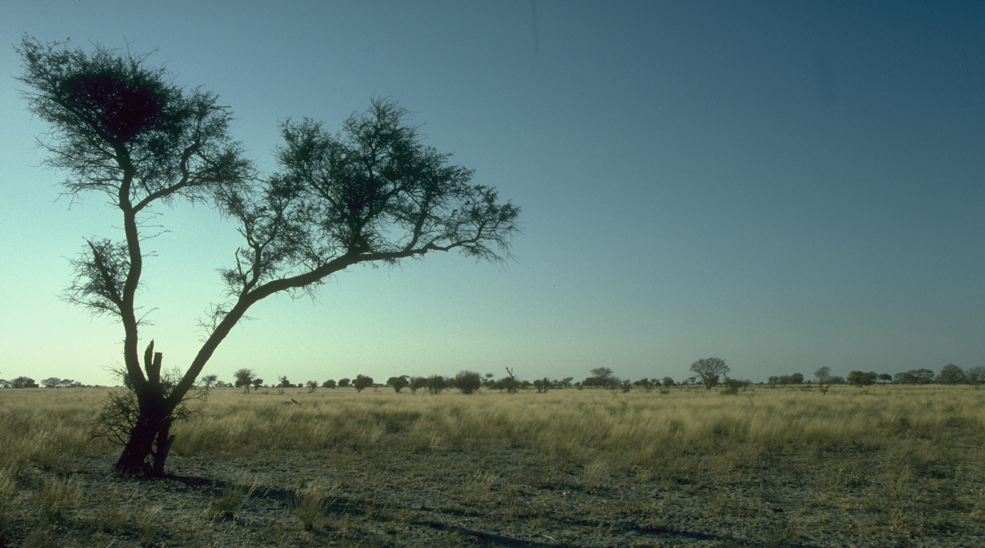
Namibia
86 communal conservancies
Covering 166,045 km²
Comprising 238,701 people
Biological diversity
Wildlife population
Notes:
There are also good examples of how conservation can benefit biodiversity and people.
For example in Namibia, a country considered by the IUCN (International Union for Conservation of Nature) to be a global leader in biodiversity conservation.
As of the end of 2022, the country had 86 communal conservancies covering 166,045 km² and comprising 238,701 people.
These conservancies are setup as agreements between the government and local communities, including Indigenous communities, organising the management of lands in a way that communities have the right to use resources for their own benefit. The communities can also lease the right to manage the resources to private companies and, in return, receive various benefits, such as employment, food and medicines.
This model has not only increased biological diversity in the areas but has also led to population increases of wildlife, including megafauna, but also shows us a way where people and wildlife can live symbiotically rather than the binary construction of keeping people off protected lands.

Slide 14
Kunming-Montreal Global Biodiversity Framework (KMGBF)
Section C
The framework acknowledges the important roles and contributions of indigenous peoples and local communities as custodians of biodiversity and partners in conservation, restoration and sustainable use.
Its implementation must ensure the rights, knowledge, including traditional knowledge associated with biodiversity, innovations, worldviews, values and practices of indigenous peoples and local communities are respected, documented and preserved
with their free, prior and informed consent, including through their full and effective participation in decision-making, in accordance with relevant national legislation, international instruments, including the United Nations Declaration on the Rights of Indigenous Peoples, and human rights law. In this regard, nothing in this framework may be construed as diminishing or extinguishing the rights that indigenous peoples currently have or may acquire in the future.
Notes:
So as we move on with our day I want to bring up the Kunming-Montreal Global Biodiversity Framework which was adopted by States in December 2022.
This landmark global agreement on the protection of the world’s biodiversity is highly important as it will guide global actions to protect and restore biodiversity by 2050.
One aspect of it that is encouraging is that Indigenous Peoples’ rights and their knowledge and contribution to the goals are mentioned in one of the four goals to be achieved by 2050 and in 7 of the 23 targets for 2030.
This strong emphasis is exemplified in Section C above, is remarkable and will hopefully mark a paradigm shift in international conservation efforts as past State-centred conservation efforts have often led to human rights violations and failed nature conservation outcomes.

Slide 15
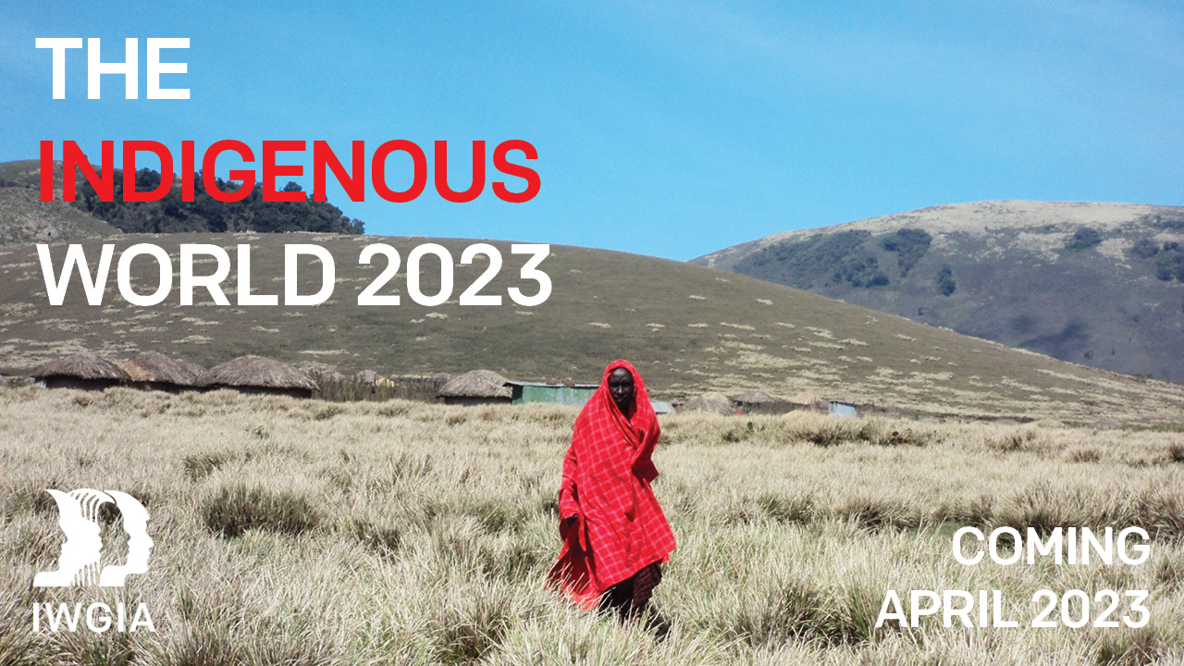

Slide 16
www.iwgia.org
Notes:
Thank you for your time today and I look forward to being here with you. Please visit us for further information and please come find me in the rooms and halls today if you have any questions.

