Slide 1
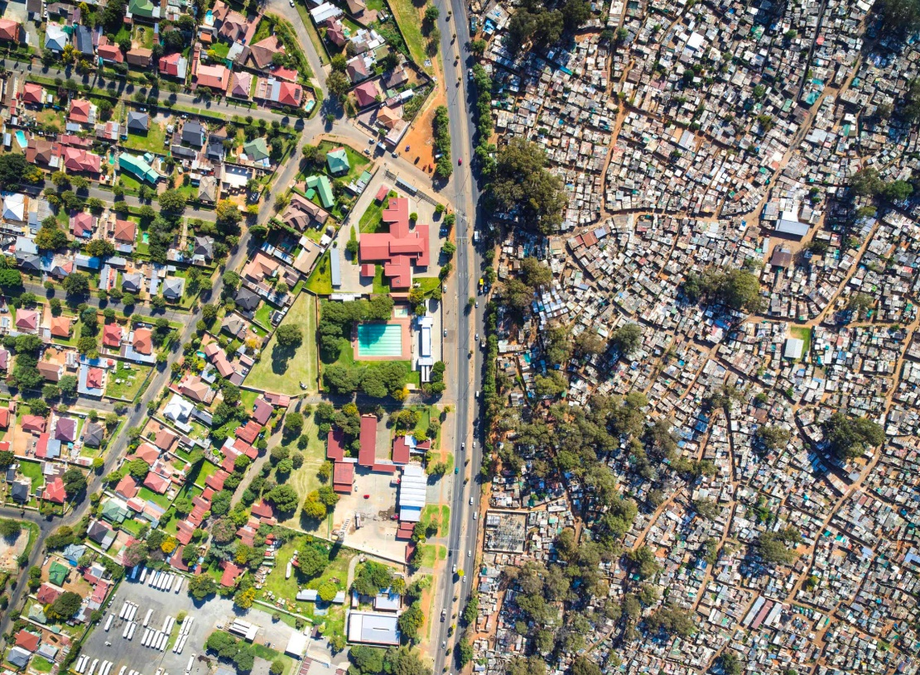
EU Support to Sustainable Urban Development
Lars Gronvald
Head of Section –
Sustainable Urban Development, INTPA F4
27 April 2023

Slide 2
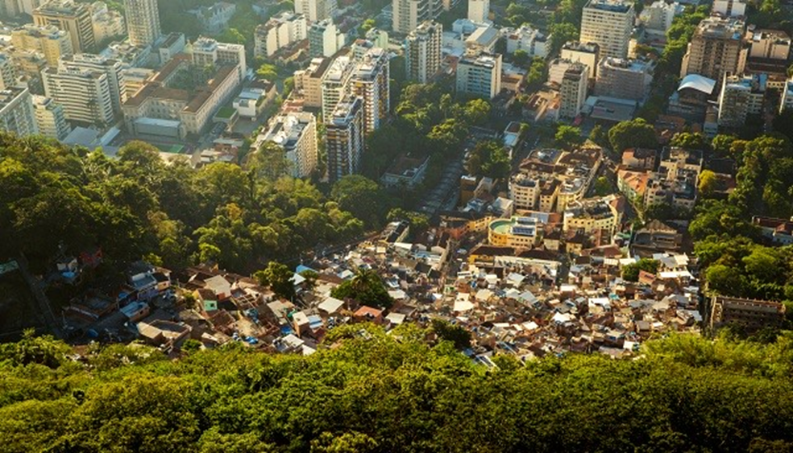
INTPA Support to cities/urban development
Focus on cities is fairly recent – following the New Urban Agenda 2016
Cities/urban development underpin most of INTPA high level objectives/strategic initiatives
- Global Gateway, Green Transition, Jobs and Growth, Sustainable Finance, Health,
Fight against Inequality, Migration…
Cities is a key area of intervention – but not a high level objective as such

Slide 3
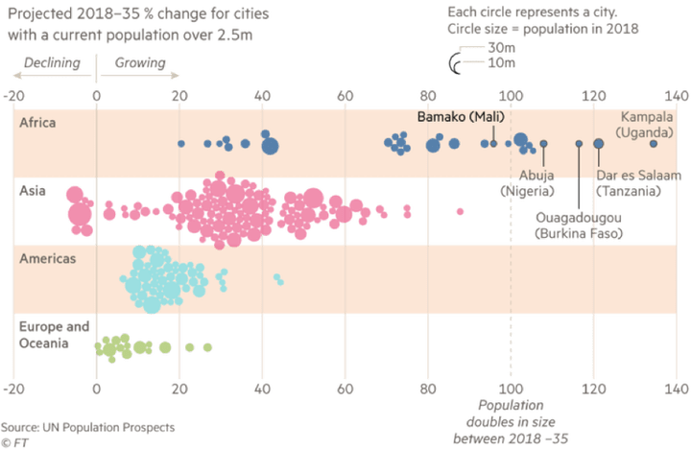
Context
Urbanisation is one of the most important transformations of the 21st century
54% of the global urban population, more than 2.2 billion people, live in Asia.
By 2050, the urban population in Asia is expected to grow by 50% - an additional 1.2 billion people.
- (UN Habitat)

Slide 4
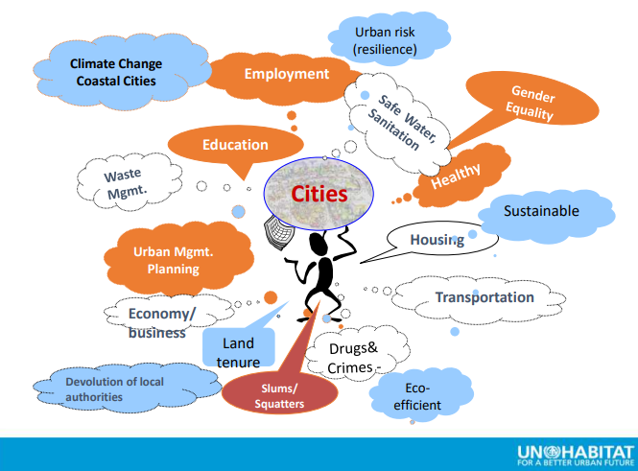
The challenges
Cities are responsible for:
60% of the world’s energy
over 60% of global GHG emissions
2.01 billion tonnes of municipal solid waste/year (at least 33 % not managed in an environmentally safe manner - WB)
Urban sprawl is closely linked to urban poverty. Currently, about 1 billion people in developing countries live in slums.
10% of the world’s population live in coastal areas less than 10 meters above sea level; about 40% live within 100 km of the coast.
Notes:
Intro: Current main trends of urban developments, unplanned sprawl, are a threat to surrounding ecosystems and contribute to land degradation.
Conclusion: Once established, urban development is difficult to alter, hence the urgency for actions.

Slide 5
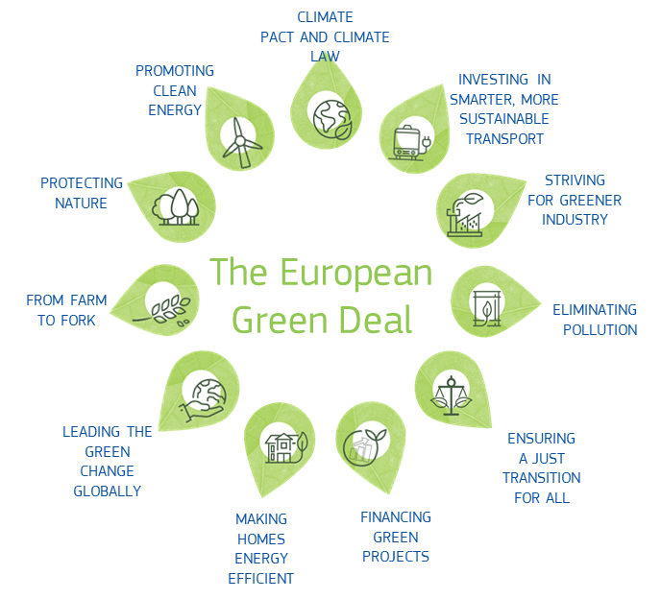
The opportunities – no Green Deal without cities
Cities generate 80% of the global GDP
50% of the new urban areas are not yet built - a huge opportunity to “get urbanisation right”
Urban Planning can become an important tool for the development of sustainable urban and national futures.
Notes:
Intro:
Cities are also economic powerhouses, dynamic hubs of innovation and transformative urban solutions and awarded for their protection and use of cultural heritage.
2. All aspects of the Green Deal have an urban dimension:
Green solutions are often multi-purpose and multi-sector
Urban areas occupy only 2% of global land area
Well-planned urban development provides:
Greater resource efficiency and less energy use.
Avoiding sprawling land consumption protects natural and agricultural areas
High population and infrastructure density: ideal locations for ICT implementation

Slide 6
Main avenues for EU support to urban development
  Country programmes (MIPs)
  Blending & Guarantees
  Thematic facilities and multi-Country programmes
Underpinned by:
  Policy Dialogue
  Coordination among actors and instruments
  Strengthening of a knowledge agenda

Slide 7
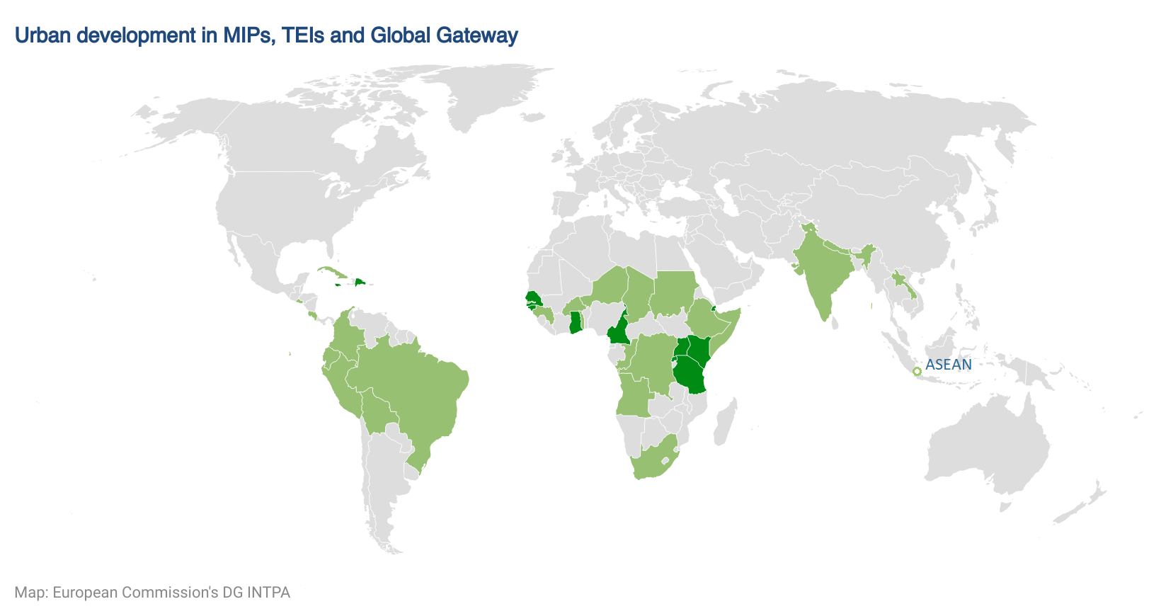

Slide 8
Financing Instruments -
European Fund for Sustainable Development (EFSD+)
Blended finance – combining grants and loans – to make lending more affordable (concessionality) and to advance specific development objectives
Guarantees – to support the mobilisation of third party finance
  Specific investment window targeting sustainable cities
  AFD CityRIZ (30 mill EUR), Fast Cities (50 million EUR)
  UNCDF – urban investment programme (150 million EUR)
Notes:
Guarantees – examples of applications
Supporting PPPs
What: help cities develop PPPs and lower risk for financing infrastructure, e.g. waste management, transport;
How: Partial guarantee of payment to the private operator;
Supporting urban investment funds
What: address market failures hampering investments in urban infrastructure and mobilise public and private capital where resilient municipal infrastructure lacks; portfolio of smaller projects
How: Partial Guarantee of loss from investments made by the fund – more attractive for investors;
Increase cities access to local finance
What: creating incentives for domestic commercial banks ion Africa to lend at affordable rates to local governments and public sector companies. Developing the local borrowing market;
How: Partial guarantee of repayment of loans to local banks;

Slide 9

Thematic Facilities and Multi-Country Programmes
The Participatory Slum Upgrading Programme PSUP
Covenant of Mayors
Cities and climate in
Sub-Saharan Africa
CICLIA
Mobilise Your City

Slide 10
Urban Development Technical Assistance Facility
Objective
Improve the quality and impact of European Commission’s external actions in support of urban development at local, regional and global level
Specific features/services
1) Support to Delegations in delivering sustainable urban development
2) Knowledge creation and sharing
3) EU Urban Platform (#TeamEurope)

Slide 11
Where could the urban development support be relevant for you
Not many MIPs in Asia has defined urban development/cities as an area of interventions
Some MIPs have focus on areas that will be implemented in urban areas but without defining urban development as a perspective
Blending has in many cases in the past been focussed on urban development issues – this is were much of the investment takes place
Use of EFSD+

Slide 12
Thank you!

