Slide 1
Session 11
Integrating TALD into EU Development Cooperation Programmes
Marco GEMMER
Head of Cooperation
EU Delegation to Nepal
ASIA – PACIFIC Regional Seminar on
Territorial Approach to Local Development (TALD)
26-28 April in New Delhi
Organised by the European Commission’s DG INTPA, Unit G2- Local Authorities, Civil Society Organizations, Foundations

Slide 2
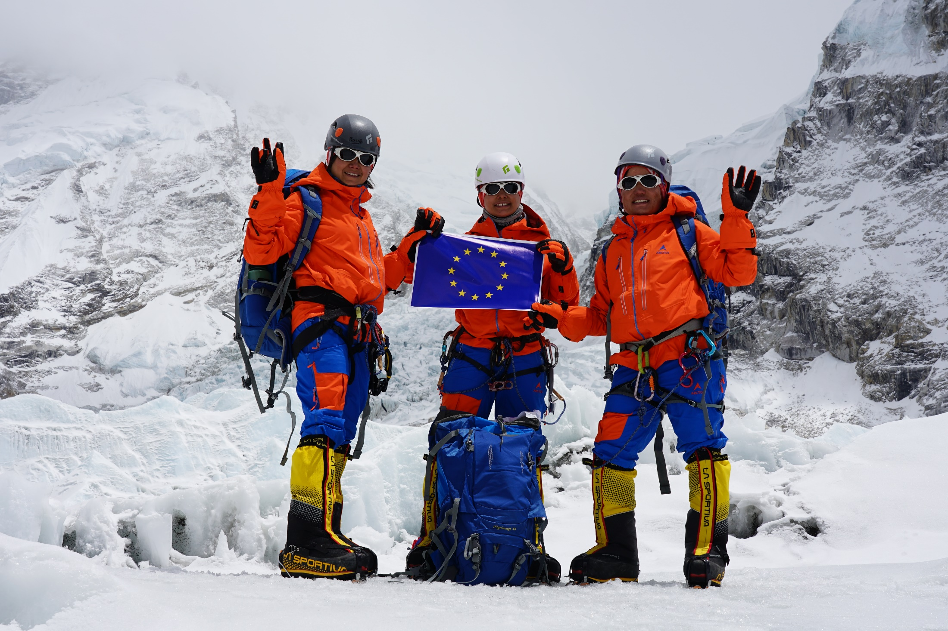
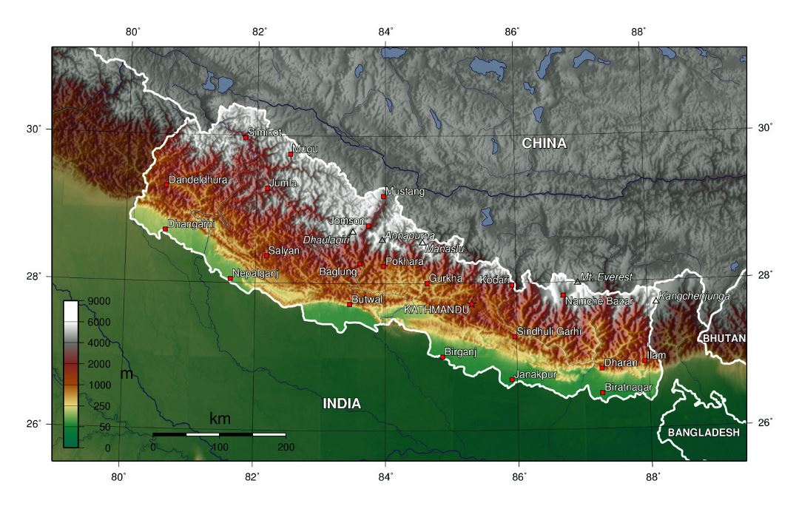
Brief description of the country context

Slide 3
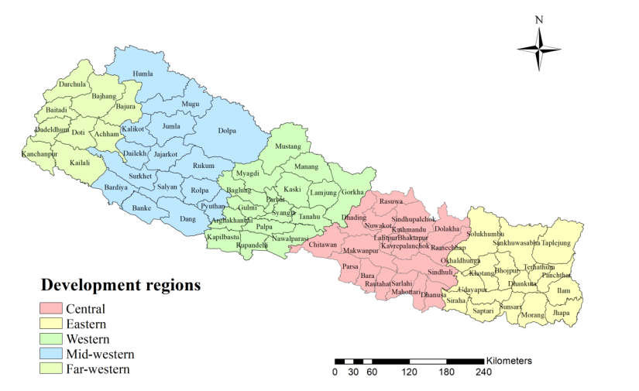
Before 2015
5 development regions
75 districts
3000+ village development committees

Slide 4
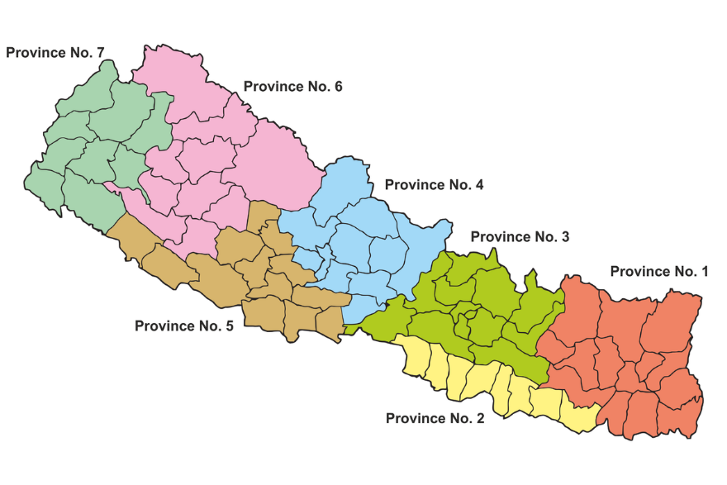
After 2015
7 provinces
753 municipalities

Slide 5
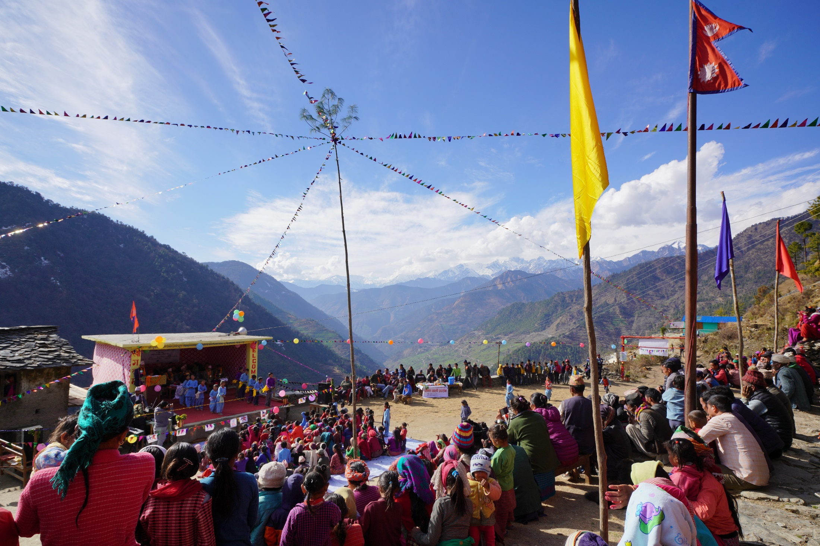
Engagement with Municiaplities

Slide 6
Main issues, lessons learned & recommendations
Devolution of budget -> central skills and local budget
Role of provinces to be strengthened
Gender, RBA, conflict sensitivity

Slide 7
Thank you!

