Slide 1
Regional Seminar on the Territorial Approach to Local Development (TALD) for Asia-Pacific countries How the EU works with local governments: The Indian experience The International Urban & Regional Cooperation (IURC) perspective Panagiotis Karamanos 27th April, 2023

Slide 2
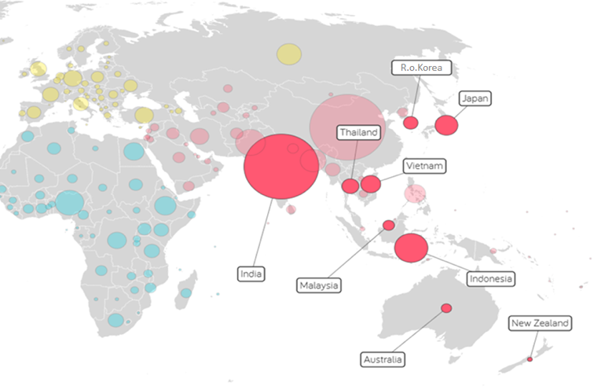
The EU funded IURC programme
Region’s population: 2+ billion
IURC Countries: 9
IURC cities: 84
Focus: City to city cooperation & cluster activities
Indicative topics: Urban planning, circular economy, smart city, mobility, tourism, culture, education, etc.
Process: Events, meetings, visits, thematic clusters, workshops, etc.
Source: Based on Gapminder World

Slide 3
Thematic concentrations for cooperation
TH-NW. 1 – ECOLOGICAL TRANSITION- GREEN DEAL
A Greener Future for Cities in Europe and Asia / Australasia
CROSS CUTTING OVERALL CHALLENGES
POST COVID RECOVERY IN CITIES
CLIMATE CHANGE & ENERGY TRANSITION
SMART CITY & DIGITAL TRANSITION
CIRCULAR ECONOMY
Waste Management
GREEN INFRASTRUCTURE
Nature Based Solutions
Water Management
SUSTAINABLE AGRICULTURE
Food systems, Urban Gardens
TH.NW. 2 – URBAN & REGIONAL RENEWAL & SOCIAL COHESION
A Sustainable Future for Cities in Europe and Asia / Australasia
URBAN AGENDA/PLANNING
SUD Strategies,
Public Space,
Urban Model: 15 min. Vision
MOBILITY & TRANSPORT
Street 4 people -
Superblocks – Metropolitan Connections
TH.NW.3 – INNOVATIVE, SUSTAINABLE & CARBON NEUTRAL ECOSYSTEMS & STRATEGIC SECTORS
A Smarter Future for Cities in Europe and Asia / Australasia
TOURISM & CULTURE
HEALTH,LIFE SCIENCE, ELDERY BIOECONOMY
EDUCATION, JOBS & SKILLS,
Clusters, Innovation Centres

Slide 4
India-EU: Partners on urban development issues

Slide 5
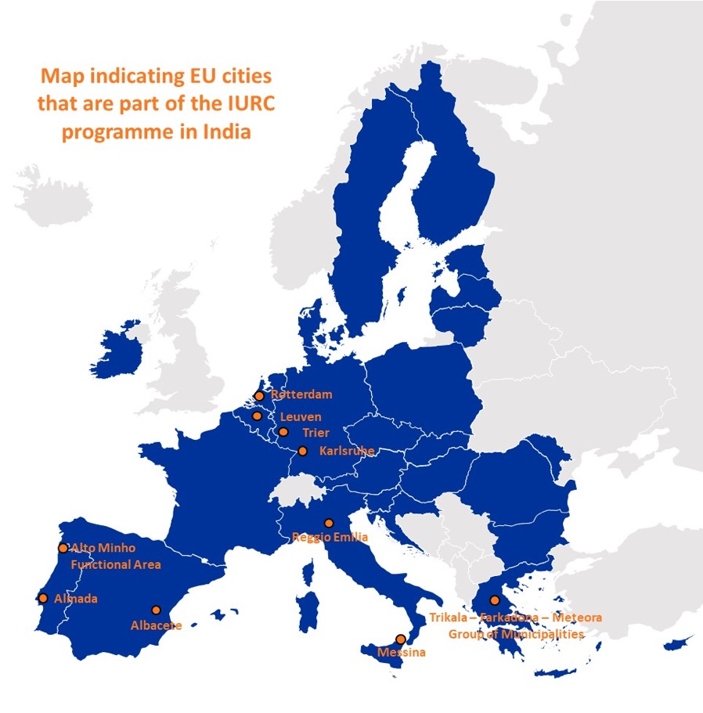
The cities

Slide 6
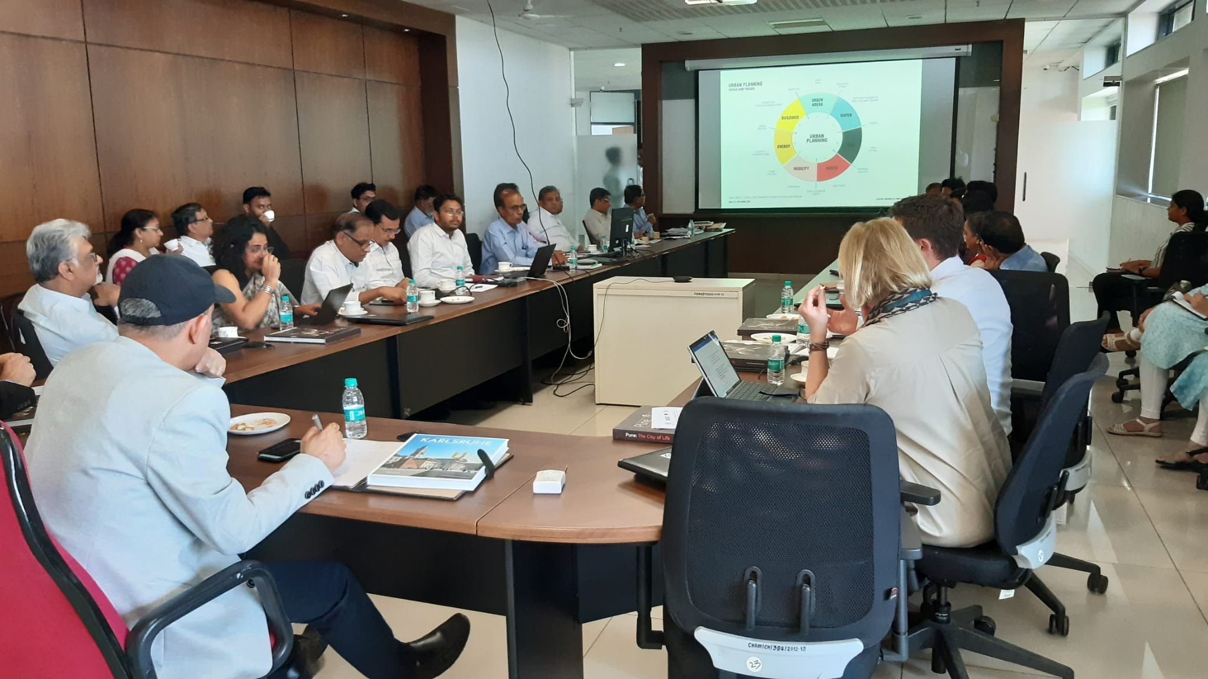
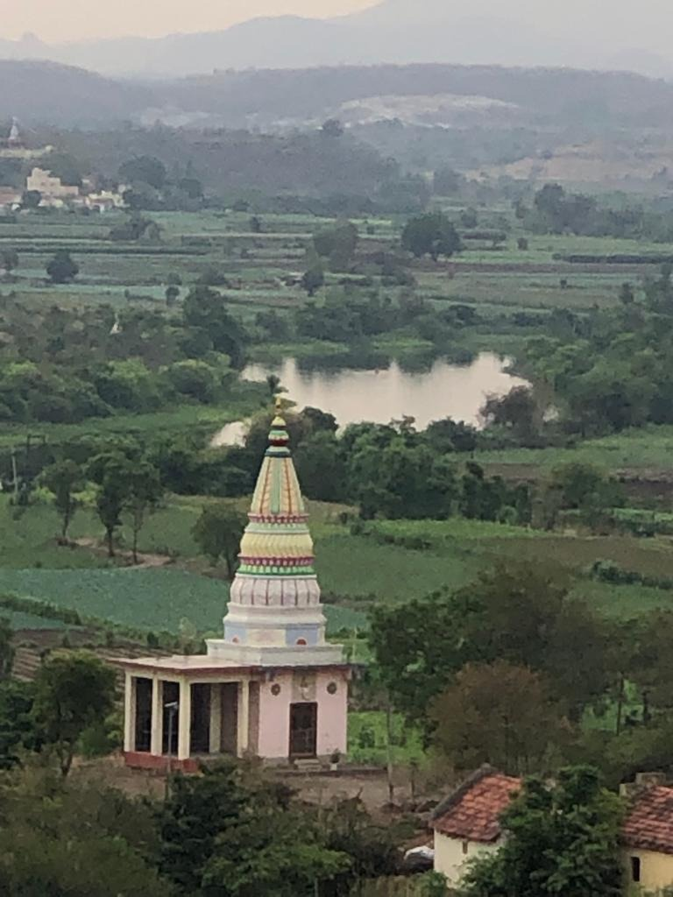
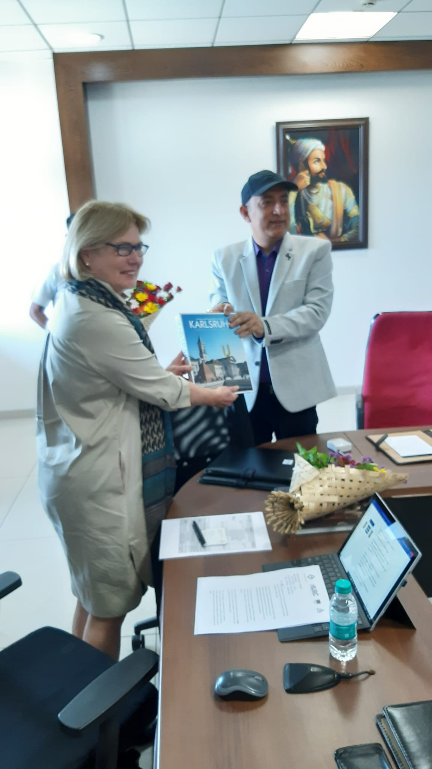
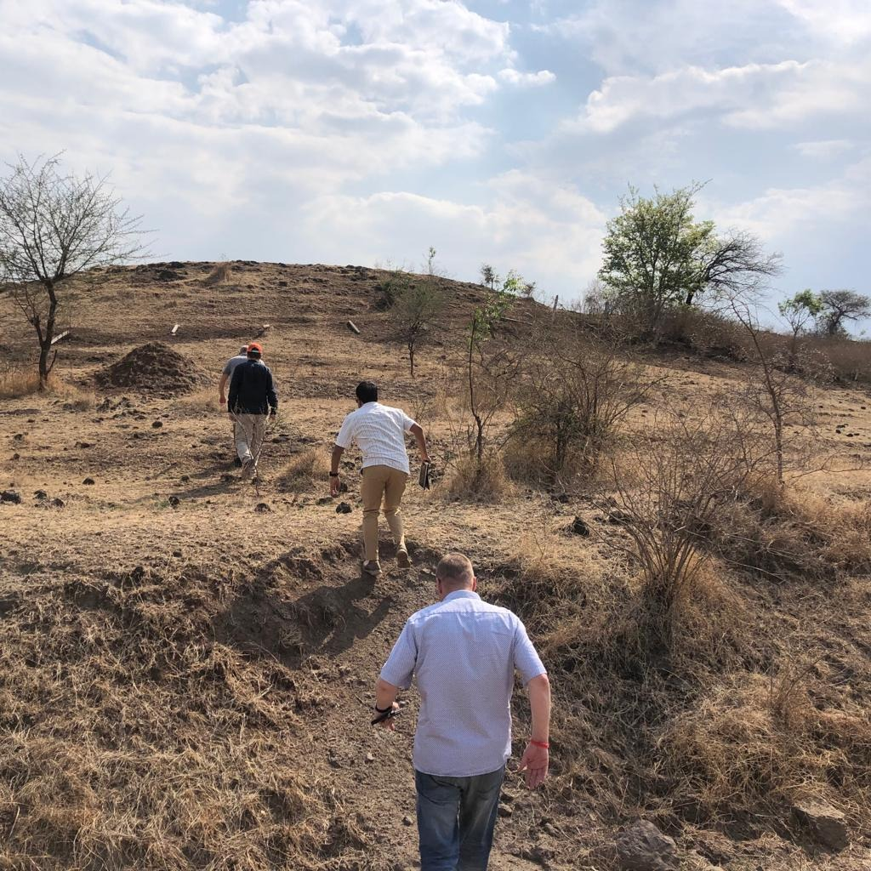
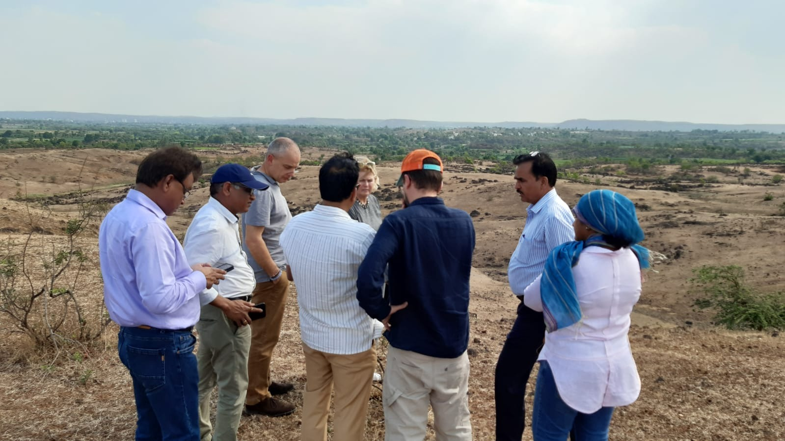
Karlsruhe to PMRDA exchange visit

Slide 7
Creating shared value
Building partnerships and strengthening networks during Covid-19
Pilot projects, engage in research in solving pressing city problems
Knowledge exchange
Grow city champions to accelerate urban innovation combining EU expertise and India’s local knowledge on the ground
EU best practices
Thematic study visits to EU to witness challenges and best practices in action
India’s best practices
Thematic study visits to India to witness challenges and best practices as well as opportunities for collaboration
Global knowledge platform
EU-India case studies and U-CAPs as replication models

Slide 8
Case 1: Rotterdam-Surat Cooperation
Cooperation since in 2017
Focus on water management/water plazas
Exchange visits
Development of Urban Cooperation Action Plan
Pilot water plaza
Vision for another 7 water plazas
Other areas (water management strategy, business)

Slide 9
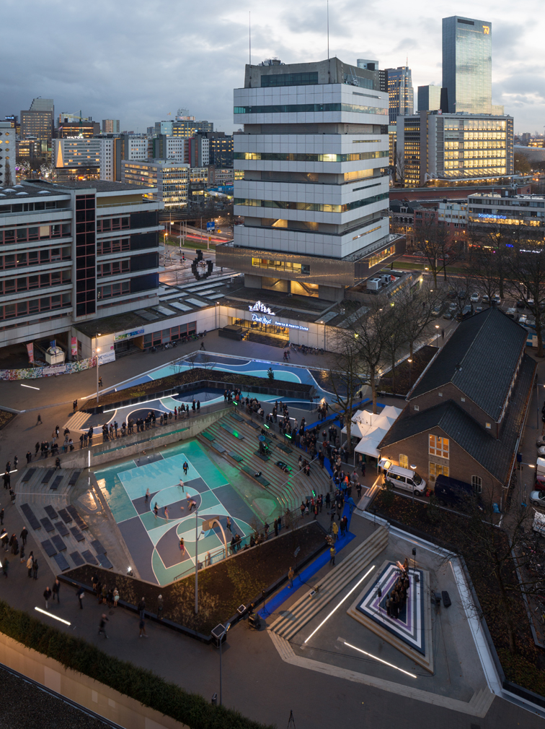
Water plazas in Rotterdam
Means for climate adaptation in cities
Multifunctional use of public space
Effective on local scale & city scale
Drive funding by different stakeholders (municipality, waterboards, regional/ national government)
First water plaza in 2014, up to now an additional 30 plazas constructed

Slide 10
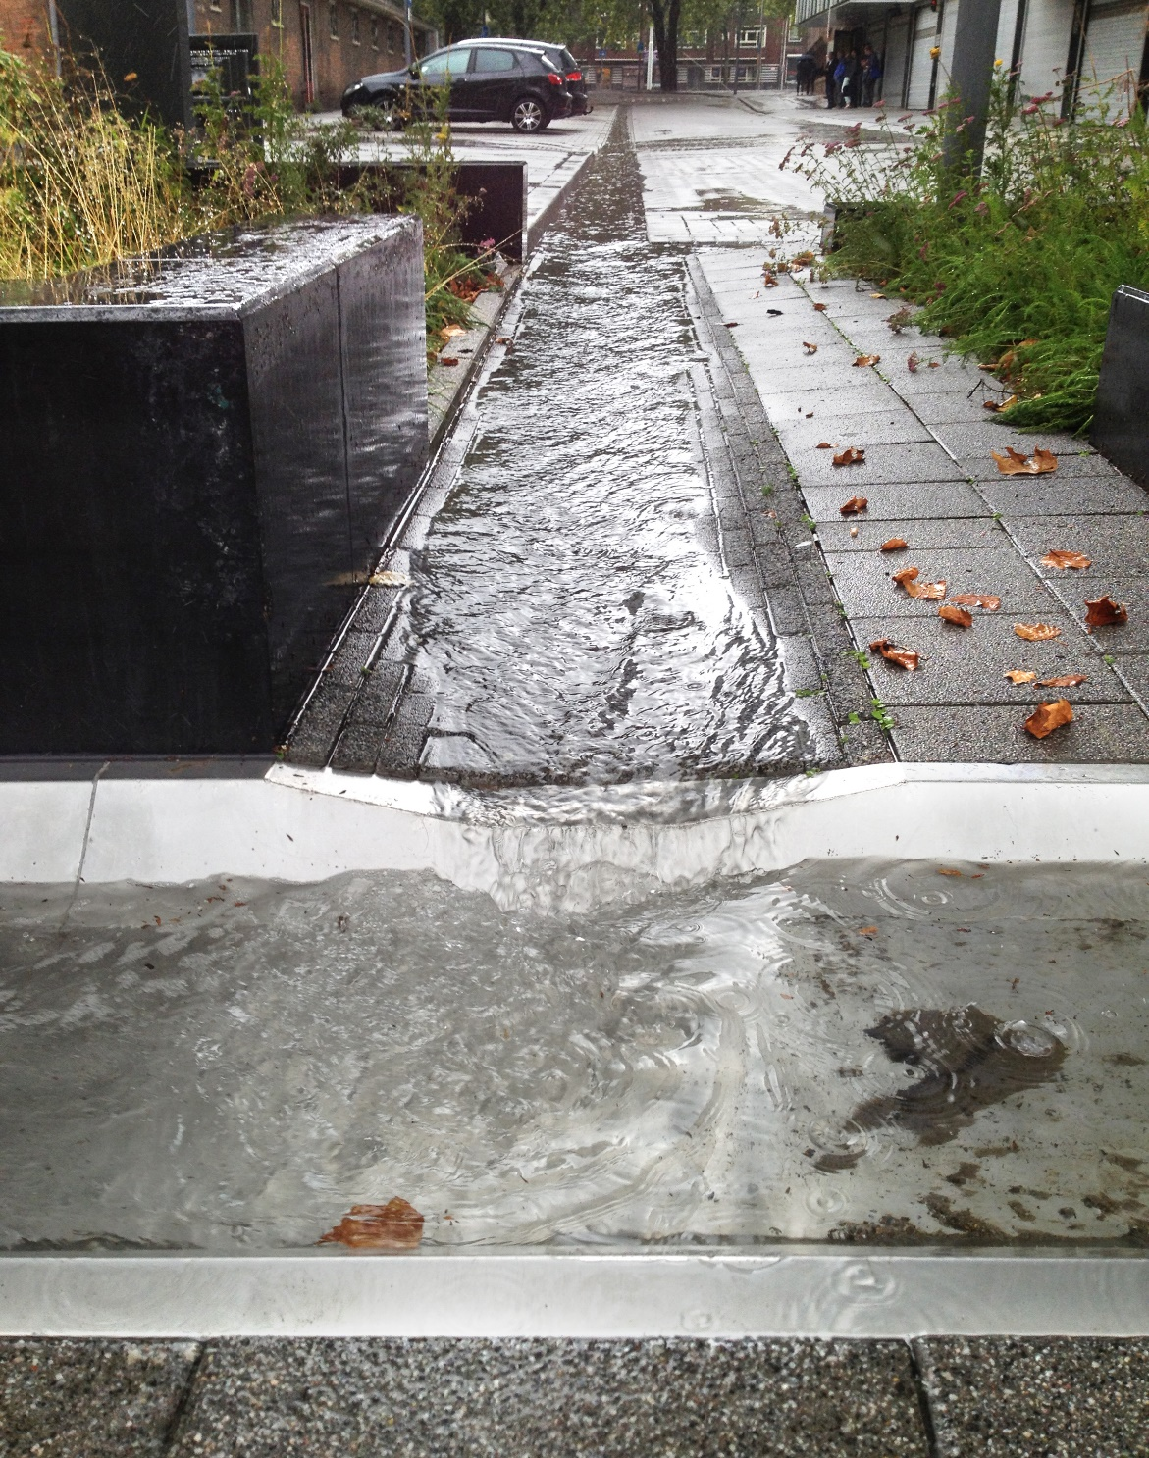
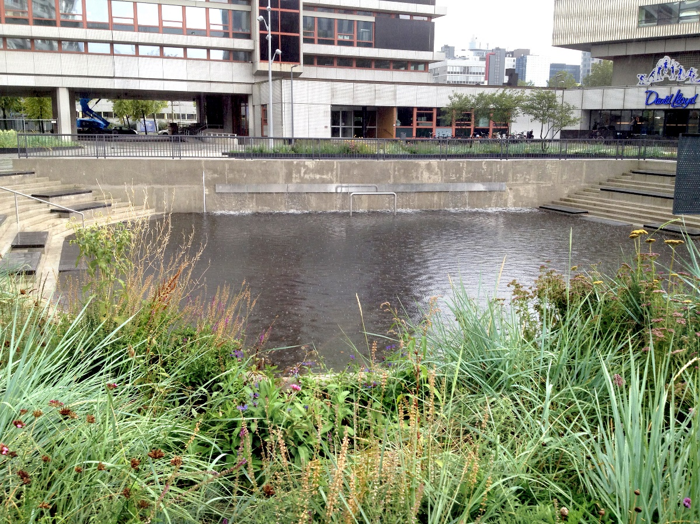
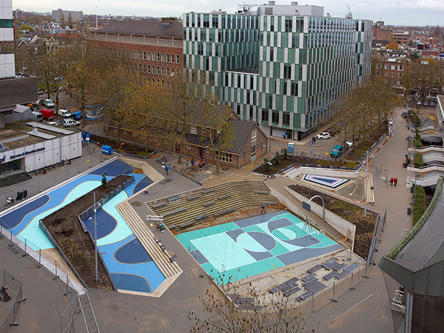
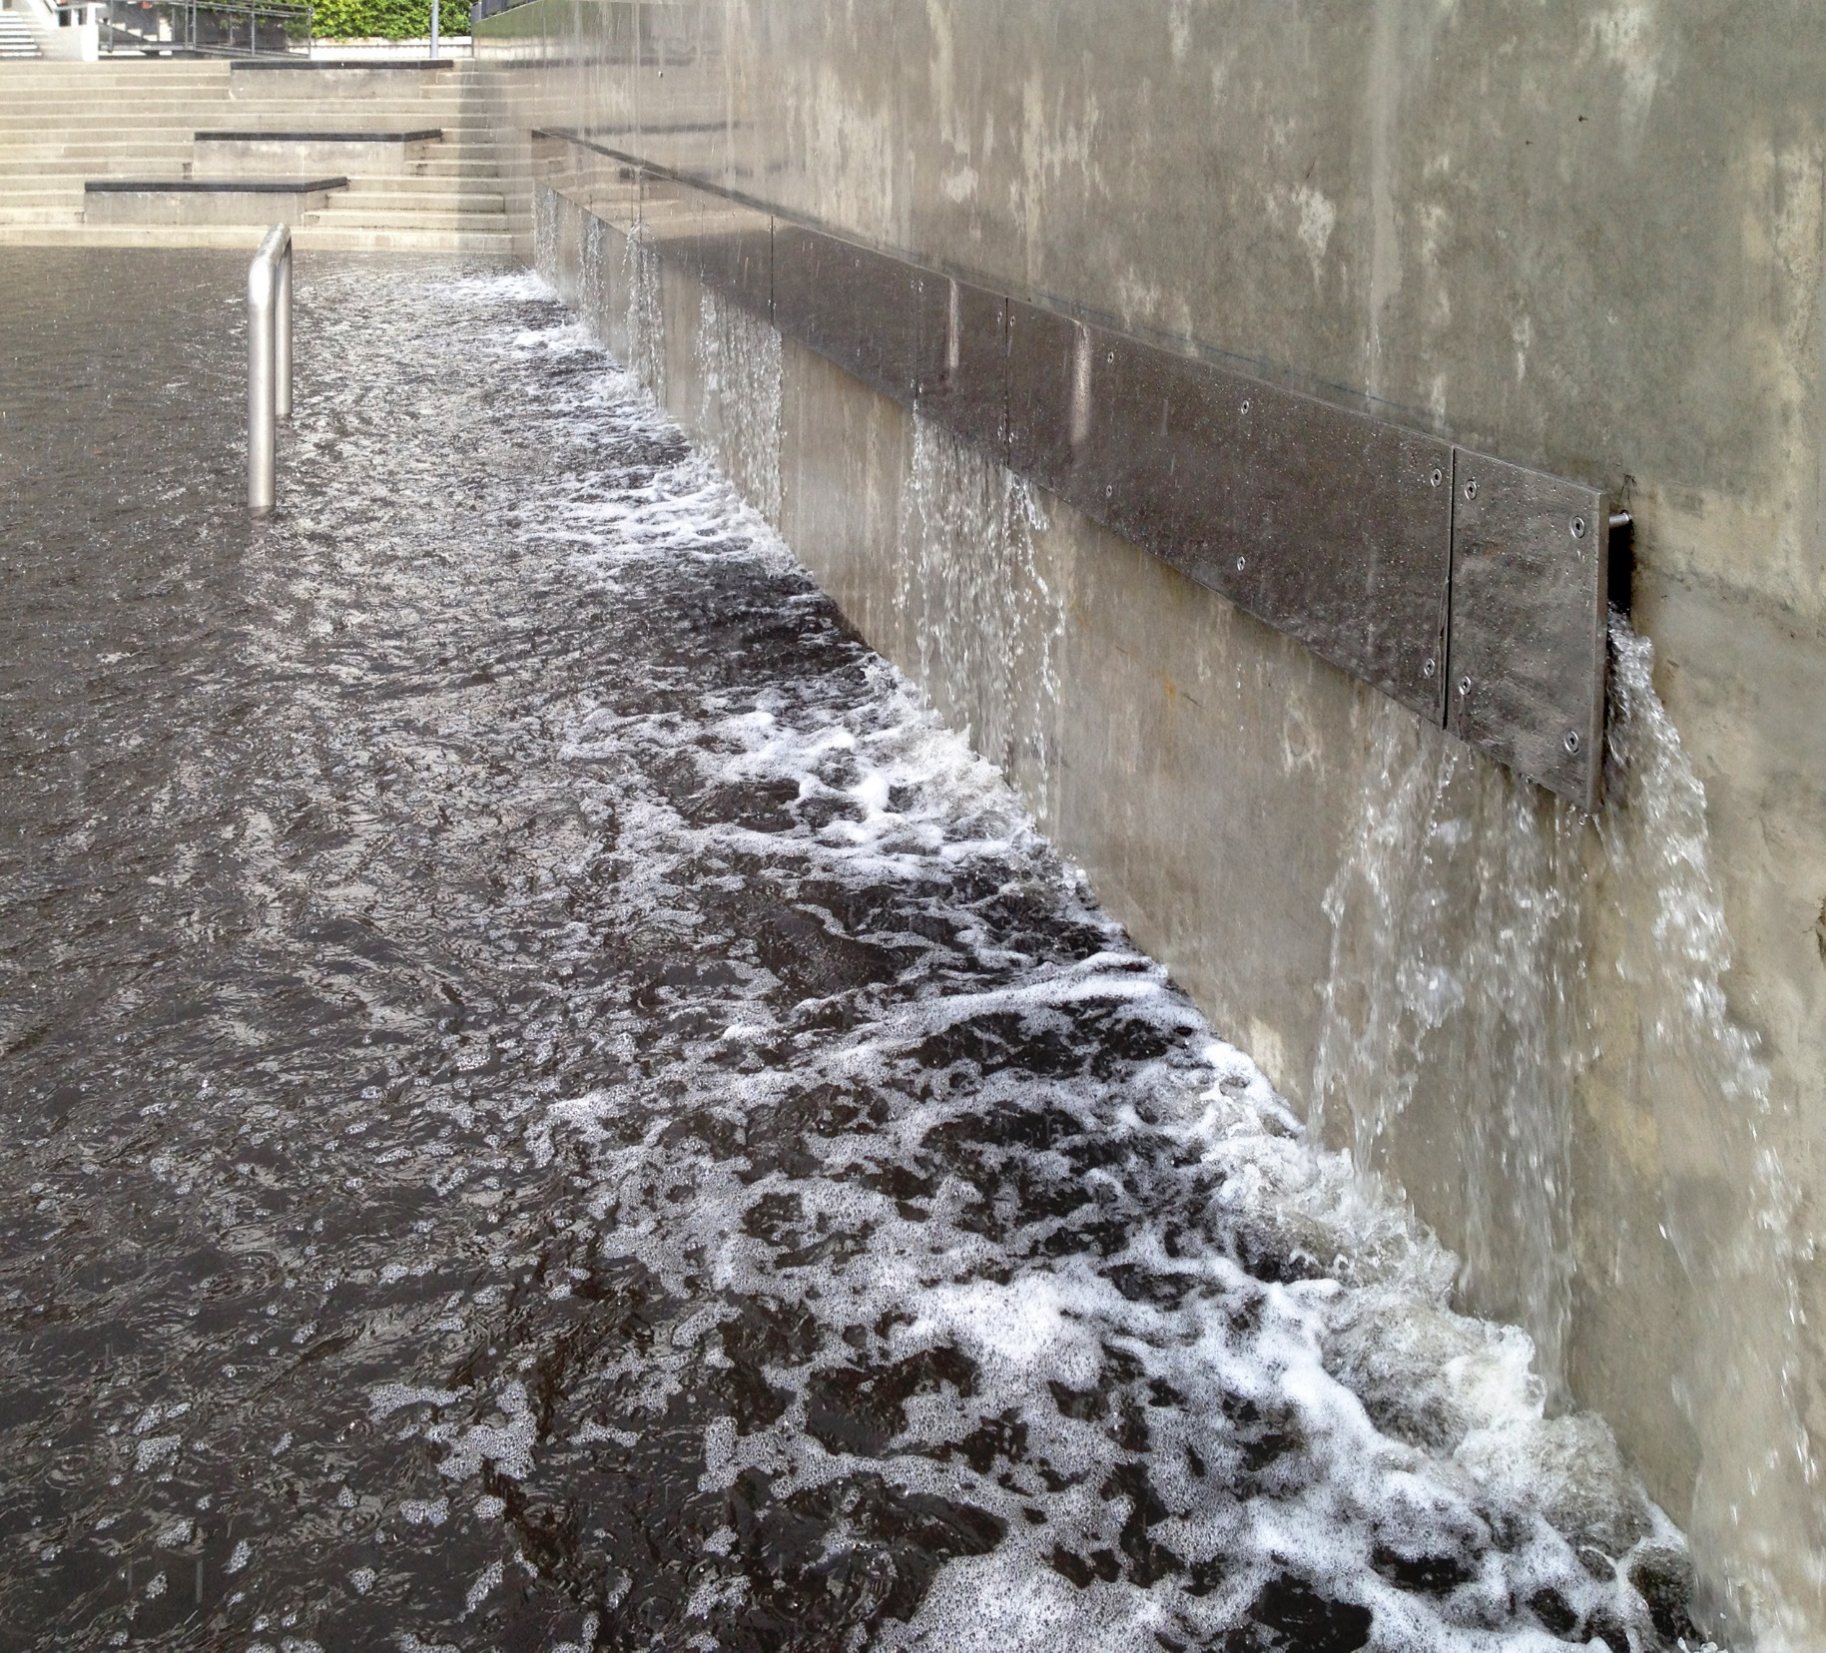
Water plaza Benthemplein
(City center)
Notes:
10

Slide 11
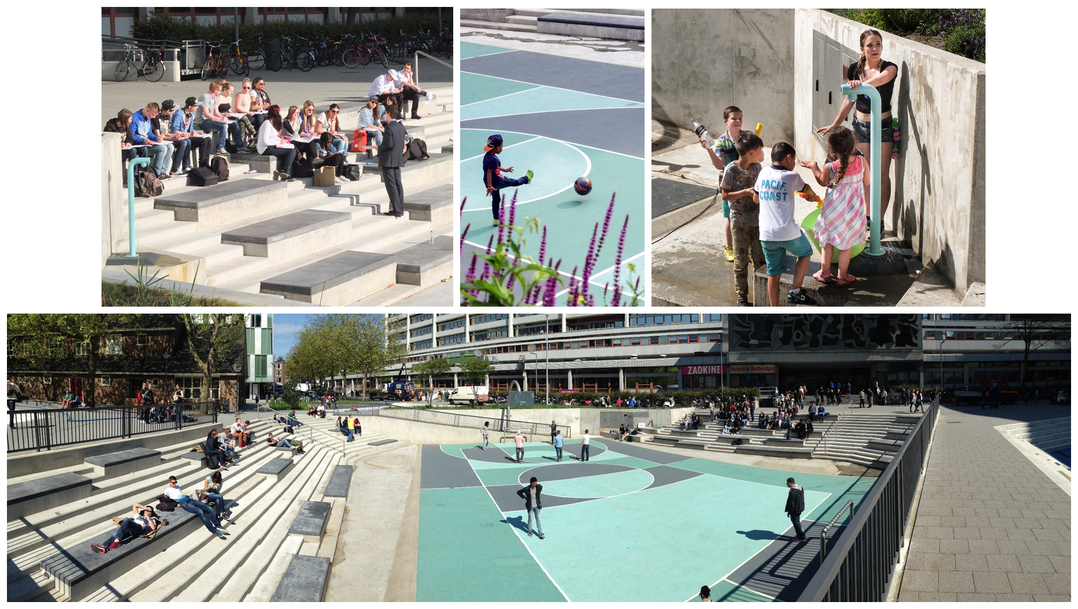

Slide 12
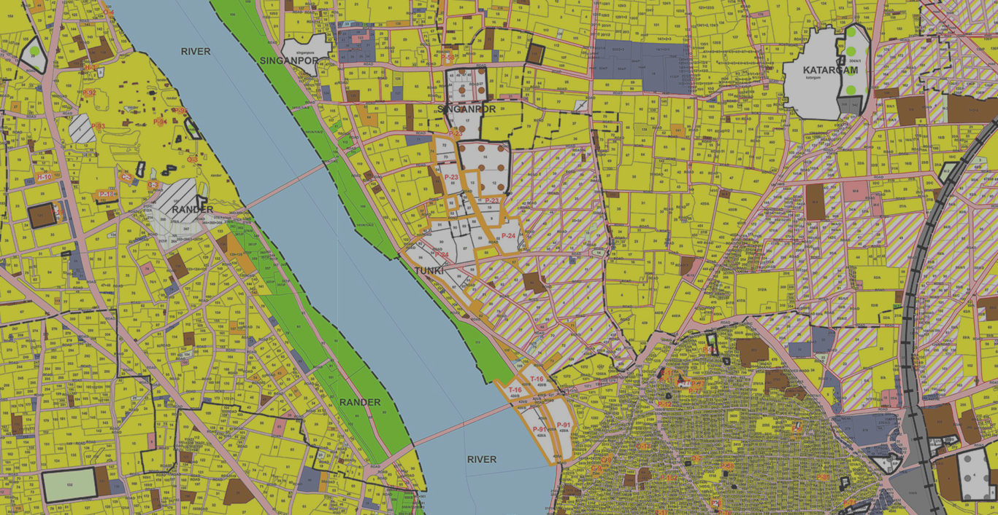
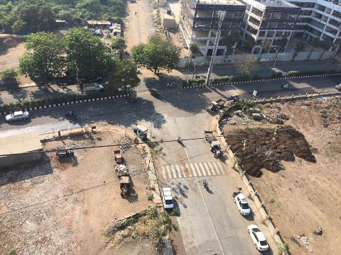
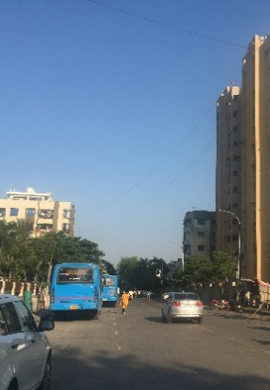
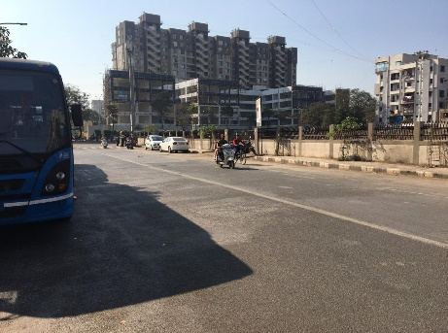
PROPOSED SITE
N

Slide 13
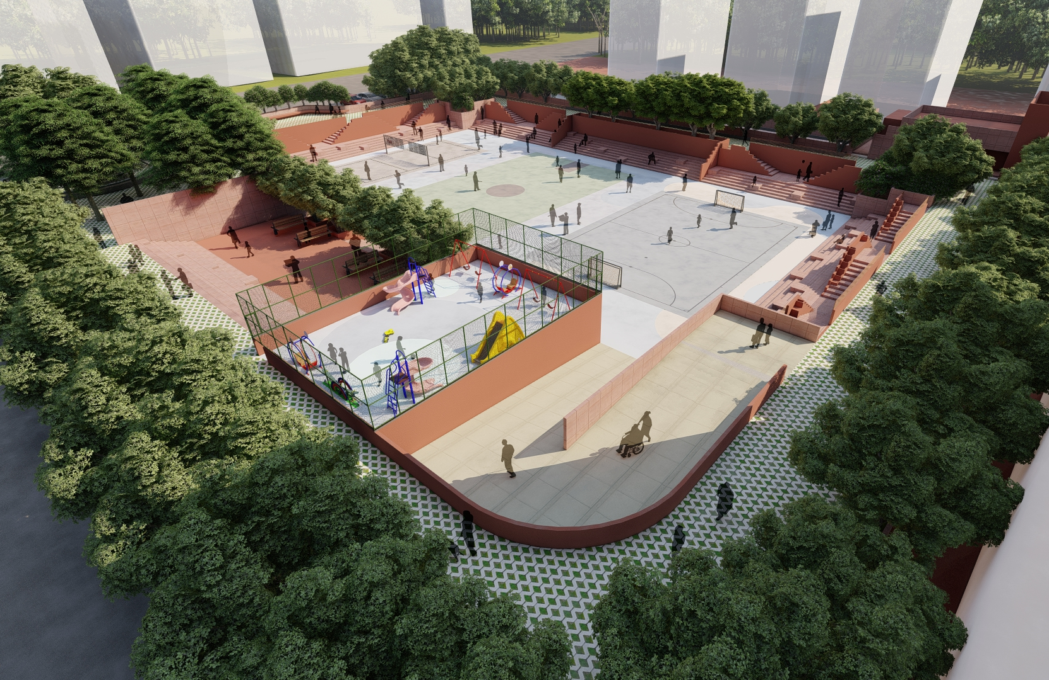
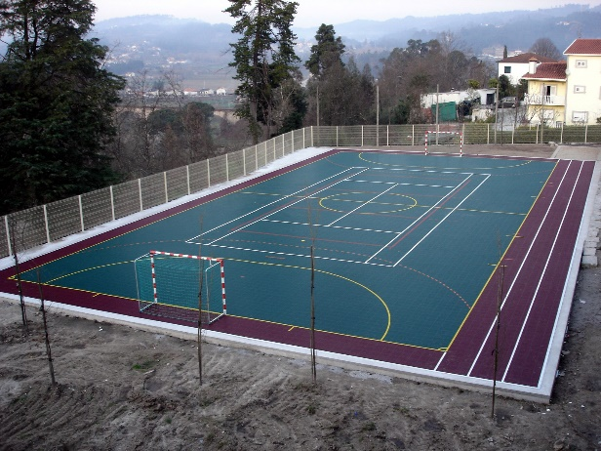
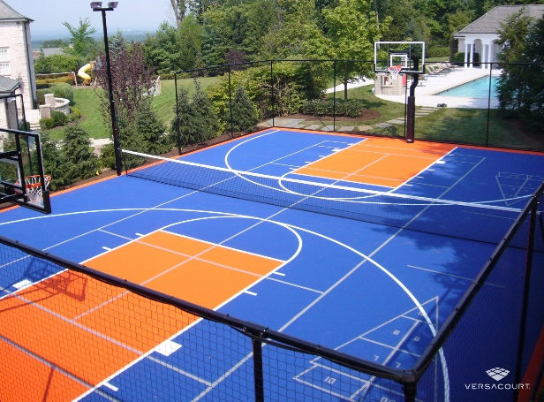
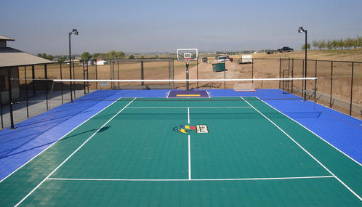
Pilot water plaza
Futsal
Multi Sports court
Volley Ball court

Slide 14
Rotterdam Statement on cooperation benefits
The cooperation and exchange visits gave Rotterdam several new insights. We learned that the context of a water management solution like a water plaza opens up ideas to new functions of such a water plaza. In Surat the Ganesha festival is related to the use of the plaza in a wholly different way. This is inspiring. Also the thinking about potential revenues and business models regarding the exploitation of the water plaza’s is on a different track than in Rotterdam. There is a lot of experience in Surat on public-private partnerships and this is also projected on the new water plaza. Rotterdam can learn from this approach and translate it to it’s own context. Not at the least Rotterdam learned that there are more challenges related to water in Surat in which we can open and coordinate support upon from Dutch counterparts. We think the hands-on mentality of both Rotterdam and Surat helps us both to understand each other and feel comfortable with this cooperation.
Corjan Gebraad, City of Rotterdam Advisor

Slide 15
Case 2: Leuven-Gwalior Cooperation
Cooperation since 2017
Focus on start-up business promotion
Exchange visits
Development of Urban Cooperation Action Plan
Workshops
Competitive fund champion

Slide 16
Competitive fund champion
3 startups & 1 mentor from Gwalior to visit Leuven for networking and development work at start up event, 1-5 May, 2023

Slide 17
Case 3: Messina-Kochi Cooperation
Cooperation since in 2021
Focus on water management
Exchange visits
Development of Urban Cooperation Action Plan
Workshops
Competitive fund champion

Slide 18
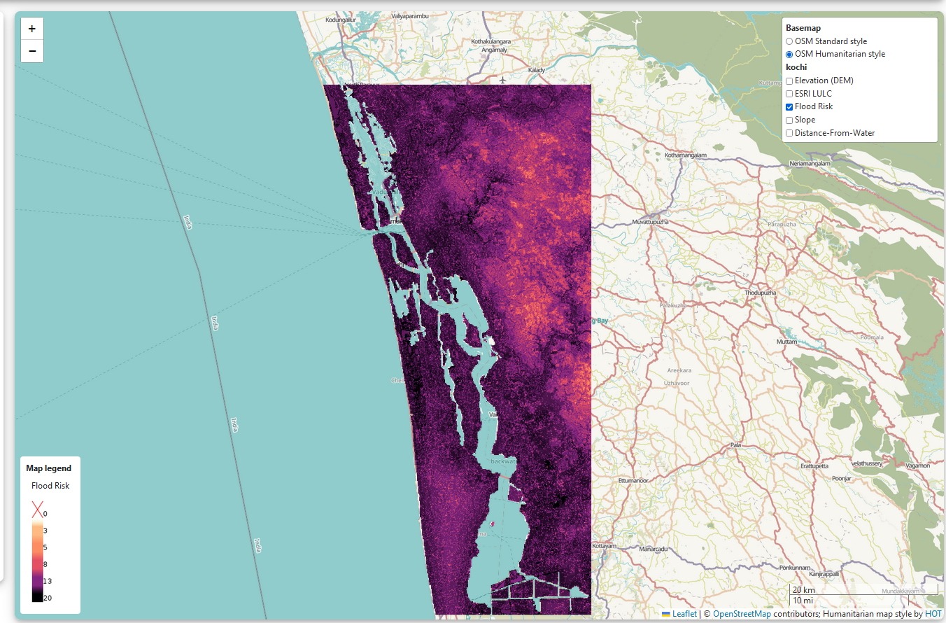
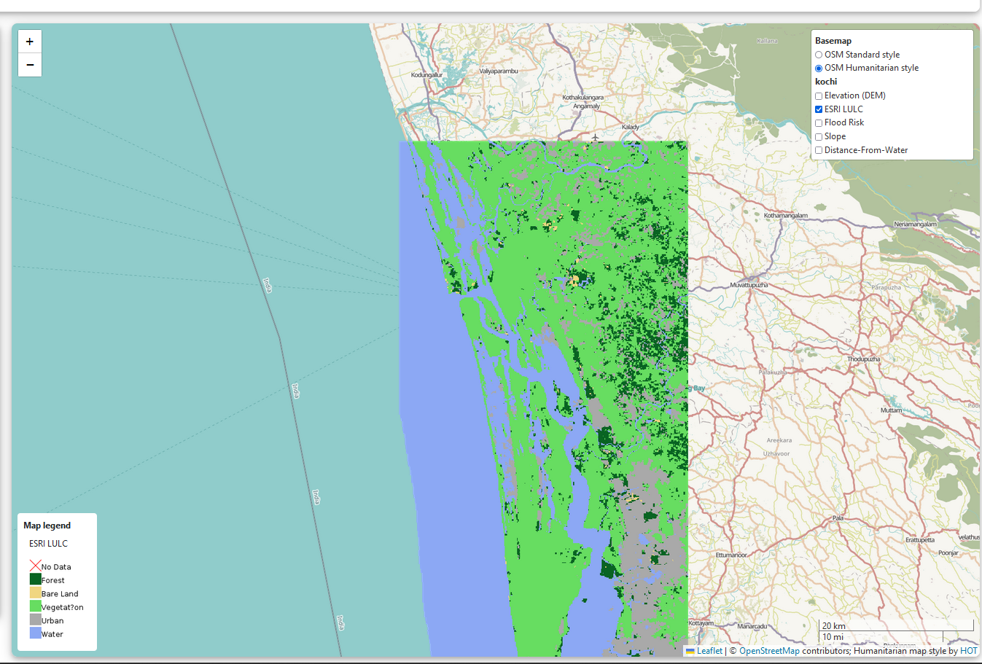
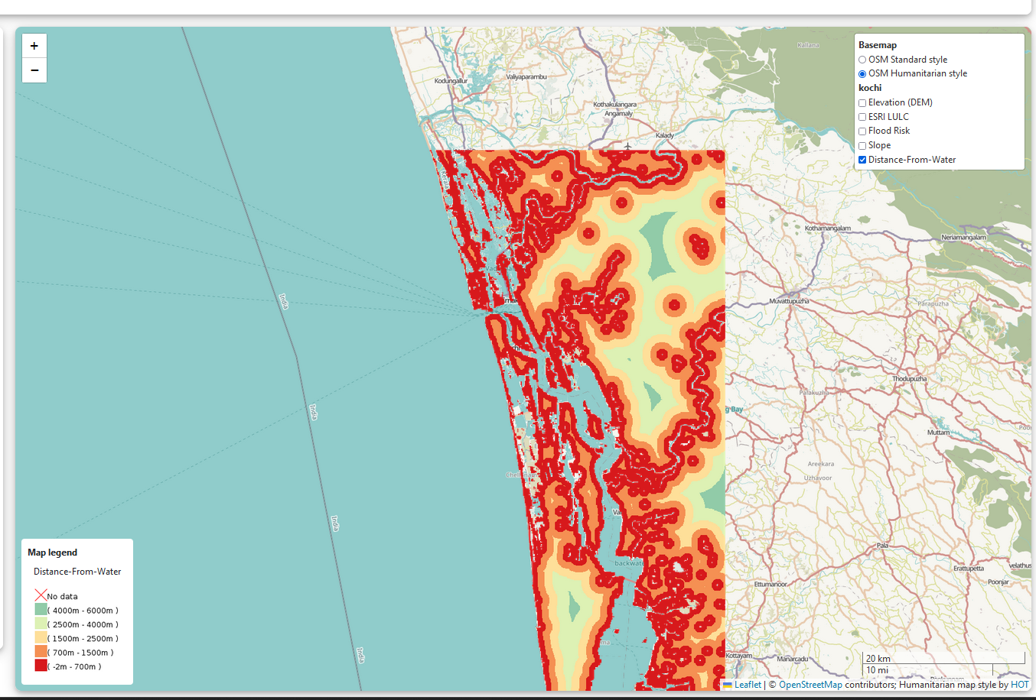
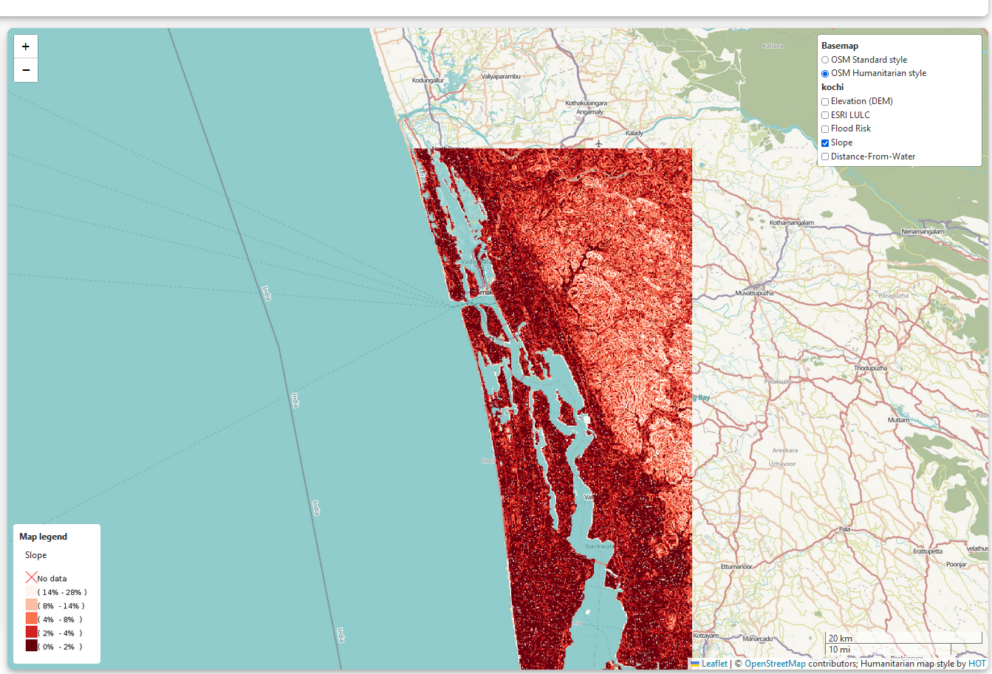
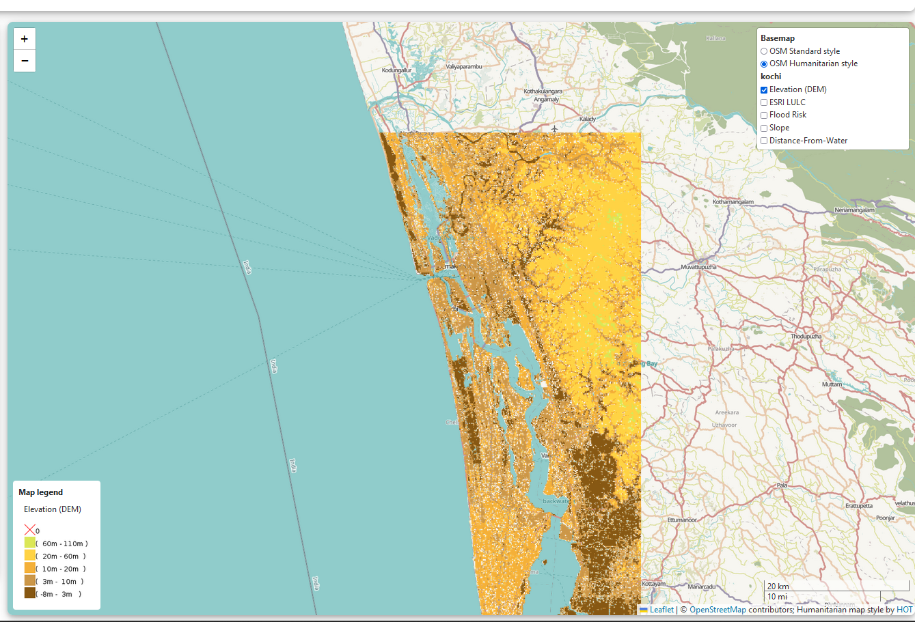
Flood warning demonstration
Cooperation between the 2 cities, and Hafen City University (TOSCA), Universities of Messina and Kerala for development of demo project.

Slide 19
Drivers of sucessful cooperation
Success
Local champion
Pilot/demo project
Small funding
Time/
Continuity
Patience

