Slide 1
THEMATIC SEMINAR ON
Social Transfers in the Fight against Hunger
Introduction to the Seminar and Relevance to EC Programming Cycle
Phnom Penh, 21-23 February 2013
Andrea Massarelli – Policy Officer
DEVCO C1

Slide 2
Outline of the presentation
Background of Social Transfers in Food and Nutrition Security
Legal framework
Available EC Resources
Recent actions in the region
The EC Programming exercise 2014-2020
Social Transfers in the Fight against Hunger
DEVCO C1

Slide 3
Background of Social Transfers in Food and Nutrition Security
Why Social Transfers
Food insecurity is a problem of production, nutrition but also access to food.
Social transfers are a logical response.
Social transfers provides EC aid towards the most vulnerable part of global populations in the most efficient and effective way.
Social Transfers in the Fight against Hunger
DEVCO C1

Slide 4
Background of Social Transfers in Food and Nutrition Security
Definition of social transfers
Social transfers are non-contributory, publicly-funded, direct, regular and predictable resource transfers (in cash or in kind) to poor or vulnerable individuals or households, aimed at reducing their deficits in consumption, protecting them from shocks (including economic and climatic), and, in some cases, strengthening their productive capacity
Social Transfers in the Fight against Hunger
DEVCO C1

Slide 5
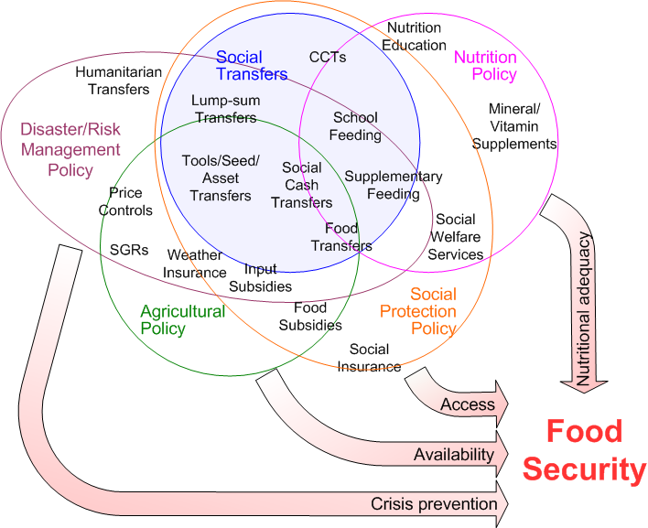
Background of Social Transfers in Food and Nutrition Security
Fitting social transfers in the FS context
Social Transfers in the Fight against Hunger
DEVCO C1

Slide 6
Legal framework
EU communication on Food Security (2010)
Evolved from food aid delivery into support for broad-based food security strategies at all level.
Special focus on food insecure countries MDG1 off-track
Address Food security challenges across 4 pillars:
  availability of food (at national and regional levels)
  access to food (by households)
  food use and nutritional adequacy (at the individual level)
  crisis prevention, preparedness and management (dealing with the stability of the other three pillars over time.
Social Transfers in the Fight against Hunger
DEVCO C1
Notes:
What a policy is
Representing the voice of the EU and MS, approved by Parliament and Council it becomes a EU POLICY
MDG1: Eradication of extreme poverty and hunger

Slide 7
Legal framework
Conclusions of the Court of Auditors evaluation
Special Court of Auditor report on food security 1/2012
Recommendation 1
For the programming period after 2013, the Commission and the European External Action Service should carry out a structured assessment of the food security situation in each country and systematically consider the potential scope for EU support in this area.
Recommendation 2
The Commission and the European External Action Service should give adequate priority to nutrition when defining the cooperation strategy, identifying and designing interventions, and using policy dialogue with partner governments, notably in the framework of budget support programmes.
Recommendation 3
The Commission should set out intervention objectives that are sufficiently precise and measurable through performance indicators. It should ensure that the objectives are achievable by better assessing the risks and assumptions concerning the successful implementation of interventions.
Social Transfers in the Fight against Hunger
DEVCO C1
Notes:
EC and other EU services are accountable to the Court of Auditors

Slide 8
Legal framework
Conclusions of the Court of Auditors evaluation
Special Court of Auditor report on food security 1/2012
Recommendation 4
The Commission should better support the financial sustainability of agriculture and social transfer programmes. In doing so, the Commission should place more emphasis on the development of effective agricultural extension services, post-harvest infrastructure and rural credit.
Recommendation 5b
The Commission should better support the financial sustainability of agriculture and social transfer programmes. In doing so, the Commission should ensure that social transfer programmes provide for adequate support to the development of income-earning capacities of the beneficiaries.
Social Transfers in the Fight against Hunger
DEVCO C1

Slide 9
Legal framework
Communication on Social Protection
Adoption by the Commission: August 2012.
The purpose of the communication:
'…to explain the role of SP in underpinning inclusive and sustainable development and the role of EU development cooperation in supporting the strengthening of social protection policies and systems.'
Social Transfers in the Fight against Hunger
DEVCO C1

Slide 10
Legal framework
Communication on Social Protection
i) Placing social protection at the centre of dialogue on national development strategies
ii) Supporting national policies and programmes
iii) Revenue reform for fiscal space
iv) Capacity building for strong institutions
v) EU Added value in technical cooperation
vi) Support for job creation and employment
vii) Bring in civil society and the private sector
viii) Support for transformative social protection and social justice
ix) Gender in social protection
Social Transfers in the Fight against Hunger
DEVCO C1

Slide 11
Legal framework
Communication on Nutrition
“Enhancing maternal and child nutrition in external assistance: an EU Policy framework”
Drafted, currently in the circuit for approval
To be most likely approved before the end of the Irish Presidency (June 2013)
Social Transfers in the Fight against Hunger
DEVCO C1

Slide 12
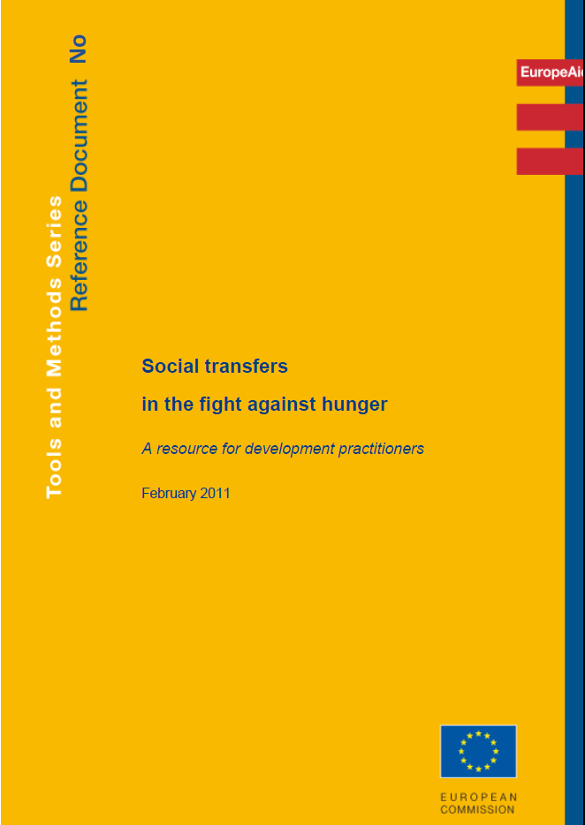
Available EC Resources
The Reference Document
Chapters
1 Introducing social transfers
2 Conceptualising social transfers
3 Justifying social transfers
4 Using social transfers to fight hunger
5 Contextualising social transfers
6 Designing social transfers
7 Managing social transfers
8 Supporting social transfers
9 Financing social transfers
Social Transfers in the Fight against Hunger
DEVCO C1
Notes:
Guidelines: mandatory
Reference Document: support tool
Information note: discussion document

Slide 13
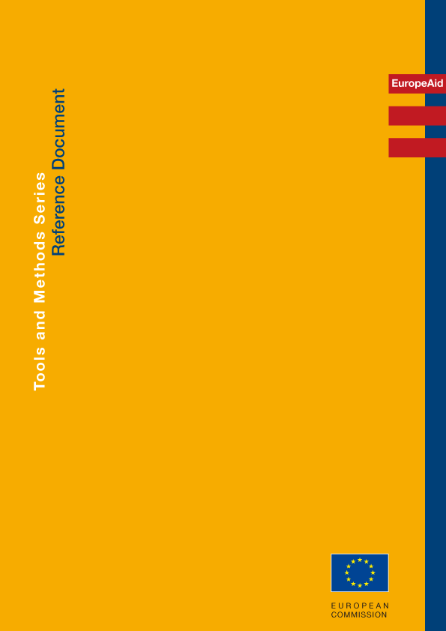

Purpose
Available EC Resources
To help transform aid programmes so as to achieve real progress in nutrition.
Target Audiences
Addressing Undernutrition in External Assistance
An integrated approach through
sectors and aid modalities
February 2011
Primarily, aid administrators working within country teams - delegations of the EU and offices of Member States.
Additionally, through discussions, national counterparts and other stakeholders.
Social Transfers in the Fight against Hunger

Slide 14
Available EC Resources
FSTP (Food Security |Thematic Programme 2011 – 2013)
Complement the EU commitment towards achieving MDG 1
Accompanies EU geographical instruments:
- address global, continental, regional FS dimensions
- ensure transition from relief to development,
- assist countries in particularly fragile situations.
3 strategic priorities:
Research (Technology transfer and innovation to enhance food security)
Governance (strengthened approaches for food security and nutrition)
Addressing food security for the poor and vulnerable in fragile situations.
Social Transfers in the Fight against Hunger
DEVCO C1
Notes:
MDG 1 definition: Eradication of extreme poverty and hunger

Slide 15
Available EC Resources
NAS (Nutrition Advisory Service)
Improve the effectiveness of the EU’s contribution and coordination with other stakeholders in nutrition
Support to EU delegations and country offices
Support to headquarters for operations, dialogue and policy development
Social Transfers in the Fight against Hunger
DEVCO C1

Slide 16
Available EC Resources
ASiST (Advisory Service on Social Transfers)
• Overall objective
– Increase the impact, quality, sustainability and coverage of social transfer schemes to address poverty and hunger
• Specific objectives
– raise awareness among public authorities and civil society in the most vulnerable partner countries and in the donor community
– promote quality throughout the project cycle in designing, strengthening and promoting sustainable national social transfer schemes for food security;
– share lessons learnt among development partners, supporting the EC in actively participating in global discussions on comprehensive systems of social transfers.
Social Transfers in the Fight against Hunger
DEVCO C1

Slide 17
Available EC Resources
Online knowledge base
Capacity for Development
http://capacity4dev.ec.europa.eu/
“Fighting hunger”
http://ec.europa.eu/europeaid/what/food-security/index_en.htm
ROSA (Operational Food Security Network)
http://reseau-rosa.eu
Social Transfers in the Fight against Hunger
DEVCO C1
Notes:
Structure de ROSA DVD et C4D add website snapshot

Slide 18
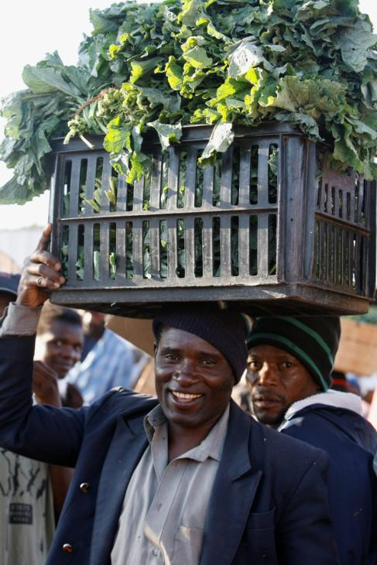
Recent actions in the region
The EU Food Facility
1 Billion EUR
232 Projects, 65% of which scaling up on-going operations
59 million direct beneficiaries (Mainly smallholders)
93 million indirect beneficiaries
49 countries
Partners: 9 UN Agencies and World Bank
3 Regional Organisations ⇨ AU/IBAR, COMESA, ECOWAS
425 Implementing Non-State Actors
Social Transfers in the Fight against Hunger
DEVCO C1

Slide 19
Recent actions in the region
Country | Initial Country Allocation | Final Country Allocation | Difference (amount changed)
Afghanistan | 24,200,000 | 24,301,279 | 101,279
Bangladesh | 50,000,000 | 52,245,061 | 2,245,061
Burma-Myanmar | 24,400,000 | 23,400,000 | -1,000,000
Cambodia | 17,200,000 | 17,891,273 | 691,273
Kyrgyz Republic | 7,000,000 | 6,700,000 | -300,000
Lao PDR | 10,800,000 | 10,845,860 | 45,860
Nepal | 23,300,000 | 22,995,639 | -304,361
Pakistan | 50,000,000 | 49,261,229 | -738,771
Philippines | 31,900,000 | 31,352,114 | -547,886
Sri Lanka | 5,200,000 | 5,127,252 | -72,748
Tajikistan | 15,500,000 | 15,170,000 | -330,000
EUFF Projects in the region
Social Transfers in the Fight against Hunger
DEVCO C1

Slide 20
Recent actions in the region
Implementing Modality/Agency | Budget Support | International Organisations |  |  |  |  |  | Call for Proposals
 |  | FAO | WFP | UNDP | UNOPS | WB | IFAD | partners | allocation
Country | M EUR
Afghanistan |  | 13.25 |  |  |  |  |  | 6 | 10.2
Bangladesh |  | 7.4 | 21.98 | 7.5 |  |  |  | 5 | 15
Burma-Myanmar |  |  |  |  | 23.4
Cambodia |  | 10.97 |  |  |  |  |  | 4 | 6
Kyrgyz Republic |  |  |  |  |  | 6.7
Lao PDR |  |  |  |  |  | 4.8 |  | 4 | 5.8
Nepal |  | 8.06 | 9 |  |  |  |  | 4 | 6
Pakistan |  | 24.7 | 13.96 |  |  |  |  | 6 | 10
Philippines |  | 4.2 | 6.39 |  |  |  | 9.99 | 5 | 11.3
Sri Lanka |  | 5.12
Tajikistan | 7.75 |  |  |  |  | 7.42
EUFF Projects in the region
Social Transfers in the Fight against Hunger
DEVCO C1

Slide 21
Recent actions in the region
The EU FF
Three categories of measures were eligible for financing:
Measures to improve access to agricultural inputs and services,
Safety net measures, and
Other small-scale measures aiming at increasing production based on country needs.
Social Transfers in the Fight against Hunger
DEVCO C1

Slide 22
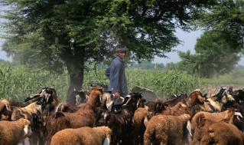
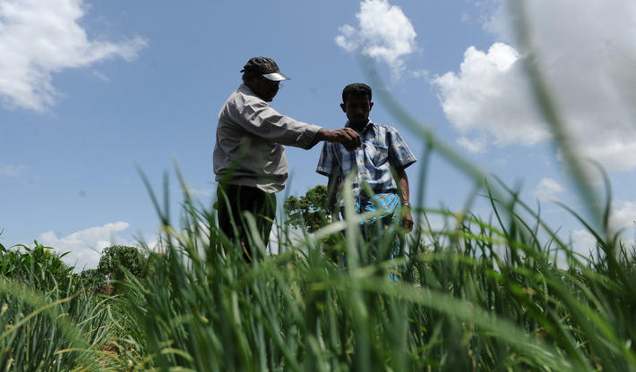
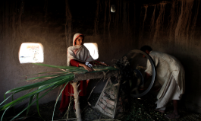
Better access to inputs and services (2)
Recent actions in the region
Major Results
The EU Food Facility: General Overview
DEVCO C1

Slide 23
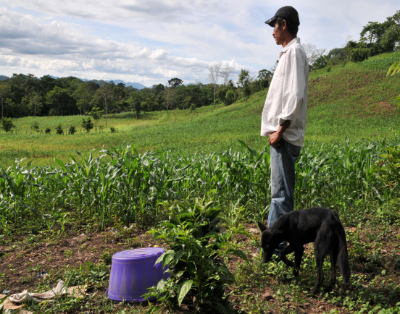
Sustainable agricultural production boosted
Recent actions in the region
Major Results
60%
projects focus on agricultural production and access to inputs
50%
increase in agricultural production
(as an average –
range between 20% and 100%)
DEVCO C1

Slide 24
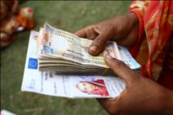
The effects of the food price crisis mitigated
Recent actions in the region
Major Results
35% projects including nutrition component
€ 290
increase household annual income
(as an average,
range between € 40 - € 2100)
DEVCO C1

Slide 25
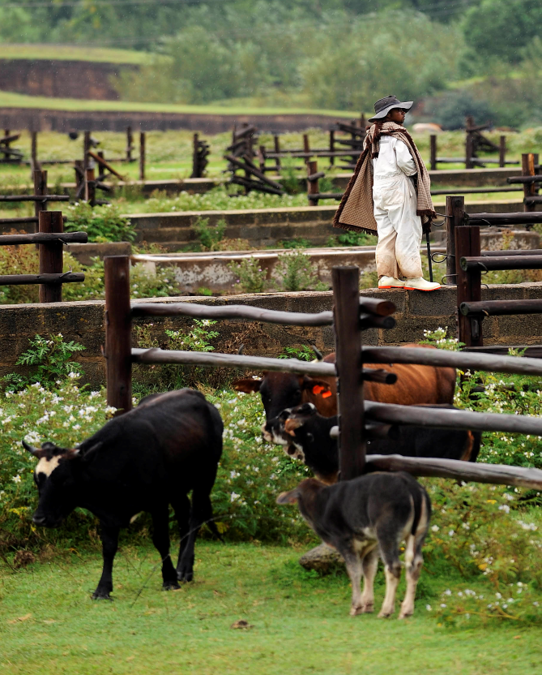
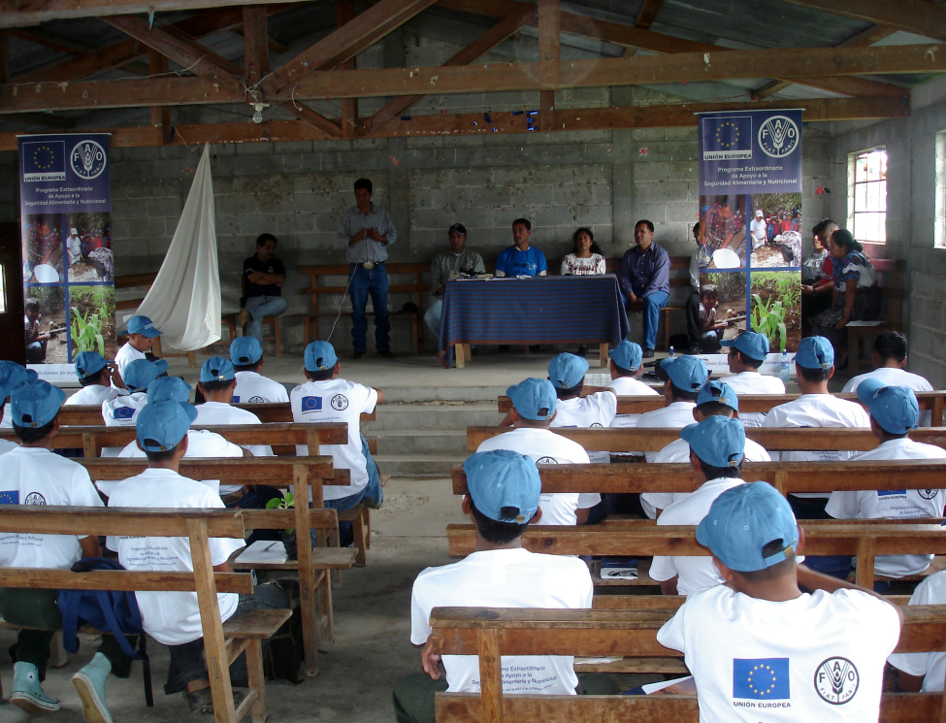
Productive capacities/governance strengthened
Recent actions in the region
Major Results
2.5 million people trained in sustainable production
Intensification, good agriculture practices, conservation agriculture, soil fertility management, small-scale irrigation and crop diversification.
44.6 mn livestock vaccinated
in 28 countries,
VACNADA regional programme
DEVCO C1

Slide 26
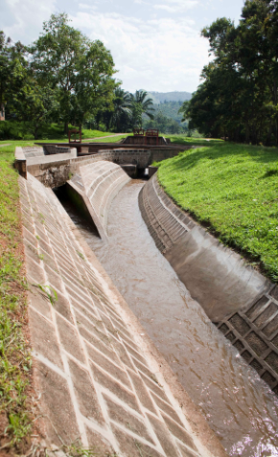
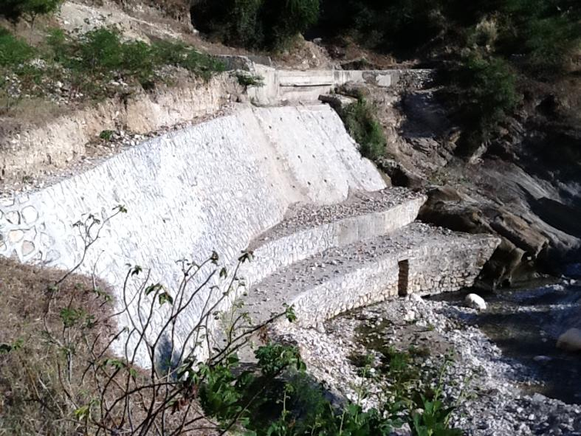
Infrastructures improved
Recent actions in the region
Major Results
315,000 ha of agricultural land rehabilitated and/or irrigated
13,500 dikes/dams/micro-dams rehabilitated or constructed
10,500 km of road rehabilitated or constructed
The EU Food Facility: General Overview
DEVCO C1

Slide 27
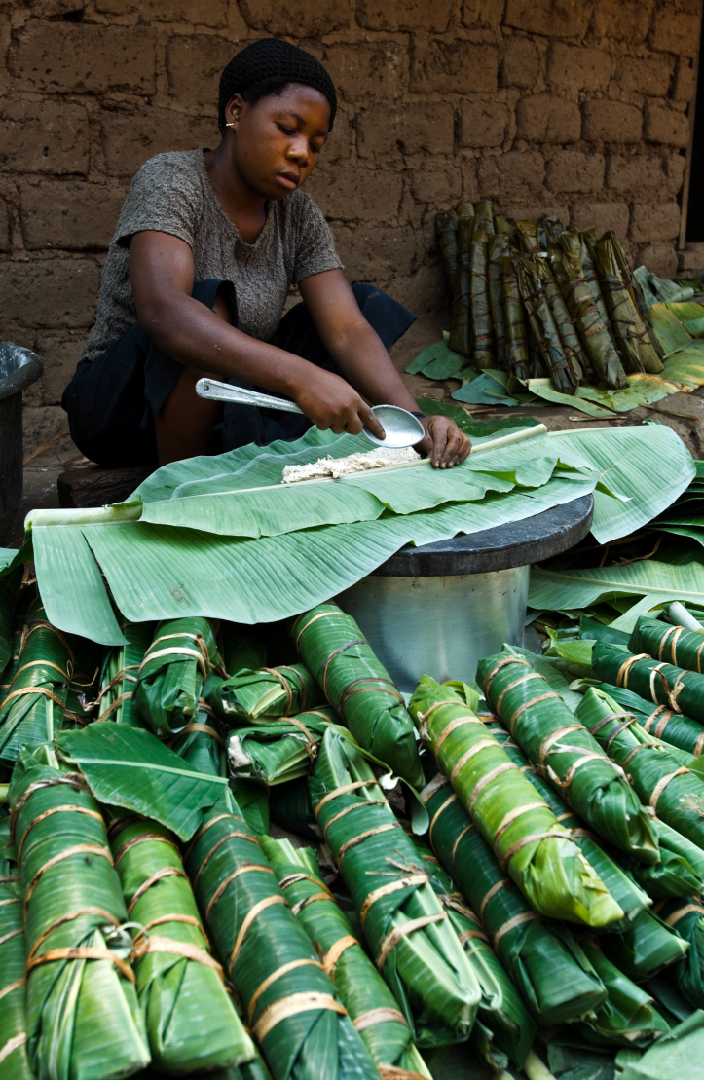
Recent actions in the region
Lessons learned
Partner countries long term support to sustainable agriculture/food security needs to be strengthened.
Articulation between short and medium to-long term action must be reinforced.
Resilience of the most vulnerable people to cope with adverse events needs to be enhanced.
Maternal and child undernutrition must be given more attention.
The EU needs to maintain a strong capacity to react promptly.
DEVCO C1

Slide 28
Recent actions in the region
What after the Food Facility:
Food & Nutrition Security on top of the EU Development agenda
Focus on resilience (SHARE, AGIR)
Permanent instrument to cope with crisis (recommendation of the EUFF final evaluation)
Social Transfers in the Fight against Hunger
DEVCO C1
Notes:
Point 1 in the light of programming

Slide 29
Recent actions in the region
Where does(did) the EC operate Social Transfers?
Indicator 2: Nr of people assisted through food security related social transfers (2009-2012)
Social Transfers in the Fight against Hunger
DEVCO C1

Slide 30
The EC Programming exercise 2014-2020
?
?
?
?
?
LDC
LMIC
UMIC & Graduated

Slide 31
The EC Programming exercise 2014-2020
LDC
LMIC
Positive feedback
Afghanistan
Nepal
Korea, DPR
Awaiting positive
FSTP
Bangladesh
Awaiting negative
FSTP, FF
Bhutan
Negative feedback
FF
Laos
FF
Pakistan
FSTP, FF
Vietnam
FSTP, FF
FSTP, FF
Philippines
FF
FSTP, FF
FF
Sri Lanka
Myanmar
Focal: Focal sector
Non focal: Geographic intervention
FSTP: Thematic intervention
FF: Food Facility
SHARE/AGIR
Period 2007 - 2013
Cambodia

Slide 32
The EC Programming exercise 2014-2020
LDC
LMIC
Positive feedback
Awaiting positive
Awaiting negative
FSTP
Negative feedback
FSTP, FF
FSTP, FF
Focal: Focal sector
Non focal: Geographic intervention
FSTP: Thematic intervention
FF: Food Facility
SHARE/AGIR
Period 2007 - 2013
FSTP, FF
Red indicators 3/3 4/5 5/5
Red indicators 2/3 3/5 2/5
Red indicators 1/3 0/3 1/5 0/5
No data or N/A

Slide 33
NAS and ASiST:
Continuing support to EU Delegations and beneficiary countries;
Engagement in advocacy and awareness;
Possible second phase of ASiST.
Social Transfers in the Fight against Hunger
DEVCO C1

Slide 34
Social Transfers in the Fight against Hunger
Phnom Penh, 21-23 February 2013
THANK YOU
DEVCO C1

